Slide 1
The Intersection Between Child Health and Education
David Figlio*
Director, Institute for Policy Research
Northwestern University
Presentation at NSW Centre for Education Statistics and Evaluation, 20 March 2014
*Collaborative research with Janet Currie, Josh Goodman, Jonathan Guryan, Krzysztof Karbownik, Claudia Persico and Jeffrey Roth

Slide 2
Long literature on effects of poor neonatal health on long-term outcomes
A large literature documents the effects of neonatal health on many adult outcomes
Wages, disability, adult chronic conditions, human capital accumulation
Twin-pair comparisons in Canada, Chile, China, Norway, United States show that the heavier twin is more likely to have better adult outcomes
While the existing literature makes clear that there appears to be a permanent effect of poor neonatal health on socio-economic and health outcomes, it is important to know how neonatal health affects child development, whether public policies might be beneficial, and whether parental inputs and neonatal health are complements or substitutes
To date, we know little about how neonatal health’s effects vary at different stages of development, or whether public policies (e.g., school quality) can help mitigate the relationship

Slide 3
A new data resource: Florida “registry” data
We make use of the first, to our knowledge, large-scale dataset that
Links birth records to school records in a highly developed context
Includes annual assessment data for children to track children’s trajectories over time – important for observing whether birth weight effects open or close over time so that we might be able to pinpoint resources
To date, children born from 1992-2002 matched to school records
>14,000 twin pairs, >1.3 million singletons old enough for test scores
Florida is a location with many desirable characteristics for study:
Large: Florida’s population of ~17M and ~200K births/year compares to Norway, Denmark, and Sweden combined
Heterogeneous: 45% of moms racial/ethnic minorities; 25% of moms foreign born
Politically and socially representative of the United States
Excellent institutional conditions for matching birth and school data

Slide 4
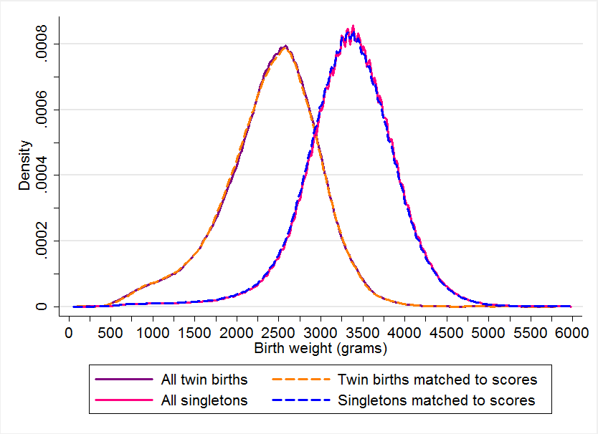
Distributions of birth weight

Slide 5
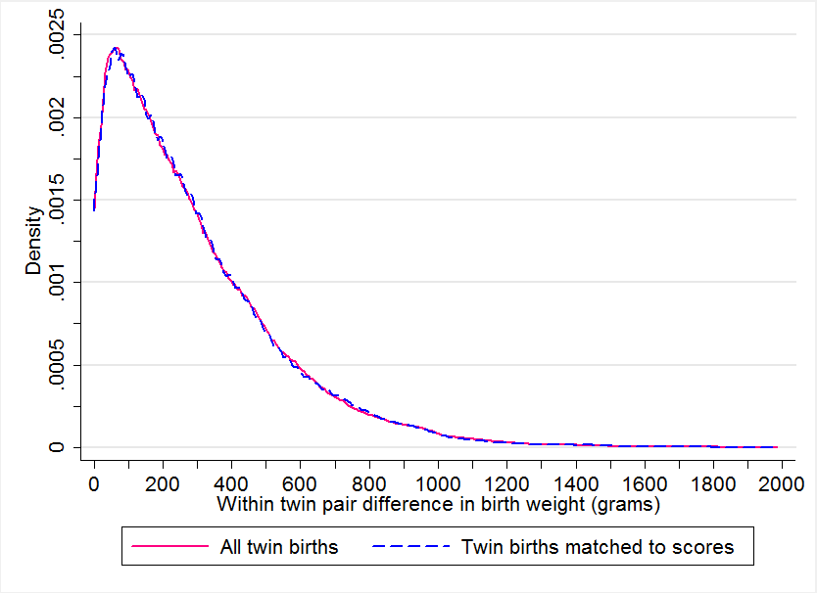
Distribution of twin birth weight discordance

Slide 6
Student outcomes in Florida
Since 1998, Florida tests students on the criterion-referenced Florida Comprehensive Assessment Test in reading and mathematics
Initially tested in grades 4, 8, 10 in reading; 5, 8, 10 in math; from 2001 grades 3-10 in reading and math
Nearly universal testing
Students with some disabilities are not tested
Though there are several makeup dates, it is possible to miss the test if a student is absent for a long period of time
Therefore, it is important to see whether there are differential rates of missing the test
For ease of interpretation, we standardize scores at the state-by-grade level
Average performance in matched twins sample is a little higher than state average, due to higher SES of families with twins, and the fact that those remaining in Florida from birth through school are more stable

Slide 7
Effects roughly constant over time in twin fixed effect models

Slide 8
Same-sex versus opposite-sex twin pairs

Slide 9
Twin fixed effects versus singletons

Slide 10
Differences by groups, part 1

Slide 11
Differences by groups, part 2

Slide 12
Differences by groups, part 3

Slide 13
Test performance and estimated birth weight effects across groups

Slide 14
Does school quality affect the birth weight gap?
Since 1999, Florida has graded schools on an A (best) to F (worst) basis
Initially based mainly on average proficiency rates on the criterion-referenced Florida Comprehensive Assessment Test
From 2002 based on a combination of average proficiency rates and average student-level test score gains from year to year
We measure “school quality” in three ways:
State-awarded school grade
Average FCAT performance level
Average FCAT gain score

Slide 15
Does school quality affect the birth weight gap?

Slide 16
Results appear invariant to method of grading schools

Slide 17
Conclusions from birth weight analysis
There exists considerable evidence that birth weight has persistent effects into adulthood, but the time from birth to 18 has been largely a black box
This work represents the first systematic attempt to study the period from age 5 through school
We find that birth weight gaps are present for all groups studied, and persist regardless of family SES or school quality – suggesting that poor neonatal health plays a long-term role throughout schooling
Smaller twins/siblings from high SES families tend to do very well, but not quite as well as larger twins/siblings from the same families!
Birth weight gaps appear to be stable throughout schooling
Pattern persists despite parental attempts to provide different experiences to their different children in early childhood

Slide 18
Does children’s health affect siblings?
We next consider whether younger siblings’ health influences older siblings’ schooling outcomes
Empirical approach: Consider “focal children” (first-born children) and their first younger sibling
Consider two types of sibling health spillovers today:
Birth weight of younger sibling
Whether younger sibling has a significant cognitive or physical disability

Slide 19
Sibling birth weight affects own test scores

Slide 20
Sibling birth weight affects own test scores

Slide 21
Sibling disability affects own test scores

Slide 22
Results hold even when eliminating focal children who have a disability themselves

Slide 23
U-shaped relationship between sibling disability and test scores

Slide 24
U-shaped relationship between sibling disability severity and test scores

Slide 25
U-shaped relationship holds when limiting to non-disabled focal children

Slide 26
General conclusions about “starting values”
Early health matters for children’s cognitive outcomes
Results are present for all subgroups and are strikingly robust
Sibling early health affects older children in the family
True for birth weight as well as disability
Note: Younger siblings born just above 1500g have much more negative effects than do younger siblings born just below 1500g
Early health effects persist regardless of family socio-economic status or school quality

Slide 27
The promise of early intervention
Just because we see that it is difficult to move the needle doesn’t mean that the needle can’t be moved
My research from Florida suggests that early interventions can be highly valuable
The case of autism spectrum disorders: Children can receive services through Florida’s Early Steps Program
Once children receive a diagnosis in an Early Steps office (16 statewide), they can receive services in their local community
Using empirical strategies that deal with differential selection into early intervention, we find that children who receive early interventions for autism have dramatically better outcomes despite being relatively disadvantaged to start!

Slide 28
To fix ideas: Cohort-level evidence

Slide 29
To fix ideas: No evidence for other disabilities very rarely served by Early Steps
Note: autistic children are not included in this analysis

Slide 30
Effects of early intervention for autism
Children who receive early services for autism:
15 percentage points more likely to start school on time
30 percentage points less likely to be suspended in school
Half a standard deviation better test scores
The upshot: Providing high-quality services to children in early life can pay huge dividends down the road

