Slide 1
All that jazz!
Stage 5 dance

Slide 2
Instructions for use
This resource is not a teaching and learning program. It should be used in conjunction with Stage 5 dance – sample unit – all that jazz. It is intended to support a primarily practical approach to teaching performance.
Classroom teachers are encouraged to add and adapt slides as required to meet the needs of their students.
Save a copy of the file to make changes to the slide deck – go to File > Download a Copy (this downloads a copy to the computer to edit in the PowerPoint app).
To convert the PowerPoint to Google Slides:
Upload the file into Google Drive and open it.
Go to File > Save as Google Slides.

Slide 3
Contents 1
1 - Creating a safe dance environment | 5
Class protocols and responsibilities | 7
Consent in dance | 11
2 – Developing jazz dance technique and safe dance practice | 13
What is jazz dance? | 15
Body awareness | 17
Warm-up | 18
Cool-down | 20
The skeleton | 21
Joints | 24
Alignment | 27
Characteristics of jazz dance | 32
Muscles | 34
Dance technique | 37

Slide 4
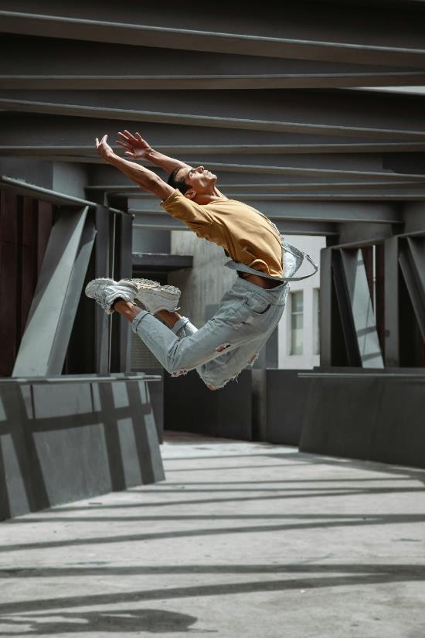
Contents 2
3 – The elements of dance and performance quality | 41
The elements of dance | 43
Performance quality | 48
Communicating with the desired intent | 49
Kinaesthetic awareness | 50
Musicality | 51
Commitment and confidence | 53
Projection and focus | 54
Glossary | 57
‘Dancer Dancing at the Hallway’ by Los Muertos Crew is licensed under the Pexels License.

Slide 5
Creating a safe dance environment
1
Notes:
Teachers note – section 1 of this presentation relates to learning sequence 1 in Dance Stage 5 (Year 9) – sample unit – all that jazz

Slide 6
Learning intentions and success criteria (1)
Creating a safe dance environment
Learning intentions
We are learning to:
know about safe protocols and responsible behaviours in the dance classroom
understand how safe protocols and responsibilities help create a safe dance classroom for everyone
be safe and responsible to ourselves and others in the dance classroom.
Success criteria
I can:
identify positive and negative behaviours in the dance classroom
explain and show safe, responsible behaviours when working individually and with others including giving and/or denying consent
demonstrate respectful behaviour and language when working with others and be responsible to bring and manage the appropriate equipment for a safe environment.
Notes:
Learning intentions and success criteria are most effective when they are contextualised to meet the needs of students in the class. The examples provided in this resource are generalised to demonstrate how learning intentions and success criteria could be created.

Slide 7
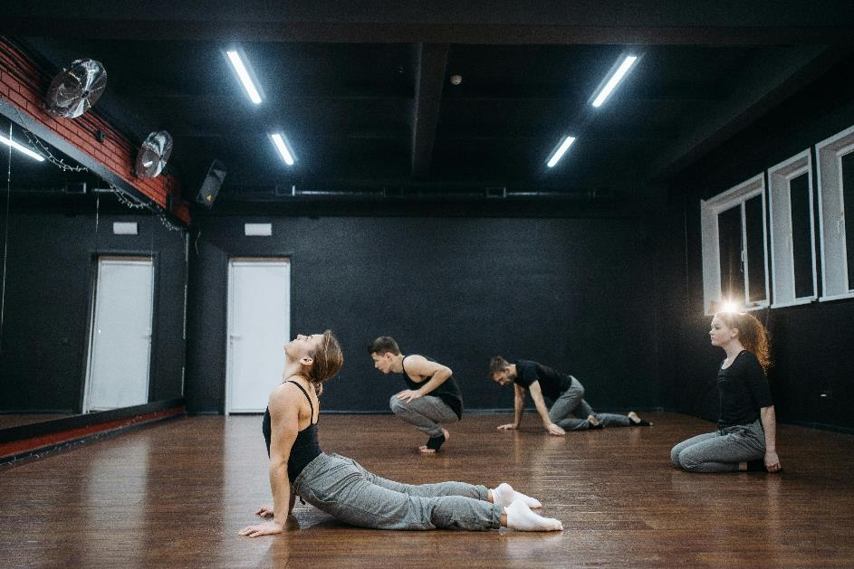
Establishing dance class protocols
Have a look around the dance classroom and consider the following questions:
What does it look like?
What does it sound like?
What does it feel like?
What do you need to do so you and others feel safe?
‘Group of Dancers Warming Up’ by Pavel Danilyuk is licensed under the Pexels License.

Slide 8
Class protocols and responsibilities
Activity – Think Pair Share
Using ‘The dance classroom: behaviour’ slide, think of examples of how positive and negative behaviour looks, sounds and feels in the dance classroom. This can be done independently.
Pair up with another student, share your ideas and categorise the ideas into the ‘Your responsibilities to yourself and others’ slide.
Share your ideas with the rest of the class, adding any additional ideas from others in the class to your slide.

Slide 9
The dance classroom – behaviour
Positive
[insert responses]
Negative
[insert responses]
Positive
[insert responses]
Looks like
Positive
[insert responses]
Sounds like
Feels like
Negative
[insert responses]
Negative
[insert responses]

Slide 10
Your responsibilities to yourself and others
Activity – discussion
Responsibilities to yourself
Responsibilities to others
For example – I am responsible for bringing appropriate dance clothes.
For example – I am responsible for speaking to others respectfully.
[insert your responses here]
[insert your responses here]

Slide 11
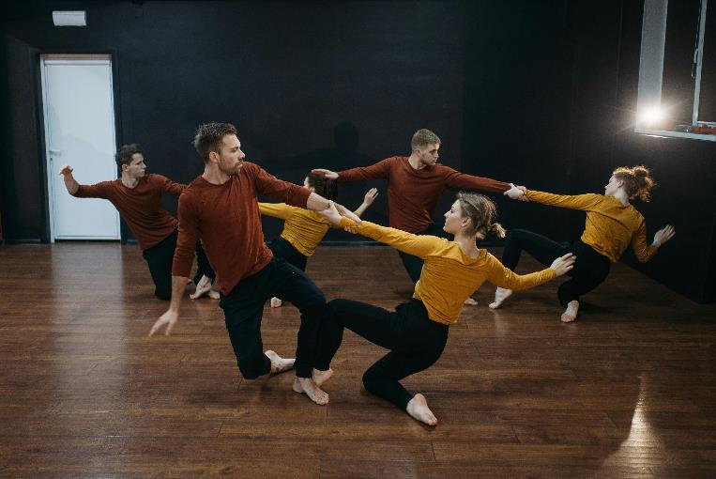
Consent in dance (1)
In dance we often work in pairs or small groups. Sometimes we may use physical touch when we are dancing, for example in partner work.
It is important to understand that consent should be gained before commencing group work and can be given and/or denied at any time.
When giving and/or denying consent, it is important to be respectful and responsible and uphold the class protocols.
‘People Rehearsing a Dance’ by Pavel Danilyuk is licensed under the Pexels License.

Slide 12
Consent in dance (2)
Activity – role playing scenarios
Scenario 1
The teacher is leading the class through a new centre exercise. The teacher has indicated to the whole class that as they move around the room, they may approach individuals to give corrections that may be physical, such as helping you find the correct leg alignment in a balance.
Practise ways you can let the teacher know if:
you are comfortable with physical corrections such as holding your hands for stability whilst giving you verbal cues to find correct placement of the leg
you would not like physical connection whilst receiving feedback.
Scenario 2
You are working on a group performance dance, but you are new to the class and don’t feel comfortable making physical contact with others.
As a class, discuss strategies all group members could use to ensure everyone is comfortable in the group when rehearsing and performing dance together.

Slide 13
Developing jazz dance technique
2
Notes:
Teachers note – section 2 of this presentation relates to learning sequence 2 and 3 in Dance Stage 5 (Year 9) – sample unit – all that jazz

Slide 14
Learning intentions and success criteria (2)
Developing jazz dance technique
Learning intentions
We are learning to:
know about the components of dance technique and safe dance practice
understand the relationship between jazz dance technique and dancing safely
use jazz dance technique and safe dance practices.
Success criteria
I can:
identify dance technique through strength, control, flexibility, coordination and endurance to dance safely using warm-up, cool-down, body awareness and alignment.
describe how jazz dance technique assists safe dance practice
demonstrate jazz dance technique in skills to perform movements safely with body awareness and alignment.
Notes:
Learning intentions and success criteria are most effective when they are contextualised to meet the needs of students in the class. The examples provided in this resource are generalised for the learning sequence to demonstrate how learning intentions and success criteria could be created.

Slide 15
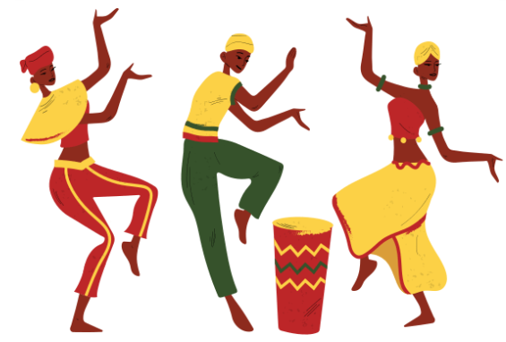
What is jazz dance?
Jazz dance is a genre that encompasses a wide range of styles characterised by energetic and rhythmic movements
emerged in the early 20th century in the United States, with roots in African and African American dance
draws inspiration from a diverse array of sources, including social dances, traditional African dances and tap dance
has fluidity that allows for constant innovation, making it a versatile and evolving art form.
Adapted from Uprooted (2024)

Slide 16
Personal context of jazz dance
Activity – pre-test and discussion
Brainstorm and complete – what is jazz dance?
Share and discuss your ideas with the class.
Add any additional information from the class discussion to your own table.
What I know about jazz dance | What I want to know about jazz dance | What I learned about jazz dance | How I learn more about jazz dance
[insert your responses here] | [insert your responses here] | [insert your responses here] | [insert your responses here]

Slide 17
Body awareness
Activity – personal reflection
Personal reflection:
What is unique about your dancing body?
Do you have any injuries you need to consider?
What is it about your personal context that might influence your body awareness? For example, previous dance training or other sports and training you may do.
The dancing body:
is the medium for expression; much like a painter uses a paintbrush to create their art, a dancer uses their body
is unique to each dancer
needs preparation and training to move safely and efficiently
can develop body awareness with training.

Slide 18
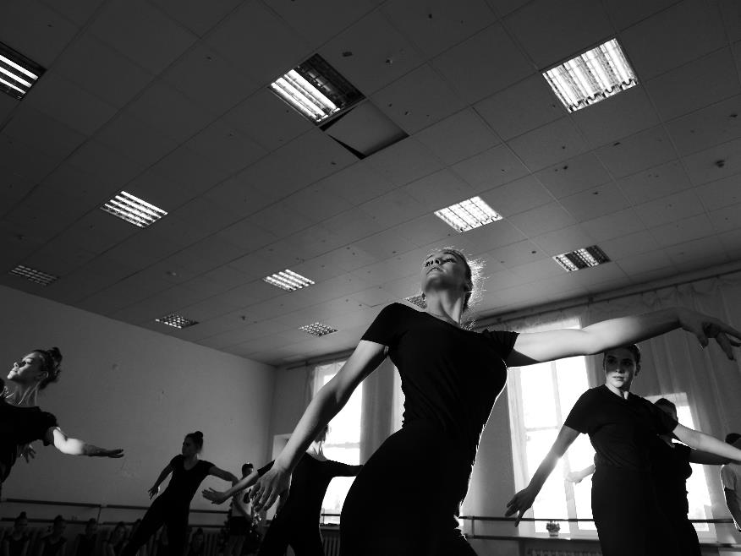
What is a warm-up?
NESA defines a warm-up as ‘movements and/or movement phrases designed to raise the core body temperature and bring the mind into focus for the dance activities to follow.’
(NESA 2023)
‘Ballerinas dancing under lamps during class in hall’ by Mary Nikitina is licensed under the Pexels License.

Slide 19
Steps to a warm-up
Raise pulse or heart rate
Move the joints
Stretch
Strength
Now the temperature of the muscles has increased, begin lengthening the muscles
Raise pulse or heart rate
Increase the intensity and the pace of the movement
Begin strengthening the muscles
Perform relevant stretching techniques to prepare specific muscles for movements you will perform
Perform relevant strengthening exercises to prepare specific muscles for movements you will perform
Gently increase the pulse/ heart rate
Move all joints in the body
For example, if you are performing kicks, a dynamic stretch of the legs will prepare the muscles for the quick action
For example, walking around the dance space, progress to a jog, then a run
For example, extension, flexion and rotation of the shoulders, hips, knees, elbows, spine and ankles
For example, if you are performing jumps, plié exercises will help strengthen to quadriceps

Slide 20
Cool-down
NESA defines a cool-down as ‘to bring the body back to its normal physiological level after fast, vigorous exercise or activity by gradually slowing the pace of activity or by doing gentle exercises or stretches’.​
(NESA 2023)
Other cool-down facts:
helps to flush out the lactic acid in muscles to reduce soreness the next day
muscles are their most pliable at the end of a class due to the increased temperature of the muscles, oxygen and blood circulation
the cool-down is an optimum time to increase flexibility of the muscles.

Slide 21
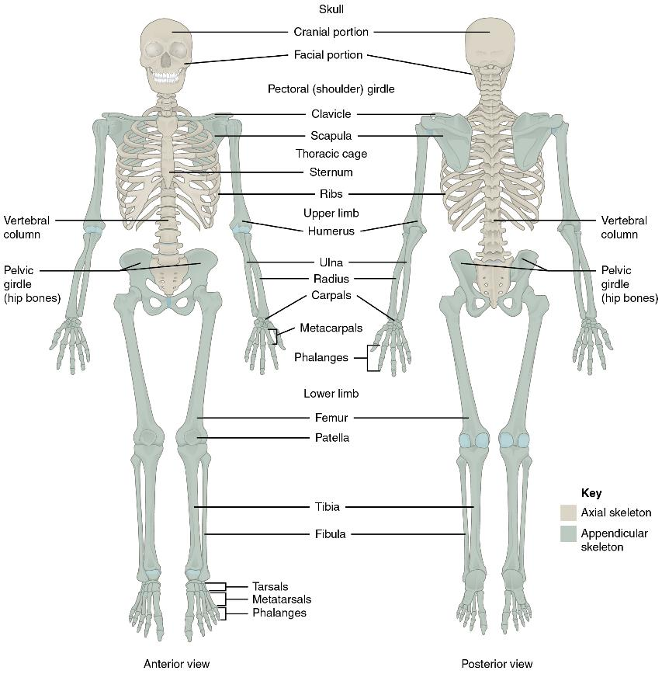
The skeleton (1)
Our bones
The skeletal system is made up of bones and cartilage. It performs the following important functions:
supports the body and gives it shape
facilitates movement
protects internal organs
produces blood cells
stores and releases minerals and fats.
Where 2 bones meet is called a joint.
'Axial and Appendicular Skeleton' by OpenStax College, Anatomy and Physiology is licensed under CC BY 4.0.

Slide 22
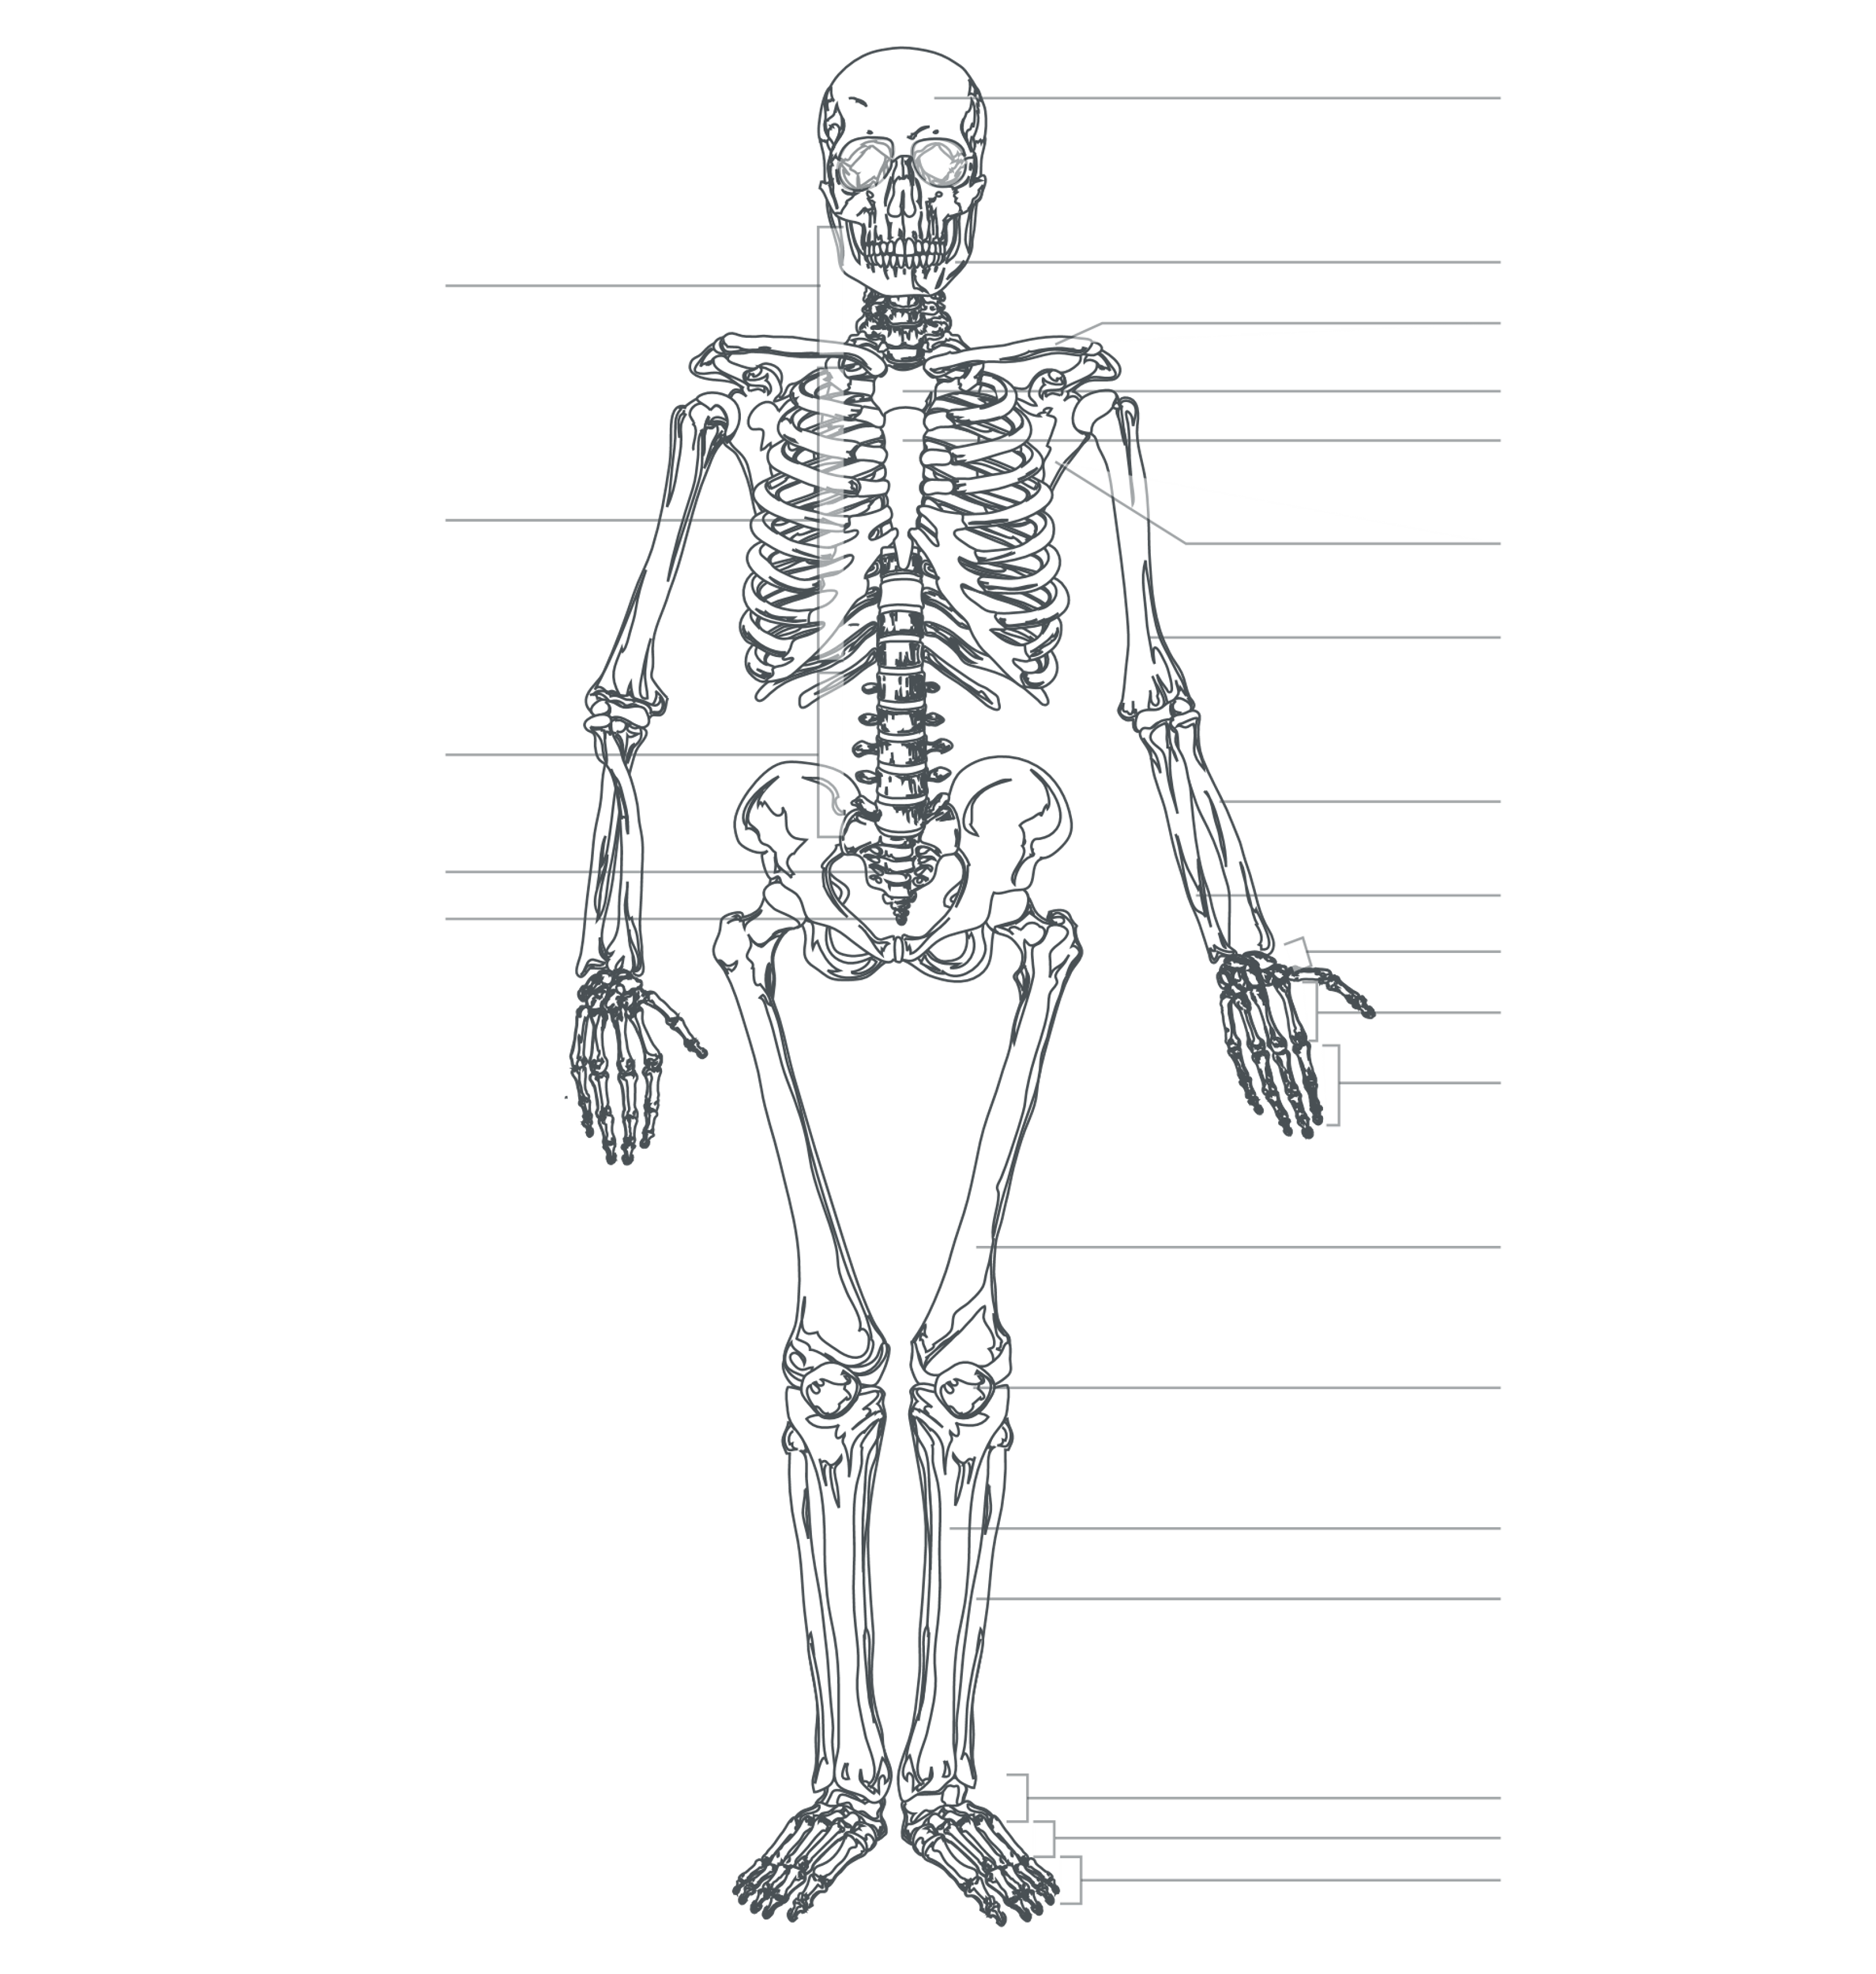
The skeleton (2)
‘Human skeleton front’ by Wikimedia Commons is in the public domain.
Activity – labelling
Drag and drop words from the bank below to label the skeleton.
Clavicle
Coccyx
Ribs
Sacrum
Tibia
Femur
Scapula
Cranium
Humerus
Metacarpals
Phalanges
Radius
Pelvic girdle
Patella
Tarsals
Ulna
Fibula
Carpals
Sternum
Metatarsals
Phalanges
Mandible
Thoracic
vertebrae
Cervical vertebrae
Lumbar vertebrae
Once you have labelled the bones correctly, colour each bone using a different colour. Be sure to use the same colour for the bone on both sides of the body.
Notes:
This slide can be printed and completed as a worksheet. Students are encouraged to use pencil initially to avoid mistakes.

Slide 23
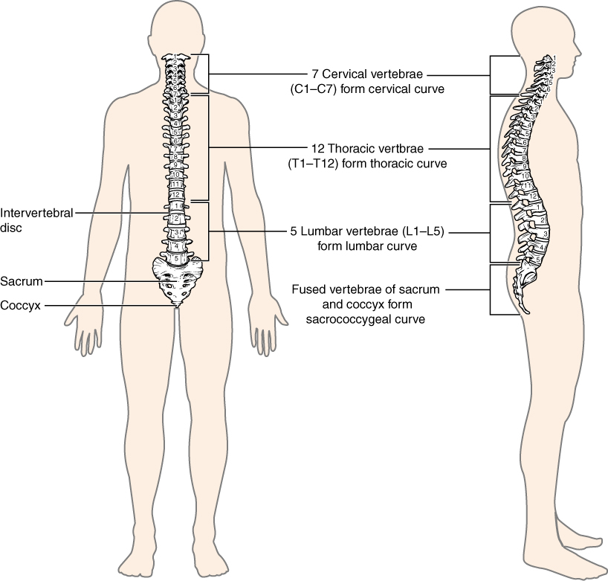
The spine
The spine is made up of vertebrae and has natural curves that are important for movement. The sections of the spine are:
cervical spine
thoracic spine
lumbar spine
sacrum
coccyx.
‘Vertebral Column’ by Wikimedia Commons is licensed under CC BY 3.0.

Slide 24
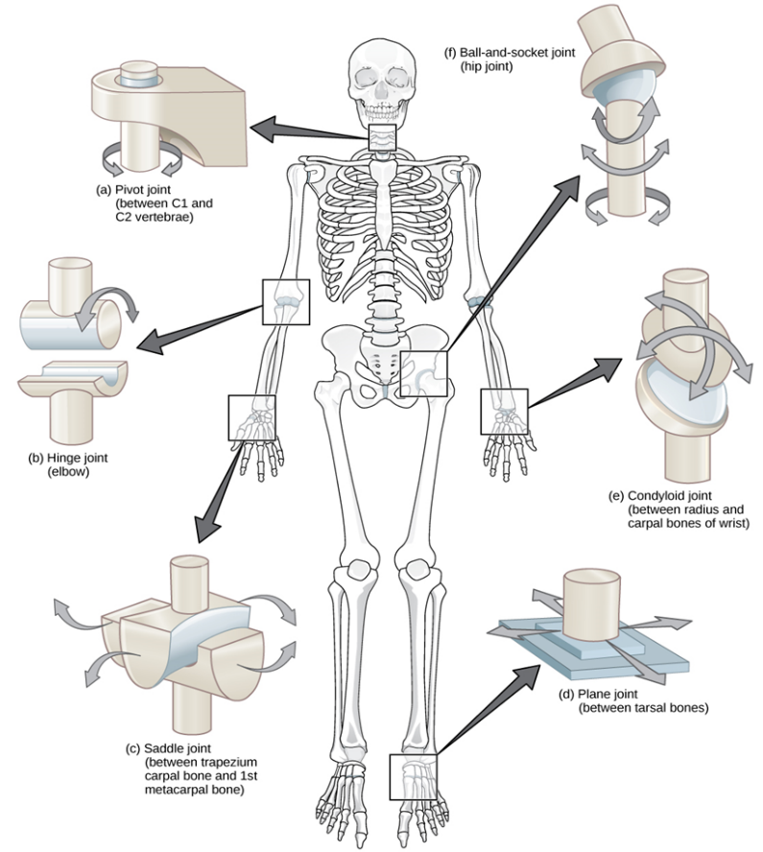
Joints (1)
There are many types of moving joints in the body. Some of the most important to consider in dance are:
ball-and-socket joint (for example the hip and shoulder joints)
hinge joint (for example the elbow and knee joints)
pivot joint (for example between cervical vertebrae in the neck).
‘Types of synovial joints' by Wikimedia Commons is licensed under CC BY 3.0.

Slide 25
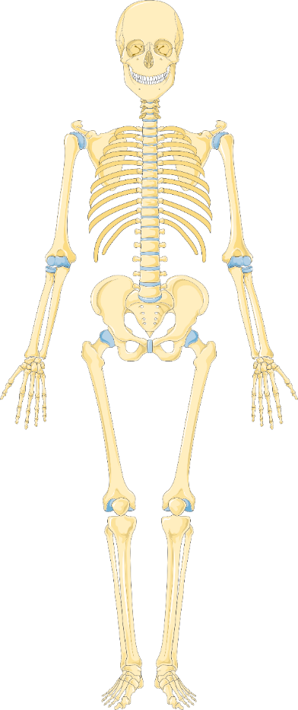
Joints (2)
Activity – labelling
Label the skeleton with:
2 ball-and-socket joints
2 hinge joints
1 pivot joint.
Hint – examples can be found on the previous slide.
‘Human skeleton front’ by Wikimedia Commons is in the public domain.

Slide 26
Joint actions
Joint action | Definition
Flexion | Bending a joint or making the angle at the joint smaller. For example, bending the knee into retiré position, flexion occurs at the knee joint.
Extension | Straightening a joint or making the angle at the joint larger. For example, flicking the leg in front of the body, extension occurs at the knee joint.
Rotation | Circular movement around a fixed joint. For example, finding a turnout position by rotating the legs outwards at the hip joint.
Activity – describing
Joint actions in dance
Describe a movement that requires:
flexion of the elbow
extension at the knee joint
rotation of the hip joint.
Can you think of more dance movements that use flexion, extension or rotation?

Slide 27
Alignment (1)
NESA defines alignment as ‘an aspect of safe dance practice. The relationship of the skeleton to the line of gravity and the base of support, which makes movement more efficient and reduces the chance of injury.’
(NESA 2023)
Unpacking this definition:
The base of support is the body part(s) that are in contact with the ground (for example, 2 feet, one foot, one hand).
The line of gravity is an imaginary vertical line from the centre of gravity to the ground or surface the object or person is on. It is the direction that gravity is acting upon the person or object.

Slide 28
Alignment and posture
There are 3 natural curves in a healthy spine found in the cervical, thoracic and lumbar sections.
Correct posture is the alignment of the body so that the bones and muscles can hold you upright, against gravity, with the least amount of energy.
Lengthening through the spine is important for good posture, however, we still want to retain the spine's natural curves.
Performing spinal mobiliser exercises can be useful for finding correct and safe posture.
Some common postural issues to avoid:
Tilted pelvis – tilting the pelvis too far forward or back can put strain on other parts of the body.
Hip-sitting – a tendency to 'sit' into one hip resulting in one tight hip and one overstretched.
Banana or sway back – curving or rounding too far in the upper or lower back.

Slide 29
Alignment (2)
The plumb line
When standing side on to a mirror, we can use the plumb line to help check for safe and efficient alignment and posture in a neutral standing position. The plumb line is an imaginary line that passes through the:
centre of the ear
midpoint of shoulder
centre of hip
back of the knee
ankle joint.
Find a partner and help each other find neutral alignment!
Note – engaging the appropriate muscles to safely control alignment is important!
'Posture types’ by Wikimedia Commons is in the public domain.

Slide 30
Parallel alignment
What does it look and feel like?
Parallel means having 2 objects side by side with the same distance continually between them.
In dance this looks like:
feet placed underneath your hips, with the second toe and heel in a line, as if standing on train tracks
knees slightly softened so they are not snapped back
a line running from the hip bones to the knees and down to the centre of the feet to enable safe tracking
knees tracking over the toes when bending.
Let’s apply this to a class exercise!

Slide 31
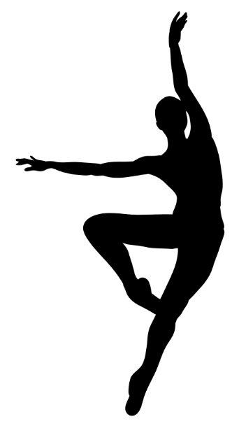
Turnout alignment
What does it look and feel like?
Turnout means to stand with each leg rotated in the opposite direction from the other (externally) and facing away from the midline of the body as observed from the front.
Turnout comes from the hip, at the ball-and-socket joints that connect the pelvis with the femur (thigh bone).
The 6 deep external rotators are the muscles that should be used to turnout.
In jazz dance, both parallel and turnout alignment are important to safely control a range of movements.
Let’s apply this to a class exercise!

Slide 32
Characteristics of jazz dance
Rhythmic and syncopated – rhythm is very important in jazz dance often mirroring the beats of the music. Syncopation places emphasis on the off-beats or unexpected parts of the music.
Isolations – isolating and articulating different parts of the body, such as the head, shoulders, ribs or hips, independently from the rest of the body to create sharp and controlled movements.
High energy – jazz is known for its vibrant and energetic movements, often fast-paced using a contrast of sharp, precise and smooth movements.
Technical and athletic – jazz dance requires a strong technical foundation including skills from ballet and modern dance such as turns, leaps and jumps. Many movements are athletic requiring strength, flexibility and stamina.

Slide 33
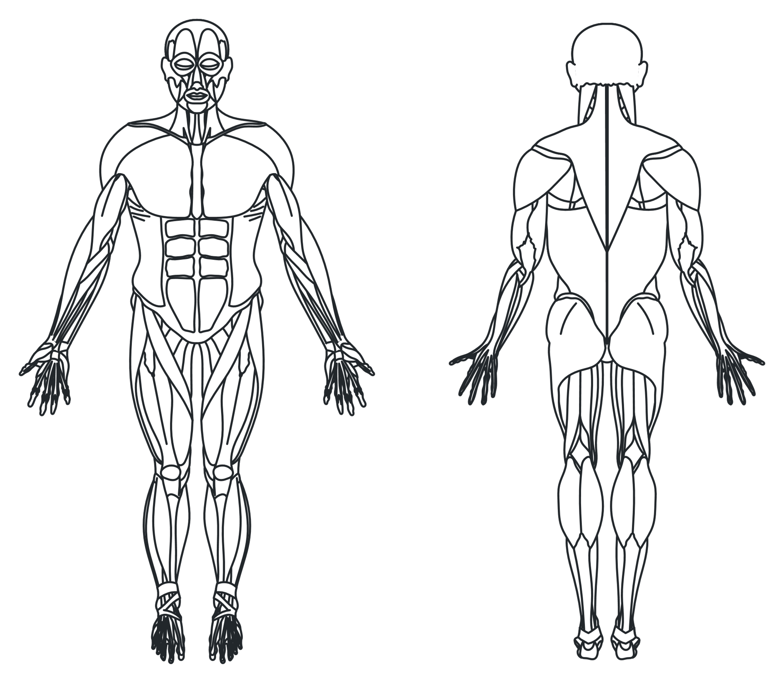
Muscles of the body (1)
Trapezius
Things to know about the muscles and how they work:
Muscles work in pairs.
Muscles work by contracting and relaxing to cause movement.
Muscles are attached by tendons to bone at each end.
Deltoids
Rhomboids
Pectorals
Biceps
Triceps
Rectus abdominis
External obliques
Latissimus dorsi
Sartorius
Gluteus maximus
Quadriceps
Hamstrings
Gastrocnemius
Tibialis anterior
Soleus
Image adapted from 'Muscles front and back' by Wikimedia Commons is licensed under CC BY-SA 4.0.

Slide 34
Muscles of the body (2)
Drag and drop words from the bank below to label the muscular system.
Activity – labelling
Sartorius
Hamstring
Soleus
Pectorals
Gastrocnemius
Deltoids
Trapezius
Tibialis anterior
Quadricep
Rhomboids
Biceps
Triceps
Rectus abdominis
External oblique
Gluteus maximus
Latissimus dorsi
Once you have labelled the muscles correctly, colour in each muscle using a different colour for each. Be sure to use the same colour for the muscle on both sides of the body and the front and back of the body, if applicable.
Image adapted from 'Muscles front and back' by Wikimedia Commons is licensed under CC BY-SA 4.0.
Notes:
This slide can be printed and completed as a worksheet. Students are encouraged to use pencil initially to avoid mistakes.

Slide 35
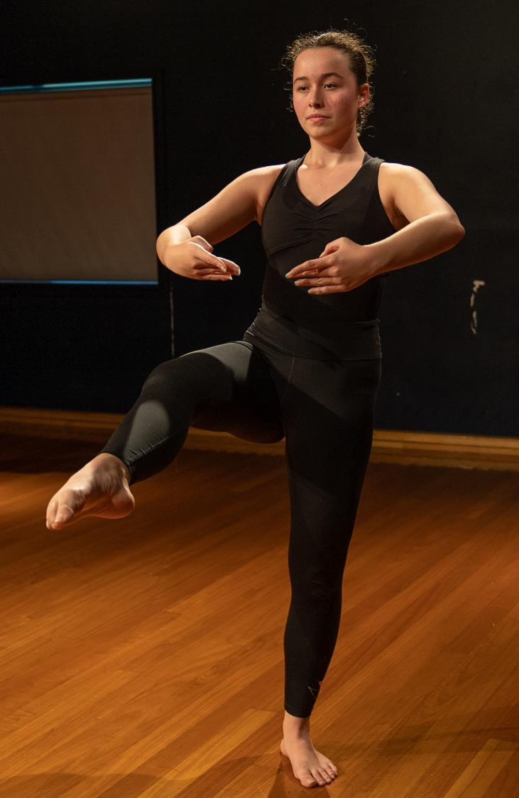
Turns in jazz dance
Activity – practical and reflection
Complete the practical activity and answer the following questions.
Identify and perform a class exercise that allows you to develop your dance technique in turns.
Describe each part of the turn, for example, the preparation, the turn and the exit of the turn.
Why is alignment important when executing a turn?

Slide 36
Applying strength in jazz dance
Activity – reflection
Identify a class exercise that builds strength in a specific muscle group.
Describe how the above exercise allows you to build strength. For example:
What is your body doing?
Which muscles are you trying to engage?
Which muscles do you want to avoid using and why?
Explain why this strength is important in jazz dance.
Repeat these steps and replace the word ‘strength’ with ‘flexibility’.

Slide 37
What does dance technique look like?
Dance technique is relative to personal anatomical structure showing the relationship between:
Alignment
Control
Strength
Flexibility
Endurance
Coordination

Slide 38
Reflecting on jazz dance technique
Activity – practical and speaking
In groups you will be given a jazz dance skill to demonstrate and explain. Use the following as a guide for your responses:
“A skill we have been learning in jazz dance is [insert skill]. We use this skill in the [insert exercise].”
Physically demonstrate the exercise or part of the exercise you will be explaining.
Explain how the exercise helps you to control the technique of the skill which may include giving examples of:
how you are using the correct alignment applied to the movement(s)
how you are developing strength and/or flexibility in specific muscle groups
how you are developing coordination and/or endurance.

Slide 39
Dance technique and safe dance practice (1)
Activity – formative check-in opportunity 1
In small groups perform one warm-up, centre or locomotor exercise for your teacher and peers.
Select one aspect of dance technique or safe dance practice you would like to receive feedback on. For example, lower-body alignment in a centre exercise or application of strength in a locomotor exercise.
After performing, you will receive feedback from your teacher and peers for you to reflect on.
Ways to receive feedback and reflect may include verbal or written responses.
Remember class protocols and responsibilities when giving and receiving feedback.

Slide 40
Dance technique and safe dance practice (2)
Activity – formative check-in opportunity 2
Review video footage from the class performing a warm-up, centre or locomotor exercise.
Reflect on your application of dance technique and/or safe dance practice using ‘Two stars and a wish’ for self-reflection.
Two stars includes 2 aspects that are improving.
A wish includes an aspect you would like to keep working on.
Pair up with another person in the class to share your Two stars and a wish.
Note – in your discussion you may like to brainstorm ways or strategies you could use to work on your ‘wish’.

Slide 41
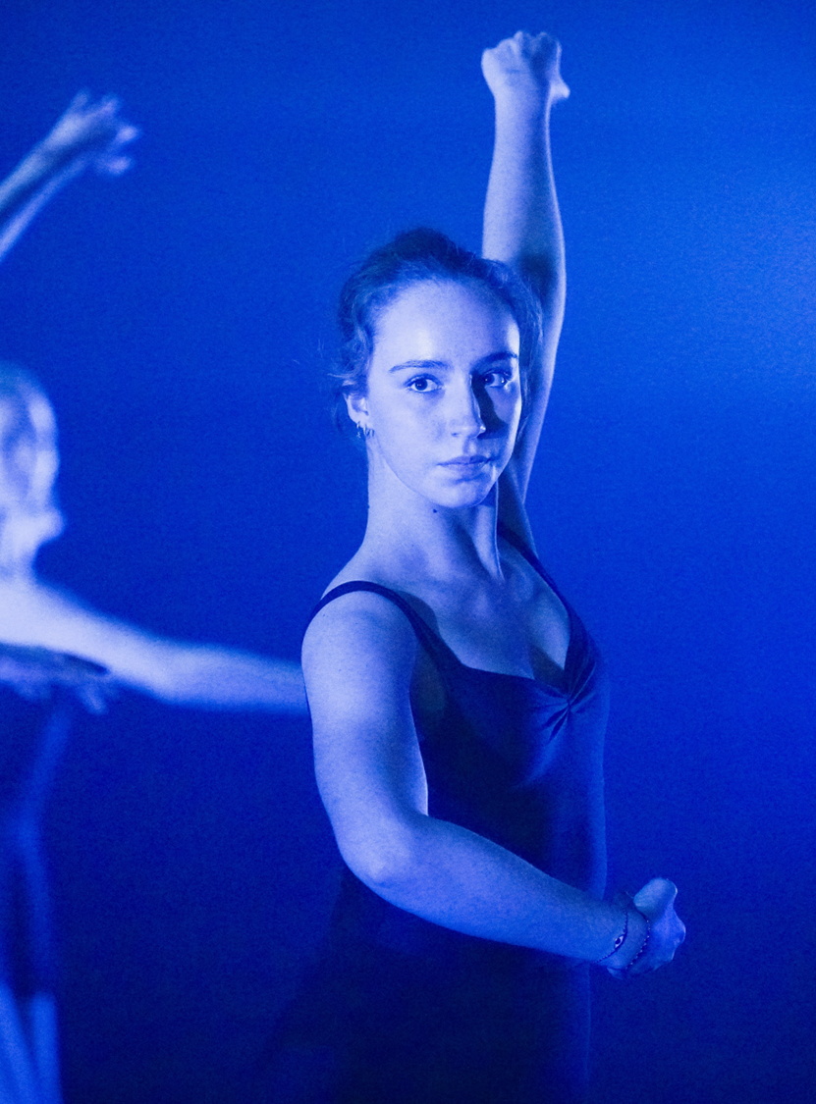
The elements of dance and performance quality
3
Notes:
Teachers note – section 3 of this presentation relates to learning sequences 4 in Dance Stage 5 (Year 9) – sample unit – all that jazz

Slide 42
Learning intentions and success criteria (3)
Dance technique and performance quality in the jazz dance exercises
Learning intentions
We are learning to:
identify the elements of dance as space, time and dynamics
understand the relationship between dance technique and performance quality
use dance technique with the elements of dance and performance quality.
Success criteria
I can:
describe the components of the space, time and dynamics
demonstrate how dance technique such as control, alignment, coordination, strength and flexibility can enhance the performance quality in jazz dance skills
perform jazz dance using space, time and dynamics to enhance my confidence and commitment to achieve performance quality.
Notes:
Learning intentions and success criteria are most effective when they are contextualised to meet the needs of students in the class. The examples provided in this resource are generalised for the learning sequence to demonstrate how learning intentions and success criteria could be created.

Slide 43
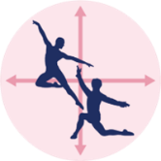
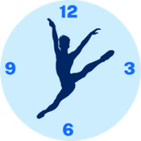
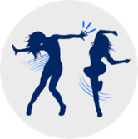
The elements of dance (1)
NESA defines the elements of dance as ‘the tools used to perform, compose and appreciate dance works in artistic, cultural, social and personal contexts.’
(NESA 2023)
Space
Where you are moving
Time
When you are moving
Dynamics
How you are moving
Notes:
Teachers can download the Elements of dance posters from the Planning, programming and assessing in the creative arts website.

Slide 44
The elements of dance (2)
Space | Time | Dynamics
Read Elements of dance – definitions and examples (DOCX 3.62 KB).
Drag and drop words from the bank below into the correct categories.
Swap your table with another student and compare your responses.
Rhythm
Level
Stillness
Direction
Pathway
Accent
Metre
Stage space
Duration
Dimension
Tempo
Shape
Weight and/or force
Release of energy
Movement qualities
Floor pattern
Notes:
This slide can be printed and completed as a worksheet.

Slide 45
The elements of dance in jazz dance (1)
Space | Time | Dynamics
High level | Slow tempo | Heavy weight
Medium level | Medium tempo | Light weight
Low level | Fast tempo | Strong force
Open shape | Accelerating tempo | Gentle force
Closed shape | Decelerating tempo | Sudden release of energy
Angular shape | Accents on gesture | Gradual release of energy
Curved shape | Accent on jump | Sustained release of energy
Symmetrical shape | Accent on beat of music | Percussive quality
Asymmetrical shape | Long duration | Suspended quality
Forwards | Short duration | Swinging quality
Backwards | Syncopated rhythm | Collapsed quality
Sideways |  | Vibratory quality
Diagonal
Activity – reflection and discussion
Apply your understanding of the elements of dance to your jazz dance.
Reflect on the jazz dance you have been learning in class.
Highlight components of the elements of dance used in the table. You may also add some rows to include your own descriptive words.
Discuss your ideas with the class about how the elements of dance are used in jazz dance.

Slide 46
The elements of dance in jazz dance (2)
Activity – reflection
After reflecting on your jazz dance, answer the questions in the space provided below.
Brainstorm any emotions, feelings or ideas you have when performing this dance.
_________________________
_________________________
_________________________
_________________________
_________________________
How did the use of space support the emotions, feelings or ideas in the dance?
_________________________
_________________________
_________________________
_________________________
_________________________
How did the use of time and dynamics support the emotions, feelings or ideas in the dance?
_________________________
_________________________
_________________________
_________________________
_________________________

Slide 47
Using technique to manipulate the elements of dance
Activity – practical and discussion
In small groups you will be given a specific class exercise and a component of space, time and/or dynamics.
Select one skill or sequence from the class exercise to experiment manipulating the components of the elements of dance you have been allocated.
After experimenting, reflect on what you noticed including:
Did you require increased control in the body? Where?
Did you require flexibility in the body? Where?
Did the manipulation affect your coordination?
Does it alter the meaning, feeling or intent of the movement?
Perform the movement to the class and discuss:
the components of the elements of dance allocated to manipulate the skill
the dance technique used to control the skill.

Slide 48
What is performance quality?
NESA defines performance quality as ‘the dancer’s skill in applying projection, focus, musicality, quality of line, kinaesthetic awareness, commitment and confidence in order to communicate the desired intent.’
(NESA 2023)
In other words, using performance quality helps the dancer to:
look like they know what they are doing
have ownership of the movement
create clear shapes and lines with their body
communicate the choreographer’s intent.

Slide 49
Communicating the desired intent
What it’s all about!
As we have learnt, the dancer’s application of performance quality is used to communicate the intent.
All dance works have an intent, though this intent can vary relative to context.
In this unit we may be influenced by various contexts, though the focus for our jazz dance performance assessment is the artistic context.
The contexts of performance are:
artistic
cultural
social
personal.

Slide 50
Kinaesthetic awareness
NESA defines kinaesthetic awareness as ‘sensing or perceiving the body’s muscles, joints and tendons while in motion or while still.’
(NESA 2023)
Kinaesthetic awareness allows the dancer to use their understanding of dance technique and alignment to place their body in shapes and movements that communicate the intent.
By becoming aware of your body parts, you can control the movement you are executing.

Slide 51
Musicality (1)
Musicality could include:
how dancers hear, interpret, and dance to music
how dancers create an emotional connection to the music with their movement
the relationship with music, movement and the element of time
the relationship with time which then influences the dynamics of the movement.
‘Jazz dance is known for its emphasis on rhythm and musicality… This musicality is an essential aspect of jazz dance and requires a keen sense of timing and precision.’
(Art & Dance Studio 2023)

Slide 52
Musicality (2)
Activity – practical
In small groups you will be given a sequence from the jazz dance to focus on.
Listen to the section of the music for this sequence.
Identify features of the music including accents, tempo, sounds, mood and emotions.
Consider the choreography and how you could further highlight or explore aspects of the music through manipulating the movement.
Tips to think about:
Consider the elements of time and dynamics.
Can you alter the tempo or duration of movements?
How can your use of weight/force change the dynamic to suit the music?
Does the connection with the music affect the meaning, mood or emotion of the movement?

Slide 53
Commitment and confidence
Activity discussion
Commitment is about being dedicated to something.
Discuss:
What does it look like when a dancer is not committed or lacking confidence?
How does this affect the different aspects of performance quality?
How does this affect the dance technique?
How does it affect the communication of meaning?
Confidence refers to the ability to feel assured of your strengths, abilities and value.

Slide 54
Projection and focus (1)
Projection can be described as a confident presentation of one’s body and energy to communicate movement and meaning to an audience.
Possible examples of projection:
external – open shapes and energy outwards of the body
internal – closed-in shapes with energy in towards the body.
Focus can be described as the purposeful gaze and direction of the eye line of the dancer to communicate meaning.
Possible examples of focus:
towards or away from the direction the dancer is travelling
following gesturing limbs such as the hands
upwards to the sky, downwards to the earth.

Slide 55
Projection and focus (2)
Activity – practical and self-reflection
Practical
You are to experiment with focus and projection when executing a leap.
Try performing the leap with:
internal projection and downwards focus
external projection and outward/lifted focus.
Self-reflection
How does the focus and projection affect the:
height of the jump?
dance technique, including alignment, strength, flexibility and coordination?
safe execution including control of the preparation, jump and landing?
performance quality including commitment, confidence, the clarity of the line and overall aesthetic?

Slide 56
The jazz dance
Activity – formative check-in opportunity 3
In small groups, you will present the progress of your jazz dance for feedback and give feedback to others.
The feedback should include specific components of dance technique and/or performance quality to express and communicate the intent.
Engage in a discussion with your group about how the feedback you have received can be used to refine your jazz dance performance.
Some possible points of feedback could include the dancer’s:
execution of alignment, control, strength, flexibility, endurance and coordination
use of focus, projection, musicality, confidence and commitment
ability to express and communicate ideas through their body.
Remember class protocols and responsibilities when giving and receiving feedback.

Slide 57
Glossary (1)
Term | Definition
balance | sustained or held position on a limited base of support, for example standing on one foot
chainé | a type of travelling turn involving 2 half-steps to complete a full rotation that is executed repeatedly
coordination | ability to use different parts of the body together, smoothly and efficiently
elevation | movements which lift away from the floor and generally performed on a high level
endurance | ability of a muscle or group of muscles to perform work over a period of time
fall | purposeful and controlled collapse of the body or limb
flexibility | the ability of a joint or series of joints to move freely through a full range of motion (sfconservatoryofdance 2024)
intent | the purpose or message a choreographer or performer aims to communicate (NESA 2023)
kicks | forceful action of moving the leg away from the body either to the front, side or back

Slide 58
Glossary (2)
Term | Definition
leap | a travelling jump where the weight is transferred from one foot to the other
locomotor | travelling movements from one place to another
parallel | two objects side by side with the same distance continually between them, for example to stand with feet directly under the pelvis as if on train tracks
pirouette | a type of non-locomotor turn on one leg with the working leg in retiré position
plié | bending and softening of the knees
retiré | standing on one leg with the other leg bent at the knee. This can be performed in parallel or in turned out positions (sfconservatoryofdance 2024)
strength | the body’s ability to produce and exert force
supporting leg | the leg which is connected to the floor, supporting the body weight in a skill

Slide 59
Glossary (3)
Term | Definition
tendu | the stretching and articulation of the leg, foot and toe along the floor which can be performed to the front, side or back (Haley 2018)
turn | rotation of the body around a vertical axis
turnout | to stand with each leg rotated in the opposite direction from the other (externally) and facing away from the midline of the body as observed from the front
working leg | the leg which is moving or held in a position in a skill

Slide 60
Glossary (4)
The elements of dance – definitions and examples
The Elements of dance – definitions and examples resource can be used to support this unit and provide guidance for language to describe the elements of dance.

Slide 61
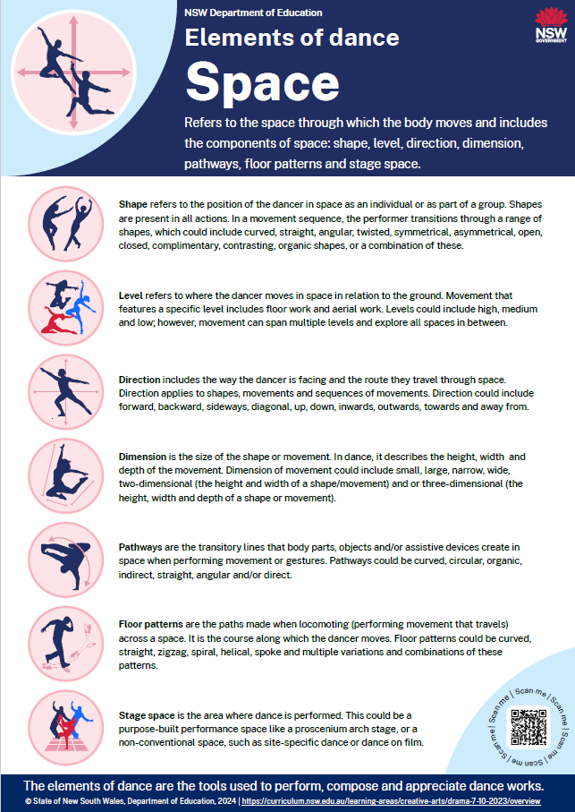
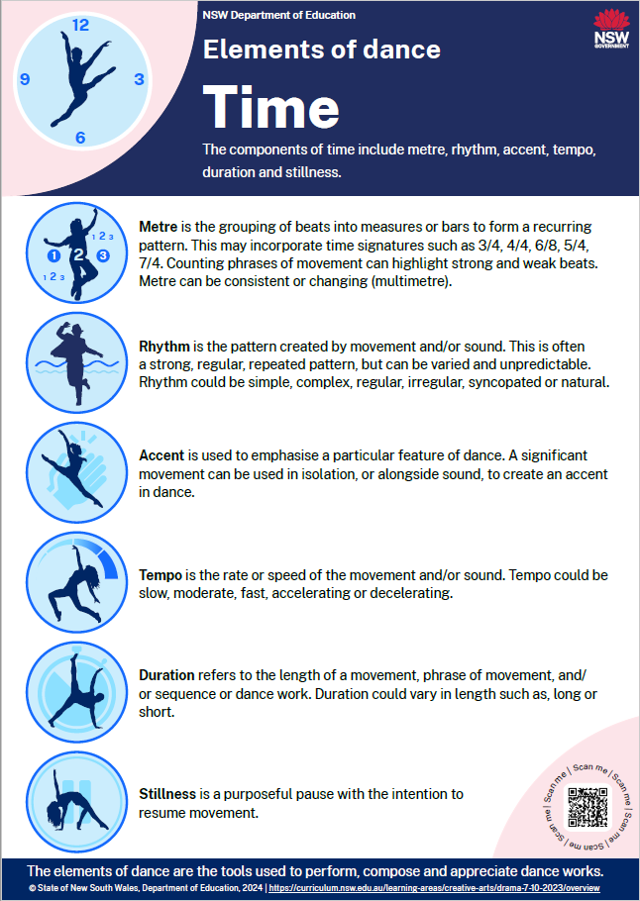
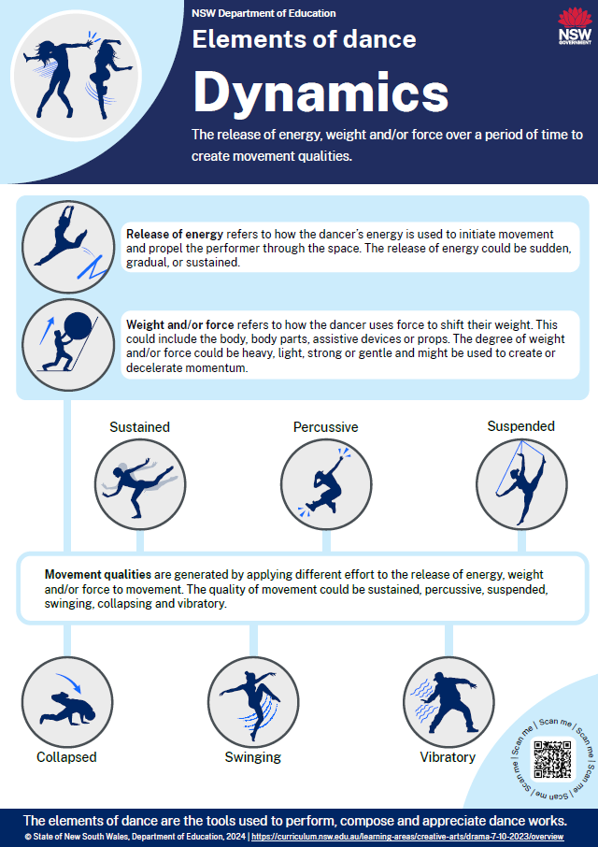
Glossary (5)
The elements of dance – posters

Slide 62
References
This presentation contains NSW Curriculum and syllabus content. The NSW Curriculum is developed by the NSW Education Standards Authority. This content is prepared by NESA for and on behalf of the Crown in the right of the State of New South Wales. The material is protected by Crown copyright.
Please refer to the NESA Copyright Disclaimer for more information https://educationstandards.nsw.edu.au/wps/portal/nesa/mini-footer/copyright.
NESA holds the only official and up-to-date versions of the NSW Curriculum and syllabus documents. Please visit the NSW Education Standards Authority (NESA) website https://educationstandards.nsw.edu.au/wps/portal/nesa/home and the NSW Curriculum website https://curriculum.nsw.edu.au.
Dance 7–10 Syllabus © NSW Education Standards Authority (NESA) for and on behalf of the Crown in right of the State of New South Wales, 2023.
admin-sfconservatoryofdance (2024) Retiré – Definition & Detailed Explanation – Dance Techniques Glossary, sfconservatoryofdance website, accessed 18 July 2024.
admin-sfconservatoryofdance (2024) Flexibility – Definition & Detailed Explanation – Dance Techniques Glossary, sfconservatoryofdance website, accessed 18 July 2024.
Art & Dance Studio (15 April 2023) ‘Jazz Dance: A Fusion of Rhythm and Style’, Art & Dance Studio, accessed 11 June 2024.
Gordon Betts J, Young K, Wise J, Johnson E, Poe B, Kruse D, Oksana K, Johnson J, Womble M & DeSaix P (2013) Anatomy and Physiology, OpenStax, Texas.
Haley (10 September 2018) ‘Just Tendu It – Tips for a Perfect Tendu’, BalletBox, accessed 18 July 2024.
NESA (NSW Education Standards Authority) (2023) ‘Dance 7–10 Syllabus: Glossary’, Resources, NESA website, accessed 25 July 2024.
Uprooted (2024) A comprehensive guide to Jazz Dance and it’s Cultural Tapestry, Uprooted website, accessed 22 June 2024.

Slide 63
Copyright
© State of New South Wales (Department of Education), 2024
The copyright material published in this resource is subject to the Copyright Act 1968 (Cth) and is owned by the NSW Department of Education or, where indicated, by a party other than the NSW Department of Education (third-party material).
Copyright material available in this resource and owned by the NSW Department of Education is licensed under a Creative Commons Attribution 4.0 International (CC BY 4.0) license.
This license allows you to share and adapt the material for any purpose, even commercially.
Attribution should be given to © State of New South Wales (Department of Education), 2024.
Material in this resource not available under a Creative Commons license:
the NSW Department of Education logo, other logos and trademark-protected material
Material owned by a third party that has been reproduced with permission. You will need to obtain permission from the third party to reuse its material.
Links to third-party material and websites
Please note that the provided (reading/viewing material/list/links/texts) are a suggestion only and implies no endorsement, by the New South Wales Department of Education, of any author, publisher, or book title. School principals and teachers are best placed to assess the suitability of resources that would complement the curriculum and reflect the needs and interests of their students.
If you use the links provided in this document to access a third party’s website, you acknowledge that the terms of use, including licence terms set out on the third-party’s website apply to the use which may be made of the materials on that third-party website or where permitted by the Copyright Act 1968 (Cth). The department accepts no responsibility for content on third-party websites.

