Slide 1
Instructions for use
This resource is not a teaching and learning program. It should be used in conjunction with the Stage 5 (Year 9) ‘Nothing is neutral – designing for theatre’ sample unit and assessment task, available on the Planning, programming and assessing drama 7–10 (2023) webpage. Classroom teachers are encouraged to add and adapt slides as required to meet the needs of their students.
Save a copy of the file to make changes to the slide deck. Go to File > Download a Copy (this downloads a copy to the computer to edit in the PowerPoint app).
To convert the PowerPoint to Google Slides:
Upload the file into Google Drive and open it.
Go to File > Save as Google Slides.
(Note – conversion may cause formatting changes in the slides.)

Slide 2
Nothing is neutral – designing for theatre
Stage 5 drama

Slide 3
Learning sequences
1
5
People, Place, Protocols and props
Sound
2
6
Costume
Developing a design concept
3
7
Set
Feedback, refinement and showcase
4
Lighting
Notes:
Teacher notes:
Click lesson numbers to go to specific lessons
Interactive features can be viewed in slide show
Notes for vendors [to be removed after slide deck creation]:
Create hyperlinks to dividers that match lesson numbers by
Right click on the number>edit link>select slide in deck to connect to

Slide 4
Learning sequence 1 – People, Place, Protocols and props

Slide 5
Learning intentions and success criteria (1)
We are learning to
develop knowledge about cultural safety and the elements of drama through our exploration of a short, scripted work by an Aboriginal practitioner
work safely with the elements of production, including props, to create dramatic meaning in a scripted work.
I can
document my understanding and apply respectful protocols for creating dramatic action in response to a script excerpt by an Aboriginal playwright
safely experiment with and use props, and collectively consider their impact on intention and dramatic meaning.
Notes:
Notes for teachers:
Dependent on school context and student needs, teachers may use this sample LISC as a starting point for unpacking unfamiliar, subject specific terminology with students. Teachers can refer to NESA’s Glossary and Teaching and learning support downloadable documents when unpacking these terms.
Learning intentions and success are best co-constructed with students. Adapt the learning intention as required and add matching success criteria.
For more information See ⁠AITSL or the NSW Department of Education explicit teaching strategies, ⁠Sharing learning intentions and ⁠Sharing success criteria
LISC is not necessarily presented at the beginning of the lesson. Teacher needs to consider most effectual time to introduce
LISC should be revisited during the lesson to support students' evaluation of their learning

Slide 6
1.1a – Acknowledging Country
We Acknowledge Country and recognise the lands, skies and waterways of where our schools and workplaces are located.
We pay respect to Elders past and present as ongoing leaders and teachers of knowledge, songlines and stories, and acknowledge the Aboriginal and Torres Strait Islander Peoples that contributed to the development of this film.

Slide 7
1.1b – advice
We advise this resource may contain images, voices or names of deceased persons in photographs, film, audio recordings or historical content.
In some third-party links, terms including First Nations and Indigenous are used. In NSW public schools, ‘Aboriginal’ or ‘Aboriginal and/or Torres Strait Islander’ are preferred.

Slide 8
1.1c – Jack Davis
Playwright – Honey Spot
Jack Davis was born in 1917 and grew up in Yarloop, a small timber town south of Perth. He was a Nyoongar man and spent his early years in Nyoongar Country. Davis was a well-known playwright and poet who used his work to share the richness and diversity of Aboriginal cultures.
Davis often included Nyoongar language in his plays, helping to keep it alive. For many years, he worked to record the Nyoongar language, preserving it for future generations. By writing about Nyoongar language and culture, Davis made sure that these stories and traditions would be remembered.
Text adapted from Jack Davis on Currency Press.

Slide 9
1.1d – Honey Spot by Jack Davis
A synopsis
Honey Spot explores issues of racism in Australian society through the eyes of 2 teenagers and their families. Tim, an Aboriginal boy, and Peggy a white girl.
Their friendship is contrasted by the tension which develops between their families over the forest in which they live.
Tim and Peggy connect and share their culture through dance. Over time, Peggy learns about Tim’s culture and traditions, and the play charts their journey of friendship and cultural connection.
Text summarised from Honey Spot from Sydney Opera House. Image licensed under Pixabay Content License.

Slide 10
1.1e – audience experience
What can we see?
What can we hear?
Notes:
Teacher note: Give students 3 sticky notes, which they can attach in the appropriate circles on this slide, under the headings ‘What can we see and what can we hear’. Unpack where students have identified opportunities to consider lighting, sound, set, costume or props.

Slide 11
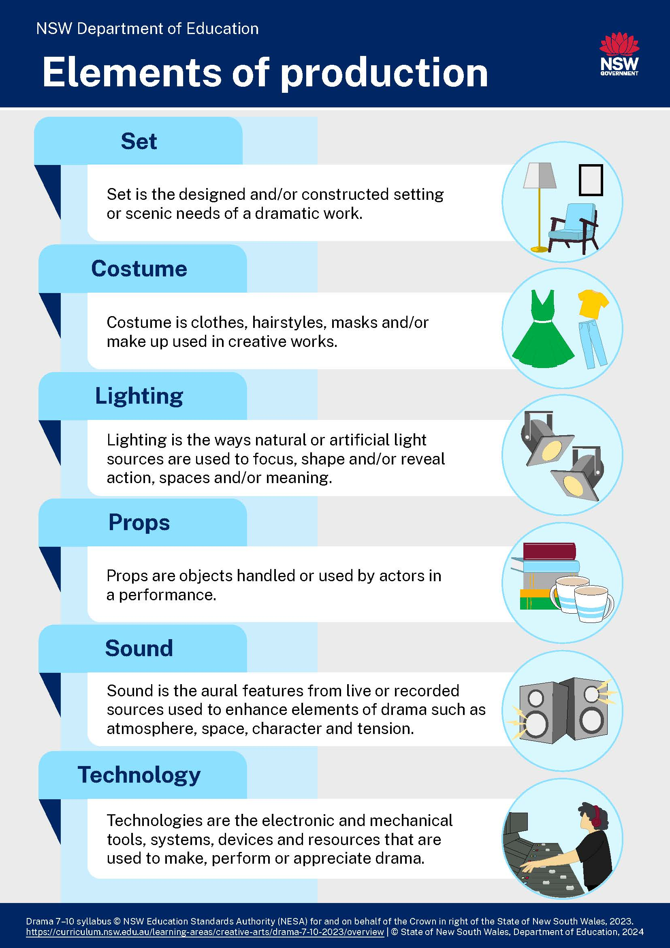
1.2a – the elements of production
Can you see where these may be used in the excerpt from Honey Spot?

Slide 12
1.2b – documenting your journey
Fabrics
Drawings
Objects
Sketches
Plans
Materials
What’s in the box?
Designs
Notes
Ideas
Stories
Scripts
Images
Research
Feedback
Concepts

Slide 13
1.2c – individual reflection and evaluation activities
1
As you work through the different elements of production, collect and annotate items and materials which show how you have understood and reflected on each learning sequence.
These should be placed in your box and will form the basis of your final design concept.
Props
2
Documentation of learning and planning for the Showcase
Costume
3
Reflection activities
Set
4
Lighting
5
Sound

Slide 14
1.2d – How do I annotate?
Honey Spot example annotation
Identify where different elements of production could be considered and could contribute to dramatic meaning.
Analyse how dialogue may impact design choices.
Sketch your vision of what the play could look like on stage.
Record questions you may need to consider when planning your design.
Tip – annotations can include many things and don’t have to be written. They could be recorded in many ways. Be creative and imaginative.

Slide 15
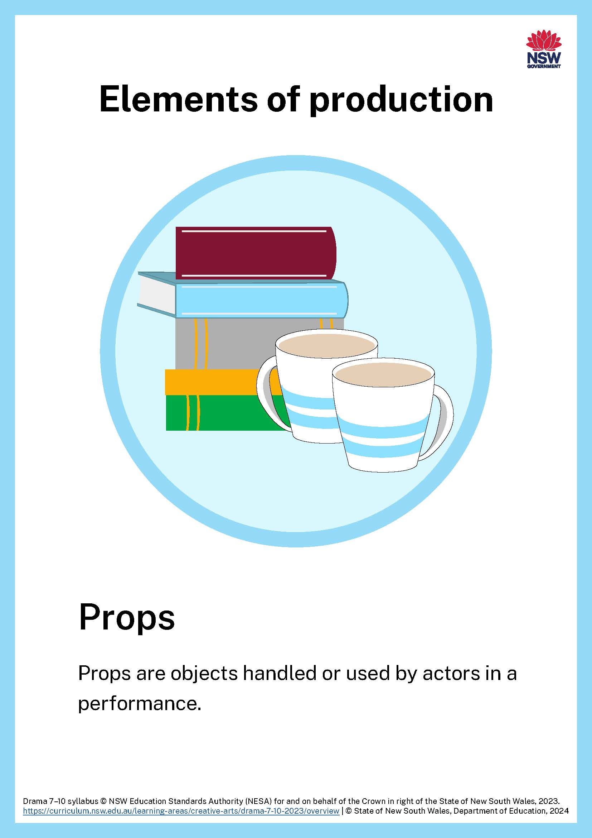
1.3a – props

Slide 16
1.3b – safe protocols for using props
It is important we consider safe processes when using and designing props. Safety in drama spaces includes safely making, performing and appreciating drama in spaces such as drama classrooms. Some props are not safe to use in the classroom or on stage. These includes props such as weapons (real or replica). Other props can impact an emotional response based on culture.
Questions to consider:
Is there a dangerous prop required in this play?
What creative alternatives are there to using this prop?
What are some rules our class should think about when using and designing props?
Dangerous props should not be used in drama

Slide 17
1.3c – thinking creatively about props and safe processes
Props
In the red boxes, identify a prop which could be inappropriate or unsafe.
In the green boxes, suggest a creative solution.

Slide 18
1.3d – using props
Read the script excerpt from the play Honey Spot.
Identify a prop which is not appropriate or unsafe for a school performance.
Brainstorm and design an appropriate solution.
Check your solution with your teacher.
Present a moved reading of this scene, incorporating your solution.
Reflect on your experience of Honey Spot and how you used props.
Reflect on your understanding of Place and how you can Acknowledge Country in the drama classroom and on stage.
These reflections would be great documentation of your creative and critical processes and could be included in your box.

Slide 19
1.4 – 3-2-1 things I learned about staging works created by Aboriginal practitioners
List 3 things you learned about staging works created by Aboriginal practitioners.
3
1.
2.
3.
List 2 questions you have about staging work by Aboriginal practitioners or exploring Aboriginal characters in drama.
2
1.
2.
Give one reason why it’s important to learn about respectful and culturally-safe protocols for exploring Aboriginal and/or Torres Strait Islander works in drama.
1
1.

Slide 20
Learning sequence 2 – costume

Slide 21
Learning intentions and success criteria (2)
We are learning to
develop our understanding of how to interpret meaning and make directorial choices using a short, scripted extract
develop our understanding of how costume can be used to create dramatic meaning for an audience.
I can
explore and interpret a script excerpt, using costume to strengthen moments of dramatic action
explain how costume can be used to shape audience response.
Notes:
Notes for teachers:
Dependent on school context and student needs, teachers may use this sample LISC as a starting point for unpacking unfamiliar, subject specific terminology with students. Teachers can refer to NESA’s Glossary and Teaching and learning support downloadable documents when unpacking these terms.
Learning intentions and success are best co-constructed with students. Adapt the learning intention as required and add matching success criteria.
For more information See ⁠AITSL or the NSW Department of Education explicit teaching strategies, ⁠Sharing learning intentions and ⁠Sharing success criteria
LISC is not necessarily presented at the beginning of the lesson. Teacher needs to consider most effectual time to introduce
LISC should be revisited during the lesson to support students' evaluation of their learning

Slide 22
2.1a – costume

Slide 23
2.1b – What is costume?
Hair
Clothing
Make-up
Costume
Accessories
Wigs
Jewellery
Masks
Disguises

Slide 24
2.1c – costume starters
Here are some things you can change or add to your clothing to create character
If you add one of these to your clothing, what character or role would it indicate to an audience?
a crown
a bow tie
reading glasses
sunglasses
a reflective vest.
If you change your appearance by doing one of the following things, what ‘character’ could it create?
tucking in your shirt and doing up the top button
wearing your hat on an angle or backwards
styling your hair in pigtails.

Slide 25
2.1d – using costumes
In groups of 4, you will be given garbage bags, masking tape and scissors.
Using only the items you have been given, transform one person in your group into a superhero and another person into their sidekick. You have 10 minutes.
Get them to pose in costume as these characters!
Reflect on how you used costume differently to create the superhero and then the sidekick.
Reflect on how you used colour, shape, texture and style to create character through your costume design.
These reflections would be great documentation of your creative and critical processes and could be included in your box.

Slide 26
2.3 – Compass by Jessica Bellamy
A synopsis
A group of Year 7 students get separated from their teacher during a rainy school camp and have to form their own community.
A mysterious kid who can’t speak shows up at their campsite and starts stealing their food.
Under pressure, alone and beginning to fight amongst themselves, the group has to decide what to do.
The play explores themes like right and wrong, leadership, community, and how people act under pressure.
Text summarised from Compass from Australian Theatre for Young People. Image licensed under Pixabay Content License.

Slide 27
2.4 – costumes for characters
In small groups, choose characters from the Compass scene who you have costume ideas for.
Choose 3 moments from the scene where these characters are active. Then create these theatrical moments using your garbage bags as accessories.
Form each theatrical moment as a tableau. Share it and document it!
Reflect on how the use of the garbage bags heightened the theatrical moments you created.
Reflect on what further choices you might consider if you were to create a complete costume for these characters.
These reflections would be great documentation of your creative and critical processes and could be included in your box.

Slide 28
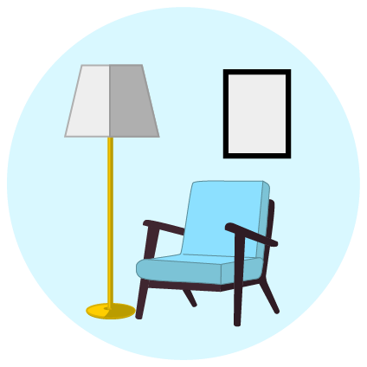
Learning sequence 3 – set

Slide 29
Learning intentions and success criteria (3)
We are learning to
make visual representations of places and spaces imagined in a short, scripted excerpt
appreciate how set design and construction can contribute to an audience response in drama.
I can
interpret meaning from a dramatic work and apply it to a theatrical set design
use fixed and mobile set pieces to shape dramatic meaning for an audience
use set design to enhance dramatic meaning for an audience responding to a performance.
Notes:
Notes for teachers:
Dependent on school context and student needs, teachers may use this sample LISC as a starting point for unpacking unfamiliar, subject specific terminology with students. Teachers can refer to NESA’s Glossary and Teaching and learning support downloadable documents when unpacking these terms.
Learning intentions and success are best co-constructed with students. Adapt the learning intention as required and add matching success criteria.
For more information See ⁠AITSL or the NSW Department of Education explicit teaching strategies, ⁠Sharing learning intentions and ⁠Sharing success criteria
LISC is not necessarily presented at the beginning of the lesson. Teacher needs to consider most effectual time to introduce
LISC should be revisited during the lesson to support students' evaluation of their learning

Slide 30
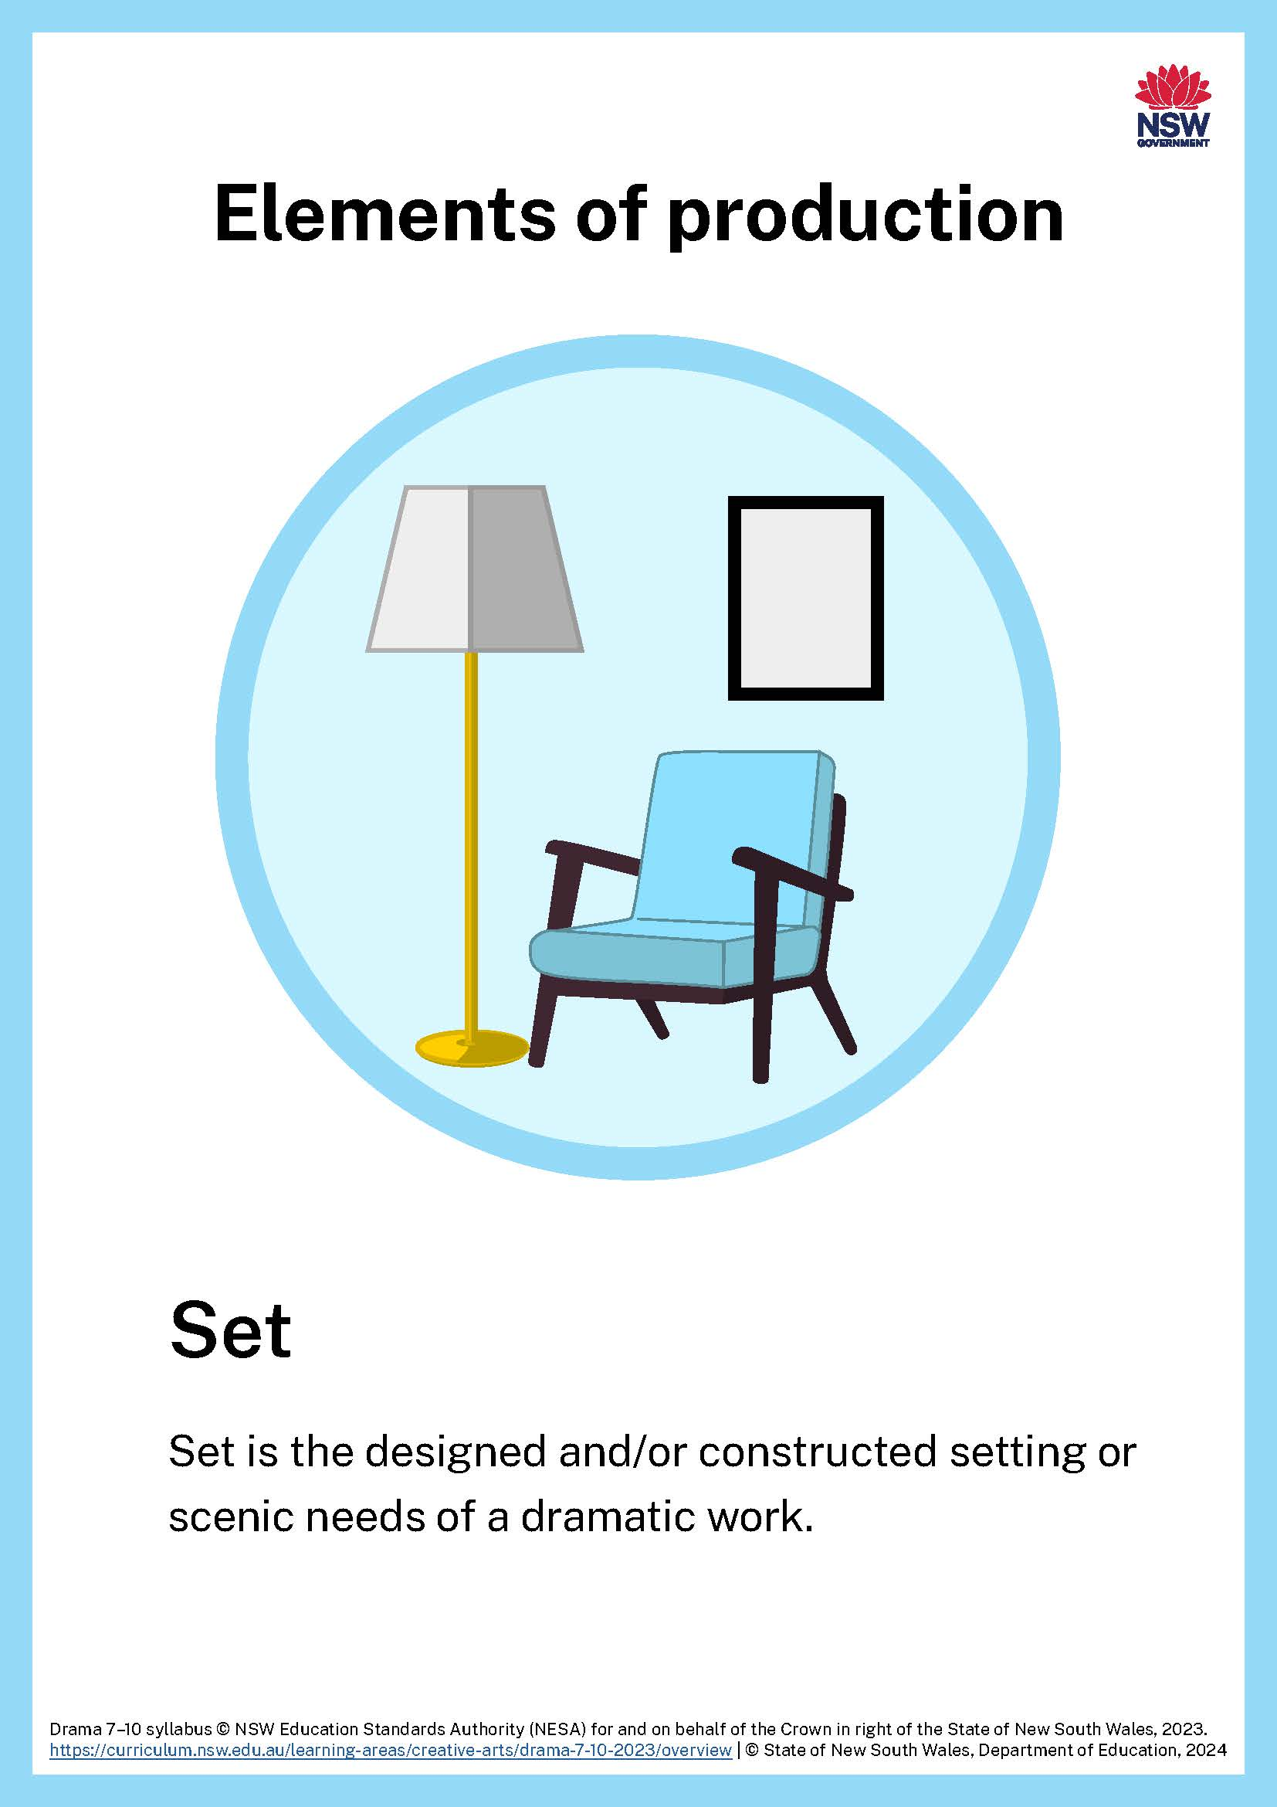
3.1a – set

Slide 31
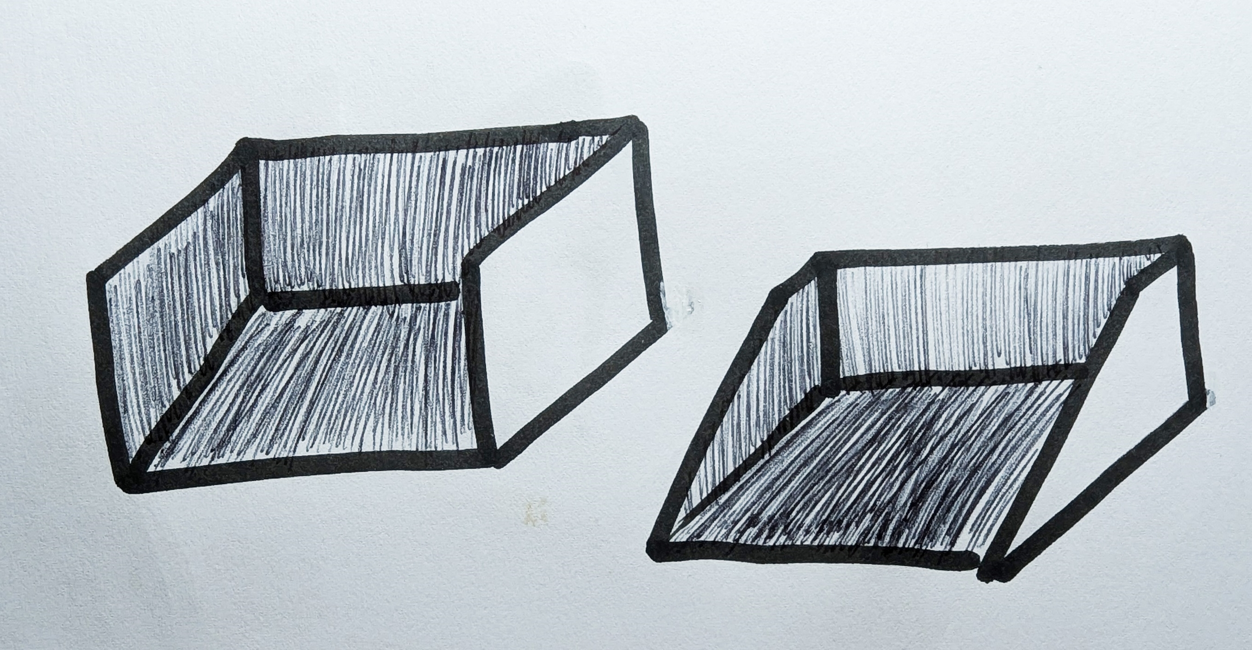
3.1b – creating a ‘black box’ set
Using the box and other materials provided by your teacher, complete the following steps:
Remove the ‘roof’ of the box (keep the cardboard, you may need it later).
Place the box on a desk so you can see into it.
You can choose to cut the side walls on an angle from the back corner to the bottom front corner, creating triangular walls, or you can leave them as rectangular walls.
Make the interior of the box black with the materials the teacher provides you.

Slide 32
3.1c – proscenium arch stage
This work was generated using artificial intelligence. Any copyright subsisting in this work is owned by © State of New South Wales (Department of Education), 2024.

Slide 33
3.1d – thrust stage
This work was generated using artificial intelligence. Any copyright subsisting in this work is owned by © State of New South Wales (Department of Education), 2024.

Slide 34
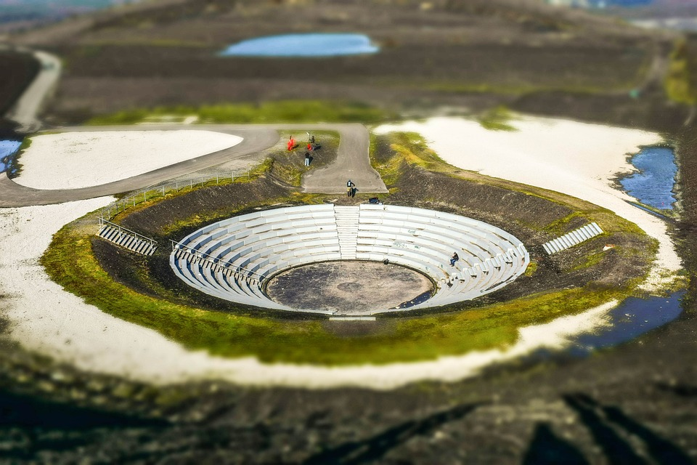
3.1e – theatre in the round
Image licensed under Pixabay Content License.

Slide 35
3.1f – theatre machinery
There are many types of theatre machinery which can be used to alter sets and scenery during a performance. Two common forms of theatre machinery are:
a revolve – many stages use a revolve, a large spinning disc which allows a set and the performers on it to rotate
a fly system – large theatres will often have a fly system, which allows curtains, backdrops, set pieces and even sometimes performers to be lowered from the ceiling (or flown) onto the stage.
This work was generated using artificial intelligence. Any copyright subsisting in this work is owned by © State of New South Wales (Department of Education), 2024.

Slide 36
3.2 – Shack by George Kemp
A synopsis
Eight high school students, stranded in a shack amidst a brutal Antarctic blizzard, must navigate survival with a sinister force lurking outside. Inspired by Ernest Shackleton's legacy, they face the extreme challenges of nature and the unknown. Cut off from the world, their courage and sanity are pushed to the limits as they question their roles in society and their environment. Each student brings unique strengths and vulnerabilities to the group, discovering that leadership and unity are crucial. Through their ordeal, they learn the true meanings of bravery, solidarity, and survival.
Shack is a gripping tale of adventure and self-discovery, showcasing the extraordinary resilience and strength of the younger generation.
Text summarised from Shack on Australian Theatre for Young People. Image licensed under Pixabay Content License.

Slide 37
3.3 – building the set
You will need the ‘black box’ set you created earlier.
Using only paper and/or card and the adhesives supplied by your teacher, create a set model which reflects the scene you have been looking at in the Shack script excerpt.
How will you create the frozen world that the characters inhabit in this scene?
How will you construct the shack? What information can you use from the scene to help you create this?
These thoughts would be great documentation of your devising processes and could be included in your box.

Slide 38
3.4 – projecting the scene
Using the Shack script excerpt that you have just read:
Plan a design that could be projected onto your black and white set model that will create the icy world evoked in the scene.
Using the materials your teacher gives you, project your design onto your box set!
Reflect on the challenges you faced in creating and projecting your design onto the set box.
Reflect on what you could do with projections in your school’s performance space.
These reflections would be great documentation of your creative and critical processes and could be included in your box.

Slide 39
Learning sequence 4 – lighting

Slide 40
Learning intentions and success criteria (4)
We are learning to
experiment with lighting to understand how it is used to create focus and shape action, spaces and dramatic meaning
evaluate how lighting effects can be used to influence audience response.
I can
work safely with different lighting states and understand the importance of safety when working in low light
collaborate in an ensemble to stage dramatic action by manipulating an element of production
make and analyse choices in the use of lighting to shape audience engagement.
Notes:
Notes for teachers:
Dependent on school context and student needs, teachers may use this sample LISC as a starting point for unpacking unfamiliar, subject specific terminology with students. Teachers can refer to NESA’s Glossary and Teaching and learning support downloadable documents when unpacking these terms.
Learning intentions and success are best co-constructed with students. Adapt the learning intention as required and add matching success criteria.
For more information See ⁠AITSL or the NSW Department of Education explicit teaching strategies, ⁠Sharing learning intentions and ⁠Sharing success criteria
LISC is not necessarily presented at the beginning of the lesson. Teacher needs to consider most effectual time to introduce
LISC should be revisited during the lesson to support students' evaluation of their learning

Slide 41
4.1a – lighting

Slide 42
4.1b – What is the purpose of stage lighting?
To Illuminate
To evoke
Explain how light can be used to ‘evoke’ in the theatre
Explain how light can be used to ‘illuminate’ in drama

Slide 43
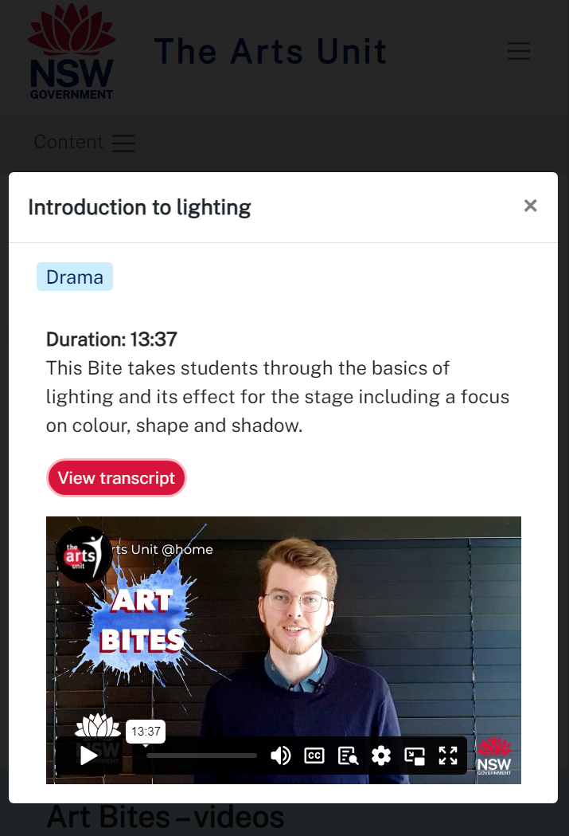
4.1c – introduction to lighting
The Arts Unit – Art Bites
While you are watching this video note down:
3 things you have learned about the direction of light
3 things you have learned about colour
3 things you have learned about shape and shadow.

Slide 44
4.1d – What do I know about stage lighting?
List 3 things you have learned about the direction and focus of light.
1.
2.
3.
List 3 things you have learned about colour.
1.
2.
3.
List 3 things you have learned about shape and shadow.
1.
2.
3.

Slide 45
4.2 – experimenting with light
You will need to use a torch for this activity.
Remember the world of ‘Antarctica’ you created for our last ‘Shack’ activity?
In small groups, you will now devise a one-minute scene where the young explorers venture outside into the snowstorm…
What creatures lurk out in the frozen wilderness? How will you ‘discover’ them with your torches?
How can you use the torches to create a suspenseful atmosphere and sense of adventure for both performers and the audience watching?
These thoughts would be great documentation of your improvising, and creative and critical processes. They could be included in your box.

Slide 46
4.3 – Where in the World is Frank Sparrow by Angela Betzien
A synopsis
In the cold, dark streets of Stab City, a jogger discovers a mysterious young boy, Frank Sparrow, born from the black earth. Adopted by a childless couple, Frank's fragile health condemns him to a seemingly menial existence. Doctors believe he won't live beyond his teenage years.
One day, everything changes when Frank has a strange conversation with a dead rat in biology class. Shortly after, he meets Kira Kelly, a girl who, like Frank, dreams of escaping the oppressive, crime-ridden urban sprawl of Stab City.
Their connection sparks a journey of love, death, life and the pursuit of freedom. As Frank and Kira navigate their struggles and dreams, the question looms: Where in the world is Frank Sparrow?
Text summarised from Teaching Australian Gothic Theatre through Angela Betzien on Austlit. Image licensed under Pixabay Content License.

Slide 47
4.4a – whole class collaboration
Collaboratively select which lighting states from the last activity most powerfully evoked the world of the play.
Using these ideas, create a whole class ensemble performance of the script excerpt.
Reflect on the impact of ensemble in creating meaning and engaging an audience.
Reflect on how the collaborative use of light heightened theatrical moments in the scene.
These reflections would be great documentation of your collaborative, and creative and critical processes. They could be included in your box.

Slide 48
4.4b – What are my reflections on today’s activity?
A positive success or highlight
Something you are looking forward to
A challenge experienced

Slide 49
Learning sequence 5 – sound

Slide 50
Learning intentions and success criteria (5)
We are learning to
use sound to enhance the elements of drama such as atmosphere, space, character and tension
extend our understanding of cultural safety and cultural expression through our exploration of script.
I can
use live sound to strengthen a theatrical moment
appreciate how the performance space can impact the quality of sound
work with classmates to ensure we use safe protocols for exploring works by Aboriginal and/or Torres Strait Islander playwrights.
Notes:
Notes for teachers:
Dependent on school context and student needs, teachers may use this sample LISC as a starting point for unpacking unfamiliar, subject specific terminology with students. Teachers can refer to NESA’s Glossary and Teaching and learning support downloadable documents when unpacking these terms.
Learning intentions and success are best co-constructed with students. Adapt the learning intention as required and add matching success criteria.
For more information See ⁠AITSL or the NSW Department of Education explicit teaching strategies, ⁠Sharing learning intentions and ⁠Sharing success criteria
LISC is not necessarily presented at the beginning of the lesson. Teacher needs to consider most effectual time to introduce
LISC should be revisited during the lesson to support students' evaluation of their learning

Slide 51
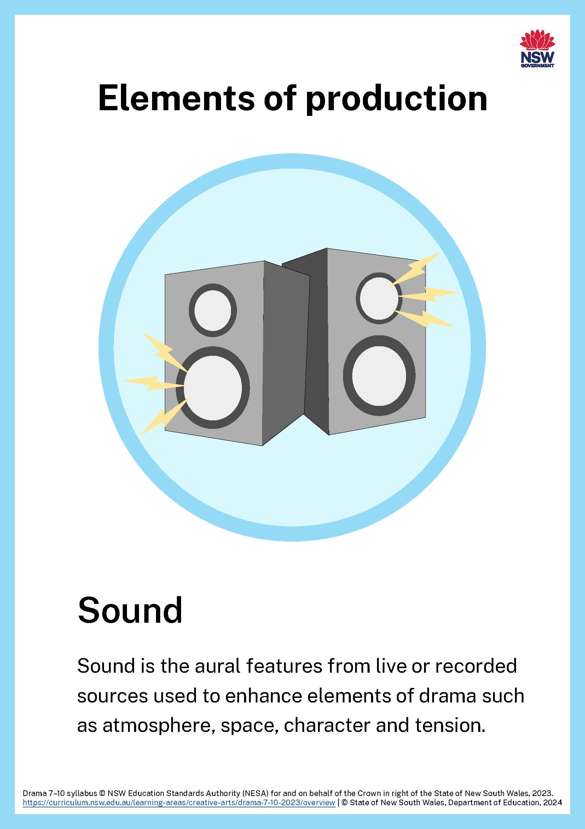
5.1a – sound

Slide 52
5.1b – soundscape
Read page 2 of your Compass script excerpt.
Think of a noise you can make or produce which would be appropriate as a sound effect for this scene.
Share your noise with the rest of the class.
Have some members of the class ‘conduct’ you all to create a whole class soundscape for the scene.
Reflect on your contribution and the whole class contribution to the soundscape.
How did different conductors manipulate volume, timing and rhythm?
These reflections would be great documentation of your collaborative and improvising processes. They could be included in your box.

Slide 53
5.2a – Sunshine Super Girl by Andrea James
A synopsis
A young Aboriginal girl from the tiny town of Barellan in southern NSW first plays tennis with a racket made from a fruit box. She became one of Australia's greatest tennis players winning 14 grand slam and 86 singles titles.
What many Australians don't know was that her journey as a young Wiradjuri woman was a battle against racism and prejudice, hiding from the black government car and being segregated from white people in the cinemas. Despite the fame and fortune, her connection to Country is never lost and even when she is on top of the world, she always longs for home.
Text summarised from Evonne Goolagong Cawley tennis collection from National Museum Australia. Image licensed under Pixabay Content License.

Slide 54
5.2b – creating sound for a scene
Read ‘Prologue’ from your excerpt of Sunshine Super Girl.
Form groups of 4 – you will be given 2 tennis balls.
Create a soundscape which includes both the sound of the tennis match and the sound of the crowd.
Share your soundscape with the rest of the class.
Reflect on your success in creating the sounds of the tennis match.
Consider what other items you could have used to create these sounds. Would this have been more successful?
These reflections would be great documentation of your collaborative and devising processes. They could be included in your box.

Slide 55
5.3a – foley
The creation of live sound
Foley artists are skilled sound creators who produce the everyday noises we hear in movies, TV shows and video games. Using a wide array of props and tools, they expertly generate sounds such as footsteps, the metallic slide of a sword being drawn, or the gentle rustling of clothing as people walk by. These carefully crafted auditory elements significantly enhance the realism and immersive experience for the audience.
Some common items used to create foley are:
kitchen gloves – when inflated and slapped together sounds like flapping wings
coconuts – when cut in half and clapped together they sound like horses running
newspaper – when cut up and placed in a bag they create rustling sounds like a person walking on grass.
Text summarised from What does a Foley Artist do? on Berklee.edu.

Slide 56
5.3b – performing a scene with sound
Using the foley items you have available, develop a performance of ‘Prologue’ from Sunshine Super Girl.
Remember, you need to act in the scene and use your foley items to create sound.
Share your scene with the rest of the class.
How were you able to create sound effects and perform as a character in a tennis match at the same time?
How did the use of live sound heighten the experience and engage the audience?
These reflections would be great documentation of your creative and critical processes. They could be included in your box.

Slide 57
5.4a – Evonne Goolagong Cawley research
One thing I have learned about Evonne Goolagong Cawley’s connection to Country
1
1.
Two things I have learned about Evonne Goolagong Cawley’s tennis career
2
2.
1.

Slide 58
5.4b – evoking place with sound
Consider the dialogue you can see in the blue circle.
Using the respectful protocols established by your class, create a soundscape appropriate to the props mentioned and the place evoked by the character’s dialogue.
‘This is mum’s spot. That current there? Swirling around and around? That’s the backwater. Leaves and twigs and bugs. That’s what the fish are after and that’s what I’m after. The fish.’
‘This is a good spot here.
This is mum’s spot. That current there? Swirling around and around? That’s the backwater. Leaves and twigs and bugs. That’s what the fish are after and that’s what I’m after.
The fish.’
A record of this activity would be great documentation of your devising and safe processes. It could be included in your box.
Sunshine Super Girl by Andrea James (2021) is published by Currency Press Sydney.

Slide 59
Learning sequence 6 – developing a design concept

Slide 60
Learning intentions and success criteria (6)
We are learning to
develop a design concept for a short, script excerpt.
I can
experiment with one of the elements of production to develop an idea
work effectively with my peers to give and receive feedback in the early stages of concept development.
Notes:
Notes for teachers:
Dependent on school context and student needs, teachers may use this sample LISC as a starting point for unpacking unfamiliar, subject specific terminology with students. Teachers can refer to NESA’s Glossary and Teaching and learning support downloadable documents when unpacking these terms.
Learning intentions and success are best co-constructed with students. Adapt the learning intention as required and add matching success criteria.
For more information See ⁠AITSL or the NSW Department of Education explicit teaching strategies, ⁠Sharing learning intentions and ⁠Sharing success criteria
LISC is not necessarily presented at the beginning of the lesson. Teacher needs to consider most effectual time to introduce
LISC should be revisited during the lesson to support students' evaluation of their learning

Slide 61
6.1a – assessment task – nothing is neutral
Part A – documenting process and applying feedback
Part B – design concept showcase
Throughout this unit, you will collect documents, images and other items related to the development of your design concept.
The cover or lid of the box should include a short summary of your concept, also known as a design concept statement.
Documentation in your box may include annotated scripts, descriptions, photographs, sketches, diagrams, material samples, video and/or sound bites.
Throughout the design process, document the evolution of your thinking and design ideas, as you respond to and apply peer feedback about your creative choices. You could do this by annotating your documentation to show how you generated, evaluated and refined your use of the element of production to create dramatic meaning for the audience.
Focus on either set, costume, lighting or sound design.
Select an excerpt of one of the 5 scripted works you have explored in class.
You will collaborate with your peers to evaluate and select the materials/items (from your box) that best communicates your design concept.
You will decide how best to present your individual design concept to an audience, and this could include a selection sketches, renderings, collage, models, mood boards, enactment, images, sounds and/or visual or audio clips.
Together, the class will develop a shared intention for the showcase of all designs and may decide to include design concept statements from Part A to support the Showcase.

Slide 62
6.1b – steps to success (1)
Nothing is neutral – developing the design concept
What I need to do | Ways I can do this
Choose a script excerpt and an element of production to focus on. | Review my documentation box and decide what worked and what I was interested in Get feedback from my peers. What do they recommend? Experiment with some of my draft design ideas to help me decide which ones would be good to extend Choose either prop, costume, set, lighting or sound as the element of production for my design concept
Learn about the world of the play, and how I might represent it through design. | Research the play, read the script and read about productions of it. What is the context of the play. What can I learn from past productions? Consider style and what is appropriate for this play Continue to experiment with different design ideas for my chosen script excerpt and element of production Discuss my ideas with my peers and see what they think

Slide 63
6.1c – steps to success (2)
Nothing is neutral – developing the design concept
What I need to do | Ways I can do this
Learn more about the element of production I am focusing on. | Look at other examples of this element of production in use, possibly in live theatre Learn how this element of production interplays with others. For example, how does lighting impact costume? Keep experimenting! Share my ideas with my peers and see what they think – do the same for them
Develop a design concept statement appropriate to my chosen script excerpt and the element of production I am focussing on. | Consider what my design for the script excerpt will look like in performance. Consider the audience. Does my design concept contribute to their appreciation and understanding of the theatrical moment(s)? Consider your actors. Does this design concept support and enhance their ability to develop and communicate their characters? Consider the other elements of production. Will they interplay effectively with my design concept?

Slide 64
6.1d – steps to success (3)
Nothing is neutral – developing the design concept
What I need to do | Ways I can do this
Choose how I might present my design concept in the Showcase. | Consider the best way I can present my ideas and materials so that they demonstrate my design concept. Consider the coherence of my work. Will others understand my design concept? Collaborate with my peers to ensure we have a shared intention for our Showcase and that all our design concepts are engaging for an audience Collaboratively plan a culturally-safe showcase
Document my process | Collect everything and store it in my documentation box – from my initial ideas to my final product. Annotate what I have collected so that others can understand what I was planning and how well it worked. Ask others to help me refine my concept through a collaborative process of peer feedback. Plan and finalise a design concept statement which unpacks my idea and is displayed on the lid or cover of my documentation box.

Slide 65
6.1e – audience engagement
Suspension of disbelief
The fourth wall
Audience
Alienation
Immersion
The hook
Identification
Notes:
Teacher note: This may be used as an extension activity.

Slide 66
6.1f – using one of the 6 terms you have investigated
Definition
Facts/Characteristics
________________
Examples
Non-examples
Notes:
Teacher note: This may be used as an extension activity.

Slide 67
6.2 – planning your design concept
Make sure you consider:
the playwright
the context and the setting of the play as a whole
the style of your chosen play or excerpt
what you can learn from past productions
how the audience will engage with your chosen excerpt
the material available to you to demonstrate design choices
how you manage your time effectively.

Slide 68
6.4 – developing your idea
Choose 3 items from your documentation box which reflect your chosen script excerpt or element of production.
Choose one item and spend 30 minutes refining it to accurately reflect the script excerpt and element of production you have chosen.
Share it with a partner.
Could your partner instantly recognise what script you are working with?
Could your partner identify which element of production you have chosen?
Did your partner have any other feedback?
This feedback would be great for your documentation box.

Slide 69
6.5 – consolidating your idea
Take the A3 sheet of paper you have been given and use it to enhance one of the ideas you are working on as part of your design concept. You might use it to write or draw on, as structural material, or as a frame for an existing design idea/item. Get creative! You have 30 minutes to work – then share with a partner.
What were some of the creative ideas you considered in this activity?
Did your partner have any suggestions or feedback that you can use going forward?
This feedback would be great for your documentation box.

Slide 70
6.6 – What is your design concept?
You should include:
a sentence that clearly explains the overall design concept/vision or intention of your work
a paragraph explaining significant moments, ideas, images, techniques, approaches, demands and/or stylistic conventions you have chosen to explore
a sentence explaining how you chose to manipulate, highlight, analyse and/or explore the element of production in developing and expressing your design concept
a sentence reflecting on the intended audience response to your design concept in performance.
Notes:
Teacher note: teachers may choose to share the scaffolding questions and sample design concept statement provided in the Appendix section of Sample unit – nothing is neutral. These could be used to support the whole class or individual students.

Slide 71
Learning sequence 7 – feedback, refinement and showcase

Slide 72
Learning intentions and success criteria (7)
We are learning to
plan and implement effective collaborative processes to showcase design concepts and documentation as a group
seek and exchange ideas and feedback to enhance the development of our design concepts
use collaborative processes to communicate shared intention to an audience in our design concept showcase.
I can
collaborate to build a process for giving and using peer feedback
support the work of my peers with constructive feedback and use feedback to develop and refine my own design concept
work with my peers to display our design concepts for an audience
reflect on and evaluate how the elements of production create dramatic meaning and audience engagement.
Notes:
Notes for teachers:
Dependent on school context and student needs, teachers may use this sample LISC as a starting point for unpacking unfamiliar, subject specific terminology with students. Teachers can refer to NESA’s Glossary and Teaching and learning support downloadable documents when unpacking these terms.
Learning intentions and success are best co-constructed with students. Adapt the learning intention as required and add matching success criteria.
For more information See ⁠AITSL or the NSW Department of Education explicit teaching strategies, ⁠Sharing learning intentions and ⁠Sharing success criteria
LISC is not necessarily presented at the beginning of the lesson. Teacher needs to consider most effectual time to introduce
LISC should be revisited during the lesson to support students' evaluation of their learning

Slide 73
7.2a – the feedback process
Designer | Peers | Peers | Designer
You have 4 minutes to explain your design concept and share some of your documentation to your peers. | They have 3 minutes (one minute each) to ask you questions about your design concept. | They have 6 minutes to give feedback, 3 minutes of silent time to write and then one minute each for verbal feedback. | You have 2 minutes to respond to the feedback and thank your classmates for their suggestions.

Slide 74
7.2b – exit ticket
A positive success or highlight from the feedback process
Something you are looking forward to working on
A challenge you experienced

Slide 75
7.3 – finalising your concept for the Showcase
Some things to ask yourself:
Have I checked the assessment task requirements?
Have I gathered my documentation?
Have I completed my design concept statement?
Have I exchanged, reflected on and responded to peer feedback?
Is my work ready to be displayed in the Showcase event?

Slide 76
7.5 – collaboratively planning for the Showcase event
Some things to ask ourselves:
What permissions and protocols do we need to think about when developing this Showcase?
What are the limitations of the exhibition space?
How will the audience enter and exit the space?
How do we think we should organise the different exhibits?
What do we need to consider in order to showcase everybody’s design concepts effectively?
What equipment is available to support the Showcase event?
This collaborative planning would be great for your documentation box.

Slide 77
7.7a – ensuring a culturally safe and appropriate showcase
What Aboriginal cultural material could be shown and Acknowledged in your showcase? This could include language, descriptions of lived experiences, images or sounds.
Have you identified what cultural material in your showcase might be culturally sensitive, sacred or secret?
Have you consulted with Aboriginal groups in your school community, such as your local AECG?
Does your showcase feature any deceased Aboriginal person? Is it a biography or are you using images of a particular Aboriginal person?
How does your showcase Acknowledge and respectfully represent Aboriginal perspectives?
Adapted from Aboriginal Arts & Culture protocols Create NSW.

Slide 78
7.7b – the Showcase
As you set up, ask yourself:
Have I included everything I need to in my design concept presentation?
Have I supported my classmates in ensuring we are communicating a shared intention to the audience?
Have all the design concepts been displayed effectively?
Is the space ready for an audience – is it clean and welcoming and safe?

Slide 79
7.10 – reflection
Using an example from the Showcase, explain how the elements of production can be manipulated to create meaning for an audience.
Using an example from the Showcase, explain how a designer’s concept can shape the way an audience may interpret a scripted work in performance.
Considering an example from the Showcase, explain why the context of the play and the playwright should be considered when making design choices.
In a small group, consider these 3 prompts.
Agree who from your group will report your responses back to the rest of the class.

Slide 80
References (1)
This presentation contains NSW Curriculum and syllabus content. The NSW Curriculum is developed by the NSW Education Standards Authority. This content is prepared by NESA for and on behalf of the Crown in the right of the State of New South Wales. The material is protected by Crown copyright.
Please refer to the NESA Copyright Disclaimer for more information https://educationstandards.nsw.edu.au/wps/portal/nesa/mini-footer/copyright.
NESA holds the only official and up-to-date versions of the NSW Curriculum and syllabus documents. Please visit the NSW Education Standards Authority (NESA) website https://educationstandards.nsw.edu.au/wps/portal/nesa/home and the NSW Curriculum website https://curriculum.nsw.edu.au.
Drama 7–10 Syllabus © NSW Education Standards Authority (NESA) for and on behalf of the Crown in right of the State of New South Wales, 2023.
ATYP (Australian Theatre for Young People) (2013) 'Compass’, Productions, ATYP, accessed 8 October 2024.
ATYP (2022) 'Shack', Productions, ATYP, accessed 8 October 2024.
Bellamy J (2013) Compass, Playlab, Australia.
Berrell B (n.d.) 'Teaching Australian Gothic Theatre through Angela Betzien', AustLit, St Lucia: The University of Queensland, accessed 8 October 2024.
Betzien A (2012) Where in the World is Frank Sparrow?, Playlab, Australia.
Currency Press (n.d.) 'Jack Davis’, Authors, Currency Press website, accessed 9 October 2024.
Currency Press (n.d.) Sunshine Super Girl, Currency Press, Sydney, Australia.
Kemp J (2022) Shack, Playlab, Australia.

Slide 81
References (2)
State of New South Wales (Department of Education) (2020) 'Introduction to lighting' [video], The Arts Unit, NSW Department of Education website, accessed 8 October 2024.
Sydney Opera House (2012) Honey Spot, Yumpu, accessed 8 October 2024.
The National Museum of Australia 'Evonne Goolagong Cawley tennis collection', Collection Highlights, National Museum of Australia website, accessed 8 October 2024.

Slide 82
Copyright
© State of New South Wales (Department of Education), 2024
The copyright material published in this resource is subject to the Copyright Act 1968 (Cth) and is owned by the NSW Department of Education or, where indicated, by a party other than the NSW Department of Education (third-party material).
Copyright material available in this resource and owned by the NSW Department of Education is licensed under a Creative Commons Attribution 4.0 International (CC BY 4.0) license.
This license allows you to share and adapt the material for any purpose, even commercially.
Attribution should be given to © State of New South Wales (Department of Education), 2024.
Material in this resource not available under a Creative Commons license:
the NSW Department of Education logo, other logos and trademark-protected material
Material owned by a third party that has been reproduced with permission. You will need to obtain permission from the third party to reuse its material.
Links to third-party material and websites
Please note that the provided (reading/viewing material/list/links/texts) are a suggestion only and implies no endorsement, by the New South Wales Department of Education, of any author, publisher, or book title. School principals and teachers are best placed to assess the suitability of resources that would complement the curriculum and reflect the needs and interests of their students.
If you use the links provided in this document to access a third-party’s website, you acknowledge that the terms of use, including licence terms set out on the third-party’s website apply to the use which may be made of the materials on that third-party website or where permitted by the Copyright Act 1968 (Cth). The department accepts no responsibility for content on third-party websites.

