Slide 1
Instructions for use
This resource is not a teaching and learning program. It should be used in conjunction with ‘Powerful youth voices’ – Year 7, Term 1.
Classroom teachers are encouraged to add and adapt slides as required to meet the needs of their students.
Save a copy of the file to make changes to the slide deck. Go to File > Download a Copy (this downloads a copy to the computer to edit in the PowerPoint app).
To convert the PowerPoint to Google Slides
Upload the file into Google Drive and open it.
Go to File > Save as Google Slides.
(Note – conversion may cause formatting changes in the slides.)

Slide 2
Phase 6 – Writing process
Stage 4 – 7.1
‘Powerful youth voices’ – Year 7, Term 1
Photo by Alvaro Reyes on Unsplash

Slide 3
Sharing learning intentions and success criteria
Notes:
Teacher note: this slide has been used to identify the Explicit teaching learning strategy and should be deleted or hidden when using in a classroom setting. Sharing learning intentions allows a teacher to effectively communicate learning goals with students. They allow students to connect new learning to existing knowledge, skills and understanding. When used with success criteria students have a clear idea of the learning goal and how to get there (AERO 2024). The sample success criteria are aligned to the syllabus. They break the learning intention into smaller and more manageable actions. They show students what they must do, say, make, create or perform to demonstrate their learning (Griffin 2018). These have been left blank with suggestions provided in the notes to allow for the co-construction of success criteria that reflects student need. When co-constructing with students, teachers use their expertise to guide student thinking, and often model and use exemplars to show students what success 'looks like'.

Slide 4
Learning intentions and success criteria
We are learning to
understand the stages of the writing process
use the writing process to develop effective compositions.
[insert learning intention].
We can
[classroom teacher to insert co-constructed success criteria]
[classroom teacher to insert co-constructed success criteria]
[classroom teacher to insert co-constructed success criteria].
Notes:
Teacher note:
Learning intentions and success criteria are best co-constructed with students. Adapt the learning intention as required and add matching success criteria.
For more information See ⁠AITSL or the NSW Department of Education explicit teaching strategies, ⁠Sharing learning intentions and ⁠Sharing success criteria
LISC is not necessarily presented at the beginning of the lesson. Teacher needs to consider most effectual time to introduce
LISC should be revisited during the lesson to support students' evaluation of their learning

Slide 5
Connecting learning
Notes:
Teacher note: this slide has been used to identify the explicit teaching learning strategy and should be deleted or hidden when used in a classroom setting. The strategy of connecting learning involves making connections within and across learning. In this example, students are connecting learning to their prior knowledge of the terms ‘adjective’ and ‘adverb’, with checking this knowledge before gradually releasing responsibility.
Teachers actively support students to make connections within and across knowledge, skills and understanding as well as to prior learning experiences. Learning is a change to long term memory. Long term memory is a network of overlapping information with many connections (AERO 2024a), which are called schemas (CESE 2017).

Slide 6
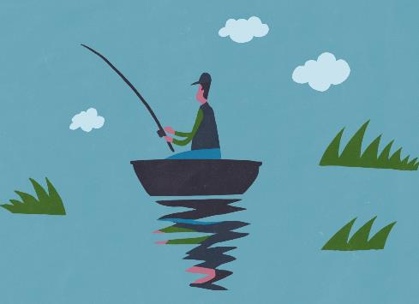
The writing process – what do you know?
Activating your thoughts on the writing process by connecting with your past learning and experience
Think back to a time when you have composed a piece of writing. This might have been an assessment task that you in Year 6, or it might have been a story that you wrote over the summer holidays, or an email that you sent to someone to convince them of your opinion on something. Ponder on this for a moment… did you use a ‘process’ to help you write? What do you think a ‘writing process’ might mean?
Draw this KWLH table into your book.
Connect with your past learning by completing the first column.
Activate your learning by completing the second column.
Notes:
Teacher note: students are guided to use the KWLH table to consider what they know, and would like to know, about the writing process.

Slide 7
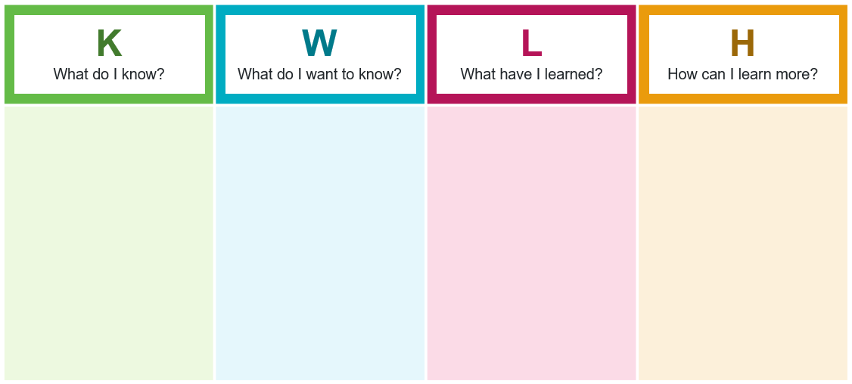
Further connecting your knowledge
The writing process – what exactly is it?
Activities
As a class, use a spider map on the board to brainstorm what you think the processes in ‘the writing process’ might actually be. What would you do first before you start writing?
Revisit the KWLH table in your book and add any information to the first 2 columns. Has the brainstorming activity sparked any curiosity about what you want to learn about the writing process?
The writing process
[Text]
[Text]
[Text]
[Text]
Notes:
Teacher note: students could work in pairs, then the teacher could construct an agreed spider map on this slide based on students sharing.

Slide 8
The writing process (1)
How can we use it to benefit our learning?
What is in your toolbox?
In what ways is a writer like an artist or builder or mechanic?
What is similar and different about all the tools they use?
Why is a process important to them all?
Notes:
Teacher note: questions for class discussion – come back to this slide at the end of the assessment task writing process to reflect.

Slide 9
The writing process (2)
Working like professional writers to get the most out of our ideas
Brainstorming
Planning and drafting
Seeking feedback
Editing and publishing
Notes:
Teacher note: this slide is for teacher and student reference. Students could be guided to create a display version for the classroom after their work in this resource.
Possible discussion questions:
Are the stages really that simple or sequential?
What does your actual process look like as a diagram?

Slide 10
Chunking and sequencing learning
Notes:
Teacher note: this slide has been used to identify the explicit teaching and learning strategy and should be deleted or hidden when using in a classroom setting.
Chunking learning into manageable components reduces demand on students’ working memory. Sequencing those chunks in a logical progression supports students to incorporate new information into their mental model, or schema (AERO 2024a).

Slide 11
Step 1 – brainstorming
Notes:
Teacher note: the purpose of this section is squeezing as many useful ideas out onto paper as possible.

Slide 12
What is brainstorming?
The writing process – step 1 – brainstorming
Brainstorming is the first step of the writing process. It is when you generate as many ideas as possible about a topic, regardless of whether you will end up using them or not in your writing. Recording your ideas in an organised manner is a beneficial first step before you start drafting your piece of writing. It helps you to remember what you want to write about and track your progress as you work through these ideas.
Photo by Milad Fakurian on Unsplash
Notes:
Teacher note: show students the definition and get personal feedback.
What kinds of brainstorming have worked for you in the past? What are the challenges of brainstorming?

Slide 13
Graphic organisers to support brainstorming
Recording your brainstorming can be approached in a variety of ways
When we think about brainstorming, our minds often go straight to constructing a mind map. However, there are several methods (both hardcopy and digital) that can be used to brainstorm. These are accessible through the Digital Learning Selector (DLS) and include:
Brainstorm bubbles
Words and images brainstorm
Detailed concept maps (slides 5 and 6)
Double bubble maps
Digitally with peers using templates in Microsoft PowerPoint (for example, Group brainstorm), Microsoft Whiteboard, or Canva for Education.
Notes:
Teacher note: students could be given one to trial during an upcoming writing task. They should report back to the class on the pros and cons of the strategy.

Slide 14
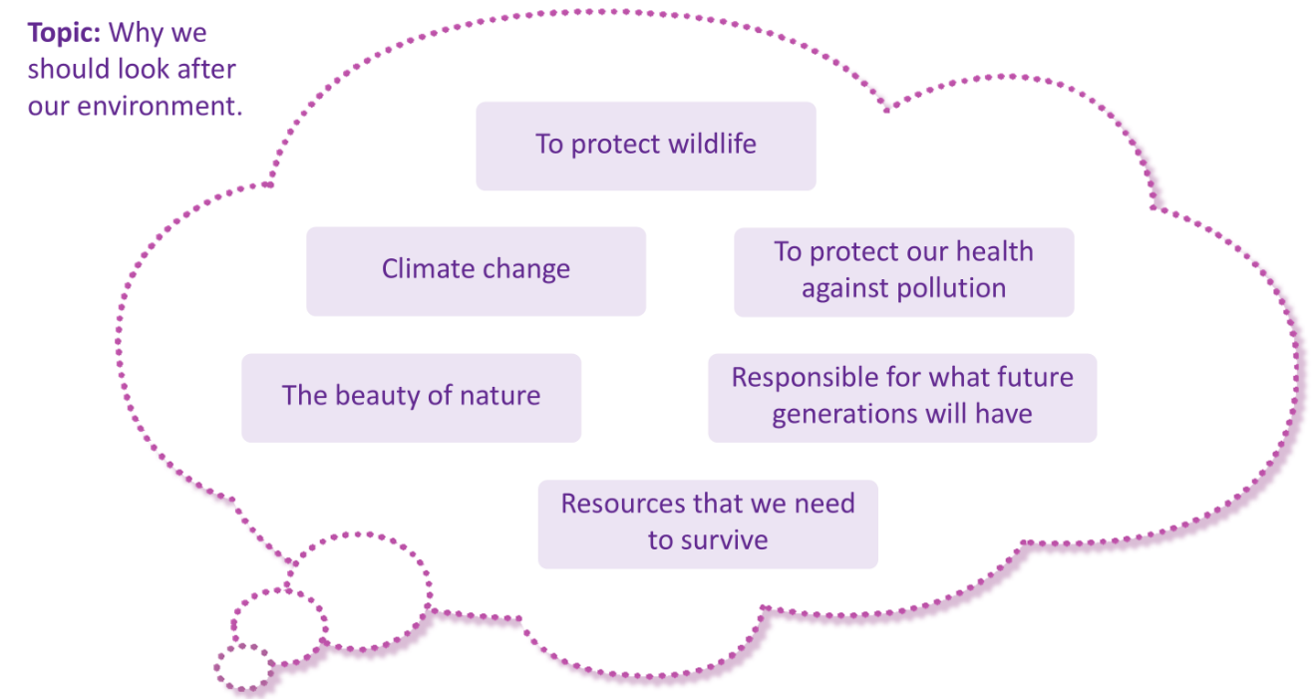
Modelled example of brainstorming
Brainstorming can help us map out our ideas
Below is a worked example using the Brainstorm bubbles PowerPoint template from the DLS.
Notes:
Teacher note: record each idea in a different text box.
Activity ideas:
Students may complete a brainstorm bubble for their current piece of writing. Individually, in small groups or as a whole class.
Introduce the idea of categorising from the initial free-for-all. What are the sub-groups that could be used to organise all the ideas eg a ‘protect’ group, or a ‘nature and wildlife’ group’ or a ‘responsibility to the future’ group.

Slide 15
Checking in with your learning (1)
Consolidating your understanding of the strategy of brainstorming
Discussion – how can brainstorming be utilised with your current class work?
Recording new knowledge – revisit your KWLH table. Can you add any notes to the L and H columns?
Assessing learning – imagine you are driving a car and waiting at a red traffic light. When the light turns green, are you…
I am not confident that I could use a graphic organiser to map out my ideas.
I could record my brainstormed ideas, but I may still need help organising them in a clear manner so I could draft effectively.
I could record my brainstormed ideas clearly in a graphic organiser so that they could be used effectively when drafting.
Notes:
Teacher note: students complete the KWLH chart in their English book.

Slide 16
Step 2 – planning and drafting
Notes:
Teacher note: the 2nd step in the writing process.

Slide 17
What is drafting?
The writing process – step 2 – drafting
Drafting is the next step of the writing process. It is your first go at getting your ideas down on paper or screen. It is meant to be messy. It is not meant to be finished.
Give yourself permission to:
cross things out and start again
be messy and artistic
not worry about whether it is ‘right’ or ‘good’.
Photo by Kaleidico on Unsplash
Notes:
Teacher note: the key point here for students is to reassure them that the quick process of drafting is not going to be their finished product, so they do not have to worry about it being ‘right’ or ‘good’. Many do not understand that working in this way is proven to result in a better product. Perhaps give them an example of a famous writer who indicates that they throw away or rewrite a huge percentage of their first drafts.

Slide 18
What do actual writers say about drafting?
The writing process is about working in the ways real published writers do
I’m writing a first draft and reminding myself that I’m simply shovelling sand into a box, so that later, I can build castles – Shannon Hale
To become a proper writer, you have to forgive yourself the catastrophe of the first draft – Alain de Botton
Get it down. Take chances. It may be bad, but it’s the only way you can do anything really good – William Faulkner
I probably end up tossing out a quarter of what I write in the first draft … [you] have to see how concepts play on page to decide if they deserve to stay – Cal Newport
Notes:
Teacher note: give pairs a quote each and ask them to report back on what they have learned.

Slide 19
Drafting my writing
I am worried I will make a mistake and my first attempt will not be perfect…
How do I draft without feeling overwhelmed?
Putting pen to paper is intimidating…
By setting clear goals and establishing checklists, the drafting process can become less daunting and even fun!
It will be challenging putting my ideas into clear sentences and paragraphs while also paying attention to spelling and grammar…
Notes:
Teacher note: this could be used as an opportunity for students to reflect on previous experiences. They could use the quotes as stimulus for the best advice they have received.

Slide 20
Methods for drafting
Strategy 1 – make goals to draft writing
Specific measurable goals can help students complete a draft of writing.
Which of these would be useful you?
Write 100 words.
Write for 10 minutes without stopping.
Fill a page with words.
Write the scene where …
Complete a planning template then write one section of it.
Follow a checklist, for example ‘use at least 2 persuasive language features in a body paragraph’.
Write one paragraph with 3 supporting sentences for the topic sentence.
Create an argument map (see the next slide).
Notes:
Teacher note: different goals can help different kinds of writers. Some famous writers have time or word count goals and do not get up until they have achieved them. It’s important to work out what will work for each individual.

Slide 21
Argument mapping
Topic – dogs make better pets than cats
An argument map is a way of organising ideas from your brainstorm, to get ready for drafting. Which other ways can help you do this?
Thesis – an active dog will make an appropriate pet for a large family with a yard
Dogs can be trained
Dogs are social animals
But… dogs are messy and need constant looking after
Do tricks
Guard property
Look after people
Play with children
Go for walks
Be a part of the family
Cats look after themselves
Cats are self-cleaning
Cats only eat what they need
Notes:
Teacher note: activity – co-construct one for the environment theme then students make their own for the relevant writing task.
Key understandings:
Top box = expanded to become the introduction. Each vertical row is a paragraph with the top box becoming the topic sentence and the bottom box expanded to be supporting sentences.
Use this – or other organisational diagrams – to progress from the brainstorm to the draft
Brainstorm first
Make a goal after completing the argument map – write the first paragraph beginning with the topic sentence ‘dogs are an appropriate pet for such a family as they can be trained to do a variety of useful things.’

Slide 22
Using effective questioning
Notes:
Teacher note: this slide has been used to identify the explicit teaching learning strategy of using effective questioning and should be deleted or hidden when used in a classroom setting. A hinge question is a question that assists the teacher in determining whether they should progress with the lesson content or revisit the content or skill to support student progress. If students cannot adequately respond to this type of question, they should be provided with either whole class instruction in another delivery mode or example, or if only some students are lacking confidence, they could be assisted individually when the class move on to the next stage of gradual release of responsibility.
Effective questioning strategies cause all students to think. This creates high engagement classroom environments which improve student achievement (Black and Wiliam 2018).

Slide 23
Checking in with your learning (2)
Consolidating your understanding of the strategy of drafting
Discussion – where can you see links to the strategy of drafting in your current class work?
Recording new knowledge – revisit your KWLH table. Can you add any notes to the L and H columns?
Assessing learning – where can you use this in a writing task you need to complete?
Notes:
Teacher note: students continue with their KWLH charts.

Slide 24
Step 3 – seeking feedback
Notes:
Teacher note: step 3 of the writing process.

Slide 25
What is feedback?
The writing process – step 3 – feedback
Feedback is another strategy from our ‘toolbox’ of writing skills. Written feedback is when a teacher or peer provides comments and suggestions about a piece of writing. This feedback usually highlights strengths, points out areas that could be improved and may offer suggestions on how to improve. This strategy is often a 2-pronged process – you need to develop skills in both giving and receiving feedback. Additionally, effectively actioning feedback is just as important in the writing process.
How can feedback help our learning?
Feedback is an is important part of the writing process because it allows someone to view your writing through a different lens and give you specific advice about how it can be improved.
Notes:
Teacher note: students discuss the biggest advantages and challenges of giving feedback, receiving feedback and actioning feedback.

Slide 26
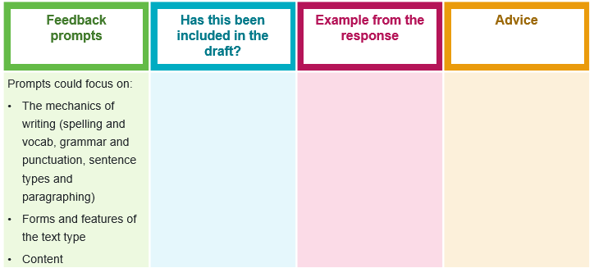
Providing quality feedback
How can we give quality feedback to a peer?
When we think about giving feedback, there are several methods (both in person, on paper and in digital form) that can be used to ensure that the feedback is constructive.
This is an example of a basic table that could be utilised when reviewing a peer’s work. Each row of the table could focus on a different element of the writing that requires feedback.
Notes:
Teacher note: note that the most effective practice is for the students as a class to co-construct the feedback prompts they will be looking for.

Slide 27
Quality feedback
How can we give and receive quality feedback?
Templates that can be used to provide structured feedback to peers includes 2 stars and a wish, See three before me and TAG feedback.
Conferencing with peers and the classroom teacher through discussion prompts and structured conversation is another method of gaining feedback. Planning for this conversation prior to entering it is crucial so that you receive effective feedback. Designing a suitable template so that you are receiving the feedback that you will find most helpful is crucial. Sample conferencing templates include the table to the right and Guided feedback chat.
Example discussion prompts | Notes from discussion
I like what you did when …
I’m not sure I fully understood what you meant by …
I was wondering if you could …
[Insert contextually relevant prompt]
Notes:
Teacher note: discuss how to give and receive quality feedback and take notes from the discussion.

Slide 28
Modelled examples of giving feedback
How can I provide quality feedback?
Student work | Feedback #1 | Feedback #2
Theres not much in the world that is important as your friends | You’re a useless editor | Check for missing punctuation and words.
A good friend is there to laugh with you. If you are crying. | ‘If you are crying’ looks like a dependent clause. | There’s something wrong here with these sentences.
A lot of adults criticise social media … kids always sit around… | ‘Criticise’ is a great word but you could also make ‘sit around’ more emotive. ‘Slouch around’? | ‘Criticise’ is a strong verb to get across your view of parents. Could you use a more emotive verb to get across a view of the kds?
Notes:
Teacher note: students work in pairs to decide which feedback is the most effective for each line of student work.
It is crucial to check together and create an agreed class philosophy such as: give feedback on the work, not the person. Be specific. Give positive feedback and explain why and how other parts could be as good.

Slide 29
Receiving and actioning feedback
How do I use the feedback from a peer or teacher to improve my writing?
To effectively edit your writing, you need to action the feedback you have received. If you have used a basic feedback table, you could add in an ‘actioning feedback’ column to keep track of what you are required to do during the editing process to improve your response.
Actioning feedback
Notes:
Teacher note: if relevant at this point, students could apply this to one of their developing pieces where they have received advice. What is their action plan from this point?

Slide 30
Actioning feedback on your actual response
Fine-tuning your writing using the ‘traffic lights’ method
What you need
your response
green highlighter and green sticky notes for your ‘do’ annotations
orange highlighter and orange sticky notes for your ‘fix’ annotations
red or pink highlighter and red or pink sticky notes for your ‘ask’ annotations
The traffic lights method will help you reflect, revise and rewrite
Highlight in green where you have done well. On a green sticky note, outline how you can carry the content or approach you applied forward.
Highlight in orange parts that were identified as needing improvement, which you know how to improve. On an orange sticky note, explain how you will refine your writing to implement the feedback provided.
Highlight in red the sections that were identified as needing improvement, which you don’t know how to improve. On a red sticky note labelled ‘ask’, write questions to ask your teacher and a peer marker.
Notes:
Teacher note: the traffic lights strategy used in this activity is an expansion of the strategy as referenced on the department’s Strategies for student peer assessment webpage. This webpage contains a variety of feedback strategies that could be used in the classroom.

Slide 31
Checking in with your learning (3)
Consolidating your understanding of effective feedback
Discussion – after building upon your understanding of the process of giving, receiving and actioning feedback, what would you do differently when approaching this process in future?
Recording new knowledge – revisit your KWLH table. Can you add any notes to the L and H columns?
Checking understanding – look at a paragraph of a partner’s work and practise giving feedback according to the class ‘philosophy’
Notes:
Teacher note: students continue the KWLH chart and practise working under the newly agreed class philosophy of giving and receiving peer feedback.

Slide 32
Step 4 – editing
Notes:
Teacher note: step 4 of the writing process.

Slide 33
What is editing?
How can I best prepare my work for publication?
Editing is the final process before publication. It can have many stages but it involves taking your work to the next level to make sure you present your best efforts.
After all, you have brainstormed, planned, drafted, actioned feedback, edited and edited again.
You want it to be your best work, right?
Photo by Jaredd Craig on Unsplash
Notes:
Teacher note: students could research a favourite author to find out how long it takes them to edit a novel.

Slide 34
Modelled example of editing
What has this person done to improve their work?
Original text
I am so greatful for social media, alot of adults criticise social media and think that kids are getting up to all kinds of no good on there but without it the pandemic would have been even more difficult for us kids. My parents just say …
Improved text
I am so grateful for social media. Although many adults criticise social media and think that kids are just passive victims, without it the pandemic would have been unbearable. Without it, I wouldn’t have had the supportive messages of my friends …
Notes:
Teacher note: the improvements are to both the control of language (eg spelling) but also the creation of an engaging writing voice (emotive language)
Possible answers: Spelling, variety of sentence types, formal register (many adults), emotive language, complex sentence, repetition for effect.
Students work in pairs to identify the ways this piece has been improved.

Slide 35
General advice about editing
It’s tough to see errors in your own work
There are 2 strategies you can use to combat this fact
Work with a partner to get a second pair of eyes – we’ve spent so long on our own writing that we may not be able to see the mistakes or weaknesses anymore.
Edit for a specific aspect of language or the task – don’t try to edit for everything all at once. Edit through your piece for spelling. Then again for punctuation. Then again for sentence structure. Then again for effective word choices.
Notes:
Teacher note: students are supported through the strategies on the slide.

Slide 36
Checking in with your learning (4)
Consolidating your understanding of the editing process
Discussion – what approaches can you take to edit your writing effectively? Where does the editing process fit in with your current class work?
Recording new knowledge – revisit your KWLH table. Can you add any notes to the L and H columns?
Assessing learning – test your partner. Put at least 6 errors of different kinds into one paragraph and see if they can find them all.
Notes:
Teacher note: students reflect on the editing process and try to catch their partner out as a test by purposefully putting 6 errors in their work.

Slide 37
Consolidating your understanding of the writing process
Notes:
Teacher note: final reflection and comparison to another process.

Slide 38
The writing process – what do we now know?
Using newly learned knowledge to improve our writing
Cast your mind back to the beginning of this PowerPoint where you were introduced to ‘the writing process’. It was here that we compared this process to having a ‘toolbox’ full of strategies that you confidently use to compose a polished piece of writing.
By using the steps of the writing process (brainstorming, drafting, feedback and editing) you are more likely in being able to reach your writing objective.
Consolidating your learning
Revisit the KWLH table that you have used throughout this PowerPoint.
Compare your notes with peers. Have you learnt similar things? How can you learn more?
Notes:
Teacher note: students complete chart and compare the writing process to another process they are familiar with, such as catching a fish or taking a penalty. What can we learn from the comparison?

Slide 39
References (1)
This presentation contains NSW Curriculum and syllabus content. The NSW Curriculum is developed by the NSW Education Standards Authority. This content is prepared by NESA for and on behalf of the Crown in the right of the State of New South Wales. The material is protected by Crown copyright.
Please refer to the NESA Copyright Disclaimer for more information https://educationstandards.nsw.edu.au/wps/portal/nesa/mini-footer/copyright.
NESA holds the only official and up-to-date versions of the NSW Curriculum and syllabus documents. Please visit the NSW Education Standards Authority (NESA) website https://educationstandards.nsw.edu.au/wps/portal/nesa/home and the NSW Curriculum website https://curriculum.nsw.edu.au.
English K–10 © Syllabus NSW Education Standards Authority (NESA) for and on behalf of the Crown in right of the State of New South Wales, [Year of publication].
Australian Education Research Organisation (AERO) (2024a) Explain learning objectives, AERO, accessed 16 April 2024.
AERO (Australian Education Research Organisation) (2024b) Why explicit instruction works, AERO website, accessed 16 April 2024.
Black P and Wiliam D (2018) ‘Classroom assessment and pedagogy’, Assessment in Education Principles Policy and Practice, 25(1):1–25.
CESE (Centre for Education Statistics and Evaluation) (2017) Cognitive load theory: Research that teachers really need to understand, NSW Department of Education, accessed 16 April 2024.
Clarke S (2014) Outstanding formative assessment: culture and practice, Hodder Education, Great Britain.

Slide 40
References (2)
Clarke S, Timperley H, Hattie J (2003) Unlocking formative assessment: Practical strategies for enhancing students’ learning in the primary and intermediate classroom, Hodder Moa Beckett, Auckland NZ, 2003.
Griffin P (2018) Assessment for teaching, Cambridge University Press.
State of New South Wales (Department of Education) (2024.) Explicit teaching strategies, NSW Department of Education website, accessed 5 April 2024.
State of New South Wales (Department of Education) (2024) the Explicit teaching – Driving learning and engagement, Centre for Education Statistics and Evaluation website, accessed 5 April 2024.
State of New South Wales (Department of Education) (n.d.) Digital Learning Selector, NSW Department of Education website, accessed 5 April 2024.
Wiliam D (2014) ‘The right questions, the right way ’, Educational Leadership, 71(6).

Slide 41
Copyright
© State of New South Wales (Department of Education), 2025
The copyright material published in this resource is subject to the Copyright Act 1968 (Cth) and is owned by the NSW Department of Education or, where indicated, by a party other than the NSW Department of Education (third-party material).
Copyright material available in this resource and owned by the NSW Department of Education is licensed under a Creative Commons Attribution 4.0 International (CC BY 4.0) license.
This license allows you to share and adapt the material for any purpose, even commercially.
Attribution should be given to © State of New South Wales (Department of Education), 2025.
Material in this resource not available under a Creative Commons license:
the NSW Department of Education logo, other logos and trademark-protected material
Material owned by a third party that has been reproduced with permission. You will need to obtain permission from the third party to reuse its material.
Links to third-party material and websites
Please note that the provided (reading/viewing material/list/links/texts) are a suggestion only and implies no endorsement, by the New South Wales Department of Education, of any author, publisher, or book title. School principals and teachers are best placed to assess the suitability of resources that would complement the curriculum and reflect the needs and interests of their students.
If you use the links provided in this document to access a third-party’s website, you acknowledge that the terms of use, including licence terms set out on the third-party’s website apply to the use which may be made of the materials on that third-party website or where permitted by the Copyright Act 1968 (Cth). The department accepts no responsibility for content on third-party websites.

