Slide 1

Year 8, Term 2 – transport me to the ‘real’
Phase 1, activity 1 – What does ‘real’ mean? – PowerPoint
Notes:
Teacher note: the purpose of this PowerPoint is to provide support for Phase 1 – engaging with the unit and the learning community. It should be used in combination with instructions from Phase 1, sequence 1 of the program and Phase 1, activity 1 – extending ideas of the ‘real’.

Slide 2
Sharing learning intentions and success criteria
Notes:
Teacher note: this slide has been used to identify the Explicit teaching learning strategy and should be deleted or hidden when using in a classroom setting. Sharing learning intentions allows a teacher to effectively communicate learning goals with students. They allow students to connect new learning to existing knowledge, skills and understanding. When used with success criteria students have a clear idea of the learning goal and how to get there (AERO 2024a). The sample success criteria are aligned to the syllabus. They break the learning intention into smaller and more manageable actions. They show students what they must do, say, make, create or perform to demonstrate their learning (Griffin 2018). These have been left blank with suggestions provided in the notes to allow for the co-construction of success criteria that reflects student need. When co-constructing with students, teachers use their expertise to guide student thinking, and often model and use exemplars to show students what success 'looks like'.

Slide 3
Learning intentions and success criteria
Learning intentions
We are learning to:
understand the subjective nature of what constitutes the ‘real’
understand the purpose of the podcast form.
Success criteria
I will know I am successful when I can:
[these could be co-constructed with the class or used as per the notes].
Notes:
Teacher note: clarify what students are learning and why.
Learning intentions and success criteria are best co-constructed with students. Adapt the learning intention as required and add matching success criteria.
For more information see ⁠AITSL or the NSW Department of Education explicit teaching strategies, ⁠Sharing learning intentions and ⁠Sharing success criteria
LISC is not necessarily presented at the beginning of the lesson. Teacher needs to consider most effectual time to introduce
LISC should be revisited during the lesson to support students' evaluation of their learning
Review the success criteria with the class. You may need to revisit these as you progress through the lesson sequence. It is recommended that success criteria be created collaboratively with students to suit individual classes.
Suggested success criteria:
I will know I am successful when I can:
identify representations of the ‘real’ in my own thoughts and ideas and in social media
reflect on how the ‘real’ is different for different people.

Slide 4
Connecting learning
Notes:
Teacher note: this slide has been used to identify the explicit teaching learning strategy and should be deleted or hidden when used in a classroom setting. The strategy of connecting learning involves making connections within and across learning. In this example, students are connecting learning to their own knowledge of how they use social media.
Teachers actively support students to make connections within and across knowledge, skills and understanding as well as to prior learning experiences. Learning is a change to long term memory. Long-term memory is a network of overlapping information with many connections (AERO 2024b), which are called schemas (CESE 2017).

Slide 5

What is the ‘real’? (1)
Think Pair Share
In pairs, create a brainstorm for:
What does ‘real’ mean and why does it matter?
Share your ideas with the class.
Notes:
Teacher note: students follow the instructions on the screen to create a brainstorm. They share their ideas with the class.

Slide 6
How does social media represent the ‘real’?
Think Pair Share
Are Facebook, TikTok and other forms of social media ‘real’?
Are the posts and images you put on social media ‘real’, constructed or a combination of both?
Complete the Venn diagram with a partner.
Share your ideas with the class using examples to support your ideas.
Real
Constructed
Notes:
Teacher note: students should be encouraged to consider the following aspects of social media use to respond to this activity:
When you take a selfie to post on social media, do you: use filters, take several photos to find the perfect picture, pose in a particular way, have a particular background … ?
Do you take photos of particular meals you eat? Are they a true representation of your life?
Do you post candid shots? Do you let your parents snap and post candid photos?
Do you think others do these things?
Do you think AI is used to make a post more appealing?

Slide 7
Gradual release of responsibility – modelled practice or ‘I do’
Notes:
Teacher note: this slide has been used to identify the explicit teaching learning strategy and should be deleted or hidden when using in a classroom setting. The strategy of gradual release of responsibility is a flexible process moving between modelled, guided and independent teaching practice responsive to student learning. Students should be supported to move between each practice based on their capabilities and requirements.
The teacher uses the gradual release of responsibility learning process to extend student thinking on the idea of the ‘real’ in Phase 1, activity 1 – extending ideas of the ‘real’. They discuss the reasons for the images chosen and their explanations.
Teachers deliver a structured and sequenced approach to explicitly teaching new content. Learning is most effective when teachers break new information down and teach it explicitly using explanation, demonstration and modelling. This is especially relevant when students are new to an area (AERO 2024a).

Slide 8
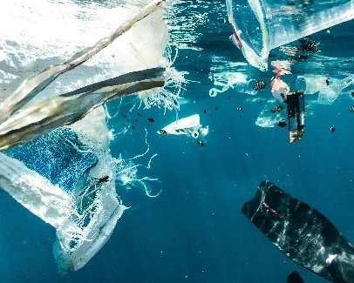
What is the ‘real’? (2)
Class discussion
Examine the image.
What does it represent?
What is the real situation of this image?
A group of garbage floating in the ocean by Naja Bertolt Jensen is licensed under Unsplash License.
Notes:
Teacher note: As part of the ‘We do’ step of gradual release, the teacher leads a class discussion to prompt ideas in response to the image.
‘I do’ – the teacher records ideas on the board to create a class brainstorm.

Slide 9
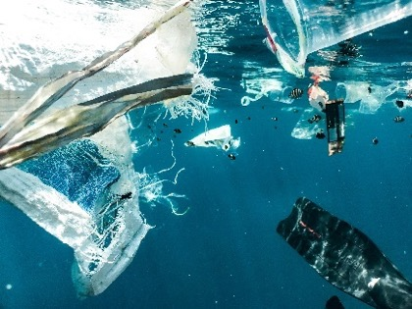
Looking closer
Responding to the image
What is this image about?
Pollution
What is the reality of this image? Explain using examples.
The ‘real’ | Image that represents the ‘real’ | Explanation of what the ‘real’ is on a larger whole world basis
Pollution | A group of garbage floating in the ocean by Naja Bertolt Jensen is licensed under Unsplash License. | This image shows an example of water pollution. It shows plastic rubbish floating in the ocean. Many people think that pollution is just rubbish on the ground or emissions coming out of smokestacks because they do not understand the problem. The real situation about pollution is that there are many forms of pollution, but water pollution is one that is having a huge effect on the world’s ecosystem …
Notes:
Teacher note: in this step of gradual release of responsibility, the teacher is demonstrating the skill of how to use brainstorming to create a response, so students can later apply it to the remaining images for Phase 1, activity 1 – extending ideas of the ‘real’.
‘I do’ – the teacher should use a think aloud to model how to turn the brainstorm items into an explanation of what the ‘real’ is on a larger whole world basis. Students should be encouraged to engage with the explanation which may include both ideas and structural elements. This is a good opportunity to incorporate embedded literacy of punctuation, sentence construction and embedded clauses as identified in the program. When examining the modelled explanation, explicit vocabulary instruction may be required for vocabulary such as: pollution, emissions, and ecosystem.
The explanation on the slide is only part of the response. The complete text can be located in Phase 1, activity 1 – extending ideas of the ‘real’.

Slide 10
Using effective questioning
Notes:
Teacher note: this slide has been used to identify the explicit teaching learning strategy of using effective questioning and should be deleted or hidden when used in a classroom setting. A hinge question is a question that assists the teacher in determining whether they should progress with the lesson content or revisit the content or skill to support student progress. If students cannot adequately respond to this type of question, they should be provided with either whole class instruction in another delivery mode or example, or if only some students are lacking confidence, they could be assisted individually when the class move on to the next stage of gradual release of responsibility.
Effective questioning strategies cause all students to think. This creates high engagement classroom environments which improve student achievement (Black and Wiliam 2018).

Slide 11
Checking for understanding
What do you know?
On a sticky note, write your name and your answer to the following question:
Why do images mean different things to different people?
Notes:
Teacher note: ask students to respond to the question prompt on the screen. Responses will indicate whether your students are ready to move on to the next stage of this learning sequence.

Slide 12
Gradual release of responsibility – guided practice or ‘We do’
Notes:
Teacher note: this slide has been used to identify the explicit teaching learning strategy and should be deleted or hidden when using in a classroom setting. The strategy of gradual release of responsibility is a flexible process moving between modelled, guided and independent teaching practice responsive to student learning. Students should be supported to move between each practice based on their capabilities and requirements.
The teacher uses the gradual release of responsibility learning process to extend student thinking on the idea of the ‘real’ in Phase 1, activity 1 – extending ideas of the ‘real’. They discuss the reasons for the images chosen and their explanations.
Teachers deliver a structured and sequenced approach to explicitly teaching new content. Learning is most effective when teachers break new information down and teach it explicitly using explanation, demonstration and modelling. This is especially relevant when students are new to an area (AERO 2024a).

Slide 13
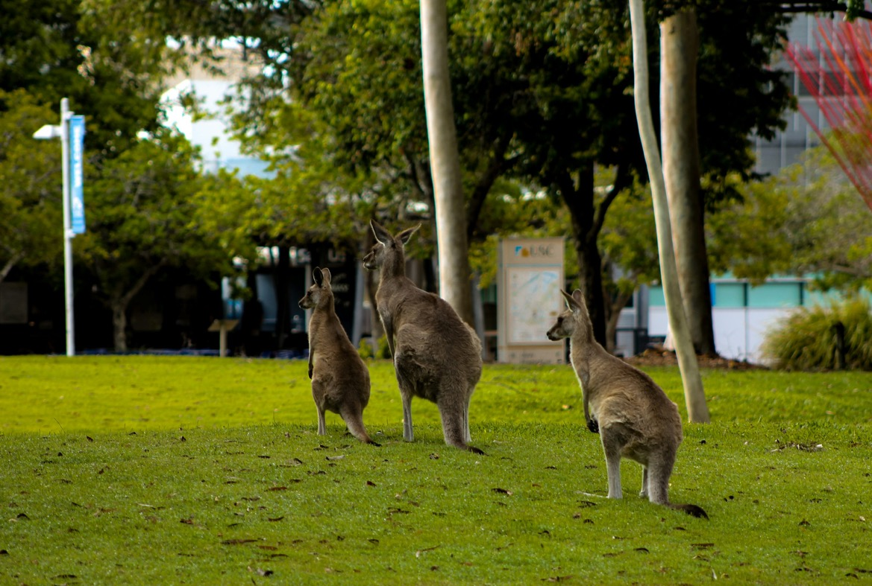
Creating an explanation
Responding to the image
What is this image representing?
What is the reality of this image? Explain using examples.
A group of kangaroos are standing in the grass by Rachel Schauerman is licensed under Unsplash License.
Notes:
Teacher note: this slide has been provided as an extra resource containing a larger version of the image. Students may prefer to see the larger imager rather than using the smaller image in the printed resource.
‘We do’ – students are encouraged to engage with the image by providing information for a class brainstorm.
’I do’ – the teacher returns to the ‘I do’ step and completes a think aloud process of using the brainstorm to construct sentences to form an explanatory paragraph.
‘We do’ – students are instructed to create a checklist in their books of what they see the teacher doing or saying as the teacher constructs the sentences. The class create a collaborative checklist of steps to be used to turn a brainstorm into an explanatory paragraph and copy it into their books.
‘We do’ – students are asked to offer suggestions as to how the teacher can improve the paragraph and edit these on the board in a think aloud as they do it. Other students can add thoughts to each edit through teacher organisation. Students reflect on the strengths of the final paragraph in a class discussion.

Slide 14
Gradual release of responsibility – independent practice or ‘You do’
Notes:
Teacher note: this slide has been used to identify the explicit teaching learning strategy and should be deleted or hidden when using in a classroom setting. The strategy of gradual release of responsibility is a flexible process moving between modelled, guided and independent teaching practice responsive to student learning. Students should be supported to move between each practice based on their capabilities and requirements.
The teacher uses the gradual release of responsibility learning process to extend student thinking on the idea of the ‘real’ in Phase 1, activity 1 – extending ideas of the ‘real’. They discuss the reasons for the images chosen and their explanations.
Teachers deliver a structured and sequenced approach to explicitly teaching new content. Learning is most effective when teachers break new information down and teach it explicitly using explanation, demonstration and modelling. This is especially relevant when students are new to an area (AERO 2024a).

Slide 15
Extending your understanding (1)
Responding to the images
Use Phase 1, activity 1 – extending ideas of the ‘real’ to:
Find an image that represents each idea in the first column.
Write an explanation of the reality of each image. Explain using examples.
Idea
Youth rights
Freedom
Power
TikTok
Notes:
Teacher note: students are encouraged to apply the new skill of brainstorming and writing an explanatory paragraph using Phase 1, activity 1 – extending ideas of the ‘real’.
‘You do’ – students find an image that represents the provided ideas. They construct explanatory paragraphs using the modelled and guided process used for the first 2 rows and the checklist. For differentiation, the teacher may choose to allow students to work in pairs or small groups, reduce the number of images and paragraphs or use guided practice with more examples (‘We do’).

Slide 16
Extending your understanding (2)
Reflecting on responses
After completing your paragraphs, summarise the reality of the image for freedom.
Share your ideas in a class discussion.
The teacher will categorise these into a class table.
Class discussion: Why do we have different ideas for each image?
Tip: remember, a summary usually provides a short overview of the who, what, when, where, why and how of a topic.
Type of image used | Reality of the image | Other realities
Notes:
Teacher note: this slide supports students to consolidate understanding of the differences in ideas.
‘You do’ – students summarise the reality of the image they selected for freedom.
‘We do’ – students share their ideas with the class and the teacher categorises them into a table of ideas.
‘We do’ – class discussion: Why do we have different ideas for each image?

Slide 17
Using effective feedback
Notes:
Teacher note: this slide has been used to identify the explicit teaching learning strategy of using effective feedback and should be deleted or hidden when using in a classroom setting.
Feedback is most useful when it is aligned to the learning intentions and success criteria of a lesson or learning experience (Clarke, Timperley and Hattie 2003). It is most effective when delivered during learning (Clarke 2014).

Slide 18
Monitoring and revising (1)
The ‘traffic lights’ method – Step 1
Select your best paragraph.
Use Phase 6, activity 5 – actioning feedback to guide your revision of your work.
Step 1 – revise
Read and highlight in green the sections of your response where you have done well. On a green sticky note, make points about how you can keep these successes in your next draft.
Read and highlight in orange sections of your work that were identified as needing improvement, which you know how to improve. On an orange sticky note, explain how you will refine your writing to implement the feedback provided.
Read and highlight in red the sections of your work that were identified as needing improvement, which you don’t know how to improve. On a red sticky note labelled ‘ask’, write questions to ask a peer.
Notes:
Teacher note: students engage with the reviewing and refining process.
Students select their best paragraph and complete the traffic lights method of revising their work.
This is an opportune time to introduce Phase 6, activity 5 – actioning feedback to support student development. They seek feedback from a peer.

Slide 19
Monitoring and revising (2)
The ‘traffic lights’ method - Step 2
Select your best paragraph.
Use Phase 6, activity 5 – actioning feedback to guide your revision of your work.
Step 2 – refine and rewrite
Refine your response based on the traffic light strategy. Seek clarification or advice from your peer on areas that you have highlighted in red.
Submit your work to your teacher.
Notes:
Teacher note: students engage with the reviewing and refining process.
When the feedback process is complete, students swap back their work and apply the feedback. The teacher should provide feedback to students on their finalised paragraph.

Slide 20
Checking for understanding
Notes:
Teacher note: this slide has been used to identify the explicit teaching learning strategy of using effective questioning and should be deleted or hidden when using in a classroom setting. If students cannot adequately respond to this type of question, they should be provided with either whole class instruction in another delivery mode or example, or if only some students are lacking confidence, they could be assisted individually when the class move on to the next stage of learning.
Teachers analyse the information they collect to make evidence-based instructional decisions. This includes when to move between modelled, guided and independent practice.
Checking understanding requires teachers to collect the responses of all students (Wiliam 2014).

Slide 21

Checking for understanding
Checking for understanding of the ‘real’
Write 3 sentences using the conjunctions: because, but, so.
Because explains why something is true.
But indicates a change of direction – similar to a U-turn.
So tells us what happens as a result of something else (cause and effect)
Reality is different to everyone because …
Reality is different to everyone, but …
Reality is different to everyone, so …
Notes:
Teacher note: give students a sentence stem (the beginning of a sentence) and ask them to turn it into 3 separate sentences using each of the conjunctions. Explain the meaning of each conjunction. This is also a good opportunity to reinforce the fact that a comma comes before a FANBOYS conjunction when joining 2 simple sentences. Ask students to complete each sentence about reality in their books.
The teacher can use this as an exit ticket for this learning sequence. It is important that the teacher checks student work to see if they understand the concept of reality being different to everyone. If they do not, it may be necessary to revisit the ideas in a different way.

Slide 22
References (1)
This presentation contains NSW Curriculum and syllabus content. The NSW Curriculum is developed by the NSW Education Standards Authority. This content is prepared by NESA for and on behalf of the Crown in the right of the State of New South Wales. The material is protected by Crown copyright.
Please refer to the NESA Copyright Disclaimer for more information https://educationstandards.nsw.edu.au/wps/portal/nesa/mini-footer/copyright.
NESA holds the only official and up-to-date versions of the NSW Curriculum and syllabus documents. Please visit the NSW Education Standards Authority (NESA) website https://educationstandards.nsw.edu.au/wps/portal/nesa/home and the NSW Curriculum website https://curriculum.nsw.edu.au.
English K–10 Syllabus © NSW Education Standards Authority (NESA) for and on behalf of the Crown in right of the State of New South Wales, 2022.
AERO (Australian Education Research Organisation) (2024a) Explain learning objectives, AERO website, accessed 16 April 2024.
AERO (Australian Education Research Organisation) (2024b) Why explicit instruction works, AERO website, accessed 16 April 2024.
Black P and Wiliam D (2018) ‘Classroom assessment and pedagogy’, Assessment in Education Principles Policy and Practice, 25(1):1–25.
CESE (Centre for Education Statistics and Evaluation) (2017) Cognitive load theory: Research that teachers really need to understand, NSW Department of Education, accessed 16 April 2024.
Clarke S (2014) Outstanding formative assessment: culture and practice, Hodder Education, Great Britain.

Slide 23
References (2)
Clarke S, Timperley H, Hattie J (2003) Unlocking formative assessment: Practical strategies for enhancing students’ learning in the primary and intermediate classroom, Hodder Moa Beckett, Auckland NZ, 2003.
Griffin P (2018) Assessment for teaching, Cambridge University Press.
State of New South Wales (Department of Education) (n.d.) Digital Learning Selector, NSW Department of Education website, accessed 5 April 2024.
State of New South Wales (Department of Education) (2024) Explicit teaching strategies, NSW Department of Education website, accessed 5 April 2024.
State of New South Wales (Department of Education) (2024) Explicit teaching – Driving learning and engagement, Centre for Education Statistics and Evaluation website, accessed 5 April 2024.
Wiliam D (2014) ‘The right questions, the right way ’, Educational Leadership, 71(6).

Slide 24
Copyright
© State of New South Wales (Department of Education), 2024
The copyright material published in this resource is subject to the Copyright Act 1968 (Cth) and is owned by the NSW Department of Education or, where indicated, by a party other than the NSW Department of Education (third-party material).
Copyright material available in this resource and owned by the NSW Department of Education is licensed under a Creative Commons Attribution 4.0 International (CC BY 4.0) license.
This license allows you to share and adapt the material for any purpose, even commercially.
Attribution should be given to © State of New South Wales (Department of Education), 2023.
Material in this resource not available under a Creative Commons license:
the NSW Department of Education logo, other logos and trademark-protected material
Material owned by a third party that has been reproduced with permission. You will need to obtain permission from the third party to reuse its material.
Links to third-party material and websites
Please note that the provided (reading/viewing material/list/links/texts) are a suggestion only and implies no endorsement, by the New South Wales Department of Education, of any author, publisher, or book title. School principals and teachers are best placed to assess the suitability of resources that would complement the curriculum and reflect the needs and interests of their students.
If you use the links provided in this document to access a third party’s website, you acknowledge that the terms of use, including licence terms set out on the third-party’s website apply to the use which may be made of the materials on that third-party website or where permitted by the Copyright Act 1968 (Cth). The department accepts no responsibility for content on third-party websites.

