Slide 1
Instructions for use
This resource is not a teaching and learning program. It should be used in conjunction with Year 8, Term 4 – The camera never lies.
Classroom teachers are encouraged to add and adapt slides as required to meet the needs of their students.
Save a copy of the file to make changes to the slide deck. Go to File > Download a Copy (this downloads a copy to the computer to edit in the PowerPoint app).
To convert the PowerPoint to Google Slides:
Upload the file into Google Drive and open it.
Go to File > Save as Google Slides.
(Note – conversion may cause formatting changes in the slides.)

Slide 2
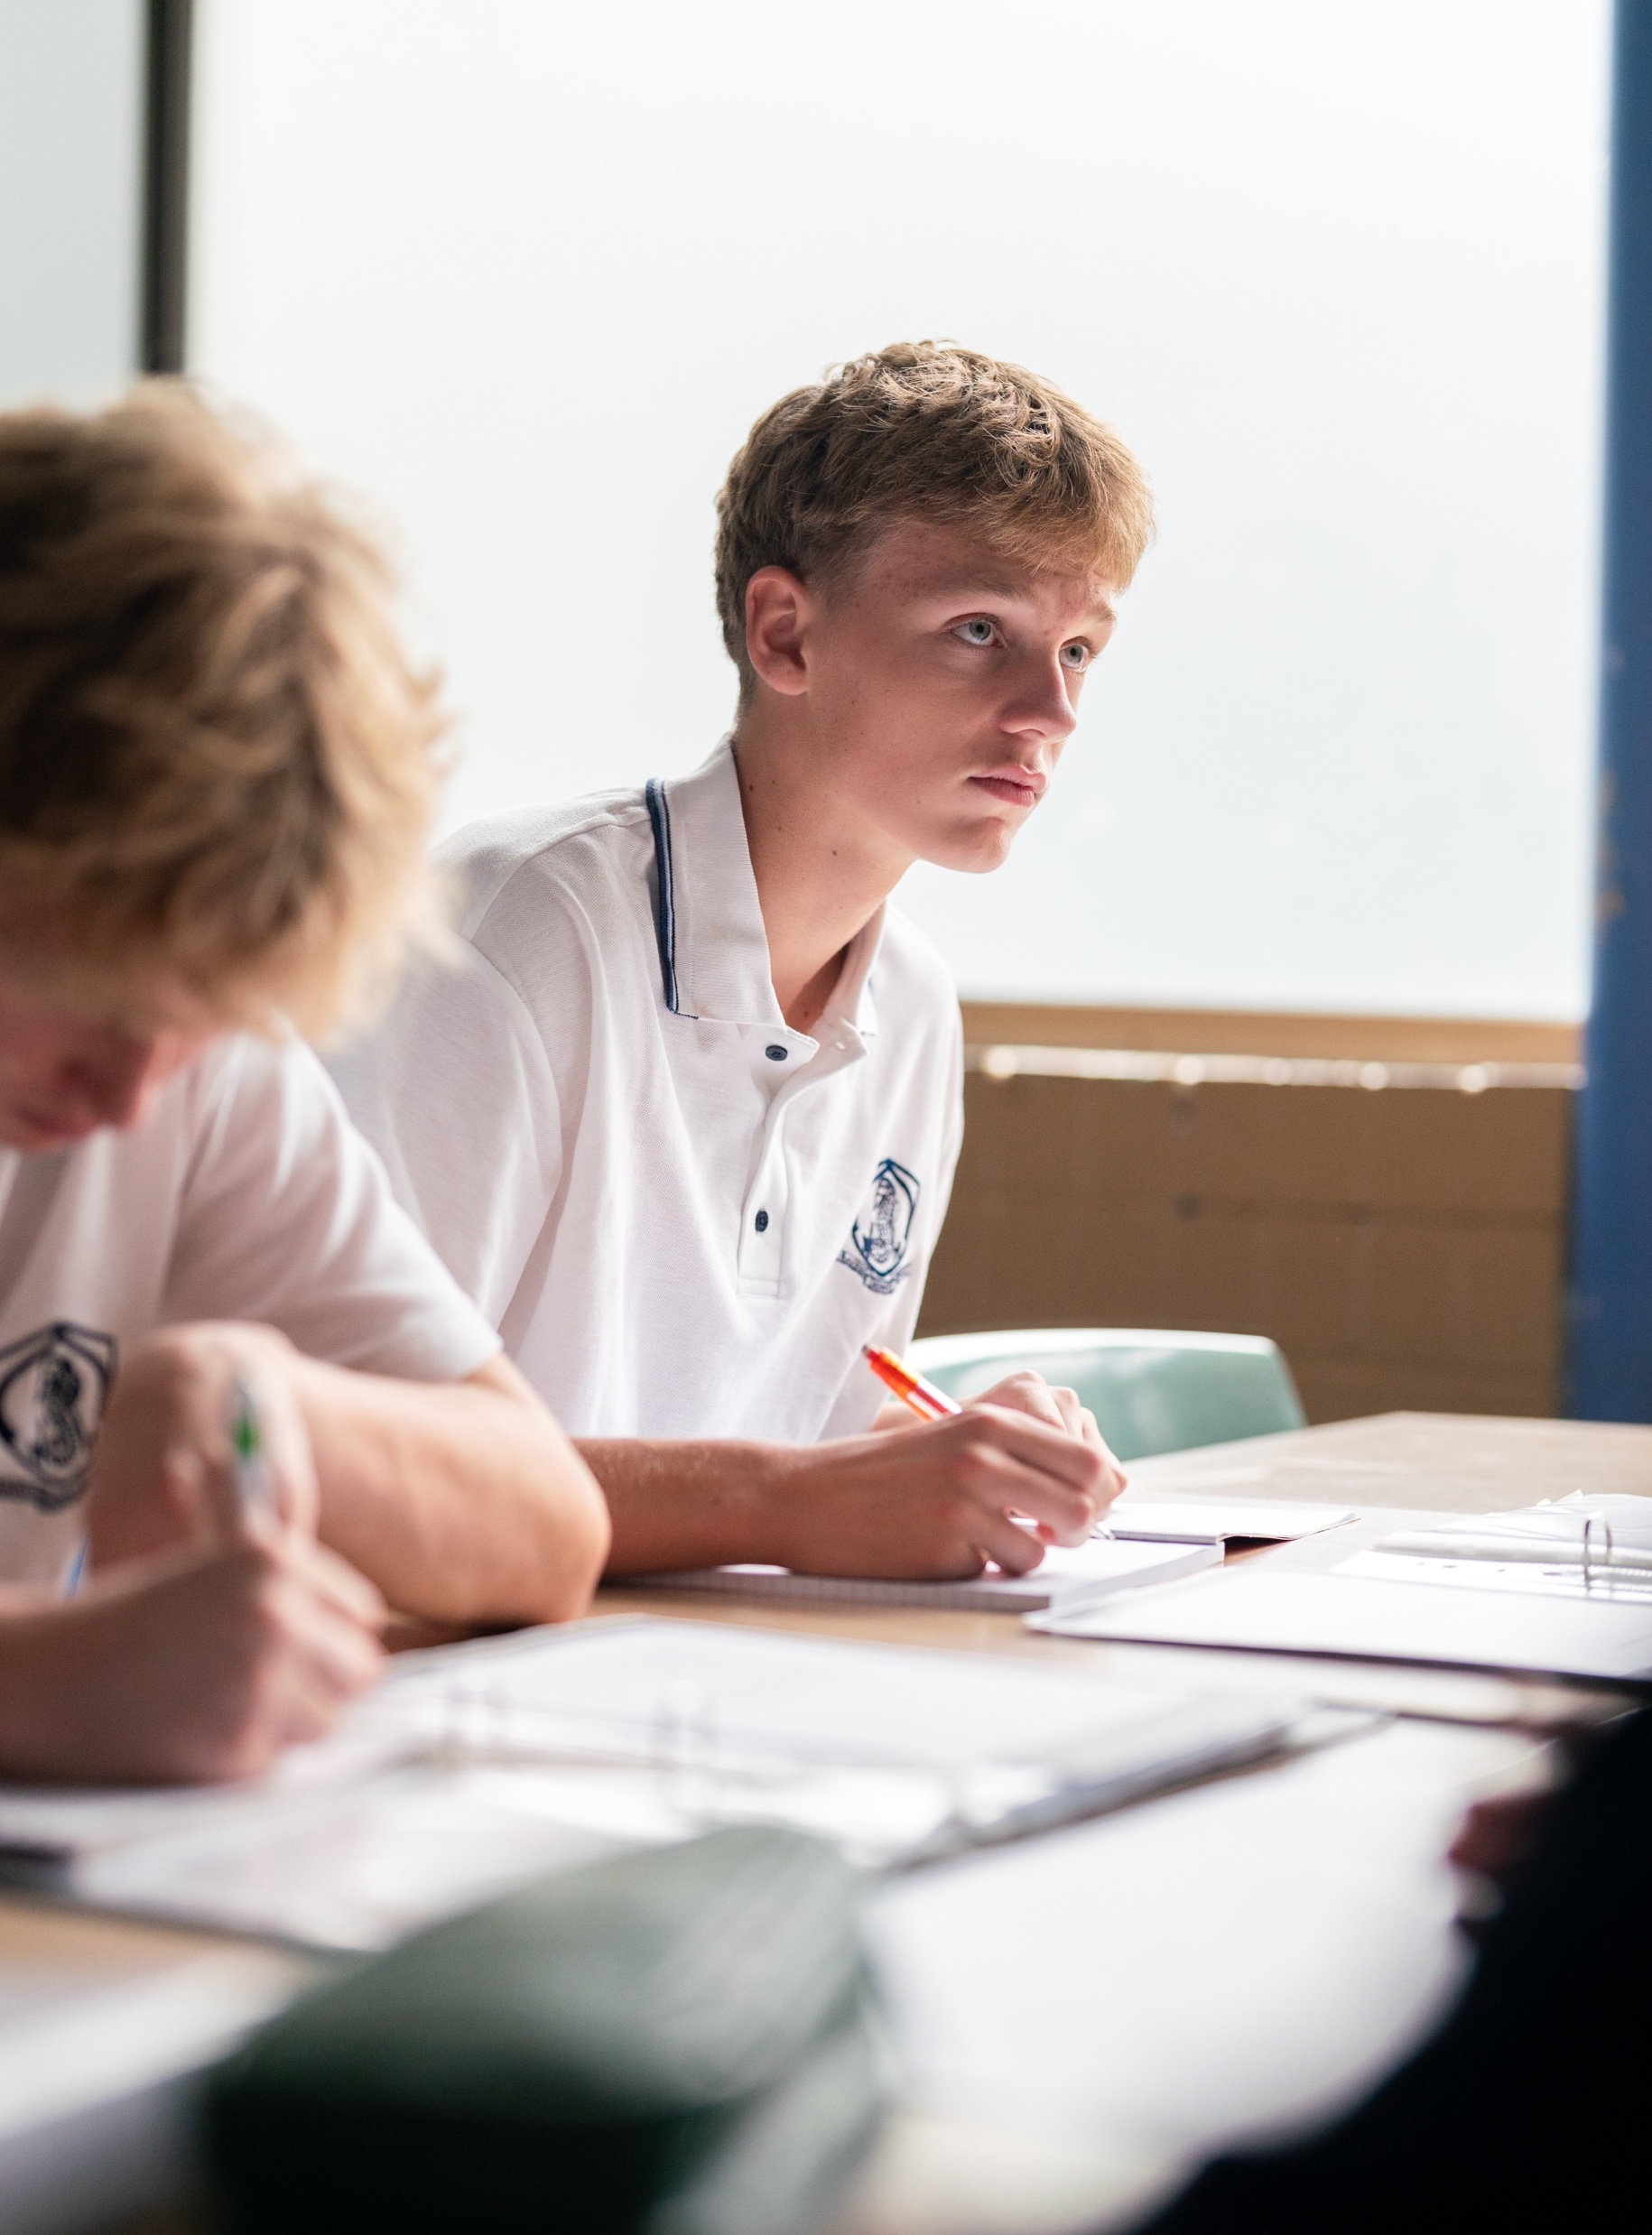
Phase 1 – identifying key visual features – PowerPoint
Stage 4
The camera never lies

Slide 3
Lessons
1
Symbolism
2
Juxtaposition
3
Salience
4
Colour palette
5
Layout
Notes:
Teacher notes:
Click lesson numbers to go to specific lessons
Interactive features can be viewed in slide show

Slide 4
Sharing learning intentions and success criteria
Notes:
Teacher note: this slide has been used to identify the Explicit teaching learning strategy and should be deleted or hidden when using in a classroom setting. Sharing learning intentions allows a teacher to effectively communicate learning goals with students. They allow students to connect new learning to existing knowledge, skills and understanding. When used with success criteria students have a clear idea of the learning goal and how to get there (AERO 2024). The sample success criteria are aligned to the syllabus. They break the learning intention into smaller and more manageable actions. They show students what they must do, say, make, create or perform to demonstrate their learning (Griffin 2018). These have been left blank with suggestions provided in the notes to allow for the co-construction of success criteria that reflects student need. When co-constructing with students, teachers use their expertise to guide student thinking, and often model and use exemplars to show students what success 'looks like'.

Slide 5
Learning intentions and success criteria
We are learning to:
understand the metalanguage of visual text analysis
understand how visual and written texts combine to create meaning.
We can:
[classroom teacher to insert co-constructed success criteria]
[classroom teacher to insert co-constructed success criteria]
[classroom teacher to insert co-constructed success criteria].
Notes:
Notes for teachers:
Learning intentions and success are best co-constructed with students. Adapt the learning intention as required and add matching success criteria.
For more information See ⁠AITSL or the NSW Department of Education explicit teaching strategies, ⁠Sharing learning intentions and ⁠Sharing success criteria
LISC is not necessarily presented at the beginning of the lesson. Teacher needs to consider most effectual time to introduce
LISC should be revisited during the lesson to support students' evaluation of their learning

Slide 6
Gradual release of responsibility
Notes:
Teacher note: this slide has been used to identify the explicit teaching learning strategy and should be deleted or hidden when using in a classroom setting. The strategy of gradual release of responsibility is a flexible process moving between modelled, guided and independent teaching practice responsive to student learning. Students should be supported to move between each practice based on their capabilities and requirements.
Teachers deliver a structured and sequenced approach to explicitly teaching new content. Learning is most effective when teachers break new information down and teach it explicitly using explanation, demonstration and modelling. This is especially relevant when students are new to an area (AERO 2024).

Slide 7
Symbolism
Notes:
Teacher note: symbolism is a visual feature students will us in Phase 1, activity 7 – analysing a layout of Took the Children Away.

Slide 8
Symbolism (1)
Definition
Symbolism refers to a word or concrete object that represents something else, especially an object representing something that is abstract.
Notes:
Teacher note: provide a definition of the metalanguage and ask students to define it in their own words in their books.

Slide 9
Symbolism (2)
Modelled practice
Hearts make us think of ...
Image by Michael Schaffler is licensed under Unsplash License.
Notes:
Teacher note: ask students to look at the image red heart balloons floating in the sky. What do hearts make them think of? Discuss ideas as a class. The teacher should model the practice of thinking about all the things it could represent or symbolise.
Photo by michael schaffler on Unsplash

Slide 10
Symbolism (3)
Guided practice
Why is this heart black? What message might that convey?
Why is a heart, which usually represents positive emotions, drawn on a damaged dirty wall? How does that further our understanding of its symbolic purpose?
What other symbols could be used to convey this message?
Image by Jean-Luc Benazet is licensed under Unsplash License.
Notes:
Teacher note: guide students through their analysis of this image. A copy of the questions can be found in Phase 1, activity 6 – identifying key visual features. Students should respond in their books, then discuss their responses as a class.
Photo by Jean-Luc Benazet on Unsplash

Slide 11
Juxtaposition
Notes:
Teacher note: juxtaposition is a visual feature students will us in Phase 1, activity 7 – analysing a layout of Took the Children Away.

Slide 12
Juxtaposition (1)
Definition
Juxtaposition refers to placing things side by side or close together, often to emphasise similarity or difference.
Image by Courtnie Tosana is licensed under Unsplash License.
Notes:
Teacher note: provide a definition of the metalanguage and ask students to define it in their own words in their books.
Photo by Courtnie Tosana on Unsplash

Slide 13
Juxtaposition (2)
Modelled practice
Here, juxtaposition is created through the contrast of colours (the green vines and purple flowers) and the dark grey of the barbed wire.
The symbols are also juxtaposed because we associate nature with life and growth, and barbed wire with imprisonment and danger. By showing the flowers growing on the barbed wire, we connect the messages, suggesting that we can positively overcome danger, and find joy despite restrictions in life.
Image by Bernd Dittrich is licensed under Unsplash License.
Notes:
Teacher note: model the process of determining juxtaposition in this image and its effect using the sample below.
Model analysis
In the image below, juxtaposition is created through the contrast of colours (the green vines and purple flowers) and the dark grey of the barbed wire. The symbols are also juxtaposed: we associate nature with life and growth, and barbed wire with imprisonment and danger. By showing the flowers growing on the barbed wire, we connect the messages, suggesting that we can positively overcome danger, and find joy despite difficulties in life.
Photo by Bernd 📷 Dittrich on Unsplash https://unsplash.com/photos/purple-flowers-are-growing-on-a-wire-fence-Vnrd5fAd5tk

Slide 14
Juxtaposition (3)
Guided practice
Compare and contrast the people in this image.
What indications do we have that these people are different? Is there something that connects them despite this difference?
What could the message of this image be?
Image by Rod Long is licensed under Unsplash License.
Notes:
Teacher note: guide students through their analysis of this image. A copy of the questions can be found in Phase 1, activity 6 – identifying key visual features. Students should respond in their books, then discuss their responses as a class.
Photo by Rod Long on Unsplash

Slide 15
Salience
Notes:
Teacher note: salience is a visual feature students will use in Phase 1, activity 7 – analysing a layout of Took the Children Away.

Slide 16
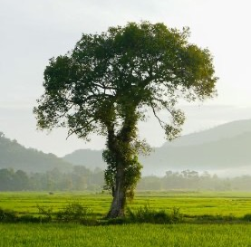
Salience (1)
Definition
Salience refers to the importance given to particular elements of an image.
For example, the size, expression and foreground position of an object demands the viewer’s attention first.
Image by Kiona is licensed under Unsplash License.
Notes:
Teacher note: provide a definition of the metalanguage and ask students to define it in their own words in their books.
Photo by Kiona on Unsplash

Slide 17
Salience (2)
Modelled practice
In this image, the salient feature is the alleyway.
The alleyway takes up half of the image. It is foregrounded at the bottom of the image, and vector lines draw our eyes up to the end of the street.
The alleyway is framed by the buildings, trees, and powerlines.
Image by Erin White is licensed under Unsplash License.
Notes:
Teacher note: model the process of determining salience in this image and its effect. Point out that importance given to particular elements. For example, the size, expression and foreground position of an object demands the viewer’s attention first.
Model analysis
In this image, the salient feature is the alleyway.
The alleyway takes up half of the image, is foregrounded at the bottom of the image, and vector lines draw our eye up to the end of the street.
The alleyway is framed by the buildings, trees, and powerlines.
Photo by Erin White on Unsplash

Slide 18
Salience (3)
Guided practice
What is salient in this image?
How does the size and placement of images emphasise that this is the most significant feature?
Image by Mark Basarab is licensed under Unsplash License.
Notes:
Teacher note: guide students through their analysis of this image. A copy of the questions can be found in Phase 1, activity 6 – identifying key visual features. Students should respond in their books, then discuss their responses as a class.
Photo by Mark Basarab on Unsplash

Slide 19
Salience (4)
Independent practice
Add a figure or object, making it the salient point in this image. Consider size, expression, and placement when adding your salient image.
Image by Adriel Kloppenburg is licensed under Unsplash License.
Notes:
Teacher note: students should add an image to the diagram in Phase 1, activity 6 – identifying key visual features. The teacher can use the slide for students to indicate where they placed an image and explain why.
Photo by Adriel Kloppenburg on Unsplash

Slide 20
Colour palette
Notes:
Teacher note: this and the following slides and visual features can be used to extend student understanding in association with Phase 1, activity 7 – analysing a layout of Took the Children Away.

Slide 21
Colour palette (1)
Definition
Colour palette refers to the range of colours often used deliberately in visual texts for symbolic meaning.
A colour palette can contribute to meaning through:
hue
intensity
warm versus cool colours.
Image by Quino Al is licensed under Unsplash License.
Notes:
Teacher note: provide a definition of the metalanguage and ask students to define it in their own words in their books.
Photo by Quino Al on Unsplash

Slide 22
Colour palette (2)
Modelled practice
In this image, the vibrant colours make this setting feel inviting.
The orange of Uluru and the sand are warm colours, and the yellow in the grass contributes to the feeling that this is a hot place.
The colours symbolise the heat of the Australian outback.
Image by Michael Jerrard is licensed under Unsplash License.
Notes:
Teacher note: model the process of determining colour palette in this image and its effect. Extend students to explain why they think the colours determine particular things.
Modelled analysis
In the image below the vibrant colours make this setting feel inviting.
The orange of Uluru and the sand are warm colours, and the yellow in the grass contributes to the feeling that this is a hot place.
The colours symbolise the heat of the Australian outback and the power of nature.
Photo by Michael Jerrard on Unsplash

Slide 23
Colour palette (3)
Guided practice
What emotions might this picture evoke?
How does the artist feel about this dog? How does the juxtaposition or contrast between the dog and landscape emphasise this?
How do they feel about this setting?
Are the colours:
vibrant or dull?
warm or cool?
Image by Catherine Kay Greenup is licensed under Unsplash License.
Notes:
Teacher note: guide students through their analysis of this image. A copy of the questions can be found in Phase 1, activity 6 – identifying key visual features. Students should respond in their books, then discuss their responses as a class.
Photo by Catherine Kay Greenup on Unsplash

Slide 24
Colour palette (4)
Independent practice
What emotions might this picture evoke?
How does the artist feel about the incoming storm?
Are the colours:
vibrant or dull?
warm or cool?
Image by Nathan Anderson is licensed under Unsplash License.
Notes:
Teacher note: students can complete this independent practice activity if they are suitably prepared to work independently. Alternatively, the teacher can use this as another guided practice activity.
Photo by Nathan Anderson on Unsplash

Slide 25
Layout
Notes:
Teacher note: this and the following slides and visual features can be used to extend student understanding.

Slide 26
Layout (1)
Definition
Layout refers to the placement and arrangement of elements in a visual text. We consider which elements are in the foreground, midground and background, which elements take up the most space, and what this tells us about the object's importance in conveying meaning. We should also consider the placement of objects.
Image by Ashleigh Joy Photography is licensed under Unsplash License.
Notes:
Teacher note: provide a definition of the metalanguage and ask students to define it in their own words in their books.
Photo by Ashleigh Joy Photography on Unsplash

Slide 27
Layout (2)
Modelled practice
Foreground – the rocky shore, establishing setting
Midground – the beached boat
Background – the storm and the mountain range, providing more detail about the setting and the events which may have contributed to this boat's beaching
Size – the boat is the largest object, taking nearly half of the space, so we know this is a significant feature.
Image by Massimiliano Morosinotto is licensed under Unsplash License.
Notes:
Teacher note: model the process of determining colour palette in this image and its effect.
Photo by Massimiliano Morosinotto on Unsplash

Slide 28
Layout (3)
Guided practice
If you imagine the image to be divided equally into 4 quadrants, where is the main subject(s) and the action placed in the text? For example, is this in the top or bottom of the image? On the left or right side? Or in the middle?
Is there a frame around the image? How thick is the frame border?
How do these elements draw the image together as a cohesive whole?
If you changed any of these aspects, how would that affect the meaning of this image?
Image by Oleksandr Kuzmin is licensed under Unsplash License.
Notes:
Teacher note: guide students through their analysis of this image.
Photo by Oleksandr Kuzmin on Unsplash

Slide 29
References (1)
This presentation contains NSW Curriculum and syllabus content. The NSW Curriculum is developed by the NSW Education Standards Authority. This content is prepared by NESA for and on behalf of the Crown in the right of the State of New South Wales. The material is protected by Crown copyright.
Please refer to the NESA Copyright Disclaimer for more information https://educationstandards.nsw.edu.au/wps/portal/nesa/mini-footer/copyright.
NESA holds the only official and up-to-date versions of the NSW Curriculum and syllabus documents. Please visit the NSW Education Standards Authority (NESA) website https://educationstandards.nsw.edu.au/wps/portal/nesa/home and the NSW Curriculum website https://curriculum.nsw.edu.au.
Anderson N (2016) Blue house in field, Unsplash, accessed 22 September 2024.
Basarah M (2016), blue starry night, Unsplash, accessed 22 September 2024.
Benazet, J (2018) Derelict abandoned building, Unsplash, accessed 1 November 2024.
Dittrich B (2024) Delicate purple morning glory flowers, Unsplash, accessed 1 November 2024.
Greenup C (2024) A painting of a black and white dog standing on a hill, Unsplash, accessed 22 September 2024.
Jerrad M (2020) Uluru ( Ayers Rock) Australia, Unsplash, accessed 22 September 2024.
Joy A (2017) white RV trailer in the middle of grass field, Unsplash, accessed 22 September 2024.

Slide 30
References (2)
Kiona (2022) Untitled, Unsplash, accessed 22 September 2024.
Kuzmin O (2022) a cat lying on a porch, Unsplash, accessed 22 September 2024.
Long R (2018) an older woman holding a baby’s hand, Unsplash, accessed 22 September 2024.
Morosinotto M (2022) black and red ship on shore, Unsplash, accessed 22 September 2024.
Quino A (2019) blue green and red abstract painting, Unsplash, accessed 22 September 2024.
Schaffer M (2018) ‘red heart balloon lot, Unsplash, accessed 22 September 2024.
Tosana C (2019) Fire, Unsplash, accessed 22 September 2024.

Slide 31
Copyright
© State of New South Wales (Department of Education), 2024
The copyright material published in this resource is subject to the Copyright Act 1968 (Cth) and is owned by the NSW Department of Education or, where indicated, by a party other than the NSW Department of Education (third-party material).
Copyright material available in this resource and owned by the NSW Department of Education is licensed under a Creative Commons Attribution 4.0 International (CC BY 4.0) licence.
This licence allows you to share and adapt the material for any purpose, even commercially.
Attribution should be given to © State of New South Wales (Department of Education), 2024.
Material in this resource not available under a Creative Commons licence:
the NSW Department of Education logo, other logos and trademark-protected material
Material owned by a third party that has been reproduced with permission. You will need to obtain permission from the third party to reuse its material.
Links to third-party material and websites
Please note that the provided (reading/viewing material/list/links/texts) are a suggestion only and implies no endorsement, by the New South Wales Department of Education, of any author, publisher, or book title. School principals and teachers are best placed to assess the suitability of resources that would complement the curriculum and reflect the needs and interests of their students.
If you use the links provided in this document to access a third party’s website, you acknowledge that the terms of use, including licence terms set out on the third-party’s website apply to the use which may be made of the materials on that third-party website or where permitted by the Copyright Act 1968 (Cth). The department accepts no responsibility for content on third-party websites.

