Slide 1
About this presentation
Facilitator instructions
This slide deck contains 3 parts that require some preplanning.
Part A – Strategy overview, approach and impact – opportunity to collect data that could be used in Part C. The presenter will need to facilitate this. Part A includes an activity relating to technique guides that can be found on the chunking and sequencing webpage.
Part B – Implementing the strategies through techniques – the group activity requires pre-planning.
Part C – Evaluating a whole-school approach – opportunity to link to the School Excellence Plan.
Leaders should engage with Part C before implementing the professional learning with staff.
Slides are repeated across strategy modules so they can be implemented with the same structure. Note: some slides contain animations indicated by [click] in the presenter notes.

Slide 2

Chunking and sequencing learning
Strategy learning module

Slide 3

Acknowledgement of Country
We recognise the Traditional Custodians of the lands and waterways where we work and live. We pay respect to Elders past and present as ongoing teachers of knowledge, songlines and stories. We strive to ensure every Aboriginal and Torres Strait Islander learner in NSW achieves their potential through education.
‘Gaawaa’ created by Finley Andrews from John Palmer Public School on Dharug Country as part of the 2022 Schools Reconciliation Challenge.
Notes:
Acknowledgement of Country
[00:30]
Speaker notes:
I would like to acknowledge the traditional custodians of the land on which we meet today. We pay our respects to their Elders past and present. We recognise their continuing connection to land, water, and culture, and we are committed to continuing to learn from their wisdom and traditions.

Slide 4
Introduction
Notes:
Purpose: Introduction slide

Slide 5
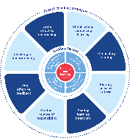
Enabling factors
Know students and how they learn
High expectations
Teachers understand how learning happens, and this informs their practice.
Students benefit from teachers holding high expectations for their learning.
Know the content and how to teach it
Safe, inclusive learning environments
Teachers know how the knowledge builds and connects to create learning that is strategic, sequenced and cumulative.
Explicit teaching both relies on, and brings about, a safe and inclusive learning environment.
Notes:
Purpose: Revisiting core knowledge
[00:30]
Speaker notes:
Let’s remind ourselves that explicit teaching is an optimal way to teach knowledge and skills that are new or complex.
There are important enabling factors for explicit teaching that relate to the strategy we are focusing on. Let’s revisit them.
Note to presenter: you may wish for participants to read these to themselves
Our understanding of the how learning happens informs our practice
We know how knowledge builds across syllabuses
We hold high expectations for our students’ learning
And, explicit teaching both relies on, and brings about a safe, inclusive learning environment
Resources:
Leading explicit teaching – school-facilitated workshops 1–3 on core content and the enabling factors of explicit teaching –https://education.nsw.gov.au/teaching-and-learning/curriculum/explicit-teaching/leading-explicit-teaching
Classrooms of Possibility – https://education.nsw.gov.au/inside-the-department/teaching-and-learning/classrooms-of-possibility
Explicit instruction – implementing evidence-based teaching practices for students with disability - https://resources.education.nsw.gov.au/detail/IPR-LD230526144351
Strong Strides Together: Meeting the educational goals for Aboriginal and/or Torres Strait Islander students – https://education.nsw.gov.au/teaching-and-learning/aec/universal-resources---aboriginal-education/strong-strides-together--meeting-the-educational-goals-for-abori

Slide 6
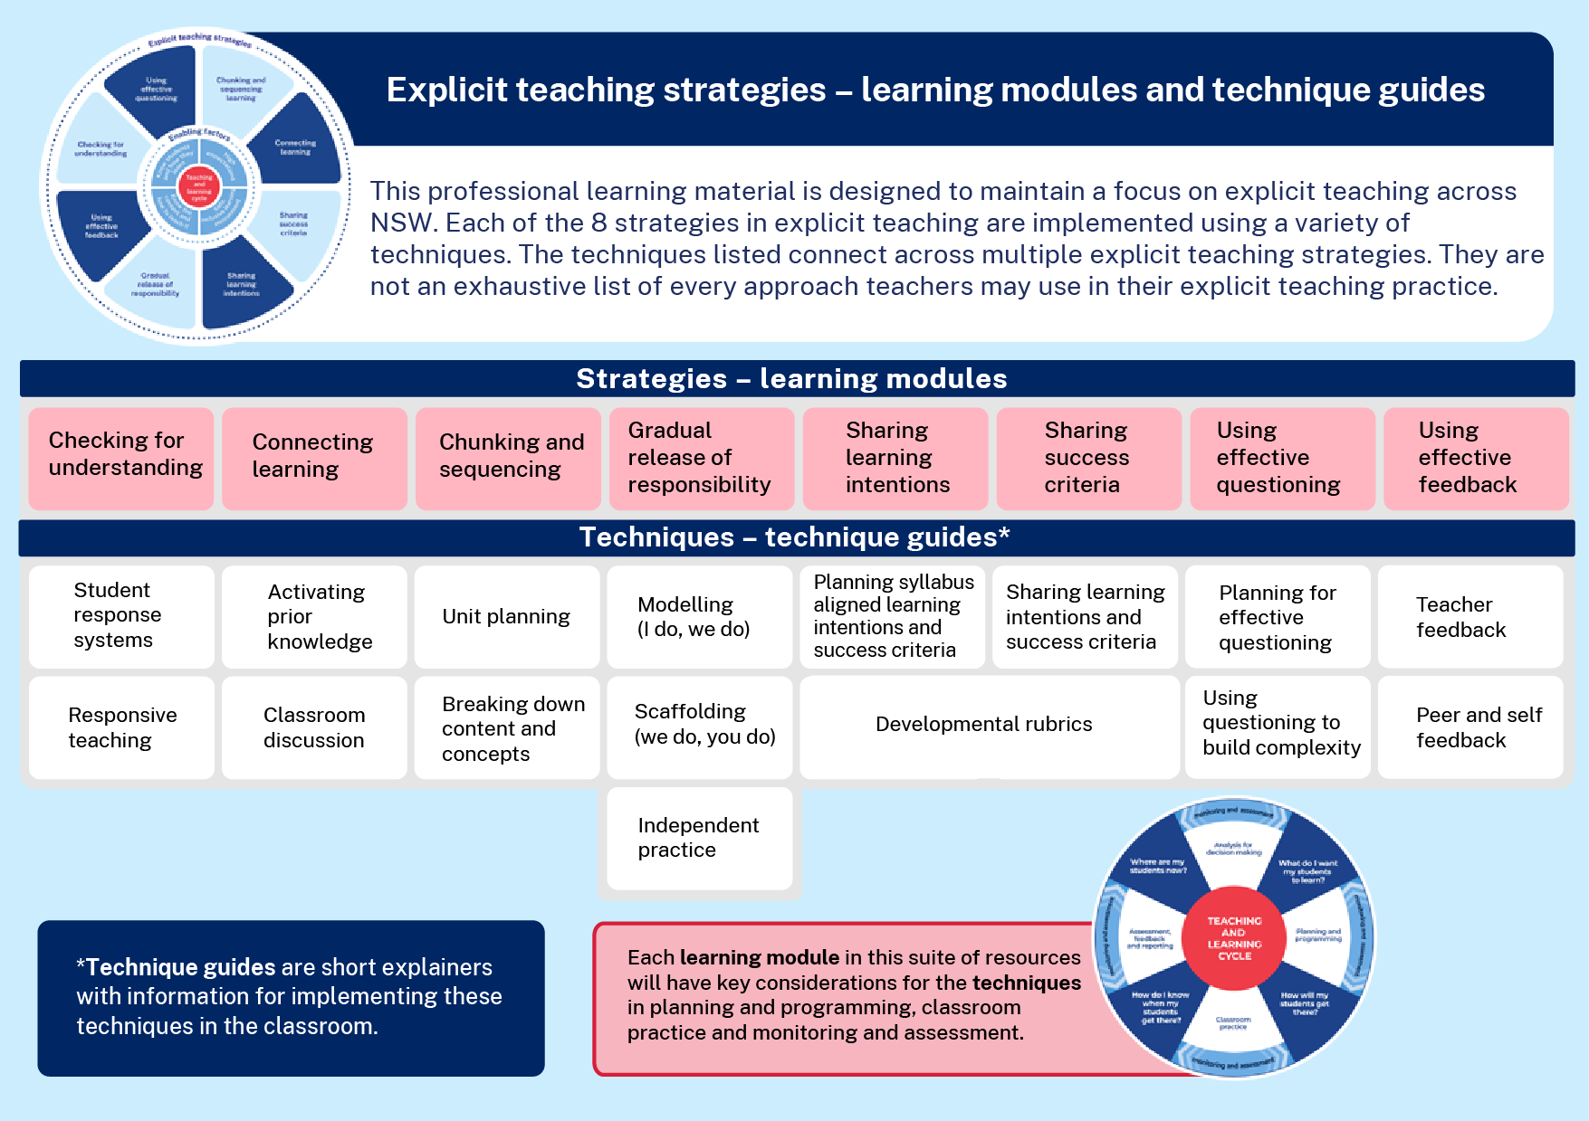
Learning modules and technique guides
Notes:
Purpose: To highlight where this module fits with other current and future modules and technique guides.
[00:20]
Speaker notes:
This module looks at one of the 8 explicit teaching strategies, chunking and sequencing and some techniques for this strategy, unit planning and breaking down content and concepts. These learning modules and the corresponding technique guides will have staggered release dates.
Note to presenter:
Technique guides are available to supplement this presentation. For the activity on slide 25, it is expected that teachers have seen and read the guides.
Chunking and sequencing resources:
https://education.nsw.gov.au/teaching-and-learning/curriculum/explicit-teaching/explicit-teaching-strategies/chunking-and-sequencing-learning

Slide 7

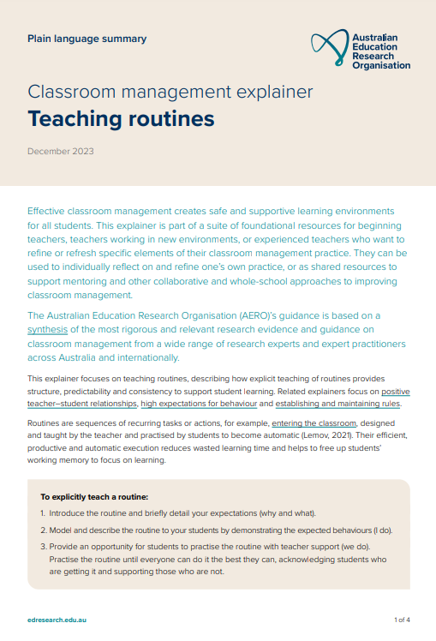
The importance of all moving together
Saves learning time¹
Frees up students’ working memory²
Certain and consistent expectations for students³
Students learn the routine more quickly when it is done in the same way across the school⁴
Fosters a strong sense of belonging⁵
Notes:
Purpose: to restate why a whole school teaching routine is powerful
[01:00]
Speaker notes:
These modules use the power of whole school teaching routines. When a group of expert teachers from across the school come together and create a whole school approach, they are far more effective than when they go it alone. Teaching routines:
[click] save learning time
[click] can free up students’ working memory
[click] provide certainty and expectations for students to contribute to a learning environment where they’re safe to participate.
[click] they’re efficient, because when done the same way across the school, students can learn the routine more quickly.
[click] and they foster a strong sense of belonging.
As we go through the learning module here, and other learning modules for explicit teaching we will revisit the idea of the whole school teaching routines.
References:
Archer AL and Hughes CA (2011) Explicit instruction: effective and efficient teaching, Guilford Press.
AERO (Australian Education Research Organisation) (2021) Focused classrooms: managing the classroom to maximise learning, AERO, accessed 20 November 2024.
AERO (Australian Education Research Organisation) (2023a) Teaching routines: their role in classroom management, AERO. accessed 20 November 2024.
McCrea P (2020) Motivated Teaching: harnessing the science of motivation to boost attention and effort in the classroom, Createspace Independent Publishing Platform.
McCrea P (2020) Motivated Teaching: harnessing the science of motivation to boost attention and effort in the classroom, Createspace Independent Publishing Platform.
Further reading:
Tharby A (12 May 2023) ‘We are what we do: the case for explicit and consistent school-wide routines’, Class Teaching, find the bright spots, accessed 20 November 2024. https://classteaching.wordpress.com/2023/05/17/we-are-what-we-do-the-case-for-explicit-and-consistent-school-wide-routines/

Slide 8
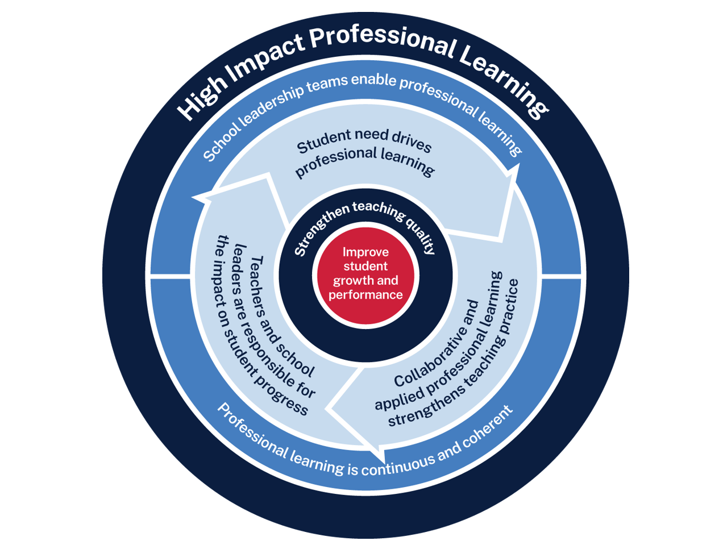
Chunking and sequencing professional learning
Measure baseline student data and set a goal
Analyse data to determine further cycles
Use the whole school teaching approach and plan for instruction
Implement the teaching routine in the classroom and measure impact
Rehearse and give feedback to each other
Notes:
Purpose: Familiarising High Impact Professional Learning model (HIPL) and how it may inform our implementation of explicit teaching.
[01:00]
Speaker notes:
The High Impact Professional Learning (HIPL) model forms the basis of this professional learning. This model has five elements.
Professional learning is driven by identified student needs - https://education.nsw.gov.au/teaching-and-learning/professional-learning/high-impact-professional-learning/what-is-hipl/student-needs-drive-teacher-learning
School leadership teams enable professional learning - https://education.nsw.gov.au/teaching-and-learning/professional-learning/high-impact-professional-learning/what-is-hipl/leadership-that-prioritises-learning
Collaborative and applied professional learning strengthens teaching practice - https://education.nsw.gov.au/teaching-and-learning/professional-learning/high-impact-professional-learning/what-is-hipl/collaboration-that-improves-classroom-practice
Professional learning is continuous and coherent - https://education.nsw.gov.au/teaching-and-learning/professional-learning/high-impact-professional-learning/what-is-hipl/a-culture-of-continuous-learning
Teachers and school leaders are responsible for the impact of professional learning on student growth and performance - https://education.nsw.gov.au/teaching-and-learning/professional-learning/high-impact-professional-learning/what-is-hipl/accountability-for-impact-on-student-progress
The actions and steps we take to enact each of these elements will be shaped by our increasing shared understanding of check for understanding strategy and how specific check for understanding techniques can be used to optimise the learning of our students.

Slide 9
Initial data reflection point
Teacher observation | 0 | 1 | 2 | 3 | 4
At the end of a lesson students can articulate the key learning from the lesson | Not yet observable | Minimal students can identify the chunks that comprise the learning | Some students can identify the chunks that comprise the learning | Most students can identify the chunks that comprise the learning | All students can identify the chunks that comprise the learning
Notes:
Purpose: Initial teacher collected data as an early indicator.
[02:00]
Speaker notes:
Think about one class you taught today. What parts of the scale would best describe your students?
An initial indicator is an observable change in student learning. It can help teachers to understand how effective their use of a technique may be. Initial indicators are important because they can give teachers insights into what parts of the instruction may need to be refined.
Here is an example of a tool that could be used for teacher reflection. This is one way to measure one aspect of the effectiveness of chunking and sequencing.
We will be able to refer to our early indicator observations when we evaluate our impact in Part C.
Note to presenter: There is an opportunity to use this data in the final session. This measure is not the only consideration, and schools should select a model that is right for them.
This data could be collated and compared to other “school and classroom data about growth and performance.”
For example:
NAPLAN report overview accessed through Scout
https://education.nsw.gov.au/about-us/education-data-and-research/scout/training/digital-learning-centre/naplan-report-overview
NAPLAN report overview
Learn more about the NAPLAN reports in Scout.
https://education.nsw.gov.au/technology/scout/scout-training/digital-learning-centre/naplan-for-teachers
Class report
The Class report shows the distribution of students’ scaled scores across domains and proficiency levels for NAPLAN 3, 5, 7 or 9.
References:
AERO (Australian Education Research Organisation) (2023b) How students learn best: an overview of the learning process and the most effective teaching practices, AERO.

Slide 10




Planning and rehearsing
Plan
Rehearse
Feedback
Evidence for Learning (2022) Effective Professional Development
Notes:
Purpose: to explain the process of rehearsing
[01:10]
Speaker notes:
Research from Evidence for Learning shows teachers are more likely to put professional learning into practice when they plan and rehearse during professional learning, before implementing techniques in the classroom. This is enhanced by feedback from colleagues.
Note to presenter: it is advisable to prepare school leaders beforehand if modelling and rehearsing are not yet established practices in the school.
Further reading on this research:
AERO (Australian Education Research Organisation) (2023b) Classroom management practice guide – gaining all students’ attention outlines how teachers should script and rehearse and use a checklist to refine before doing it with students present, AERO, accessed 20 November 2024.
Evidence for Learning (2022) Effective professional development, Evidence for Learning.
Sims S, Fletcher-Wood H, O’Mara-Eves A, Cottingham S, Stansfield C, Van Herwegen J and Anders J (2021) What are the characteristics of teacher professional development that increase pupil achievement? A systematic review and meta-analysis, Education Endowment Foundation.

Slide 11
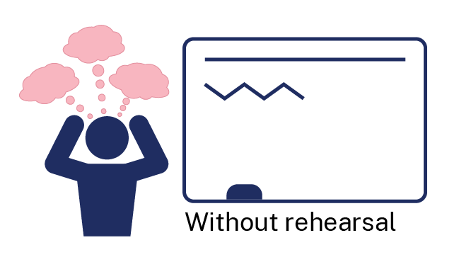

Rehearsal
Notes:
Purpose of slide: To explain why rehearsing is so important
Speaker notes:
[01:10]
Application is a real key to success in professional learning.
Why might professional learning not be applied in the classroom, despite our best intentions?
Teachers often have practices described to them – but it is much clearer to have lead teachers model the practice (out of the classroom, without students) while the observer uses prompts to reflect on what made that practice successful.
Teaching is a habit-forming practice. By necessity, teaching requires us to automate a number of behaviours. The cognitive load on teachers to introduce a new behaviour is high and so we often rely on those previously formed habits.
Rehearsal (out of the classroom, without students) makes our PL a habit. When we try a rehearsed routine in a classroom, our cognitive load is reduced because we have one thing to think about, rather than 4 or 5.
This is why rehearsing is a key mechanism for success in professional learning.
References:
Evidence for Learning (2022) Effective professional development, Evidence for Learning. https://evidenceforlearning.org.au/education-evidence/guidance-reports/effective-professional-development

Slide 12
Overview of this module
Part A – Understanding the strategy
Part B – Implementing the strategies through techniques
Part C – Evaluating a whole-school approach
Notes:
Purpose: Outline the learning sequence in this module.
[00:30]
Speaker notes:
In this module, the focus is on chunking and sequencing and selecting the optimal techniques for students in your class.
We will then develop teaching routines as a whole school to reduce cognitive load for our students, giving them the best opportunity for routines to benefit their learning outcomes.
We will evaluate the impact of our work in terms of how effectively the approach has met the student need we've identified as the focus for our professional learning. We will do this by considering the short-term outcomes and the potential longer term learning outcomes for our students.

Slide 13
Understanding the strategy
Part A

Slide 14
Purpose and outcome (1)
Purpose
To use our understanding of schema theory and cognitive load theory so we can chunk and sequence learning to optimise student understanding, engagement and participation.
Outcome
We can articulate how and why we chunk and sequence learning.
Notes:
Purpose: Purpose and outcome of Part A
[00:30]
Speaker notes:
This strategy learning module focuses on teachers making purposeful decisions to chunk and sequence learning.
The purpose of Part A is:
To use our understanding of schema theory and cognitive load theory so we can chunk and sequence learning effectively to optimise student understanding, engagement and participation.
Working towards the outcome that:
We can articulate how and why we chunk and sequence learning.

Slide 15
Thinking about learning
“Teachers need to move beyond those questions about ‘What should I teach next week?’ and into discussing ‘How should we teach this best?’. Whatever they are teaching it is crucial that teachers break the learning down sufficiently so that a student’s working memory is not overloaded.”
(Swain 2024:192)
Notes:
Purpose: Focusing on moving teacher’s thinking from the ‘what’ to the ‘how’
[00:30]
Speaker notes:
(Read quote)
In our teaching practices, it's essential that we shift our focus. Instead of just planning what content to cover each week, we need to ask ourselves how to teach this content in the most effective way. This shift involves thinking deeply about how students learn, not just what they should learn. One key aspect here is cognitive load. Students have a limited capacity in their working memory, and when that memory is overloaded, learning becomes less effective. To support students in retaining and applying new knowledge, we need to break down complex topics into manageable, digestible chunks.
'Students may experience cognitive overload when processing too much information at one time, when information is very complex, or when trying to learn in overly distracting learning environments. Long-term memory has vast storage capacity, but to use it most effectively, information needs to be transferred between working and long-term memory bit by bit, and retrieved at regular intervals for more secure storage over time.’
(AERO 2023)
References:
AERO (Australian Education Research Organisation) (2023b) How students learn best: an overview of the learning process and the most effective teaching practices, AERO, accessed 20 November 2024.
Swain N (2024) Harnessing the science of learning, Routledge.

Slide 16




The expert teacher
Notes:
Purpose: Explaining expert teachers vs novice learners
[00:30]
Speaker notes:
Sometimes experienced educators, who have mastered their subject matter, can forget what it is like for novice learners to learn something that is new and complex. This means that teachers can inadvertently skip crucial steps in explanations, use complex terminology without clarification, or fail to break down concepts into manageable chunks. This is sometimes referred to as ‘the curse of knowledge’ (Sherrington 2019; Weinstein, Sumeracki and Caviglioli 2018).
As a result, teachers may overestimate students' prior knowledge and underestimate the difficulty of new material, potentially hindering effective instruction. It is important that we are aware of the 'curse of knowledge' so that we can actively work to overcome it by breaking down and sequencing skills, knowledge and understanding to optimise student learning.
Frequent checks for understanding, providing clear and structured explanations and scaffolding new and complex learning are also important to ensure that units of work and lessons optimise student learning.
References:
Sherrington T (2019) (Caviglioli O, illus) Rosenshine’s principles in action, John Catt Educational Ltd.
Weinstein Y, Sumeracki M and Caviglioli O (2018) Understanding how we learn: a visual guide, Taylor and Francis.

Slide 17
Knowledge is stored in schemas
concept
fact
procedure
Notes:
Purpose: To present a simple idea of schema before introducing more complex ideas
[00:30]
Speaker notes:
Let us recall what we have learnt in other strategy learning modules about how the brain stores information for later recall. The brain stores information in long-term memory in groups of interconnected information we call schema, or mental models (AERO 2023c; CESE 2017). This simple model shows a knowledge schema containing concepts, procedures, and facts.
References:
Image adapted from AERO (Australian Education Research Organisation) (2023c) Managing cognitive load optimises learning, AERO. https://www.edresearch.edu.au/summaries-explainers/explainers/managing-cognitive-load-optimises-learning
CESE (Centre for Education Statistics and Evaluation) (2017) Cognitive load theory: research that teachers really need to understand, NSW Department of Education.

Slide 18
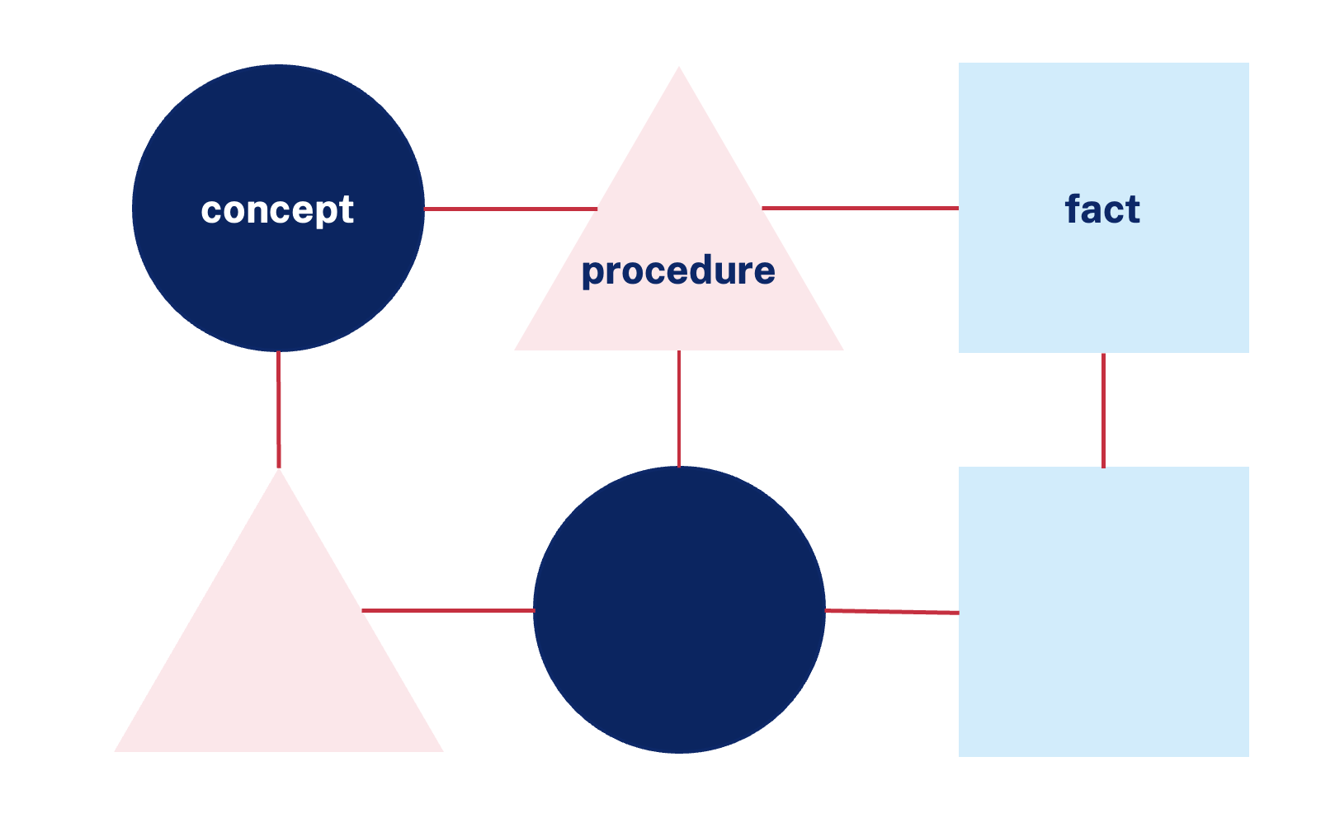
Working memory is limited
fact
fact
procedure
Available ‘spaces’ in working memory
Image adapted from AERO (Australian Education Research Organisation) (2024a) Explicit instruction
18
Notes:
Purpose: Working memory is limited
[01:00]
Speaker notes:
Current research estimates working memory for most people to be limited to between four and seven “spaces” (CESE 2017, Cowan 2010). Not all spaces are necessarily available for holding new information (CESE 2017). For instance, students for whom standard English is an additional language or dialect including Aboriginal English will, be using space in their working memory to understand the lesson being conducted in standard English. It is important to recognise the significant language learning component for some students and the impact it has on working memory capacity. This is why teachers need to chunk the learning.
Effective chunking and sequencing can support all students regardless of whether they have four or seven “spaces” in their working memory (CESE 2017).
In this image we see the working memory is completely loaded with facts or pieces of information and a procedure that is being used to manipulate these facts.
Further information:
NSW Department of Education (2024) Universal Resources- Aboriginal Education- What is a dialect? NSW Department of Education. https://education.nsw.gov.au/teaching-and-learning/aec/universal-resources---aboriginal-education/what-is-a-dialect-
References:
AERO (Australian Education Research Organisation) (2023d) Explicit instruction optimises learning, AERO.
CESE (Centre for Education Statistics and Evaluation) (2017) Cognitive load theory: research that teachers really need to understand, NSW Department of Education.
Cowan N (2010) 'The magical mystery four: how is working memory capacity limited, and why?' Current directions in psychological science, 19(1):51–57.

Slide 19
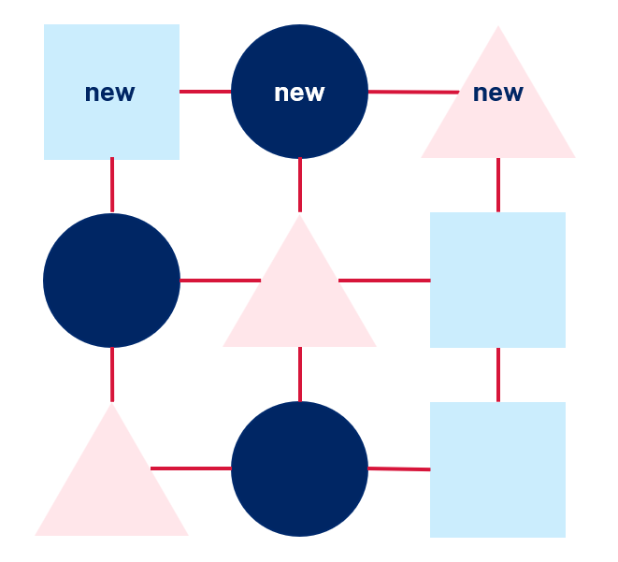
Opportunities for students to consolidate
After the teacher introduces a new piece of information, student practise enables the consolidation of the new information into their schema.
Notes:
Purpose: Practice is necessary to consolidate
[00:30]
Speaker notes:
After the teacher introduces a new piece of information, student practise enables the consolidation of the new information into their schema. Teachers factor the time to practice into their planning and facilitation of classroom learning.
References:
AERO (Australian Education Research Organisation) (2023c) Managing cognitive load optimises learning, AERO.
CESE (Centre for Education Statistics and Evaluation) (2017) Cognitive load theory: research that teachers really need to understand, NSW Department of Education.
Rosenshine B (2012) 'Principles of instruction: research-based strategies that all teachers should know', American Educator, 36(1):12–39.

Slide 20




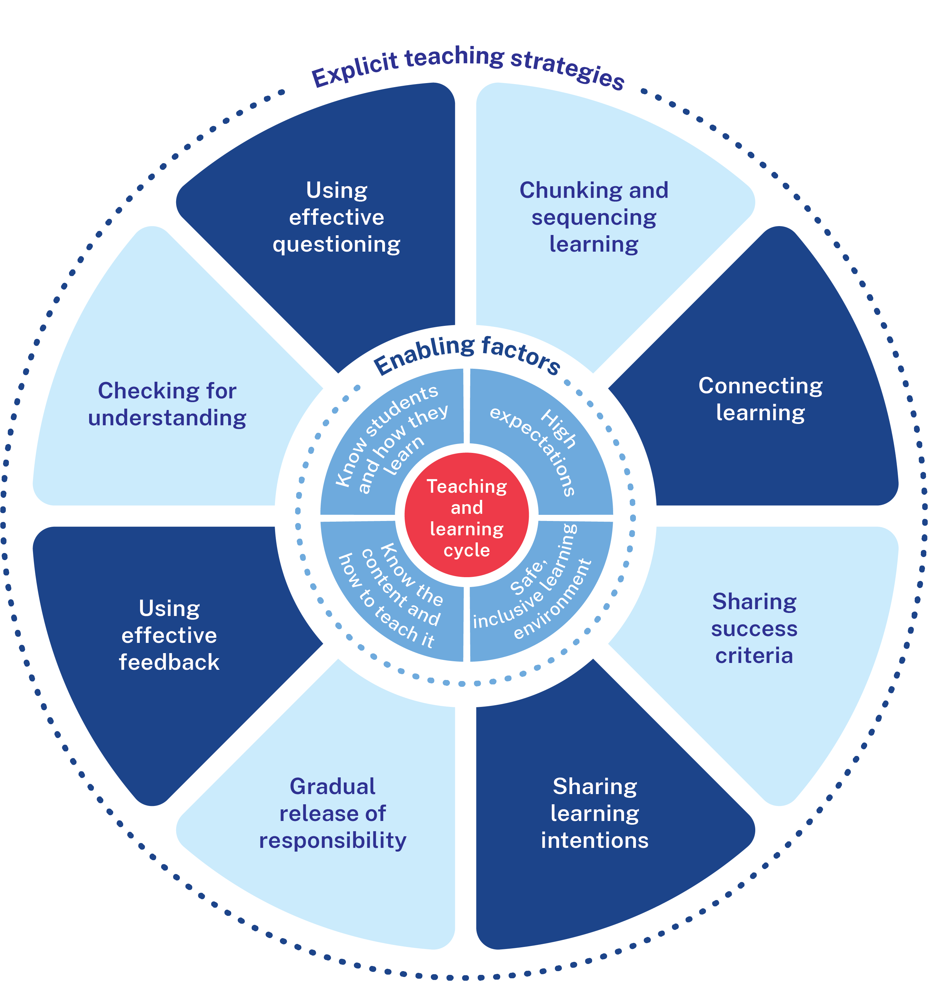
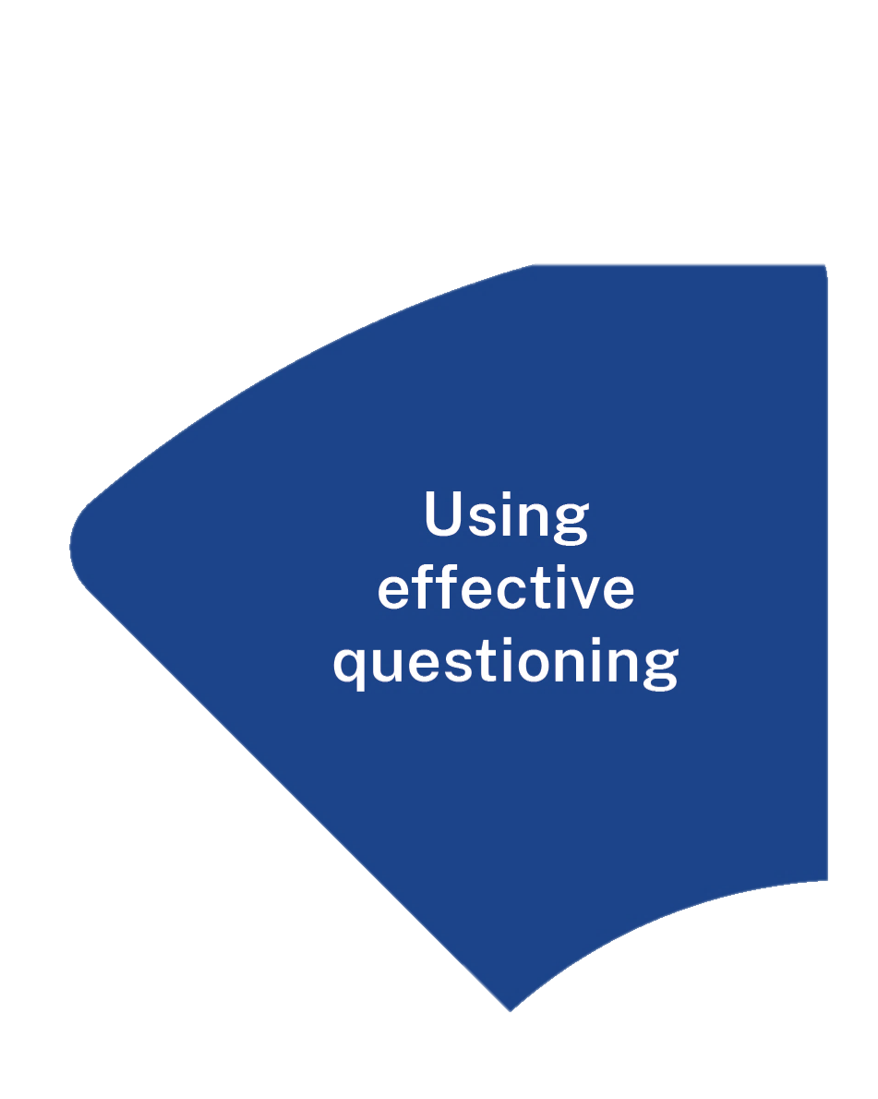
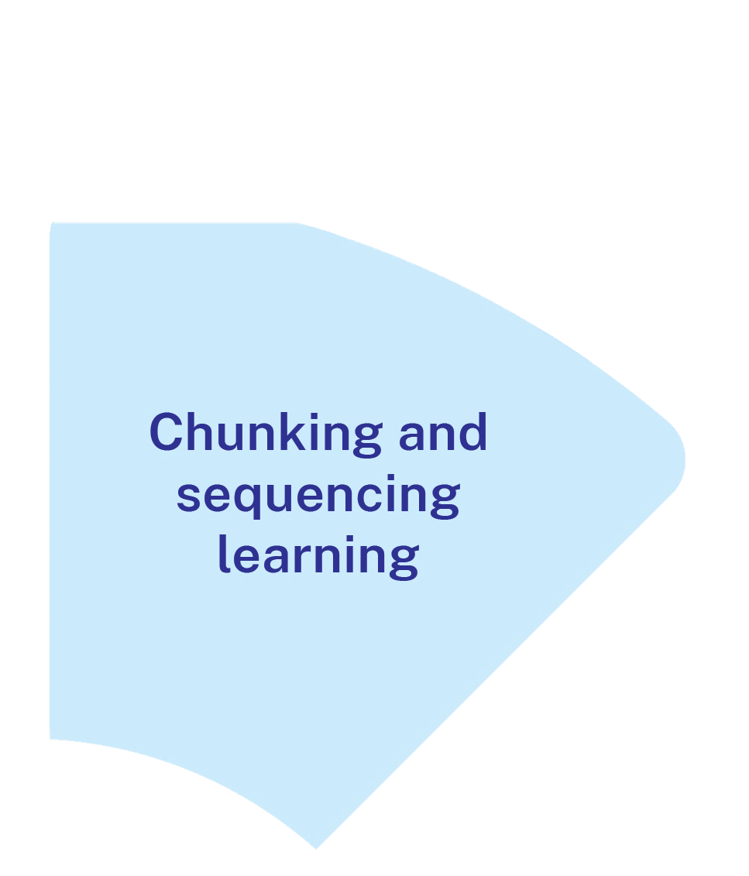
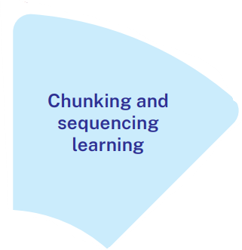

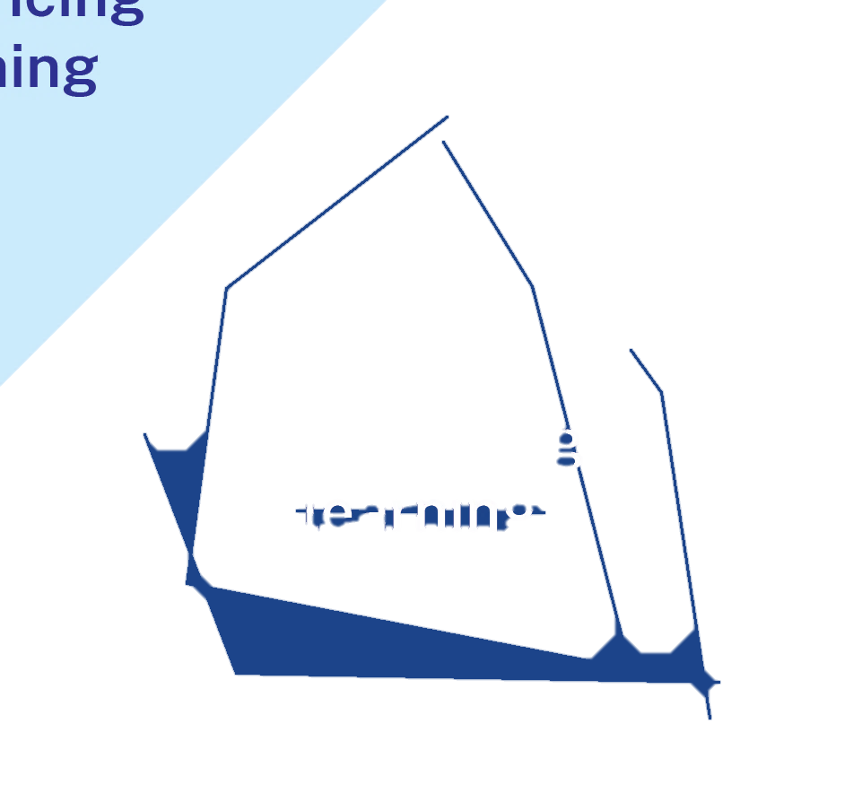
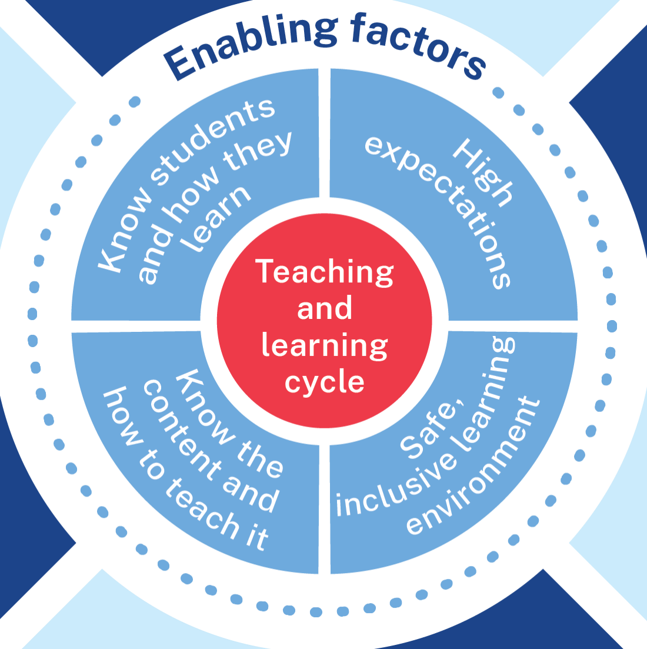

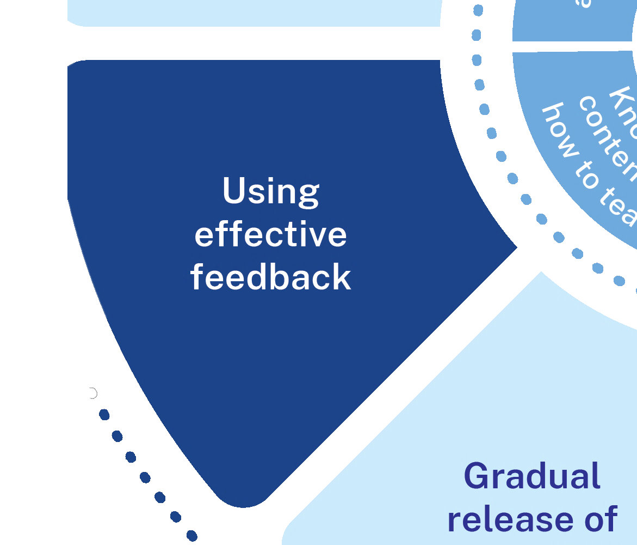
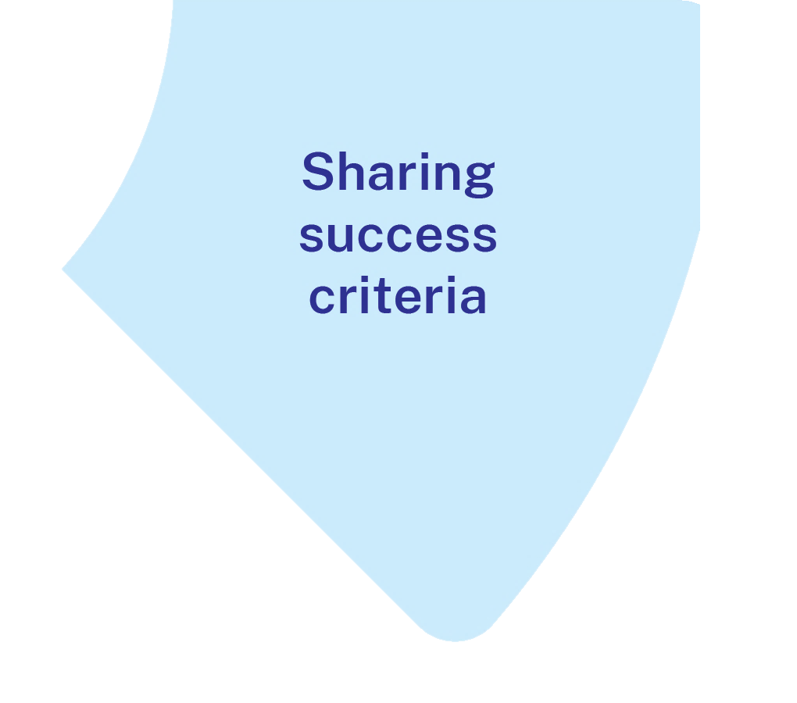

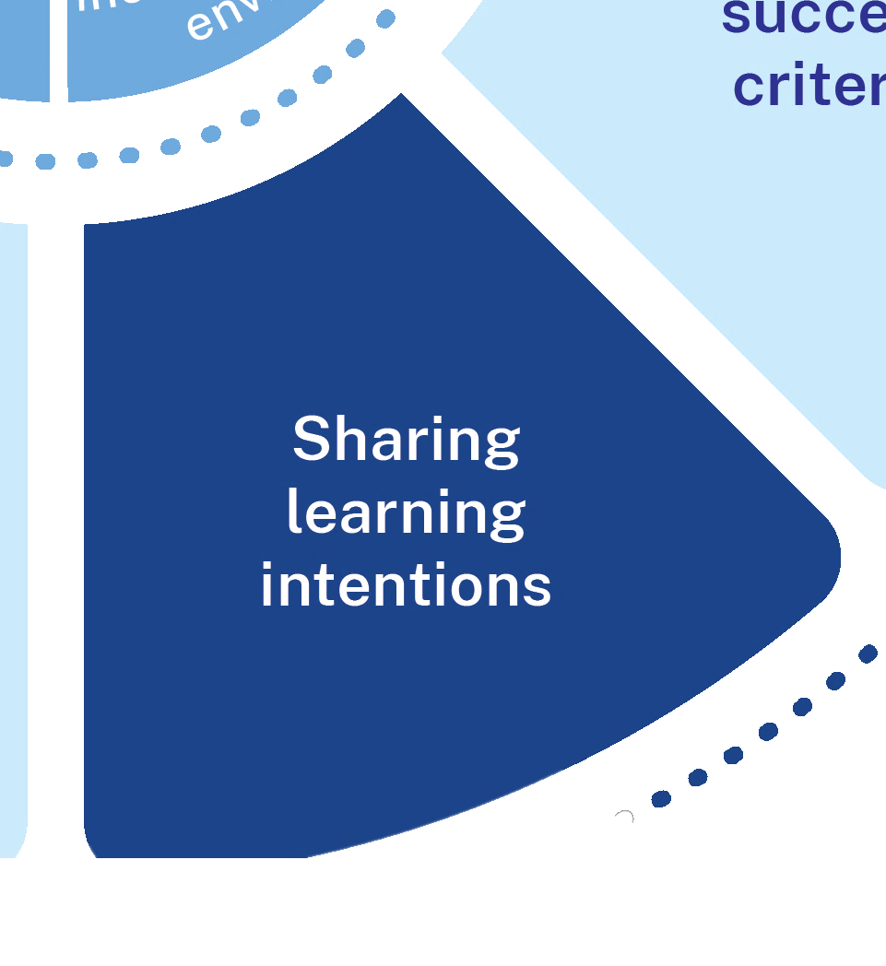
What chunking and sequencing learning is and why it is important
Chunking and sequencing information are crucial strategies for managing cognitive load and supporting schema development.
Teachers break information into manageable chunks and present it in a logical sequence with frequent opportunities for students to practice.
Teachers communicate the new information clearly through detailed explanations and models.
Chunking is also a strategy similar to the Aboriginal pedagogy process of Deconstruct Reconstruct.
Notes:
Purpose: Key idea: chunking and sequencing learning.
[01:00]
Speaker notes:
Chunking learning involves the teacher breaking up complex knowledge or skills into small steps to manage students’ cognitive load.
Sequencing learning involves teaching students foundational concepts and skills before more complex ones. Well sequenced learning helps students to create organised and accurate mental models in their long-term memory. For example, in dancing, we don’t attempt to master an entire routine all at once, instead, we break it into chunks and learn each chunk before attempting the next.
Chunking and sequencing learning are crucial strategies for managing cognitive load and supporting schema development (AERO 2023b; AERO 2024b).
Teachers break information into manageable chunks and present it in a logical sequence with frequent opportunities for students to practise (AERO 2023b; AERO 2024b).
Teachers communicate the new information clearly through detailed explanations (Fletcher-Wood 2018; Sherrington 2019). This can include think-alouds and models or worked examples (AERO 2024b).
Chunking is also a practice similar to the Aboriginal pedagogy process of Deconstruct Reconstruct where the whole picture is shown and then it is broken down into parts and then built back up to the whole picture.
Notes to presenter: (not necessary to read aloud)
In cognitive science, chunking is known as the process of combining multiple smaller elements into a larger element within long term memory (Lovell, 2020). Working memory operates by grouping information into "chunks" of different sizes. In this Chunking and Sequencing strategy, chunking is used to mean how teachers break down content into manageable chunks so that students are supported to develop robust schemas.
For further information on Aboriginal pedagogy process of Deconstruct Reconstruct contact:
https://education.nsw.gov.au/teaching-and-learning/aec/aboriginal-education-support-teams
References:
AERO (Australian Education Research Organisation) (2023b) How students learn best: an overview of the learning process and the most effective teaching practices, AERO, accessed 20 November 2024.
AERO (Australian Education Research Organisation) (2024b) Teach explicitly, AERO, accessed 20 November 2024.
Fletcher-Wood H (2018) Responsive teaching, Routledge.
Lovell O (2020) Sweller’s Cognitive Load Theory in Action, John Catt Educational Ltd.
Sherrington T (2019) (Cavigliogi O, illus) Rosenshine’s principles in action, John Catt Educational Ltd.
Yunkaporta T (2009) 8 Ways of Aboriginal Learning, accessed 20 November 2024.

Slide 21
Chunking and sequencing in the lesson
Identify key skills and knowledge to be learned.
Identify prerequisite skills and knowledge.
Break the learning down into small component parts (chunks).
Sequence chunks to build complexity.
Teach each chunk with a distinct check for understanding before moving onto the next chunk.
Notes:
Purpose: Chunking and sequencing in the lesson
[1:00]
Speaker notes:
Deliberate chunking and sequencing within the lesson supports complex schema development. Segmenting learning into small chunks can reduce cognitive load (Lovell 2020). Chunks are then sequenced logically to build in complexity, helping students ‘build on what they already know’ (AERO 2024b:3).
When chunking and sequencing in a lesson:
Identify prerequisite skills and knowledge.
Identify key skills and knowledge to be learned.
Break the learning down into small component parts (chunks).
Sequence chunks to build complexity.
Teach each chunk with a distinct check for understanding before moving onto the next chunk.
References:
AERO (Australian Education Research Organisation) (2024b) Teach explicitly, AERO, accessed 20 November 2024.
Lovell O (2020) Sweller’s Cognitive Load Theory in Action, John Catt Educational Ltd.

Slide 22
Chunking and sequencing across the unit
Refer to the syllabus to identify the expected prior knowledge, skills and understanding from previous Stages
Identify the key knowledge, skills and understanding from the syllabus.
Ensure students build proficiency prerequisite knowledge or skills before moving on to more advanced concepts.
Introduce similar knowledge, skills or strategies gradually, ensuring clarity and avoiding potential confusion.
Notes:
Purpose: Chunking and sequencing across the unit
[1:00]
Speaker notes:
When planning units of work or a sequence of lessons, it is important to consider the chunks of key knowledge or skills students need to achieve. This builds on the existing sequencing of content in NSW syllabuses. These chunks need to be organised into smaller instructional tasks and sequenced in a logical and effective order. Sequencing information thoughtfully allows students to build on prior knowledge to gradually deepen their understanding, supporting effective learning.
When chunking and sequencing across a unit:
Refer to the syllabus to identify the expected prior knowledge, skills and understanding from previous Stages.
Identify the key knowledge, skills and understanding from the syllabus.
Ensure students build proficiency with prerequisite skills before moving on to more advanced concepts
Introduce similar skills or strategies gradually, ensuring clarity and avoiding potential confusion.
This approach to chunking and sequencing learning helps create a more effective learning pathway, allowing students to build a solid foundation before tackling more challenging content.
Reference:
Archer AL and Hughes CA (2011) Explicit instruction: effective and efficient teaching, Guilford Press.
Rosenshine B (2012) 'Principles of instruction: research-based strategies that all teachers should know', American Educator, 36(1):12–39.

Slide 23
Chunking and sequencing – What it isn’t
Chunking and sequencing activities rather than chunking and sequencing knowledge and skills.
Using an existing programs, units or lesson plans without responding to evidence and data about your students.
Moving on to new information without checking for accurate understanding from students.
Reducing the expectations for students’ when learning is new and complex.
Notes:
Purpose: What it isn’t
Speaker notes:
[01:00]
What it isn’t
simply chunking and sequencing learning activities. It is only when the knowledge or skills have been chunked that we can determine the learning activities.
using an existing scope and sequence without responding to evidence and data about your students
moving on to new information without students having mastered the learning.
reducing the expectations for students’ when learning is new and complex.
References:
AERO (Australian Education Research Organisation) (2024b) Teach explicitly, AERO, accessed 20 November 2024.

Slide 24

The mechanisms of chunking and sequencing learning (1)
Proficiency in prerequisite knowledge and skills
One new chunk at a time
Effective schema development
Logical sequence
Proficiency before moving on to next chunk
Notes:
Purpose: To summarise what makes chunking and sequencing learning effective
[01:00]
Speaker notes:
When chunking and sequencing learning:
[click] Students must be proficient in prerequisite knowledge and skills.
[click] New learning is taught one chunk at a time.
[click] Students develop proficiency in the new chunk of learning, before moving to the next chunk. This is determined using a check for understanding.
[click] Chunks are learned in a logical sequence.
[click] when all 4 mechanisms work together, students are supported to build rigorous schema that optimise student understanding.
Reference:
Archer AL and Hughes CA (2011) Explicit instruction: effective and efficient teaching, Guilford Press.
AERO (Australian Education Research Organisation) (2023b) How students learn best: an overview of the learning process and the most effective teaching practices, AERO, accessed 20 November 2024.
AERO (Australian Education Research Organisation) (2024b) Teach explicitly, AERO, accessed 20 November 2024.
Fletcher-Wood H (2018) Responsive teaching, Routledge.
Rosenshine B (2012) Principles of instruction: research-based strategies that all teachers should know, American Educator, 36(1):12–39.
Sherrington T (2019) (Caviglioli O, illus) Rosenshine’s principles in action, John Catt Educational Ltd.

Slide 25


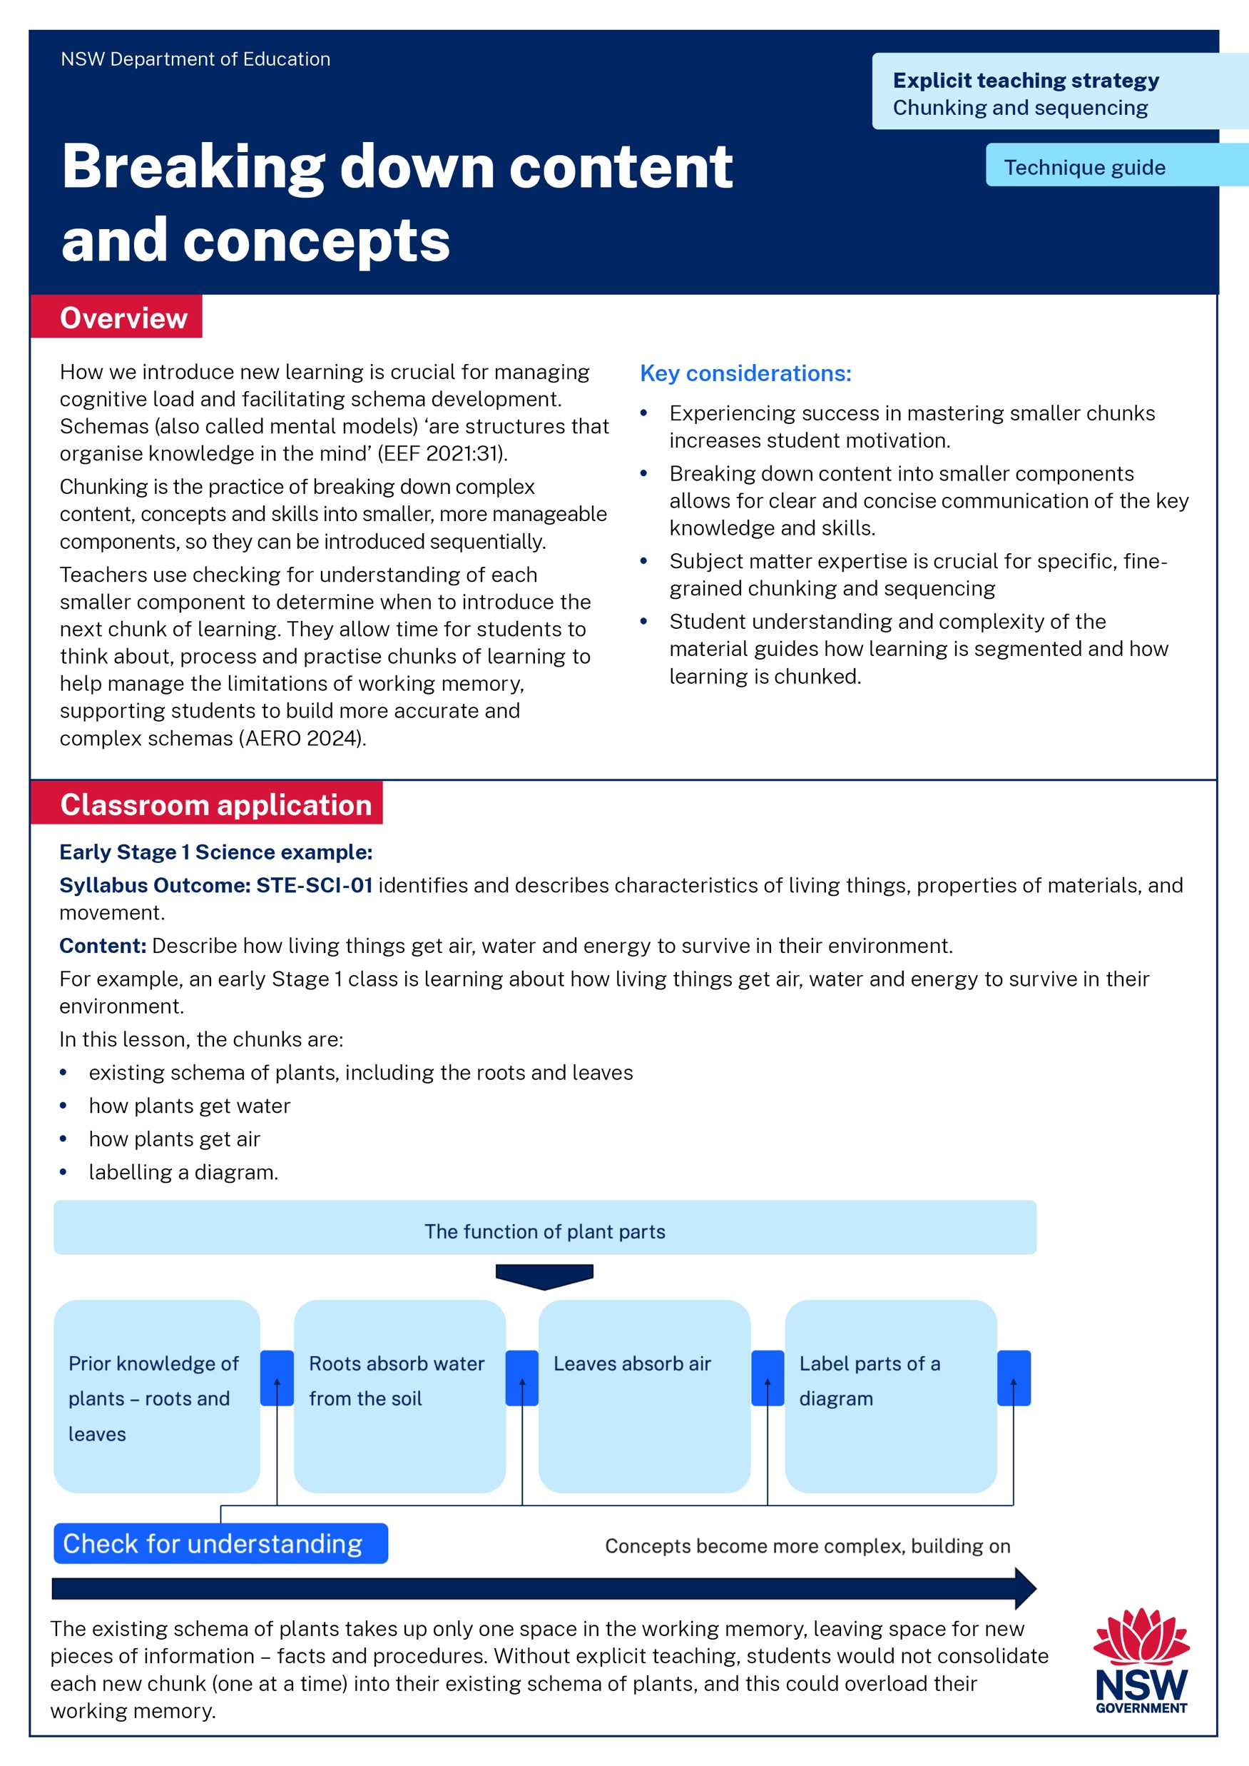
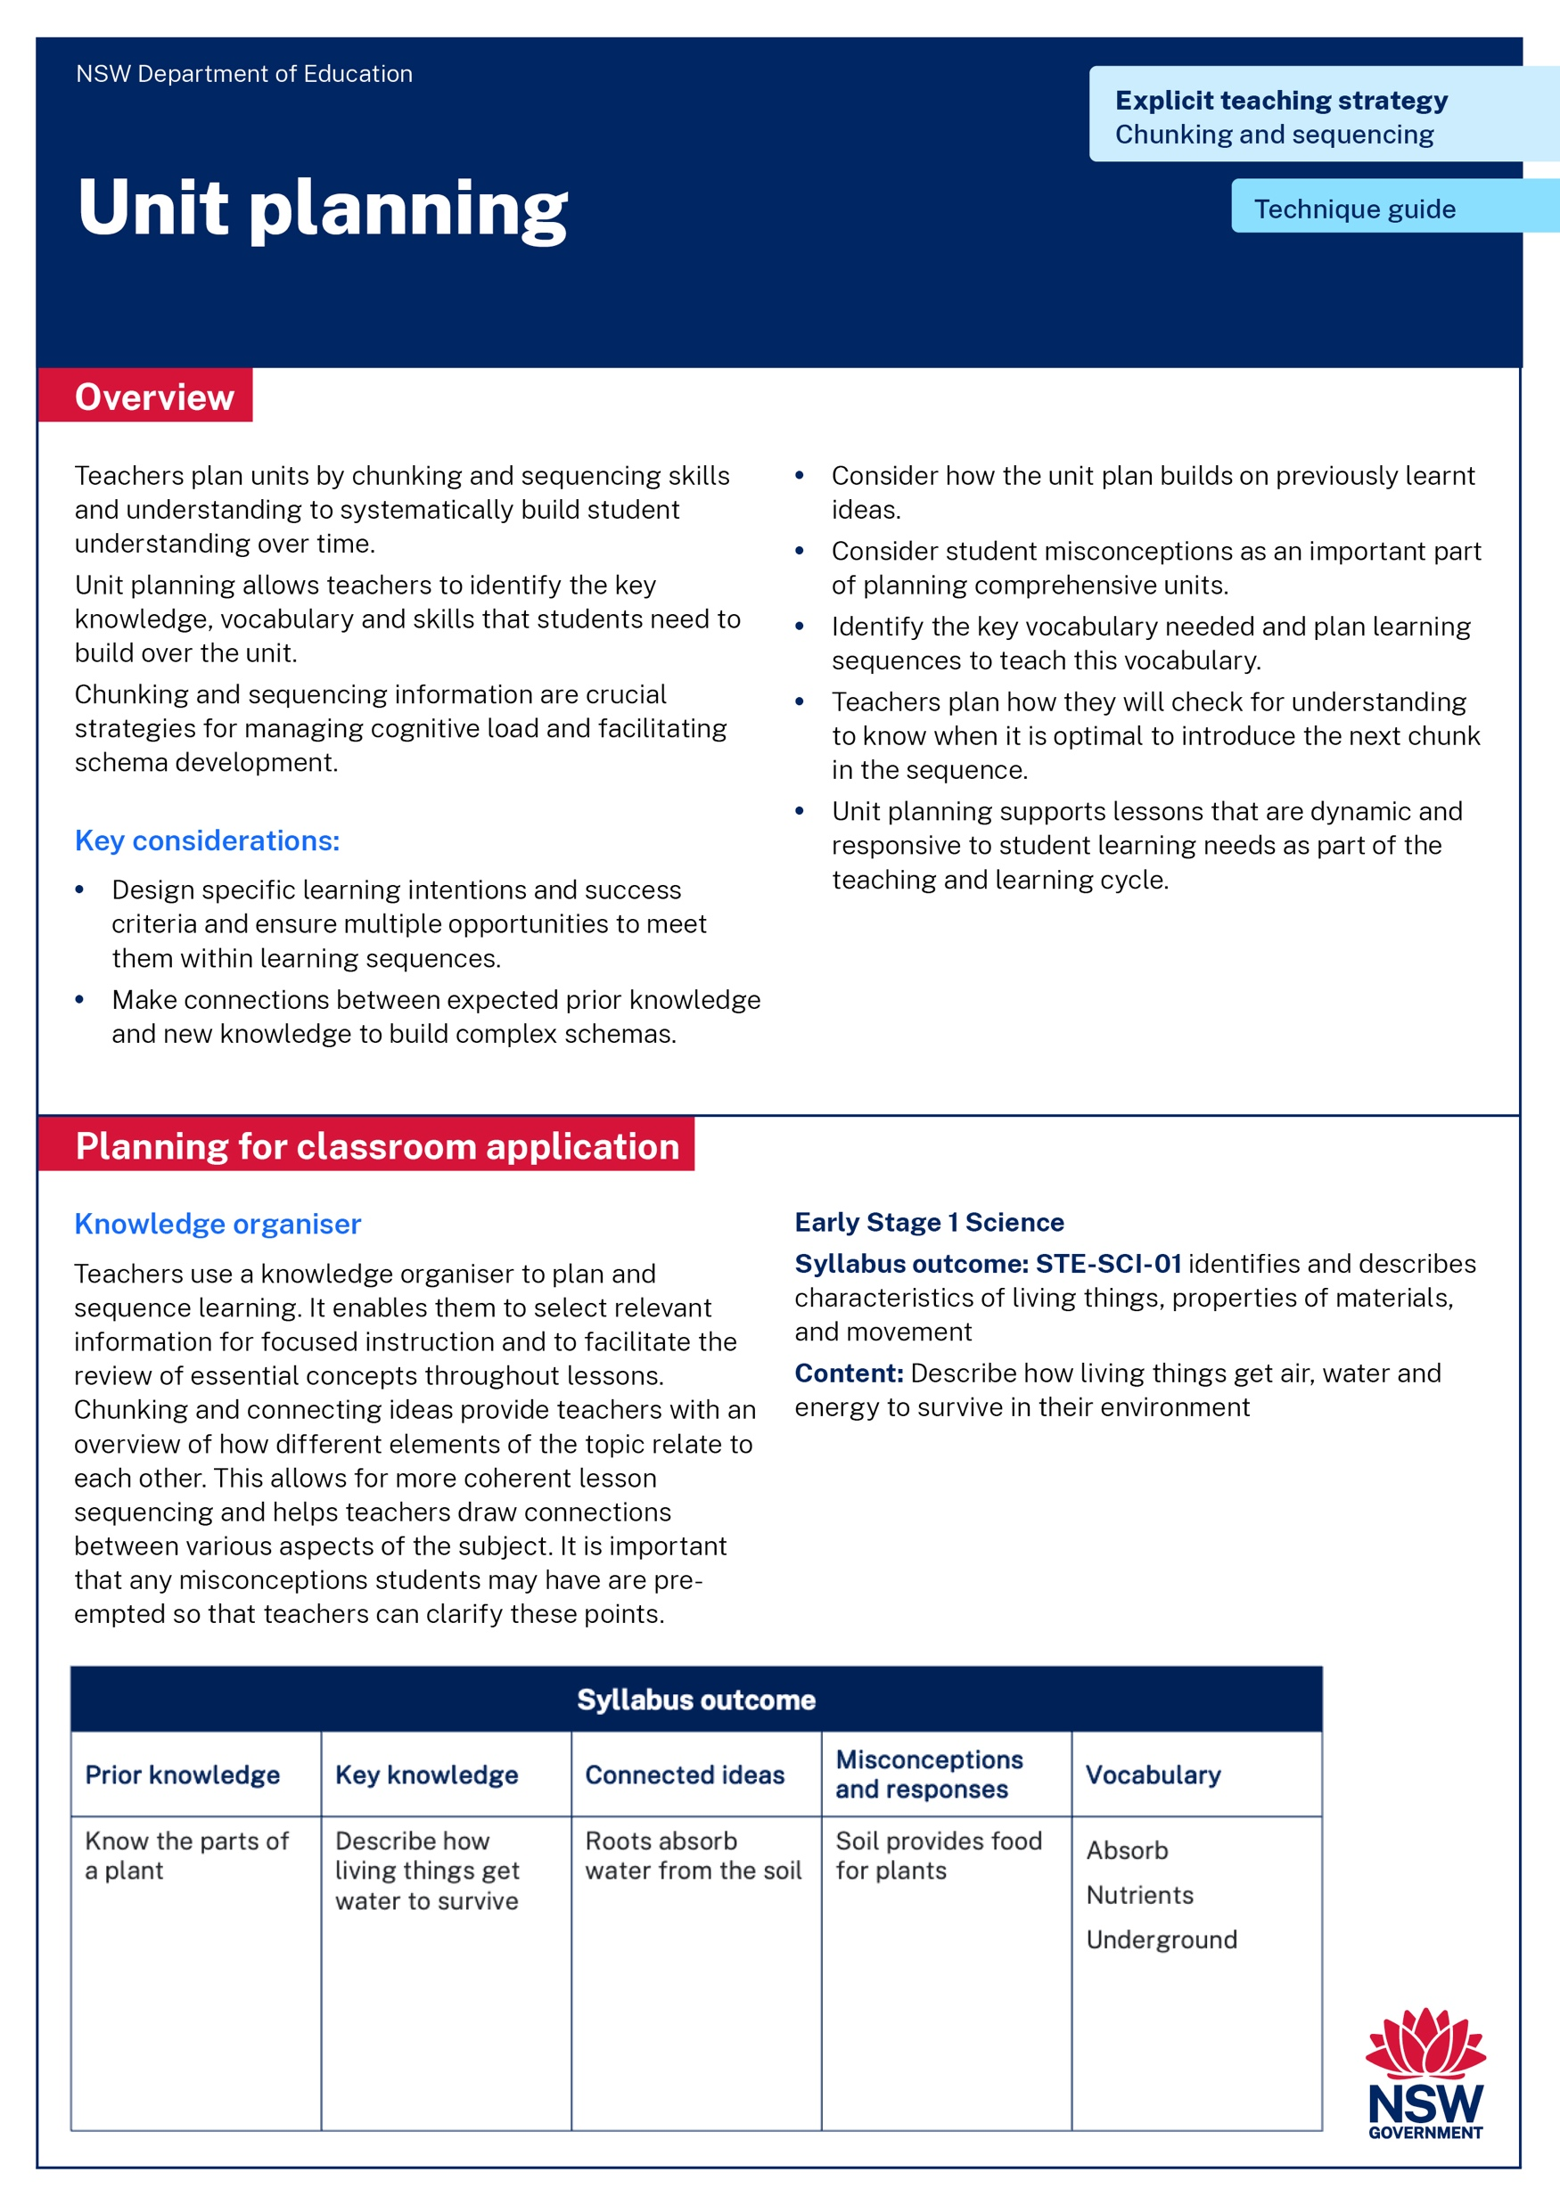
Activity 1
Read or revise – 10 min
Discuss – 10 min
Identify the key points in the Unit planning technique guide or the Breaking down content technique guide.
Describe the connections between the technique guide and the learning in Part A.
Notes:
Purpose: Deepen knowledge using chunking and sequencing learning resources
[20:00]
Speaker notes:
Read or revise – 10 minutes
Now we are going to be spending some time thinking about the connections between chunking and sequencing learning resources to deepen our knowledge and understanding.
You will have 10 mins to read or revise the technique guides and identify the key points you observed.
Discuss- 10 minutes
We have had the opportunity to read the [Unit planning and/or Breaking down content] technique guides and learning from Part A.
You will have 10 minutes to discuss with your groups the connections you can make between the readings and the learning we have done in Part A so far.
Note to presenter: use your knowledge of your school context to decide which technique guide to have participants read. You may choose both or have half of the participants read one and the other half the other. Consider providing time to share ideas with the whole group.

Slide 26
In the next part of this module, we will work on implementing the strategies through techniques. We will have opportunity to plan and rehearse how to chunk and sequence learning.
Notes:
Purpose of slide: To orient into the next part of the module.
[00:10]

Slide 27
Implementing the strategies through techniques
Part B

Slide 28
Part B instructions
Part B contains multiple techniques. To use Part B:
It is recommended teachers engage with breaking down content and concepts and unit planning.
Select a lesson to apply the techniques.
Plan and rehearse with a colleague.
Get feedback from your colleague.
Notes:
Purpose: To provide instructions on using Part B of the module.
[00:20]
Note to presenter: Select a technique to focus on with a cycle of planning, rehearsing and developing routines. This will support developing sustainable routines in the school.

Slide 29
Purpose and outcome (2)
Purpose
To develop chunking and sequencing learning techniques and routines by planning, rehearsing and developing these techniques for students in our school.
Outcome
We have whole-school routines for chunking and sequencing learning that are ready to use in lessons.
Notes:
Purpose of slide: Purpose and outcome of Part B
[00:20]
Speakers notes:
In this part, we're going to develop chunking and sequencing learning techniques and routines and have our first attempt at creating our own whole school teaching routines for chunking and sequencing learning.

Slide 30
The mechanisms of chunking and sequencing learning (2)
Proficiency in prerequisite knowledge and skills
One new chunk at a time
Effective schema development
Logical sequence
Proficiency before moving on to next chunk
Notes:
Purpose: To summarise what makes chunking and sequencing learning effective
[01:00]
Speaker notes:
When chunking and sequencing learning:
[click] Students must be proficient prerequisite knowledge and skills.
[click] New learning is taught one chunk at a time.
[click] Students develop proficiency in the new chunk of learning, before moving to the next chunk. This is determined using a check for understanding.
[click] Chunks are learned in a logical sequence.
[click] when all 4 mechanisms work together, students are supported to build rigorous schema that optimise student understanding.
Reference:
Archer AL and Hughes CA (2011) Explicit instruction: effective and efficient teaching, Guilford Press.
AERO (Australian Education Research Organisation) (2023b) How students learn best: an overview of the learning process and the most effective teaching practices, AERO, accessed 20 November 2024.
AERO (Australian Education Research Organisation) (2024b) Teach explicitly, AERO, accessed 20 November 2024.
Fletcher-Wood H (2018) Responsive teaching, Routledge.
Rosenshine B (2012) Principles of instruction: research-based strategies that all teachers should know, American Educator, 36(1):12–39.
Sherrington T (2019) (Caviglioli O, illus) Rosenshine’s principles in action, John Catt Educational Ltd.

Slide 31
Breaking down content and concepts
Technique A

Slide 32
Breaking down content and concepts – Key considerations (1)
Success in mastering smaller chunks increases student motivation
Breaking down content into its smallest components allows for clear and concise communication of the key knowledge and skills.
Subject matter expertise is crucial for specific, fine-grained chunking and sequencing
Complexity of the material guides how learning is segmented and how learning is chunked.
Notes:
Purpose: Key considerations for breaking down content and concepts
[01:00]
Speaker notes:
(Read points on the slide together. Provide some time to discuss each point).
Key considerations:
Student mastery of smaller chunks increases motivation: Breaking down new and/or complex information into smaller, manageable chunks supports cognitive load and helps students achieve a series of small successes. As students master each small chunk, their sense of accomplishment grows, boosting engagement and motivation, which are key for sustained and improved learning. Ensuring success is important for all students particularly Aboriginal and Torres Strait Islander students as some of them may feel the ‘shame factor’ and fear of getting it wrong, creating barriers to future learning. Providing feedback to students to know they are on track builds confidence in learning and positive student self-concept (Sam and McDowall 2024).
To manage cognitive load effectively, teachers should consider how they explain knowledge in concise and clear ways. This could mean using concise language, illustrating concepts with concrete examples and visually organising information.
Knowing the content and how to teach it is an enabling factor of explicit teaching. Deep subject knowledge is required for teachers to know what key pieces make up a concept or body of knowledge, and then how to put these pieces back together in a way that makes sense to students and does not overload their working memory. For example, to understand how a magnet works, students must first understand what “attract” and “repel” mean.
Complexity of the material guides how learning is segmented and how learning is chunked. Teachers can take time where needed for deeper, more challenging material while moving more quickly through simpler, more familiar content.
References:
AERO (Australian Education Research Organisation) (2023b) How students learn best, AERO, accessed 27 November 2024.
Archer AL and Hughes CA (2011) Explicit instruction: effective and efficient teaching, Guilford Press.
Rosenshine B (1995) 'Advances in research on instruction', The Journal of Educational Research, 88(5):262–268.
Rosenshine B (2012) 'Principles of instruction: research-based strategies that all teachers should know', American Educator, 36(1):12–19.
Sam T and McDowall A (2024) 'Smooth seas never made a skilled sailor: Indigenous students’ academic buoyancy and the locale of the learner', The Australian Journal of Indigenous Education, 53(1).

Slide 33
Example 1 – Science (primary)
Existing schema of “plants” includes they are green, have roots, leaves and sometimes they flower
Roots get water from the soil
Leaves get air
Put labels on a diagram
fact
fact
procedure
fact
fact
fact
Available “spaces” in working memory
Image adapted from AERO (Australian Education Research Organisation) (2024b) Explicit instruction
Notes:
Purpose: Working memory can be overloaded
[00:45]
Speaker notes:
For example, an early Stage 1 class is learning about how living things get air, water and energy to survive in their environment.
In this lesson, the chunks are:
existing schema of plants, including the roots and leaves
how plants get water
how plants get air
labelling a diagram.
The existing schema of plants takes up only one space in the working memory, leaving space for new pieces of information – facts and procedures. Without explicit teaching, students would not consolidate each new chunk (one at a time) into their existing schema of plants, and this could overload their working memory.
Science and Technology K–6 Syllabus 2024
Syllabus Outcome: STE-SCI-01 identifies and describes characteristics of living things, properties of materials, and movement.
Content: Describe how living things get air, water and energy to survive in their environment.
References:
AERO (Australian Education Research Organisation) (2023d) Explicit instruction optimises learning, AERO, accessed 20 November 2024.
AERO (Australian Education Research Organisation) (2024b) Explicit instruction, accessed 20 November 2024.
CESE (Centre for Education Statistics and Evaluation) (2017) Cognitive load theory: research that teachers really need to understand, NSW Department of Education.
NESA (NSW Education Standards Authority) (2024) Science and Technology K–6 Syllabus, NESA.

Slide 34
Sequencing new chunks
The function of plant parts
Prior knowledge of plants – roots and leaves
Roots absorb water from the soil
Leaves absorb air
Label parts of a diagram
Concepts become more complex, building on
Notes:
Purpose of slide: Primary Science example continued – sequencing new chunks
[00:30]
Speaker notes:
In this example, the teacher activates their prior knowledge of plants, by showing pictures of plants or a sample of a plant. The teacher shows the students where the roots are on a plant (live or in pictures) and tells students that the roots absorb/get water from the soil. Teacher checks for student understanding. This enables students to consolidate the new information into their schema. This schema takes up one space in working memory, ready for the next chunk to be introduced.
Each chunk is consolidated before the next one is introduced.
The chunks are sequenced to build the complexity of the concept, based on a foundational conceptual understanding.
References:
AERO (Australian Education Research Organisation) (2023b) How students learn best: an overview of the learning process and the most effective teaching practices, AERO, accessed 20 November 2024.
CESE (Centre for Education Statistics and Evaluation) (2017) Cognitive load theory: research that teachers really need to understand, NSW Department of Education.

Slide 35
Sequencing new chunks (2)
The function of plant parts
Prior knowledge of plants – roots and leaves
Roots absorb water from the soil
Leaves absorb air
Label parts of a diagram
Check for understanding
Concepts become more complex, building on
Notes:
Purpose of slide: Primary Science example continued – the importance of checking for understanding.
[00:30]
Speaker notes:
Our understanding of cognitive load theory and how students learn supports the need to check for understanding throughout the entire learning process. This could be as simple as cold calling or with mini whiteboards. It could also include 3 to 5 planned multiple-choice questions.
Checking for understanding between the smaller chunks of learning is crucial to determine when to move on and when to reteach.
References:
AERO (Australian Education Research Organisation) (2023b) How students learn best: an overview of the learning process and the most effective teaching practices, AERO, accessed 20 November 2024.
CESE (Centre for Education Statistics and Evaluation) (2017) Cognitive load theory: research that teachers really need to understand, NSW Department of Education.

Slide 36
Pair and share
Turn to the person next to you and explain what you need to consider when breaking content into the smallest chunks that will support schema development.
Notes:
Purpose: Activity
[02:00]
Notes to presenter: This activity could be done followed by selecting non-volunteers to share their dialogue.
Suggested responses:
Teachers would need to consider:
complexity of the content to be taught
student prior knowledge (schemas)
key pieces of knowledge and how to put them together in chunks to optimise student learning
adequate subject knowledge to determine the specificity of the chunk
clear and concise communication of key knowledge.

Slide 37

Example 2 – geography (secondary)
Stage 4 Geography – Geographical tools
Maps – synoptic charts
Outcome
GE4-TAP-01 selects and uses geographical tools to acquire and process geographical information
Notes:
Purpose of slide: Secondary example – Scenario.
[01:00]
Speaker notes:
Another example we can look at is a Year 8 Geography skills lesson on synoptic charts.
(Provide time for teachers to read the outcome on the slide.)
Reference:
NESA (NSW Education Standards Authority) (2024) Geography 7–10 Syllabus, NESA.

Slide 38

Example 2 – geography (secondary) (2)
State the air pressure of Sydney.
Elements in this activity:
locate Sydney
know what isobars show
recognise isobars on map
Sydney is between two isobars
find two nearest isobars and their values.
Notes:
Purpose of slide: Secondary example continued.
[01:00]
Speaker notes:
Within the lesson, students are asked to ‘state the air pressure of Sydney’ according to this map.
This may appear as one instruction but actually involves numerous ‘chunks’ of learning that need to be mastered in order to be successful.
Let's look at a list of the possible chunks of information a student would need to complete this task; they would need to simultaneously recognise and consider:
where Sydney is on the map
recognise that air pressure is shown with isobars
recognise what an isobar is either from prior knowledge or from the legend
determine that Sydney lies between two isobars and the convention is to state the range
find the two nearest isobars and find their value.
Without consideration of chunking and sequencing, students would need to hold 5 chunks in their working memory to complete this activity. As we have already discussed in Part A, students for whom standard English is an additional language or dialect including Aboriginal English will be using space in their working memory to understand the lesson being conducted in standard English. Because the language learning takes up space, they have less space available in their working memory.
References
Lovell O (2020) Sweller’s cognitive load theory in action, John Catt Educational Ltd.

Slide 39
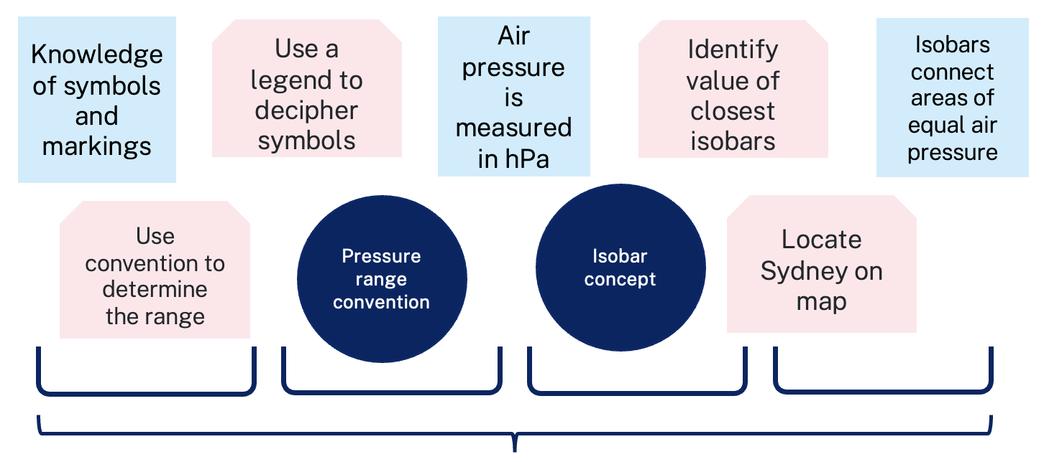

Avoid overloading working memory
The working memory of a novice can become overloaded with too many elements.
V
Working memory of a novice
Working memory of an expert
Notes:
Purpose of slide: Secondary example continued – consider the number of chunks in an activity.
[01:00]
Speaker notes:
For a novice learner – being presented with all the chunks at once is likely to result in an overload of the working memory, resulting in an inaccurate schema.
In this example, if a learner does not have sufficient prior knowledge (even if they have prior knowledge of all the basic components), attempting to solve this problem will overload their working memory. And because this is out of their control, discouragement, disengagement and negative beliefs about their ability in this domain are all possible outcomes.
Even one seemingly simple activity in this lesson is quite complex. Therefore, we need to consider breaking down the lesson into smaller parts and introduce them one at a time. Students need the opportunity to consolidate each new chunk before introducing the next one.
References:
Lovell O (2020) Sweller’s cognitive load theory in action, John Catt Educational Ltd.

Slide 40
Sequencing the chunks (3)
Synoptic charts
What is air pressure?
High and low air pressure
Air masses and fronts
Wind direction and speed
Interpreting weather from synoptic charts
Concepts become more complex, building on
Notes:
Purpose of slide: Secondary example continued – consider the number of elements in an activity.
[01:00]
Speaker notes:
One lesson on synoptic charts can be broken down into 5 smaller chunks or ‘mini lessons’ based on the elements identified, each with instruction, modelling and worked examples, and checks for understanding.
Each chunk is consolidated before the next one is introduced.
The chunks are sequenced to build the complexity of the concept, based on a foundational conceptual understanding of what air pressure is.
References:
Geography 7–10 Syllabus © NSW Education Standards Authority (NESA) for and on behalf of the Crown in right of the State of New South Wales, 2024.

Slide 41
The importance of checking for understanding
Synoptic charts
What is air pressure?
High and low air pressure
Air masses and fronts
Wind direction and speed
Interpreting weather from synoptic charts
Check for understanding
Concepts become more complex, building on
Notes:
Purpose of slide: Secondary example continued – the importance of checking for understanding.
[00:30]
Speaker notes:
Our understanding of cognitive load theory and how students learn support the need to check for understanding throughout the entire learning process. This could be as simple as cold calling or with mini whiteboards. It could also include 3 to 5 planned multiple-choice questions.
Checking for understanding between the smaller chunks of learning is crucial to determine when to move on and when to reteach.
References:
AERO (Australian Education Research Organisation) (2023b) How students learn best: an overview of the learning process and the most effective teaching practices, AERO, accessed 20 November 2024.
CESE (Centre for Education Statistics and Evaluation) (2017) Cognitive load theory: research that teachers really need to understand, NSW Department of Education.
Geography 7–10 Syllabus © NSW Education Standards Authority (NESA) for and on behalf of the Crown in right of the State of New South Wales, 2024.

Slide 42
Pair and share (2)
Turn to the person next to you and explain the importance of introducing one chunk at a time.
Notes:
Purpose: Activity
[02:00]
Notes to presenter: This activity could be done followed by selecting non-volunteers to share their dialogue.
Suggested responses:
The importance of introducing one chunk at a time:
When the learning is new, introducing too many chunks at once can overload the working memory
The information can be consolidated into an existing schema
Checking for understanding between the chunks ensures students consolidate the correct information into their schema

Slide 43
Unit planning
Technique B

Slide 44
Unit planning (2)
Teachers plan units by chunking and sequencing learning to systematically build student understanding and skills over time.
Unit planning allows teachers to identify the key knowledge and vocabulary of the concept or skill that students need to build over the unit.
Chunking and sequencing information are crucial strategies for managing cognitive load and facilitating schema development.
Sequencing tasks and monitoring learning progress before moving on to the next chunk supports information being transferred to long-term memory, where it is easier to use and connect to new learning (AERO 2022).
Notes:
Purpose: Unit planning – what it is
[01:00]
Speaker notes:
Planning units rather than detailed individual lessons helps teachers maintain a focus on core concepts and student progress, rather than being constrained by fixed time slots. This approach enables responsive teaching, allowing teachers to adapt to students' needs as they go, while still following a structured roadmap that supports comprehensive learning across the entire unit.
[click] Unit planning provides a framework for student learning.
[click] Teachers plan units by chunking and sequencing learning activities to systematically build accurate student understanding over time.
[click] Unit planning allows teachers to identify the key knowledge and vocabulary of the concept or skill that students need to build over the unit.
[click] Chunking and sequencing information are crucial strategies for managing cognitive load and facilitating schema development.
[click] Sequencing tasks and monitoring learning progress before moving on to the next concept ensures information has been transferred to long-term memory, where it is easier to use and connect to new learning (AERO 2022).
References:
AERO (Australian Education Research Organisation) (2022) Explicit instruction, AERO, accessed 15 November 2024.
Fletcher-Wood H (2018) Responsive teaching, Routledge.

Slide 45
Unit planning – Key considerations
Design specific learning intentions and success criteria, providing multiple opportunities to successfully meet them.
Identify connections between ideas that link to prior knowledge to build schemas.
Consider how the unit plan builds on current understanding, with opportunities to activate prior knowledge.
Consider misconceptions students may have.
Adapt plans and lessons in response to student learning needs as part of the teaching and learning cycle.
Notes:
Purpose: Unit planning: Key considerations
[01:40]
Speaker notes:
When planning units there are key considerations. Let's take a look at each of them.
(Read points on the slide together. Provide some time to discuss each point)
[click] Prioritise essential content and avoid irrelevant information to maximise learning time.
[click] Design specific learning intentions/success criteria with repeated opportunities to meet them.
[click] Identify connections between ideas that link to prior knowledge to build schemas.
[click] Consider how the unit plan builds on previously learnt ideas.
[click] Consider and address misconceptions students may have, as this is an important part of planning comprehensive units.
[click] Once the unit is planned – lessons become dynamic and responsive to student learning needs as part of the teaching and learning cycle.
References:
Fletcher-Wood H (2018) Responsive teaching, Routledge.

Slide 46
Example 1 – Knowledge organiser
Syllabus outcome
Prior knowledge | Key knowledge | Connected ideas | Misconceptions and responses | Vocabulary
Know the parts of a plant | Describe how living things get water to survive | Roots absorb water from the soil | Soil provides food for plants | Absorb Nutrients Underground
Notes:
Purpose: Example 1 – Knowledge organiser: What it is and how to use it
[01:00]
Speaker notes:
Knowledge organisers summarise the unit, support lesson planning, and aid in chunking and sequencing key information.
They allow teachers to choose relevant sections to teach and revisit key ideas across lessons.
Key terms are defined so teachers can introduce them purposefully and check for understanding throughout the unit.
On this slide is an example of a knowledge organiser that can be used to summarise the key information for teaching a Stage 1 Science unit on how ‘Living things change over time’.
This knowledge organiser can support unit and lesson planning and helps teachers to consider the chunking and sequencing of key information about how plants change over time.
Science and Technology K–6 Syllabus 2017
Syllabus outcome: SciTech 2017 STe1-3LW-ST explores the characteristics, needs and uses of living things
Content: Recognise that living things have basic needs including air, food and water
Science and Technology K–6 Syllabus 2024
Syllabus Outcome: STE-SCI-01 identifies and describes characteristics of living things, properties of materials, and movement.
Content: Describe how living things get air, water and energy to survive in their environment.
References:
Fletcher-Wood H (2018) Responsive teaching, Routledge.
NESA (NSW Education Standards Authority) (2017) Science and Technology K–6 Syllabus, NESA.
NESA (NSW Education Standards Authority) (2024) Science and Technology K–6 Syllabus, NESA.
NESA (NSW Education Standards Authority) (2024) Science and Technology K–6 (2024): Stage 1 Teaching advice, NESA.

Slide 47


Misconceptions
Identify misconceptions
Correct misconceptions
Check for understanding and re-teach later, if needed
Notes:
Purpose: Planning for responsive teaching: To understand the role of misconception in building learning
[01:00]
Speaker notes:
Misconceptions can be identified by the teacher both before and during the lesson. Teachers can pre-empt common misconceptions based on their subject matter expertise, bringing this experience and understanding to the scaffolding they design before teaching a lesson. For example, a primary school teacher may know that often students think rain comes from holes in clouds and so pre-empt this misunderstanding and proactively explain that this is not the case. Similarly, a secondary science teacher may know that sometimes students think ice can’t change temperature, this can be corrected by planning a lesson in which different temperatures of ice are demonstrated.
Taking time to pre-empt and identify misconceptions is important. It allows teachers to understand the accuracy or inaccuracy of knowledge students are using to develop their schema.
Teachers can do this by:
[click] identifying common misconceptions about the concept/content to assess the validity of students' prior knowledge. When students make assumptions and wrong connections it can cause incorrect schema development
[click] correcting the misconception by explaining WHY the misconception is INCORRECT and explaining the correct answer
[click] providing an opportunity later in the lesson to check for understanding on the correction of the misconception, then re-teach if needed (Nuthall 2007). Consider when re-teaching:
using even smaller chunks
whether different methods, activities or explanations may be useful.
References:
Nuthall G (2007) The hidden lives of learners, New Zealand Council for Educational Research.
Madgwick H (14 July 2021) 'EEF Blog: ECF– exploring the evidence: prior knowledge and pupil misconceptions', Education Endowment Foundation, accessed 4 October 2024.

Slide 48
Non-examples
Non-examples can make learning clear by clarifying the boundaries of a concept.
Comparing examples and non-examples clarifies misconceptions.
A triangle is a shape with 3 straight sides and 3 angles
These are all triangles:
These are not triangles:
Notes:
Purpose of the slide: explaining the usefulness of non-examples
[02:00]
Speaker notes:
Considering non-examples is an important part of unit planning.
Non-examples can make learning clear by clarifying the boundaries of a concept. The slide shows examples and then non-examples of triangles.
[click]
Another example: an ecosystem is a community of living organisms interacting with each other and their environment, such as a forest or a coral reef, where plants, animals, water, and climate all interact to support life.
A non-example would be a single plant.
This non-example highlights the complexity and interdependence required in an ecosystem, helping learners understand that an ecosystem isn’t just a single living thing but rather a whole network of relationships among living and non-living components.
References:
AERO (Australian Education Research Organisation) (2023a) Teaching routines: their role in classroom management, AERO, accessed 20 November 2024.

Slide 49

Vocabulary
Vocabulary can be considered in the unit planning process and this creates opportunity to plan explicit learning experiences of new terminology that students can use as they develop increasingly complex schemas.
Notes:
Purpose of the slide: The importance of teaching vocabulary
[04:00]
Speaker notes:
Let’s watch a video that shows the explicit teaching of vocabulary in the context of a book the students are reading.
https://players.brightcove.net/6146050564001/default_default/index.html?videoId=6336167158112
In the video, you will notice that:
the teacher has planned to teach the new vocabulary ‘fleeing’
there is a clear definition provided, multiple examples, prompted recital, and opportunity for students to practise the new vocabulary
explicit teaching comes first – students were asked to think of their own examples for the use of the words after they were taught the definition of the word
there are mechanisms to check for understanding including choral response and randomly selecting students to share responses after a pair-share.

Slide 50
Frayer diagram for teaching vocabulary
Definition
Change in the internal or external environment of the body that triggers a response in the organism.
Facts/Characteristics
Detected by sensory receptors.
Triggers a response in an organism.
Can be within the organism (internal) or outside the organism (external).
Stimulus
Examples
Increase internal body temperature (stimulus) → sweating (response).
Decrease in blood glucose levels (stimulus) → release glucagon (response).
Increase in light levels (stimulus) → pupils constrict (response).
Non-examples
Receiving a notification on your phone.
Hearing an upbeat song making you want to dance.
Advertising making you want to buy something.
50
Notes:
Purpose of the slide: Frayer diagram for teaching vocabulary
[01:00]
Speaker notes:
Frayer diagrams can be useful for subject specific words that could have different meanings in different contexts.
You will notice in this example, in addition to the definition there are also:
facts and characteristics
examples of how the word is used in the context of the subject, and
non-examples that show definitions which don’t align with the use of the target word in this context.
Here, the word 'stimulus' has a science application that students need to understand. By giving non-examples, the diagram helps clear up misconceptions. It does this by showing other meanings of the word ‘stimulus’ such as ’hearing an up-beat song’, which is a stimulus but not in the context of science.

Slide 51
Turn and talk (3)
Turn to the person next to you and explain the purpose and key components of a knowledge organiser for unit planning.
Notes:
Purpose: Activity
[02:00]
Notes to presenter: This activity could be done followed by selecting non-volunteers to share their dialogue.

Slide 52

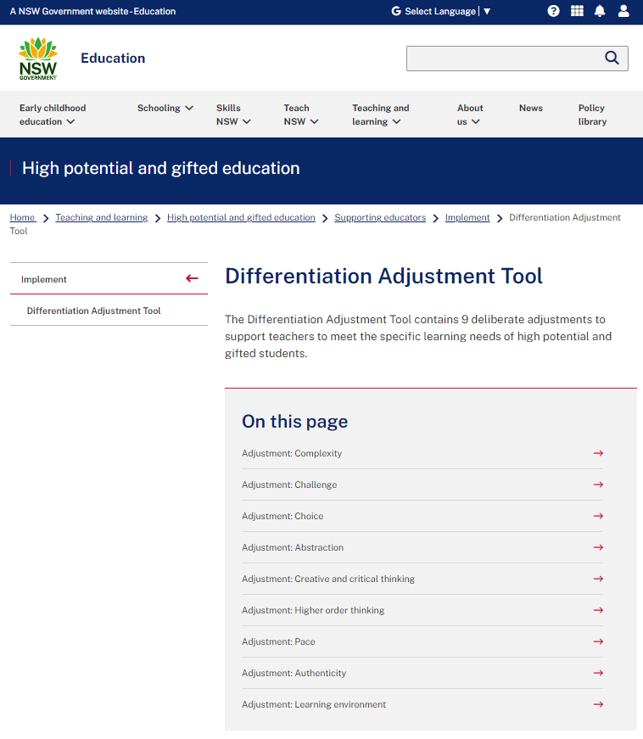

Extending to create optimal challenge
Apply new skills and knowledge to a different context.
Unpack thinking at a deeper level to provide reasoning.
Justify and communicate thinking in a variety of ways for different audiences.
Notes:
Purpose: Consider how checking for understanding can inform opportunities to extend student learning.
[2:00]
Speaker notes:
If consistent checking for understanding shows that students have deep knowledge, some options to extend their learning are:
applying new skills and knowledge to a different context
justifying thinking when given a provocative question and communicating it in a variety of ways for different audiences
unpacking thinking at a deeper level, demanding justification of reason and thought.
All students, including HPGE students, require dynamic and responsive adjustments informed by ongoing checks for understanding. Extension is only considered once students have demonstrated a consolidated understanding of key knowledge and skills.
If consistent checks for understanding reveal students are ready for extension, you may consider using the differentiation adjustment tool.
Differentiation Adjustment Tool – https://education.nsw.gov.au/teaching-and-learning/high-potential-and-gifted-education/supporting-educators/implement/differentiation-adjustment-strategies
Further reading:
AITSL (Australian Institute for Teaching and School Leadership) (2022) Indigenous cultural responsiveness capability framework, AITSL.
NSW Department of Education (2024) Re-imagining Evaluation: A Culturally Responsive Evaluation Framework?
NSW Department of Education (2024) Strong Strides Together.

Slide 53
Planning, rehearsing and developing routines

Slide 54
Creating a whole-school approach
Working in small groups:
Develop a whole-school approach to planning for chunking and sequencing.
Seek feedback and refine the approach.
Agree on a whole-school approach for planning for chunking and sequencing.
After sharing, agree on the whole-school approach to planning for chunking and sequencing of learning.
Notes:
Purpose: Consider how you can use the techniques in this learning module to plan for chunking and sequencing learning.
Note to presenter: consideration needs to be given as to how an approach is created, for example, in small groups, cross-stage or cross-faculty, etc. If working with a larger staff group, form smaller groups.
Teachers will need a unit of work and/or access to syllabus documents for this activity.
[15:00]
Speaker notes:
Today we will be completing an activity in groups to develop a whole-school approach for planning to chunk and sequence learning.
Once refined, we’ll come back together and share the approach. The goal is to adopt a cohesive approach that supports all teachers and ensures students feel confident in participating and engaging with the content.
Creating a whole-school approach may require us to:
Use the scope and sequence or syllabus to identify an outcome that needs to be taught.
Break down the key knowledge, skills or understanding into small manageable chunks considering prior learning.
Consider how we might include misconceptions, examples and non-examples, the explicit teaching of vocabulary, knowledge organiser.

Slide 55
Rehearsal steps and feedback prompts
Use your learning sequence or lesson plan to:
Choose one key idea or skill
Break down this key idea or skill into the smallest components needed for students to understand.
Plan how you will teach these components, including what type of check for understanding you will use and when you will use it.
With a partner, rehearse your introduction to the sequence including your first check for understanding.
Use the feedback from your partner to improve your approach.
Swap with your partner for their rehearsal.
Feedback prompts
Did the technique elicit a clear understanding from the whole class?
Was the teacher’s communication of new knowledge, skills or understanding clear and specific?
Did the teacher check for understanding on the 'chunk' of information taught?
Notes:
Purpose of slide: To give the steps and feedback prompts for the activity
[01:00]
Speaker notes:
Take a minute to go through the rehearsal steps and the prompts for feedback.
If you are giving feedback, we have provided a list of prompts for you to think about how the routine could be refined.
Note to presenter: this slide and the activity slide could be provided to the groups as handouts.

Slide 56
In the next part of this module, we will work on evaluating our approach to implementing the strategies through techniques
Notes:
Note to presenter: Select a technique to focus on with a cycle of planning, rehearsing and developing routines. This will support developing sustainable routines in the school.
[00:20]

Slide 57
Evaluating a whole-school approach
Part C

Slide 58
Purpose and outcome (3)
Purpose
To apply effective professional development structures, reflect on and evaluate our implementation of an explicit teaching technique.
Outcome
We have developed our whole school practices of chunking and sequencing learning and plan for future success and activities.
Notes:
Purpose of slide: To give the purpuse and outcome
[00:30]
Speaker notes:
In this part, the focus is on reflection and evaluation. We will consider the early indicators of success and use this to plan for evaluation of longer-term impact. There is also a good opportunity to refine the routines we are developing as a whole school in line with what is working in the classroom presently.

Slide 59
A whole-school approach

Slide 60
Initial data reflection point (2)
Teacher observation | 0 | 1 | 2 | 3 | 4
At the end of a lesson students can articulate the key learning from the lesson | Not yet observable | Minimal students can identify the chunks that comprise the learning | Some students can identify the chunks that comprise the learning | Most students can identify the chunks that comprise the learning | All students can identify the chunks that comprise the learning
Notes:
Purpose: Reflect on student engagement as an early indicator.
[02:00]
Speaker notes:
In the beginning, we established a baseline for where our students are now.
We looked at this example of a tool that could be used for teacher reflection. This was one way to measure one aspect of the effectiveness of chunking and sequencing.
We asked: Think about one class you taught today. What parts of the scale would best describe your students?
This module looked at the importance of breaking down content and concepts at the right challenge level and unit planning as a way to decide on the chunks and sequence of learning. Breaking learning into manageable chunks, sequencing it logically, and providing students with opportunities to practice are essential for helping students develop complex schemas. (AERO 2023b; AERO 2024b)
Consider where your students are now. Is there a change in their ability to remember learning within a unit of work over several weeks?
Note to presenter: In the beginning we noted that there is an opportunity to use this data in the final session. This measure is not the only consideration, and schools should select a model that is right for them.
This data could be collated and compared to other “school and classroom data about growth and performance.”
For example:
NAPLAN report overview accessed through Scout
https://education.nsw.gov.au/about-us/education-data-and-research/scout/training/digital-learning-centre/naplan-report-overview
NAPLAN report overview
Learn more about the NAPLAN reports in Scout.
https://education.nsw.gov.au/about-us/education-data-and-research/scout/scout-overview/apps-and-reports/naplan---doe/class-report#tabs0
Class report
The Class report shows the distribution of students’ scaled scores across domains and proficiency levels for NAPLAN 3, 5, 7 or 9.
References:
AERO (Australian Education Research Organisation) (2023b) How students learn best: an overview of the learning process and the most effective teaching practices, AERO, accessed 20 November 2024.
AERO (Australian Education Research Organisation) (2024b) Explicit instruction, AERO, accessed 20 November 2024.
Martin A and Evans P (2018) ‘Load reduction instruction: exploring a framework that assesses explicit instruction through to independent learning’, Teaching and Teacher Education, 73:203–214.

Slide 61
The mechanisms of chunking and sequencing learning
Proficiency in prerequisite knowledge and skills
One new chunk at a time
Effective schema development
Logical sequence
Proficiency before moving on to next chunk
Notes:
Purpose: To summarise what makes chunking and sequencing learning effective
[01:00]
Speaker notes:
When chunking and sequencing learning:
[click] Students must be proficient in prerequisite knowledge and skills.
[click] New learning is taught one chunk at a time.
[click] Students develop proficiency in the new chunk of learning, before moving to the next chunk. This is determined using a check for understanding.
[click] Chunks are learned in a logical sequence.
[click] when all 4 mechanisms work together, students are supported to build rigorous schema that optimise student understanding.
Reference:
Archer AL and Hughes CA (2011) Explicit instruction: effective and efficient teaching, Guilford Press.
AERO (Australian Education Research Organisation) (2023b) How students learn best: an overview of the learning process and the most effective teaching practices, AERO, accessed 20 November 2024.
AERO (Australian Education Research Organisation) (2024b) Teach explicitly, AERO, accessed 20 November 2024.
Fletcher-Wood H (2018) Responsive teaching, Routledge.
Rosenshine B (2012) Principles of instruction: research-based strategies that all teachers should know, American Educator, 36(1):12–39.
Sherrington T (2019) (Caviglioli O, illus) Rosenshine’s principles in action, John Catt Educational Ltd.

Slide 62
The importance of all moving together (2)
Saves learning time¹
Frees up students’ working memory²
Certain and consistent expectations for students³
Students learn the routine more quickly when it is done in the same way across the school⁴
Fosters a strong sense of belonging⁵
Notes:
Purpose: to restate why a whole school teaching routine is powerful
[01:00]
Speaker notes:
These modules use the power of whole school teaching routines. When a group of expert teachers from across the school come together and create a whole school approach, they are far more effective than when they go it alone. Teaching routines:
[click] save learning time
[click] can free up students’ working memory
click] provide certainty and expectations for students to contribute to a learning environment where they’re safe to participate.
[click] They’re efficient, because when done the same way across the school, students can learn the routine more quickly,
[click] and they foster a strong sense of belonging.
As we go through the learning module here, and other learning modules for explicit teaching we will revisit the idea of the whole school teaching routines.
References:
Archer AL and Hughes CA (2011) Explicit instruction: Effective and efficient teaching, Guilford Press.
AERO (Australian Education Research Organisation) (2021) Focused classrooms: managing the classroom to maximise learning, AERO., accessed 15 November 2024
AERO (Australian Education Research Organisation) (AERO) (2023a) Teaching routines: their role in classroom management, AERO, accessed 15 November 2024
McCrea P (2020) Motivated Teaching: harnessing the science of motivation to boost attention and effort in the classroom, Createspace Independent Publishing Platform.
Further reading:
Tharby A (12 May 2023) ‘We are what we do: the case for explicit and consistent school-wide routines’, Class Teaching, find the bright spots blog, accessed 20 November 2024.

Slide 63
Planning and rehearsing (2)
Plan
Rehearse
Feedback
Evidence for Learning (2022) Effective Professional Development, Sydney: Evidence for Learning.
Notes:
Purpose: to explain the process of rehearsing
[01:10]
Speaker notes:
Research from Evidence for Learning shows teachers are more likely to put professional learning into practice when they plan and rehearse during professional learning, before implementing techniques in the classroom. This is enhanced by feedback from colleagues.
Note to presenter: it is advisable to prepare school leaders beforehand if modelling and rehearsing are not yet established practices in the school.
Further reading on this research:
AERO (Australian Education Research Organisation) (2023b) Gaining all students’ attention, AERO, accessed 20 November 2024.
Evidence for Learning (2022) Effective professional development, Evidence for Learning.
Sims S, Fletcher-Wood H, O’Mara-Eves A, Cottingham S, Stansfield C, Van Herwegen J and Anders J (2021) What are the characteristics of teacher professional development that increase pupil achievement? A systematic review and meta-analysis, Education Endowment Foundation.

Slide 64
Rehearsal (2)
Notes:
Purpose of slide: To explain why rehearsing is so important
Speaker notes:
[01:10]
Application is a real key to success in professional learning.
Why might professional learning not be applied in the classroom, despite our best intentions?
[click] Research from Evidence for Learning (2022) found that rehearsing was among the key mechanisms for success in the application of PL.
New teachers often have practices described to them – but it is much clearer to have lead teachers model the practice (out of the classroom, without students) while the observer uses prompts to reflect on what made that practice successful.
Teaching is a habit-forming practice. By necessity, teaching requires us to automate a number of behaviours. The cognitive load on teachers to introduce a new behaviour is high and so we often rely on those previously formed habits.
Rehearsal (out of the classroom, without students) makes our PL a habit. When we try a rehearsed routine in a classroom, our cognitive load is reduced because we have one thing to think about, rather than 4 or 5.
This is why rehearsing is a key mechanism for success in professional learning.
References:
Evidence for Learning (2022) Effective professional development, Evidence for Learning.

Slide 65
Evaluating impact on students

Slide 66
'When implementing a new evidence-based practice, school personnel should measure fidelity early and often to provide timely and responsive professional development and maximise student outcomes.'
(Harn et al. 2013:186)
66
Notes:
Purpose:
[00:20]
Speaker notes:
Reference:​
Harn B, Parisi D and Stoolmiller M (2013) ‘Balancing fidelity with flexibility and fit: what do we really know about fidelity of implementation in schools?’ Exceptional Children, 79:181–193.

Slide 67
Measuring impact
Short term
Increased engagement
Increased ability to articulate the lesson’s learning intention(s) and success criteria
Longer term
Increased understanding
Increased learning
Student data indicates learning gains
Teacher observation | 0 | 1 | 2 | 3 | 4
At the end of a lesson students can articulate the key learning from the lesson | Not yet observable | Minimal students can identify the chunks that comprise the learning | Some students can identify the chunks that comprise the learning | Most students can identify the chunks that comprise the learning | All students can identify the chunks that comprise the learning
Notes:
Purpose: Reflecting on initial observations and considering long term measures
Note to presenter: timing for this slide will be dependent on your own allocated time and the number of staff in attendance.
Speaking notes:
When we try something new in the classroom and our students experience it for the first time, it may not have the desired impact. Over time, the impact of the approach should show signs of success.
Measure fidelity early and often to maximise student outcomes and be responsive in the approach.
Shorter term
When designing an approach to measure impact, consider, ‘what are the student outcomes that show signs of success in the shorter term?’ On the slide are examples of things we may be able to observe as shorter-term indicators of success. These indicators are more proximal to the teaching. They should be an immediately observable/collectable indicator of change in students’ knowledge, skills, motivation, or self-belief. This information of what is successful helps us plan for longer-term outcomes.
Longer term
Other data sources should be considered beyond the proximal data. As implementation of strategies progresses, consider, ‘what are the student outcomes that show signs of success in the longer term?’ On the slide are examples of things we may be able to observe that become apparent over longer periods.
In Part A, we established a baseline using the teacher observation scale for where our students are now based on teacher observation.
Activity:
What observations can you make about chunking and sequencing techniques in the classroom?
What observations can be made about what has been successful so far, while we’ve focused on chunking and sequencing learning in classrooms?
How will we measure longer-term outcomes?
How can we scale our success by refining and building the techniques and routines we’ve been developing?
Note to presenter: You may wish to display the data from the first session if it was collected. If there has been no shift identified using the early measure, discuss the barriers to success and if an adjustment to the whole-school routine is needed.
For more information about centring Aboriginal students, their families, and their communities at the heart of evaluation methodology and processes:
NSW Department of Education (2024) Re-imagining Evaluation: A Culturally Responsive Evaluation Framework?.
Further reading on High Impact Professional Learning:
High Impact Professional Learning
References:
McCrea P (2020) Motivated teaching: harnessing the science of motivation to boost attention and effort in the classroom, Createspace Independent Publishing Platform.

Slide 68
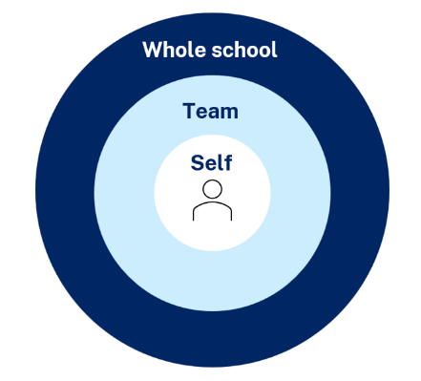
Maintaining a whole school approach through data
Video observation and reflection
Peer observation and feedback
Teacher and student survey
Growth in assessment data
Notes:
Purpose of slide: collating and using data - suggested for school leadership team
[05:00]
Speaker notes:
Evaluating data is a way we can consider the extent to which we are being effective in achieving long term goals. Data can be collected from many perspectives, including individual teachers and students, teams and whole school. Data can include a range of things, such as observational/instructional rounds, student work samples (such as exit tickets), student self-reports, teacher reflections and assessments. Data can be quantitative and qualitative.
Reflecting on data helps us consider how efficient and effective we are being in achieving our instructional goals. It also provides key insights to inform the next steps of professional learning and whole school strategic planning.
Activity:
What data have we accessed so far and what have we learnt?
How can we select and measure data over time to consider our impact?
Further reading:
More information about using data to evaluate the curriculum aligned to the School Excellence Framework
LECI: Module 5: Using data to effectively evaluate the curriculum AC01087

Slide 69
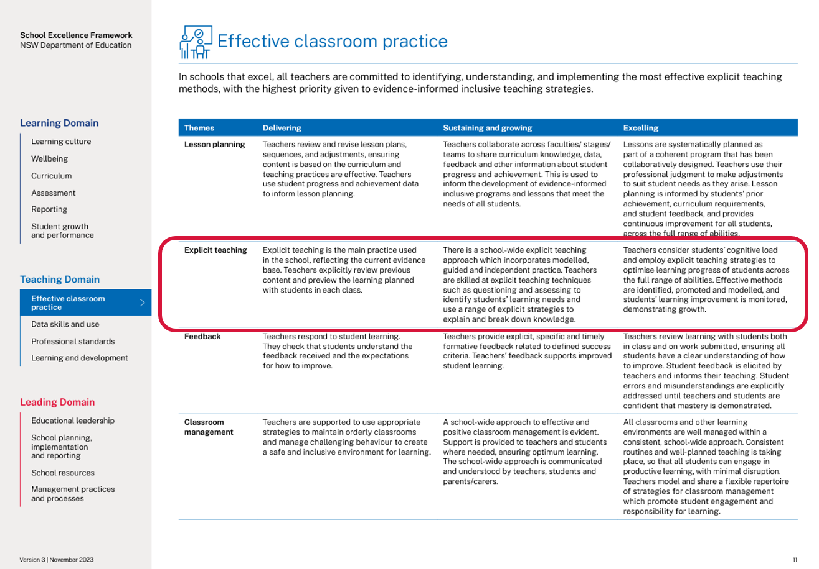
Connecting to the School Excellence Framework
‘School-wide explicit teaching approaches incorporate modelled,
guided and independent practice.
Teachers consider students’ cognitive load and employ explicit teaching strategies to optimise learning progress of students across the full range of abilities. Effective methods are identified, promoted and modelled, and students’ learning improvement is monitored, demonstrating growth.’
School Excellence Framework, Teaching Domain (p 11)
69
Notes:
Purpose of slide: Aligning the practice to the SEFv3
[02:00]
Speaker notes:​
​
Linking to longer term outcomes, the SEF is an excellent way to measure whole-school impact over time.
Chunking and sequencing learning relates to themes from the SEFv3​
​
For example, in the teaching domain, under the element of effective classroom management, this practice aligns with the descriptors for the theme of explicit teaching and classroom management.
Activity:
Access and identify key features from delivering, sustaining and growing and excelling for the explicit teaching theme.
Access and identify key features from delivering, sustaining and growing and excelling for the classroom management theme.
Describe how our classrooms would look, feel and sound if we were to move to 'sustaining and growing' or move to 'excelling’.
Discuss how this would align with the strategic direction already in place in your school?
As a whole school, how are we ensuring we continue to reflect on and share our practice?
What actions can we take to promote our effective explicit teaching practice to the wider school community?
How can the SEF be integrated in our school’s professional learning in an ongoing way?
Discussion points:
In ‘sustaining and growing’ the practice looks like a whole school approach to positive classroom management:
​
This extends to learning routines in ‘excelling’ where there are consistent school-wide approaches to learning routines that enable student engagement. ​
​

Slide 70


Feedback
Please complete the Chunking and sequencing learning – learning module survey to help us improve future professional learning and provide further support.
Contact us
ContactCurriculumImplementation@det.nsw.edu.au

Slide 71

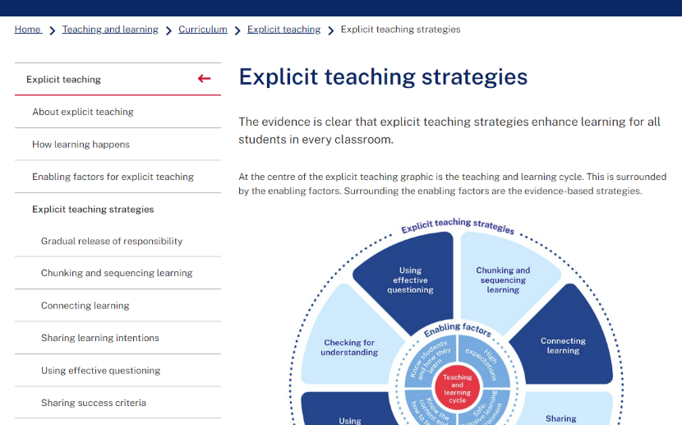
Explicit teaching strategies and resources
More information is available about:
​explicit teaching
how learning happens
the enabling factors
the explicit teaching strategies
https://education.nsw.gov.au/teaching-and-learning/curriculum/explicit-teaching
Notes:
Purpose of slide: Next steps
[0:40]
Speaker notes:
The evidence on explicit teaching is clear, it shows us how important it is to align our teaching pedagogy with how learning occurs. Ongoing information to support this is available on the department's website.
This includes information about the enabling factors, how learning happens and the explicit teaching strategies. The website will continue to be updated as new resources are released in future.
https://education.nsw.gov.au/teaching-and-learning/curriculum/explicit-teaching

Slide 72
Reference list (1)
This presentation contains NSW Curriculum and syllabus content. The NSW Curriculum is developed by the NSW Education Standards Authority. This content is prepared by NESA for and on behalf of the Crown in the right of the State of New South Wales. The material is protected by Crown copyright.
Please refer to the NESA Copyright Disclaimer for more information https://educationstandards.nsw.edu.au/wps/portal/nesa/mini-footer/copyright.
NESA holds the only official and up-to-date versions of the NSW Curriculum and syllabus documents. Please visit the NSW Education Standards Authority (NESA) website https://educationstandards.nsw.edu.au/wps/portal/nesa/home and the NSW Curriculum website https://curriculum.nsw.edu.au.
Archer AL and Hughes CA (2011) Explicit instruction: effective and efficient teaching, Guilford Press.
AERO (Australian Education Research Organisation) (2021) Focused classrooms: managing the classroom to maximise learning, AERO, accessed 20 November 2024.
AERO (Australian Education Research Organisation) (2023a) Teaching routines: their role in classroom management, AERO, accessed 20 November 2024.
AERO (Australian Education Research Organisation) (2023b) How students learn best: an overview of the learning process and the most effective teaching practices, AERO, accessed 20 November 2024.
AERO (Australian Education Research Organisation) (2023c) Managing cognitive load optimises learning, AERO, accessed 20 November 2024.
AERO (Australian Education Research Organisation) (2023d) Explicit instruction optimises learning, AERO, accessed 20 November 2024.
AERO (Australian Education Research Organisation) (2024a) Explicit instruction, AERO, accessed 20 November 2024.
AERO (Australian Education Research Organisation) (2024a) Teach explicitly, AERO, accessed 20 November 2024.

Slide 73
Reference list (2)
CESE (Centre for Education Statistics and Evaluation) (2017) Cognitive load theory: research that teachers really need to understand, NSW Department of Education.
Cowan N (2010) ‘The magical mystery four: how is working memory capacity limited, and why?’ Current directions in psychological science, 19(1):51–57.
Donohoo J, Hattie J and Eells R (2018) 'The power of collective efficacy', Educational Leadership 75:40–44.
Evidence for Learning (2022) Effective professional development, Evidence for Learning.
Fletcher-Wood H (2018) Responsive teaching, Routledge.
Fletcher-Wood H (23 April 2017) 'Better planning: better teaching, better learning', Improving teaching blog, accessed 12 September 2024.
Harn B, Parisi D and Stoolmiller M (2013) ‘Balancing fidelity with flexibility and fit: what do we really know about fidelity of implementation in schools?’ Exceptional Children, 79:181-193.
Hunter J and Haywood A (2023) How to implement a whole-school curriculum approach: a guide for principals, A Gratton Report, accessed 15 November 2024.
Lovell O (2020) Sweller’s cognitive load theory in action, John Catt Educational Ltd.
McCrea P (2020) Motivated teaching: harnessing the science of motivation to boost attention and effort in the classroom, Createspace Independent Publishing Platform.

Slide 74
Reference list (3))
Madgwick H (14 July 2021) ''EEF Blog: ECF– exploring the evidence: prior knowledge and pupil misconceptions', ', Education Endowment Foundation, accessed 4 October 2024.
NESA (NSW Education Standards Authority) (2024) Geography 7–10 Syllabus, NESA.
NESA (NSW Education Standards Authority) (2024) Science and Technology K–6 Syllabus, NESA.
NESA (NSW Education Standards Authority) (2024) Science and Technology K–6 (2024): Stage 1 Teaching advice, NESA.
NSW Department of Education (n.d.) 8 Aboriginal ways of learning: Aboriginal pedagogy, NSW Department of Education.
Nuthall G (2007) The hidden lives of learners, New Zealand Council for Educational Research.
Peeters A, Robinson V and Rubie-Davies C (2020) ‘Theories in use that explain adolescent help seeking and avoidance in mathematics’, Journal of Educational Psychology, 112(3):533–550, doi:10.1037/edu0000423.
Perry T, Lea R, Jørgensen C, Cordingley P, Shapiro K, and Youdell D (2021) Cognitive science approaches in the classroom, Education Endowment Foundation.
Rosenshine B (1995) ‘Advances in research on instruction’, The Journal of Educational Research, 88(5):262–268.
Rosenshine B (2012) 'Principles of instruction: research-based strategies that all teachers should know', American Educator, 36(1):12–39.

Slide 75
Reference list (4)
Sam T and McDowall A (2024) 'Smooth seas never made a skilled sailor: Indigenous students’ academic buoyancy and the locale of the learner', The Australian Journal of Indigenous Education, 53(1).
Sherrington T (2019) (Caviglioli O, illus) Rosenshine's principles in action, John Catt Educational Ltd.
Swain N (2024) Harnessing the science of learning, Routledge.
Yunkaporta T (2009) 8 Ways of Aboriginal Learning, accessed 20 November 2024.

Slide 76
Copyright
© State of New South Wales (Department of Education), 2025
The copyright material published in this resource is subject to the Copyright Act 1968 (Cth) and is owned by the NSW Department of Education or, where indicated, by a party other than the NSW Department of Education (third-party material).
Copyright material available in this resource and owned by the NSW Department of Education is licensed under a Creative Commons Attribution 4.0 International (CC BY 4.0) license.
This license allows you to share and adapt the material for any purpose, even commercially.
Attribution should be given to © State of New South Wales (Department of Education), 2025.
Material in this resource not available under a Creative Commons license:
the NSW Department of Education logo, other logos and trademark-protected material
Material owned by a third party that has been reproduced with permission. You will need to obtain permission from the third party to reuse its material.
Links to third-party material and websites
Please note that the provided (reading/viewing material/list/links/texts) are a suggestion only and implies no endorsement, by the New South Wales Department of Education, of any author, publisher, or book title. School principals and teachers are best placed to assess the suitability of resources that would complement the curriculum and reflect the needs and interests of their students.
If you use the links provided in this document to access a third-party’s website, you acknowledge that the terms of use, including licence terms set out on the third-party’s website apply to the use which may be made of the materials on that third-party website or where permitted by the Copyright Act 1968 (Cth). The department accepts no responsibility for content on third-party websites.

