Slide 1
About this presentation
Facilitator instructions
This slide deck contains 3 parts that require some preplanning.
Part A – Strategy overview, approach and impact – opportunity to collect data that could be used in Part C. The presenter will need to facilitate this. Part A includes an activity relating to technique guides that can be found on the sharing learning intentions webpage.
Part B – Implementing the strategies through techniques – the group activity requires pre-planning.
Part C – Evaluating a whole-school approach – opportunity to link to the School Excellence Plan.
Leaders should engage with Part C before implementing the professional learning with staff.
Slides are repeated across strategy modules so they can be implemented with the same structure. Note: some slides contain animations indicated by [click] in the presenter notes.

Slide 2
Sharing learning intentions and success criteria(1)
Strategy learning module

Slide 3
Acknowledgement of Country
We recognise the Ongoing Custodians of the lands and waterways where we work and live. We pay respect to Elders past and present as ongoing teachers of knowledge, songlines and stories. We strive to ensure every Aboriginal and Torres Strait Islander learner in NSW achieves their potential through education.
‘Reflections’ created by Zara Marulanda from Blaxland High School as part of the 2021 Schools Reconciliation Challenge.
Notes:
Acknowledgement of Country
[00:30]
Speaker notes:
I would like to acknowledge the traditional custodians of the land on which we meet today. We pay our respects to their Elders past and present. We recognise their continuing connection to land, water, and culture, and we are committed to continuing to learn from their wisdom and traditions.

Slide 4
Introduction
Notes:
Purpose: Outline the learning sequence in this module.
[00:30]
Speaker notes:

Slide 5
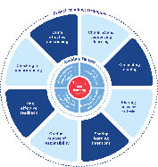
Enabling factors
Know students and how they learn
High expectations
Teachers understand how learning happens, and this informs their practice.
Students benefit from teachers holding high expectations for their learning.
Know the content and how to teach it
Safe, inclusive learning environments
Teachers know how the knowledge builds and connects to create learning that is strategic, sequenced and cumulative.
Explicit teaching both relies on, and brings about, a safe and inclusive learning environment.
Notes:
Purpose: Revisiting core knowledge
[00:30]
Speaker notes:
Let’s remind ourselves that explicit teaching is an optimal way to teach knowledge and skills that are new or complex.
There are important enabling factors for explicit teaching that relate to the technique we are focusing on. Let’s revisit them.
Note to presenter: you may wish for participants to read these to themselves.
Our understanding of the how learning happens informs our practice.
We know how knowledge builds across syllabuses.
We hold high expectations for our students’ learning.
And, explicit teaching both relies on, and brings about a safe, inclusive learning environment.
Resources:
Leading explicit teaching – school-facilitated workshops 1–3 on core content and the enabling factors of explicit teaching – https://education.nsw.gov.au/teaching-and-learning/curriculum/explicit-teaching/leading-explicit-teaching
Classrooms of Possibility – https://education.nsw.gov.au/inside-the-department/teaching-and-learning/classrooms-of-possibility
Explicit instruction – implementing evidence-based teaching practices for students with disability - https://resources.education.nsw.gov.au/detail/IPR-LD230526144351
Strong Strides Together: Meeting the educational goals for Aboriginal and/or Torres Strait Islander students – https://education.nsw.gov.au/teaching-and-learning/aec/universal-resources---aboriginal-education/strong-strides-together--meeting-the-educational-goals-for-abori

Slide 6
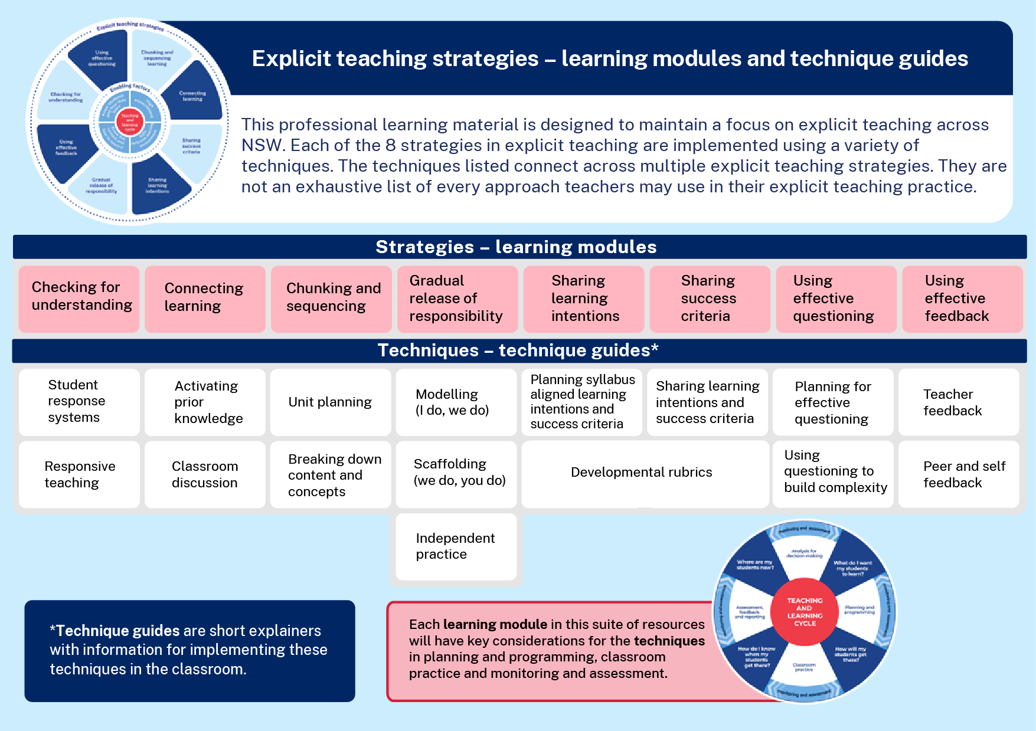
Explicit teaching strategies
Notes:
Purpose: To highlight where this module fits with other current and future modules and technique guides.
[00:30]
Speaker notes:
Due to the connectedness of learning intentions and success criteria, this module will take you through both explicit teaching strategies. It will explain and demonstrate some techniques to support effective implementation including:
syllabus-aligned learning intentions
building understanding of success criteria and
developmental rubrics.
Note to presenter:
Technique guides are available to supplement this presentation. For the activity on slide 23, it is expected that teachers have seen and read the guides.
These technique guides can be found:
Sharing learning intentions resources:
https://education.nsw.gov.au/teaching-and-learning/curriculum/explicit-teaching/explicit-teaching-strategies/sharing-learning-intentions
Sharing success criteria resources:
https://education.nsw.gov.au/teaching-and-learning/curriculum/explicit-teaching/explicit-teaching-strategies/sharing-success-criteria

Slide 7
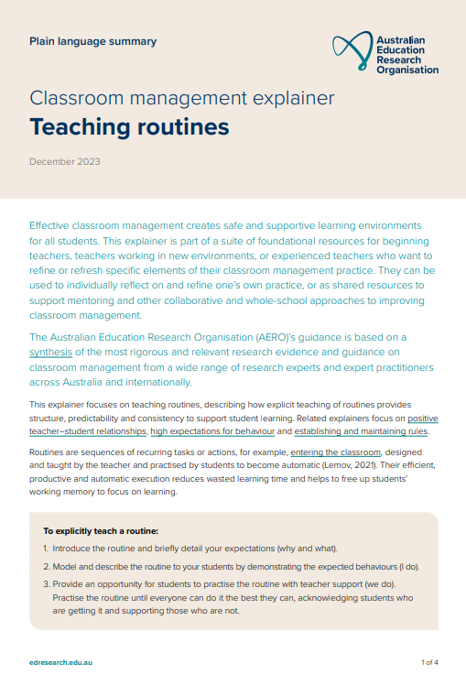
The importance of all moving together
Saves learning time¹
Frees up students’ working memory²
Certain and consistent expectations for students³
Students learn the routine more quickly when it is done in the same way across the school⁴
Fosters a strong sense of belonging⁵
Notes:
Purpose: to restate why a whole school teaching routine is powerful
[00:50]
Speaker notes:
These modules use the power of whole school teaching routines. When a group of expert teachers from across the school come together and create a whole school approach, they are far more effective than when they do it alone. Teaching routines:
[click] save learning time
[click] can free up students’ working memory
[click] provide certainty and expectations for students to contribute to a learning environment where they’re safe to participate.
[click] they’re efficient, because when done the same way across the school, students can learn the routine more quickly
[click] and they foster a strong sense of belonging.
As we go through the learning module here, and other learning modules for explicit teaching we will revisit the idea of the whole school teaching routines.
References:
1. Archer A and Hughes C (2011) Explicit instruction: effective and efficient teaching. Guilford Press.
2. AERO (Australian Education Research Organisation) (2021) Focused classrooms: managing the classroom to maximise learning, AERO.
3. AERO (Australian Education Research Organisation) (2023a) Teaching routines: their role in classroom management, AERO.
4. McCrea P (2020) Motivated Teaching: harnessing the science of motivation to boost attention and effort in the classroom, Createspace Independent Publishing Platform.
5. McCrea P (2020) Motivated Teaching: harnessing the science of motivation to boost attention and effort in the classroom, Createspace Independent Publishing Platform.
Further reading:
Tharby A (12 May 2023) ‘We are what we do: the case for explicit and consistent school-wide routines’, Class Teaching, find the bright spots blog, accessed 20 November 2024.

Slide 8
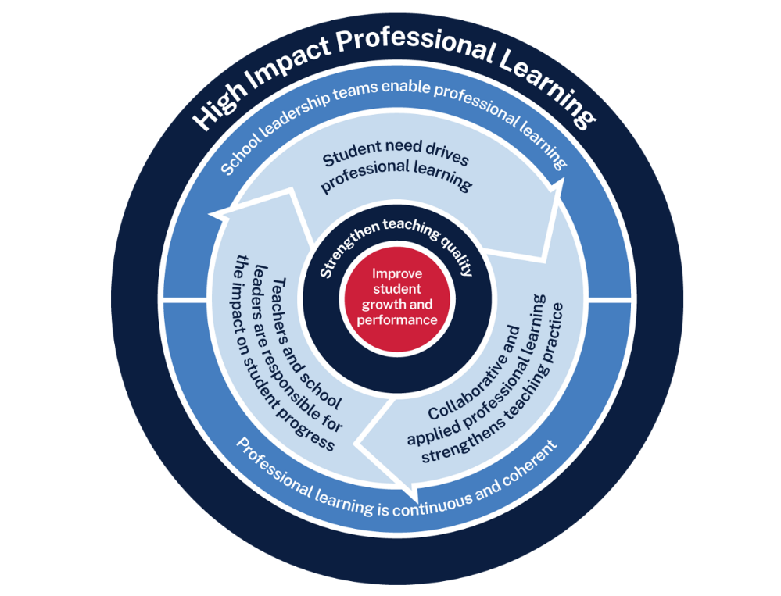
Sharing learning intentions and success criteria professional learning
Measure baseline student data and set a goal
Analyse data to determine further cycles
Use the whole-school teaching routines and, together, plan the questions they will ask
Implement the teaching routine in the classroom and measure impact
Rehearse and give each other feedback
Notes:
Purpose: Familiarising High Impact Professional Learning model (HIPL) and how it may inform our implementation of explicit teaching.
[01:00]
Speaker notes:
The High Impact Professional Learning (HIPL) model forms the basis of this professional learning. This model has five elements.
Professional learning is driven by identified student needs - https://education.nsw.gov.au/teaching-and-learning/professional-learning/high-impact-professional-learning/what-is-hipl/student-needs-drive-teacher-learning
School leadership teams enable professional learning - https://education.nsw.gov.au/teaching-and-learning/professional-learning/high-impact-professional-learning/what-is-hipl/leadership-that-prioritises-learning
Collaborative and applied professional learning strengthens teaching practice - https://education.nsw.gov.au/teaching-and-learning/professional-learning/high-impact-professional-learning/what-is-hipl/collaboration-that-improves-classroom-practice
Professional learning is continuous and coherent - https://education.nsw.gov.au/teaching-and-learning/professional-learning/high-impact-professional-learning/what-is-hipl/a-culture-of-continuous-learning
Teachers and school leaders are responsible for the impact of professional learning on student growth and performance - https://education.nsw.gov.au/teaching-and-learning/professional-learning/high-impact-professional-learning/what-is-hipl/accountability-for-impact-on-student-progress
The actions and steps we take to enact each of these elements will be shaped by our increasing shared understanding of check for understanding strategy and how specific check for understanding techniques can be used to optimise the learning of our students.

Slide 9
Initial data reflection point
Student responses | 0 | 1 | 2 | 3 | 4
In today’s lesson, what did you learn about? | Cannot recall | Recalls but can’t articulate | Mentions the activities undertaken | Repeats the learning intention | Articulates the learning in their own words
How did you know you had learnt it? | Cannot recall | Recalls but can’t articulate | Lists the activities undertaken | Articulates the criteria | Articulates the feedback they took onboard or used to guide a peer
Notes:
Purpose: Reflect on student engagement as an early indicator.
[02:00]
Speaker notes:
An initial indicator is an observable change in student learning. It can help teachers to understand how effective their use of a technique may be. Initial indicators are important because they can give teachers insights into what parts of the instruction may need to be refined.
Here is an example of a tool that could be used for teacher reflection. This is one way to measure one aspect of the effectiveness of the practice of learning intentions and success criteria.
We will be able to refer to our early indicator observations when we evaluate our impact in Part C.
Note to presenter: There is an opportunity to use this data in the final session. This measure is not the only consideration, and schools should select a model that is right for them.
This data could be collated and compared to other “school and classroom data about growth and performance.”
For example:
NAPLAN report overview accessed through Scout
https://education.nsw.gov.au/about-us/education-data-and-research/scout/training/digital-learning-centre/naplan-report-overview
NAPLAN report overview
Learn more about the NAPLAN reports in Scout.
https://education.nsw.gov.au/technology/scout/scout-training/digital-learning-centre/naplan-for-teachers
Class report
The Class report shows the distribution of students’ scaled scores across domains and proficiency levels for NAPLAN 3, 5, 7 or 9.
References:
AERO (Australian Education Research Organisation) (2023b) How students learn best: an overview of the learning process and the most effective teaching practices, AERO.

Slide 10
Planning and rehearsing (1)
Plan
Rehearse
Feedback
Evidence for Learning (2022) Effective professional development
Notes:
Purpose: to explain the process of rehearsing
[00:30]
Speaker notes:
Research from Evidence for Learning shows teachers are more likely to put professional learning into practice when they plan and rehearse during professional learning, before implementing techniques in the classroom. This is enhanced by feedback from colleagues.
Note to presenter: it is advisable to prepare school leaders beforehand if modelling and rehearsing are not yet established practices in the school.
Further reading on this research:
AERO (Australian Education Research Organisation) (2023c) Gaining all students’ attention, AERO.
Evidence for Learning (2022) Effective professional development, Evidence for Learning.
Sims S, Fletcher-Wood H, O’Mara-Eves A, Cottingham S, Stansfield C, Van Herwegen J and Anders J (2021) What are the characteristics of teacher professional development that increase pupil achievement? A systematic review and meta-analysis, Education Endowment Foundation.

Slide 11
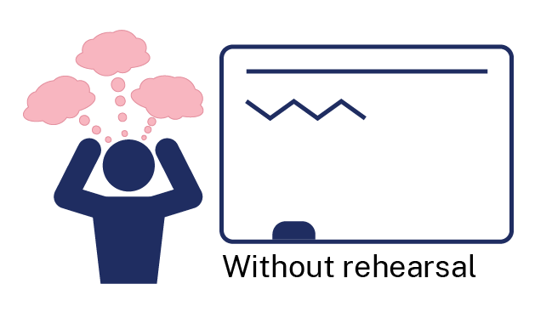
Rehearsal (1)
Notes:
Purpose of slide: To explain why rehearsing is so important
Speaker notes:
[01:10]
Application is a real key to success in professional learning.
Why might professional learning not be applied in the classroom, despite our best intentions?
Teachers often have practices described to them – but it is much clearer to have lead teachers model the practice (out of the classroom, without students) while the observer uses prompts to reflect on what made that practice successful.
Teaching is a habit-forming practice. By necessity, teaching requires us to automate a number of behaviours. The cognitive load on teachers to introduce a new behaviour is high and so we often rely on those previously formed habits.
Rehearsal (out of the classroom, without students) makes our PL a habit. When we try a rehearsed routine in a classroom, our cognitive load is reduced because we have one thing to think about, rather than 4 or 5.
This is why rehearsing is a key mechanism for success in professional learning.
References:
Evidence for Learning (2022) Effective professional development, Evidence for Learning.

Slide 12
Overview of this module
Part A – Understanding the strategy Part B – Implementing the strategies through techniques Part C – Evaluating a whole-school approach
Notes:
Purpose: Outline the learning sequence in this module.
[00:30]
Speaker notes:
In this module, the focus is on sharing learning intentions and success criteria and understanding the techniques involved to effectively support student learning.
We will then develop teaching routines as a whole school to reduce cognitive load for our students, providing them with optimal opportunities for improved learning outcomes.
We will evaluate the impact of our work in terms of how effectively the approach has met the student need we've identified as the focus for our professional learning. We will do this by considering the short-term outcomes and the potential longer term learning outcomes for our students.

Slide 13
Understanding the strategies
Part A

Slide 14
Purpose and outcome (1)
Purpose
To understand the mechanisms of sharing learning intentions and success criteria to optimise student learning and engagement.
Outcome
We can articulate how to plan, share and use learning intentions and success criteria to optimise student learning and engagement.
Notes:
Purpose: Purpose and outcome of Part A
[00:30]
Speaker notes:
This strategy learning module focuses on teachers’ effective use of learning intentions and success criteria throughout lessons.
The purpose of Part A is:
To understand the mechanisms of sharing learning intentions and success criteria in the context of optimising student understanding, engagement and participation.
We are working towards the outcome that:
We can articulate how to plan, share and use learning intentions and success criteria to optimise student learning and engagement.

Slide 15
Learning intentions and success criteria
A learning intention is a short statement about what students are expected to learn by engaging in the learning.
Learning intentions are statements aligned to the syllabus which clearly describe what students should know, understand or be able to do following an activity, lesson or series of lessons.
Success criteria communicate how students will demonstrate their learning. They break down steps to achieving the learning objective, so students know if they are on track.
Notes:
Purpose: Defining learning intentions and success criteria
[00:30]
Speaker notes:
Here is a simple definition of learning intentions and success criteria to start our conversation today. Let’s start by thinking about how using this strategy aids student learning by priming them to develop their schema (understanding) in the lesson.
References:
Clarke S (2021) Unlocking learning intentions and success criteria: shifting from product to process across the disciplines, SAGE Publications.

Slide 16
Illustrating schema (1)
You will be asked to recall this passage after hearing it
Notes:
Purpose: Demonstrate schema theory
[01:30]
Speaker notes:
In a small study conducted with psychology students Bransford and Johnson (1972) sought to demonstrate schema theory. We will have an experience of this study to illustrate how we can use an understanding of schema theory to make decisions about sharing learning intentions.
Students were read the following passage (included here if audio is unavailable)
“The procedure is actually quite simple. First, you arrange items into different groups. Of course, one pile may be sufficient depending upon how much there is to do. If you have to go somewhere else due to lack of facilities that is the next step, otherwise you are pretty well set. It's important not to overdo things. That is, it is better to do a few things at once than too many. In the short run this may not seem important, but complications from doing too many can easily arise. A mistake may be expensive as well. The manipulation of the appropriate mechanisms should be self-explanatory, and we need not delve into it here at first the whole procedure will seem complicated. Soon, however, it will become just another facet of life. It is difficult to see any end to the necessity for this task in the immediate future, but then one never can tell.” (Bransford and Johnson 1972:722)
References:
Bransford JD and Johnson MK (1972) ‘Contextual prerequisites for understanding some investigations of comprehension and recall’, Journal of Verbal Learning and Verbal Behavior, 11:717-726.
Johnson MK, Bransford JD, Nyberg SE and Cleary JJ (1972) ‘Comprehension factors in interpreting memory for abstract and concrete sentences’, Journal of Verbal Learning and Verbal Behavior, 11(4):451-454, doi 10.1016/S0022-5371(72)80026-4.

Slide 17
Illustrating schema (2)
Rate out of 10 how much you think you could recall
Rate the passage out of 10 for comprehension
Notes:
Purpose: Demonstrate schema theory
[01:30]
+1 minute for discussion
Speaker notes:
participants to answer these two questions:
Rate out of 10 how much you think you could recall
Rate out of 10 the quality of the passage for ease of comprehension
References:
Bransford JD and Johnson MK (1972) ‘Contextual prerequisites for understanding some investigations of comprehension and recall’, Journal of Verbal Learning and Verbal Behavior, 11:717-726.
Johnson MK, Bransford JD, Nyberg SE and Cleary JJ (1972) ‘Comprehension factors in interpreting memory for abstract and concrete sentences’, Journal of Verbal Learning and Verbal Behavior, 11(4):451-454, doi 10.1016/S0022-5371(72)80026-4.

Slide 18
Illustrating schema (3) 3
Adapted from Experiment 2 in Johnson, et al. (1972)
Notes:
Purpose: Demonstrate schema theory
[01:30]
Speaker notes:
What if I now told you that the passage you heard was about doing laundry – washing clothes?
In this experiment one group of students were never told what the context was, some were told after they heard the recording, and some were told before they heard the passage.
The experiment found that the students who had been told the context ‘laundry’ before hearing the passage were able to remember twice as many ideas from the passage. They also rated the comprehension of the passage about twice as high as the other 2 groups.
From this example we hope to illustrate why it is recommended to share learning intentions and success criteria at the start or early in lesson, to aid students building their schemas (understanding).
References:
Bransford JD and Johnson MK (1972) ‘Contextual prerequisites for understanding some investigations of comprehension and recall’, Journal of Verbal Learning and Verbal Behavior, 11:717-726.
Johnson MK, Bransford JD, Nyberg SE and Cleary JJ (1972) ‘Comprehension factors in interpreting memory for abstract and concrete sentences’, Journal of Verbal Learning and Verbal Behavior, 11(4):451-454, doi 10.1016/S0022-5371(72)80026-4.

Slide 19
Why sharing learning intentions and success criteria are important
Students learn most effectively when their attention is focused on what they are learning.
Teachers support students' focus by sharing the learning purpose and clearly communicating what students need to know, do or understand to successfully demonstrate the learning.
The way that learning intentions and success criteria are planned, communicated to students and used for formative assessment help students to maintain this focus.
Notes:
Purpose: Key idea as we focus on sharing learning intentions and success criteria
[01:00]
Speaker notes:
Sharing learning intentions and success criteria is essential because it focuses students' attention on the purpose of the learning and the manageable actions required to successfully demonstrate their learning (AERO 2024a). This optimises students' working memory by ensuring they are focused on the essential components and content of the learning.
The way that we plan, communicate and use learning intentions and success criteria play a role in their effectiveness to optimise student focus and learning.
References:
AERO (Australian Education Research Organisation) (2024a) Explain learning objectives, AERO.

Slide 20
What it isn’t
Vague statements about learning.
Written for teachers instead of students.
Unconnected to a purpose.
Making students copy down the LISC word for word.
Given at the start or early in the lesson and not referred to again.
Notes:
Purpose: What it is and what it isn’t
Speaker notes:
[01:00]
There is variation in the understanding and implementation of learning intentions and success criteria.
What it isn’t
Vague statements about learning that lacks detail (AERO 2024a). E.g. "Today we are learning about fractions."
Written for teachers instead of students (AERO 2024a). E.g. ”Students will understand the main idea and supporting details of a non-fiction text”
Goal not linked to a purpose. Eg: The learning intention is missing a 'so that' or clarification about why the learning is significant (Almarode and Vandas 2018).
Making students copy down the LISC word for word (Clarke 2021). Copying does not ensure understanding.
Given at the start of a lesson and not referred to again (Wiliam and Leahy 2015).
References:
Almarode J and Vandas KL (2018) Clarity for learning: five essential practices that empower students and teachers, Sage Corwin.
AERO (Australian Education Research Organisation) (2024a) Explain learning objectives, AERO.
Clarke S (2021) Unlocking learning intentions and success criteria: shifting from product to process across the disciplines, SAGE Publications.
Wiliam D and Leahy S (2015) Embedding formative assessment, Hawker Brownlow Education.

Slide 21
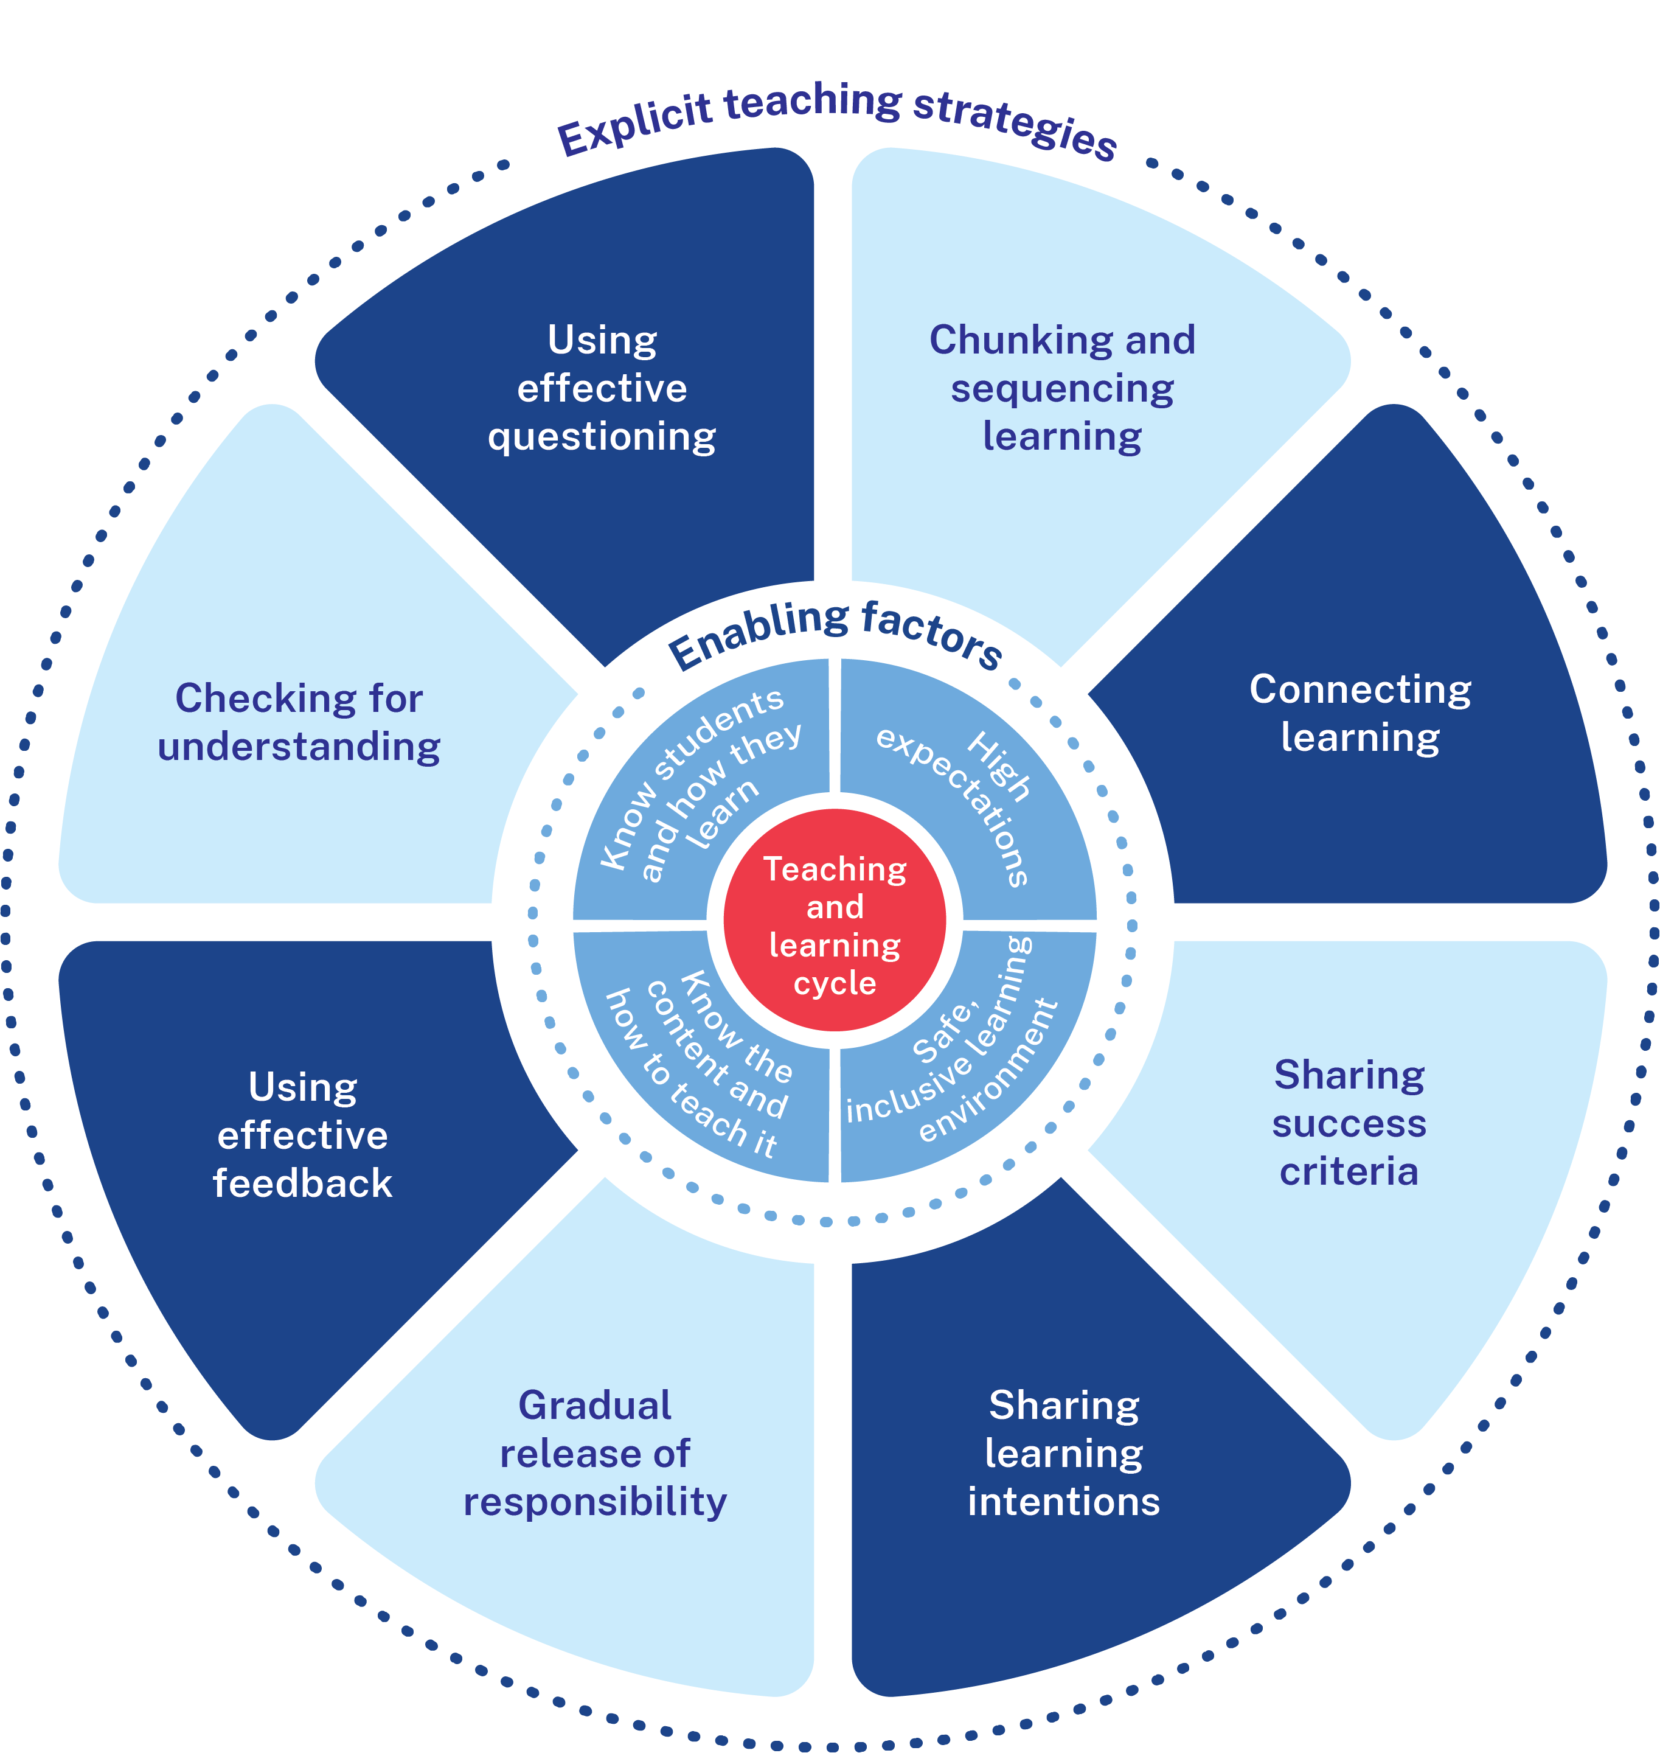
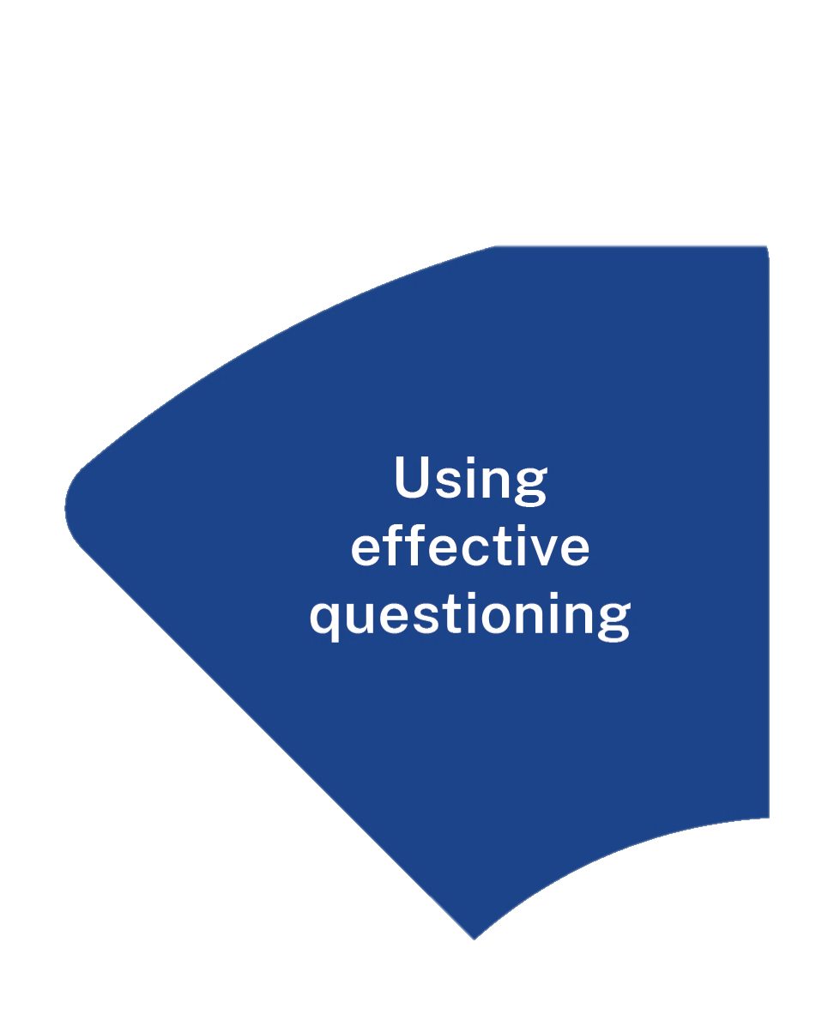
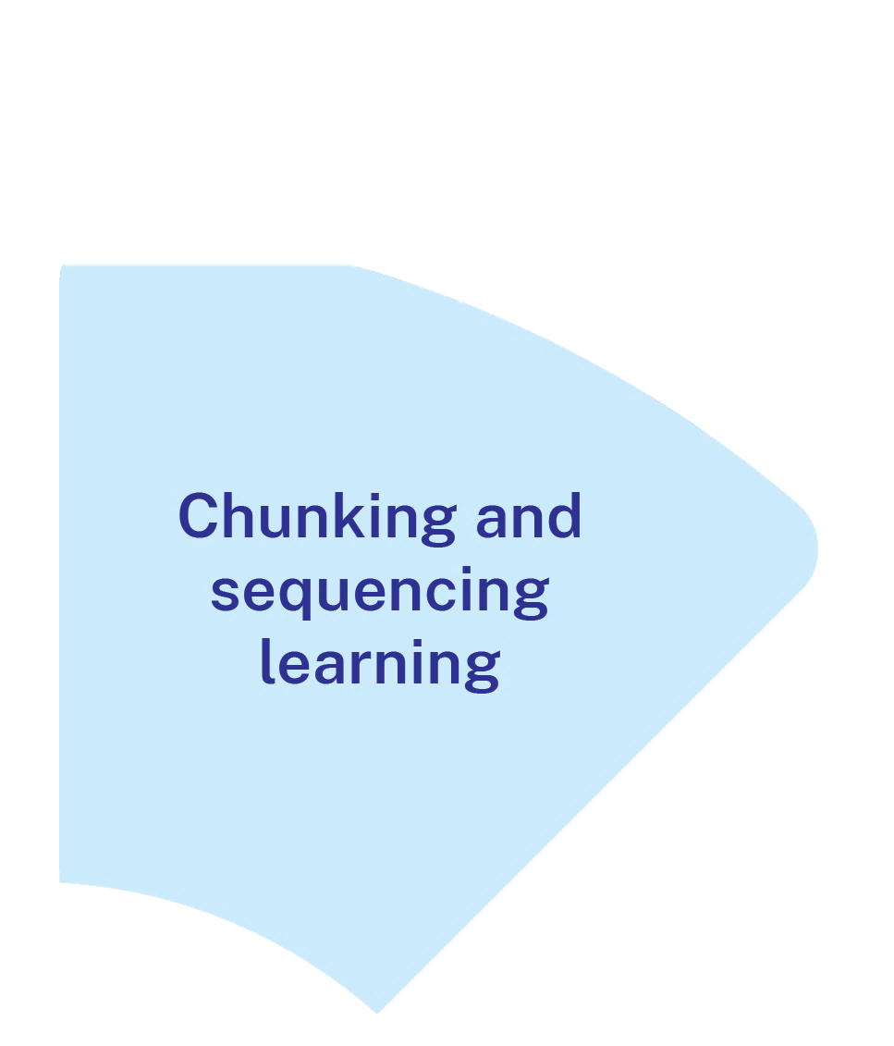
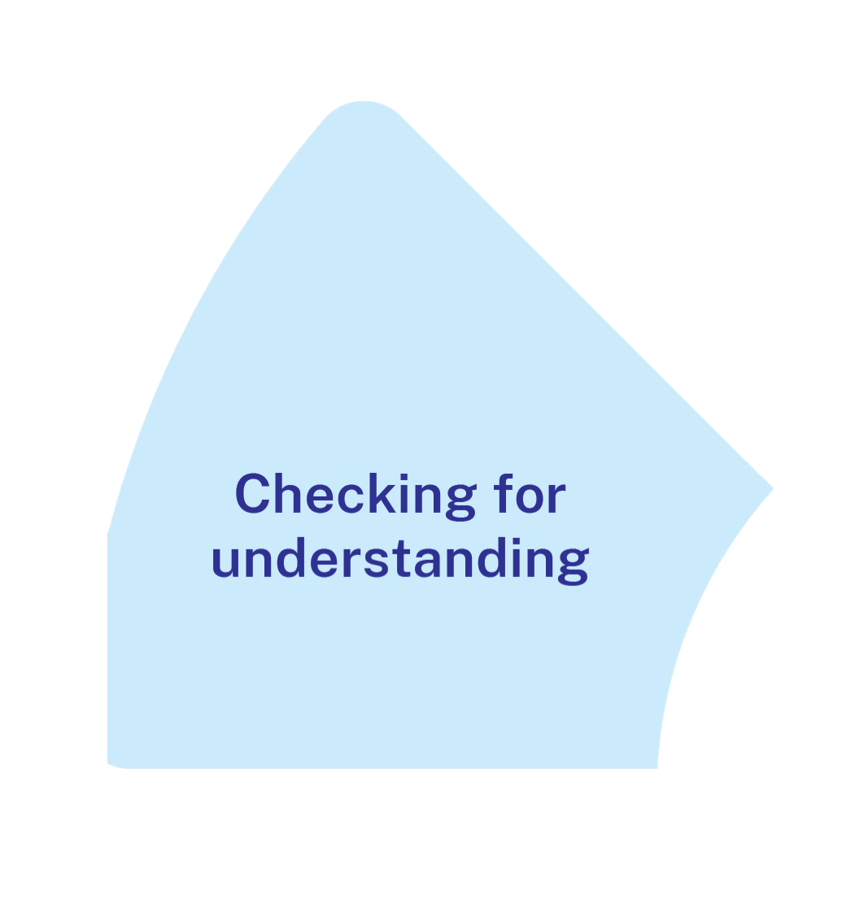
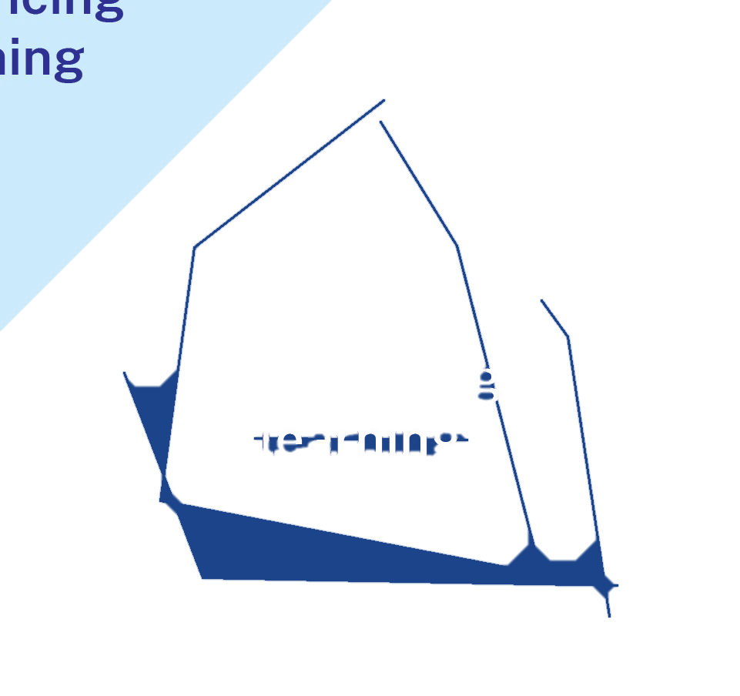
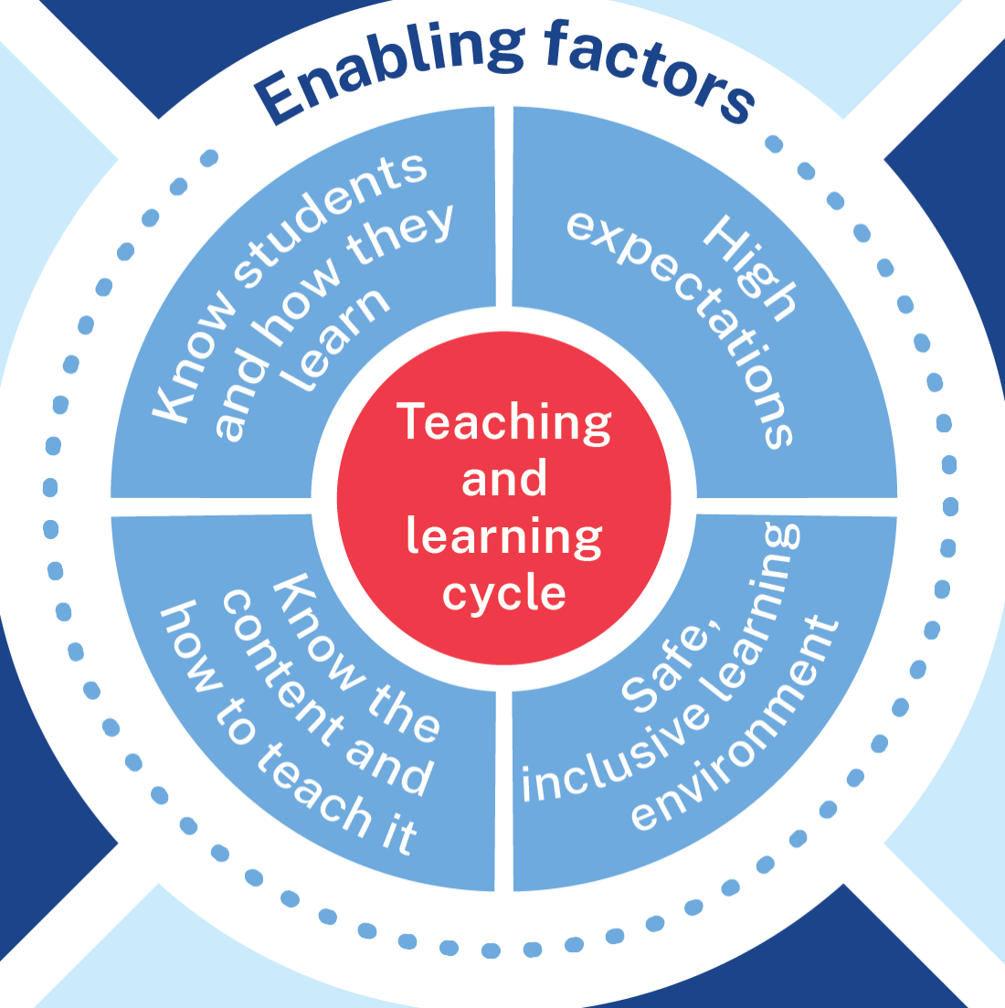
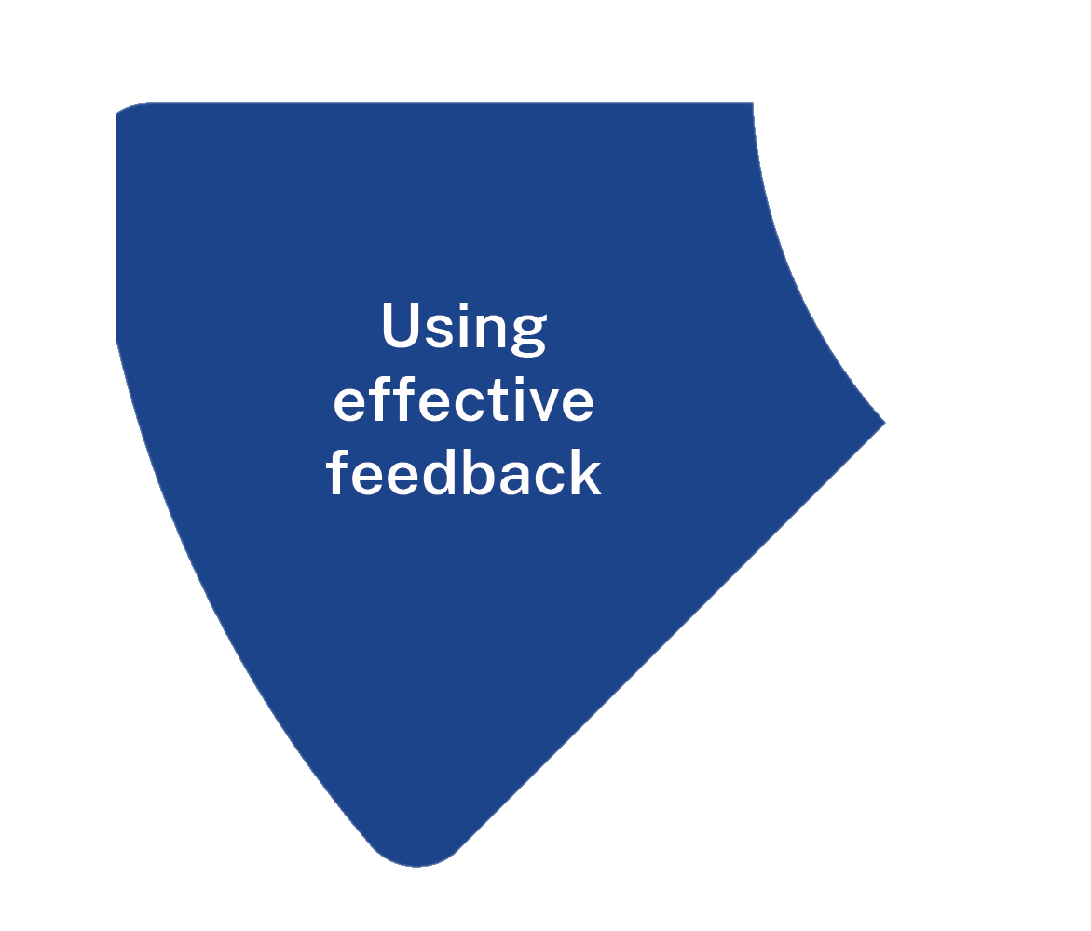
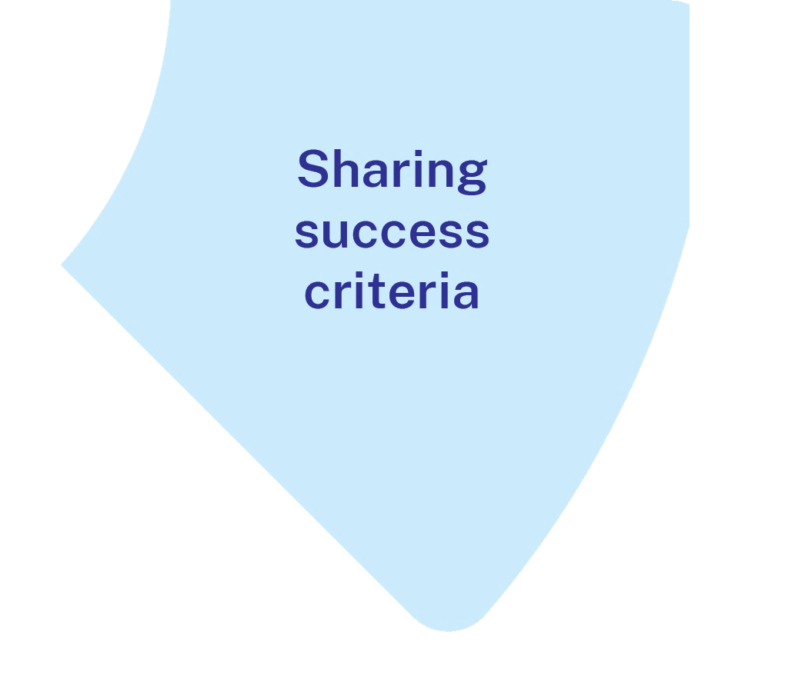
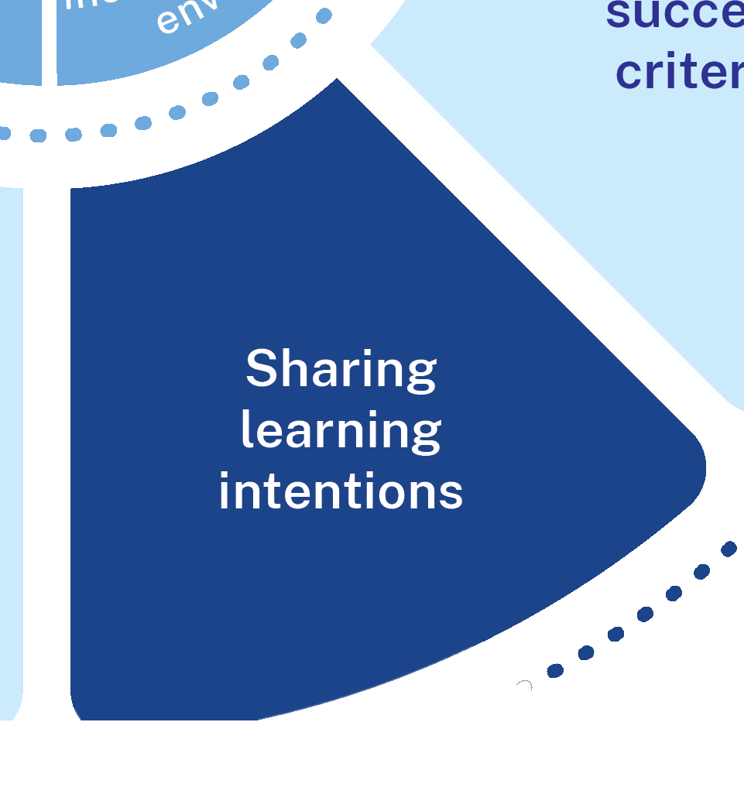
What it is
Focusing student attention
Communicating the relevance of the learning
Communicating how students will demonstrate their learning
Providing a reference point for feedback and self-assessment
Notes:
Purpose: What are learning intentions and success criteria
[01:30]
Speaker notes:
Sharing learning intentions and success criteria is about focusing students’ attention. What students think about is what they learn (Willingham 2009). Students learn more effectively when they have a clear understanding of the goal of the lesson (or what they are expected to learn) and what success looks like (what counts as quality work) (Wiliam 2018).
Sharing learning intentions and success criteria is about communicating the relevance, the connections or key skills to pay attention to in the learning.
Sharing learning intentions and success criteria is about communicating to students what a demonstration of their learning will look like and breaking down how they will get there.
Sharing learning intentions and success criteria is about providing a reference point for formative assessment. They can be used to ask ‘check for understanding’ questions, and to provide teacher, self and peer feedback (William 2018). Feedback is most useful when it is aligned to the learning intentions and success criteria of a lesson or learning experience (Clarke 2021) as this ensures feedback is explicit, actionable and relevant to the learning (AERO 2024a).
References:
AERO (Australian Education Research Organisation) (2024a) Explain learning objectives, AERO.
Clarke S (2021) Unlocking learning intentions and success criteria: shifting from product to process across the disciplines, SAGE Publications.
Wiliam D (2018) Embedded formative assessment, 2nd edn, Solution Tree Press.
Willingham D (2009) Why don't students like school? A cognitive scientist answers questions about how the mind works and what it means for the classroom, Jossey-Bass/Wiley.​

Slide 22
The mechanisms of sharing learning intentions and success criteria (1)
Students know what they are learning and what they need to do to be successful.
Well planned
Shared with students and understanding checked
Referred to throughout the learning for formative assessment
Notes:
Purpose: To summarise what makes sharing learning intentions and success criteria effective
[00:40]
Speaker notes:
When using learning intentions and success criteria:
[click] 1. Ensure they are planned prior to the lesson and are aligned to the syllabus (AERO 2024a).
[click] 2. Are displayed, explained and clarified by the teacher using student friendly language and student understanding is checked (AERO 2024a; Clarke 2021)
[click] 3. Referred to throughout the lesson for formative assessment. They can form the basis of check for understanding questions, teacher feedback, self assessment and peer assessment (Clarke 2021).
[click] 4. “When used effectively, LISC empowers students with the knowledge of where they are going in their learning, how they are progressing and where they will go next” (Almarode and Vandas 2018:5).
References:
Almarode J and Vandas KL (2018) Clarity for learning: five essential practices that empower students and teachers, Sage Corwin.
AERO (Australian Education Research Organisation) (2024a) Explain learning objectives, AERO.
Clarke S (2021) Unlocking learning intentions and success criteria: shifting from product to process across the disciplines, SAGE Publications.

Slide 23
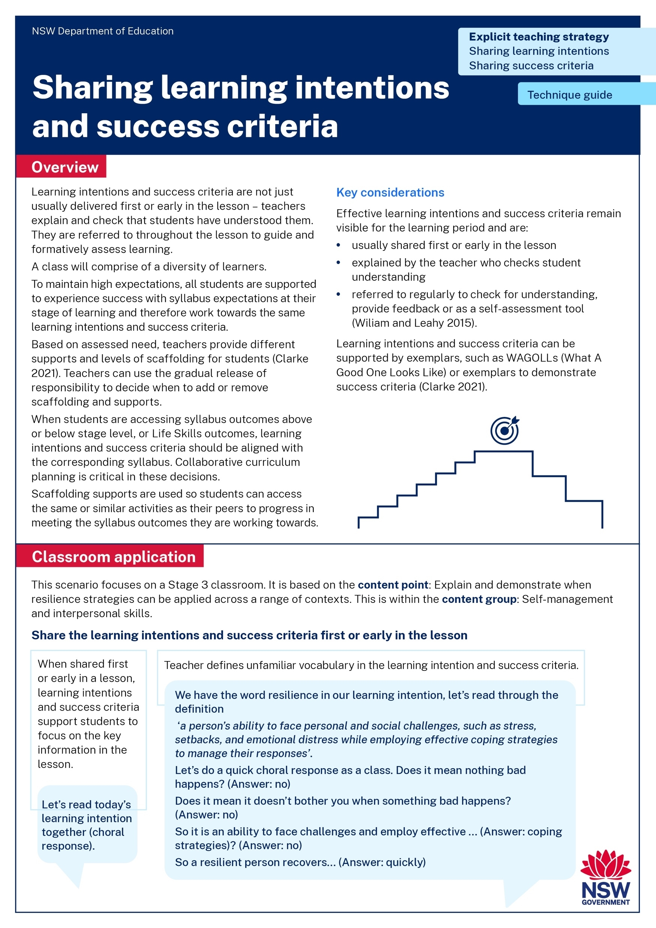
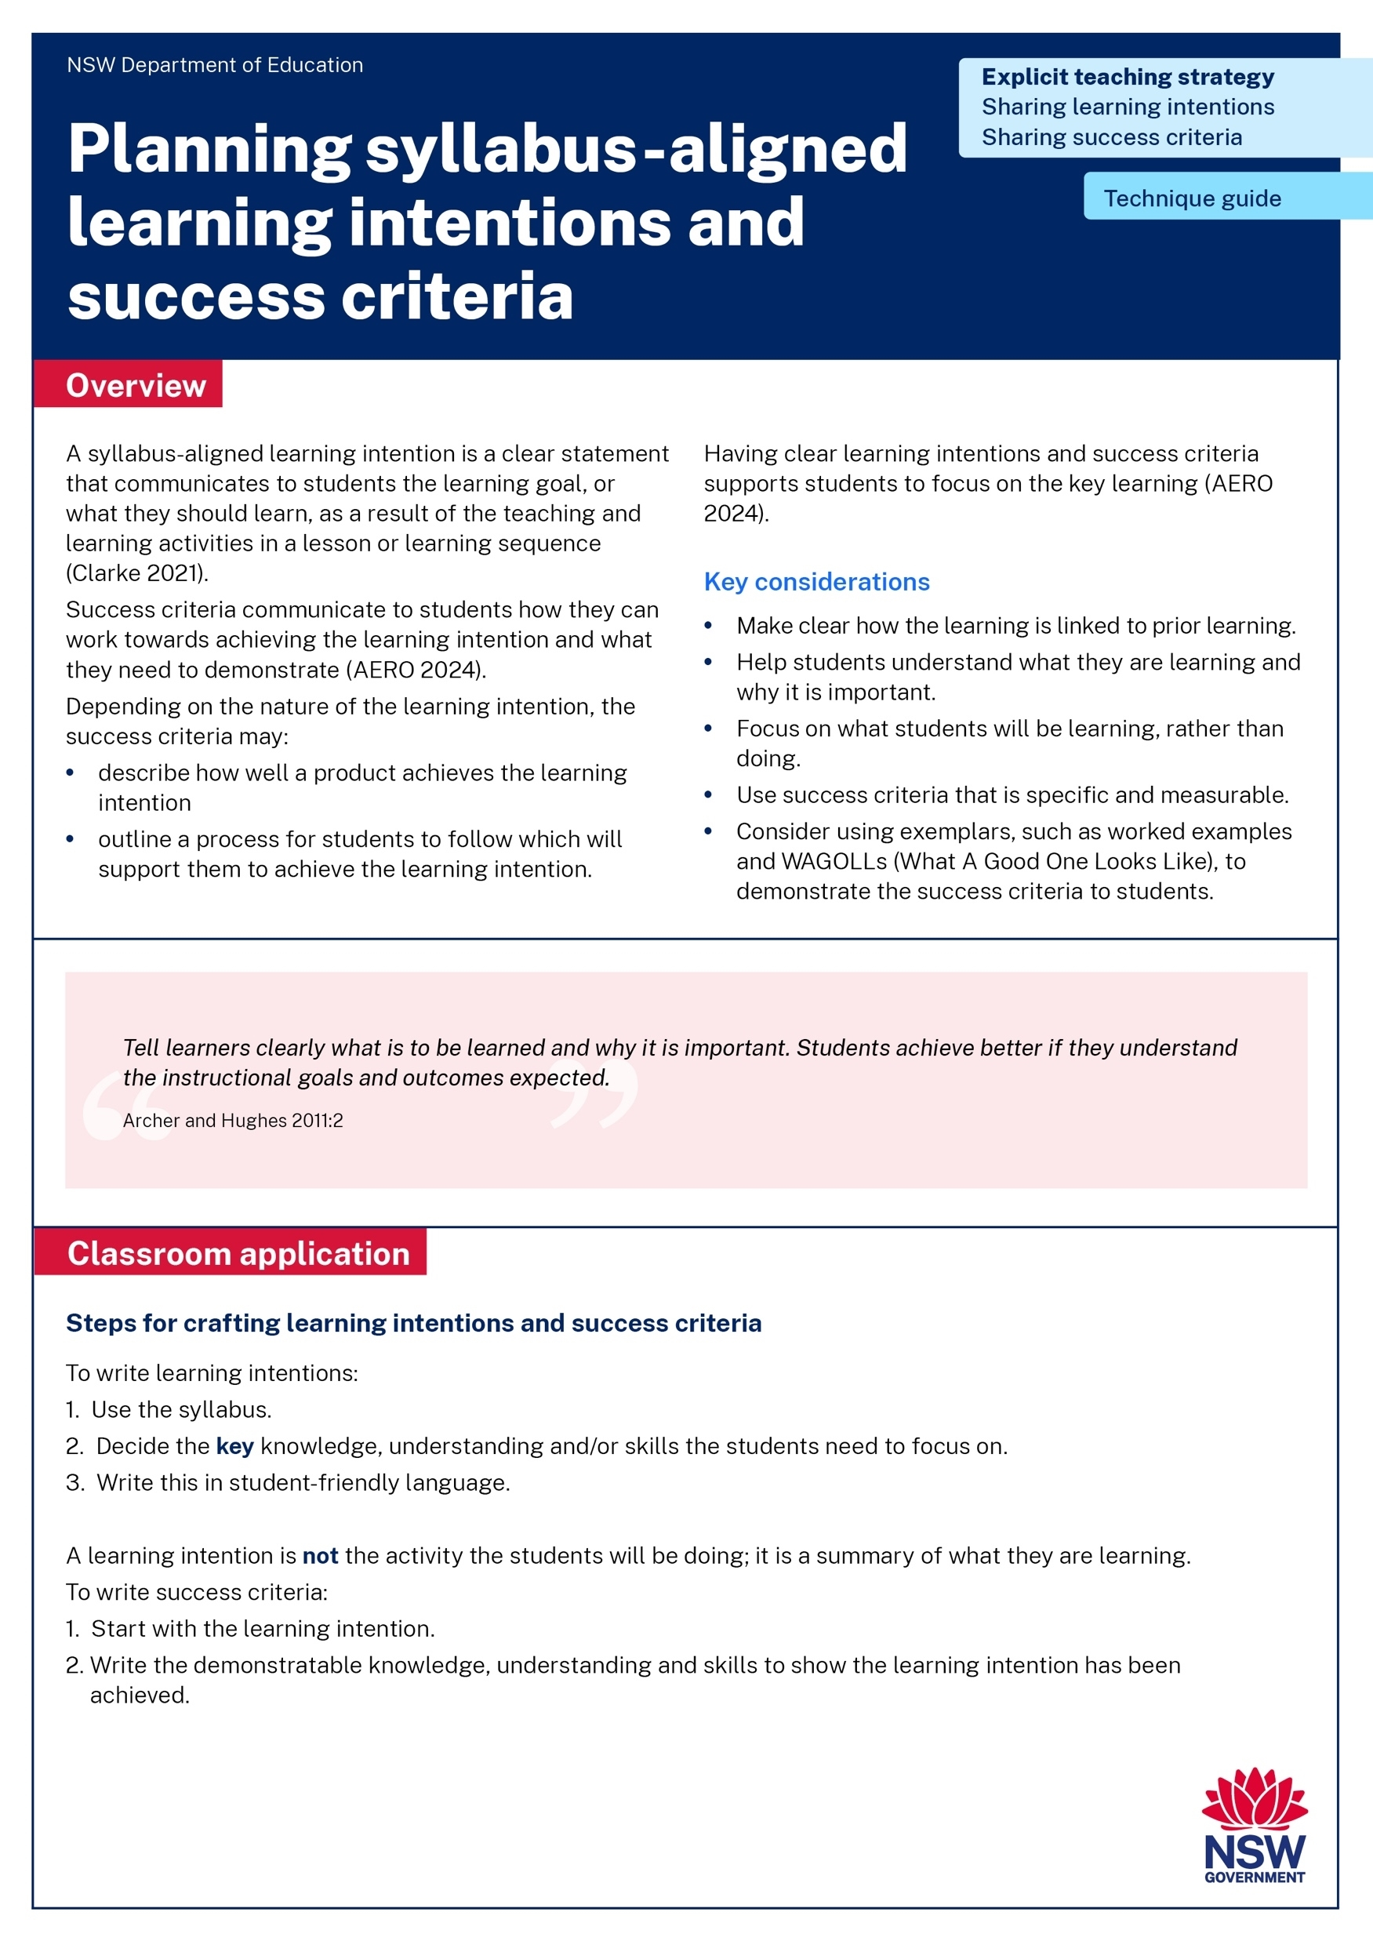
Activity 1 – Technique guide discussion
Read or revise – 10 min
Discuss – 10 min
Identify the key points in:
the Writing syllabus-aligned learning intentions and success criteria technique guide AND
the Sharing learning intentions and success criteria technique guide
Describe the connections between the technique guide and the learning in Part A.
Notes:
Purpose: Make connections between learning intentions and success criteria resources to deepen knowledge.
[20:00]
Speaker notes:
We have had the opportunity to read the Writing syllabus-aligned learning intentions and success criteria technique guide AND the Sharing learning intentions and success criteria technique guide.
Revisit that reading and identify the key points you observed.
Discuss with your groups the connections you can make between the readings and the learning we have done in Part A so far.
Note to presenter: use your knowledge of your school context to decide which technique guide participants should read. You may choose both or have half of the participants read one and the other half the other.
Learning intentions and success criteria resources:
https://education.nsw.gov.au/teaching-and-learning/curriculum/explicit-teaching/explicit-teaching-strategies/sharing-learning-intentions
https://education.nsw.gov.au/teaching-and-learning/curriculum/explicit-teaching/explicit-teaching-strategies/sharing-success-criteria

Slide 24
In the next part of this module, we will work on implementing the strategies through techniques. We will have opportunity to plan and rehearse techniques when sharing learning intentions and success criteria.
Notes:
Purpose of slide: To orient into the next part of the module.
[00:20]

Slide 25
Implementing the strategies through techniques
Part B

Slide 26
Part B instructions
The techniques in Part B are most effective when used together.
It is recommended teachers engage with syllabus aligned learning intentions, building understanding of success criteria and developmental rubrics techniques.
Select a lesson to apply the techniques.
Plan and rehearse with a colleague.
Get feedback from your colleague.
Notes:
Purpose: To provide instructions on using Part B of the module.
[00:20]
Note to speaker: The techniques in Part B are most effective when used together. Developing an understanding of all 3 techniques will help with more effective implementation.

Slide 27
Purpose and outcome
Purpose
To develop an understanding of techniques to support sharing learning intentions and success criteria.
Outcome
We have whole-school teaching routines for learning intentions and success criteria that are ready to use in our classrooms.
Notes:
Purpose: To provide the purpose and outcome of Part B
[00:20]
Speaker notes:
In this part, we're going to develop an understanding of techniques which support learning intentions and success criteria; and have our first attempt at creating our own whole school teaching routines for learning intentions and success criteria.

Slide 28
The mechanisms of sharing learning intentions and success criteria (2)
Students know what they are learning and what they need to do to be successful
Well planned
shared with students and understanding checked
referred to throughout the learning for formative assessment
Notes:
Purpose: To summarise what makes sharing learning intentions and success criteria effective
[00:40]
Speaker notes:
When using learning intentions and success criteria, ensure they are:
[click] 1. planned prior to the lesson and are aligned to the syllabus
[click] 2. displayed, explained and clarified by the teacher using student friendly language. Student understanding is checked.
[click] 3. referred to throughout the lesson for formative assessment. They can form the basis of check for understanding questions, teacher feedback, self assessment and peer assessment.
[click] 4. “When used effectively, LISC empowers students with the knowledge of where they are going in their learning, how they are progressing and where they will go next” Almarode and Vandas 2018:5).
References:
Almarode J and Vandas KL (2018) Clarity for learning: five essential practices that empower students and teachers, Sage Corwin.
AERO (Australian Education Research Organisation) (2024a) Explain learning objectives, AERO.
Clarke S (2021) Unlocking learning intentions and success criteria: Shifting from product to process across the disciplines, SAGE Publications.

Slide 29
Writing learning intentions and success criteria
Technique A

Slide 30
Importance of planning
Spending time working out exactly what you want your student to learn – and where that fits into your plan or syllabuses – has a direct impact of the quality of the lesson or lesson journey you plan (Clarke 2021:xviii).
Notes:
Purpose: Outline LISC requires careful planning
[00:30]
Speaker notes:
To maximise the impact of learning intentions, careful, intentional planning is required.
The first step for teachers is to ensure they have a clear picture of what they want their students to learn. The time spent on this careful planning has a direct impact on the quality of the learning journey (Clarke 2021).
When teachers know why students are learning what they are learning, they can better design learning experiences that are authentic and relevant to learners (Almarode and Vandas 2018:5).
References
Almarode J and Vandas KL (2018) Clarity for learning: five essential practices that empower students and teachers, Sage Corwin.
Clarke S (2021) Unlocking learning intentions and success criteria: shifting from product to process across the disciplines, SAGE Publications.

Slide 31
Planning learning intentions
Identify syllabus outcome or content
Decontextualise to give wider relevance
Focus on what students should learn, rather than the tasks they will complete
Use verbs (e.g., understand, explain, create, analyse)
Notes:
Purpose: To provide key considerations of Syllabus aligned learning intentions
[00:40]
Speaker notes:
The following slides will cover these key considerations when planning learning intentions:
Identify syllabus outcome or content and separate into knowledge, understanding and skills
Use student friendly language
Decontextualise, to focus on the learning rather than the topic, to give wider relevance
Focus on what students should learn, rather than the tasks they will complete
Use verbs (e.g., understand, explain, create, analyse)
References:
Clarke S (2021) Unlocking learning intentions and success criteria: shifting from product to process across the disciplines, SAGE Publications.

Slide 32
Planning learning intentions – from syllabus
Identify syllabus outcome or content
Syllabus | Learning intention
PDHPE – Early Stage 1 Focus area: Movement skill and physical activity. Outcome: PHE–MSP–01 demonstrates fundamental movement skills and participates with others in physical activities. Content group: Fundamental movement skills are important for health and wellbeing. Content point: Maintain stability during a static balance. | We are learning about static balance because movement is important for our health and wellbeing.
Notes:
Purpose: To provide key considerations of Syllabus aligned learning intentions
[01:00]
Speaker notes:
Syllabus outcomes and content are the starting point to planning a learning intention. Take a moment to read the example on the slide.
References:
Clarke S (2021) Unlocking learning intentions and success criteria: shifting from product to process across the disciplines, SAGE Publications.

Slide 33
Planning learning intentions – decontextualise
Decontextualise to give wider relevance
HS3–GEO–01: examines global citizenship and how people organise, protect and sustainably use the environment, using geographical information
Content group: People can protect global environments and use sustainable practices for the future
Content point: Examine places in the world where human activity has changed the environment by comparing maps and satellite images
Too broad | Too contextualised/task specific | Decontextualised but specific goal
We are learning about global environments | We are learning about how land clearing impacts native monkeys in the Amazon Rainforest | We are learning about human impacts on the environment
Notes:
Purpose: To provide key considerations of Syllabus aligned learning intentions
[01:00]
Speaker notes:
Here are 2 non-examples and an example of decontextualising a learning intention from Stage 3 Geography.
The example shows how decontextulising the learning intention focuses students on the learning and gives the learning a wider significance. Teachers may choose to include a real-world example of where the learning can be used.
References:
Clarke S (2021) Unlocking learning intentions and success criteria: shifting from product to process across the disciplines, SAGE Publications.
HSIE K-6 syllabus © NSW Education Standards Authority (NESA) for and on behalf of the Crown in right of the State of New South Wales, 2024

Slide 34
Planning learning intentions – learning
Focus on what students should learn, rather than the tasks they will complete
Tasks to complete | What they will learn
We are making a pencil box to a high standard | We are learning to safely and accurately use woodworking tools and techniques to create a functional and well-crafted product.
Notes:
Purpose: To provide key considerations of Syllabus aligned learning intentions
[01:00]
Speaker notes:
Here is a non-example and example of focusing on the learning
The non-example is the task to complete – this is the activity in the lesson. The example, on the other hand, draws students’ attention to safety and the accurate use of tools.
References:
Clarke S (2021) Unlocking learning intentions and success criteria: shifting from product to process across the disciplines, SAGE Publications.

Slide 35
Planning learning intentions – verbs
Use verbs (e.g., understand, explain, create, analyse)
Without verbs | With verbs
We are learning about the properties and behaviour of different states of matter. | We are learning to identify the properties and explain the behaviour of different states of matter.
Notes:
Purpose: To provide key considerations of Syllabus aligned learning intentions
[01:00]
Speaker notes:
Here is a non-example and example of using verbs.
The non-example, without verbs, is the subject students are learning. The example, with verbs, gives students a clearer idea about what they should pay attention to. By including the verbs ‘identify’ and ‘explain’ the learning intention clearly communicates what students will need to know and do in the lesson.
References:
Clarke S (2021) Unlocking learning intentions and success criteria: shifting from product to process across the disciplines, SAGE Publications.

Slide 36
Turn and talk
Turn to the person next to you and explain planning syllabus-aligned learning intentions.
Notes:
Purpose: Activity
[02:00]
Notes to presenter: This activity could be done followed by selecting non-volunteers to share their dialogue. See first slide on ‘Planning learning intentions’ for prompts.

Slide 37
Planning success criteria (1)
Identify knowledge, understanding and skills
Describe what success looks like
Breakdown the process students should follow
Decontextualise
Scaffolding
Notes:
Purpose: To provide key considerations of Syllabus aligned success criteria
[00:30]
Speaker notes:
The next section will cover how to plan effective success criteria.
Identify the knowledge, skills and understanding that students need to achieve.
Describe what success looks like – the product
Breakdown the process students should follow
Decontextualise from the subject material to clarify what is to be learnt.
While all students who are working toward the same stage syllabus-derived learning intention and success criteria, the scaffolding for students can be provided as per assessed student need.
The slides that follow will help us understand how to plan success criteria through examples and non-examples
References:
Clarke S (2021) Unlocking learning intentions and success criteria: shifting from product to process across the disciplines, SAGE Publications.

Slide 38
Planning success criteria (2)
Identify knowledge, understanding and skills
Syllabus | Learning intention | Success criteria
ES1 Movement skill and physical activity – Content group: Fundamental movement skills are important for health and wellbeing. Maintain stability during a static balance | We are learning about static balance because movement is important for our health and wellbeing | Knowledge – the facts | I can describe what a static balance is/is not
 |  | Understanding – the meaning behind the facts | I can explain the different parts of my body that are used to perform a static balance for strength, coordination, and focus.
 |  | Skills – the application | I can improve in performing a static balance.
Notes:
Purpose: To provide key considerations of Syllabus aligned success criteria
[01:00]
Speaker notes:
Syllabus content, where possible, can be separated into knowledge, understanding and skills.
“Knowledge is the subject-specific information, concepts and principles that students are expected to know and understand at each stage of their schooling. Knowledge provides the foundation for the development of skills, as students learn and combine subject knowledge, which they can then apply in context” (AERO 2024b:6).
“Skills are the methods, tools, strategies and processes that students develop as they learn. Examples of skills include critical thinking, communication and problem-solving. Skills are developed in context as students acquire factual and procedural subject knowledge” (AERO 2024b:6).
References:
AERO (Australian Education Research Organisation) (2024b) A knowledge-rich approach to curriculum design, AERO.
Clarke S (2021) Unlocking learning intentions and success criteria: shifting from product to process across the disciplines, SAGE Publications.

Slide 39
Planning success criteria (3)
Describe what success looks like
Learning Intention | Success Criteria
We are learning to identify the parts of a cell… | I can draw and label a diagram of a plant cell and an animal cell with the following terms: cell membrane, cytoplasm, nucleus, mitochondria (and plant cells only: cell wall, chloroplasts)
Notes:
Purpose: To provide key considerations of Syllabus aligned success criteria
[00:30]
Speaker notes:
To write effective success criteria
Describe what success looks like by explaining the product the student will complete. Drawing and labelling a diagram is offered here as an example of the task the students will complete. This success criteria is effective because it is specific and detailed. This is supported by teachers modelling, demonstrating and providing worked examples.
References:
Clarke S (2021) Unlocking learning intentions and success criteria: shifting from product to process across the disciplines, SAGE Publications.

Slide 40
Planning success criteria (4)
Breakdown the process students should follow
Learning Intention | Success Criteria
We are learning to measure angles using degrees | I can use a protractor to measure the degrees in angles by: aligning the protractor to one arm of an angle at the vertex recording angle measurement using the symbol for degrees (°)
Notes:
Purpose: To provide key considerations of Syllabus aligned success criteria
[00:30]
Speaker notes:
To plan an effective success criteria
Breakdown the process students should follow to complete the task by explaining how they do something and the order they do it in.
References:
Clarke S (2021) Unlocking learning intentions and success criteria: shifting from product to process across the disciplines, SAGE Publications.

Slide 41
Planning success criteria – decontextualise
Decontextualise
Contextualised skill (only relevant for a lesson) | Decontextualised skill (transferable)
Success criteria I can: explain why uniforms might be popular | Success criteria I can: identify and include arguments for and against a topic (Clarke 2021:7)
Notes:
Purpose: To provide key considerations of Syllabus aligned success criteria
[00:30]
Speaker notes:
In the first example, if students were asked what they learned, they would likely say they learnt about uniforms. In the second example, they would likely say they have learnt about identifying the features of an argument.
Decontextualising the success criteria is beneficial because it focuses the students' attention on what they're learning (Clarke 2021; Wiliam 2011).
References:
Clarke S (2021) Unlocking learning intentions and success criteria: shifting from product to process across the disciplines, SAGE Publications.
Wiliam D (2011) Embedded formative assessment, Solution tree press.

Slide 42
Planning success criteria – scaffolding
Students require different scaffolded support to reach the same success criteria
Notes:
Purpose: To provide elements of effective success criteria
[01:00]
Speaker notes:
A class will comprise of a diversity of learners.
To maintain high expectations, all students who are working at that stage level, work towards the same syllabus outcomes, and therefore work towards the same learning intention and success criteria.
Based on assessed need, teachers provide different supports and levels of scaffolding for students (Clarke 2021). Teachers can use the gradual release of responsibility to decide when to add or remove scaffolding and supports.
When students in a class are working above or below stage level outcomes or life skills outcomes, learning intentions and success criteria should be aligned with the corresponding syllabus. Teachers hold high expectations by scaffolding supports so these students can access the same or similar activities as their peers to progress in meeting their syllabus outcomes.
Reference:
Clarke S (2021) Unlocking learning intentions and success criteria: shifting from product to process across the disciplines, SAGE Publications.

Slide 43
Sharing learning intentions and success criteria
Technique B

Slide 44
Sharing learning intentions and success criteria (1)
Usually shared first or early in the lesson
Teacher ensures student understanding
Model success
Notes:
Purpose: To provide elements of effective success criteria
[01:00]
Speaker notes:
In the slides that follow will cover how effective learning intentions and success criteria:
should usually be shared at the start or early in the lesson, using student-friendly language and remain visible for the learning period. If the teacher elects not to share at the beginning, additional provision must be given to support the building of students’ schema.
the teacher uses routines or techniques to ‘check for understanding’ to ensure all students know what the learning intention and success criteria is and misconceptions are addressed early.
the success criteria can be supported by exemplars or examples of different levels to demonstrate the success criteria.
References:
Almarode J and Vandas KL (2018) Clarity for learning: five essential practices that empower students and teachers, Sage Corwin.

Slide 45
Sharing learning intentions and success criteria (2)
Usually shared first or early in the lesson
It’s about laundry
Organise into piles
The machine is complex
mistakes can be expensive
but you will get used to it
it is a necessity of life
Framing the learning helps students understand where it is going and how the ideas connect.
Notes:
Purpose: To provide elements of effective success criteria
[01:00]
Speaker notes:
In Part A we used the example about laundry to illustrate schema, when students’ attention is directed to the topic first (laundry), it makes it easier for them to remember and comprehend the information from the lesson (Bransford and Johnson 1972). In their famous experiment, Bransford and Johnson (1972) found that listeners who were told afterward that the topic was about laundry comprehended as poorly as those who were never told what the passage was about.
Sharing the learning intention first or early in the lesson is important when using learning intentions as an explicit teaching strategy (AERO 2024a). This would be the choice when learning is new or complex.
References:
Bransford JD and Johnson MK (1972) ‘Contextual prerequisites for understanding some investigations of comprehension and recall’, Journal of Verbal Learning and Verbal Behavior, 11:717-726.

Slide 46
Sharing learning intentions and success criteria (3)
Teacher ensures student understanding
Provide definitions for unfamiliar vocabulary
Explain the link with previous learning
Use a check for understanding
Notes:
Purpose: To provide elements of effective success criteria
[00:30]
Speaker notes:
Teachers need to teach the vocabulary students will need to understand the learning intentions and success criteria.
Students have a greater likelihood of achieving the learning intention when the objectives of the learning are connected to prior learning (AERO 2024a).
Routines that check for understanding of the learning intention and success criteria are essential to avoid misconceptions and confusion.
Reference:
AERO (Australian Education Research Organisation) (2024a) Explain learning objectives, AERO.

Slide 47
Sharing learning intentions and success criteria (4)
Model success
A shared understanding of success criteria can be achieved by:
analysing excellent worked examples
comparing good examples and non examples
demonstrating and stopping at each step
demonstrating how not to do something.
Notes:
Purpose: To provide elements of effective success criteria
[01:00]
Speaker notes:
analysing excellent products. WAGOLLs, or ‘What A Good One Looks Like’, are examples of high-quality work (showcasing the same skill in a different context) used to model expectations for students. They serve as a powerful tool to clarify what success looks like and help students understand how to meet learning objectives.
Using good examples and non-examples to analyse and discuss allows students to compare and identify strengths that they can then apply to their own work. It is easier to identify qualities of good work when 2 pieces are compared. Depending on the content being taught, step by step demonstrations and the use of non-examples can support students build a shared understanding of success.
When students use their own words to describe the differences in the examples provided, they are more likely to understand. This approach ensures that the criteria are grounded in actual samples of work rather than vague statements that can be open to multiple interpretations (Wiliam and Leahy 2015).
References:
Clarke S (2021) Unlocking learning intentions and success criteria: shifting from product to process across the disciplines, SAGE Publications.
Wiliam D (2018) Embedded formative assessment, 2nd edn, Solution Tree Press.
Wiliam D and Leahy S (2015) Embedding formative assessment, Hawker Brownlow Education.

Slide 48
Using learning intentions and success criteria throughout the lesson (1)
Check for understanding throughout the lesson
Teacher feedback
Self and peer feedback
Lesson summary
Notes:
Purpose: To provide elements of effective success criteria
[00:30]
Speaker notes:
In the slides that follow we will learn about how to use learning intention and success criteria throughout the lesson. We learn how to:
Use check for understanding throughout the lesson related to the learning intention and success criteria.
Use the learning intention and success criteria to give feedback in the lesson.
Use the learning intention and success criteria to guide students to give self and peer feedback.
Establish a lesson summary referring back to the learning intentions and success criteria.

Slide 49
Using learning intentions and success criteria throughout the lesson (2)
Check for understanding throughout the lesson
Our success criteria says we will make a scientific prediction. What is a scientific prediction and how is that different to just a prediction? (cold call or mini whiteboard response).
Notes:
Purpose: To provide elements of effective success criteria
[01:00]
Speaker notes:
The checks for understanding that are used throughout the lesson should be related to the learning intentions and success criteria of that lesson.

Slide 50
Using learning intentions and success criteria throughout the lesson (3)
Teacher feedback
I am looking for you to have named a hygiene practices and to also have explained why it is important for health. You have named them but are yet to explain. You could use your sentence stems to explain with evidence.
‘I am’
‘You have’ ​
‘You could’
Notes:
Purpose: To provide elements of effective success criteria
[01:00]
Speaker notes:
Here the teacher has used a feedback routine to draw the student’s attention to the success criteria, how it differs from what they did in their work and directing them to what they should do next. This is a way to incorporate verbal feedback in the lesson that students can action, supporting them to achieve the success criteria of the lesson.

Slide 51
Using learning intentions and success criteria throughout the lesson (4)
Self and peer feedback
Success criteria: I can | Sentence stems
identify dialogue in imaginative texts identify where the correct punctuation has been used in dialogue identify where incorrect punctuation has been used in dialogue suggest the correct punctuation. | The dialogue is located… The dialogue with correct punctuation is… The dialogue is incorrect punctuation is… To correct the punction, you should…
Notes:
Purpose: To provide elements of effective success criteria
[01:00]
Speaker notes:
Students can use the learning intention and success criteria to give self and peer feedback. In this example, sentence stems have been provided for the students to complete. The teacher can instruct students to evaluate how their work, or the work of their peers, achieves each part of the success criteria. The sentences stems them help them communicate their evaluation.
When students engage in criteria in this way, they have a closer engagement with the criteria.

Slide 52
Using learning intentions and success criteria throughout the lesson (5)
Lesson summary
We have been learning about our community and today we identified roles of community members and described what those roles are [teacher restates]. We will now be able to look at our rights and responsibilities as community members.
Notes:
Purpose: To provide elements of effective success criteria
[01:00]
Speaker notes:
At the end of a lesson the teacher makes a lesson summary. A lesson summary refers back to the learning intention and success criteria. It can also be used to signal what learning will happen next and therefore, what the next connection will be (Archer and Hughes 2011). This example demonstrates how the lesson summary can reinforce key concepts and avoid misconceptions. It also shows students how knowledge can be applied in new contexts.
References:
Archer A and Hughes C (2011) Explicit instruction: effective and efficient teaching, Guilford Press.

Slide 53
Turn and talk (1)
Turn to the person next to you and discuss the key components of effectively using learning intentions and success criteria throughout the lesson.
Notes:
Purpose: Activity
[02:00]
Notes to presenter: This activity could be done followed by selecting non-volunteers to share their dialogue. See first slide on ‘Using learning intentions and success criteria throughout the lesson’ for prompts.

Slide 54
Developmental rubrics
Technique C

Slide 55
Developmental rubrics (1)
Notes:
Purpose: What are developmental rubrics
[01:00]
Speaker notes:
Teachers already use marking rubrics for summative assessment. Developmental rubrics shift into formative assessment. The audience for a developmental rubric is the student. Teachers create these rubrics for formative rather than summative purposes, so students can identify their current level of performance and set goals to reach the next level.
When used in conjunction with explicit instruction and modelling, rubrics used in this way have been found to positively influence student performance and self regulation. The increased transparency of expectations can also reduce student anxiety and increase submission rates. A rubric can assist in making evaluative reasoning clear to students (Panadero and Jonsson 2013).
The descriptors in a developmental rubric run from bottom to top or from left to right to depict student progress.
References:
Panadero E and Jönsson A (2013) ‘The use of scoring rubrics for formative assessment purposes revisited: a review’, Educational Research Review, 9: 129-144. doi:10.1016/j.edurev.2013.01.002.

Slide 56
Writing developmental rubrics
Identify an outcome and break it down to component parts.
Start with what emerging understanding looks like for component parts.
Setting the ‘A’ level.
Progress the achievement.
Describe what the student will do, say or create.
Eliminate subjective language such as good, solid, clear, extensive etc.
Notes:
Purpose: Writing developmental rubric
[01:30]
Speaker notes:
Work with colleagues where possible. Creating a rubric to describe how students learning will progress can provide a strong foundation for consistent teacher judgement before creating resources, lesson sequences and assessments.
Identify an outcome and break it down into indicators or smaller tasks
Start with what emerging understanding looks like. When writing the E grade level (whether or not grades are used) ask yourself – “What is the first demonstration a student can make that shows they are starting to achieve in this outcome?” This should be stated in the positive where possible rather than the negative (e.g. fails to include…).
Set the ‘A’ level – what should achievement look like when the outcome is fully realised?
Progress the achievement make each step achievable from the one before (see classroom application) Each description need only cover what a student has to do at that level and not cover what they should do next. For students to understand what they should do next they would read the proceeding level. This means that the difference between the levels needs to be achievable from the level before.
Describe what the student will do, say or create. Rather than describing the level of achievement, specify what the student will demonstrate.
Eliminate subjective language such as good, solid, clear, extensive etc as they invite a range of interpretations, and therefor inconsistency.
Further resources:
Developmental rubric technique guide available on https://education.nsw.gov.au/teaching-and-learning/curriculum/explicit-teaching/explicit-teaching-strategies/sharing-success-criteria
References:
Griffin P (2018) Assessment for teaching, Cambridge University Press.

Slide 57
Planning, rehearsing and developing routines

Slide 58
A whole school approach (1)
What it is
Teachers construct learning intentions and success criteria that align with the syllabus for a lesson or lesson sequence.
Teachers create an agreed teaching approach to implement learning intentions and success criteria.
What it isn't
Our school decides only to use learning intentions and success criteria in one subject.
In our school one teacher refers to learning intentions and success criteria during learning but another teacher displays at the start of the lesson and does not refer to them again.
Notes:
Purpose: A whole school approach
[01:00]
Speaker notes:
What is a whole-school approach? It is ideal to have a number of whole school teaching routines that teachers can choose from to implement for the right purpose at the right time.
For example: the teacher plans the learning intention and success criteria as part of planning their lesson. They use the school’s agreed approach and procedure to use these explicit teaching strategies.
[click] What it’s not, we aren’t just doing one teaching routine every time. And we want to avoid teachers using different teaching routines for the same thing.
So in this session your group will come up with a whole school teaching routine for learning intentions and success criteria.

Slide 59
Creating whole-school routines
Draft whole-school teaching routines for planning, communicating and developing shared understanding for learning intentions and success criteria techniques.
Share the revised teaching routines.
Agree on whole-school routines for techniques.
Notes:
Purpose: Activity – develop possible whole school routines for learning intentions and success criteria
[01:00]
Note to presenter: consideration needs to be given as to how a routine is created, for example, in small groups, cross-stage or cross-faculty, etc. If working with a larger staff group, form smaller groups.
Speaker notes:
Today we will be doing an activity in groups to develop possible whole-school routines for learning intentions and success criteria
In your groups, draft a consensus on a LI and SC routine that aligns with effective teaching practices. Remember, this should be a routine that can be applied across the school.
After drafting, the group leader will model the routine using the routine for feedback. This step is crucial as it allows the group to reflect on and refine the process based on the feedback prompts provided.
Once refined, we’ll come back together and share these routines as a whole. The goal is to adopt a cohesive approach that supports all teachers and ensures students feel confident in participating and engaging with the content.
Example routine:
Create a routine around how to display the learning intention and success criteria in the classroom.
Create a routine around how to introduce a learning intention and success criteria to students.
Create a routine around how to refer back to learning intentions and success criteria with students.

Slide 60
Planning and rehearsing
Plan
Rehearse
Feedback
Evidence for Learning (2022) Effective professional development, Evidence for Learning.
Notes:
Purpose: to explain the process of rehearsing
[01:10]
Speaker notes:
Planning, rehearsing and getting feedback are crucial when we are working to develop techniques for implementing strategies. When we say rehearse, we mean:
[click] plan the lessons, models, think-alouds, worked examples and/ or activities
[click] deliver the instruction as if doing it in class.
Then partners can
[click] provide feedback - What may need to be added, changed, enhanced or deleted?
Note to presenter: it is advisable to prepare school leaders beforehand if modelling and rehearsing are not yet established practices in the school.
Further reading on this research:
AERO (Australian Education Research Organisation) (2023a) Gaining all students’ attention, AERO.
Evidence for Learning (2022) Effective professional development, Evidence for Learning.
Sims S, Fletcher-Wood H, O’Mara-Eves A, Cottingham S, Stansfield C, Van Herwegen J and Anders J (2021) What are the characteristics of teacher professional development that increase pupil achievement? A systematic review and meta-analysis, Education Endowment Foundation.

Slide 61
Rehearsal steps and feedback prompts
Use your learning sequence or lesson plan to:
Construct a learning intention and success criteria, ensuring it is aligned to the syllabus.
Plan how you will introduce the learning intention and success criteria to the class.
With a partner, rehearse the teaching for learning intentions and success criteria.
Use the feedback from your partner to improve your approach.
Swap with your partner for their rehearsal.
Feedback prompts
Did the learning intention align to the syllabus?
Did the success criteria clearly outline what students need to know, do, or understand to demonstrate their learning?
Did the teacher connect it to prior learning?
Did the teacher teach the necessary vocabulary?
Did the teacher check for understanding?
Notes:
Purpose: To give the steps and feedback prompts for the activity
[01:00]
Speaker notes:
Take a minute to go through the rehearsal steps and the prompts for feedback.
If you are giving feedback, we have provided a list of prompts for you to think about how the routine could be refined.
Note to presenter: this slide and the activity slide could be provided to the groups as handouts.

Slide 62
In the next part of this module, we will work on evaluating our approach to implementing the strategies through techniques.
Notes:
Note to presenter: Select a technique to focus on with a cycle of planning, rehearsing and developing routines. This will support developing sustainable routines in the school.

Slide 63
Evaluating a whole-school approach
Part C

Slide 64
Purpose and outcome (3)
Purpose
To apply effective professional development structures, reflect on and evaluate our implementation of an explicit teaching technique.
Outcome
Refine the whole-school practices of learning intentions and success criteria and plan for future success and activities.
Notes:
Purpose of slide: Purpose and outcome of Part C
Speakers notes:
[00:20]
In this part, the focus is on reflection and evaluation. We will consider the early indicators of success and use this to plan for evaluation of longer-term impact. There is also a good opportunity to refine the routines we are developing as a whole school in line with what is working in classroom presently.

Slide 65
A whole school approach

Slide 66
Initial data reflection point (2)
Student responses | 0 | 1 | 2 | 3 | 4
In today’s lesson, what did you learn about? | Cannot recall | Recalls but can’t articulate | Mentions the activities undertaken | Repeats the learning intention | Articulates the learning in their own words
How did you know you had learnt it? | Cannot recall | Recalls but can’t articulate | Lists the activities undertaken | Articulates the criteria | Articulates the feedback they took onboard or used to guide a peer
Notes:
Purpose: Reflect on student success as an early indicator.
[02:00]
Speaker notes:
In the beginning, we looked at an example of a tool that could be used to establish a baseline for where our students are now.
We will be able to refer to our early indicator observations when we evaluate our impact.
Note to presenter: There is an opportunity to use this data in the final session. Student engagement is not the only consideration, and schools should select a model that is right for them.
This data could be collated and compared to other “school and classroom data about growth and performance.”
For example:
NAPLAN report overview accessed through Scout
https://education.nsw.gov.au/about-us/education-data-and-research/scout/training/digital-learning-centre/naplan-report-overview
NAPLAN report overview
Learn more about the NAPLAN reports in Scout.
https://education.nsw.gov.au/about-us/education-data-and-research/scout/scout-overview/apps-and-reports/naplan---doe/class-report#tabs0
Class report
The Class report shows the distribution of students’ scaled scores across domains and proficiency levels for NAPLAN 3, 5, 7 or 9.
References:
AERO (Australian Education Research Organisation) (2023b) How students learn best: an overview of the evidence, AERO.
Martin A and Evans P (2018) ‘Load Reduction Instruction: Exploring a framework that assesses explicit instruction through to independent learning’, Teaching and Teacher Education, 73:203-214.

Slide 67
The mechanisms of sharing learning intentions and success criteria (2) (2)
Students know what they are learning and what they need to do to be successful
Well planned
shared with students and understanding checked
referred to throughout the learning for formative assessment
Notes:
Purpose: To summarise what makes checking for understanding effective
[00:40]
Speaker notes:
When using learning intentions and success criteria, ensure they are:
[click] 1. planned prior to the lesson and are aligned to the syllabus
[click] 2. displayed, explained and clarified by the teacher using student friendly language. Student understanding is checked.
[click] 3. referred to throughout the lesson for formative assessment. They can form the basis of check for understanding questions, teacher feedback, self assessment and peer assessment.
[click] 4. “When used effectively, LISC empowers students with the knowledge of where they are going in their learning, how they are progressing and where they will go next” Almarode and Vandas 2018:5).
References:
Almarode J and Vandas KL (2018) Clarity for learning: five essential practices that empower students and teachers, Sage Corwin.
AERO (Australian Education Research Organisation) (2024a) Explain learning objectives, AERO.
Clarke S (2021) Unlocking learning intentions and success criteria: Shifting from product to process across the disciplines, SAGE Publications.

Slide 68
The importance of all moving together (2)
Saves learning time¹
Frees up students’ working memory²
Certain and consistent expectations for students³
Students learn the routine more quickly when it is done in the same way across the school⁴
Fosters a strong sense of belonging⁵
Notes:
Purpose: to restate why a whole school teaching routine is powerful
[00:30]
Speaker notes:
These modules use the power of whole school teaching routines. When a group of expert teachers from across the school come together and create a whole school approach, they are far more effective than when they go it alone. Teaching routines:
[click] save learning time
[click] can free up students’ working memory
[click] provide certainty and expectations for students to contribute to a learning environment where they’re safe to participate.
[click] they’re efficient, because when done the same way across the school, students can learn the routine more quickly.
[click] and they foster a strong sense of belonging.
As we go through the learning module here, and other learning modules for explicit teaching we will revisit the idea of the whole school teaching routines.
References:
1.Archer A and Hughes C (2011) Explicit instruction: effective and efficient teaching, Guilford Press.
2. AERO (Australian Education Research Organisation) (2021) Focused classrooms: managing the classroom to maximise learning, AERO.
3.Australian Education Research Organisation (AERO) (2023c) Teaching routines: their role in classroom management. https://www.edresearch.edu.au/resources/teaching-routines
4.McCrea (2020) Motivated teaching.
5.McCrea (2020) Motivated teaching.
Further reading:
Tharby A (12 May 2023) ‘We are what we do: the case for explicit and consistent school-wide routines’, Class Teaching, find the bright spots blog, accessed 20 November 2024.

Slide 69
Planning and rehearsing (2)
Plan
Rehearse
Feedback
Evidence for Learning (2022) Effective Professional Development, Sydney: Evidence for Learning.
Notes:
Purpose: to explain the process of rehearsing
[01:10]
Speaker notes:
Planning, rehearsing and getting feedback are crucial when we are working to develop techniques for implementing strategies. When we say rehearse, we mean:
[click] plan the lessons, models, think-alouds, worked examples and/ or activities
[click] deliver the instruction as if doing it in class.
Then partners can
[click] provide feedback - What may need to be added, changed, enhanced or deleted?
Note to presenter: it is advisable to prepare school leaders beforehand if modelling and rehearsing are not yet established practices in the school.
Further reading on this research:
AERO (Australian Education Research Organisation) (2023c) Gaining all students’ attention, AERO.
Evidence for Learning (2022) Effective professional development, Evidence for Learning.
Sims S, Fletcher-Wood H, O’Mara-Eves A, Cottingham S, Stansfield C, Van Herwegen J and Anders J (2021) What are the characteristics of teacher professional development that increase pupil achievement? A systematic review and meta-analysis, Education Endowment Foundation.

Slide 70
Rehearsal (2)
Notes:
Purpose of slide: To explain why rehearsing is so important
Speaker notes:
[01:10]
Application is a real key to success in professional learning.
Why might professional learning not be applied in the classroom, despite our best intentions?
[click] Research from Evidence for Learning (2022) found that rehearsing was among the key mechanisms for success in the application of PL.
New teachers often have practices described to them – but it is much clearer to have lead teachers model the practice (out of the classroom, without students) while the observer uses prompts to reflect on what made that practice successful.
Teaching is a habit-forming practice. By necessity, teaching requires us to automate a number of behaviours. The cognitive load on teachers to introduce a new behaviour is high and so we often rely on those previously formed habits.
Rehearsal (out of the classroom, without students) makes our PL a habit. When we try a rehearsed routine in a classroom, our cognitive load is reduced because we have one thing to think about, rather than 4 or 5.
This is why rehearsing is a key mechanism for success in professional learning.
References:
Evidence for Learning (2022) Effective professional development, Evidence for Learning

Slide 71
Evaluating impact on students

Slide 72
'When implementing a new evidence-based practice, school personnel should measure fidelity early and often to provide timely and responsive professional development and maximise student outcomes.'
(Harn et al. 2013:186)
Notes:
Purpose:
[00:00]
Reference:
Harn B, Parisi D and Stoolmiller M (2013) ‘Balancing fidelity with flexibility and fit: what do we really know about fidelity of implementation in schools?’ Exceptional Children, 79:181–193.

Slide 73
Measuring success
What should our early measures of impact be?
Short term
Increased engagement
Increased ability to articulate the lesson’s learning intention(s) and success criteria
Longer term
Increased understanding
Increased learning
Student data indicates learning gains
Notes:
Purpose of slide: Measuring success
[00:30]
Speaker notes:
When we try something new in the classroom and our students experience it for the first time, it may not have the desired impact. Over time, the impact of the approach should show signs of success.
Measure fidelity early and often to maximise student outcomes and be responsive in the approach.

Slide 74
Data sources to measure impact
Short term
Increased engagement
Increased ability to articulate the lesson’s learning intention(s) and success criteria
Longer term
Increased understanding
Increased learning
Student data indicates learning gains
Student responses | 0 | 1 | 2 | 3 | 4
In today’s lesson, what did you learn about? | Cannot recall | Recalls but can’t articulate | Mentions the activities undertaken | Repeats the learning intention | Articulates the learning in their own words
How did you know you had learnt it? | Cannot recall | Recalls but can’t articulate | Lists the activities undertaken | Articulates the criteria | Articulates the feedback they took onboard or used to guide a peer
Notes:
Purpose: Reflecting on initial observations and considering long term measures
Note to presenter: timing for this slide will be dependent on your own allocated time and the number of staff in attendance.
[2:30]
Speaking notes:
In Part A, we used a question for students to get an indication of the effectiveness of our practice of using learning intentions and success criteria. This measure can be used as an indicator – where we consider the most immediate indicator of change and use this measure to track change over time.
We could choose a different measure, but it's important it is proximal to the teaching. It should be an immediately observable/collectable indicator of change in students’ knowledge, skills, motivation, self-belief, or teacher practice. This information of what is successful helps us plan for longer term outcomes. Other data sources should be considered beyond the proximal data. This might include formative assessment data and student interviews.
Activity:
What observations can you make about learning intentions and success criteria (LISC) in the classroom?
What observations can be made about what has been successful so far, while we’ve focused on LISC in classrooms?
How will we measure longer term outcomes?
How can we scale our success by refining and building the techniques and routines we’ve been developing?
Note to presenter: You may wish to display the data from the first session if it was collected. If there has been no shift identified using the early measure, discuss the barriers to success and if an adjustment to the whole-school routine is needed.
Further reading on High Impact Professional Learning:
https://education.nsw.gov.au/teaching-and-learning/professional-learning/high-impact-professional-learning
References:
McCrea P (2020) Motivated teaching: harnessing the science of motivation to boost attention and effort in the classroom, Createspace Independent Publishing Platform.

Slide 75
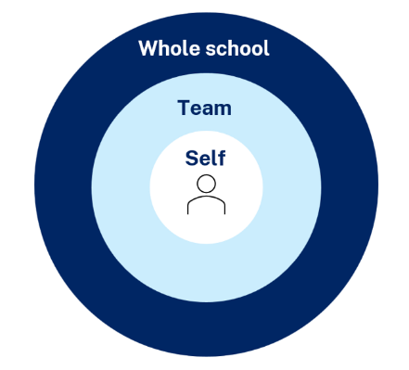
Maintaining a whole school approach
Using data
Video observation and reflection
Peer observation and feedback
Teacher and student survey
Growth in assessment data
Notes:
Purpose of slide: collating and using data - suggested for school leadership team
[05:00]
Speaker notes:
Evaluating data is a way we can consider the extent to which we are being effective in achieving long term goals. Data can be collected from many perspectives, including individual teachers and students, teams and whole school. Data can include a range of things, such as observational/instructional rounds, student work samples (such as exit tickets), student self-reports, teacher reflections and assessments. Data can be quantitative and qualitative.
Reflecting on data helps us consider how efficient and effective we are being in achieving our instructional goals. It also provides key insights to inform the next steps of professional learning and whole school strategic planning.
Activity:
What data have we accessed so far and what have we learnt?
How can we select and measure data over time to consider our impact?
Further reading:
More information about using data to evaluate the curriculum aligned to the School Excellence Framework LECI: Module 5: Using data to effectively evaluate the curriculum AC01087 – https://myplsso.education.nsw.gov.au/mylearning/catalogue/details/62ea3ae9-855b-ef11-b00f-b5aeee9b86ab

Slide 76
School Excellence Framework
Explicit teaching in NSW Public Schools
‘School-wide explicit teaching approaches incorporate modelled, guided and independent practice.
Teachers consider students’ cognitive load and employ explicit teaching strategies to optimise learning progress of students across the full range of abilities. Effective methods are identified, promoted and modelled, and students’ learning improvement is monitored, demonstrating growth.’
School Excellence Framework, Teaching Domain (p 11)
76
Notes:
Purpose of slide: Aligning the practice to the SEFv3 – suggested for school leadership team
[06:00]
Speaker notes:​
Linking to longer term outcomes, the SEF is an excellent way to measure whole-school impact over time.
Sharing learning intentions and success criteria relates to themes from the SEFv3​
​
For example, in the teaching domain, under the element of effective classroom management, this practice aligns with the descriptors for the theme of explicit teaching and classroom management.
Activity:
Access and identify key features from delivering, sustaining and growing and excelling for the explicit teaching theme.
Access and identify key features from delivering, sustaining and growing and excelling for the classroom management theme.
Describe how our classrooms would look, feel and sound if we were to move to 'sustaining and growing' or move to 'excelling’.
Discuss how this would align with the strategic direction already in place in your school?
As a whole school, how are we ensuring we continue to reflect on and share our practice?
What actions can we take to promote our effective explicit teaching practice to the wider school community?
How can the SEF be integrated in our school’s professional learning in an ongoing way?
Discussion points:
In ‘sustaining and growing’ the practice looks like a whole school approach to positive classroom management.
This extends to learning routines in ‘excelling’, where there are consistent school-wide approaches to learning routines that enable student engagement. ​
​

Slide 77
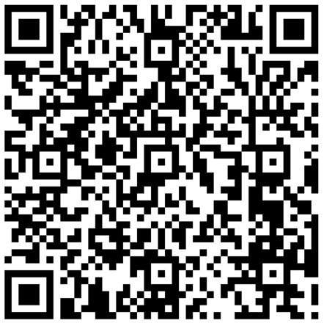
Feedback
Please complete the Sharing learning intentions and Success criteria strategy learning module to help us improve future professional learning and provide further support.
Contact us
ContactCurriculumImplementation@det.nsw.edu.au

Slide 78
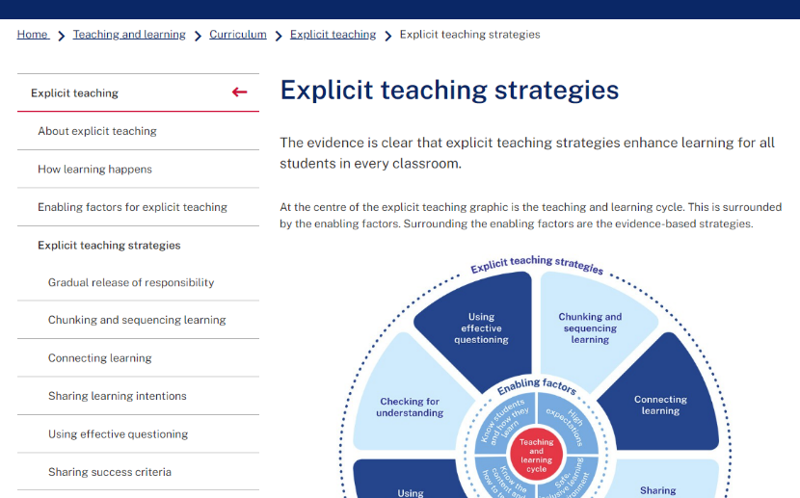
Explicit teaching strategies and resources
More information is available about:
​explicit teaching
how learning happens
the enabling factors
the explicit teaching strategies
https://education.nsw.gov.au/teaching-and-learning/curriculum/explicit-teaching
Notes:
Purpose of slide: Next steps
Speaker notes:
[0:40]
The evidence on explicit teaching is clear, it shows us how important it is to align our teaching pedagogy with how learning occurs. Ongoing information to support this is available on the department's website.
This includes information about the enabling factors, how learning happens and the explicit teaching strategies. The website will continue to be updated as new resources are released in future. https://education.nsw.gov.au/teaching-and-learning/curriculum/explicit-teaching

Slide 79
Further reading
AERO (Australian Education Research Organisation) (2024) Foundational classroom management resources handbook, AERO.
CESE (Centre for Education Statistics and Evaluation) (2024) Guide to evidence-based models of collaborative inquiry, NSW Department of Education.
NSW Department of Education (2024) What is high impact professional learning?, NSW Department of Education, accessed 4 October 2024.
Timperley H, Parr J and Bertanees C (2009) Promoting professional inquiry for improved outcomes for students in New Zealand, Professional Development in Education, 35(2):227–245.
Tips for Teachers (14 December 2022) ‘Check for understanding: tips for teachers’[video], YouTube, accessed 12 September 2024.

Slide 80
Reference list (1)
This presentation contains NSW Curriculum and syllabus content. The NSW Curriculum is developed by the NSW Education Standards Authority. This content is prepared by NESA for and on behalf of the Crown in the right of the State of New South Wales. The material is protected by Crown copyright.
Please refer to the NESA Copyright Disclaimer for more information https://educationstandards.nsw.edu.au/wps/portal/nesa/mini-footer/copyright.
NESA holds the only official and up-to-date versions of the NSW Curriculum and syllabus documents. Please visit the NSW Education Standards Authority (NESA) website https://educationstandards.nsw.edu.au/wps/portal/nesa/home and the NSW Curriculum website https://curriculum.nsw.edu.au.
Almarode J and Vandas KL (2018) Clarity for learning: five essential practices that empower students and teachers, Sage Corwin.
Archer A and Hughes C (2011) Explicit instruction: effective and efficient teaching, Guilford Press.
AERO (Australian Education Research Organisation) (2021) Focused classrooms: managing the classroom to maximise learning, AERO.
AERO (Australian Education Research Organisation) (2023a) Teaching routines: their role in classroom management, AERO.
AERO (Australian Education Research Organisation) (2023b) How students learn best: an overview of the learning process and the most effective teaching practices, AERO.
AERO (Australian Education Research Organisation) (2023c) Gaining all students’ attention, AERO.
AERO (Australian Education Research Organisation) (2024a) Explain learning objectives, AERO.
AERO (Australian Education Research Organisation) (2024b) A knowledge-rich approach to curriculum design, AERO

Slide 81
Reference list (2)
Bransford JD and Johnson MK (1972) 'Contextual prerequisites for understanding some investigations of comprehension and recall', Journal of verbal learning and verbal behavior, 11:717-726
CESE (Centre for Education Statistics and Evaluation) (2017) Cognitive load theory: research that teachers really need to understand, NSW Department of Education.
Clarke S (2021) Unlocking learning intentions and success criteria: shifting from product to process across the disciplines, SAGE Publications.
English K-10 Syllabus© NSW Education Standards Authority (NESA) for and on behalf of the Crown in right of the State of New South Wales 2023.
Evidence for Learning (2022) Effective professional development, Evidence for Learning.
Griffin P (2018) Assessment for teaching, Cambridge University Press.
Harn B, Parisi D and Stoolmiller M (2013) ‘Balancing fidelity with flexibility and fit: what do we really know about fidelity of implementation in schools?’ Exceptional Children, 79:181–193.
Johnson MK, Bransford JD, Nyberg SE and Cleary JJ (1972) ‘Comprehension factors in interpreting memory for abstract and concrete sentences’, Journal of Verbal Learning and Verbal Behavior, 11(4):451-454, doi 10.1016/S0022-5371(72)80026-4.
Martin A and Evans P (2018) ‘Load Reduction Instruction: exploring a framework that assesses explicit instruction through to independent learning’, Teaching and Teacher Education, 73:203-214.
McCrea P (2020) Motivated teaching: harnessing the science of motivation to boost attention and effort in the classroom, Createspace Independent Publishing Platform.

Slide 82
Reference list (3)
NSW Department of Education (2023) Classrooms of possibility, NSW Department of Education, accessed 19 November 2024.
Panadero E and Jonsson A (2013) 'The use of scoring rubrics for formative assessment purposes revisited: a review', Educational Research Review, 9:129–144.
Sims S, Fletcher-Wood H, O’Mara-Eves A, Cottingham S, Stansfield C, Van Herwegen J and Anders J (2021) What are the characteristics of teacher professional development that increase pupil achievement? A systematic review and meta-analysis, Education Endowment Foundation.
Tharby A (12 May 2023) ‘We are what we do: the case for explicit and consistent school-wide routines’, Class Teaching, find the bright spots blog, accessed 20 November 2024.
Timperley H, Parr J and Bertanees C (2009) 'Promoting professional inquiry for improved outcomes for students in NEW Zealand’, Professional Development in Education, 35(2)227–245
Willingham D (2009) Why don't students like school? A cognitive scientist answers questions about how the mind works and what it means for the classroom. Jossey-Bass/Wiley.
Wiliam D (2011) Embedded formative assessment, Solution Tree Press.
Wiliam D (2018) Embedded formative assessment, 2nd edn, Solution Tree Press.
Wiliam D and Leahy S (2015) Embedding formative assessment, Hawker Brownlow Education.

Slide 83
Copyright
© State of New South Wales (Department of Education), 2025
The copyright material published in this resource is subject to the Copyright Act 1968 (Cth) and is owned by the NSW Department of Education or, where indicated, by a party other than the NSW Department of Education (third-party material).
Copyright material available in this resource and owned by the NSW Department of Education is licensed under a Creative Commons Attribution 4.0 International (CC BY 4.0) license.
This license allows you to share and adapt the material for any purpose, even commercially.
Attribution should be given to © State of New South Wales (Department of Education), 2025.
Material in this resource not available under a Creative Commons license:
the NSW Department of Education logo, other logos and trademark-protected material
Material owned by a third party that has been reproduced with permission. You will need to obtain permission from the third party to reuse its material.
Links to third-party material and websites
Please note that the provided (reading/viewing material/list/links/texts) are a suggestion only and implies no endorsement, by the New South Wales Department of Education, of any author, publisher, or book title. School principals and teachers are best placed to assess the suitability of resources that would complement the curriculum and reflect the needs and interests of their students.
If you use the links provided in this document to access a third-party’s website, you acknowledge that the terms of use, including licence terms set out on the third-party’s website apply to the use which may be made of the materials on that third-party website or where permitted by the Copyright Act 1968 (Cth). The department accepts no responsibility for content on third-party websites.

