Slide 1
Lesson 4 – BOLTSS
Stage 4 geography
Landscapes and landforms
[TEACHER NAME]
[DATE]

Slide 2
Learning intentions and success criteria
We are learning to
identify mapping conventions
We can
recognise the purpose of mapping conventions
understand and interpreting maps using mapping conventions.
Notes:
Notes for teachers:
Learning intentions and success are best co-constructed with students. Adapt the learning intention as required and add matching success criteria.
For more information See ⁠AITSL or the NSW Department of Education explicit teaching strategies, ⁠Sharing learning intentions and ⁠Sharing success criteria
LISC is not necessarily presented at the beginning of the lesson. Teacher needs to consider most effectual time to introduce
LISC should be revisited during the lesson to support students' evaluation of their learning
Pre test and post test:
Set 86A - Geography – Maps
Set 86B - Geography - Maps

Slide 3
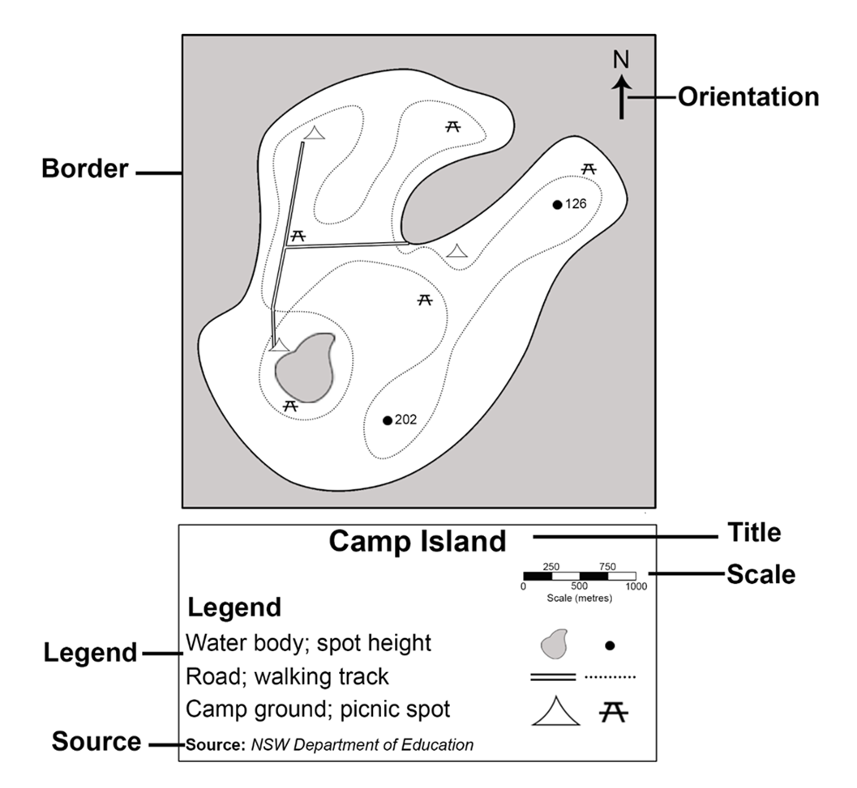
BOLTSS
Identify BOLTSS

Slide 4
Border and orientation
Border
Why do we need a border on a map?
Orientation
Why do we need to know the orientation of a map?
Use a compass to find north in your classroom.
Notes:
Note – equipment (compass) required

Slide 5
Legend and title
Legend
What is the symbol for a picnic spot on our map?
What is the purpose of a legend on a map?
Title
What is the purpose of a title on a map?
If you created a map of your classroom, what title would you give it?

Slide 6
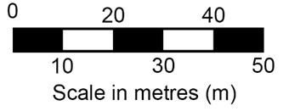
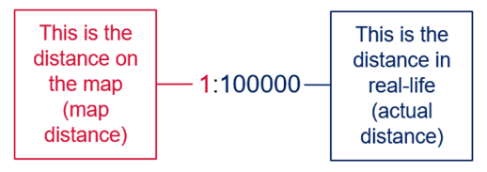
Scale
What is the purpose of scale on a map?
What type of scale is used on the map?
Linear scale –
Ratio scale –
Ratio in writing – 1 centimetre to 100 000
metres
Notes:
Note: The scale of the map tells the relationship between distances on the map and distances in real life. It provides the ratio of map distance to actual distance.

Slide 7
Source
What is the source of this map?

Slide 8
Need more explanation?
BOLTSS and scale
(Duration 4:06)
Notes:
BOLTTS and scale video: Check for understanding questions
True/False Questions
A map’s orientation is shown by a compass indicating direction. Answer: True. Explainer: Orientation is represented by a compass, helping users understand the directions on the map.
The title of a map is unnecessary as long as there is a legend. Answer: False. Explainer: The title is a critical part of BOLTSS, as it provides the name or purpose of the map, making it clear what the map represents.
A representative fraction scale of 1:250,000 means that 1 centimetre on the map equals 25 kilometres in real life. Answer: False. Explainer: A scale of 1:250,000 means 1 centimetre on the map equals 2.5 kilometres in real life, not 25 kilometres.
Linear scales use a numbered line to visually represent scale on a map. Answer: True. Explainer: Linear scales provide a visual way to measure distances, making it easier to interpret the map's scale.
The source on a map indicates where the information or data used to create the map came from. Answer: True. Explainer: The source is an important part of BOLTSS, providing credibility and context for the map's data.
Short answer questions
What does BOLTSS stand for in map reading? Answer: BOLTSS stands for Border, Orientation, Legend, Title, Scale, and Source. Explainer: These are the essential elements that every map should include to ensure it is useful and accurate.
What is the purpose of scale on a map? Answer: Scale shows the ratio of map distance to actual distance, allowing users to understand how the map represents the real-world size of areas and distances. Explainer: Scale helps users translate measurements on the map into real-life distances, which is essential for navigation and understanding spatial relationships.
How is a scale of 1:100,000 represented in words? Answer: A scale of 1:100,000 is represented as 1 centimetre on the map equals 1 kilometre in real life. Explainer: The ratio means that every unit of measurement on the map is 100,000 times smaller than in reality, and this is often converted to simpler terms for practical use.

Slide 9
3-2-1 things I learned today
List 3 things you learned today:
3
1.
2.
3.
List 2 questions you have about these things:
2
1.
2.
Give 1 reason why it’s important to learn about these things:
1
1.

Slide 10
References
This presentation contains NSW Curriculum and syllabus content. The NSW Curriculum is developed by the NSW Education Standards Authority. This content is prepared by NESA for and on behalf of the Crown in the right of the State of New South Wales. The material is protected by Crown copyright.
Please refer to the NESA Copyright Disclaimer for more information https://educationstandards.nsw.edu.au/wps/portal/nesa/mini-footer/copyright.
NESA holds the only official and up-to-date versions of the NSW Curriculum and syllabus documents. Please visit the NSW Education Standards Authority (NESA) website https://educationstandards.nsw.edu.au/wps/portal/nesa/home and the NSW Curriculum website https://curriculum.nsw.edu.au.
Geography 7-10 © Syllabus NSW Education Standards Authority (NESA) for and on behalf of the Crown in right of the State of New South Wales, 2024.

Slide 11
Copyright
© State of New South Wales (Department of Education), 2024
The copyright material published in this resource is subject to the Copyright Act 1968 (Cth) and is owned by the NSW Department of Education or, where indicated, by a party other than the NSW Department of Education (third-party material).
Copyright material available in this resource and owned by the NSW Department of Education is licensed under a Creative Commons Attribution 4.0 International (CC BY 4.0) licence.
This licence allows you to share and adapt the material for any purpose, even commercially.
Attribution should be given to © State of New South Wales (Department of Education), 2024.
Material in this resource not available under a Creative Commons licence:
the NSW Department of Education logo, other logos and trademark-protected material
Material owned by a third party that has been reproduced with permission. You will need to obtain permission from the third party to reuse its material.
Links to third-party material and websites
Please note that the provided (reading/viewing material/list/links/texts) are a suggestion only and implies no endorsement, by the New South Wales Department of Education, of any author, publisher, or book title. School principals and teachers are best placed to assess the suitability of resources that would complement the curriculum and reflect the needs and interests of their students.
If you use the links provided in this document to access a third party’s website, you acknowledge that the terms of use, including licence terms set out on the third-party’s website apply to the use which may be made of the materials on that third-party website or where permitted by the Copyright Act 1968 (Cth). The department accepts no responsibility for content on third-party websites.

