Slide 1
School canteen
Stepping stones

Slide 2
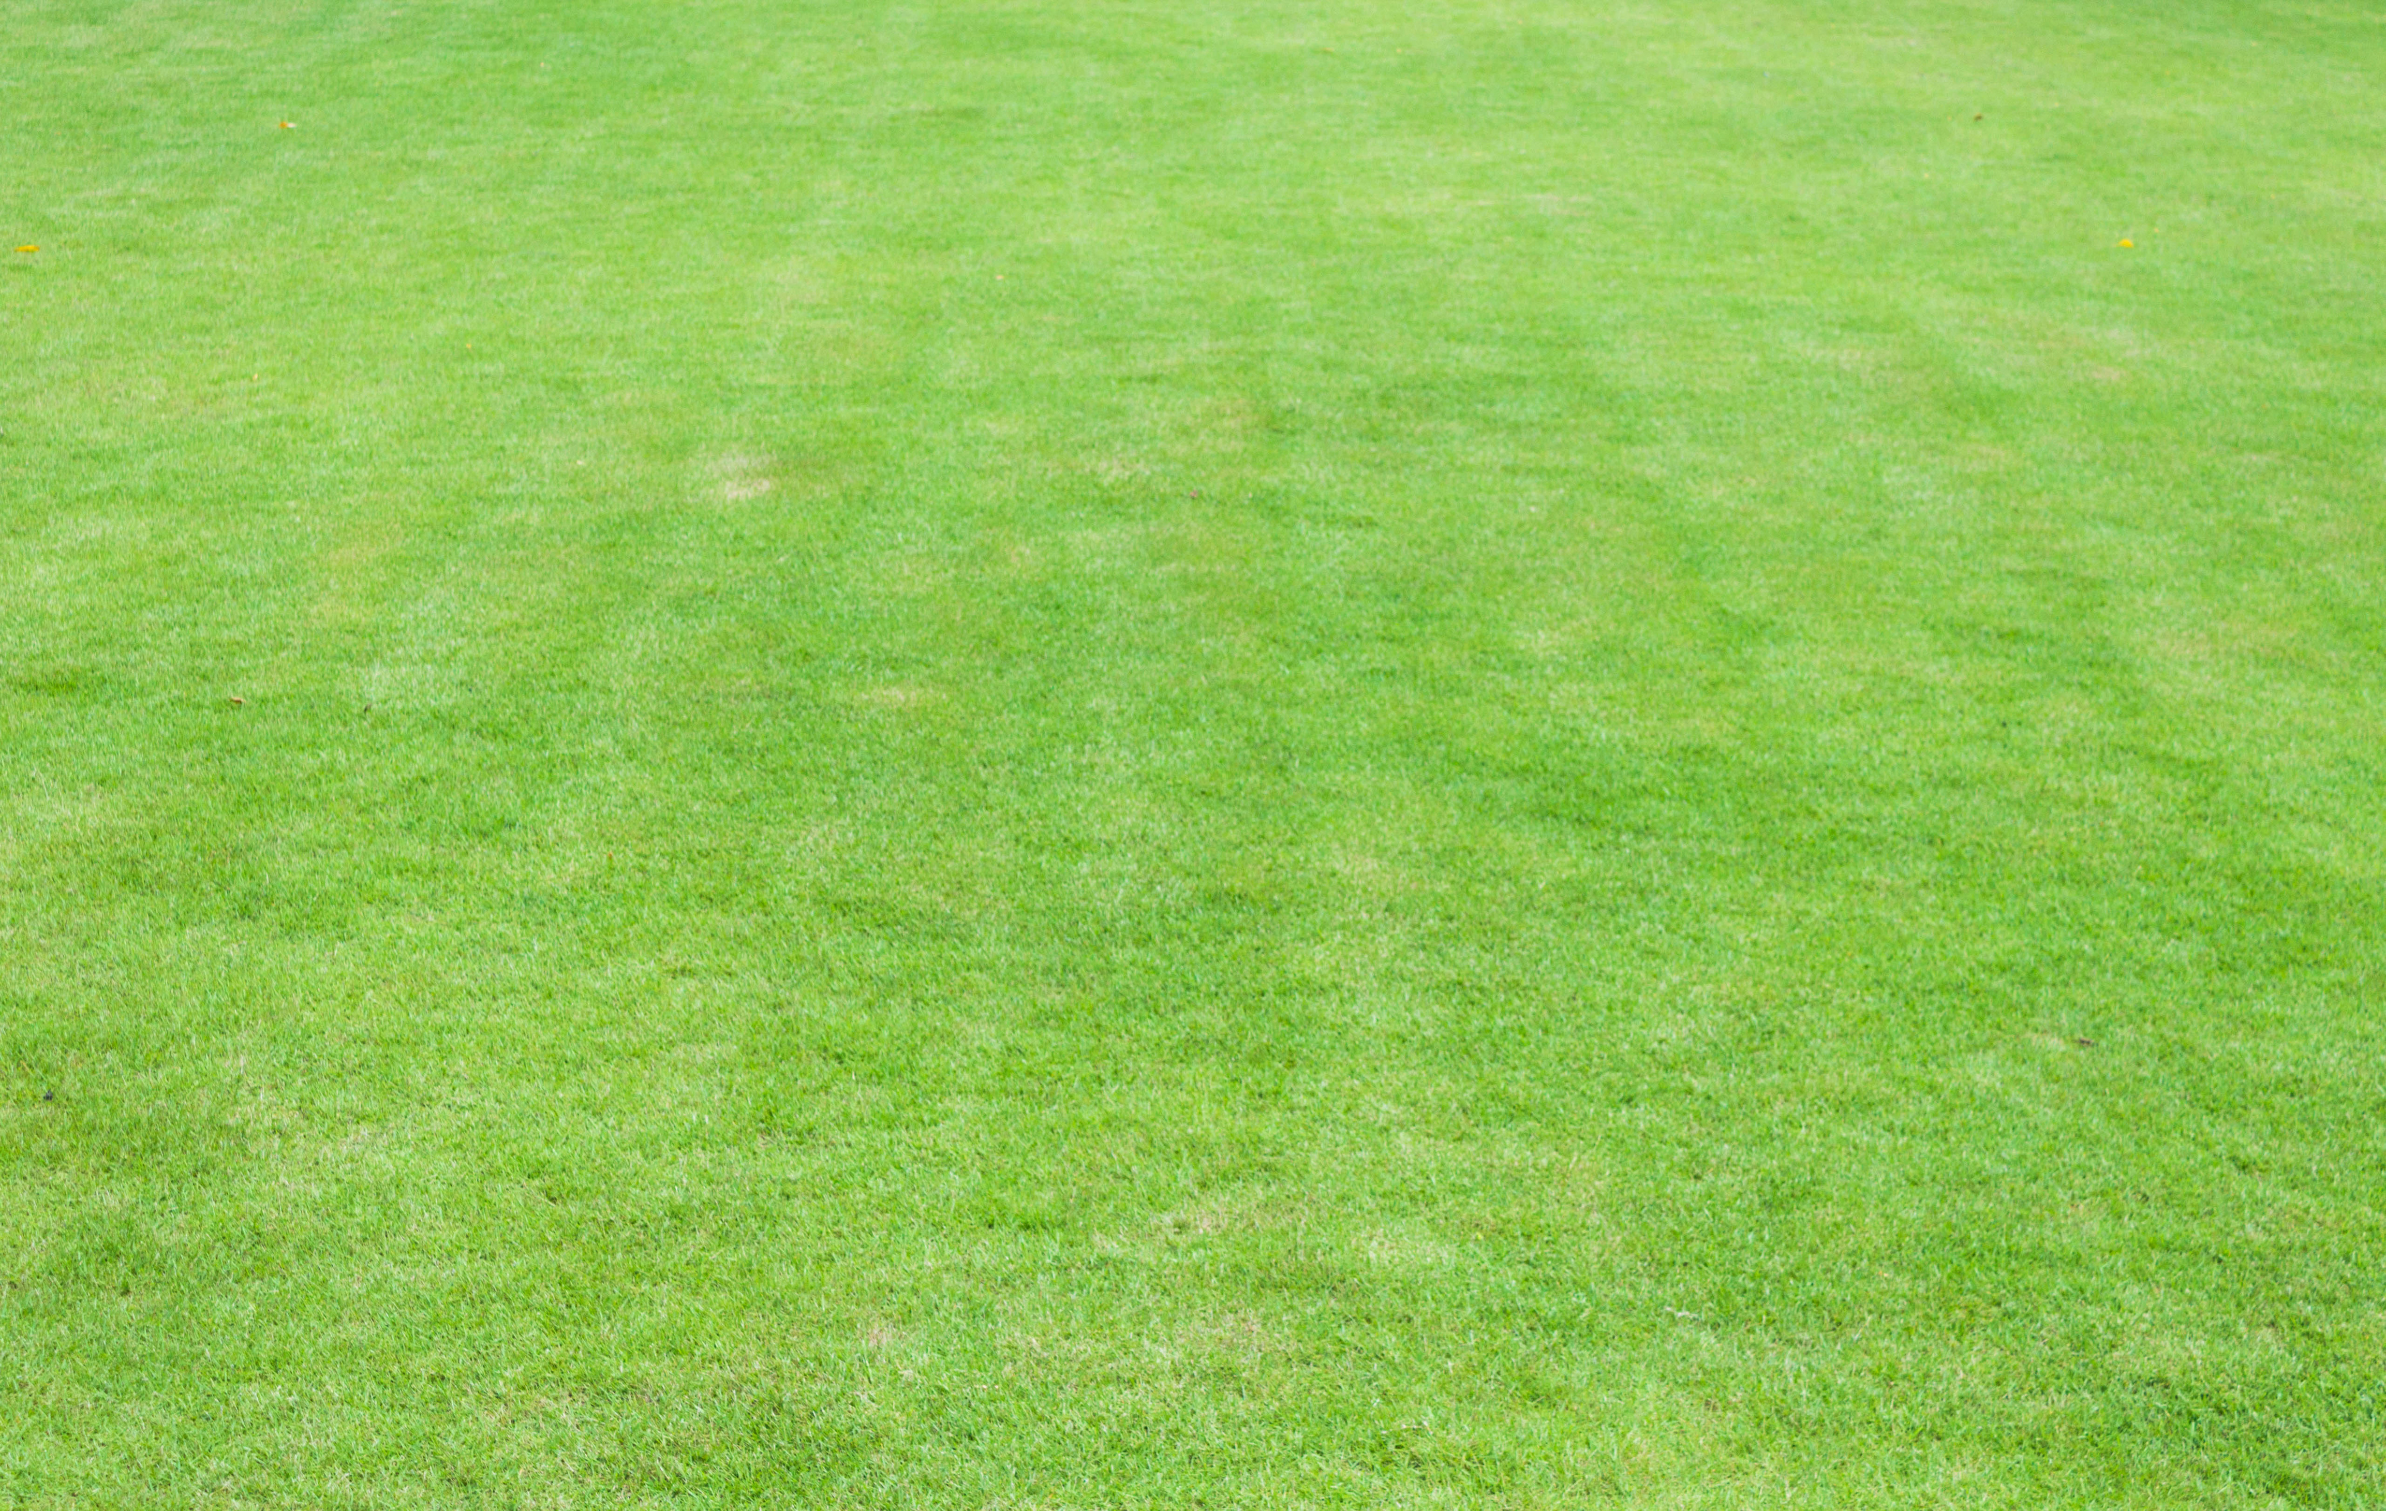
Stepping stones 1
I
you
don’t
like
oranges
sandwich
rice
sushi
banana
pasta
ice cream
and
apple
lollies
cake

Slide 3
Stepping stones 2
I
you
he
she
we
don’t
really
doesn’t
love
like
enjoy
oranges
sandwich
rice
sushi
banana
pasta
ice cream
and
apple
lollies
cake

Slide 4
© State of New South Wales (Department of Education) 2023

