Slide 1
Giving directions
Pour aller à…?

Slide 2
Turn left
Notes:
(tournez) à gauche: turn left

Slide 3
Turn right
Notes:
(tournez) à droite: turn right

Slide 4
Go straight
Notes:
continuez/allez tout droit: go straight ahead

Slide 5
Directions to train station
Notes:
Pour aller à la gare? How do you get to the train station?
Tournez à gauche: Turn left

Slide 6
Directions to the cinema
Notes:
Pour aller au cinéma ? How do you get to the cinema?
Tournez à droite: Turn right

Slide 7
Directions to the church
Notes:
Pour aller à l’église ? How do you get to the church?
Continuez/allez tout droit: Go straight ahead

Slide 8
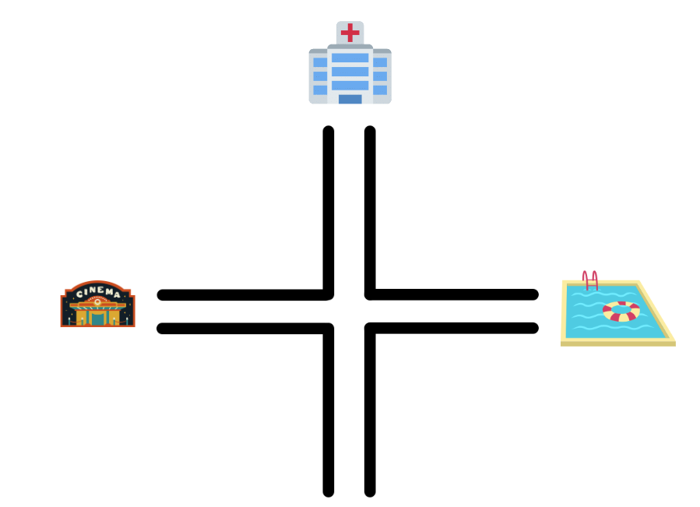
How to you get there
Notes:
Pour aller à l’hôpital ? How do you get to the hospital?
Allez tout droit: Go straight ahead
Pour aller à la piscine ? How do you get to the pool?
Tournez à droite: turn right
Pour aller au cinéma ? How do you get to the movies?
Pour aller à l’hôpital
Allez tout droit
Pour aller à la piscine
Tournez à droite
Pour aller au cinéma Tournez à gauche: Turn left

Slide 9
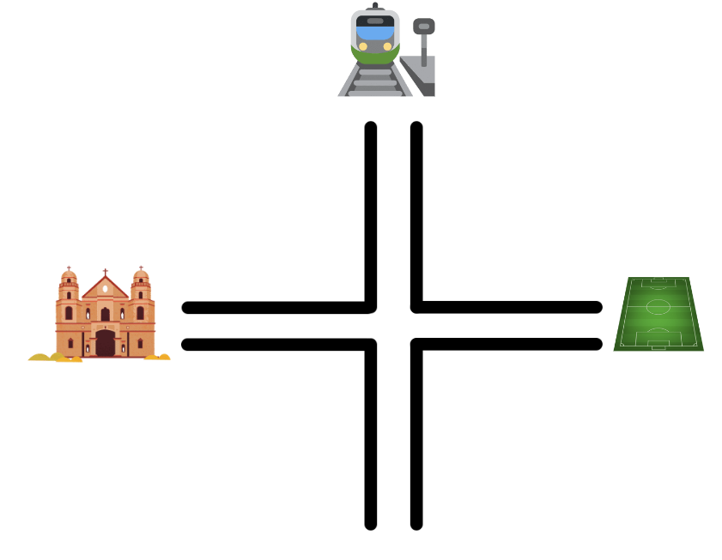
How to you get there continued
Notes:
Pour aller à l’église ? How do you get to the church?
Tournez à gauche: Turn left
Pour aller à la gare ? How do you get to the train station?
Allez tout droit: Go straight ahead
Pour aller au terrain de sport ? How do you get to the sports field?
Tournez à droite: turn right

Slide 10
First street
Notes:
prenez la première (rue) à gauche: take the first (street) on the left

Slide 11
Second street
Notes:
prenez la deuxième (rue) à gauche: take the first (street) on the left

Slide 12
Third street
Notes:
prenez la troisième (rue) à droite: take the third (street) on the right

Slide 13
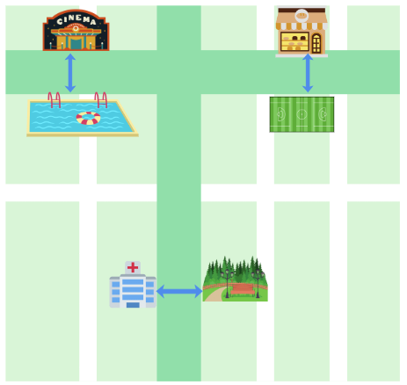
Opposite
Notes:
le cinéma est en face de la piscine: the cinema is opposite the swimming pool
le parc est en face de l’hôpital: the park is opposite the hospital
la boulangerie est en face du terrain de sport: the bakery is opposite the sports ground

Slide 14
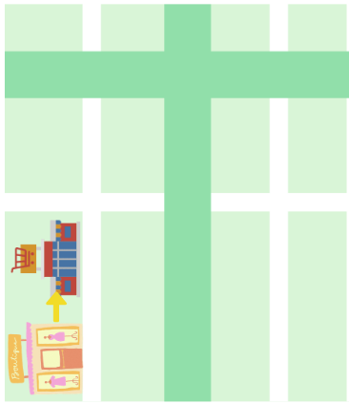
Next to/beside
Notes:
le supermarché est à côté du magasin: the supermarket is beside the shop

Slide 15
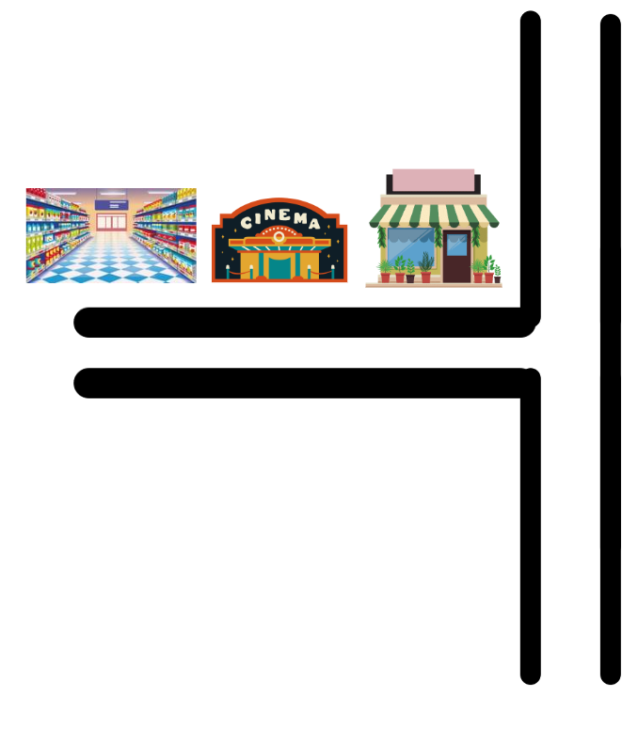
Between
Notes:
le cinéma est entre le supermarché et le magasin: the cinema is between the supermarket and the shop

Slide 16
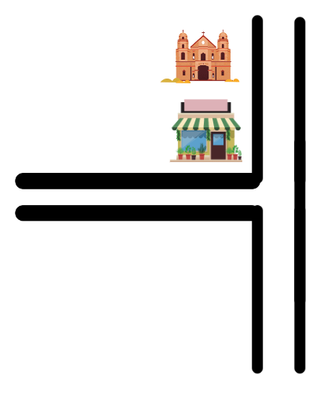
Behind and in front
Notes:
L’église est derrière le magasin: The church is behind the shop
le magasin est devant l’église: The shop is in front of the church

Slide 17
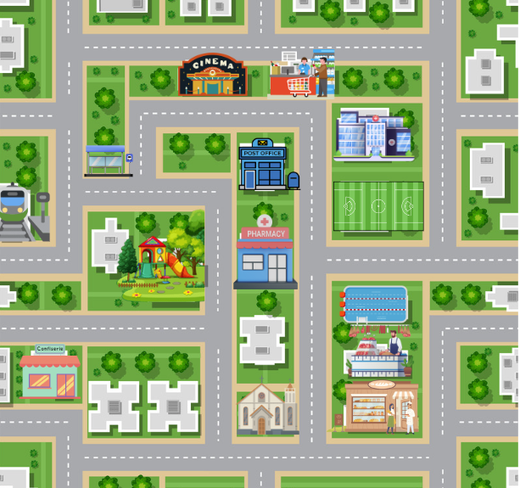
Map

Slide 18
Copyright
© State of New South Wales (Department of Education), 2023
The copyright material published in this resource is subject to the Copyright Act 1968 (Cth) and is owned by the NSW Department of Education or, where indicated, by a party other than the NSW Department of Education (third-party material).
Copyright material available in this resource and owned by the NSW Department of Education is licensed under a Creative Commons Attribution 4.0 International (CC BY 4.0) licence.
This license allows you to share and adapt the material for any purpose, even commercially.
Attribution should be given to © State of New South Wales (Department of Education), 2023.
Material in this resource not available under a Creative Commons license:
the NSW Department of Education logo, other logos and trademark-protected material
Material owned by a third party that has been reproduced with permission. You will need to obtain permission from the third party to reuse its material.
Links to third-party material and websites
Please note that the provided (reading/viewing material/list/links/texts) are a suggestion only and implies no endorsement, by the New South Wales Department of Education, of any author, publisher, or book title. School principals and teachers are best placed to assess the suitability of resources that would complement the curriculum and reflect the needs and interests of their students.
If you use the links provided in this document to access a third party’s website, you acknowledge that the terms of use, including licence terms set out on the third-party’s website apply to the use which may be made of the materials on that third-party website or where permitted by the Copyright Act 1968 (Cth). The department accepts no responsibility for content on third-party websites.

Slide 19
© State of New South Wales (Department of Education) 2023

