Slide 1
In France
Types of housing in France

Slide 2
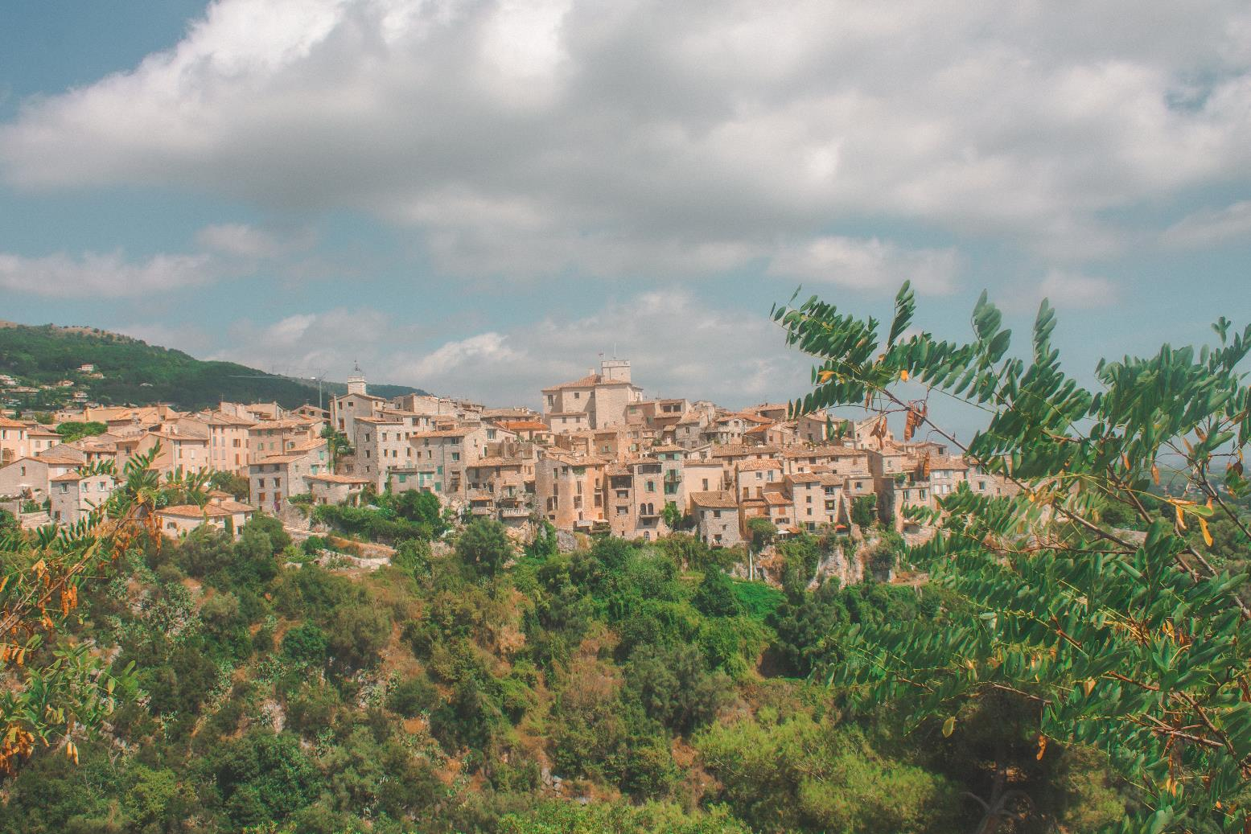
Villages
Image licensed under Unsplash License.
Notes:
Village in the south of France. Houses are built closely together, often from the same building materials. The design of housing is uniform so all the houses look the same. The town is built within a wall. Houses have shutters on their windows. The church is in the centre. There is a castle keep visible in the rear of the picture.

Slide 3
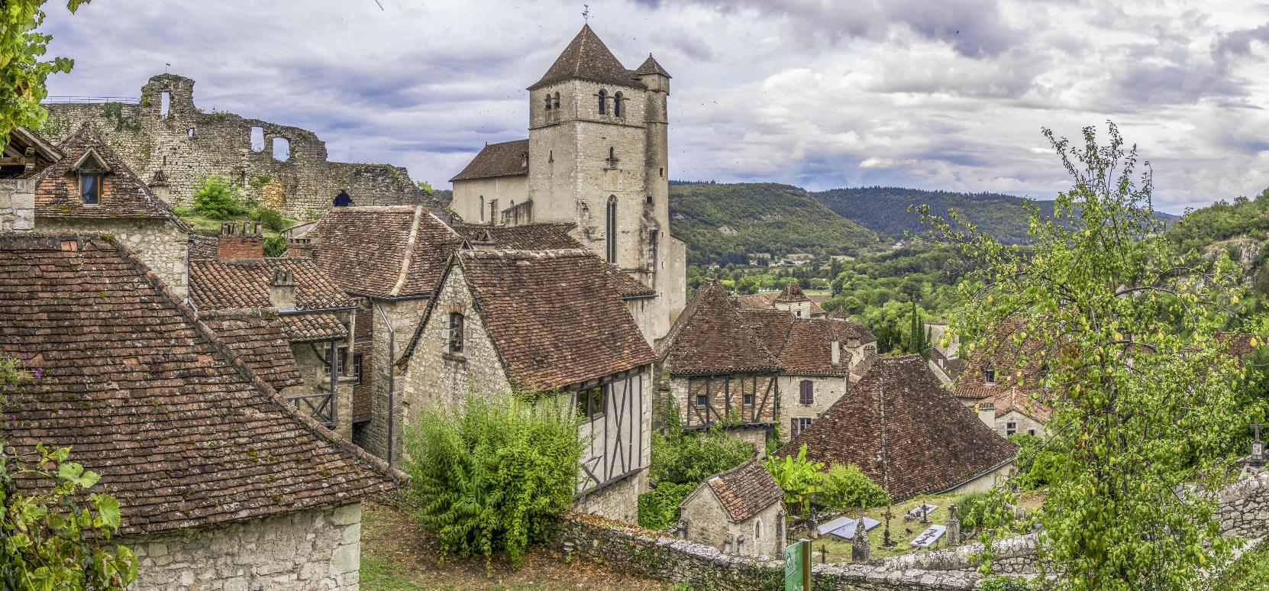
Medieval villages
Image licensed under Unsplash License.
Notes:
Medieval French village.
Houses are closely built from the same materials and with the same design. The village is built on the side of a hill in a (presumably) defensible position. Castle ruins are visible to the left of the picture. Shutters are on the windows. The church is the most impressive and biggest building in the town, centrally located.

Slide 4
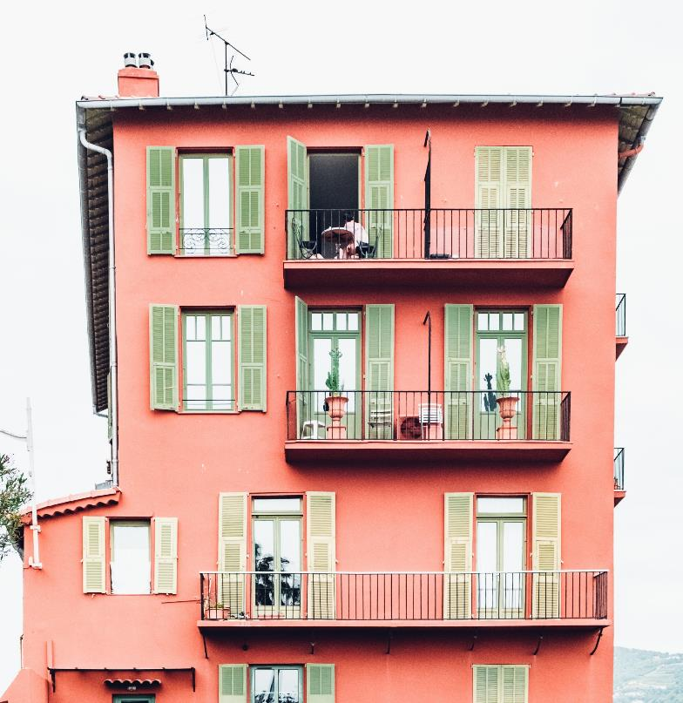
Apartments
Image licensed under Unsplash License.
Notes:
Apartment housing.
Shutters on all of the windows and narrow balconies.

Slide 5
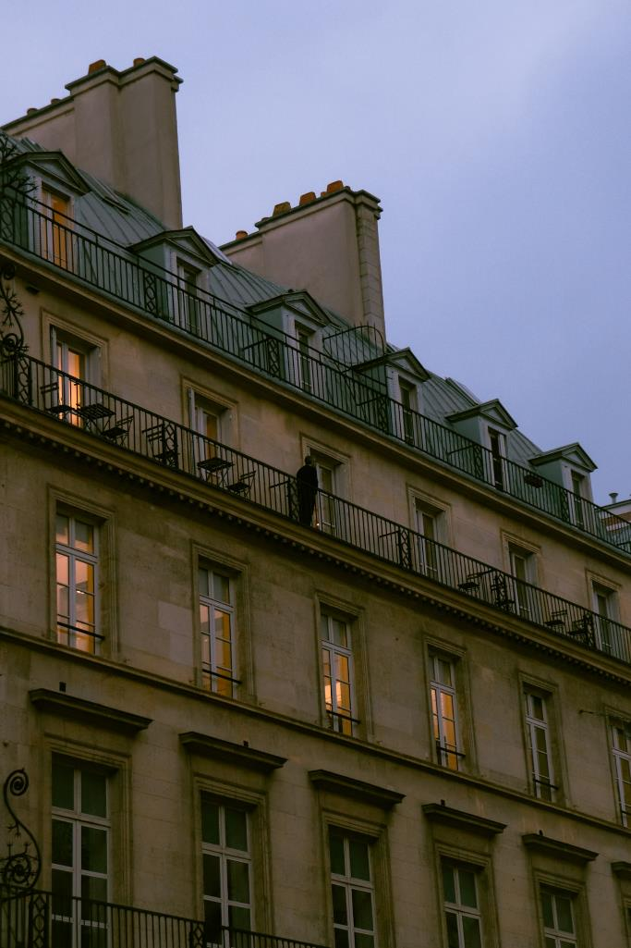
Paris apartments
Image licensed under Unsplash License.
Notes:
Apartment building in the city of Paris. Shutters are located on the interior of the building. These ‘maisons’ were at one time the property of a single owner. They have since been divided into apartment buildings (post French revolution).

Slide 6
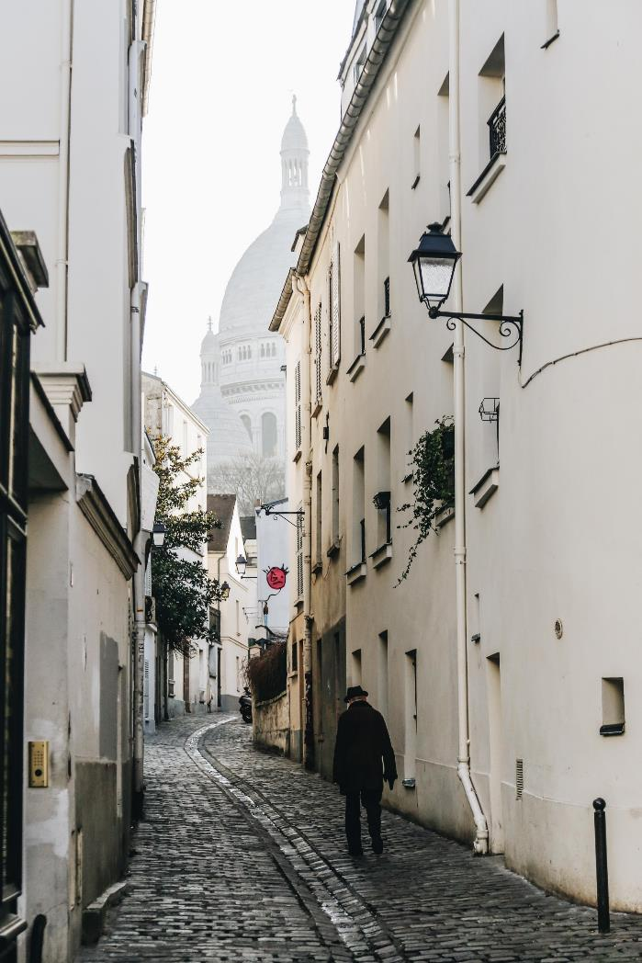
Apartment in town
Image licensed under Unsplash License.
Notes:
Apartment in town.
Narrow cobbled streets. The buildings are closely huddled together from a time where cars were not the means of transport. The gutters run down the middle of the street from an era when raw sewage, refuse and rain ran freely down the streets.

Slide 7
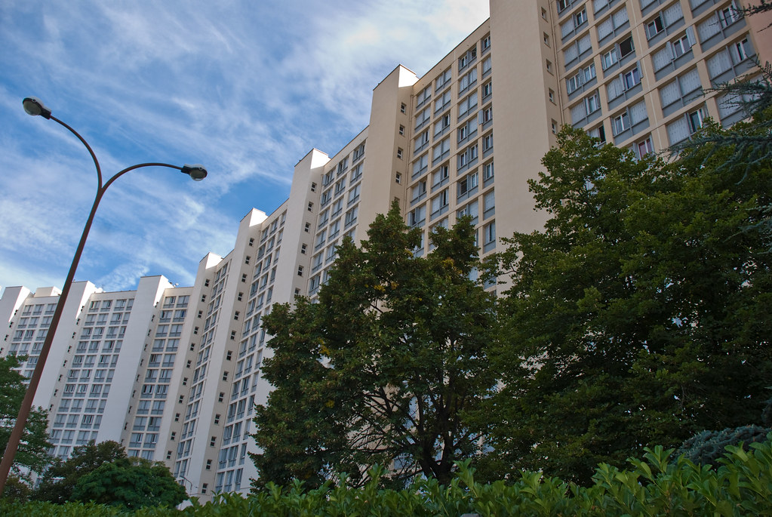
Multi-storey apartments
‘Apartment block, Toulouse, France, Sept. 2008 by In Memoriam: PhillipC is licensed under CC BY 2.0.
Notes:
Modern multi-storey apartment block.
Some cities in France have modern apartment blocks, more closely resembling what we see in Australia.

Slide 8
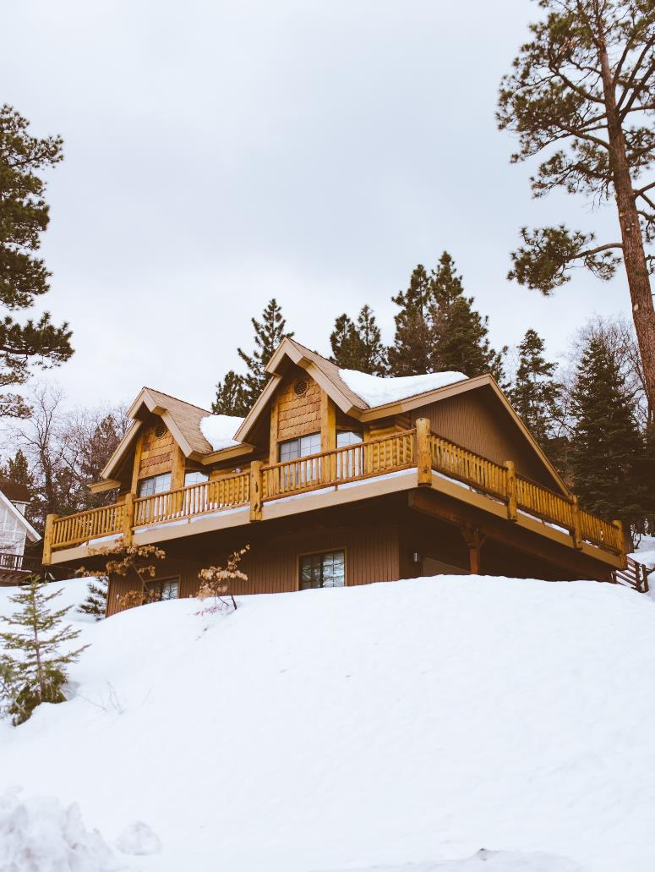
Mountain chalets
Image licensed under Unsplash License.
Notes:
A chalet in the mountains.
High pitched roof to prevent snow remaining on the roof. Timber is likely the most accessible resource at the time of construction.

Slide 9
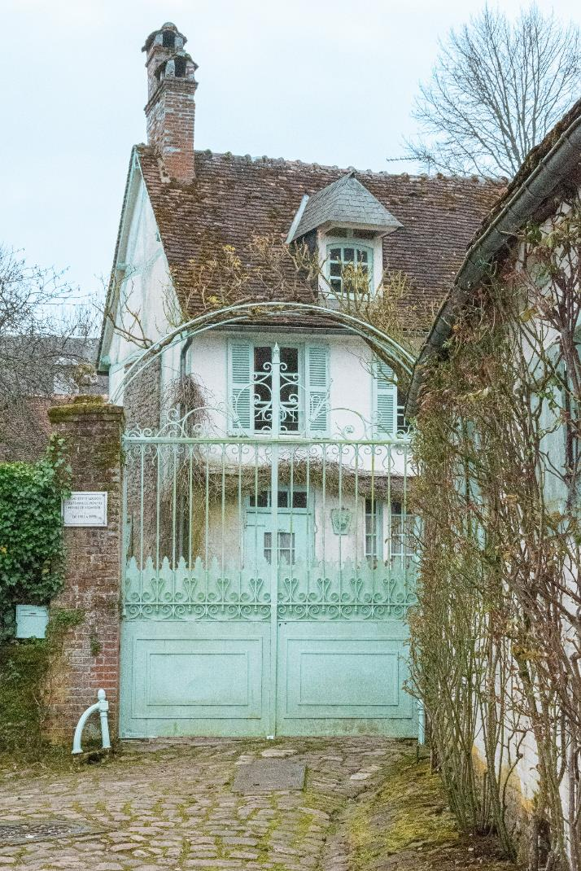
Villas
Image licensed under Unsplash License.
Notes:
House (villa).
High gates, letter box built into front fence, shutters on the windows. Multiple chimney stacks from an era when fireplaces were the only source of heat. Houses with gates like these usually have an intercom system to unlock the gate from inside the house.

Slide 10
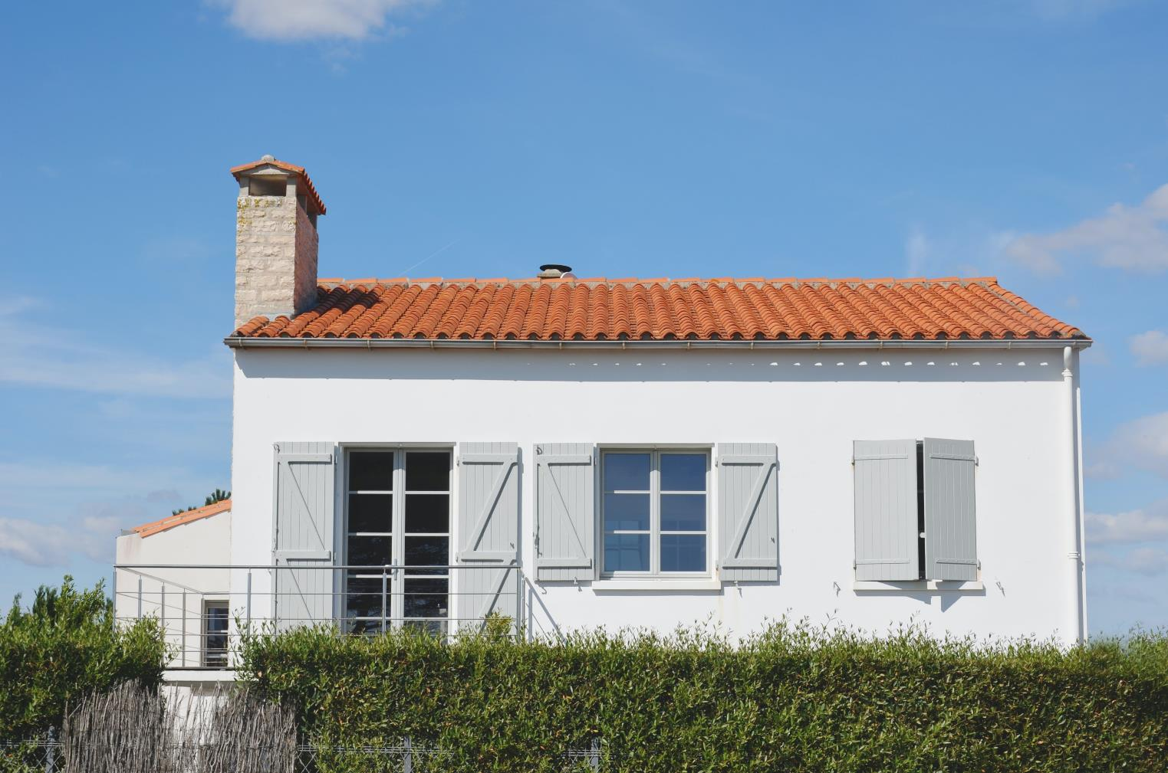
Country houses
Image licensed under Unsplash License.
Notes:
A villa/free-standing house in the country.
A new-looking building that has been built in the style of the region, regardless of age. The shutters are still included in houses to facilitate heating and cooling and for added security. The windows open inwards to be able to access the shutters when required. Free-standing single homes like this are usually seen in the country, not within the cities and towns.

Slide 11
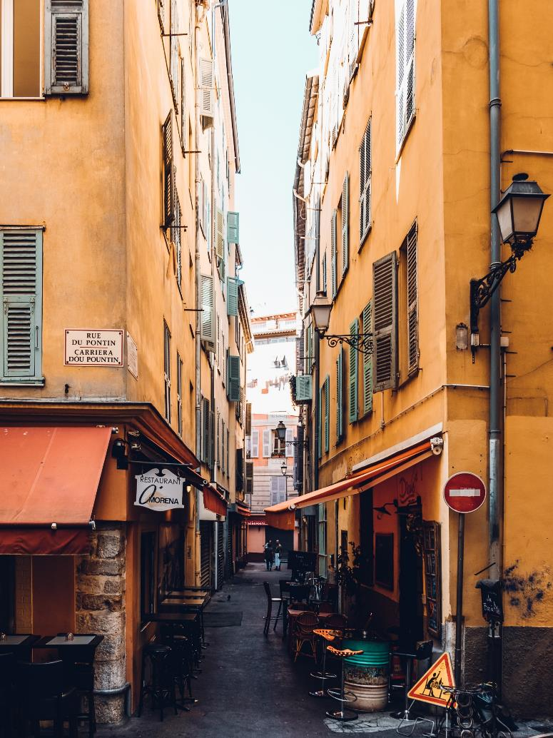
Terrace houses
Image licensed under Unsplash License.
Notes:
Typical street in a French town, with terrace houses above the shops.
The colour of the buildings indicates it is likely a house in the southern towns of France. The streets are narrow and shutters are on the windows. The street sign is written in French and Occitan, a French dialect spoken in Southern France, Italy, Monaco and Spain.

Slide 12
Copyright
© State of New South Wales (Department of Education), 2023
The copyright material published in this resource is subject to the Copyright Act 1968 (Cth) and is owned by the NSW Department of Education or, where indicated, by a party other than the NSW Department of Education (third-party material).
Copyright material available in this resource and owned by the NSW Department of Education is licensed under a Creative Commons Attribution 4.0 International (CC BY 4.0) licence.
This license allows you to share and adapt the material for any purpose, even commercially.
Attribution should be given to © State of New South Wales (Department of Education), 2023.
Material in this resource not available under a Creative Commons license:
the NSW Department of Education logo, other logos and trademark-protected material
Material owned by a third party that has been reproduced with permission. You will need to obtain permission from the third party to reuse its material.
Links to third-party material and websites
Please note that the provided (reading/viewing material/list/links/texts) are a suggestion only and implies no endorsement, by the New South Wales Department of Education, of any author, publisher, or book title. School principals and teachers are best placed to assess the suitability of resources that would complement the curriculum and reflect the needs and interests of their students.
If you use the links provided in this document to access a third party’s website, you acknowledge that the terms of use, including licence terms set out on the third-party’s website apply to the use which may be made of the materials on that third-party website or where permitted by the Copyright Act 1968 (Cth). The department accepts no responsibility for content on third-party websites.

