Slide 1
When I go to the markets 시장에 가면
Stage 4 – Korean

Slide 2
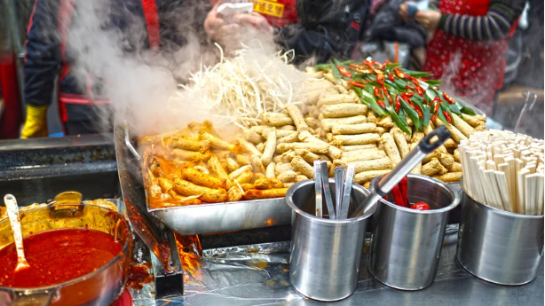
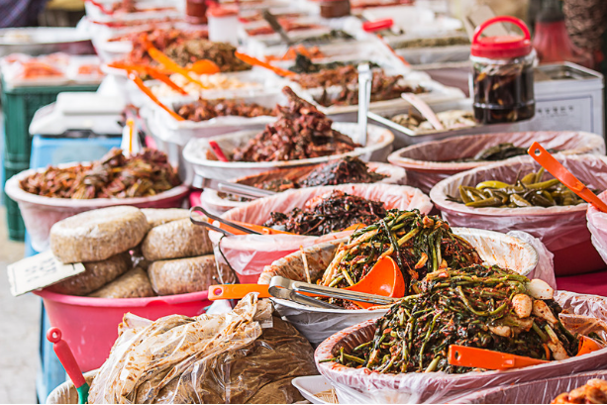
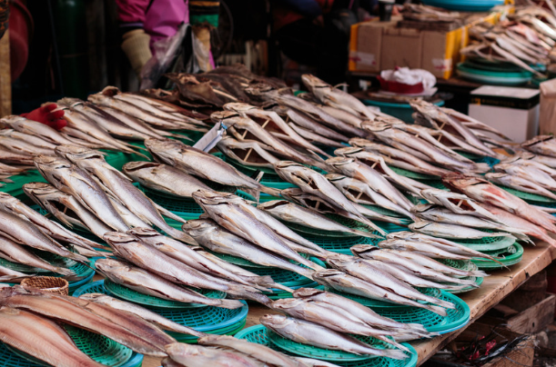
Introduction to Korean markets – 1
한국 시장 소개
Korean traditional markets, known as 시장 (pronounced shi-jang), are considered a special place for the country’s culture and economy. These markets are often a place where local residents and tourists can experience the rich tapestry of Korean daily life, sample traditional foods and find a wide array of fresh products.

Slide 3
Introduction to Korean markets – 2
한국 시장 소개
The key features of a 시장 are:
Diverse products: Traditional markets offer a diverse range of products, including fresh produce, seafood, meat, clothing, textiles, kitchenware and traditional Korean crafts. You can find everything from fresh vegetables and fruits to hanboks (traditional Korean clothing) and handmade pottery. They also showcase regional, local and seasonal specialties.
Street food and snacks: One of the highlights of Korean traditional markets is the abundance of street food stalls. Visitors can enjoy a variety of snacks and meals, such as 떡볶이 (spicy rice cakes), 비빔밥 (bibimbap), 호떡 (sweet pancakes), and more.
Negotiation and haggling culture: Haggling is a common practice in traditional markets, and vendors may be open to negotiation, especially for non-fixed price items. This adds an interactive element to the shopping experience.

Slide 4
Types of Korean markets
한국 시장의 종류
While there are many different 시장 in Korea, some of the most well-known are:
Namdaemoon Market (남대문 시장), one of the oldest and largest markets in Korea, also known for its historical landmark Namdaemoon (South) gate 남대문.
Dongdaemoon Market (동대문 시장), a popular shopping district also known for its late-night shopping and street food.
Gwangjang Market (광장시장), one of the oldest markets in Seoul, known for traditional Korean textiles, silk goods, hanboks (traditional Korean dress), street food and snacks.
Jagalchi Fish Market (자갈치 시장), one of Korea’s largest seafood markets, known for its fresh seafood and maritime culture.

Slide 5
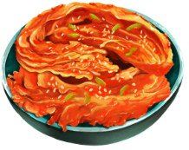
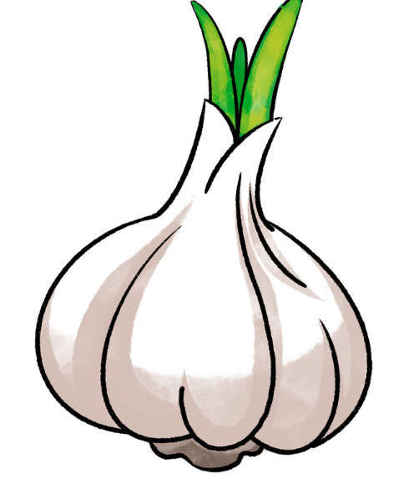
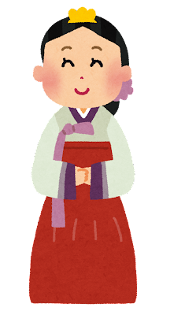
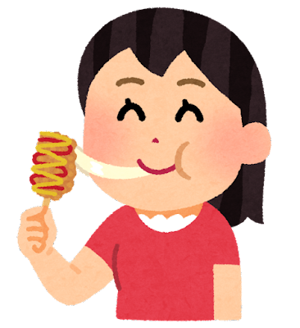
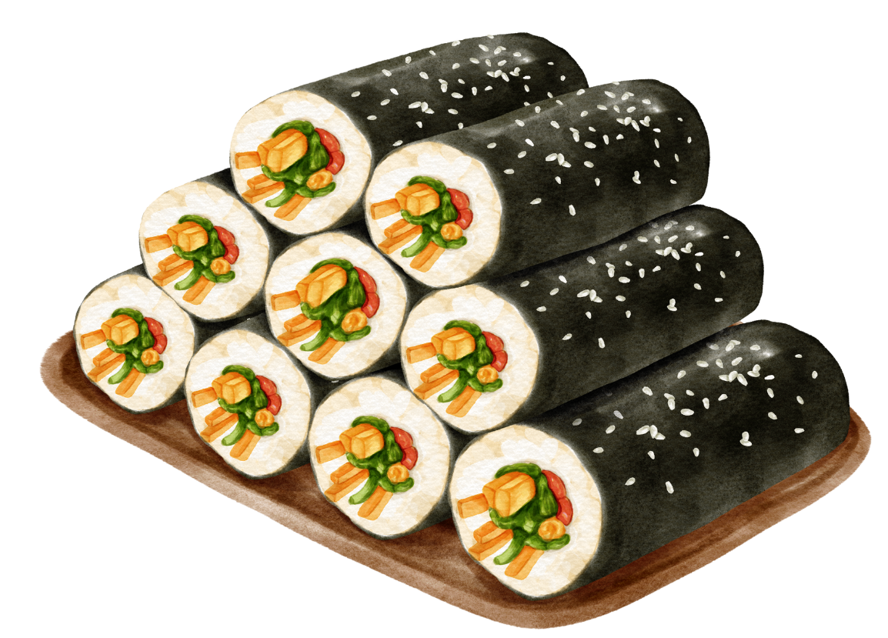
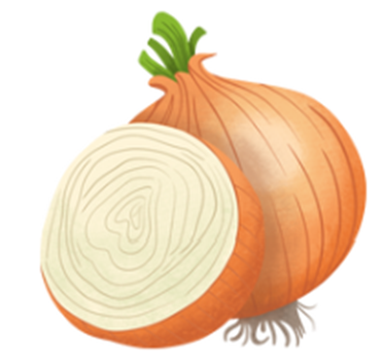
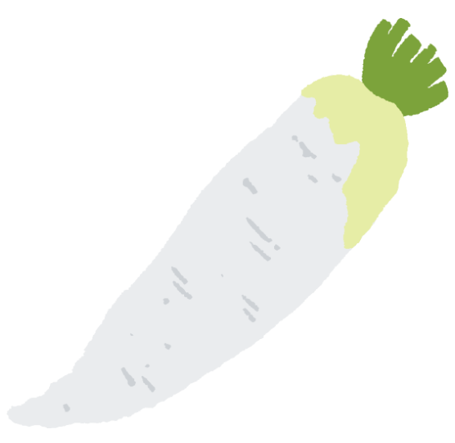
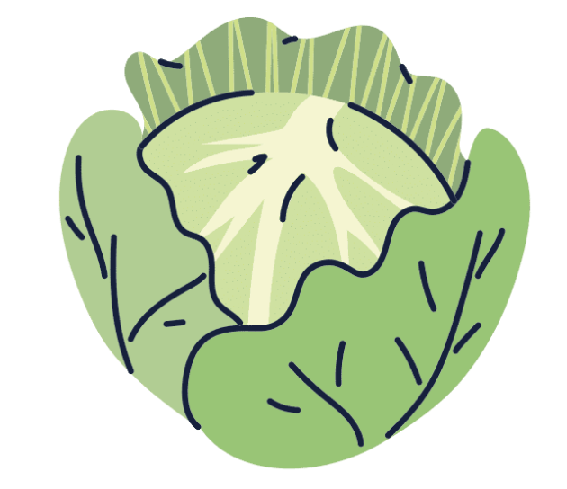
Things you can find in a Korean market
한국 시장에서 볼 수 있는 것 들
Notes:
Korean food markets offer a wide variety of fresh produce, meats, seafood, snacks, and prepared foods including:
Various types of fruits and vegetables, including staples like kimchi ingredients (cabbage, radish),
Fresh fish, shrimp, crab, clams, squid, octopus, and seaweed as well as prepared seafood dishes like grilled fish, sushi, and sashimi.
Beef, pork, chicken, and duck, including marinated meats for grilling like bulgogi and galbi.
Korean street food such as tteokbokki (spicy rice cakes), hoddeok (sweet pancakes), gimbap (seaweed rice rolls), mandu (dumplings), and fried snacks like twigim (tempura).
Traditional Korean sweets like hangwa (traditional cookies), yakgwa (honey cookies), and rice cakes (tteok) and modern desserts like bingsu (shaved ice dessert), patbingsu (shaved ice with sweet red beans), and various types of cakes and pastries.
Various types of kimchi (fermented vegetables), including traditional cabbage kimchi, radish kimchi, and cucumber kimchi and other pickled vegetables and fermented foods like soy sauce, fermented bean paste (doenjang), and fermented red pepper paste (gochujang).
Staples like rice, barley, beans and lentils for making traditional Korean dishes like doenjang-jjigae (soybean paste stew) and kongbap (bean rice).
Various spices, herbs, and seasonings used in Korean cuisine, including garlic, ginger, green onions, sesame oil, sesame seeds, and dried red pepper flakes.

Slide 6
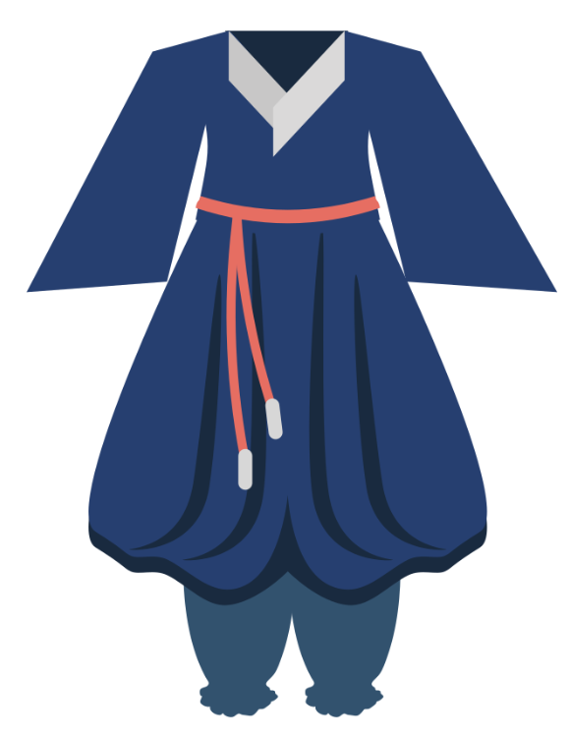
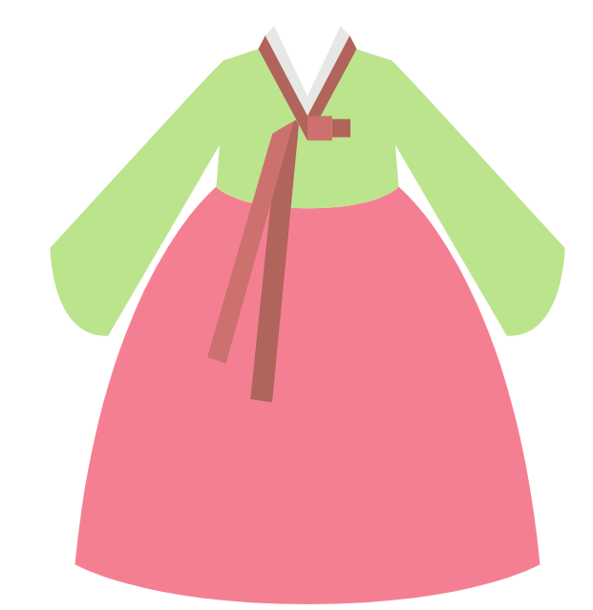
Interesting facts about Korean markets
한국 시장의 특이점
Cultural experiences:
Whether you are a local or a tourist, in these markets you can often view traditional practices, such as artisans crafting goods, and opportunities to participate in activities like pottery making or trying on Korean traditional clothes such as 한복 (hanbok).
Night markets:
Many Korean markets come alive at night with various busy street food vendors, eye-catching entertainment, and of course, late-night shoppers.

Slide 7
Copyright
© State of New South Wales (Department of Education), 2024
The copyright material published in this resource is subject to the Copyright Act 1968 (Cth) and is owned by the NSW Department of Education or, where indicated, by a party other than the NSW Department of Education (third-party material).
Copyright material available in this resource and owned by the NSW Department of Education is licensed under a Creative Commons Attribution 4.0 International (CC BY 4.0) license.
This license allows you to share and adapt the material for any purpose, even commercially.
Attribution should be given to © State of New South Wales (Department of Education), 2024.
Material in this resource not available under a Creative Commons license:
the NSW Department of Education logo, other logos and trademark-protected material
material owned by a third party that has been reproduced with permission. You will need to obtain permission from the third party to reuse its material.
Links to third-party material and websites
Please note that the provided (reading/viewing material/list/links/texts) are a suggestion only and implies no endorsement, by the New South Wales Department of Education, of any author, publisher, or book title. School principals and teachers are best placed to assess the suitability of resources that would complement the curriculum and reflect the needs and interests of their students.
If you use the links provided in this document to access a third-party's website, you acknowledge that the terms of use, including licence terms set out on the third-party's website apply to the use which may be made of the materials on that third-party website or where permitted by the Copyright Act 1968 (Cth). The department accepts no responsibility for content on third-party websites.
Notes:
Slide not shared

