Slide 1
Korean food and drinks – 한국 음식, 음료
Stage 4 – Korean

Slide 2
한국음식 (han-guk-eum-sik)
Korean foods

Slide 3
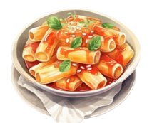
spicy rice cakes
떡볶이
(tteok-bokk-i)
*pronounced (tteok-bok-gi)
Notes:
Spicy rice cakes.

Slide 4
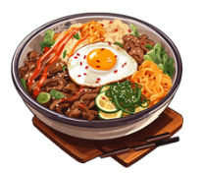
bibimbap
비빔밥
(bi-bim-bap)
Notes:
A bowl of steamed rice topped with assorted vegetables, meat, a fried egg and a spicy sauce called gochujang.

Slide 5
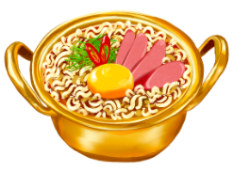
instant noodle dish
라면
(ra-myeon)
Notes:
Instant noodle dish.

Slide 6
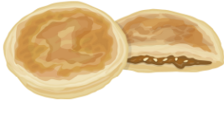
Korean sweet pancake
호 떡
(ho-ddeok)
Notes:
A pancake with a sweet filling.

Slide 7
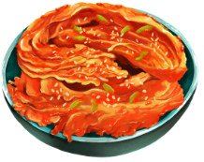
fermented vegetables
김치
(kim-chi)
Notes:
Fermented vegetables (usually cabbage and radish).

Slide 8
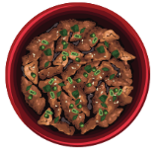
bulgogi
불고기
(bul-go-gi)
Notes:
Thinly sliced beef marinated in sweet and savoury sauce.

Slide 9
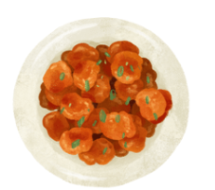
Korean fried chicken
치킨
(chi-kin)
Notes:
Korean fried chicken.

Slide 10
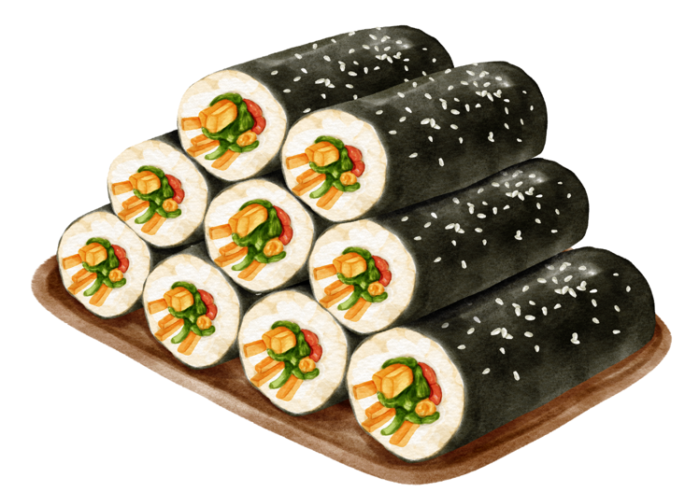
Korean rice vegetable rolls
김밥
(gim-bap)
Notes:
Korean rice vegetable rolls.

Slide 11
음료 (eum-ryo)
Drinks

Slide 12
coffee
커 피
(keo-pi)
Notes:
Coffee.

Slide 13
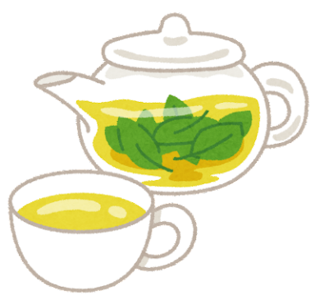
tea
차
(cha)
Notes:
Tea.

Slide 14
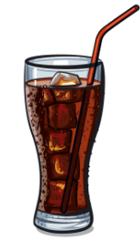
cola
콜라
(kol-ra)
Notes:
Cola.

Slide 15
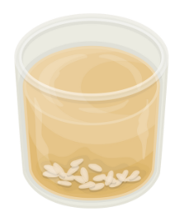
Korean sweet rice drink
식혜
(shik-hye)
Notes:
Korean sweet rice drink.

Slide 16
milk
우유
(u-yu)
Notes:
Milk.

Slide 17
water
물
(mul)
Notes:
Water.

Slide 18
Beat the teacher
Notes:
For slides 19 to 26, show students an image and identify the image in Korean. The students repeat after you if you have used the word that identifies the image correctly. If the word you say is different from the image on the board, they remain silent to win a point. If the word does not match the image and anyone in the class makes a sound, you take the point. The first to 7 points is the winner.

Slide 19
Beat the teacher: water (no text)
Notes:
water

Slide 20
Beat the teacher: bibimbap (no text)
Notes:
Bibimbap.

Slide 21
Beat the teacher: milk (no text)
Notes:
Milk.

Slide 22
Beat the teacher: tteokbokki (no text)
Notes:
Tteokbokki.

Slide 23
Beat the teacher: kimchi (no text)
Notes:
Kimchi.

Slide 24
Beat the teacher: shikhye (no text)
Notes:
Shikhye.

Slide 25
Beat the teacher: bulgogi (no text)
Notes:
Bulgogi.

Slide 26
Beat the teacher: tea (no text)
Notes:
Tea.

Slide 27
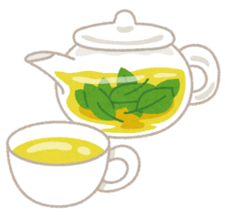
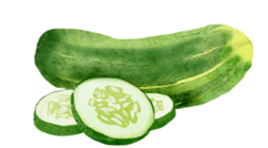
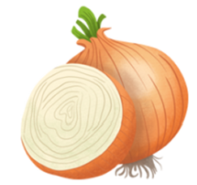
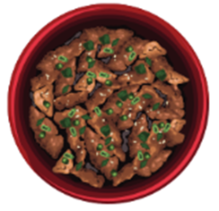
뭐가 있어요? (1)
What is there?
Notes:
뭐가 있어요? What is there?
차가 있어요. There is a tea.
오이가 있어요. There is a cucumber.
토마토가 있어요. There is a tomato.
떡볶이가 있어요. There is tteokbokki.
식혜가 있어요. There is shikhye.
콜라가 있어요. There is cola.
커피가 있어요. There is coffee.
김치가 있어요. There is kimchi.
바나나가 있어요. There is a banana.
불고기가 있어요. There is bulgogi.
양파가 있어요. There is an onion.
딸기가 있어요. There is a strawberry.
우유가 있어요. There is milk.

Slide 28
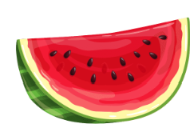
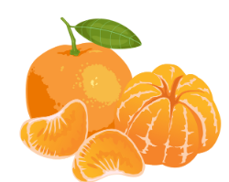
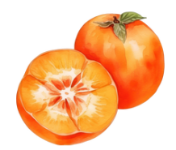
뭐가 있어요? (2)
What is there?
Notes:
뭐가 있어요? What is there?
비빔밥이 있어요. There is bibimbap.
라면이 있어요. There is ramyeon.
수박이 있어요. There is watermelon.
감이 있어요. There is a persimmon.
호떡이 있어요. There is hoddeok.
물이 있어요. There is water.
김밥이 있어요. There is rice vegetable rolls.
치킨이 있어요. There is chicken.
귤이 있어요. There is a tangerine.

Slide 29
Copyright
© State of New South Wales (Department of Education), 2024
The copyright material published in this resource is subject to the Copyright Act 1968 (Cth) and is owned by the NSW Department of Education or, where indicated, by a party other than the NSW Department of Education (third-party material).
Copyright material available in this resource and owned by the NSW Department of Education is licensed under a Creative Commons Attribution 4.0 International (CC BY 4.0) license.
This license allows you to share and adapt the material for any purpose, even commercially.
Attribution should be given to © State of New South Wales (Department of Education), 2024.
Material in this resource not available under a Creative Commons license:
the NSW Department of Education logo, other logos and trademark-protected material
material owned by a third party that has been reproduced with permission. You will need to obtain permission from the third party to reuse its material.
Links to third-party material and websites
Please note that the provided (reading/viewing material/list/links/texts) are a suggestion only and implies no endorsement, by the New South Wales Department of Education, of any author, publisher, or book title. School principals and teachers are best placed to assess the suitability of resources that would complement the curriculum and reflect the needs and interests of their students.
If you use the links provided in this document to access a third-party's website, you acknowledge that the terms of use, including licence terms set out on the third-party's website apply to the use which may be made of the materials on that third-party website or where permitted by the Copyright Act 1968 (Cth). The department accepts no responsibility for content on third-party websites.
Notes:
Slide not shared

