Slide 1
This or that?
Stage 4 – Korean

Slide 2
~주세요? (1)
Can I have hoddeok?
호떡 주세요?
Notes:
Ask students how they would ask for this item: (click to reveal)
호떡 주세요?

Slide 3
~주세요? (2)
Can I have bulgogi?
불고기 주세요?
Notes:
Ask students how they would ask for this item: (click to reveal)
불고기 주세요?

Slide 4
순대
Ssundae
뭐예요?
Notes:
How would you ask what this is? (click to reveal)

Slide 5
빙수
Bingsu
뭐예요?
Notes:
How would you ask what this is? (click to reveal)

Slide 6
짬뽕
Jjambbong
뭐예요?
Notes:
How would you ask what this is? (click to reveal)

Slide 7
콩국수
Kongguksu
뭐예요?
Notes:
How would you ask what this is? (click to reveal)

Slide 8
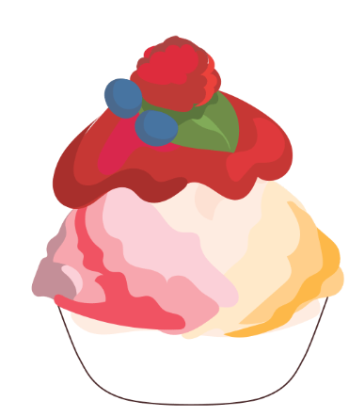
이것
This
이것은 뭐예요?
Notes:
To ask about something that is close by, add the phrase 이건 to 뭐예요?
(click to reveal)

Slide 9
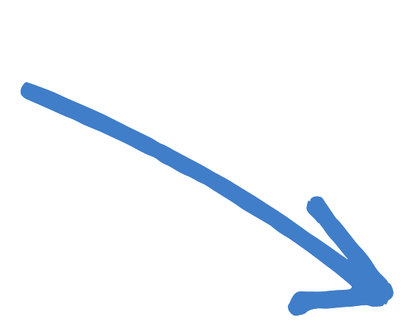
그것
That
그것은 뭐예요?
Notes:
To ask about something that is far from the speaker add the phrase 그건 to 뭐예요?
(click to reveal)

Slide 10
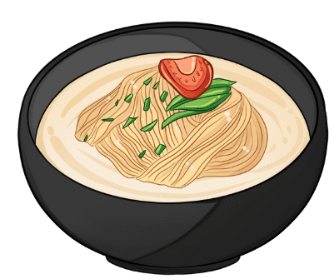
저것
That over there
저것은 뭐예요?
Notes:
To ask about something that is even further away add the phrase 저건 to 뭐예요?
(click to reveal)

Slide 11
이것은 뭐예요?
This
이것은 뭐예요?
이것은 빙수예요.
Notes:
(click to reveal)

Slide 12
그것은 뭐예요?
That
그것은 뭐예요?
그것은 순대예요
Notes:
CLICK to reveal the answer.

Slide 13
저것은 뭐예요?
That over there
저것은 뭐예요?
저것은 콩국수예요
Notes:
(click to reveal)

Slide 14
Copyright
© State of New South Wales (Department of Education), 2024
The copyright material published in this resource is subject to the Copyright Act 1968 (Cth) and is owned by the NSW Department of Education or, where indicated, by a party other than the NSW Department of Education (third-party material).
Copyright material available in this resource and owned by the NSW Department of Education is licensed under a Creative Commons Attribution 4.0 International (CC BY 4.0) license.
This license allows you to share and adapt the material for any purpose, even commercially.
Attribution should be given to © State of New South Wales (Department of Education), 2024.
Material in this resource not available under a Creative Commons licencse:
the NSW Department of Education logo, other logos and trademark-protected material
material owned by a third party that has been reproduced with permission. You will need to obtain permission from the third party to reuse its material.
Links to third-party material and websites
Please note that the provided (reading/viewing material/list/links/texts) are a suggestion only and implies no endorsement, by the New South Wales Department of Education, of any author, publisher, or book title. School principals and teachers are best placed to assess the suitability of resources that would complement the curriculum and reflect the needs and interests of their students.
If you use the links provided in this document to access a third-party's website, you acknowledge that the terms of use, including licence terms set out on the third-party's website apply to the use which may be made of the materials on that third-party website or where permitted by the Copyright Act 1968 (Cth). The department accepts no responsibility for content on third-party websites.
Notes:
Slide not shared

