Slide 1
Irregular verb conjugation fare
Notes:
Teacher notes:
Students have seen this verb before. Perhaps they have seen some conjugations, but not all.
This is a resource to revise the complete conjugation of fare. It is broken into 2 parts: singular verb forms then plural verb forms. To avoid cognitive overload, it is suggested to revise the singular forms first, then the plural.
Revise the infinitive expressions first then the conjugations.
Note that there is some new vocabulary in the sentences that accompany each conjugation. Ask students to guess what the vocabulary might be before providing the answer.

Slide 2
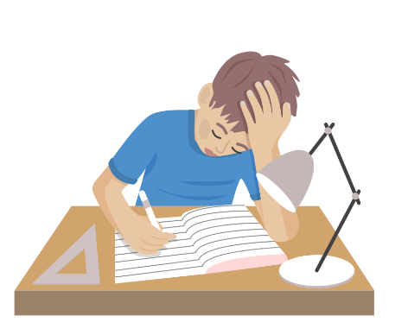
fare i compiti
Faccio i compiti.
Notes:
Teacher notes:
Ask students if they remember how to say ‘to do homework’.
CLICK fare i compiti
Ask students if they remember how to say ‘I do homework’.
Click Faccio i compiti.

Slide 3
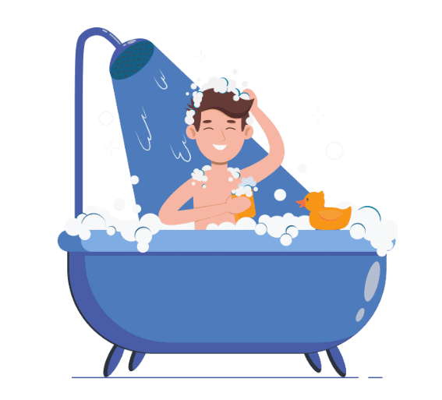
fare la doccia
Fai la doccia.
Fai la doccia?
3
Notes:
Teacher notes:
Ask students if they remember how to say ‘to have a shower’.
CLICK fare la doccia
Ask students if they remember how to say ‘You have a shower’.
CLICK Fai la doccia.
Remind students about questioning techniques in Italian: take the phrase and add a question mark or appropriate questioning intonation.
Ask if they remember how to ask the question ‘Are you having a shower?’
CLICK Fai la doccia?

Slide 4
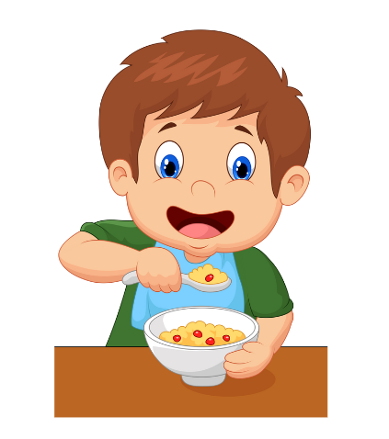
fare colazione
Fa colazione.
Fa colazione?
4
Notes:
Teacher notes:
Ask students if they remember how to say ‘to have breakfast’.
CLICK fare colazione
Ask students if they remember how to say ‘He/she has breakfast’.
CLICK Fa colazione.
Ask students if this sentence then translates to ‘he is having breakfast’ or ‘she is having breakfast’. Remind them that you have to know the context of the sentence or the personal pronoun or name should be used to clarify.
Ask if they remember how to ask the question ‘Is he/she having breakfast?’
CLICK Fa colazione?

Slide 5
Singular
fare – to make/do
Subject pronoun | Verb conjugation
io | faccio
tu | fai
lui/lei | fa
Notes:
Teacher notes:
Conjugation of the singular forms of fare for choral repetition.
Direct students to make sentences with these forms using the vocabulary presented or prior knowledge, for example, Che cosa fai? and students have to produce a response.

Slide 6
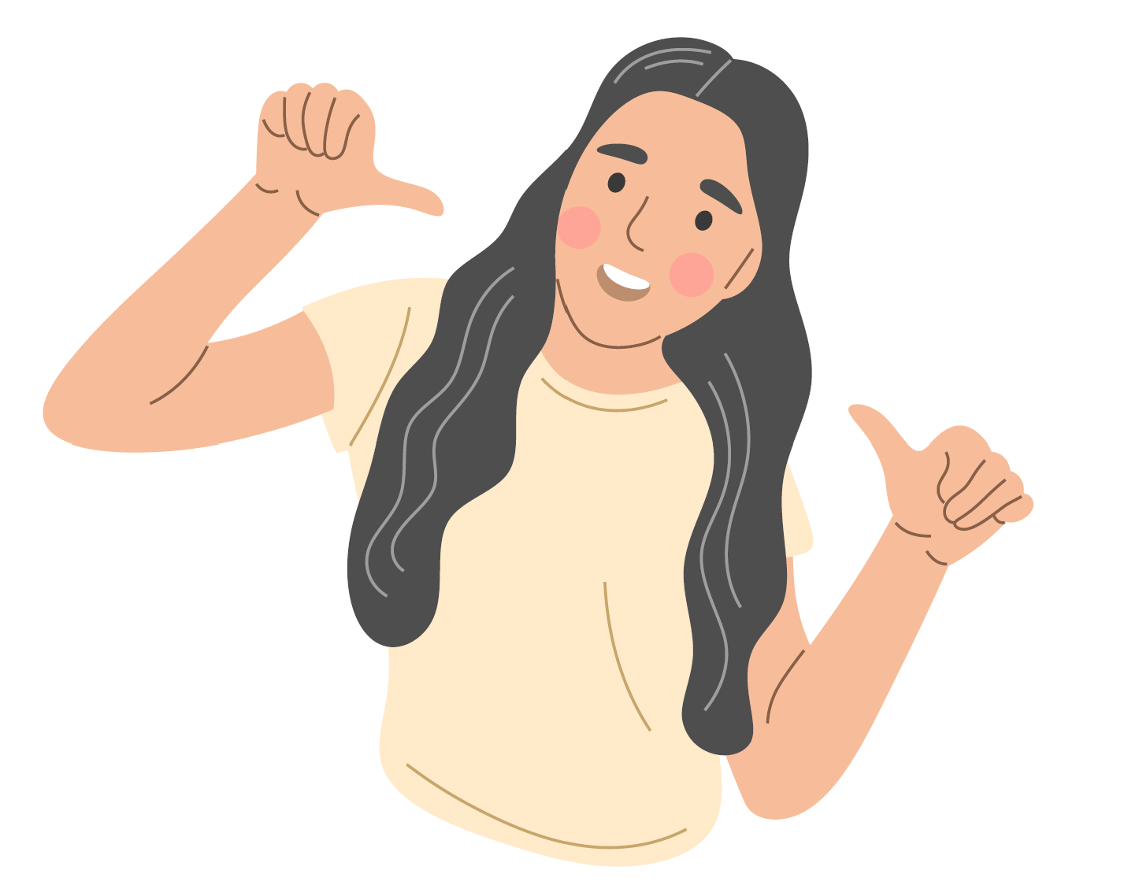
Let’s practise! (1)
Notes:
Teacher notes:
Use the 4 images on the slide – I, you, he and she – to practise expressions with fare.
Point to the image and have students repeat the correct conjugation of an expression with fare. For example, point to the image of the hand pointing and say tu fai i compiti. When students are confident, ask individual students for the conjugation which matches the image you point to each time.

Slide 7
fare lo shopping
Facciamo lo shopping.
Facciamo lo shopping?
we
7
Notes:
Teacher notes:
Ask students if they remember how to say ‘to shop’.
CLICK fare lo shopping
Ask students if they remember how to say ‘We are shopping’.
CLICK Facciamo lo shopping.
Ask students if they remember how to make a suggestion about shopping using the noi form of the imperative tense to express ‘Let’s’.
CLICK Facciamo lo shopping?

Slide 8
fare i compiti
Fate i compiti.
Fate i compiti?
you (plural)
Notes:
Teacher notes:
Here is another example with fare i compiti.
Ask students if they remember how to say ‘You (plural) do homework’.
CLICK Fate i compiti.
Ask students if they remember how to ask if 2 or more people are doing homework.
CLICK Fate i compiti?

Slide 9
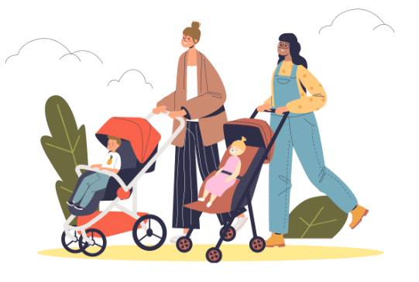
fare una passeggiata
Fanno una passeggiata.
Fanno una passeggiata?
they
9
Notes:
Teacher notes:
This might be a new expression for students. If so, go directly to the verb. If not, ask students if they remember how to say ‘to go for a walk’.
CLICK fare una passeggiata
Ask students if they remember how to say ‘They are going for a walk’.
CLICK Fanno una passeggiata.
Ask them how you would ask the question ‘Are they going for a walk?”.
CLICK Fanno una passeggiata?

Slide 10
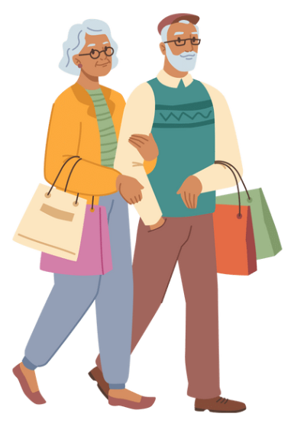
Plural
Fare – to make/do
Subject pronoun | Verb conjugation
noi | facciamo
voi | fate
loro | fanno
Notes:
Teacher notes:
Conjugation of the plural forms of fare for choral repetition. If further practice is needed, you could get students to make sentences with these forms using the vocabulary presented or prior knowledge.
Ensure students have the full conjugation written in their books or devices and added to their anchor chart.

Slide 11
Let’s practise! (2)
Notes:
Teacher notes:
Use the 3 images on the slide – we, you (plural) and they – to practise expressions with fare.
Point to the image and have students repeat the correct conjugation of an expression with fare. For example, point to the image of the boy pointing to the 3 other people and say fanno una passeggiata.
When students are confident, ask individual students for the conjugation which matches the image you point to each time.

Slide 12
Copyright
© State of New South Wales (Department of Education), 2024
The copyright material published in this resource is subject to the Copyright Act 1968 (Cth) and is owned by the NSW Department of Education or, where indicated, by a party other than the NSW Department of Education (third-party material).
Copyright material available in this resource and owned by the NSW Department of Education is licensed under a Creative Commons Attribution 4.0 International (CC BY 4.0) license.
This license allows you to share and adapt the material for any purpose, even commercially.
Attribution should be given to © State of New South Wales (Department of Education), 2024.
Material in this resource not available under a Creative Commons license:
the NSW Department of Education logo, other logos and trademark-protected material
material owned by a third party that has been reproduced with permission. You will need to obtain permission from the third party to reuse its material.
Links to third-party material and websites
Please note that the provided (reading/viewing material/list/links/texts) are a suggestion only and implies no endorsement, by the New South Wales Department of Education, of any author, publisher, or book title. School principals and teachers are best placed to assess the suitability of resources that would complement the curriculum and reflect the needs and interests of their students.
If you use the links provided in this document to access a third-party's website, you acknowledge that the terms of use, including licence terms set out on the third-party's website apply to the use which may be made of the materials on that third-party website or where permitted by the Copyright Act 1968 (Cth). The department accepts no responsibility for content on third-party websites.
Notes:
Slide not shared

