Slide 1
Reflexive verbs in Italian

Slide 2
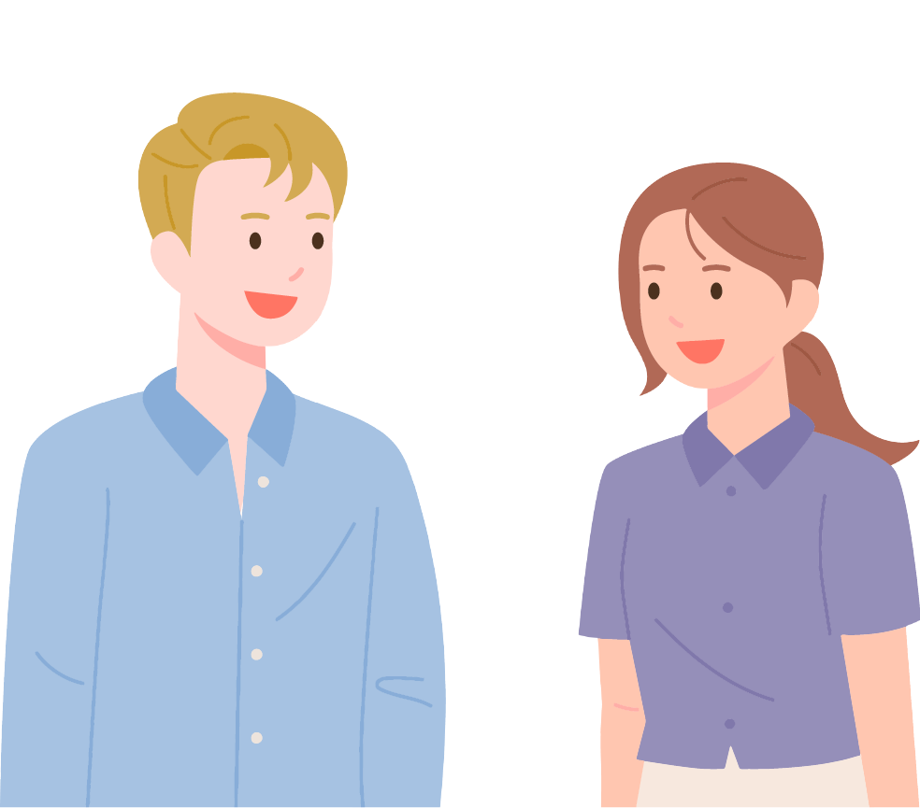
chiamarsi
Come ti chiami?
Mi chiamo Elena.
Notes:
Teacher notes:
Remind students of this structure, What is your name? My name is Elena. This is really a reflexive structure as the literal translation is: ‘How do you call yourself? I call myself Elena’. So, students have already seen a reflexive verb in action.
Ask students to indicate the difference between the verb conjugations they have previously seen (io vado al cinema, tu giochi a calcio) and these phrases above. They might pick out the reflexive pronouns, ti and mi.
Explain briefly what reflexive verbs are: the subject of the action (the person doing the action) is also the object of the action. The subject of the verb is doing the action to themselves. They look a bit different to the infinitives they have met so far.
Go through the following slides, directing students to repeat after you.

Slide 3
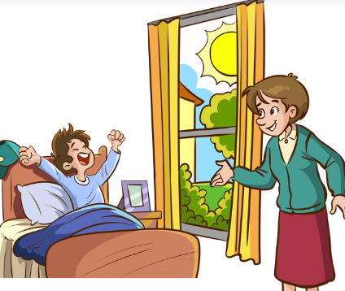
svegliare versus svegliarsi
Mamma sveglia mio fratello.
Anna si sveglia alle sei.
Notes:
Teacher notes:
Compare these 2 verbs – svegliare (a non-reflexive verb) and svegliarsi (a reflexive verb).
In the first sentence, mum is waking my brother, so the subject of the verb (mum – CLICK to reveal arrow) is different to the object of the verb (my brother - CLICK).
In the second sentence, Anna is waking herself, so the subject of the verb (Anna - CLICK to reveal arrow) is the same as the object of the verb (Anna - CLICK). This is represented by a reflexive pronoun, in this case si, as the verb reflects back on itself.

Slide 4
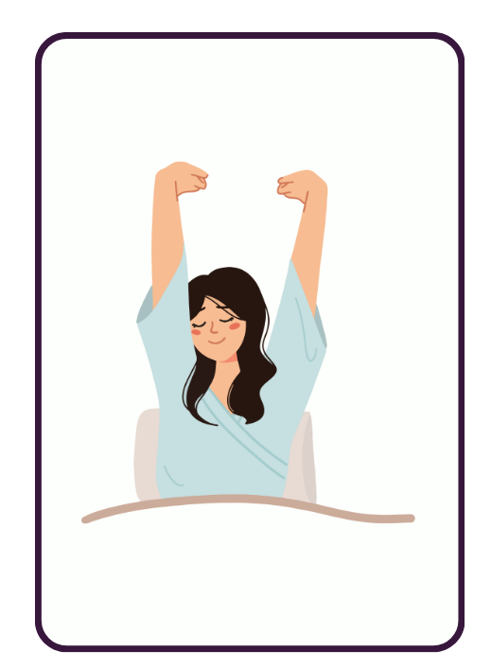
svegliarsi
Notes:
Teacher notes:
Introduce infinitives first. Direct students to repeat after you. Add in an action as well if appropriate in your context.

Slide 5
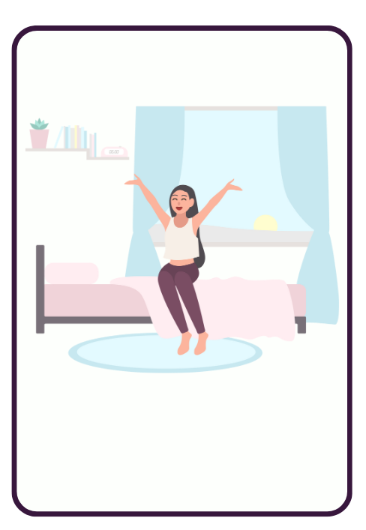
alzarsi

Slide 6
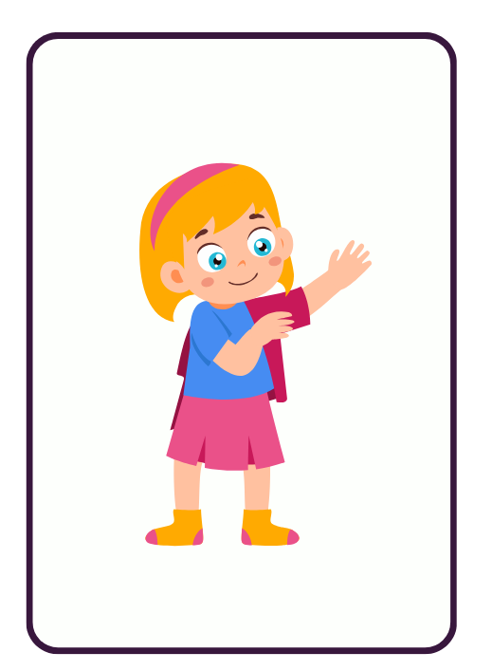
vestirsi

Slide 7
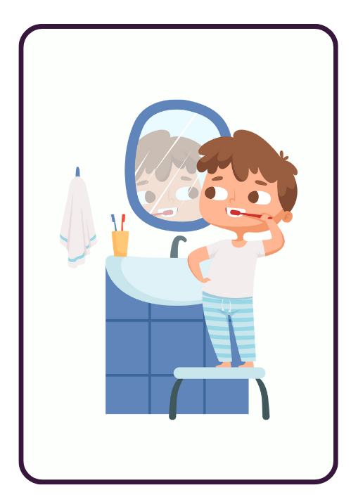
lavarsi
Notes:
Teacher notes:
Point out that unlike English, we don’t use the possessive pronoun to say ‘I brush MY teeth’, as the reflexive pronoun in Italian makes it clear, MI lavo i denti.

Slide 8
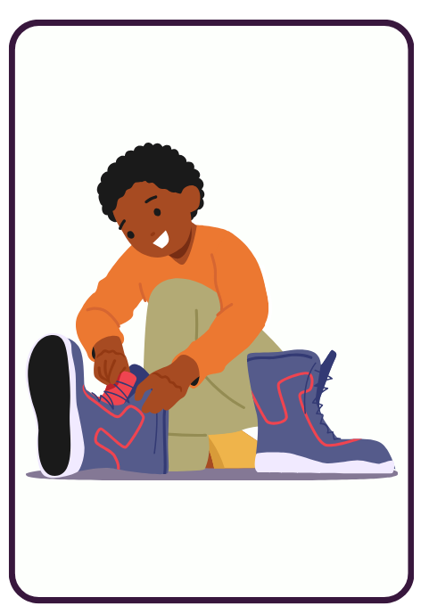
prepararsi

Slide 9
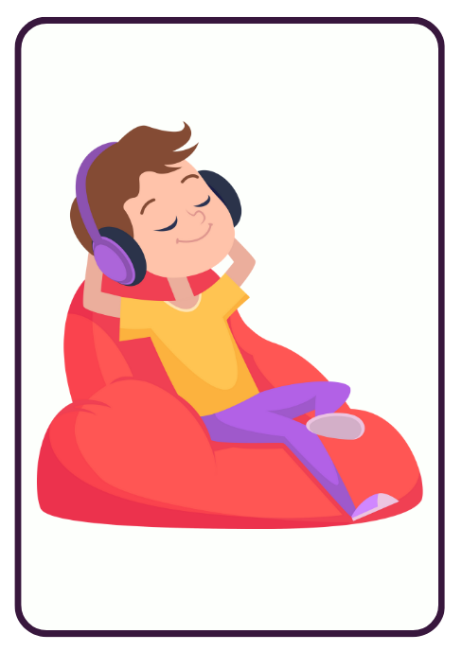
riposarsi

Slide 10
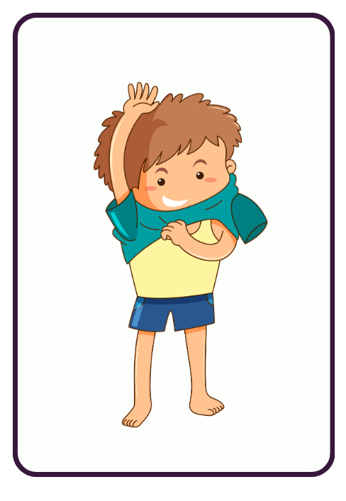
spogliarsi

Slide 11
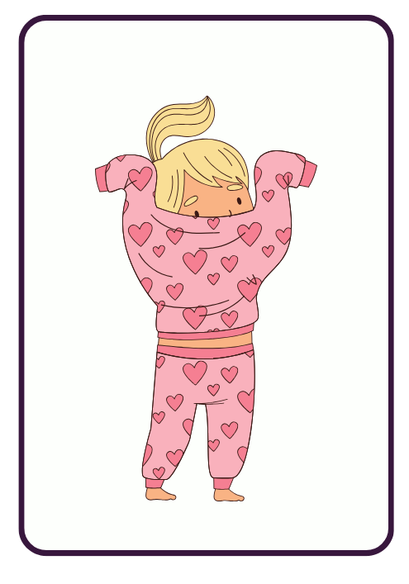
mettersi (il pigiama)
Notes:
Teacher notes:
As with lavarsi i denti, we don’t use the possessive pronoun for pyjamas, as the reflexive pronoun in Italian makes it clear, MI metto il pigiama.

Slide 12
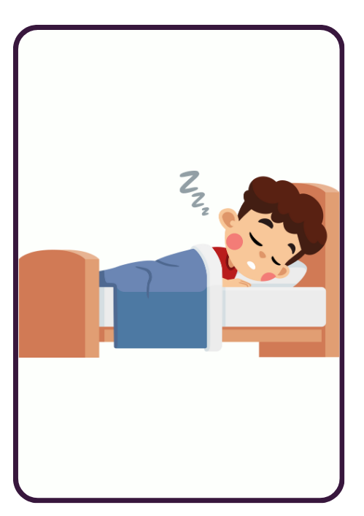
addormentarsi
Notes:
Teacher notes:
Students need to practise these so they can recognise them easily.
Before moving to the next slide to look at conjugations, ask the students what they have noticed about all of these infinitives. You might want to go back through the slides to stimulate recognition if you need to. Hopefully they will recognise that they all end in –si which is what distinguishes them from regular verbs.
Once students have practised the infinitives move to the next slide for the conjugation of reflexive verbs.

Slide 13
Reflexive verb conjugation
svegliarsi – to wake (oneself) up
Subject pronoun | Reflexive pronoun | Verb conjugation
io | mi | sveglio
tu | ti | svegli
lui/lei | si | sveglia
noi | ci | svegliamo
voi | vi | svegliate
loro | si | svegliano
Notes:
Teachers notes:
Remind students they have already seen io mi and tu ti forms of the reflexive in Come ti chiami? Mi chiamo…. Introduce the conjugation of the reflexive verbs. Get students to repeat each conjugation, singular to plural.
Pick out the reflexive pronouns first. Ask students why they think they are necessary? Answer: to reflect that the subject of the verb is doing the action to themselves. The subject is both doing and receiving the action. For example, alzarsi = getting oneself up as opposed to someone else getting you up (for example, a baby), vestirsi = dressing oneself rather than someone else dressing you. This could be broken down into introducing the singular forms first then the plural forms.

Slide 14
Reflexive verb list
Italian | English
chiamarsi | to call oneself
svegliarsi | to wake up
alzarsi | to get up
vestirsi | to get dressed
lavarsi (i denti) | to wash (brush teeth)
prepararsi | to prepare
riposarsi | to rest
spogliarsi | to get undressed
mettersi (il pigiama) | to put on (pyjamas)
addormentarsi | to go to sleep
Notes:
Teacher notes:
List of all reflexive verbs students have met so far.

Slide 15
Activity
Antonio _____ sveglia alle sette.
Tu _____ alzi alle otto di mattina?
Antonella _____ lava i denti dopo il pranzo.
Io e Gino, _____ riposiamo davanti alla TV.
Io _____ metto il pigiama alle nove e mezza.
Tu e Fabrizio, ______ addormentate alle dieci?
Giuseppe e Rosa _____ preparano per andare alla festa.
si
ti
si
ci
mi
vi
si
Notes:
Teacher notes:
Students need to give the correct reflexive pronoun to complete each sentence. CLICK TO REVEAL.

Slide 16
Copyright
© State of New South Wales (Department of Education), 2024
The copyright material published in this resource is subject to the Copyright Act 1968 (Cth) and is owned by the NSW Department of Education or, where indicated, by a party other than the NSW Department of Education (third-party material).
Copyright material available in this resource and owned by the NSW Department of Education is licensed under a Creative Commons Attribution 4.0 International (CC BY 4.0) license.
This license allows you to share and adapt the material for any purpose, even commercially.
Attribution should be given to © State of New South Wales (Department of Education), 2024.
Material in this resource not available under a Creative Commons license:
the NSW Department of Education logo, other logos and trademark-protected material
material owned by a third party that has been reproduced with permission. You will need to obtain permission from the third party to reuse its material.
Links to third-party material and websites
Please note that the provided (reading/viewing material/list/links/texts) are a suggestion only and implies no endorsement, by the New South Wales Department of Education, of any author, publisher, or book title. School principals and teachers are best placed to assess the suitability of resources that would complement the curriculum and reflect the needs and interests of their students.
If you use the links provided in this document to access a third-party's website, you acknowledge that the terms of use, including licence terms set out on the third-party's website apply to the use which may be made of the materials on that third-party website or where permitted by the Copyright Act 1968 (Cth). The department accepts no responsibility for content on third-party websites.
Notes:
Slide not shared

