Slide 1
Household chores – infinitives
Notes:
Teacher notes:
The next 13 slides have the infinitive form of the verbs for household chores. Use these slides to drill each infinitive form of the verb for correct pronunciation as well as practise simple questions and answers.
The question and answers on each slide are spread across different activities in the unit to manage cognitive load.

Slide 2
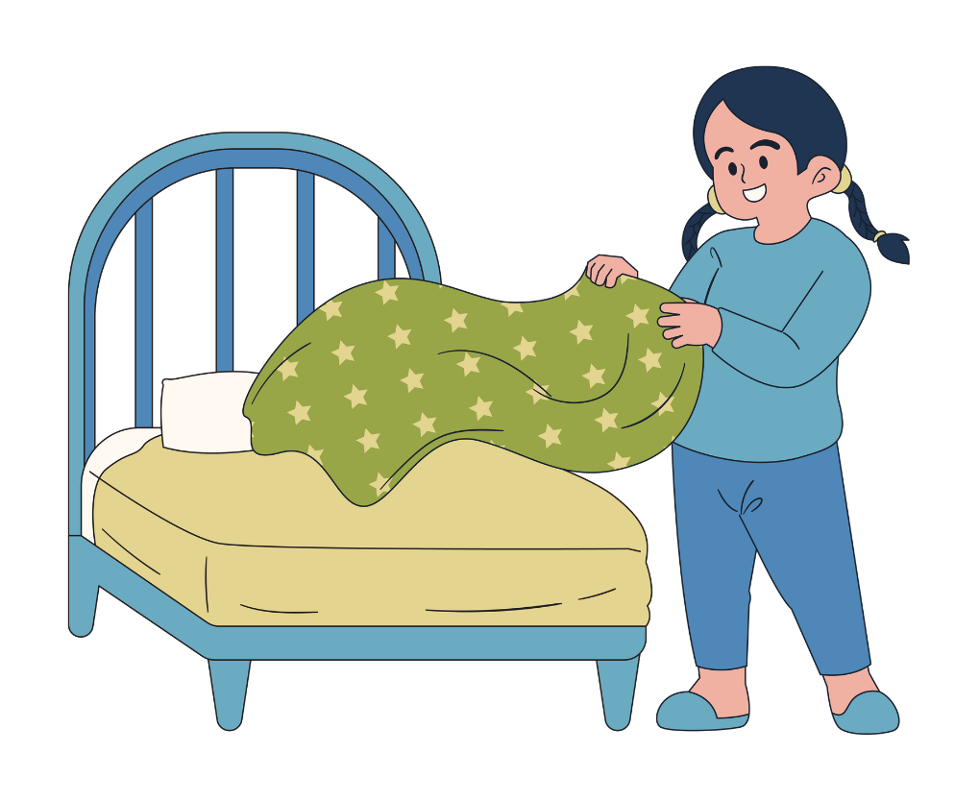
fare il letto
Notes:
To make the bed
Teacher notes:
Drill the verb for correct pronunciation and ask students if they do the chore, to practise io/tu forms of the verb and negation.
Fai il letto?
Sì, faccio il letto.
No, non faccio il letto.
---
Using direct object pronouns:
Fai il letto?
Sì, lo faccio.
No, non lo faccio.
---
Build to questions such as the following, when students are more confident:
Quando fai il letto?
Fai il letto ogni giorno?
Ti piace fare il letto?
Non fai mai il letto?

Slide 3
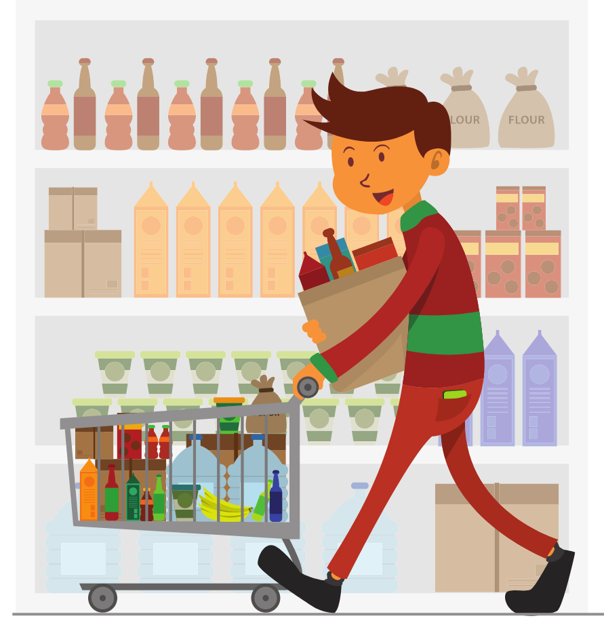
fare la spesa
Notes:
To do the grocery shopping
Teacher notes:
Drill the verb for correct pronunciation and ask students if they do the chore, to practise io/tu forms of the verb and negation.
Fai la spesa?
Sì, faccio la spesa.
No, non faccio la spesa.
---
Using direct object pronouns:
Fai la spesa?
Sì, la faccio.
No, non la faccio.
---
Build to questions such as the following, when students are more confident:
Quando fai la spesa?
Con chi fai la spesa?
Dove fai la spesa?
Ti piace fare la spesa?
Fai spesso la spesa?

Slide 4
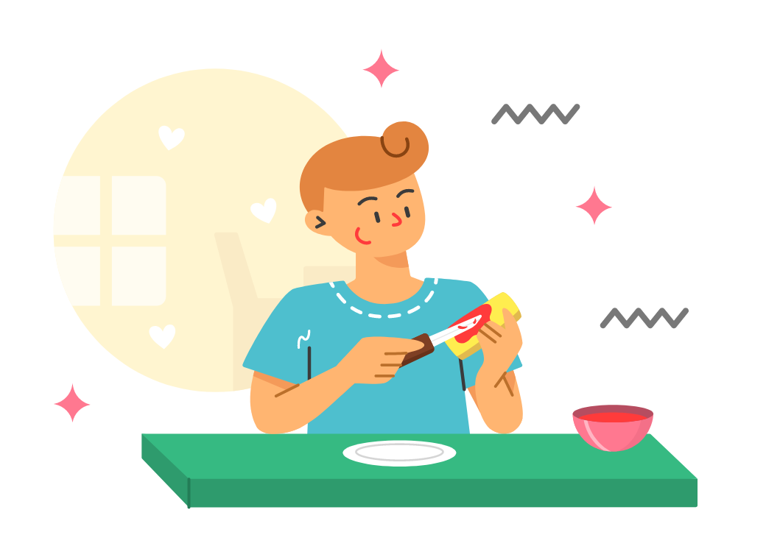
preparare la colazione
Notes:
To prepare breakfast
Teacher notes:
Drill the verb for correct pronunciation and ask students if they do the chore, to practise io/tu forms of the verb and negation.
Prepari la colazione?
Sì, preparo la colazione.
No, non preparo la colazione.
---
Using direct object pronouns:
Prepari la colazione?
Sì, la preparo.
No, non la preparo.
---
Build to questions such as the following, when students are more confident:
Che prepara la colazione a casa tua?
Cosa ti piace preparare per colazione?
Fai una colazione calda o fredda?
Mangi spesso cereali?
A che ora mangi colazione?
Preferisci toast o cereali?

Slide 5
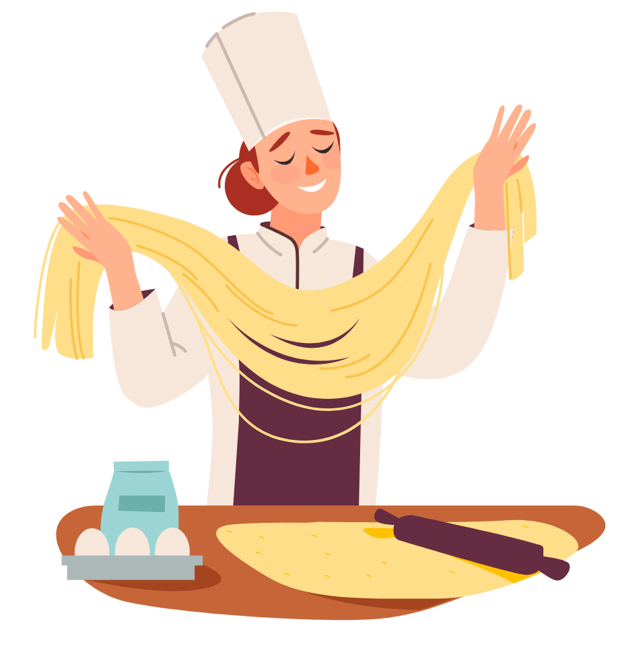
preparare la cena
Notes:
To prepare dinner
Teacher notes:
Drill the verb for correct pronunciation and ask students if they do the chore, to practise io/tu forms of the verb and negation.
Prepari la cena?
Sì, preparo la cena.
No, non preparo la cena.
---
Using direct object pronouns:
Prepari la cena?
Sì, la preparo.
No, non la preparo.
---
Build to questions such as the following, when students are more confident:
Che prepara la cena a casa tua?
Che prefersci preparare?
Ti piace cucinare?
Mangi la cena con la tua famiglia?
A che ora cenate?
Qual’è la tua cena preferita?

Slide 6
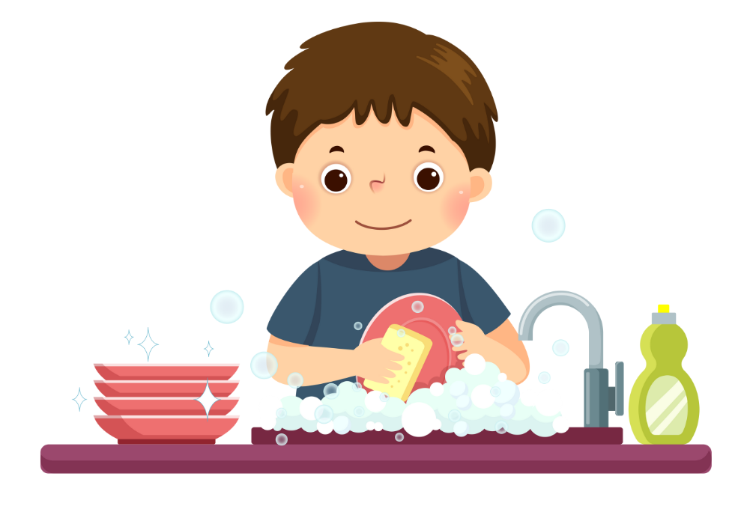
lavare i piatti
Notes:
To wash the dishes
Teacher notes:
Drill the verb for correct pronunciation and ask students if they do the chore, to practise io/tu forms of the verb and negation.
Lavi i piatti?
Sì, lavo i piatti.
No, non lavo i piatti.
---
Using direct object pronouns:
Lavi i piatti?
Sì, li lavo.
No, non li lavo.
---
Build to questions, when students are more confident, such as:
Quando lavi i piatti?
Chi lava i piatti?
Lavi spesso i piatti?

Slide 7
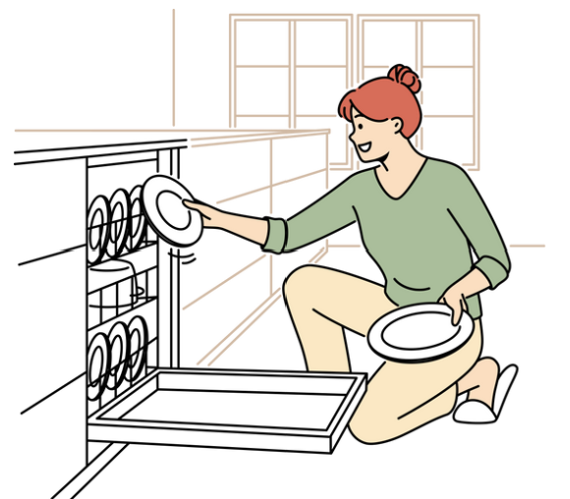
caricare la lavastoviglie
Notes:
To load the dishwasher
Teacher notes:
Drill the verb for correct pronunciation and ask students if they do the chore, to practise io/tu forms of the verb and negation.
Carichi la lavastoglie?
Sì, carico la lavastoglie.
No, non carico la lavastoglie.
---
Using direct object pronouns:
Carichi la lavastoglie?
Sì, la carico.
No, non la carico.
---
Build to questions such as the following, when students are more confident:
Hai una lavastoviglie?
Preferisci lavare i piatti o usare la lavastoviglie?
Preferisci caricare o svuotare la lavastoglie?
Carichi la lavastoglie dopo la colazione e dopo cena, o la carichi solo una volta al giorno?

Slide 8
svuotare la lavastoviglie
Notes:
To empty the dishwasher
Teacher notes:
Drill the verb for correct pronunciation and ask students if they do the chore, to practise io/tu forms of the verb and negation.
Svuoti la lavastoglie?
Sì, svuoto la lavastoglie.
No, non svuoto la lavastoglie.
---
Using direct object pronouns:
Svuoti la lavastoglie?
Sì, la svuoto.
No, non la svuoto.
---
Build to questions such as the following, when students are more confident:
Preferisci caricare o svuotare la lavastoglie?
Svuoti la lavastoglie la sera o la mattina?

Slide 9
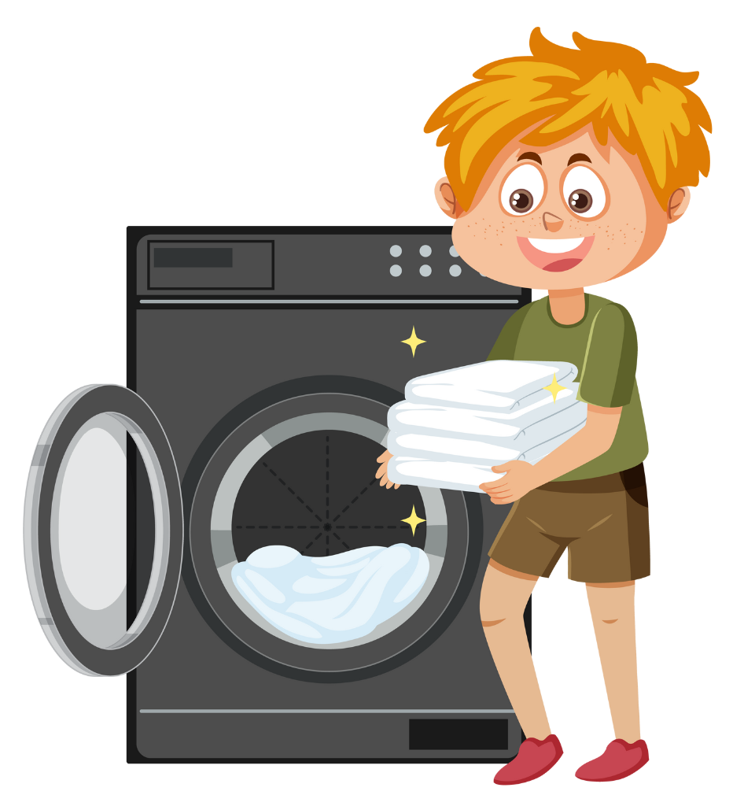
fare il bucato
Notes:
To do the washing
Teacher notes:
Drill the verb for correct pronunciation and ask students if they do the chore, to practise io/tu forms of the verb and negation.
Fai il bucato?
Sì, faccio il bucato.
No, non faccio il bucato.
---
Using direct object pronouns:
Fai il bucato?
Sì, lo faccio.
No, non lo faccio.
---
Build to questions such as the following, when students are more confident:
Quando fai il bucato?
Chi fai il bucato?

Slide 10
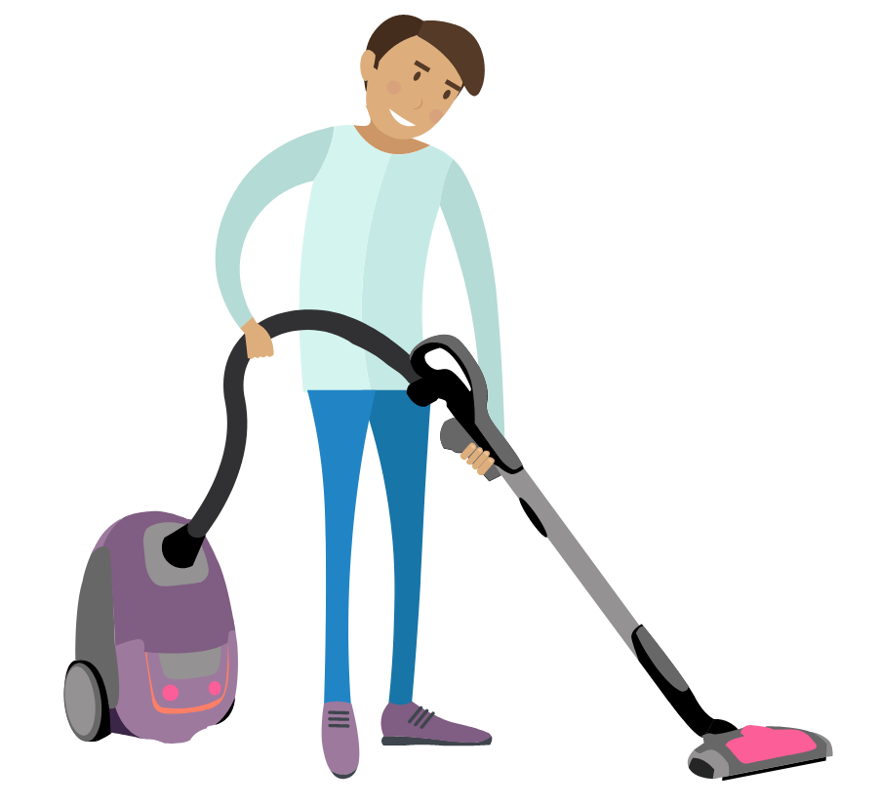
passare l’aspirapolvere
Notes:
To do the vacuuming
Notes for teacher:
Drill the verb for correct pronunciation and ask students if they do the chore, to practise io/tu forms of the verb and negation.
Passi l’aspirapolvere?
Sì, passo l’aspirapolvere.
No, non passo l’aspirapolvere.
---
Remind students that the gender of nouns with l’ are not obvious so students might need to use a dictionary to check or consult the teacher.
l’aspirapolvere (f)
Using direct object pronouns:
Passi l’aspirapolvere?
Sì, la passo.
No, non la passo.
---
Build to questions such as the following, when students are more confident:
Quando passi l’aspirapolvere?
Chi passi l’aspirapolvere a casa tua?

Slide 11
riordinare la camera da letto
Notes:
To tidy the bedroom
Teacher notes:
Drill the verb for correct pronunciation and ask students if they do the chore, to practise io/tu forms of the verb and negation.
Riordini la camera da letto?
Sì, riordino la camera da letto.
No, non riordino la camera da letto.
---
Using direct object pronouns:
Riordini la camera da letto?
Sì, la riordino.
No, non la riordino.
---
Build to questions such as the following, when students are more confident:
Quando riordini la camera da letto?
Quante volte alla settimana riordini la camera da letto?
Ti piace riordinare la camera da letto?

Slide 12
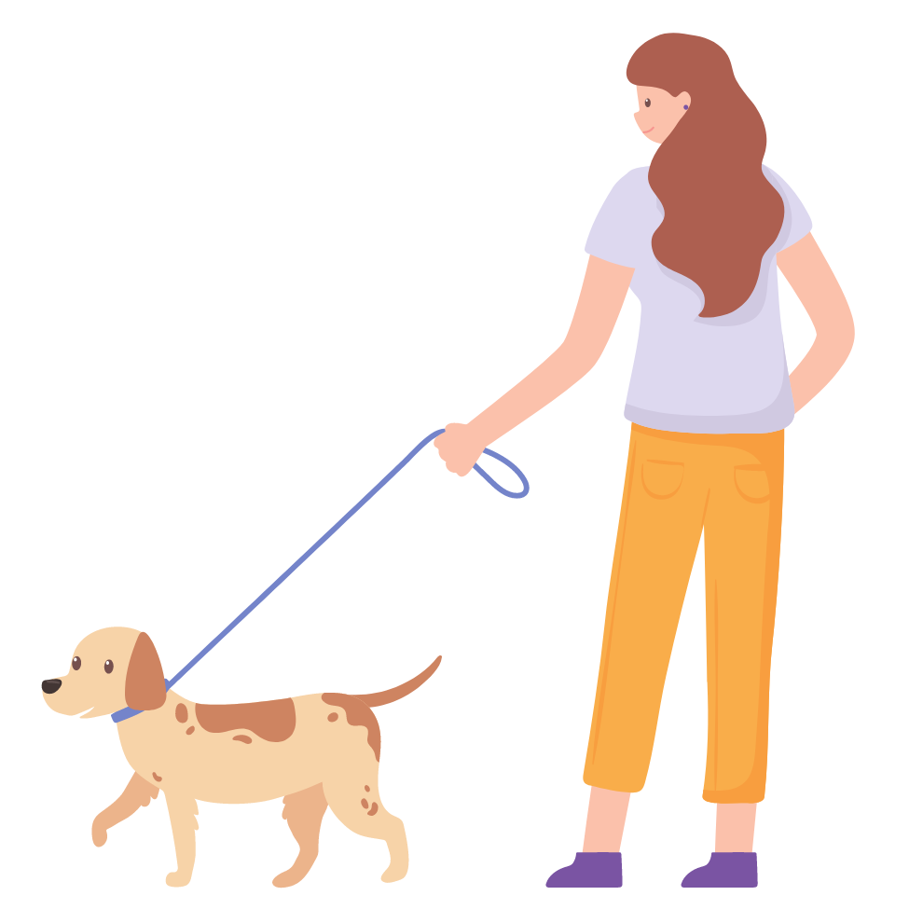
portare a passeggio il cane
Notes:
To walk the dog
Teacher notes:
Drill the verb for correct pronunciation and ask students if they do the chore, to practise io/tu forms of the verb and negation.
Porti a passaggio il cane?
Sì, porto a passaggio il cane.
No, non porto a passaggio il cane.
---
Using direct object pronouns:
Porti a passaggio il cane?
Sì, lo porto a passaggio.
No, non lo porto a passaggio.
---
Build to questions such as the following, when students are more confident:
Hai un cane?
Come si chiama il tuo cane?
Porti a passeggio ogni giorno il cane?
Chi porta a passeggio il cane?

Slide 13
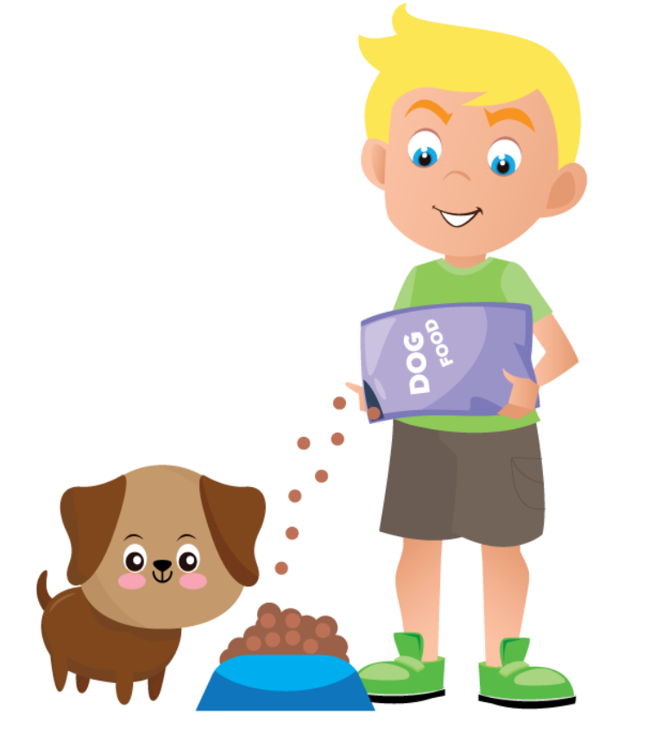
dare da mangiare al cane
Notes:
To feed the dog
Teacher notes:
Drill the verb for correct pronunciation and ask students if they do the chore, to practise io/tu forms of the verb and negation.
Dai da mangiare al cane?
Sì, do da mangiare al cane.
No, non do da mangiare al cane.
---
Build to questions such as the following, when students are more confident:
Hai un cane?
Come si chiama il tuo cane?
Chi dà da mangiare al cane?
Dai da mangiare una volta o due volte al giorno?
Dai da mangiare la mattina o la sera?
Point out to students that the third person form of dare has an accent on the a – lui/lei dà.

Slide 14
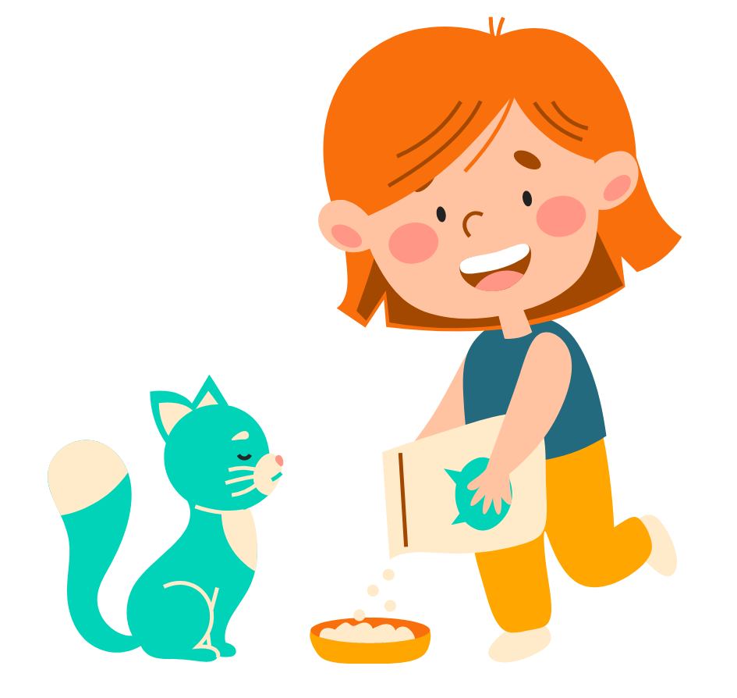
dare da mangiare al gatto
Notes:
To feed the cat
Notes for teacher:
Drill the verb for correct pronunciation and ask students if they do the chore, to practise io/tu forms of the verb and negation.
Dai da mangiare al gatto?
Sì, do da mangiare al gatto.
No, non do da mangiare al gatto.
---
Build to questions such as the following, when students are more confident:
Hai un gatto?
Come si chiama il tuo gatto?
Chi dà da mangiare al gatto?
Dai da mangiare una volta o due volte al giorno?
Dai da mangiare la mattina o la sera?

Slide 15
Le faccende domestiche
fare il letto
fare la spesa
preparare la colazione/la cena
lavare i piatti
caricare la lavastoviglie
svuotare la lavastoviglie
fare il bucato
passare l’aspirapolvere
riordinare la camera da letto
dare da mangiare al cane/gatto
portare a passeggio il cane
to make the bed
to do the shopping
to prepare breakfast/dinner
to wash the dishes
to load the dishwasher
to empty the dishwasher
to do the washing
to do the vacuuming
to tidy the bedroom
to feed the dog/cat
to walk the dog
Notes:
Teacher notes:
Students can add these verbs to their anchor charts.

Slide 16
Giving an opinion on household chores

Slide 17
Ti piace fare le faccende domestiche? (1)
Sì, mi piace.
Mi piace essere ordinato/a.
I like to be organised.
Mi piace aiutare a casa.
I like to help at home.
È rilassante.
It’s relaxing.
Notes:
Teacher notes:
Drill the phrases for correct pronunciation and check for understanding.

Slide 18
Ti piace fare le faccende domestiche? (2)
No, non mi piace
Non è piacevole.
It’s not pleasant.
Sono stufo(a) di + infinitive
I am sick of + infinitive
Preferisco il disordine.
I prefer mess.
Ci vuole troppo tempo.
It takes too long.
È una vera sfida!
It’s a real challenge!
Che noia!
How boring!
Notes:
Teacher notes:
Drill the phrases for correct pronunciation and check for understanding.

Slide 19
Copyright
© State of New South Wales (Department of Education), 2024
The copyright material published in this resource is subject to the Copyright Act 1968 (Cth) and is owned by the NSW Department of Education or, where indicated, by a party other than the NSW Department of Education (third-party material).
Copyright material available in this resource and owned by the NSW Department of Education is licensed under a Creative Commons Attribution 4.0 International (CC BY 4.0) license.
This license allows you to share and adapt the material for any purpose, even commercially.
Attribution should be given to © State of New South Wales (Department of Education), 2024.
Material in this resource not available under a Creative Commons license:
the NSW Department of Education logo, other logos and trademark-protected material
Material owned by a third party that has been reproduced with permission. You will need to obtain permission from the third party to reuse its material.
Links to third-party material and websites
Please note that the provided (reading/viewing material/list/links/texts) are a suggestion only and implies no endorsement, by the New South Wales Department of Education, of any author, publisher, or book title. School principals and teachers are best placed to assess the suitability of resources that would complement the curriculum and reflect the needs and interests of their students.
If you use the links provided in this document to access a third-party’s website, you acknowledge that the terms of use, including licence terms set out on the third-party’s website apply to the use which may be made of the materials on that third-party website or where permitted by the Copyright Act 1968 (Cth). The department accepts no responsibility for content on third-party websites.

