Slide 1
Jeopardy game
Notes:
Jeopardy game created using ‘What’s the question?’ from Digital Learning Selector, DoE NSW.

Slide 2
Jeopardy (1)
Instructions – part a
The Jeopardy game board displays different point values on tiles. Behind each tile is a word or an image of a weekly routine activity. Tiles are revealed left to right, and from top to bottom.
Students play the game in 2 teams, with students in each team taking a turn to answer.
There are 2 parts to this version of Jeopardy. First, teams take turns to create a question containing the phrase (or the phrase corresponding to the image) behind each tile. The question can be inspired by any part of the unit. If the question is correct, the student’s team wins the tile points. Questions could include:
whether they do the activity or not: Fai i compiti?
what time they do the activity: A che ora vai a scuola?
when they do the activity: Quando chatti online?
whether they like they activity: Ti piace fare lo skateboard?
why they do the activity: Perché ti piace andare a correre?
specifying when they do an activity: Riordini la tua camera da letto il sabato o la domenica?
Notes:
These instructions are for the teacher. They can be adapted to show the class if written instructions are helpful.

Slide 3
Jeopardy (2)
Instructions – part b
Next, a student from the other team gets the chance to win the same points for their team by answering the question with a correct sentence in Italian. For example:
Fai i compiti? No, non faccio mai i compiti.
A che ora vai a scuola? Vado a scuola alle otto e mezza.
Quando chatti online? Chatto online ogni pomeriggio per due ore.
Ti piace fare lo skateboard? Sì, mi piace moltissimo.
Perché ti piace andare a correre? Perché fa bene al corpo.
Riordini la tua camera da letto il sabato o la domenica? Riordino la mia camera da letto il sabato mattina.
Teams swap turns being the team to ask the question or answer, each time a new tile is revealed.
The teacher can keep score on the board to encourage student engagement. The team with the most points when all tiles have been selected is the winner. The game can continue by starting over and requiring a different question than what was asked in the previous round.
Notes:
These instructions are for the teacher. They can be adapted to show the class if written instructions are helpful.

Slide 4
Differentiation strategies
High potential and gifted students and students with advanced proficiency – edit the slides and put all terms and sentences in English so that students are required to recall the required vocabulary when forming their responses.
Students requiring additional support – write the sample question structures covered so far, as well as the language structures required for answering the questions, on the board to assist students in participating in the game. Students can use their notes or language support sheets to play the game.

Slide 5
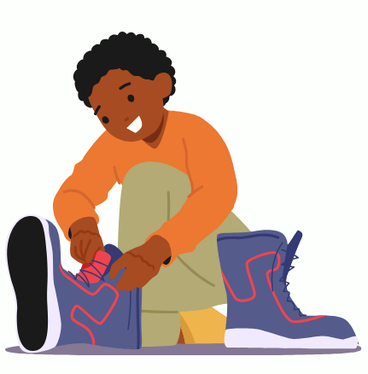
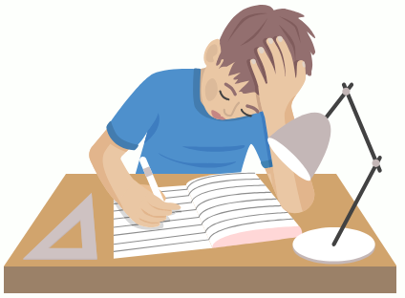
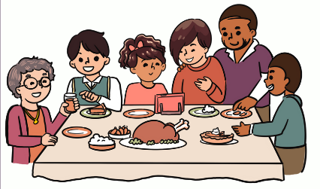
Game (1)
Press the spacebar or tap on the screen to begin.
30 points
40 points
5 points
10 points
15 points
20 points
vestirsi
svegliarsi
giocare ai videogiochi
fare la doccia
50 points
60 points
70 points
andare a correre
80 points
fare il bucato
chattare online
fare il letto
100 points
90 points
250 points
fare un giro in bici
350 points
spogliarsi
150 points
fare lo skateboard
300 points
400 points
200 points
450 points
700 points
600 points
fare la spesa
800 points
riposarsi
500 points
andare a scuola
tornare a casa
550 points
5
Notes:
Jeopardy game created using What’s the question? from Digital Learning Selector, DoE NSW

Slide 6
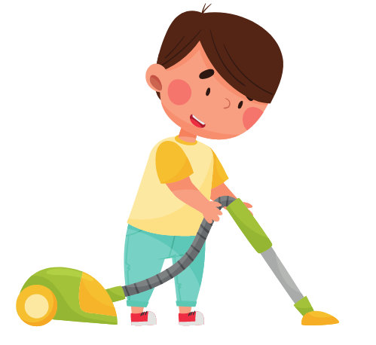
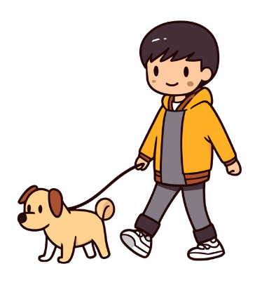
Game (2)
Click the spacebar or tap on the screen to begin.
dare da mangiare al gatto/cane
1000 points
riordinare la camera da letto
1000 points
1000 points
2000 points
2000 points
6
Notes:
Jeopardy game created using What’s the question? from Digital Learning Selector, DoE NSW

Slide 7
Copyright
© State of New South Wales (Department of Education), 2024
The copyright material published in this resource is subject to the Copyright Act 1968 (Cth) and is owned by the NSW Department of Education or, where indicated, by a party other than the NSW Department of Education (third-party material).
Copyright material available in this resource and owned by the NSW Department of Education is licensed under a Creative Commons Attribution 4.0 International (CC BY 4.0) license.
This license allows you to share and adapt the material for any purpose, even commercially.
Attribution should be given to © State of New South Wales (Department of Education), 2024.
Material in this resource not available under a Creative Commons license:
the NSW Department of Education logo, other logos and trademark-protected material
material owned by a third party that has been reproduced with permission. You will need to obtain permission from the third party to reuse its material.
Links to third-party material and websites
Please note that the provided (reading/viewing material/list/links/texts) are a suggestion only and implies no endorsement, by the New South Wales Department of Education, of any author, publisher, or book title. School principals and teachers are best placed to assess the suitability of resources that would complement the curriculum and reflect the needs and interests of their students.
If you use the links provided in this document to access a third-party's website, you acknowledge that the terms of use, including licence terms set out on the third-party's website apply to the use which may be made of the materials on that third-party website or where permitted by the Copyright Act 1968 (Cth). The department accepts no responsibility for content on third-party websites.
Notes:
Slide not shared

