Slide 1
Ancient Roman graffiti
Stage 5 Latin

Slide 2
Learning intentions and success criteria
We are learning to:
understand the importance of Roman graffiti in ancient Rome
create Roman graffiti that would have been suited to the time.
We can:
explain the significance of graffiti in ancient Rome and their roles in daily life, communication and culture
identify and describe various types of Roman graffiti
design and create Roman graffiti that reflects the themes, styles and language of the time
use appropriate Latin vocabulary and phrases that would have been relevant in ancient Rome.
Notes:
Notes for teachers:
Learning intentions and success criteria (LISC) are best co-constructed with students. Adapt the learning intention as required and add matching success criteria.
For more information see ⁠AITSL or the NSW Department of Education explicit teaching strategies, ⁠Sharing learning intentions and ⁠Sharing success criteria.
LISC is not necessarily presented at the beginning of the lesson. Teacher needs to consider most effectual time to introduce.
LISC should be revisited during the lesson to support students' evaluation of their learning.

Slide 3
Ancient Roman graffiti
These days, graffiti is seen by many as unsightly and destructive. However, in Pompeii and surrounds, graffiti is one of the richest sources of archaeological evidence for everyday life from that time.
Graffiti can provide insights into the life and times of people in ancient Rome, linking the past and present, and showing us similarities and differences between then and now.

Slide 4
Think-Pair-Share activity
Most of the graffiti that is available is from Pompeii. Why do you think this is?
Instructions:
Read the statement above and THINK to yourself about the statement. (2 minutes)
When instructed, discuss your response with a person sitting near you (PAIR). (2 minutes)
Finally, your group will SHARE what you have discussed with your partner with the entire class. (2 minutes)

Slide 5
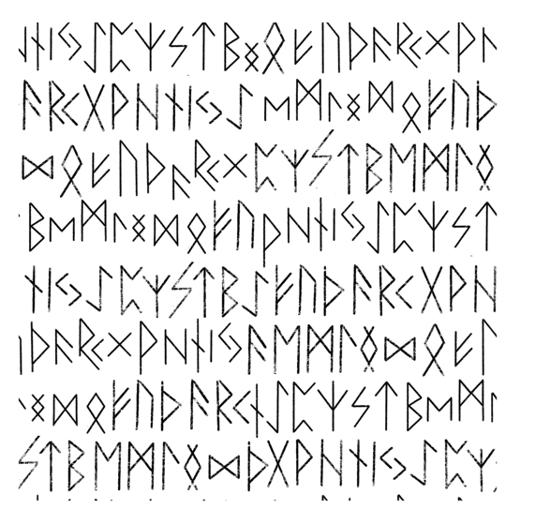
Examples of ancient Roman graffiti

Slide 6
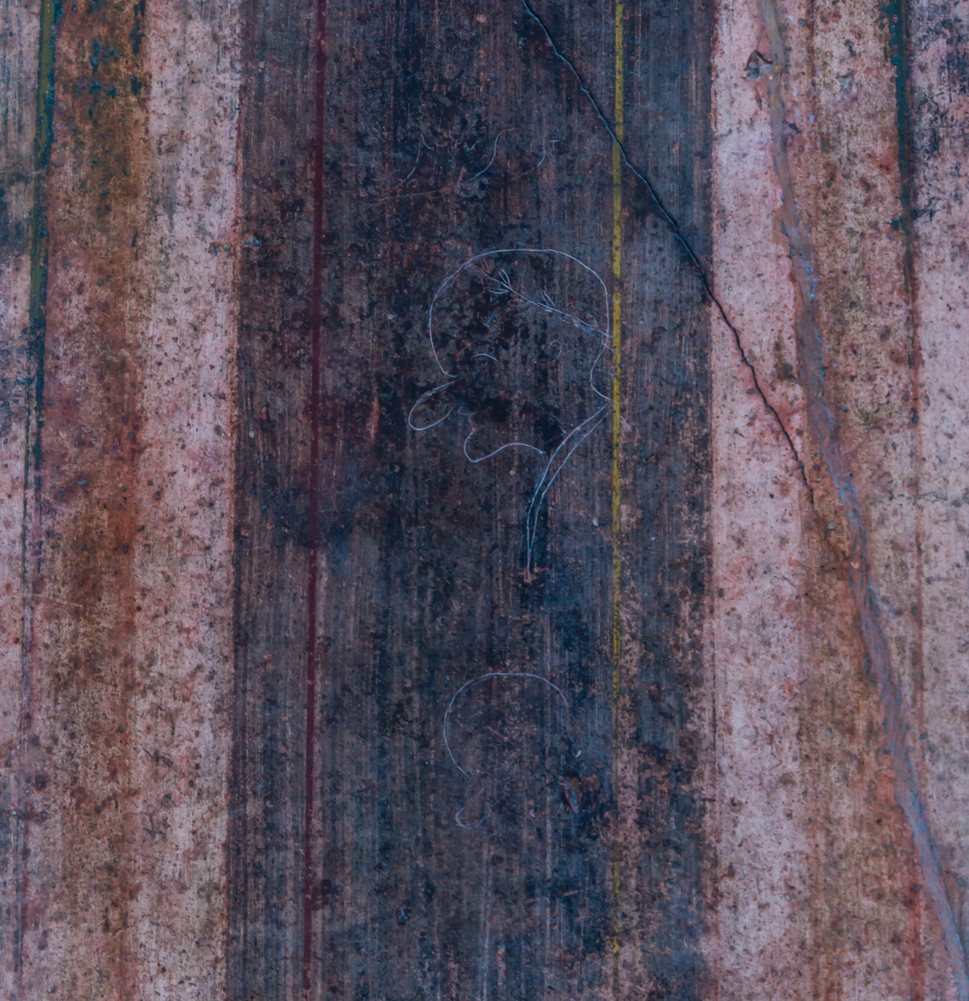
RVFVS EST – It’s Rufus
Is this a self-portrait?
This graffito, from the north wall of the atrium in the villa of the Mysteries in Pompeii, is of a man Rūfus. It may be the artist’s self-portrait.
It has been compared to ‘Mr Magoo’, the cranky, near-sighted, balding and bubble-nosed cartoon character created in the 1940s and made popular especially in the animated 1960s television series. Rūfus himself would not appreciate the comparison, as the laurel wreath he wears was a symbol of imperial power.
Rūfus means red, tawny, red-haired, but the word was used frequently as a cognomen.
‘Rufus est caricature villa misteri Pompeii’ by Jebulon is licensed under CCO 1.0 Universal.
Notes:
A cognomen is a term used in ancient Roman naming conventions. It was the third name in a traditional 3-part Roman name system, which typically included:
Praenomen: The personal name (e.g., Gaius, Lucius).
Nomen: The family name or gens (e.g., Julius, Cornelius).
Cognomen: The nickname or additional name that often indicated a specific branch of the family or a particular characteristic.

Slide 7
Rigulus loves Idaia
This graffito is from a column at a house on Pompeii’s Vicolo del Panattiere.
The standard form of the male name was Regulus, so it may show that even the ancients themselves made spelling mistakes.
Idaia was a female name and means ‘name of a slave or freedwoman, possibly a celebrant of the goddess Cybele, who had an important cult centre on Mount Ida in Phrygia’.
The possibility of ‘Rigulus’ being a mistake is reinforced by the grammatical error of the nominative ‘Idaia’ rather than the accusative case.

Slide 8
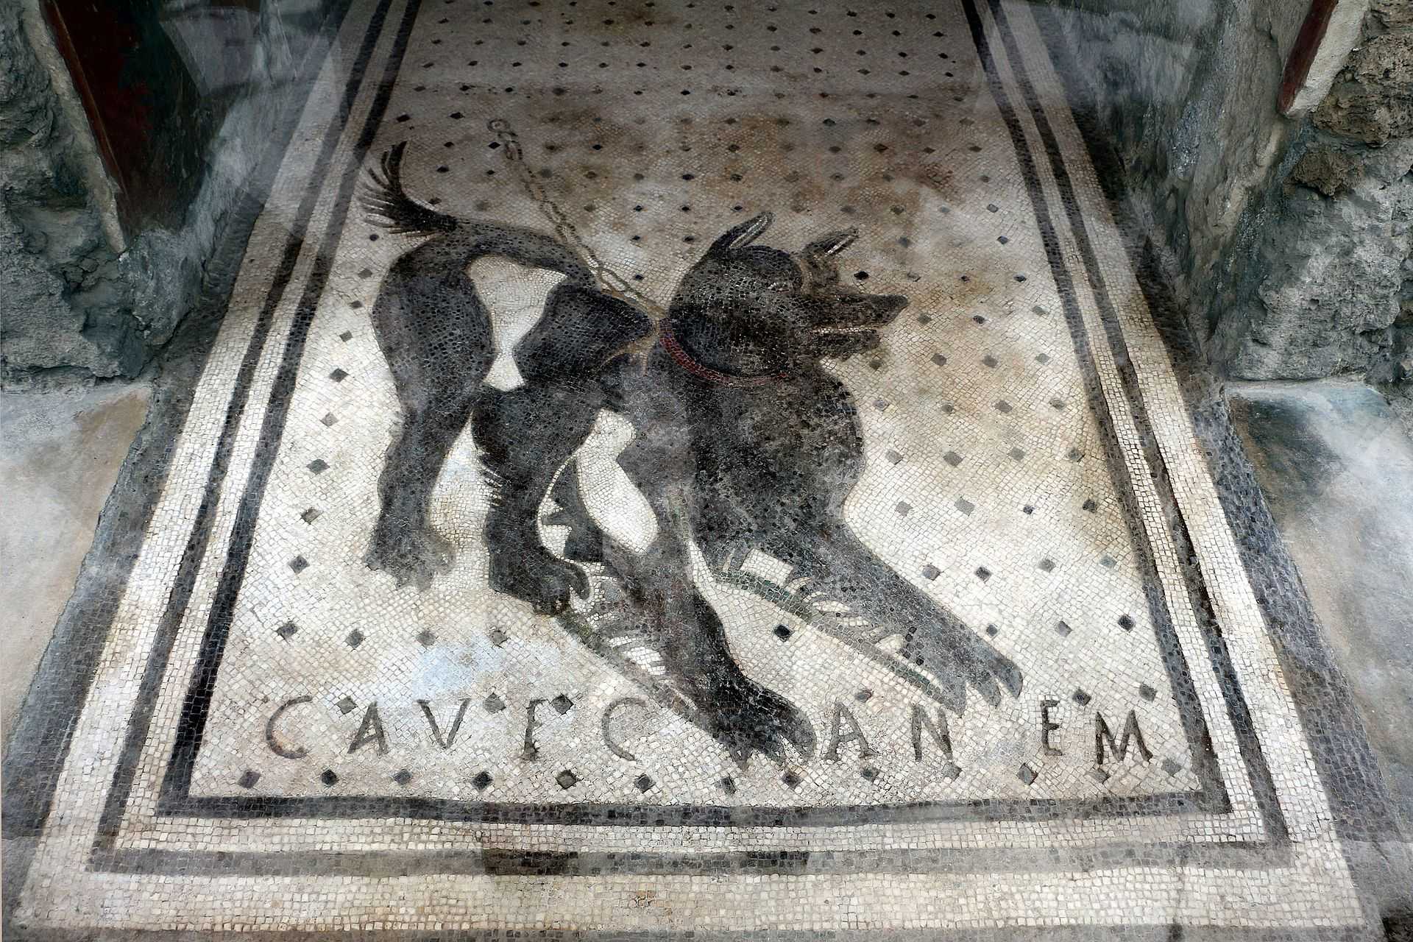
Cave Canem
Beware of the dog!
This floor mosaic is from the entrance of the House of the Tragic Poet in Pompeii.
What do you think a passerby would think of this mosaic and message?
‘Casa del poeta tragico, mosaico del cave canem’ by Sailko is licensed under CC BY-SA 4.0.

Slide 9
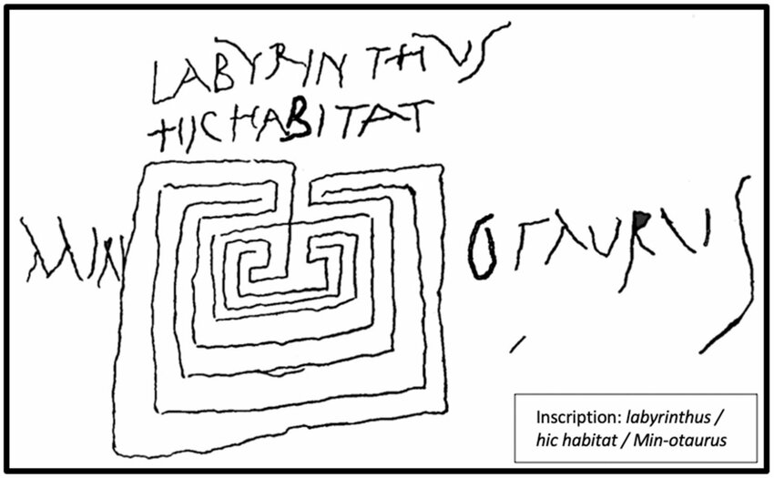
LABYRINTHVS HIC HABITAT MIN OTAVRVS
On one of the piers supporting the portico of the garden at the House of Lucretius, was scratched a drawing of a labyrinth, with the following text: LABYRINTHVS HIC HABITAT MIN OTAVRVS.
Labyrinthus – the legendary labyrinth on Crete that housed the Minotaur.
Minotaurus – Minotaur, the mythic offspring of Pasiphaë, wife of the Cretan king Minos.
‘Labyrinth from the Marco Lucrezio's House in Pompeii’ by Bruno Brunone is licensed under CC BY-SA 4.0.

Slide 10
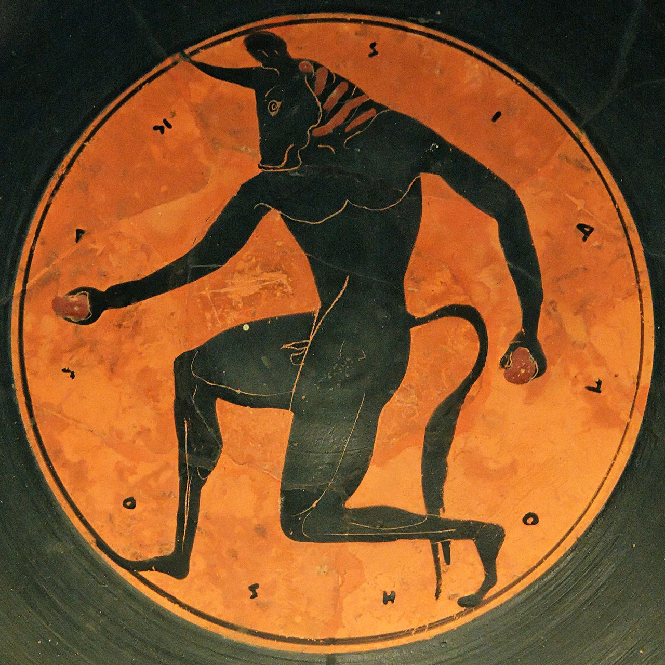
The labyrinth – here lives the Minotaur
This graffito means ‘The labyrinth – here lives the Minotaur’ and is one of several graffiti representations of the Minos myth at Pompeii.
The Minotaur was a monstrous, mythical, man-eating creature with the body of a man and the head of a bull.
What do you think this graffito suggests about the house or its owner/occupants?
‘The Minotaur, tondo of an Attic bilingual kylix’ by Marie-Lan Nguyen is licensed by CC-BY 2.5.
Notes:
The Minotaur is a creature from Greek mythology, depicted as having the body of a man and the head of a bull. According to the myth, the Minotaur was born from the union of Pasiphaë, the wife of King Minos of Crete, and a magnificent bull sent by the god Poseidon.
The creature was imprisoned in the Labyrinth, an elaborate maze designed by the architect Daedalus, to prevent it from escaping. The Minotaur was known for devouring human sacrifices, typically young Athenians sent to Crete. The hero Theseus ultimately defeated the Minotaur with the help of Ariadne, who provided him with a thread to navigate the Labyrinth.

Slide 11
I am the apartment of Marcus Iunus
M(arci) Iuni insula sum
This graffito was located near the entrance to a residence.
The brackets in the text above shows that in the original graffito the praenomen was abbreviated, which was common in Latin inscriptions, including in graffiti.
insula – island, apartment building, apartment (from which we get ‘insular’, and ‘isolate’ in English)

Slide 12
Celadus the Thracian
The heartthrob of the girls
This is a graffito from one of the gladiators’ barracks at Pompeii, and one of many gladiatorial ‘advertisements’ found in Pompeii and other cities of the empire.
suspirium – sigh, a person sighed over, heartthrob
Celadus – a popular Pompeiian fighter
Thracus – Thracian gladiators were a class of fighters equipped with a helmet, greaves, a small shield and a curved sword

Slide 13
I sing of fullers and owls, not arms and the man
Fullōnēs ululamque canō nōn arma virumque
What is a fuller?
How important do you think they were in the ancient world?
This graffito draws on the famous opening lines of the Roman poet Virgil’s great epic work, the Aeneid, ‘Arma virumque canō’ ‘I sing of arms and the man’. This poem, studied by Romans in secondary school, was about the legendary Trojan hero Aeneas whose descendants founded the Roman race.
Why do you think the creator of this graffito is referencing this poem?
Website: Ancient Rome
Notes:
In ancient Rome, a fuller was a person who specialised in the cleaning and processing of cloth, particularly wool. Fullers played a crucial role in the textile industry by using various techniques to clean, bleach, and finish fabrics. This often involved soaking the cloth in a mixture of water and a type of alkaline substance, like urine, which helped remove dirt and grease.
Fullers typically worked in a workshop called a fullonica where they would also stretch and thicken the fabric to prepare it for dyeing or further finishing. The profession was essential for ensuring that garments were clean and suitable for wear, making fullers an important part of the economy and daily life in ancient Rome.

Slide 14
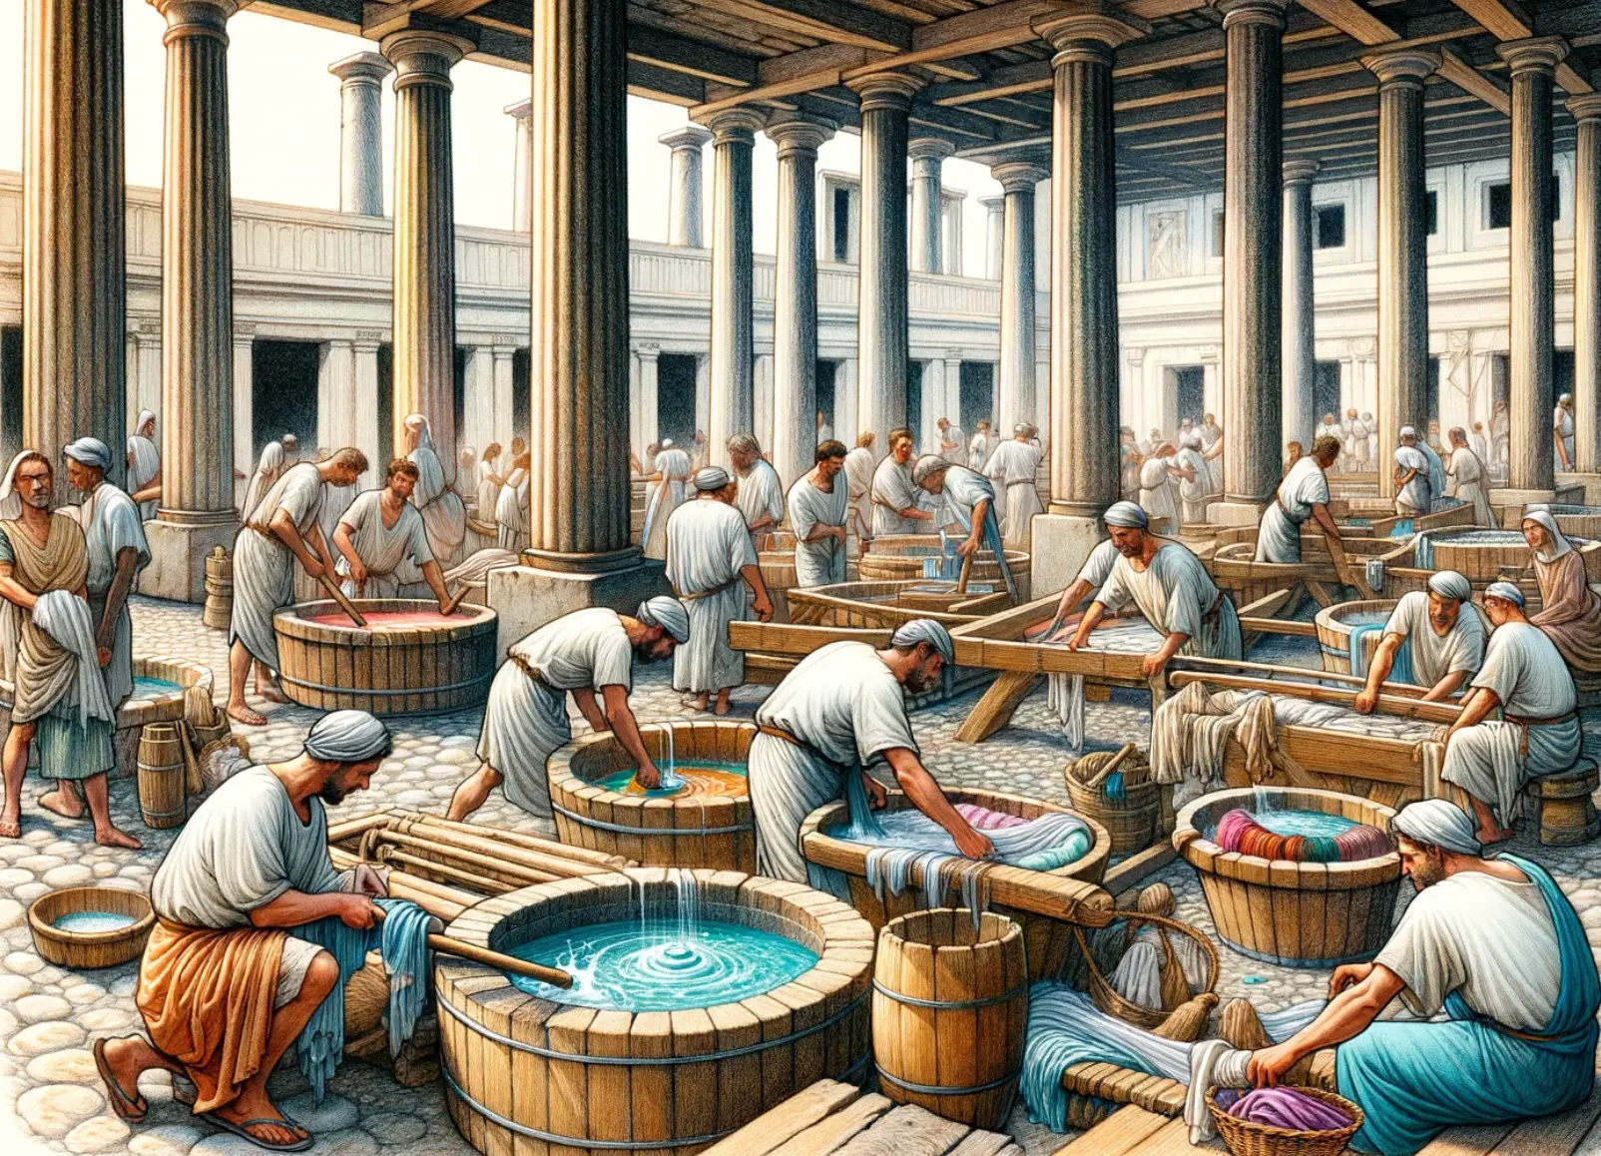
Crescēs fullōnibus salūtem (dat) hīc et ubīque
Cresces gives a greeting to the fullers, here and everywhere
What do you think this means?
What does this graffito and the previous one (Fullōnēs ululamque canō nōn arma virumque) suggest about the occupation of the fullers in the ancient world?
Image on ‘History affairs: The Fullers (fullones) in Ancient Rome’ is available in the public domain.

Slide 15
Create your own graffito
Create your own piece of graffiti, drawing inspiration from the graffiti of ancient Rome. Your graffito may be drawn freehand or created using a digital tool like Canva.
Your graffito should be A4 sized and may be submitted digitally.
When creating your graffito consider:
where your graffito will be located
how it would have been written and/or drawn (style)
the message you want to convey.

Slide 16
Copyright
© State of New South Wales (Department of Education), 2024
The copyright material published in this resource is subject to the Copyright Act 1968 (Cth) and is owned by the NSW Department of Education or, where indicated, by a party other than the NSW Department of Education (third-party material).
Copyright material available in this resource and owned by the NSW Department of Education is licensed under a Creative Commons Attribution 4.0 International (CC BY 4.0) license.
This license allows you to share and adapt the material for any purpose, even commercially.
Attribution should be given to © State of New South Wales (Department of Education), 2024.
Material in this resource not available under a Creative Commons license:
the NSW Department of Education logo, other logos and trademark-protected material
Material owned by a third party that has been reproduced with permission. You will need to obtain permission from the third party to reuse its material.
Links to third-party material and websites
Please note that the provided (reading/viewing material/list/links/texts) are a suggestion only and implies no endorsement, by the New South Wales Department of Education, of any author, publisher, or book title. School principals and teachers are best placed to assess the suitability of resources that would complement the curriculum and reflect the needs and interests of their students.
If you use the links provided in this document to access a third-party’s website, you acknowledge that the terms of use, including licence terms set out on the third-party’s website apply to the use which may be made of the materials on that third-party website or where permitted by the Copyright Act 1968 (Cth). The department accepts no responsibility for content on third-party websites.

