Slide 1

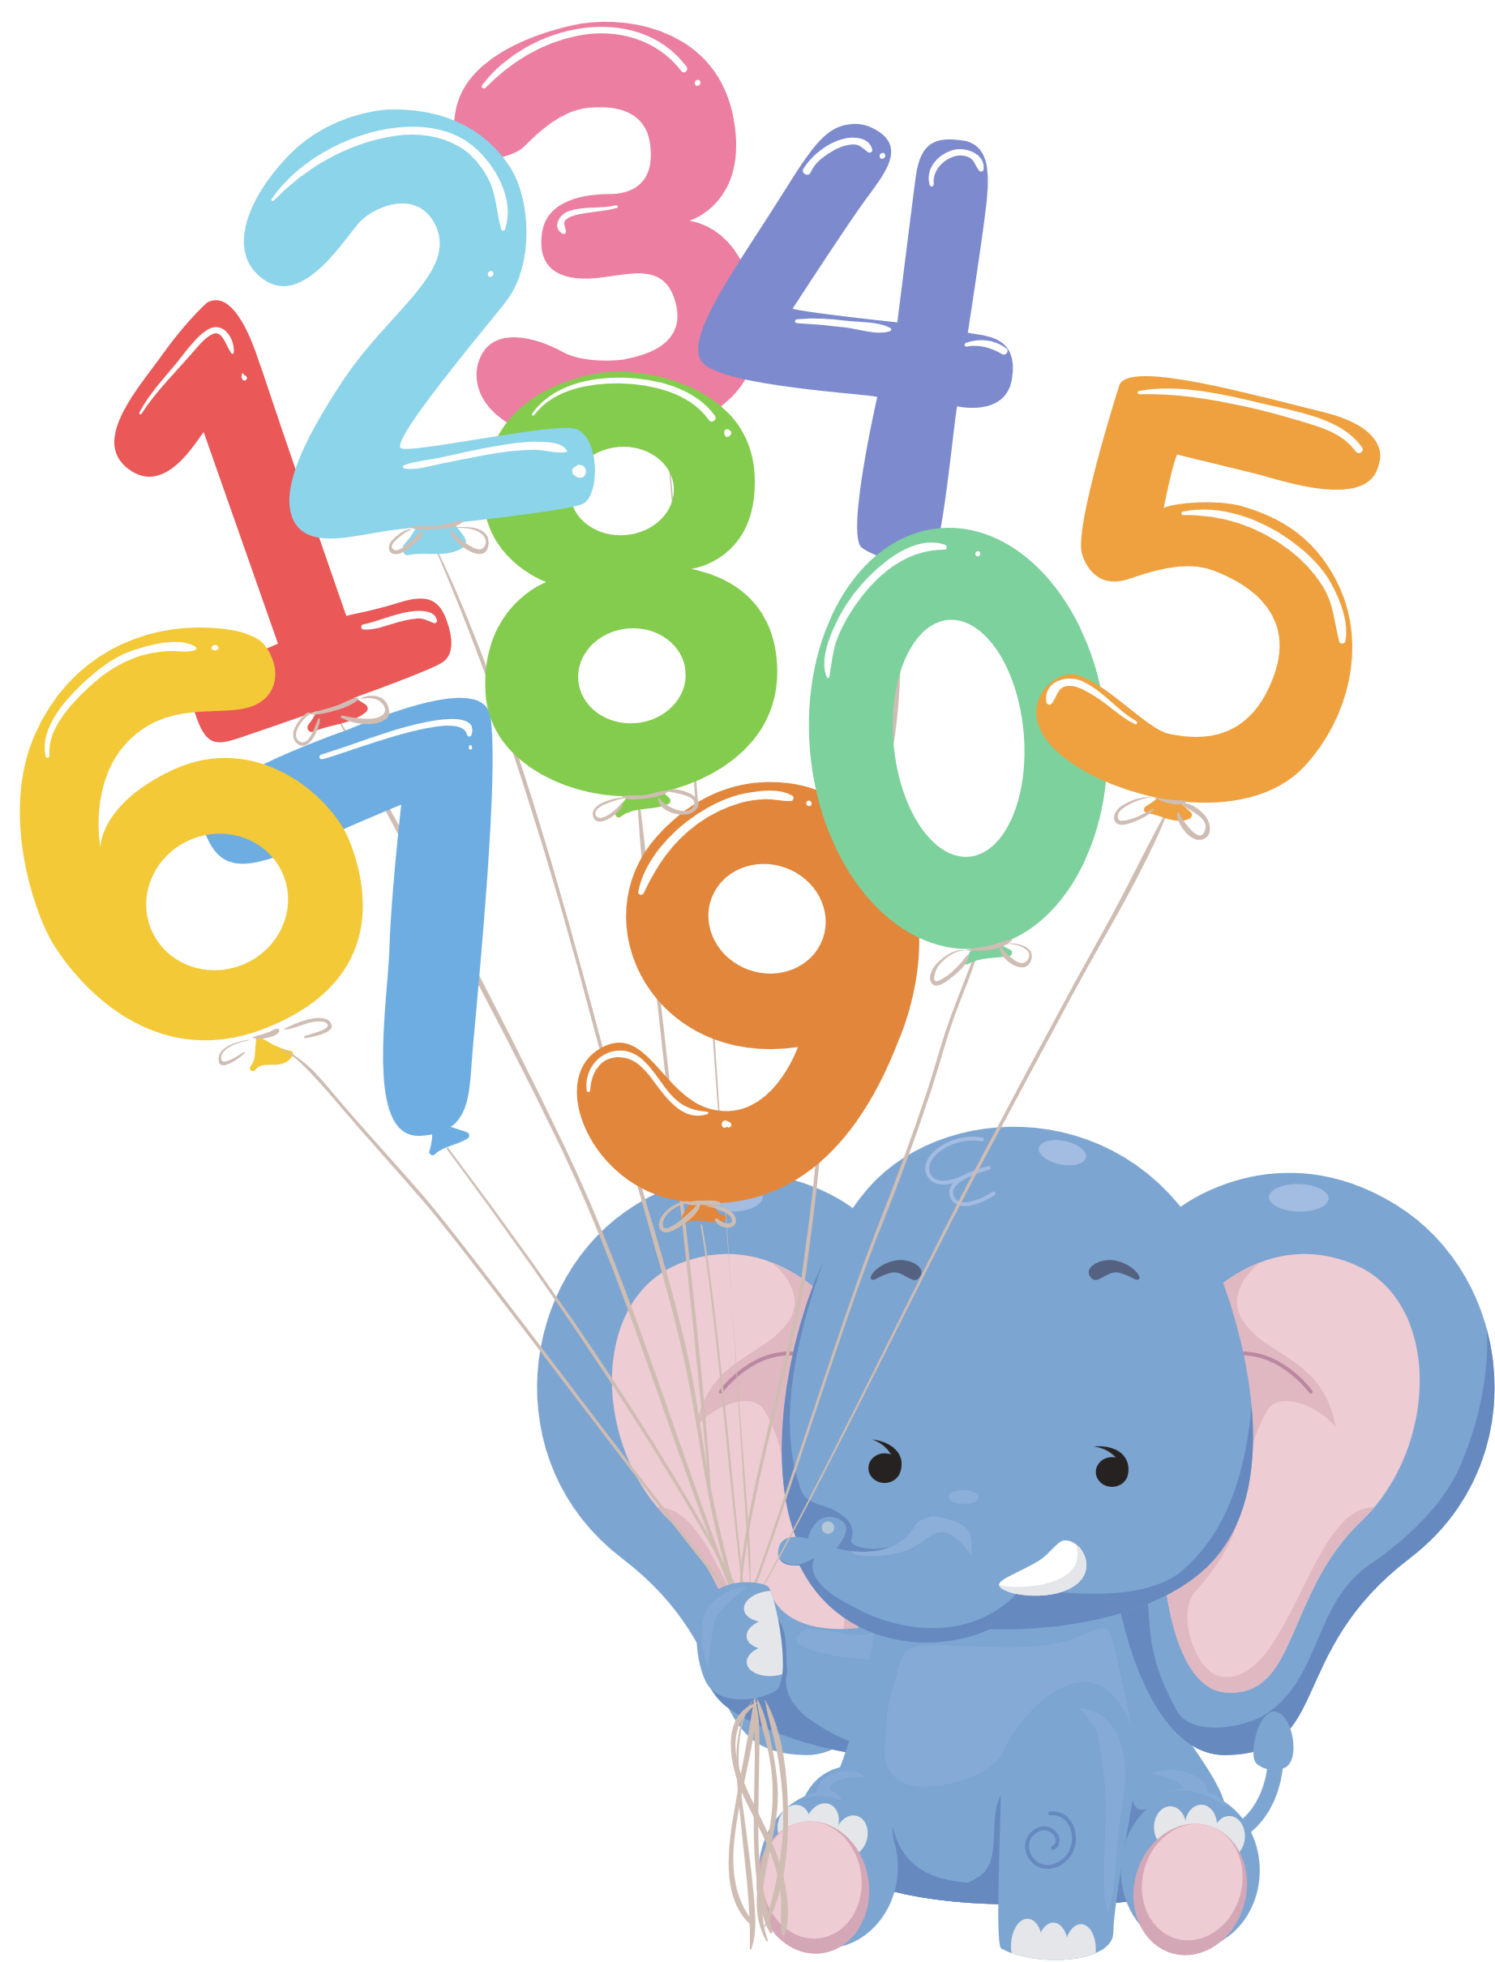

I practise counting song
Stage 1 Vietnamese

Slide 2
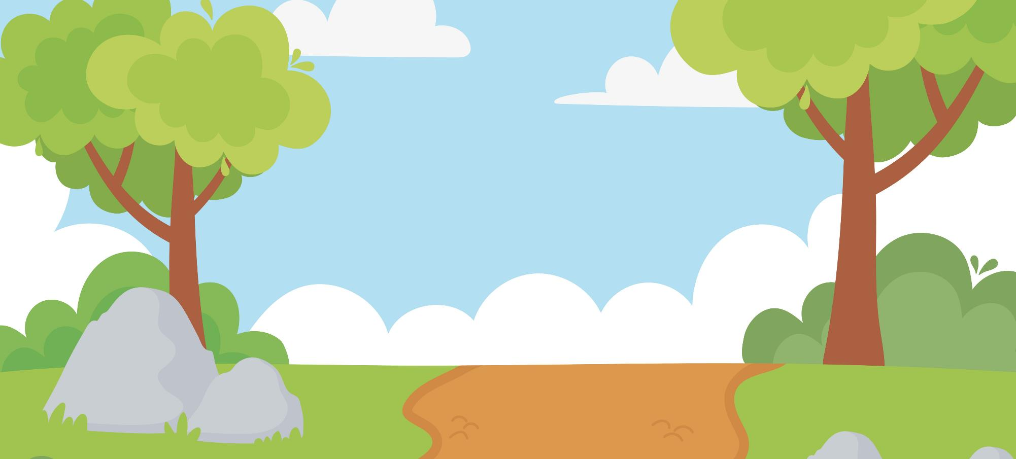




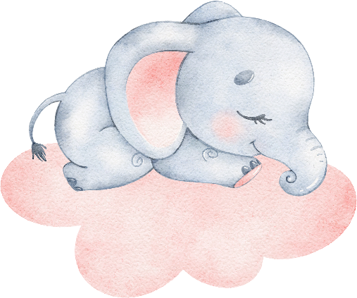

Page 2
Look! One, two, three, four elephants lying in the forest.

Slide 3


Page 3
And then the five, six, next seven, eight, nine, ten.

Slide 4
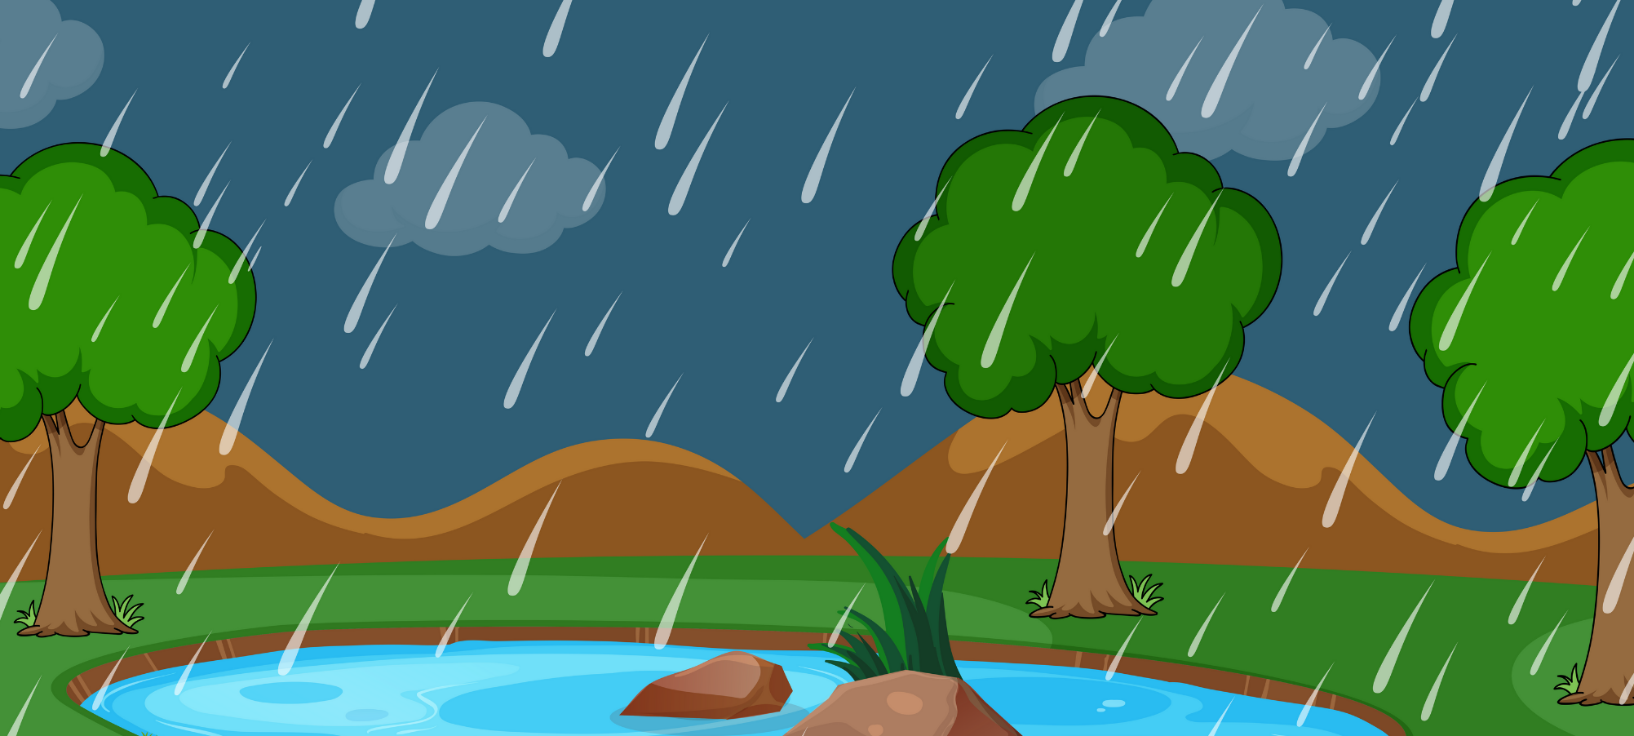
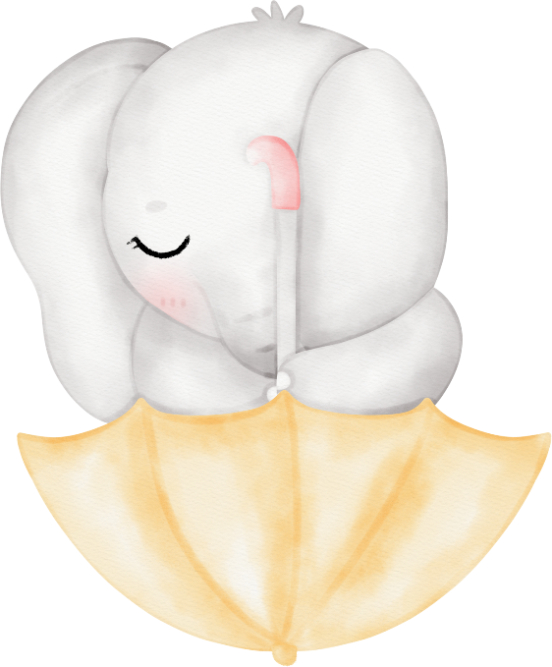
Page 4
The rain came.

Slide 5





Page 5
The elephants ran away very quickly.

Slide 6
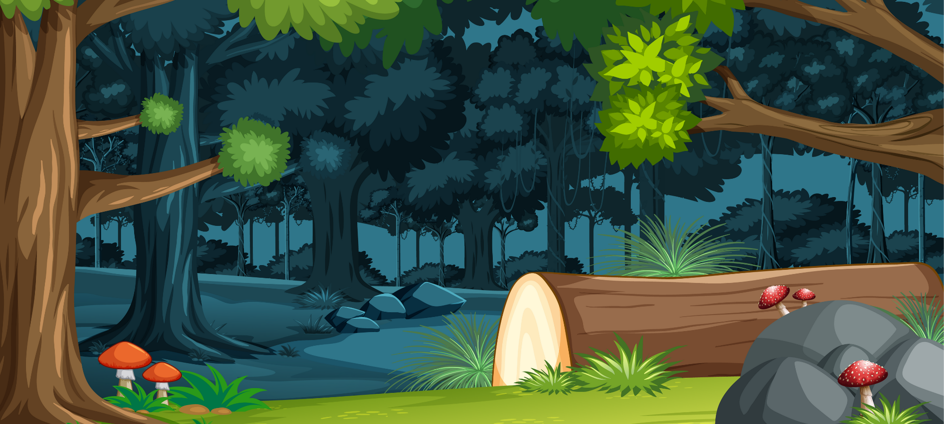
Page 6
And there were no more elephants in the forest.

Slide 7
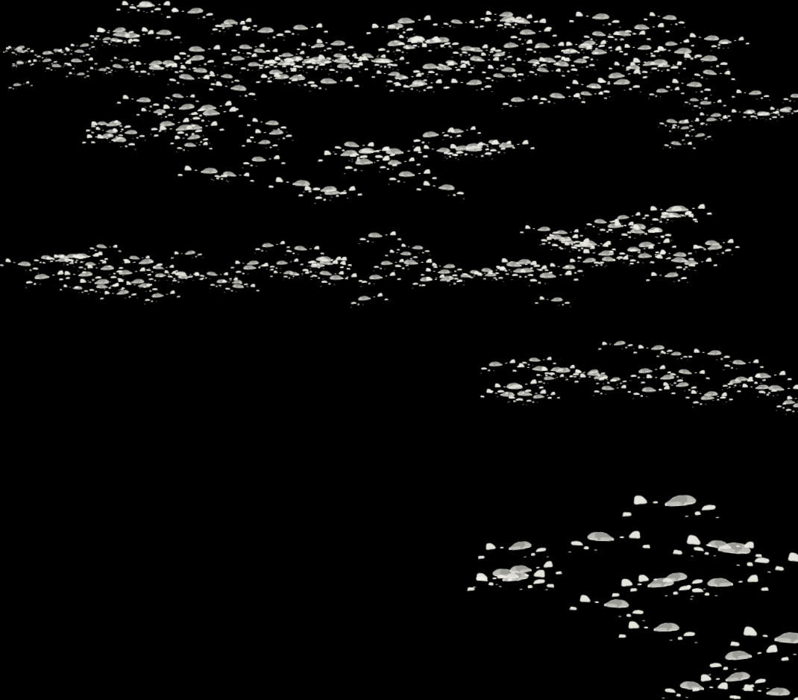
Page 7
La la la la la la la la la la la.

Slide 8
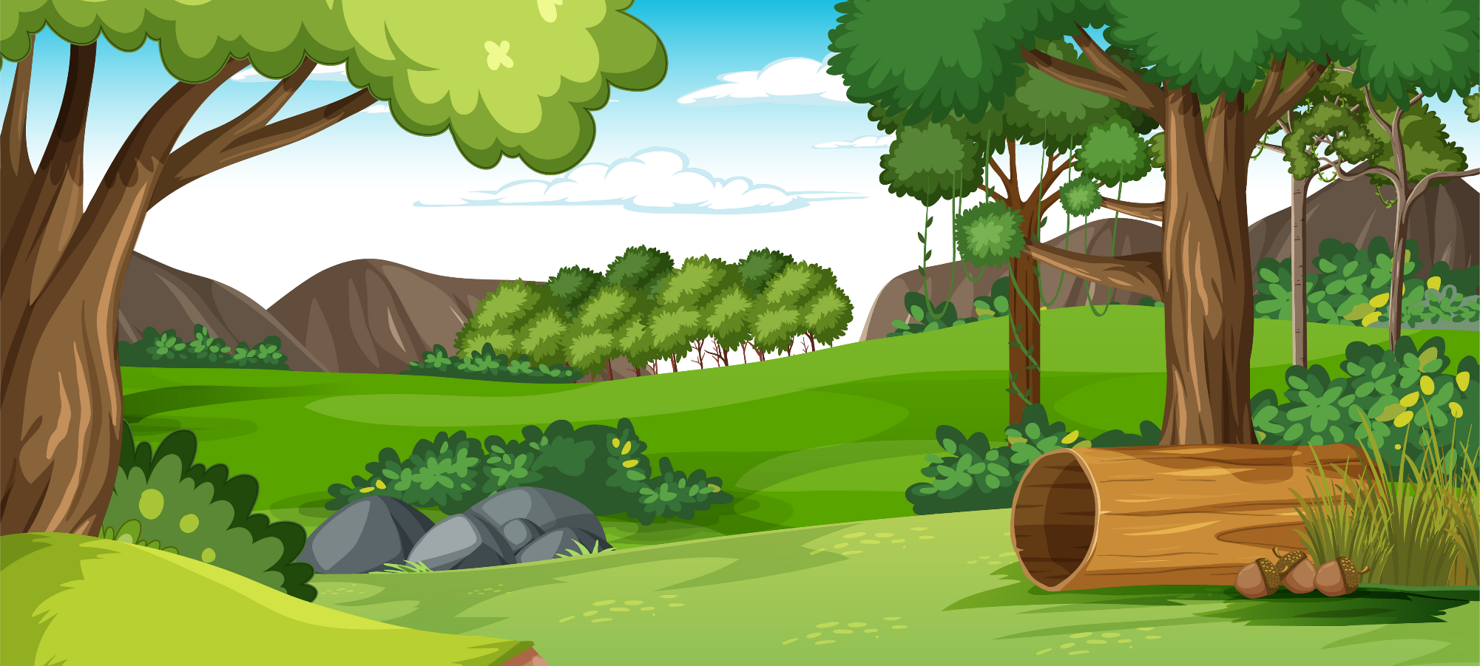




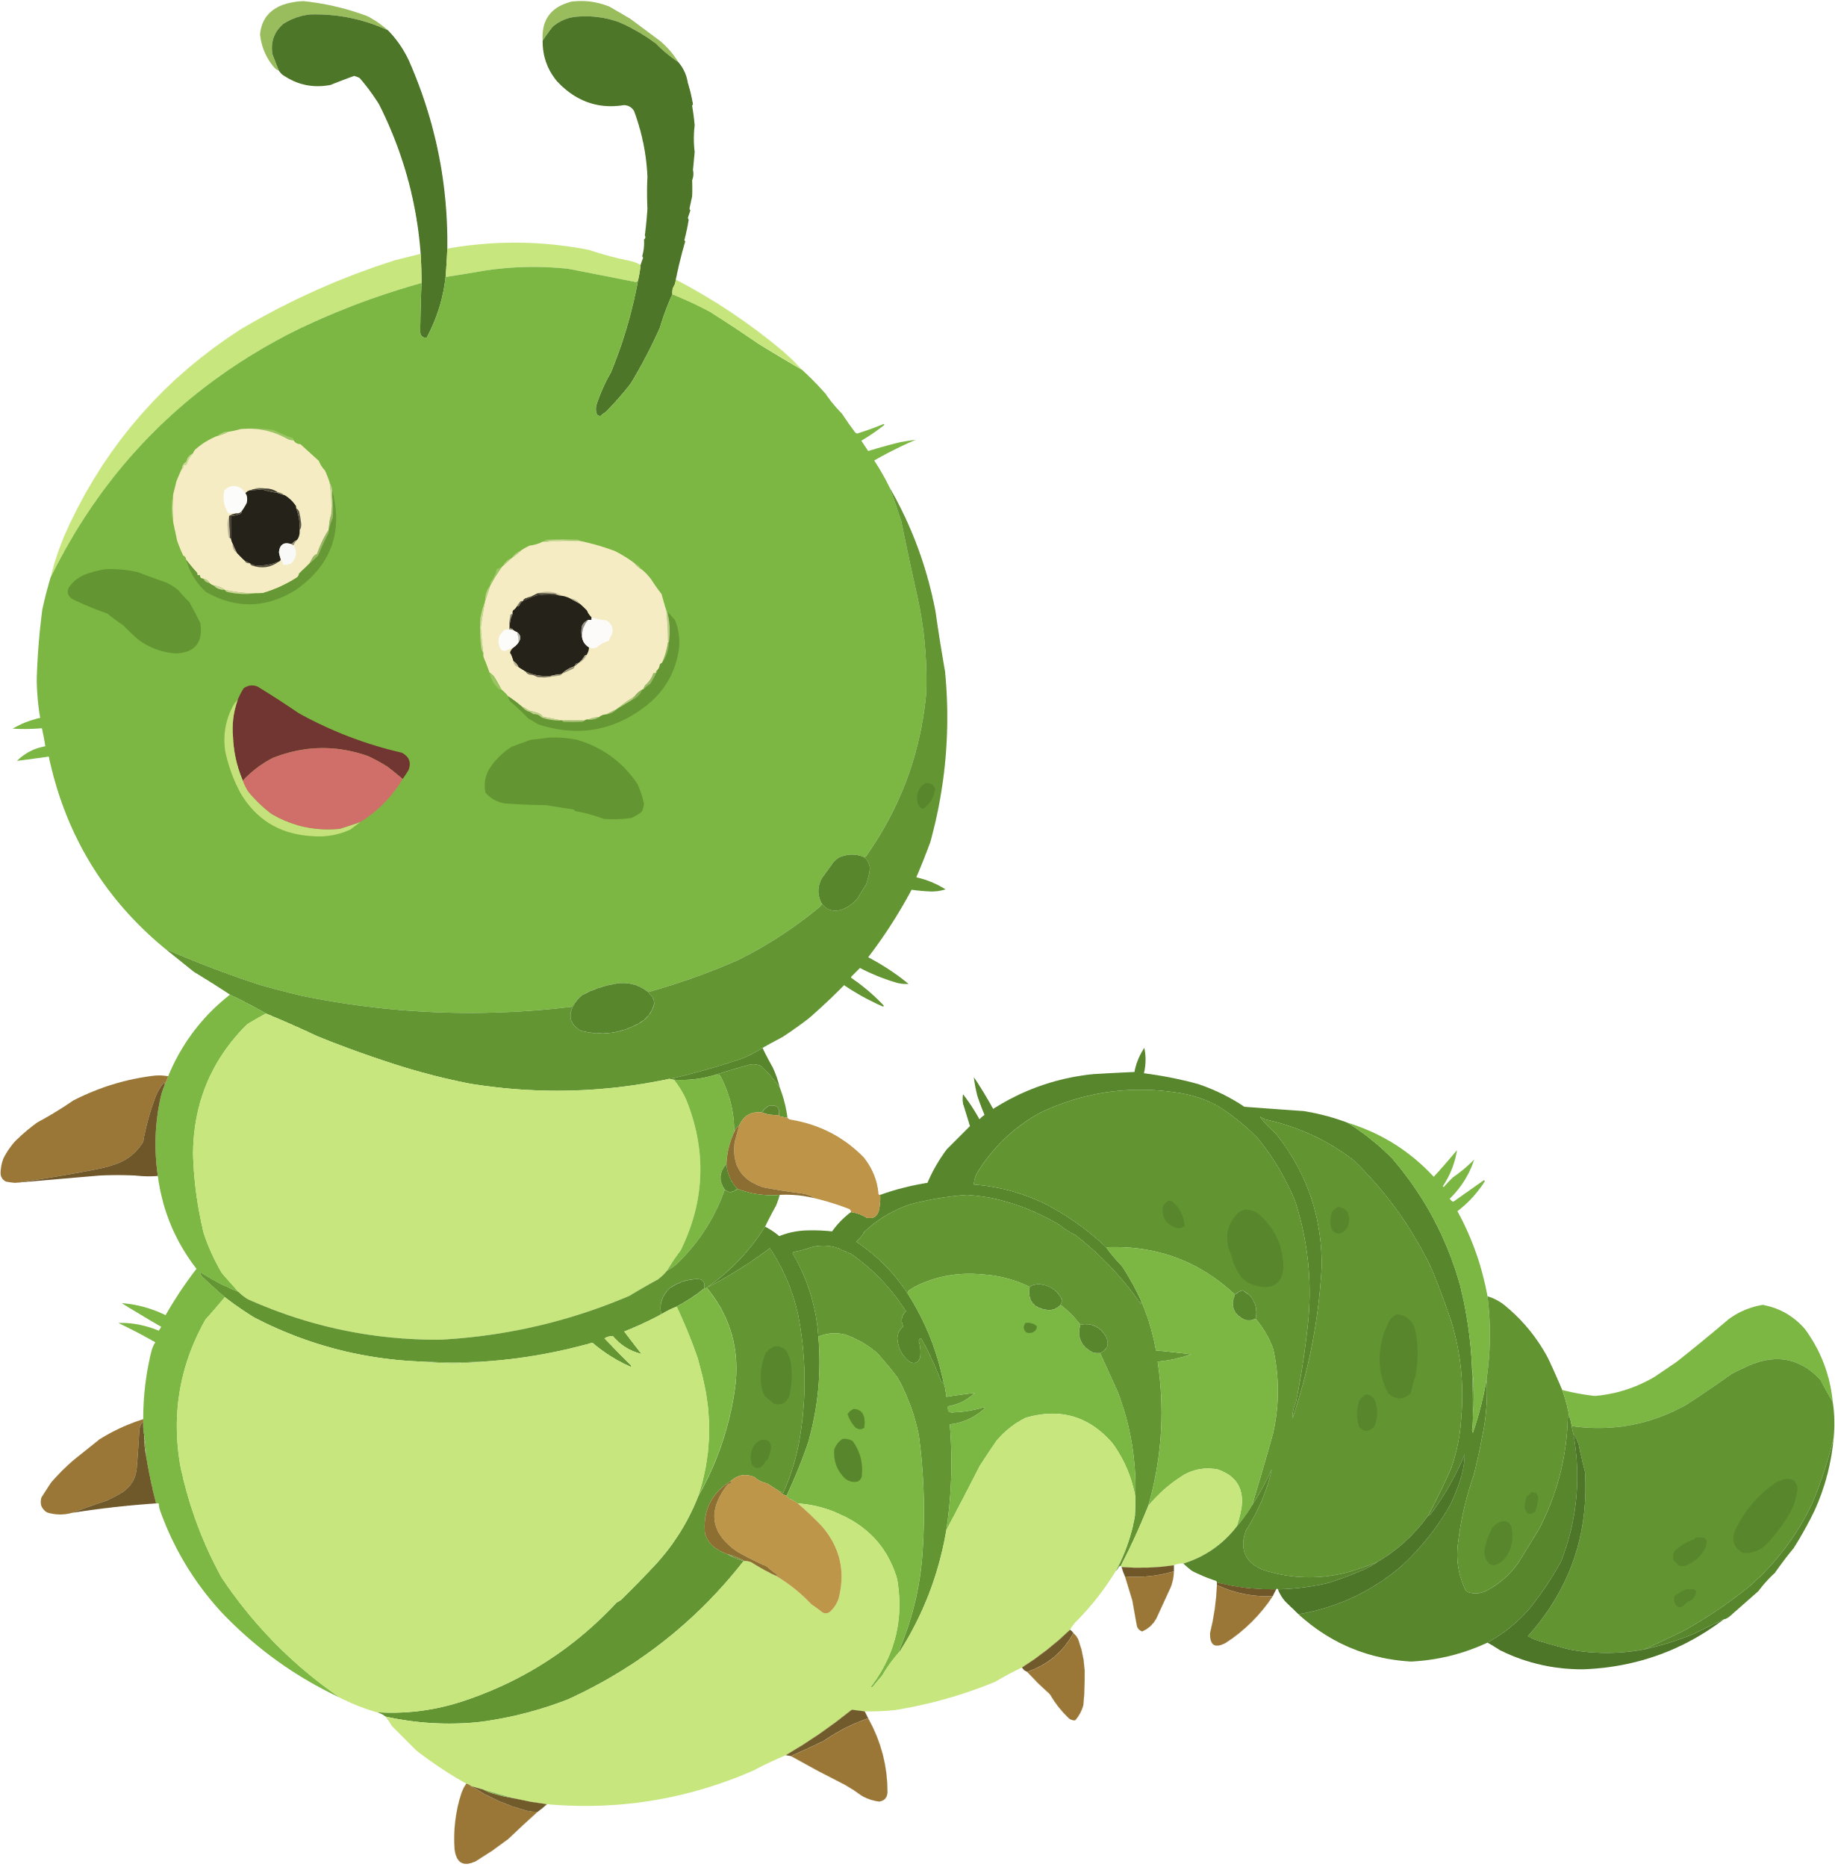
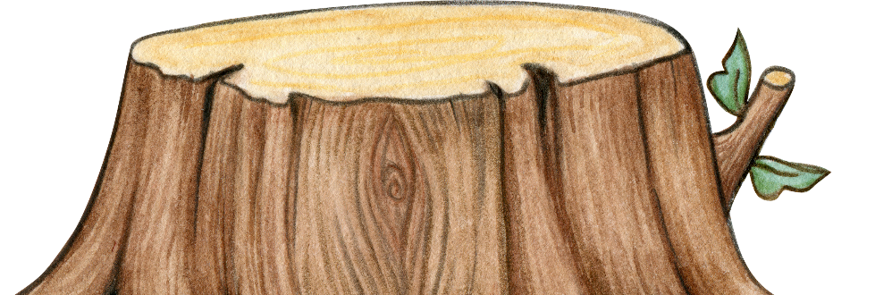
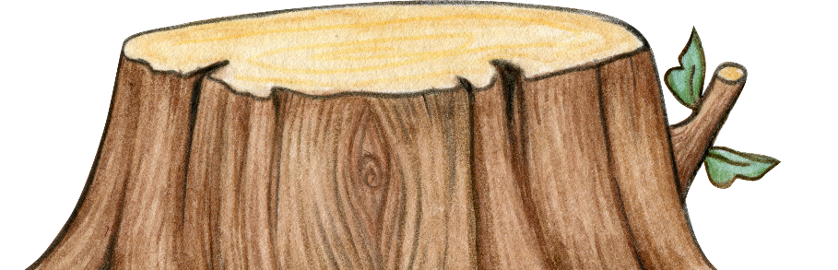
Page 8
Look! One, two, three, four worms crawling on the tree stump.

Slide 9

Page 9
And then the five, six, next seven, eight, nine, ten.

Slide 10

Page 10
Then the rain came.

Slide 11




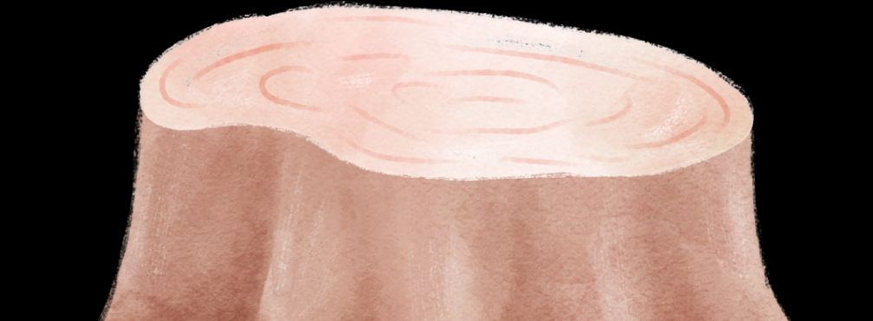
Page 11
The worms crawled away quickly.

Slide 12


Page 12
And there were no worms left on the tree stump.

Slide 13
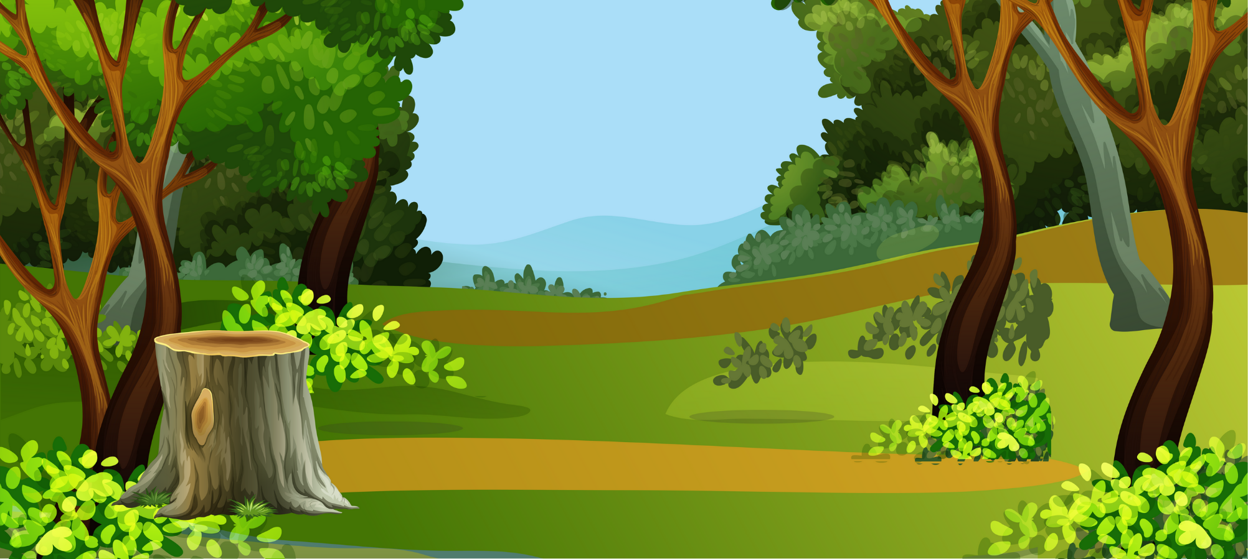
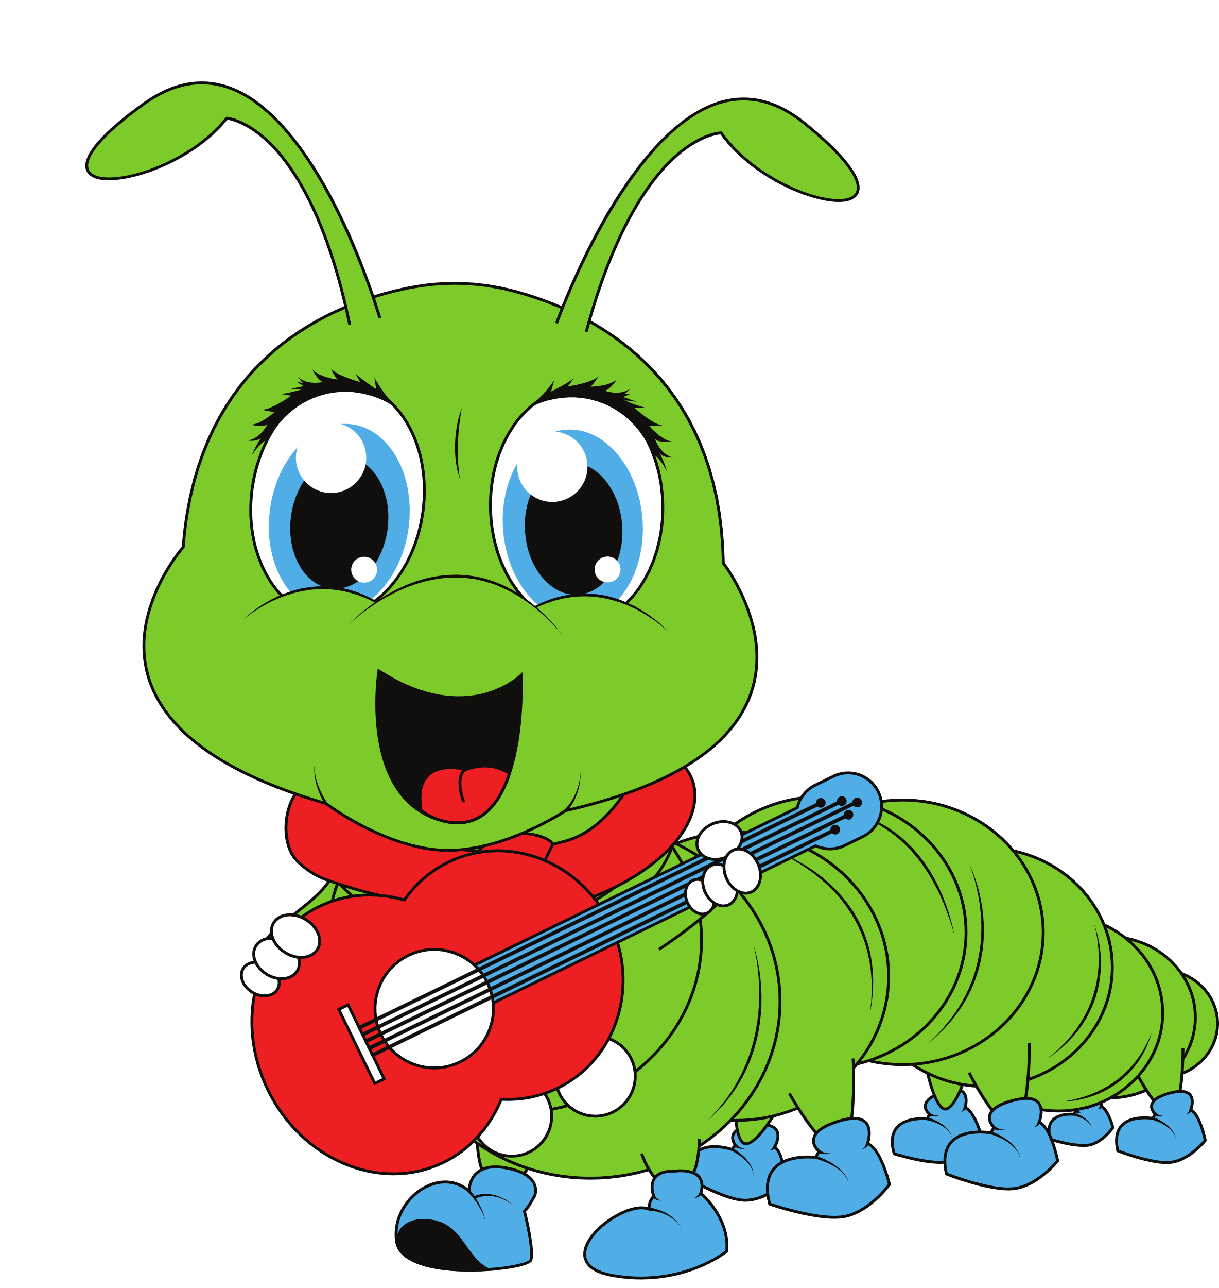
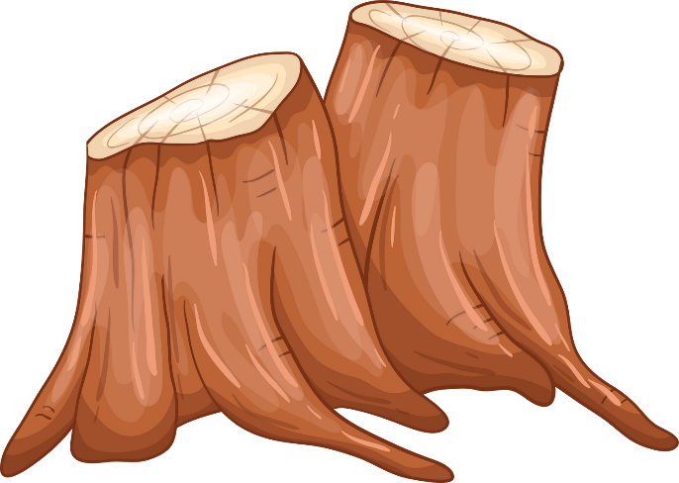
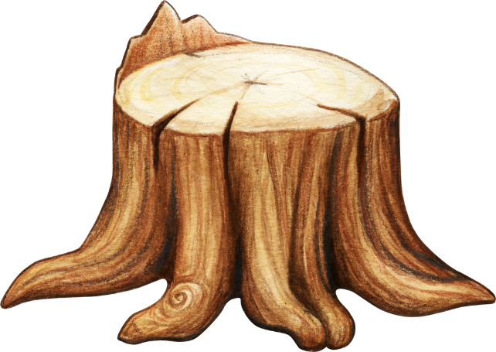
Page 13
La la la la la la la la la la la.

Slide 14

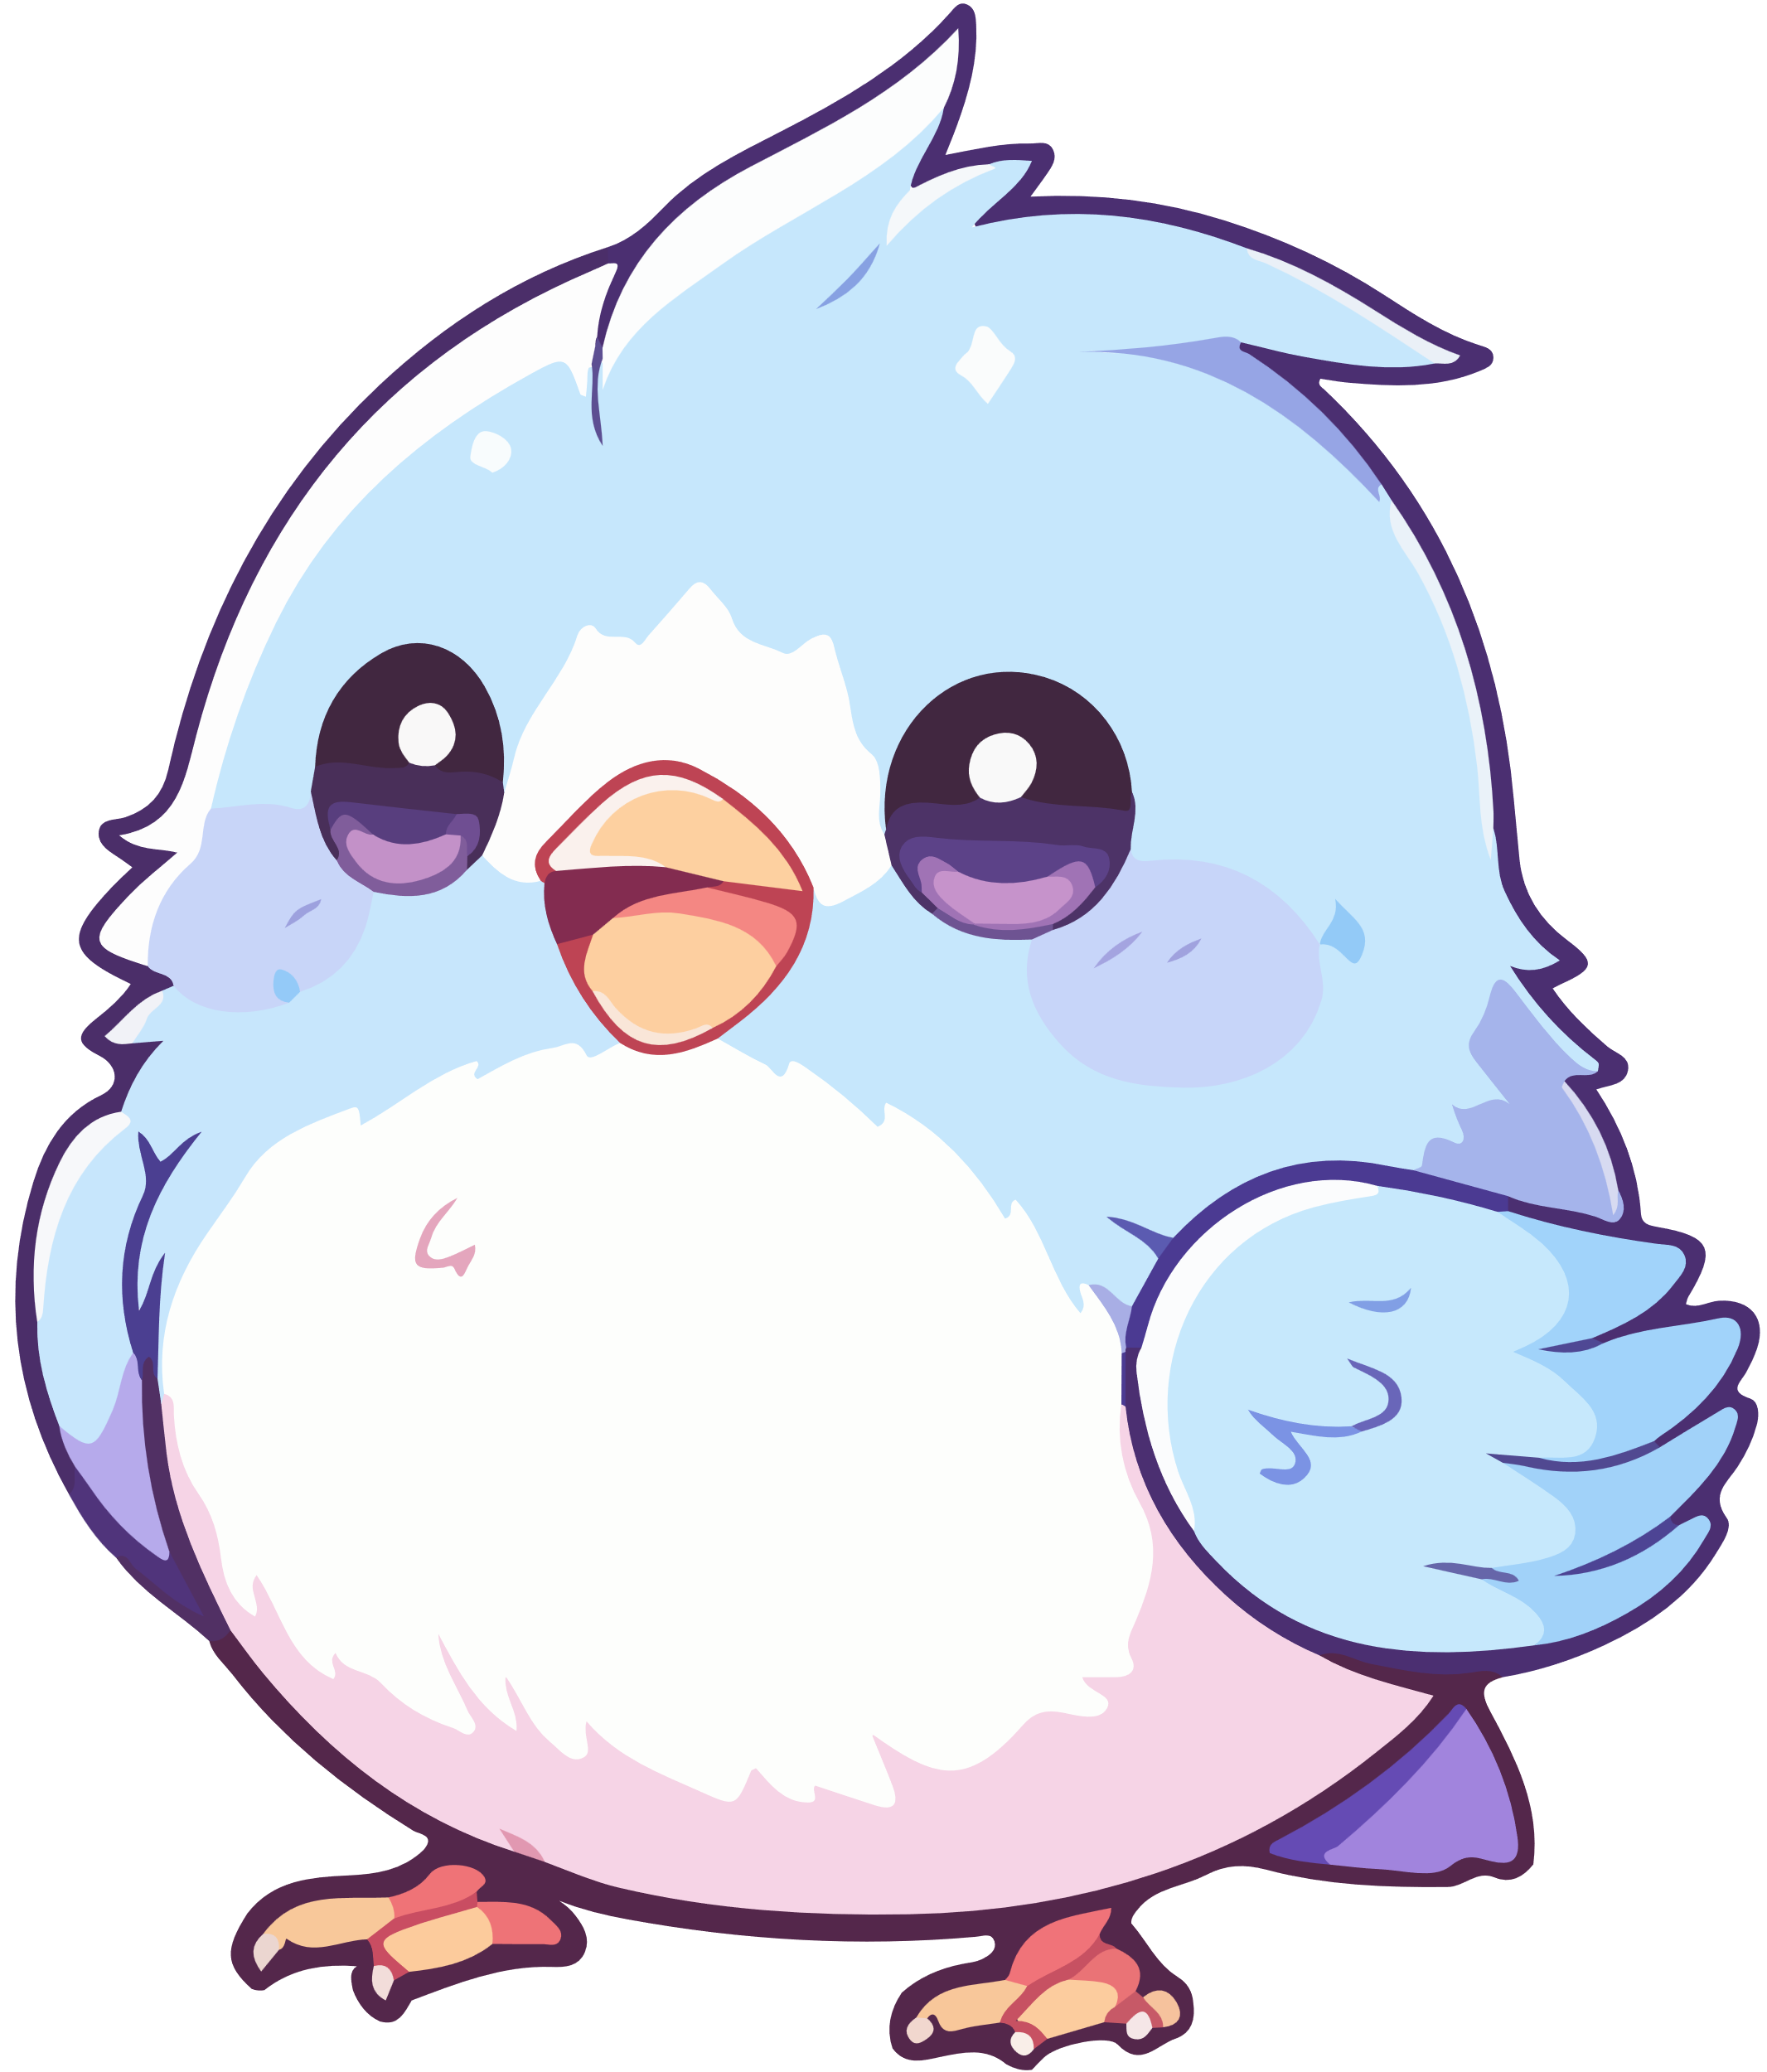
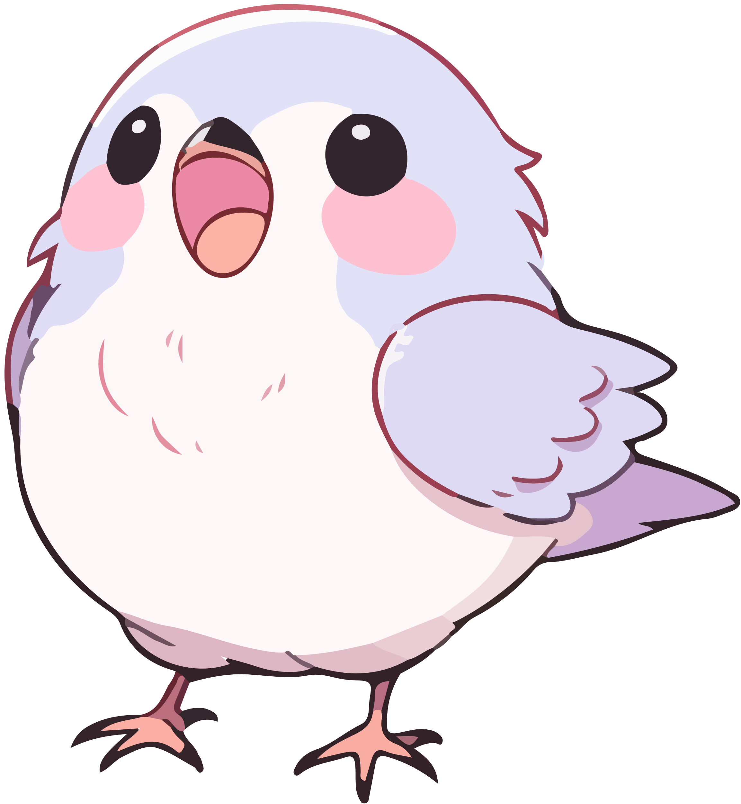
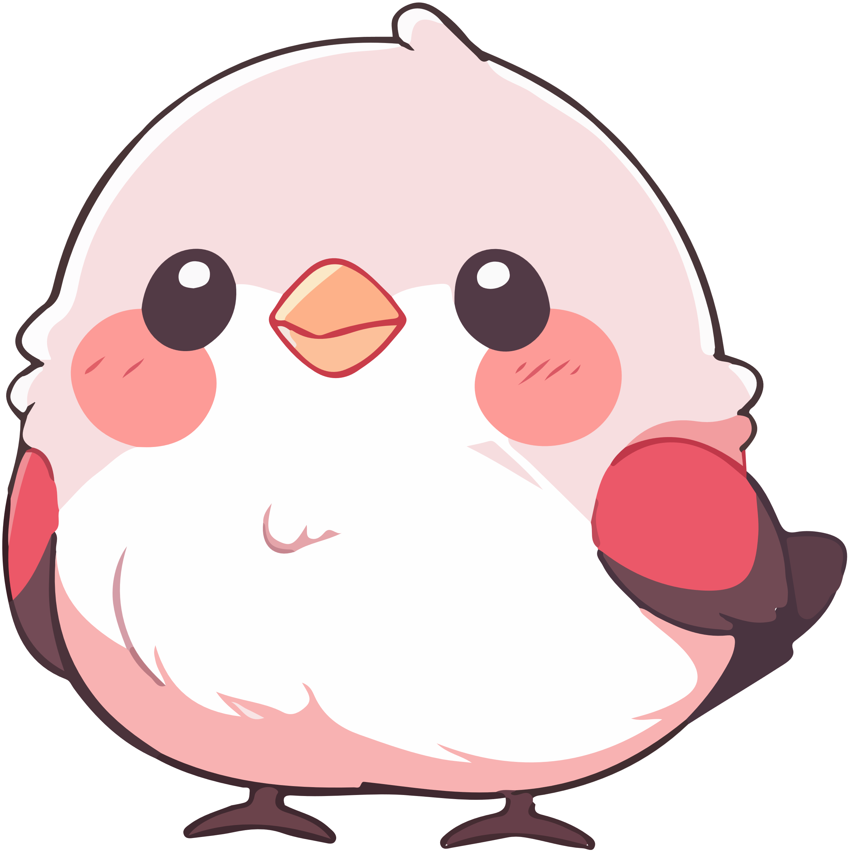



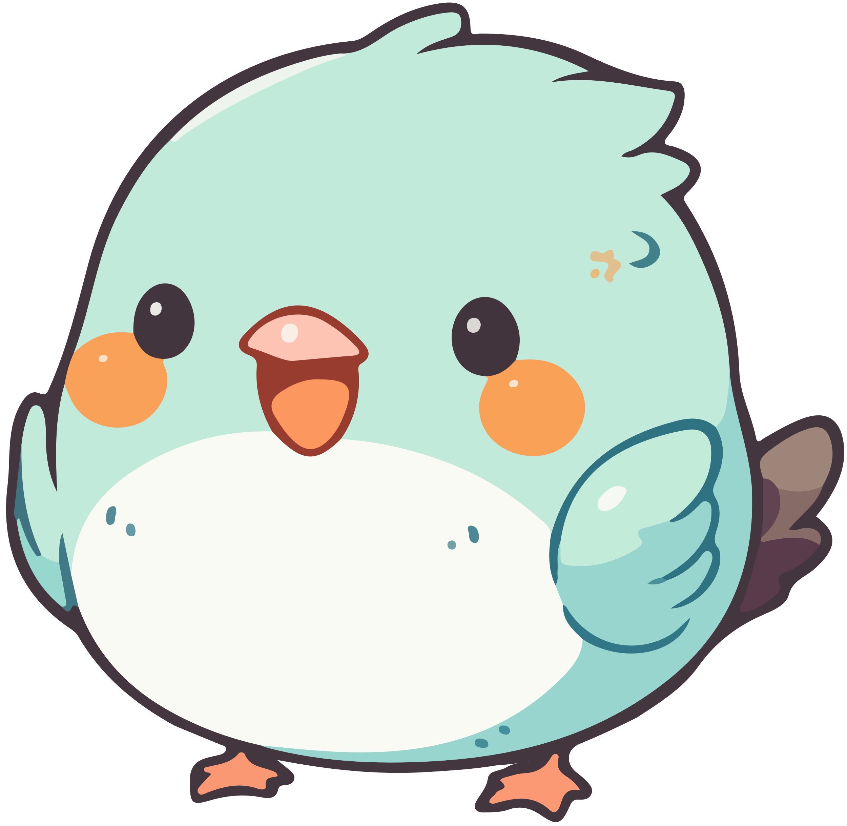

Page 14
Look! One, two, three, four birds perched on the roof.

Slide 15
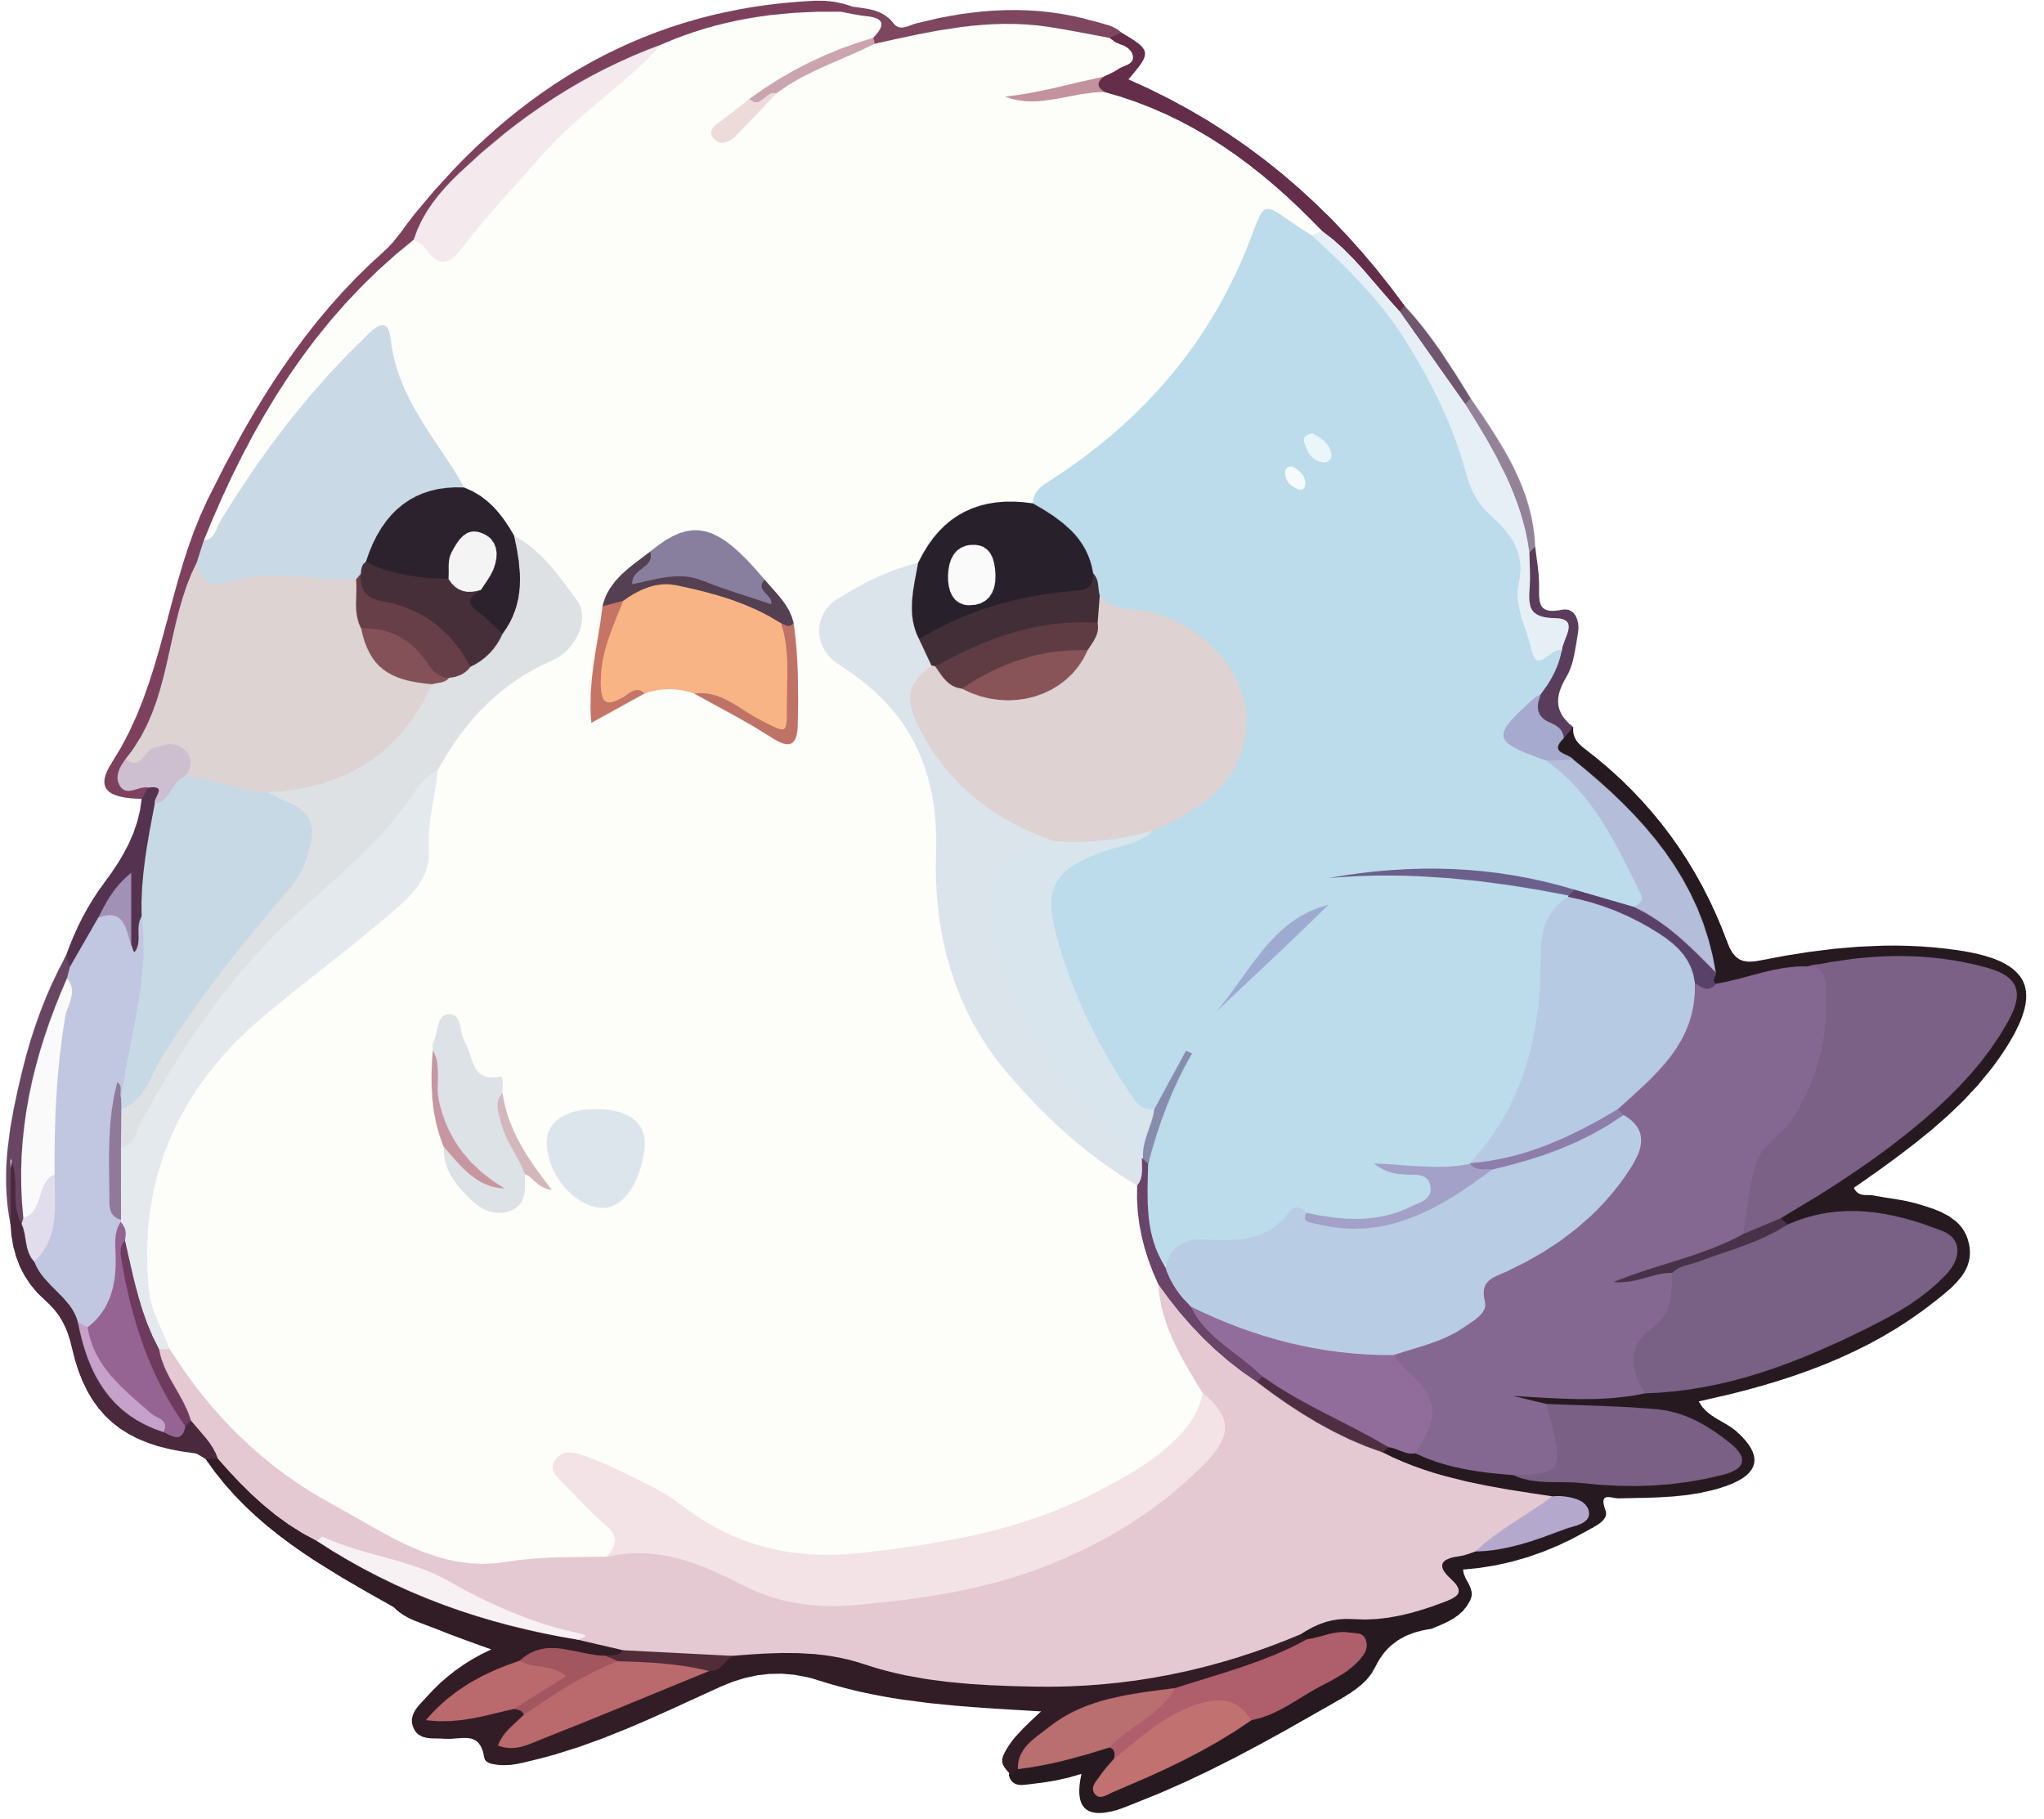
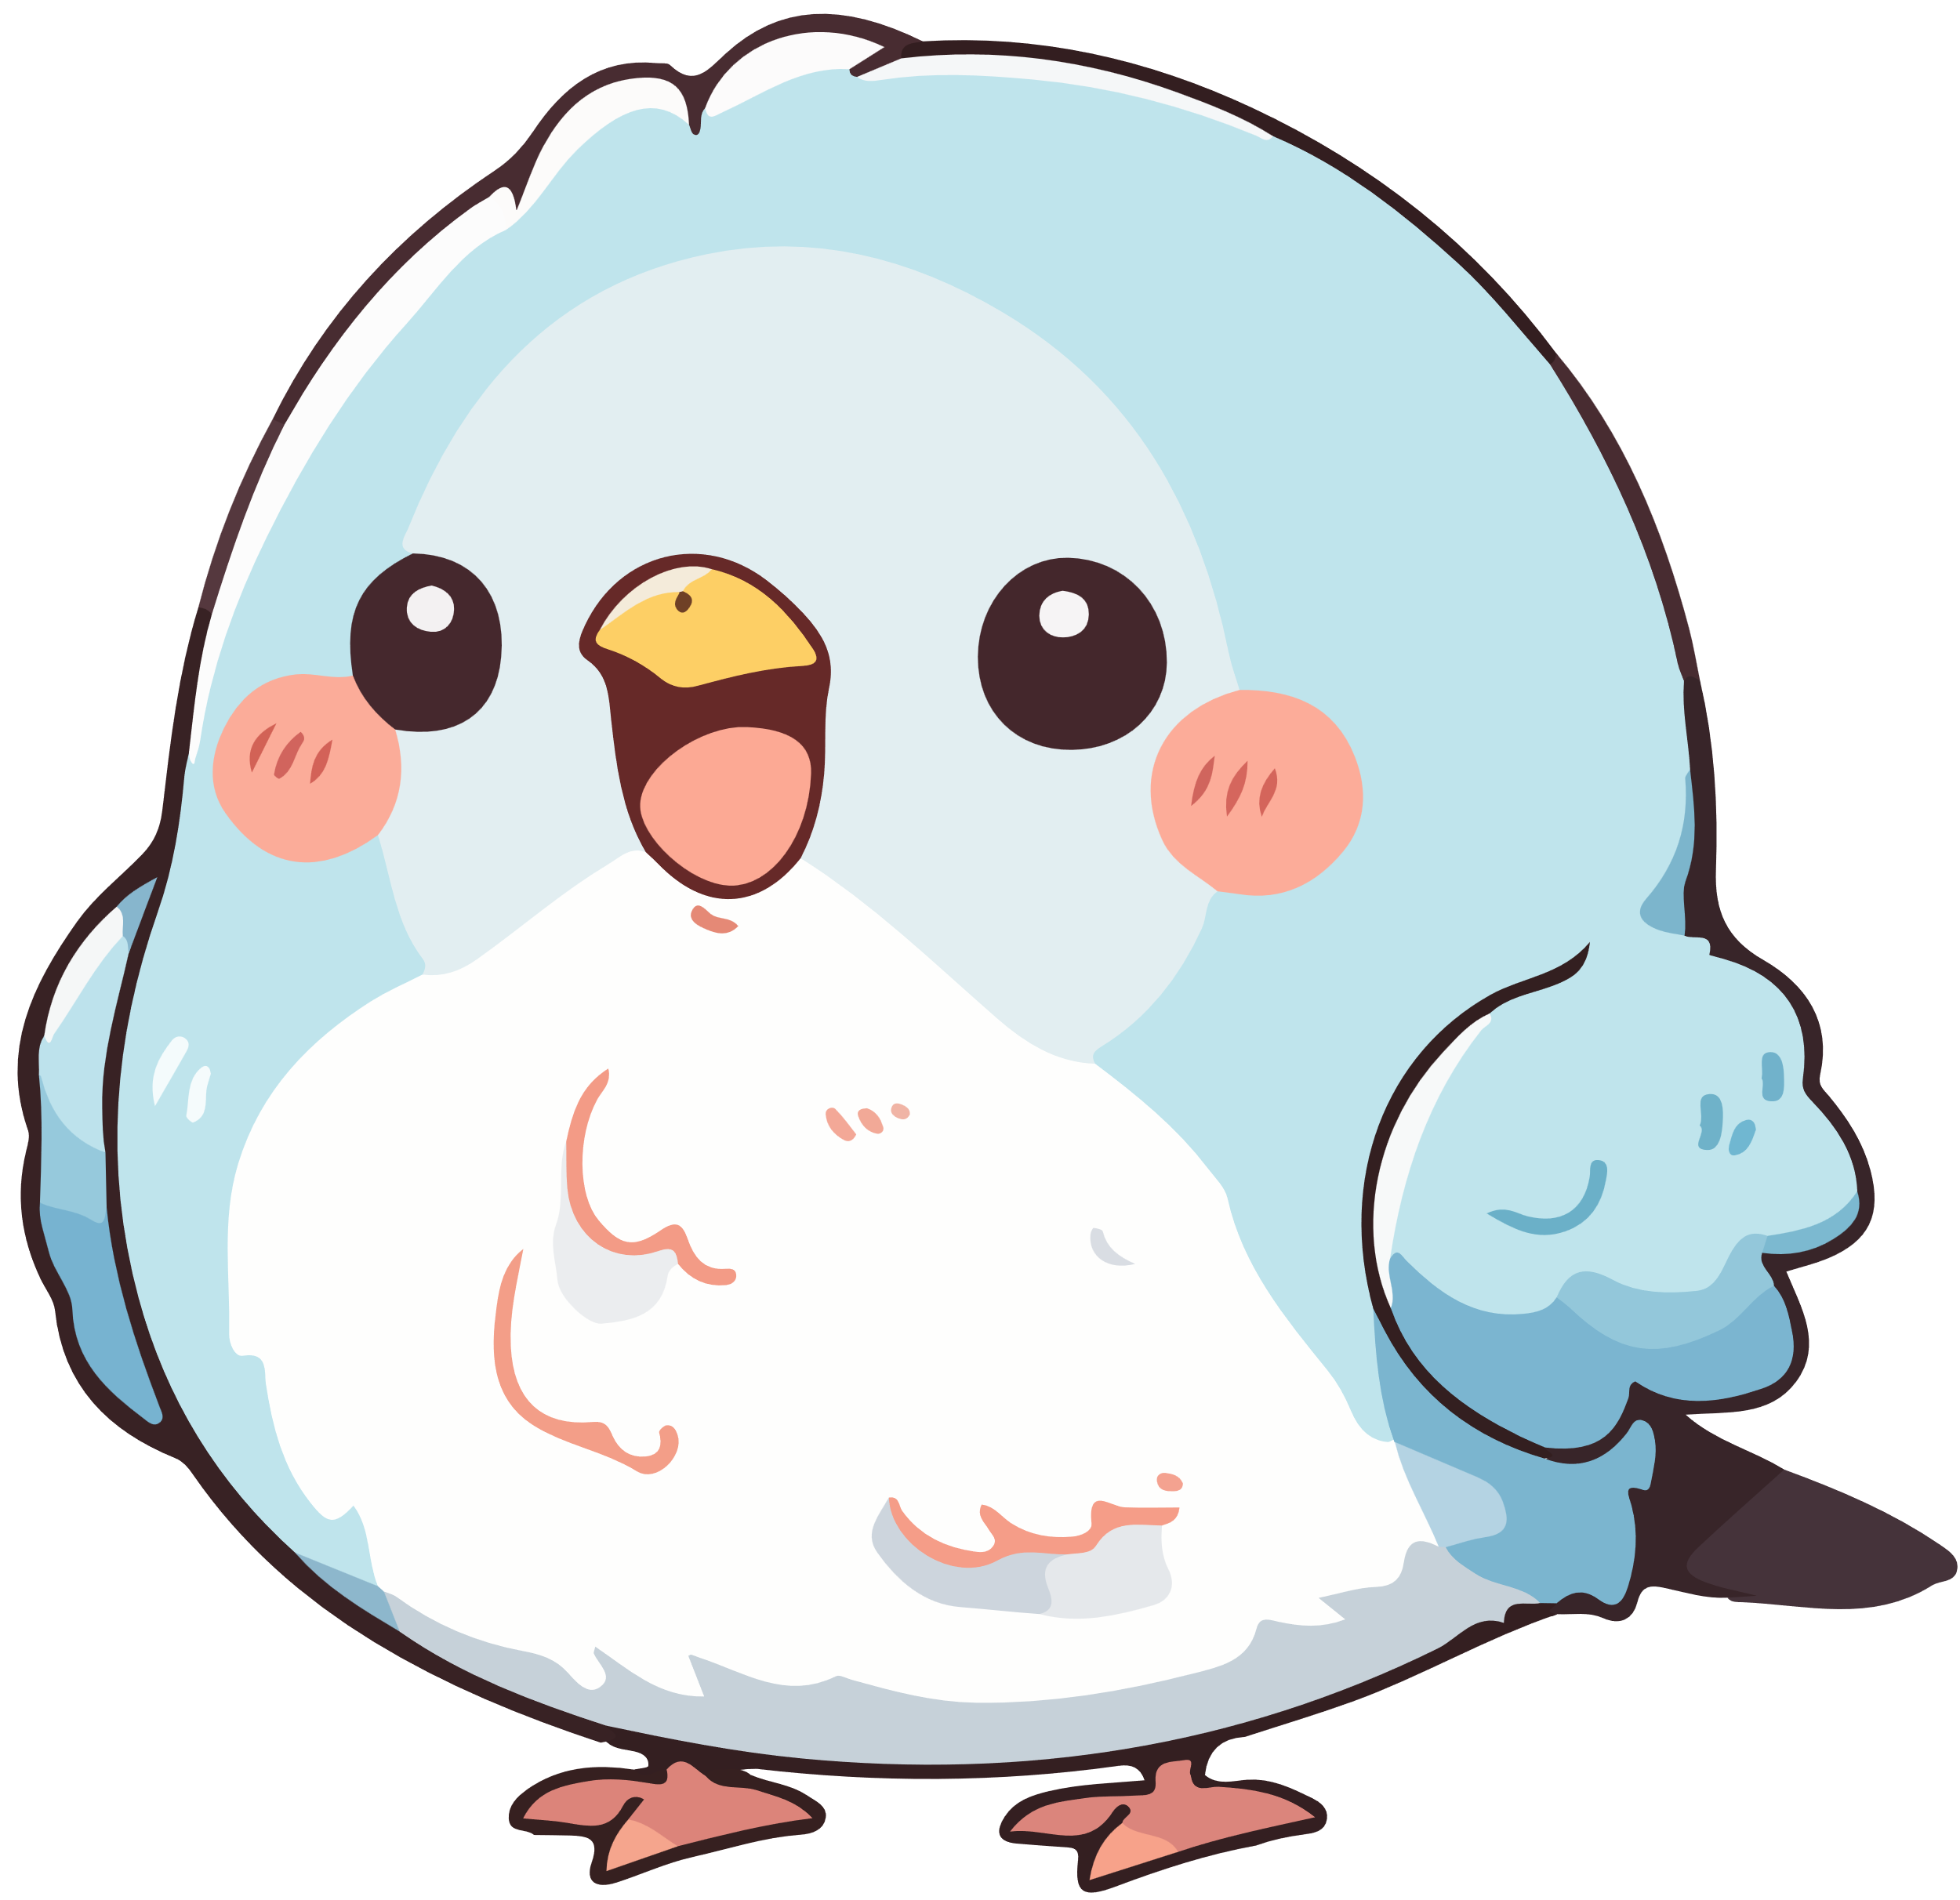
Page 15
And then the five, six, next seven, eight, nine, ten.

Slide 16

Page 16
The rain came.

Slide 17
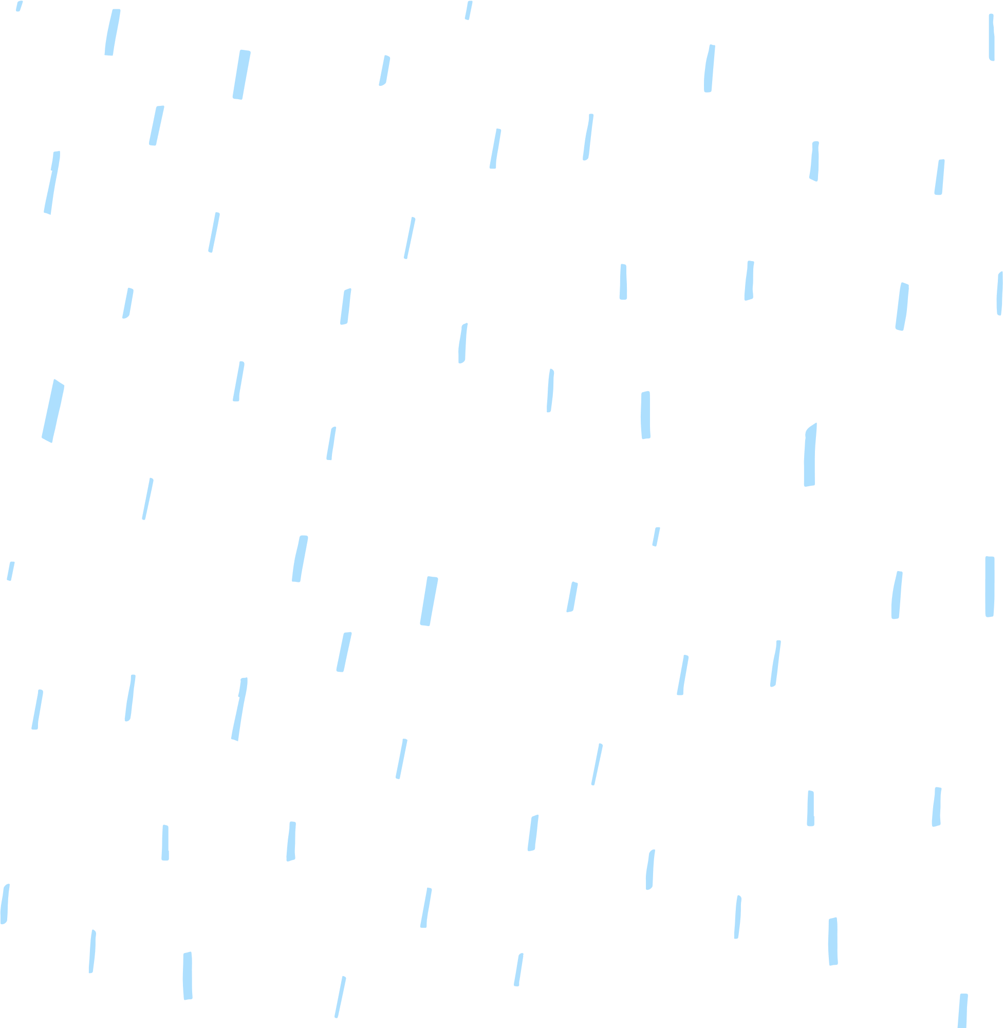






Page 17
The birds flew away very quickly.

Slide 18
Page 18
And there were no more birds on the roof.

Slide 19
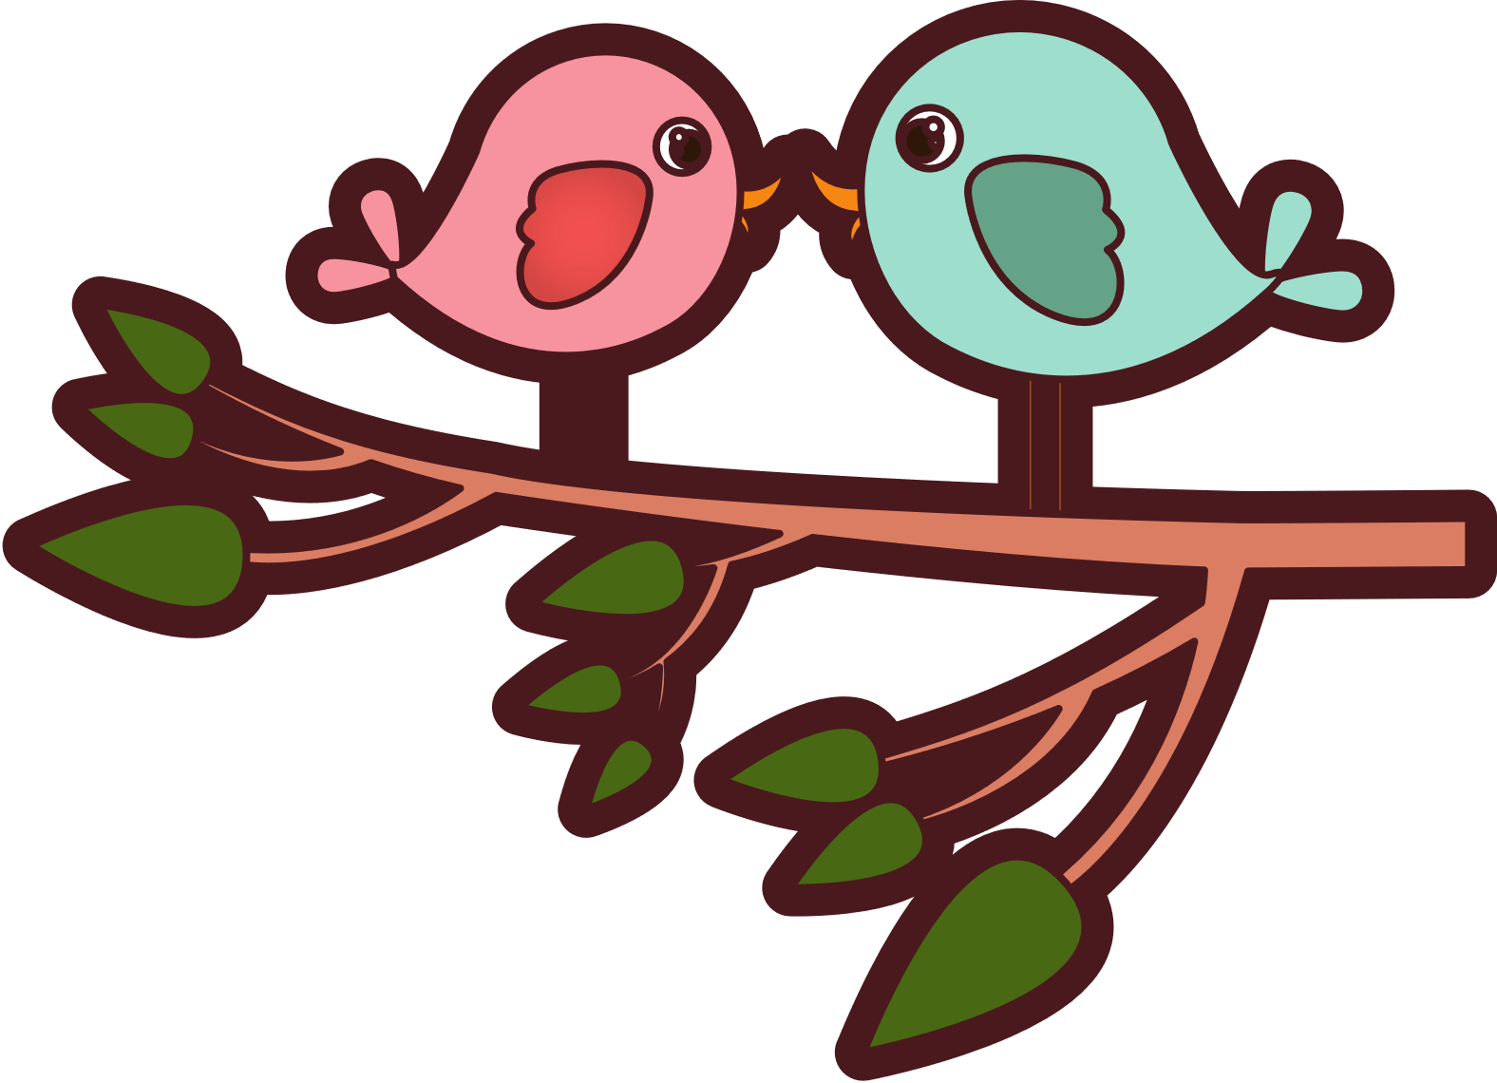
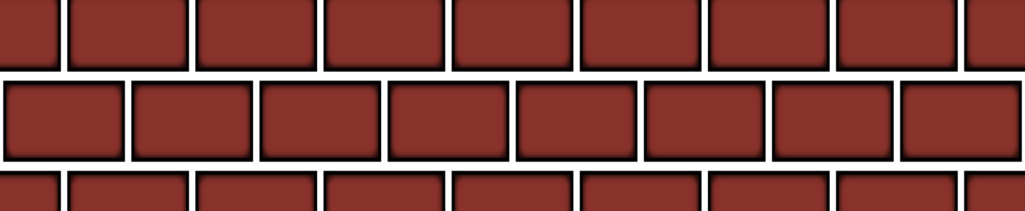
Page 19
La la la la la la la la la la la.

Slide 20
Copyright
© State of New South Wales (Department of Education), 2024
The copyright material published in this resource is subject to the Copyright Act 1968 (Cth) and is owned by the NSW Department of Education or, where indicated, by a party other than the NSW Department of Education (third-party material).
Copyright material available in this resource and owned by the NSW Department of Education is licensed under a Creative Commons Attribution 4.0 International (CC BY 4.0) licence.
This licence allows you to share and adapt the material for any purpose, even commercially.
Attribution should be given to © State of New South Wales (Department of Education), 2023.
Material in this resource not available under a Creative Commons licence:
the NSW Department of Education logo, other logos and trademark-protected material
Material owned by a third party that has been reproduced with permission. You will need to obtain permission from the third party to reuse its material.
Links to third-party material and websites
Please note that the provided (reading/viewing material/list/links/texts) are a suggestion only and implies no endorsement, by the New South Wales Department of Education, of any author, publisher, or book title. School principals and teachers are best placed to assess the suitability of resources that would complement the curriculum and reflect the needs and interests of their students.
If you use the links provided in this document to access a third party’s website, you acknowledge that the terms of use, including licence terms set out on the third-party’s website apply to the use which may be made of the materials on that third-party website or where permitted by the Copyright Act 1968 (Cth). The department accepts no responsibility for content on third-party websites.

