Slide 1
Bargaining strategies

Slide 2
Phrases that a buyer might use

Slide 3
Berapa harganya?
Notes:
Berapa harganya? means ‘How much is it?’

Slide 4
Wah, terlalu mahal!
Notes:
Wah, terlalu mahal! means ‘Wow, it’s too expensive!’

Slide 5
Bisa tawar-menawar?
Notes:
Bisa tawar-menawar? means ‘Can I bargain?’

Slide 6
Bisa kurang?
Notes:
Bisa kurang? means ‘Can you reduce it?’

Slide 7
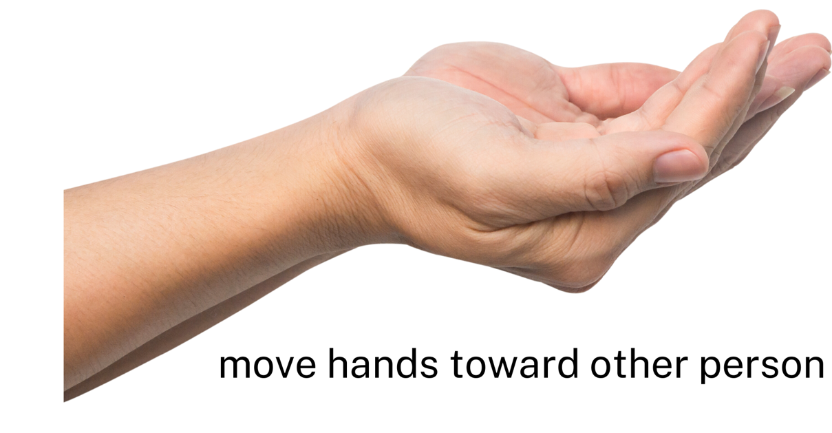
Ini uangnya.
Notes:
Ini uangnya means ‘Here is the money’.

Slide 8
Phrases that a seller might use

Slide 9
Mau beli apa?
Notes:
Mau beli apa? means ‘What do you want to buy?’

Slide 10
Yang mana?
Notes:
Yang mana? means ‘Which one?’

Slide 11
Saya rugi!
Notes:
Saya rugi! means ‘I will lose!’ (implying, ‘I will lose out financially!’)

Slide 12
Bisa tambah lagi?
Notes:
Bisa tambah lagi? means ‘Can you increase it more?’

Slide 13
Kualitasnya baik!
Notes:
Kualitasnya baik! means ‘It is good quality!’

Slide 14
Kamu pandai tawar-menawar!
Notes:
Kamu pandai tawar-menawar! means ‘You are good at bargaining!’

Slide 15
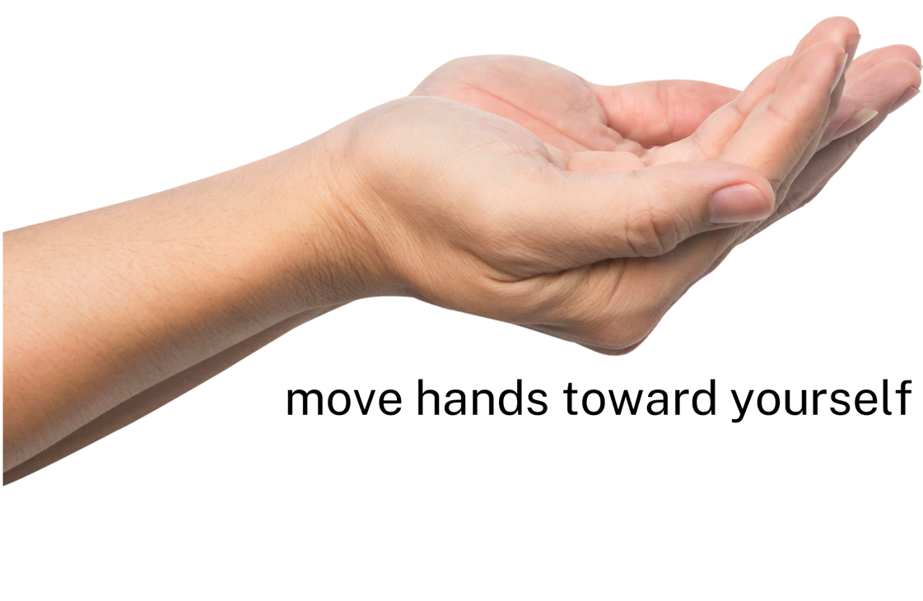
Ini uang kembalinya.
Notes:
Ini uang kembalinya means ‘Here is the change’

Slide 16
Maaf, harga pas.
Notes:
Maaf, harga pas means ‘Sorry, it’s fixed price’

Slide 17
Tips and tricks
Don’t start bargaining unless you have full intentions of buying the item.
You can use the phrase Bagaimana kalau…? to suggest a price to the seller. For example, Bagaimana kalau tiga puluh ribu rupiah?, which means, ‘How about thirty thousand rupiah?’. It is reasonable to offer a third or half of the first price the seller gives.
The seller might reduce the price if you buy more of a particular item. For example, you could ask Berapa harganya untuk dua…? The seller might reply with Kalau beli dua, harganya…
You can use tactics such as comparing the prices to another shop or stall, or pretending to walk away from the seller to see if they will meet your price.
Use greetings and phrases to be polite, for example, Selamat pagi Bu; Terima kasih; Apa kabar?
Be friendly, enjoy the experience and use Indonesian as much as you can!

Slide 18
Copyright
© State of New South Wales (Department of Education), 2024
The copyright material published in this resource is subject to the Copyright Act 1968 (Cth) and is owned by the NSW Department of Education or, where indicated, by a party other than the NSW Department of Education (third-party material).
Copyright material available in this resource and owned by the NSW Department of Education is licensed under a Creative Commons Attribution 4.0 International (CC BY 4.0) license.
This license allows you to share and adapt the material for any purpose, even commercially.
Attribution should be given to © State of New South Wales (Department of Education), 2024.
Material in this resource not available under a Creative Commons license:
the NSW Department of Education logo, other logos and trademark-protected material
material owned by a third party that has been reproduced with permission. You will need to obtain permission from the third party to reuse its material.
Links to third-party material and websites
Please note that the provided (reading/viewing material/list/links/texts) are a suggestion only and implies no endorsement, by the New South Wales Department of Education, of any author, publisher, or book title. School principals and teachers are best placed to assess the suitability of resources that would complement the curriculum and reflect the needs and interests of their students.
If you use the links provided in this document to access a third-party's website, you acknowledge that the terms of use, including licence terms set out on the third-party's website apply to the use which may be made of the materials on that third-party website or where permitted by the Copyright Act 1968 (Cth). The department accepts no responsibility for content on third-party websites.
Notes:
Slide not shared

