Slide 1
Food items revision

Slide 2
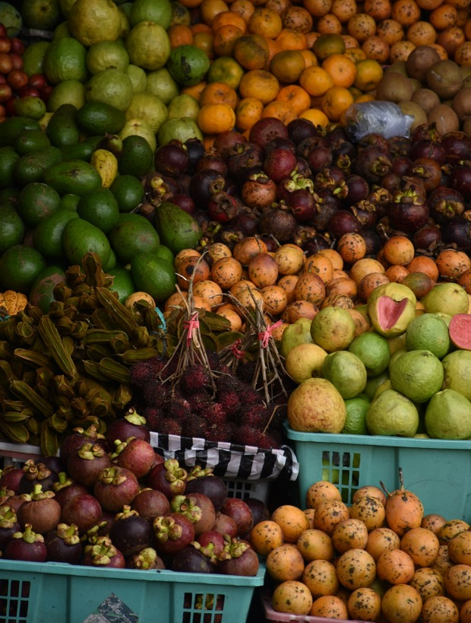
buah-buahan
Notes:
Buah-buahan means ‘fruit’.

Slide 3
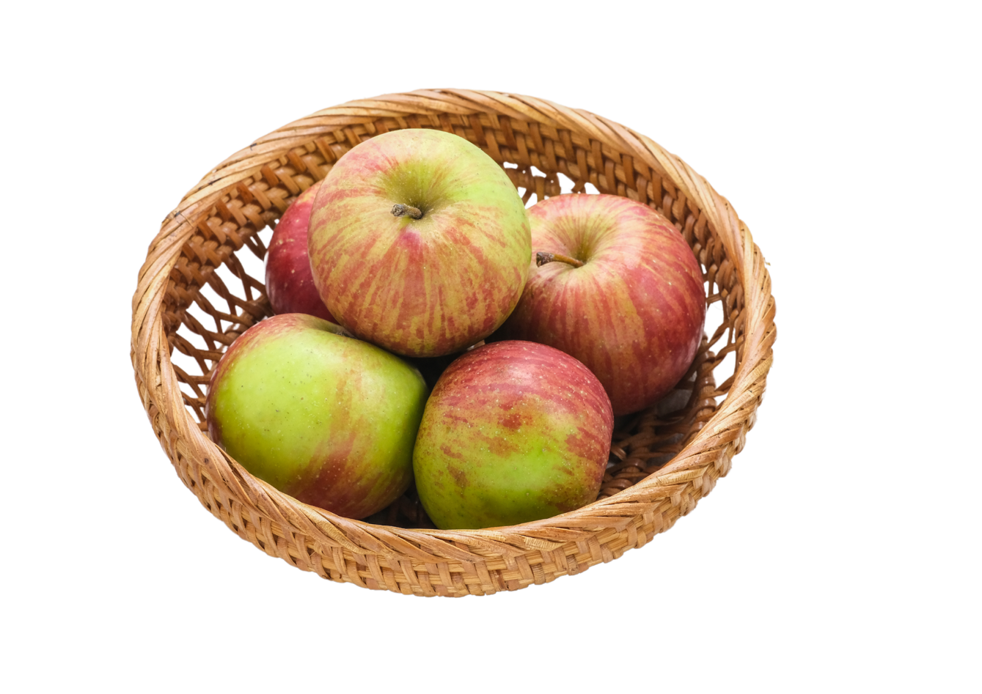
apel
Notes:
Apel means ‘apple’.

Slide 4
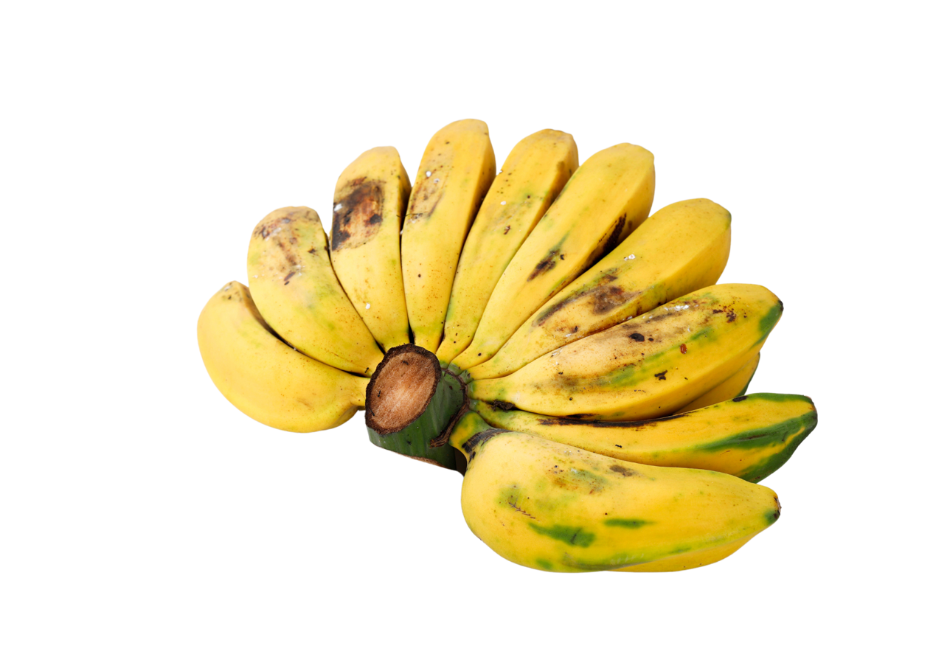
pisang
Notes:
Pisang means ‘banana’. In Indonesia, bananas are often small and sometimes green.

Slide 5
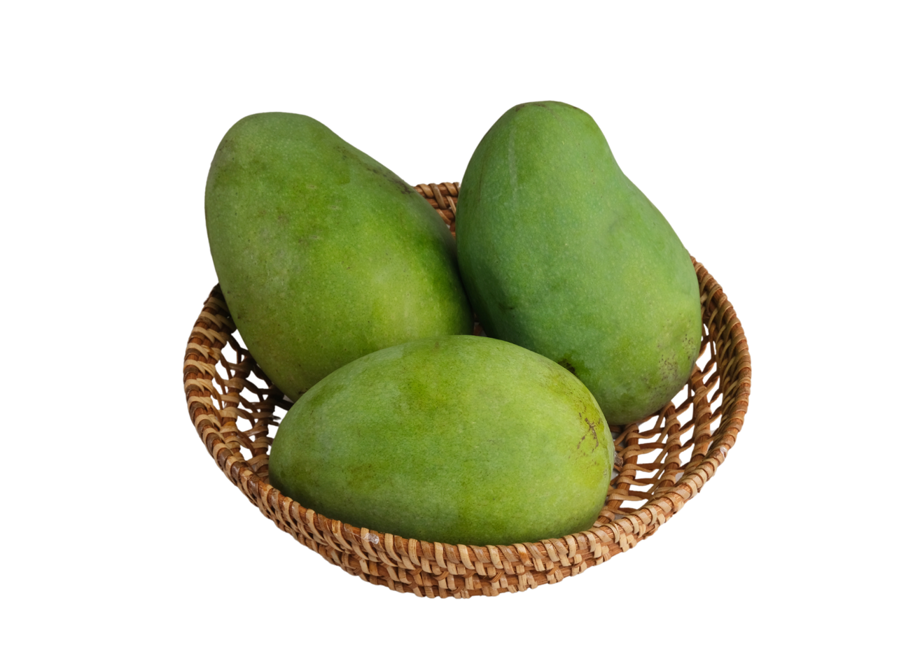
mangga
Notes:
Mangga means ‘mango’. In Indonesia, mangoes often have green skin.

Slide 6
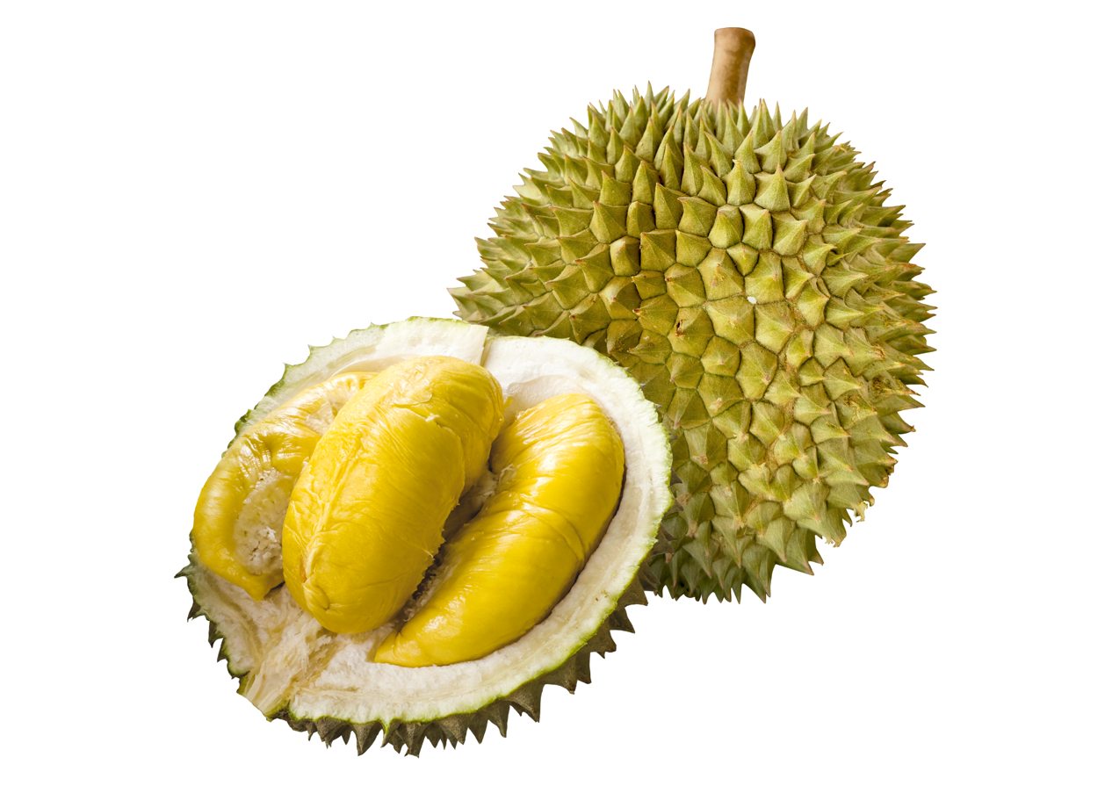
durian
Notes:
Durian is a tropical fruit known for its strong smell.

Slide 7
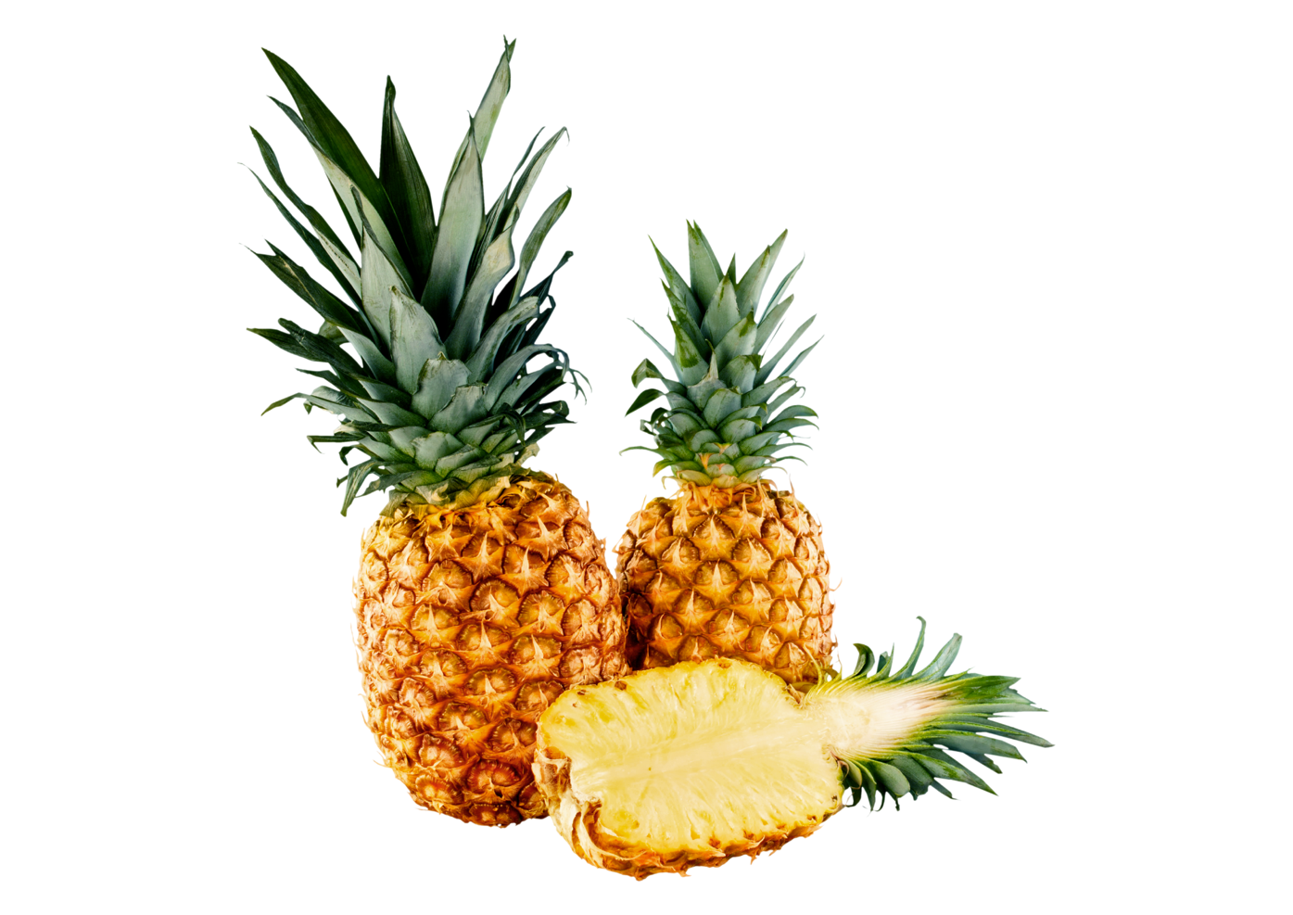
nanas
Notes:
Nanas means ‘pineapple’.

Slide 8
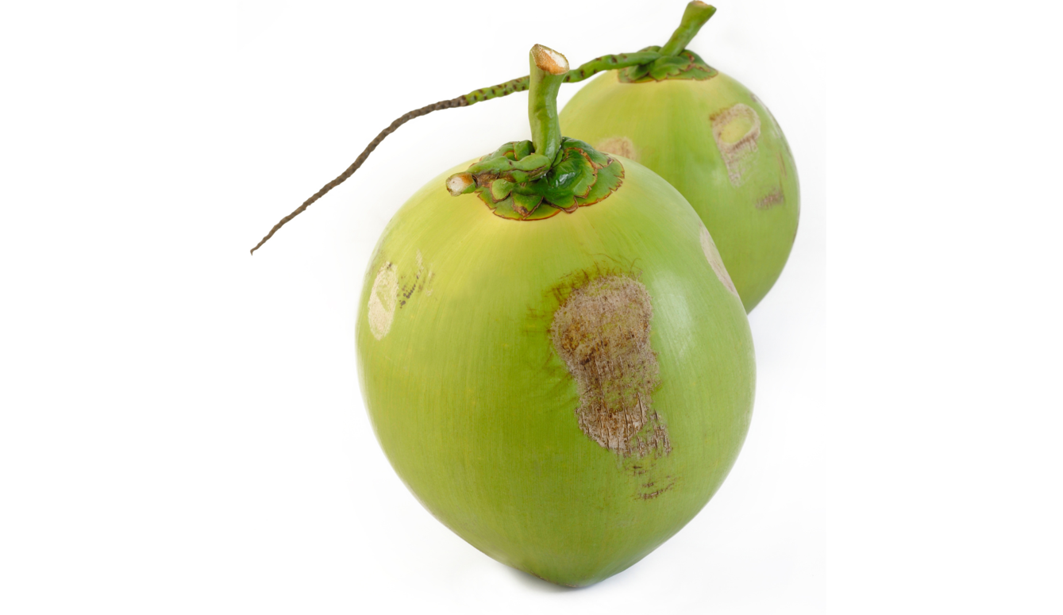
kelapa
Notes:
Kelapa means ‘coconut’.

Slide 9
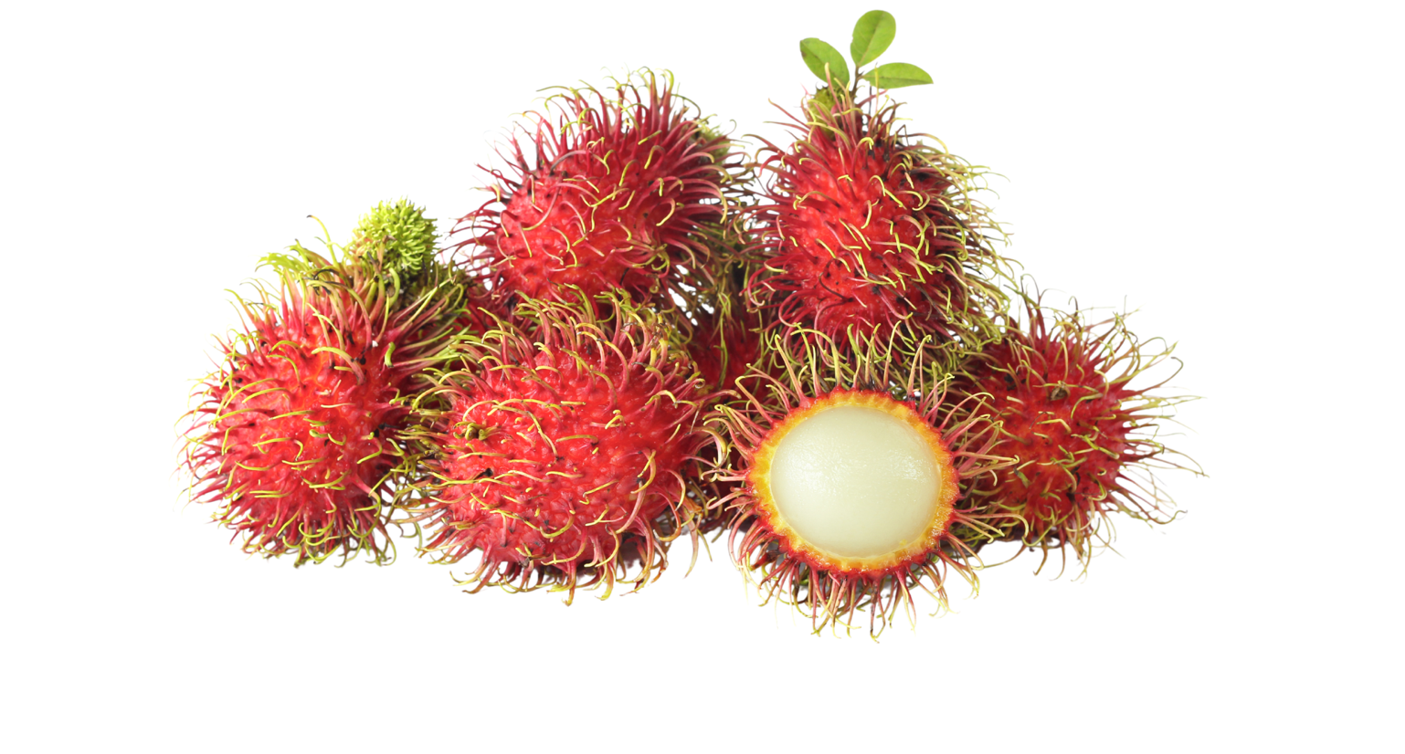
rambutan
Notes:
Rambutan is a tropical fruit with red, spiky skin and white flesh inside.

Slide 10
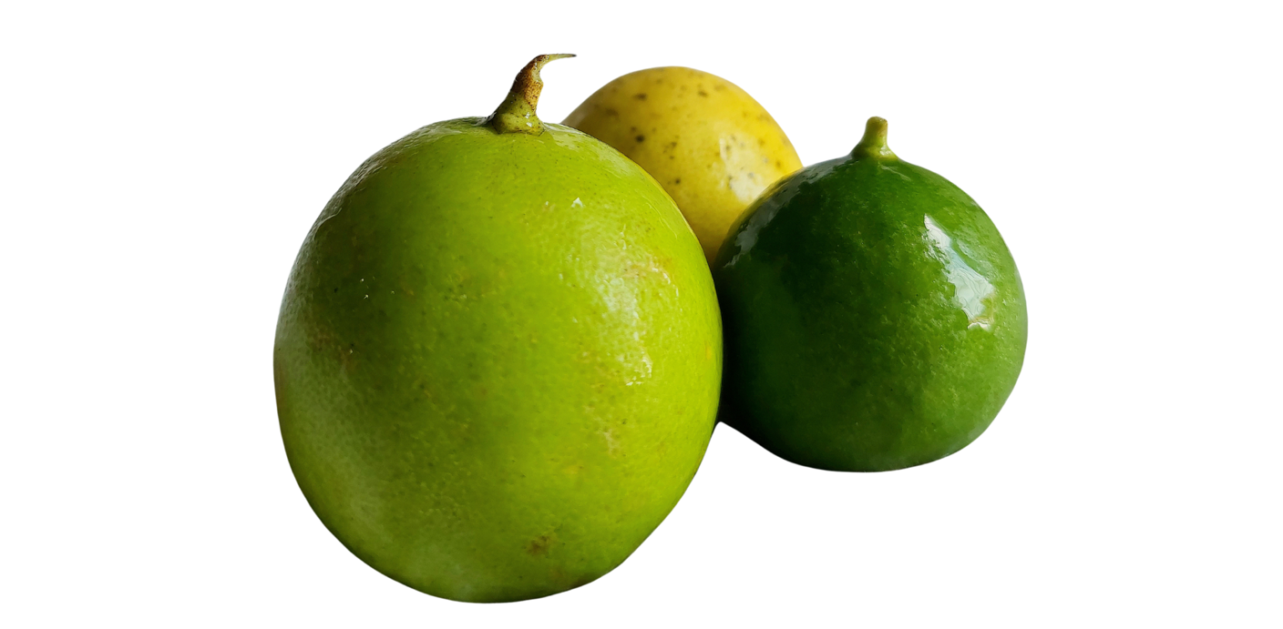
jeruk
Notes:
Jeruk means ‘orange’ or ‘citrus fruit’.

Slide 11
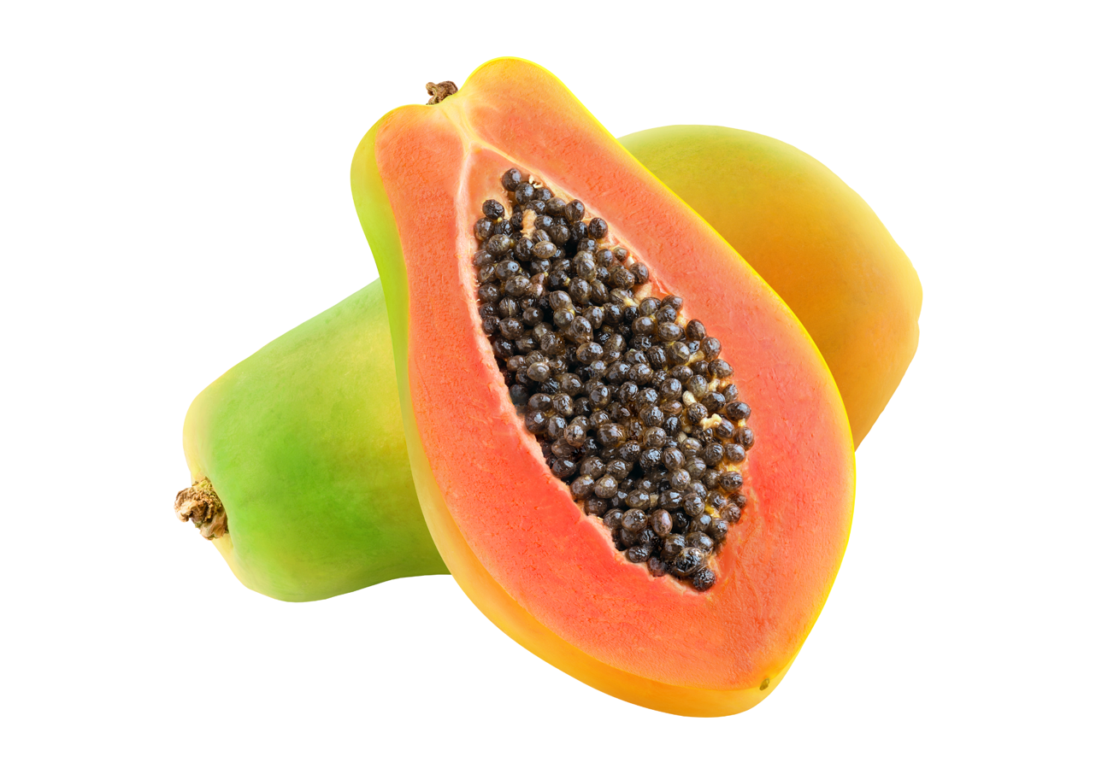
pepaya
Notes:
Pepaya means ‘papaya’.

Slide 12
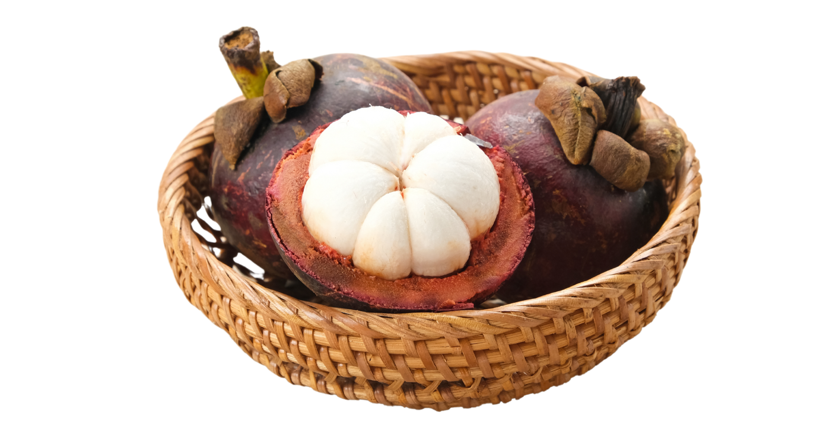
manggis
Notes:
Manggis means ‘mangosteen’. Mangosteen is a tropical fruit with purple skin and white flesh.

Slide 13
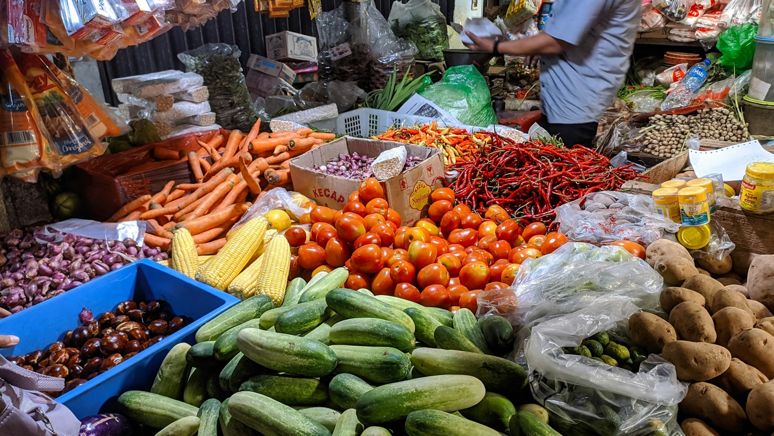
sayur-sayuran
Notes:
Sayur-sayuran means ‘vegetables’.

Slide 14
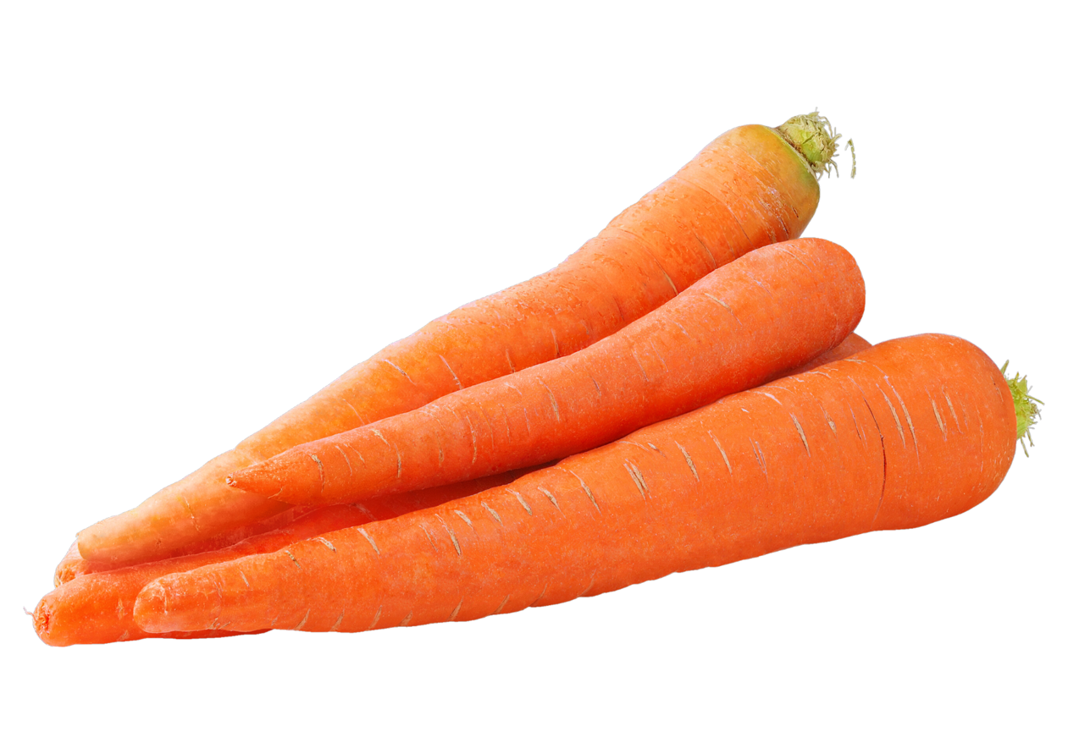
wortel
Notes:
Wortel means ‘carrot’.

Slide 15
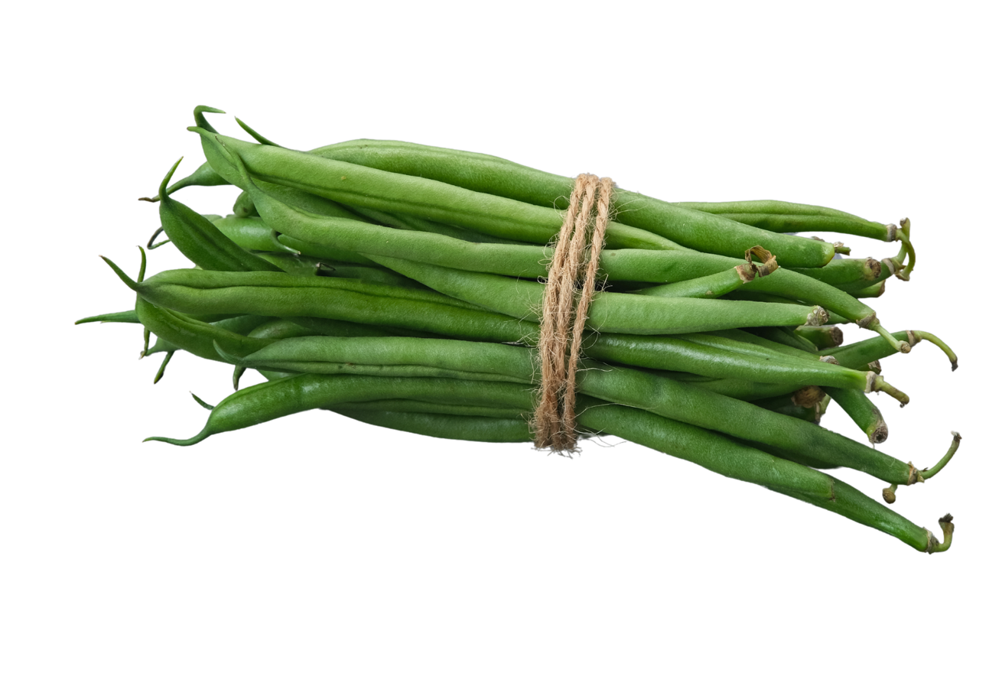
buncis
Notes:
Buncis means ‘green beans’.

Slide 16
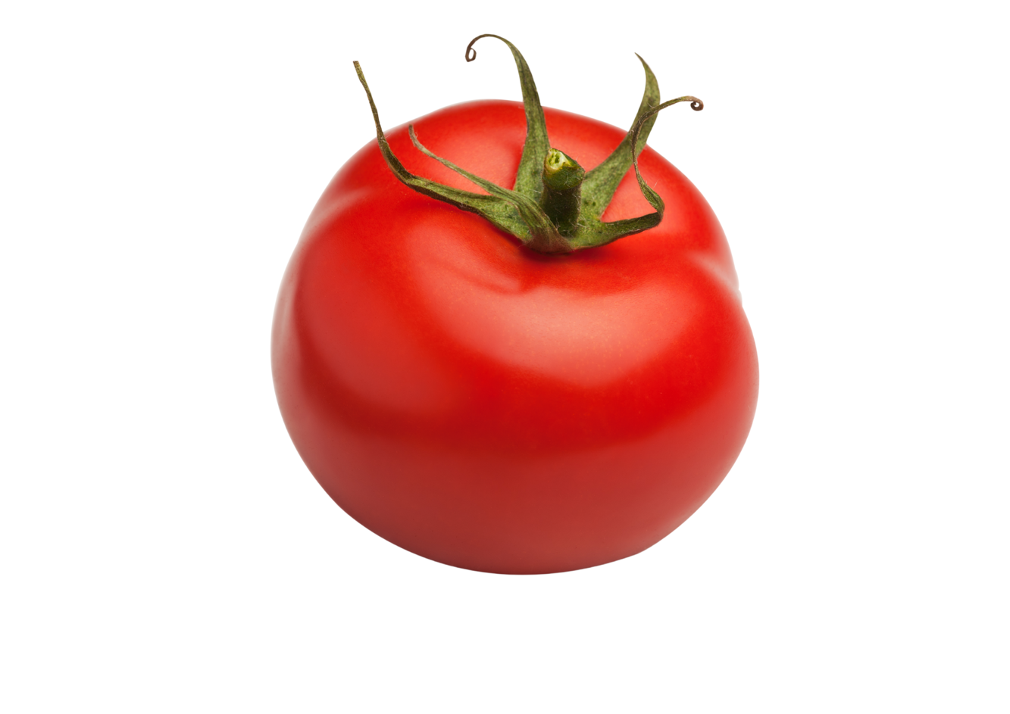
tomat
Notes:
Tomat means ‘tomato’.

Slide 17
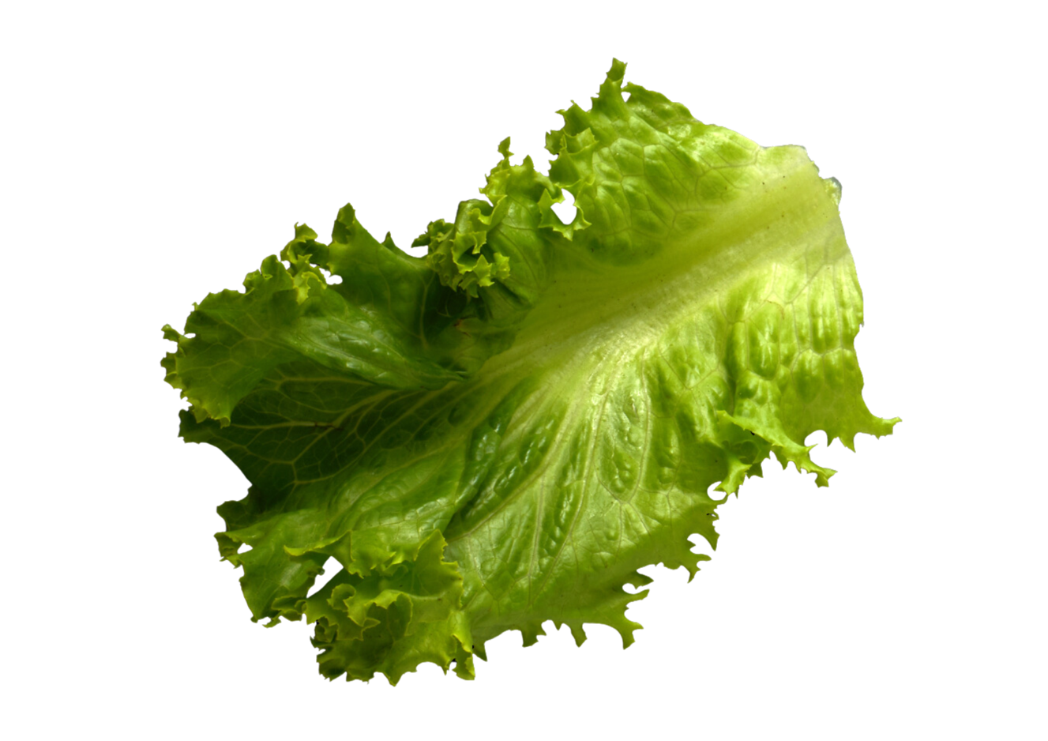
selada
Notes:
Selada means ‘lettuce’.

Slide 18
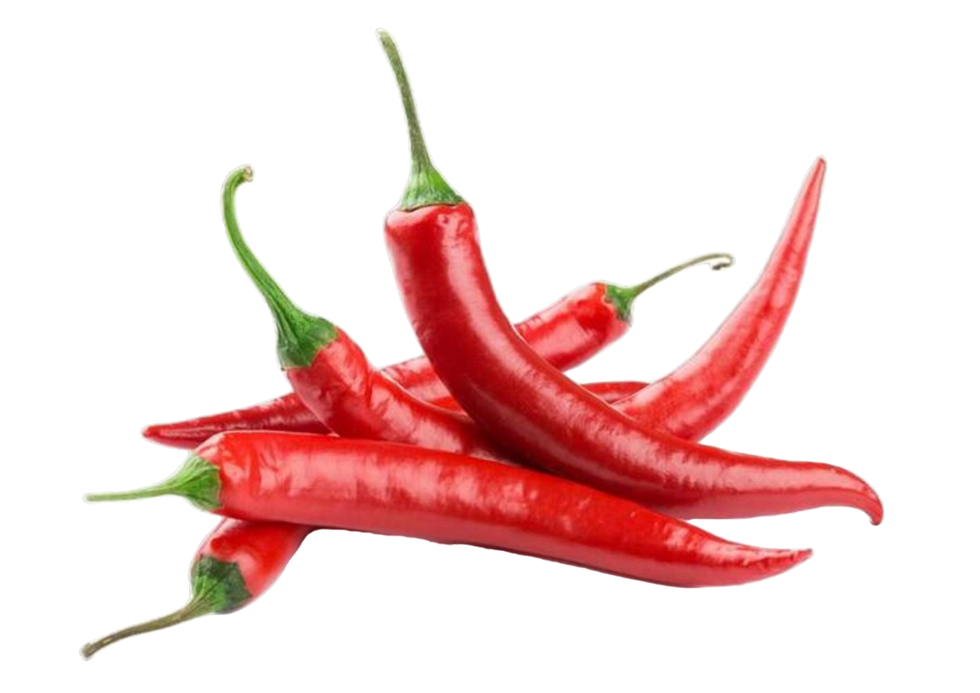
cabe
Notes:
Cabe means ‘chilli’.

Slide 19
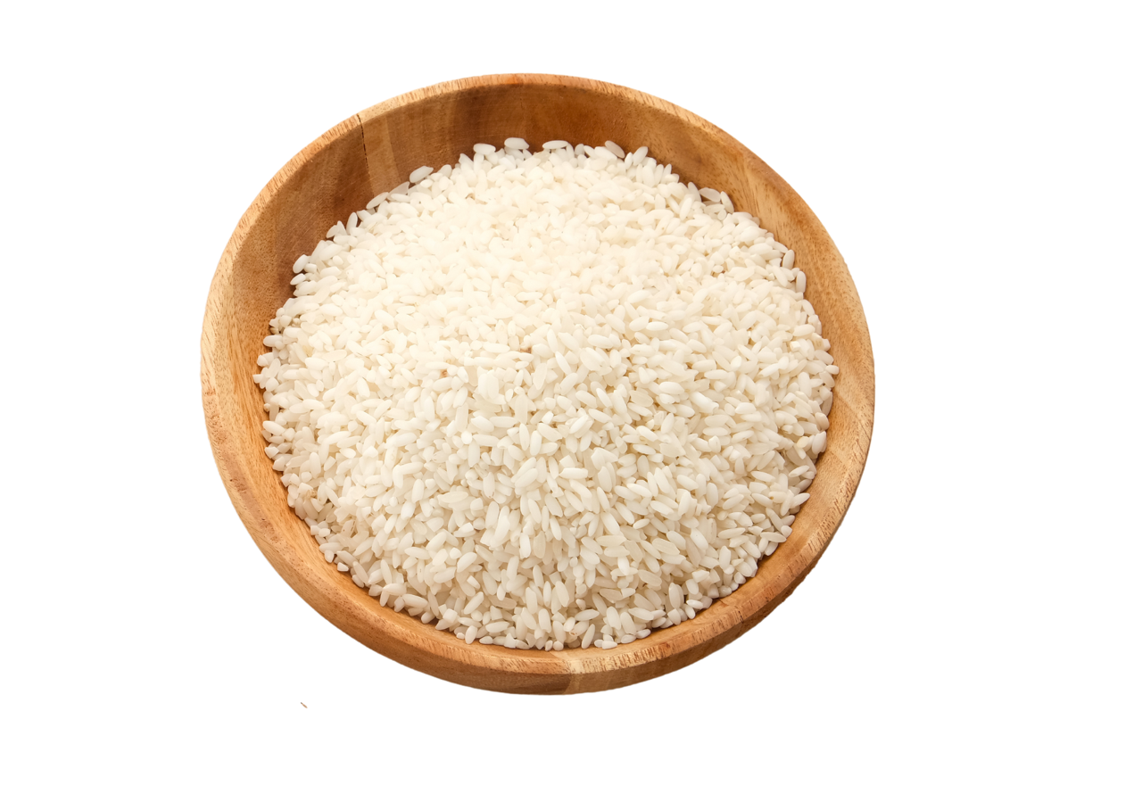
beras
Notes:
Beras means ‘uncooked rice’. Once rice has been cooked, it is called nasi.

Slide 20
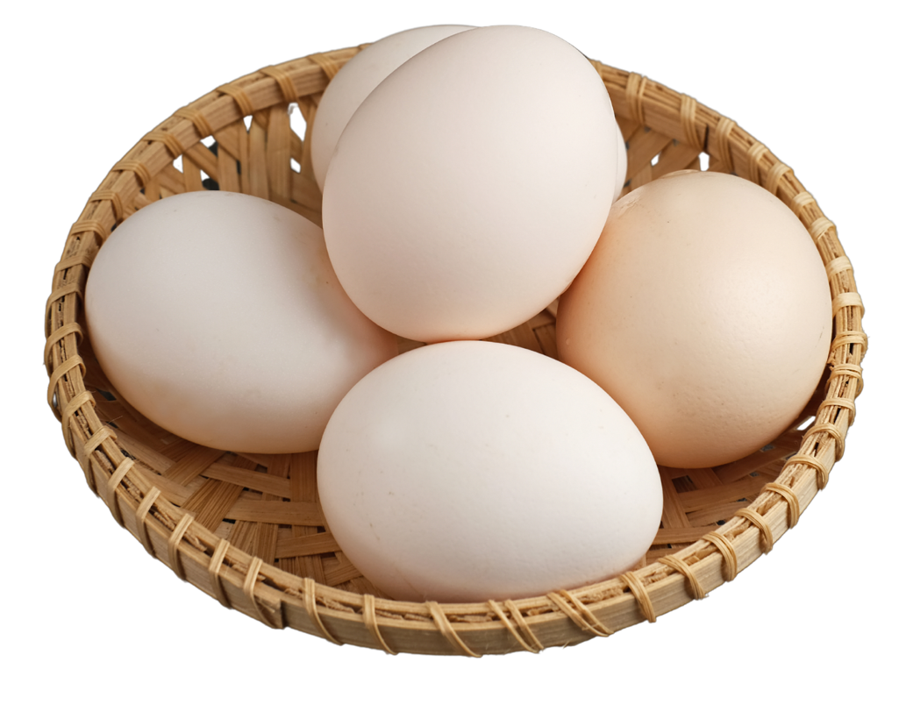
telur
Notes:
Telur means ‘egg’.

Slide 21
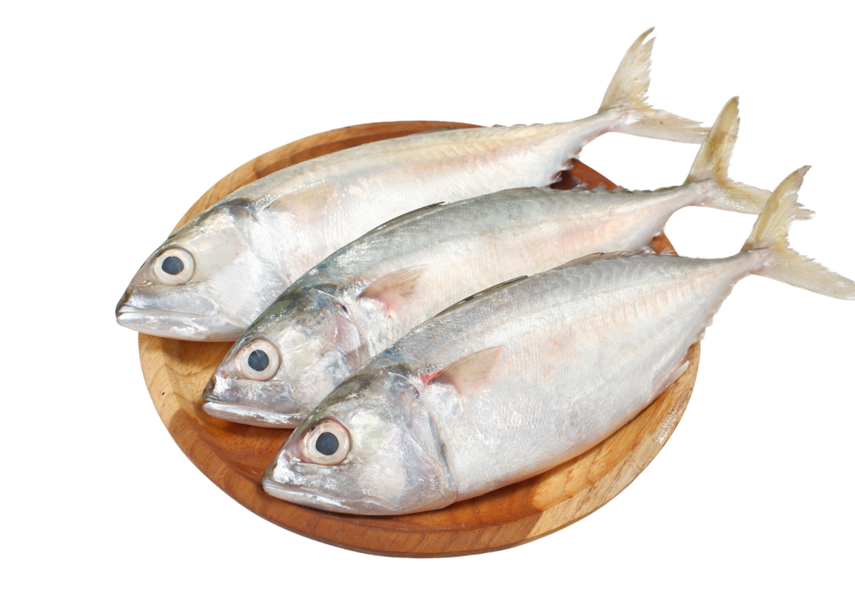
ikan
Notes:
Ikan means ‘fish’.

Slide 22
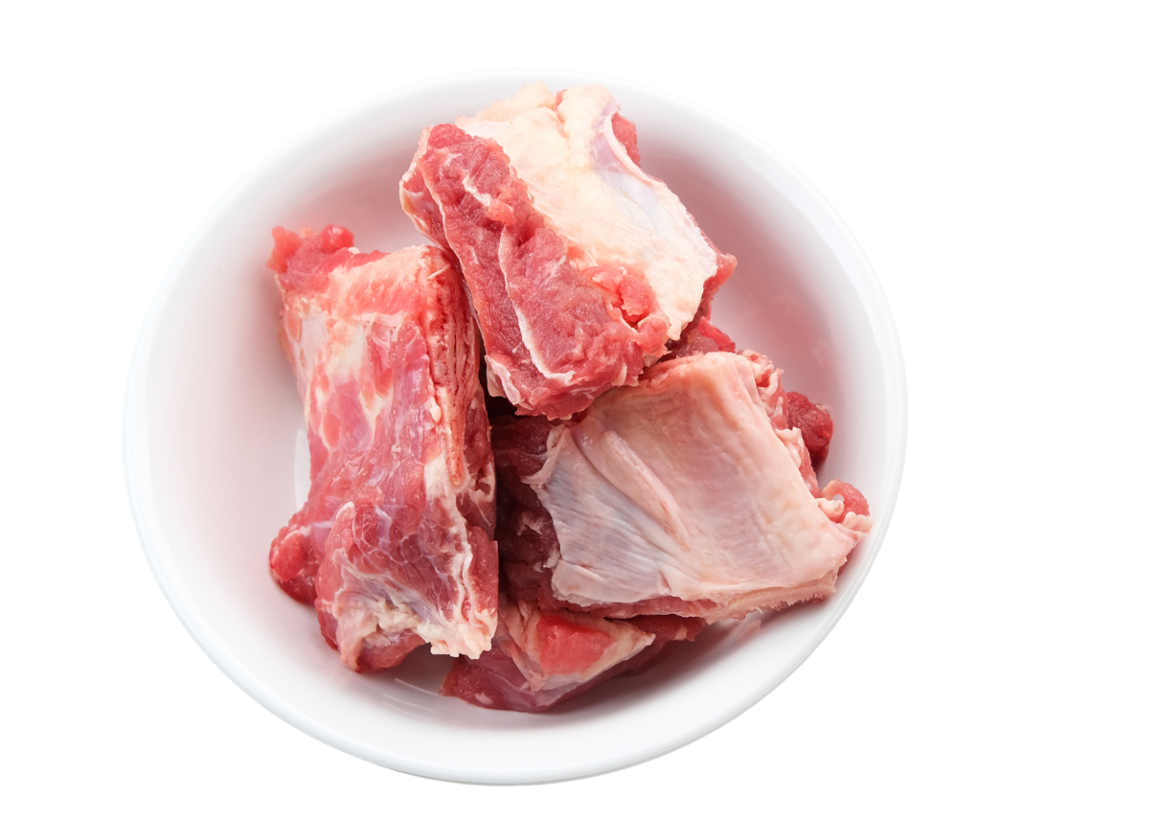
daging
Notes:
Daging means ‘meat’.

Slide 23
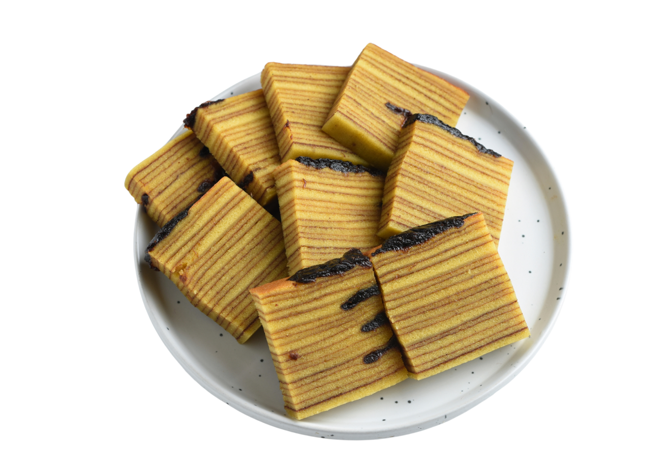
kue
Notes:
Kue means ‘cake’. Kue lapis (pictured) is a common type of Indonesian layer cake.

Slide 24
Copyright
© State of New South Wales (Department of Education), 2024
The copyright material published in this resource is subject to the Copyright Act 1968 (Cth) and is owned by the NSW Department of Education or, where indicated, by a party other than the NSW Department of Education (third-party material).
Copyright material available in this resource and owned by the NSW Department of Education is licensed under a Creative Commons Attribution 4.0 International (CC BY 4.0) license.
This license allows you to share and adapt the material for any purpose, even commercially.
Attribution should be given to © State of New South Wales (Department of Education), 2024.
Material in this resource not available under a Creative Commons license:
the NSW Department of Education logo, other logos and trademark-protected material
Material owned by a third party that has been reproduced with permission. You will need to obtain permission from the third party to reuse its material.
Links to third-party material and websites
Please note that the provided (reading/viewing material/list/links/texts) are a suggestion only and implies no endorsement, by the New South Wales Department of Education, of any author, publisher, or book title. School principals and teachers are best placed to assess the suitability of resources that would complement the curriculum and reflect the needs and interests of their students.
If you use the links provided in this document to access a third party’s website, you acknowledge that the terms of use, including licence terms set out on the third-party’s website apply to the use which may be made of the materials on that third-party website or where permitted by the Copyright Act 1968 (Cth). The department accepts no responsibility for content on third-party websites.
Notes:
Slide not shared

