Slide 1
Jeopardy game
Notes:
Jeopardy game created using ‘What’s the question?’ from Digital Learning Selector, DoE NSW

Slide 2
Instructions – Part A
Jeopardy
The Jeopardy game board displays different point values on tiles. Behind each tile is a word or an image of a food item or souvenir. Tiles are revealed left to right, and from top to bottom. Students play the game in 2 teams, with students in each team taking a turn to answer. There are 2 parts to this version of Jeopardy. First, teams take turns to create a question containing the word (or the word corresponding to the image) behind each tile. The question can be inspired by any part of the unit and can relate to any part of the shopping process covered so far. If the question is correct, the student’s team wins the tile points. Questions could include:
Kamu suka ikan?
Mau beli apel?
Ada telur?
Kamu jual cincin?
Bagaimana sarong ini?
Dompet yang mana?
Berapa harga sekilo pisang?
Notes:
These instructions are for the teacher. They can be adapted to show the class if written instructions are helpful.

Slide 3
Instructions – Part B
Jeopardy
Next, a student from the other team gets the chance to win the same points for their team by answering the question with a correct Indonesian sentence. For example:
Ya, saya suka ikan.
Saya tidak mau beli apel.
Maaf, tidak ada telur.
Ya, ada cincin or ya saya jual cincin.
Sarong ini hijau dan berkualitas tinggi.
Dompet yang biru.
Harganya 10.000 rupiah.
Teams swap turns being the team to ask the question or answer, each time a new tile is revealed.
The teacher can keep score on the board to encourage student engagement. The team with the most points when all tiles have been selected is the winner. The game can continue by starting over and requiring a different question than what was asked in the previous round.
Notes:
These instructions are for the teacher. They can be adapted to show the class if written instructions are helpful.

Slide 4
Differentiation strategies
High potential and gifted students and students with advanced proficiency – edit the slides and put all terms and sentences in English so that students are required to recall the required vocabulary when forming their responses.
Students requiring additional support – write the sample question structures covered so far, as well as the language structures required for answering the questions, on the board to assist students in participating in the game. Students can use their notes or language support sheets to play the game.

Slide 5
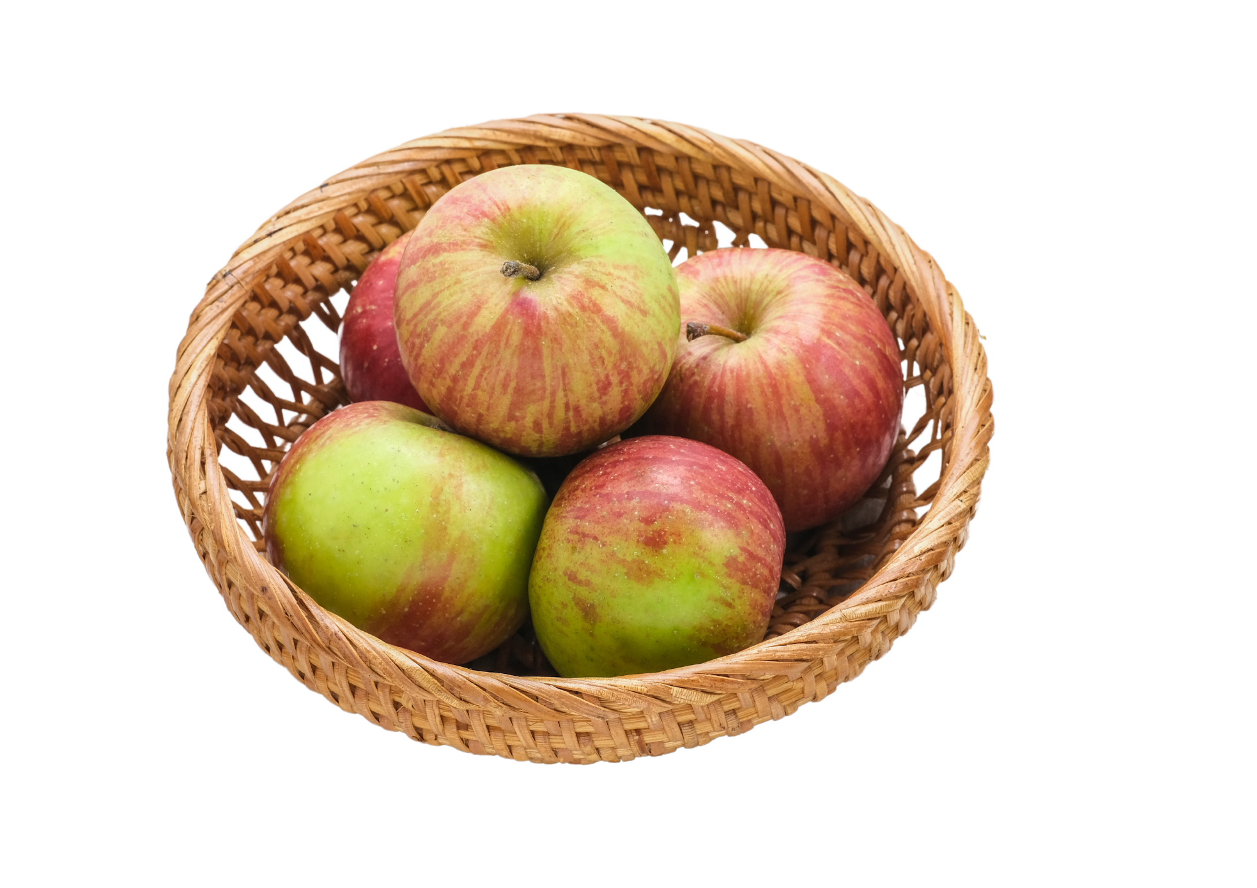
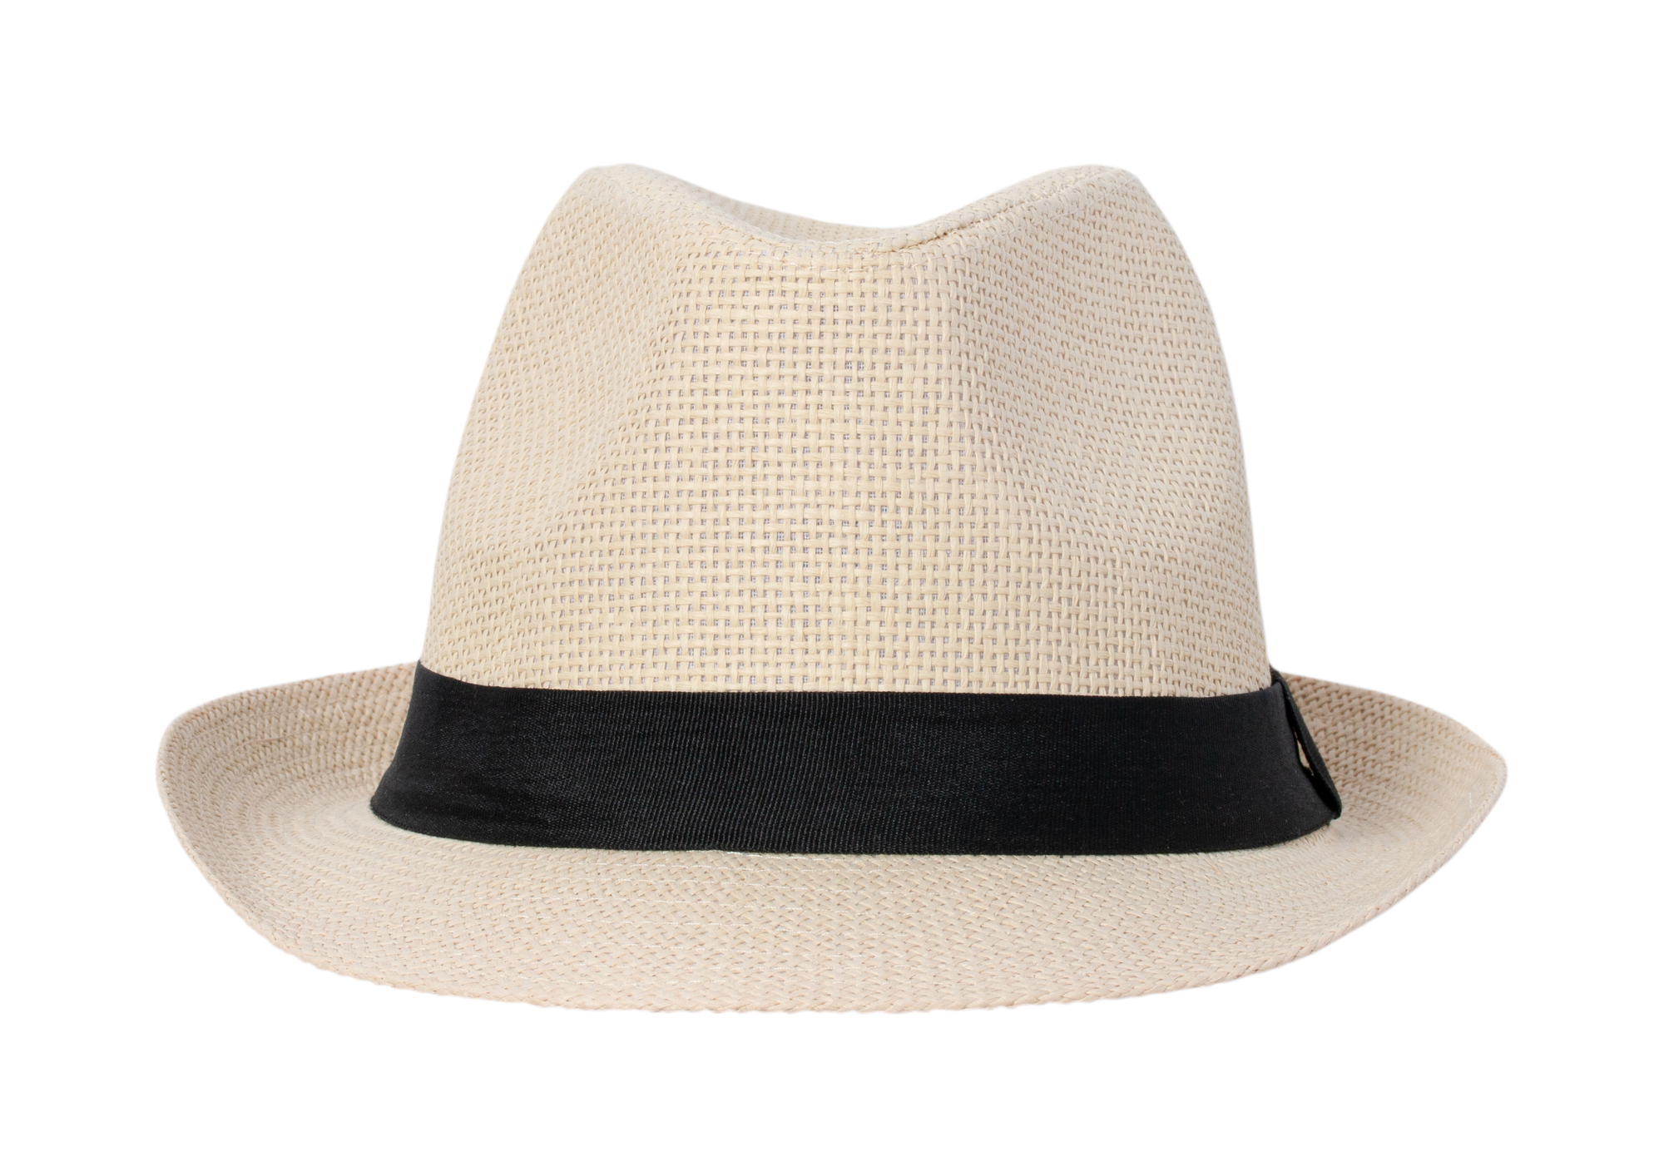
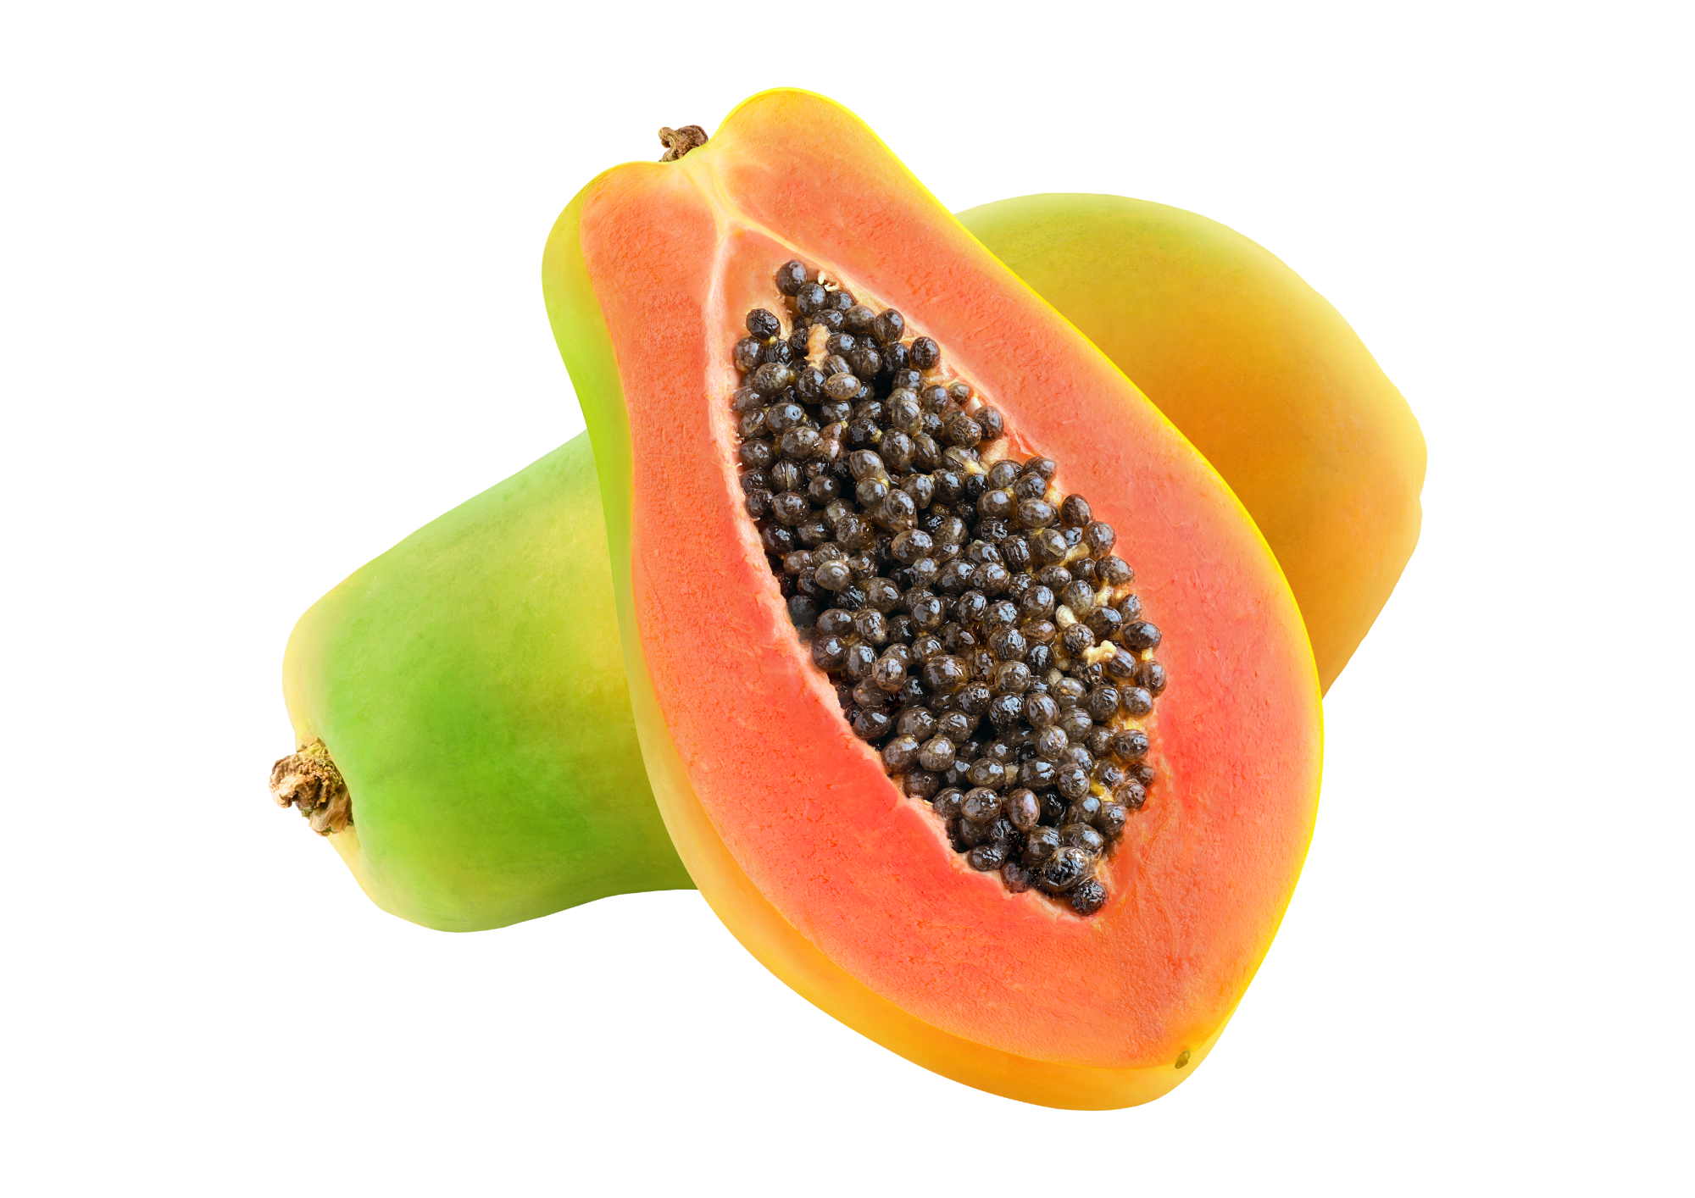
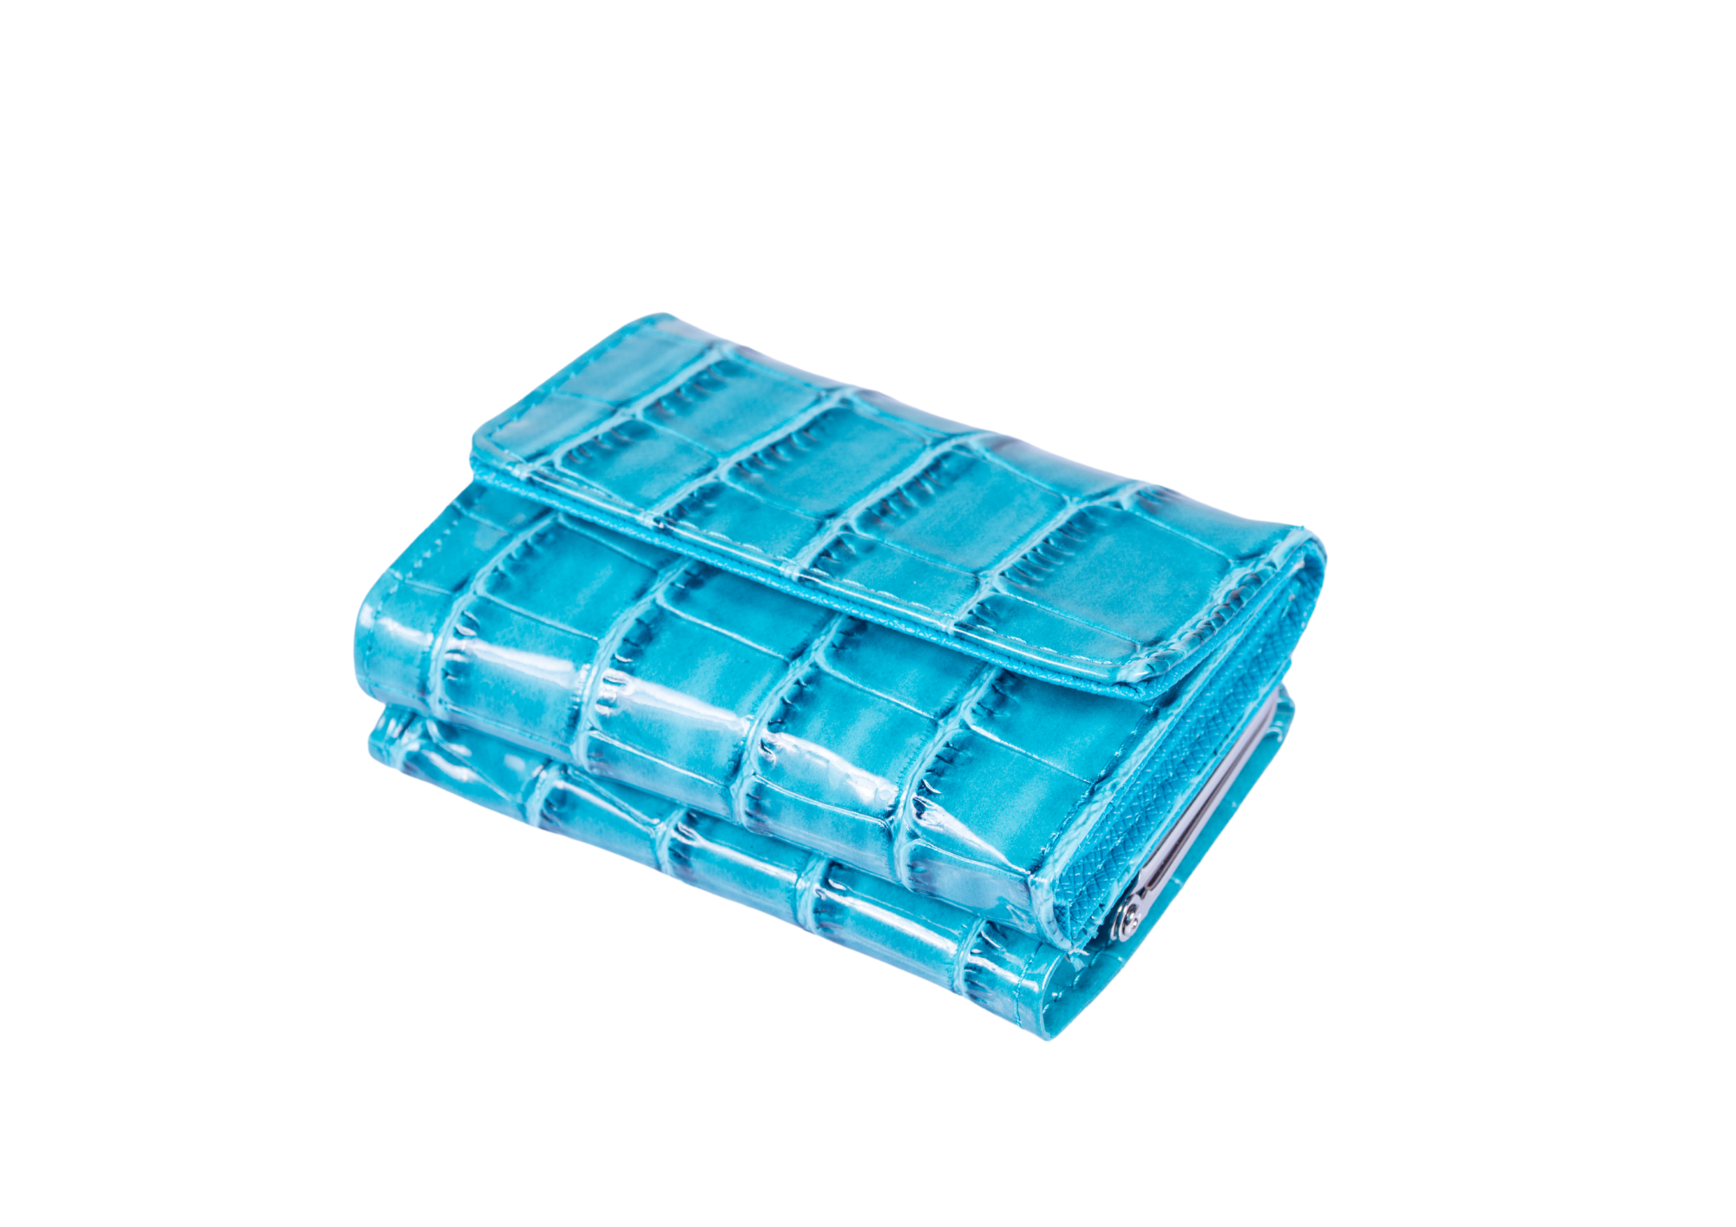
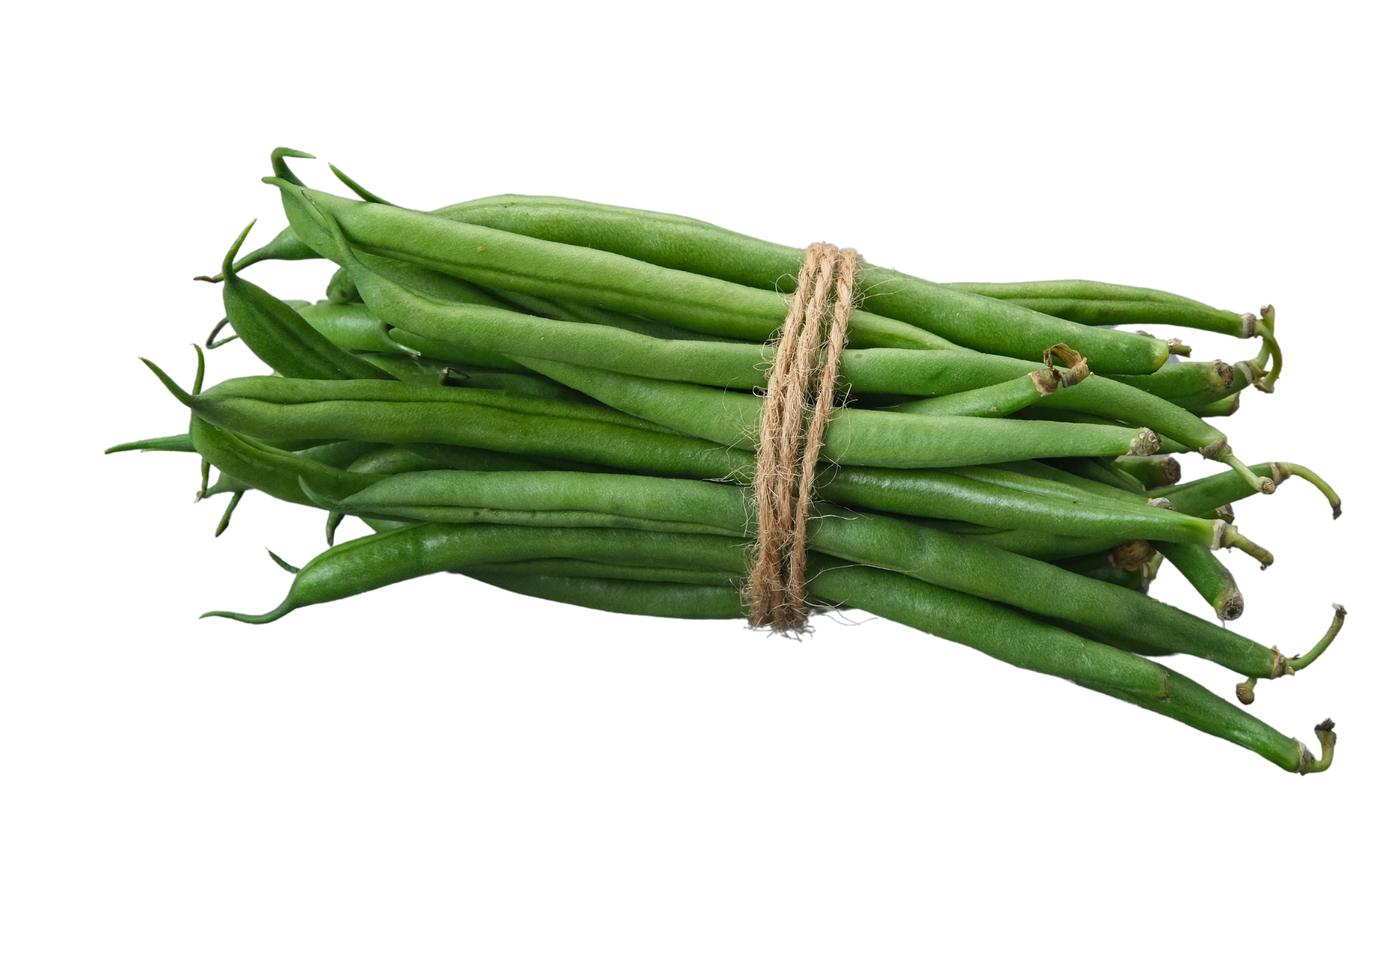
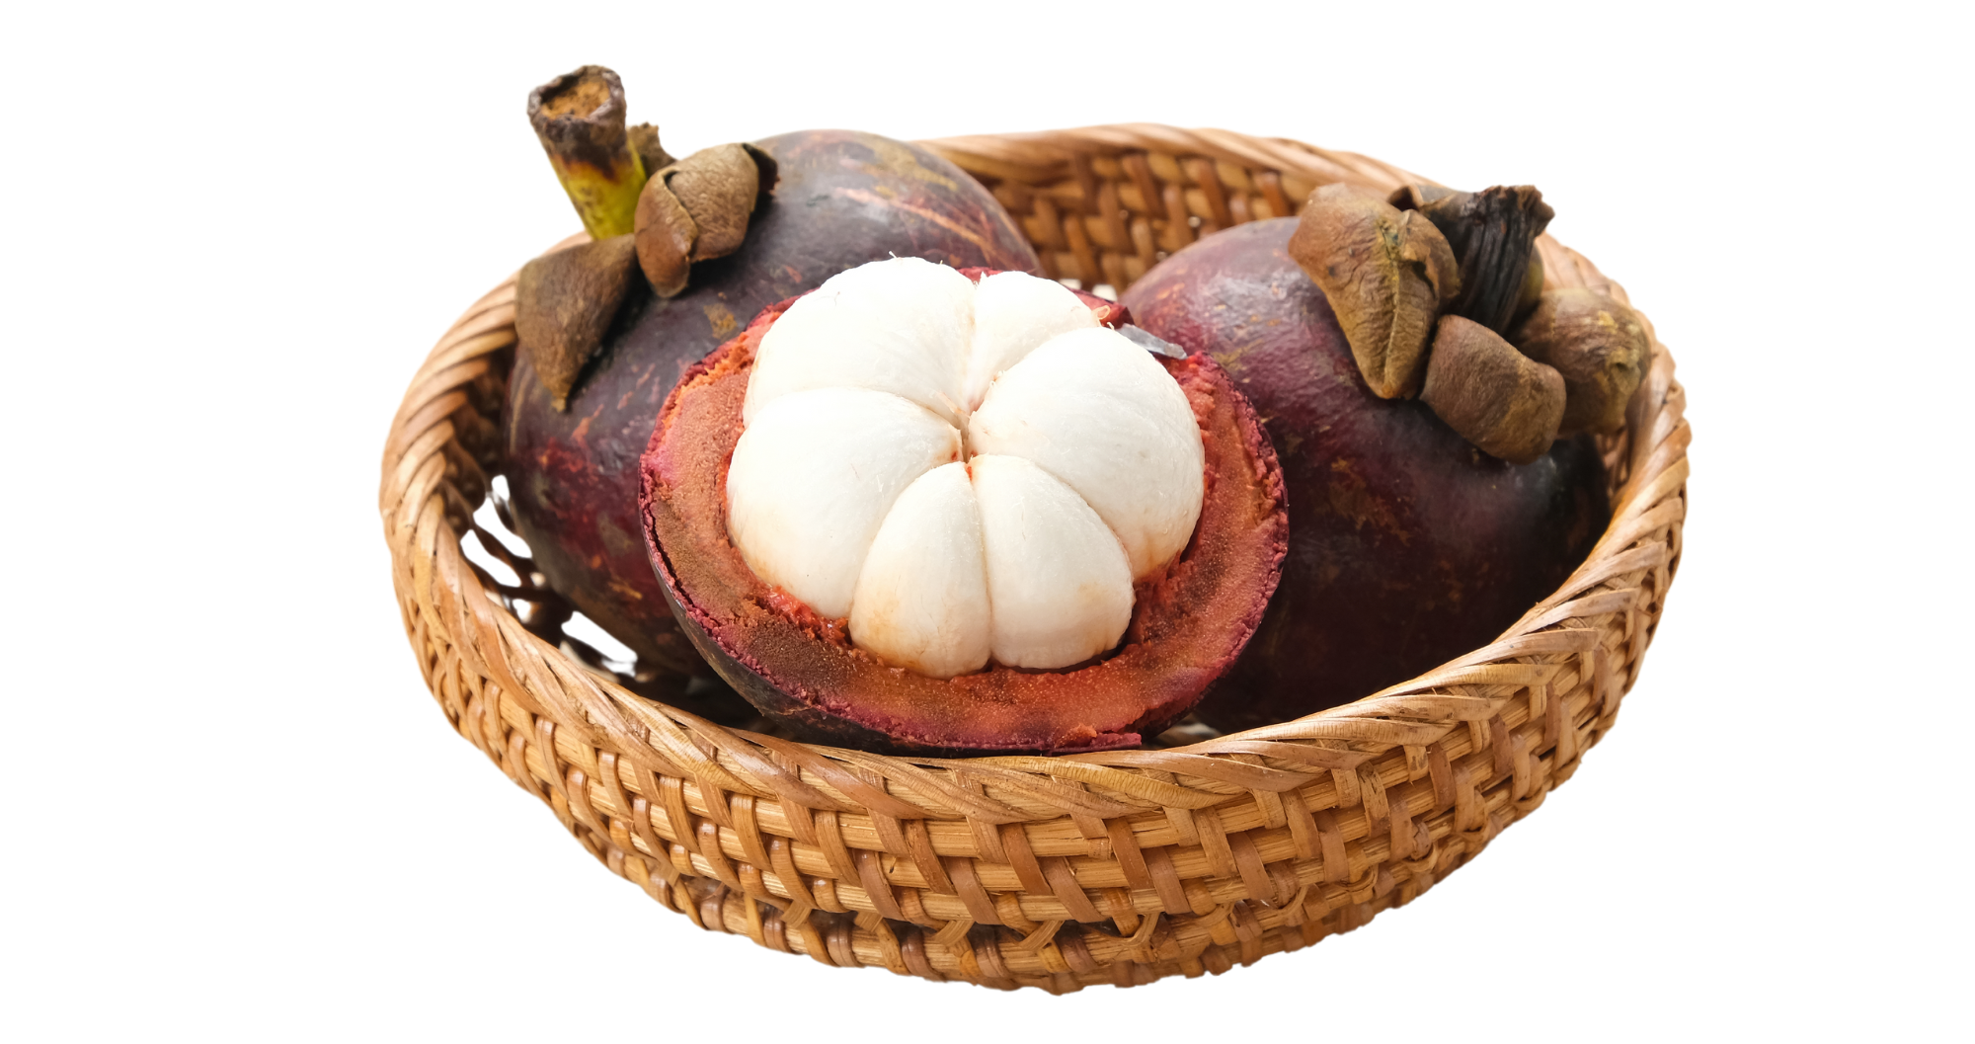
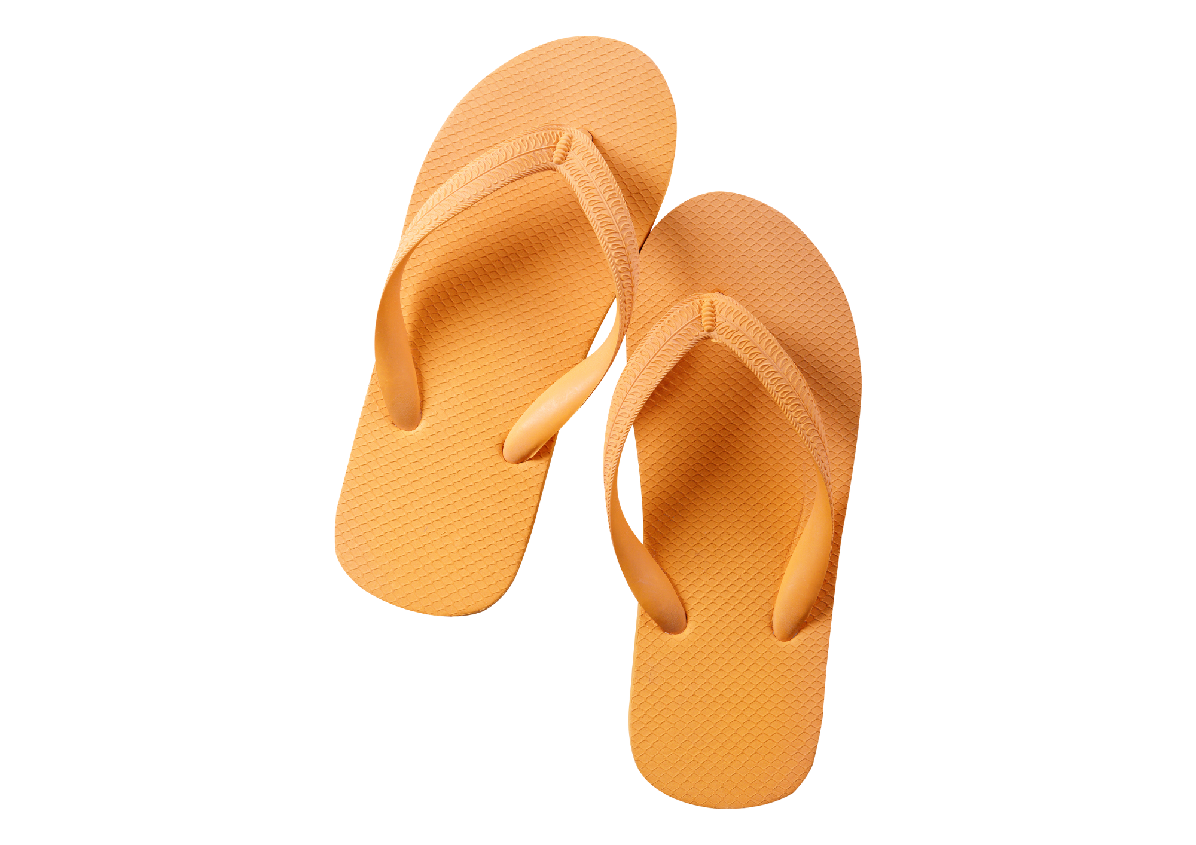
Press the spacebar or tap on the screen to begin.
5 points
10 points
nanas
40 points
tomat
15 points
20 points
30 points
kopi
70 points
90 points
kaus
sarung
100 points
50 points
60 points
cabe
buah-buahan
80 points
300 points
400 points
150 points
250 points
350 points
beras
kalung
200 points
sekilo jeruk
daging
700 points
550 points
lima kelapa
oleh-oleh
800 points
sekilo pisang
500 points
tiga rok yang kuning
600 points
450 points
5
Notes:
Jeopardy game created using What’s the question? from Digital Learning Selector, DoE NSW

Slide 6
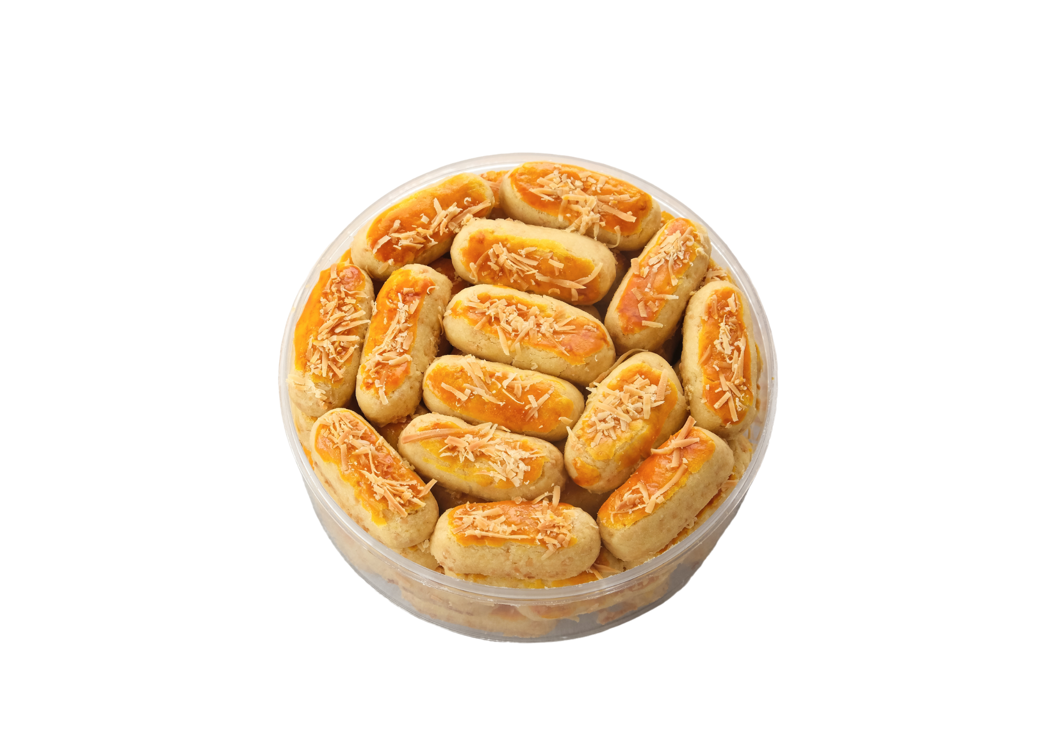
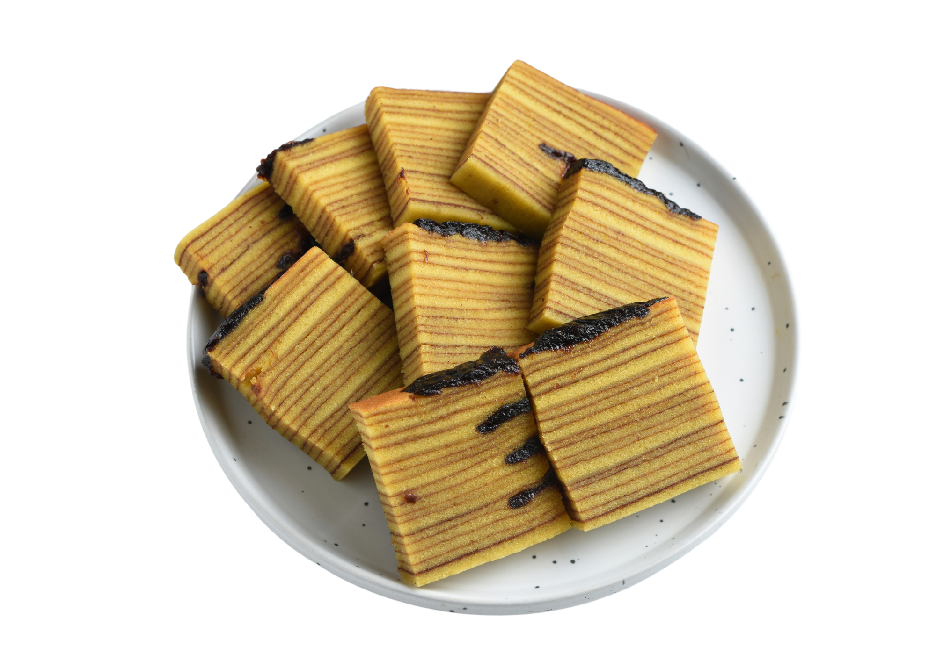
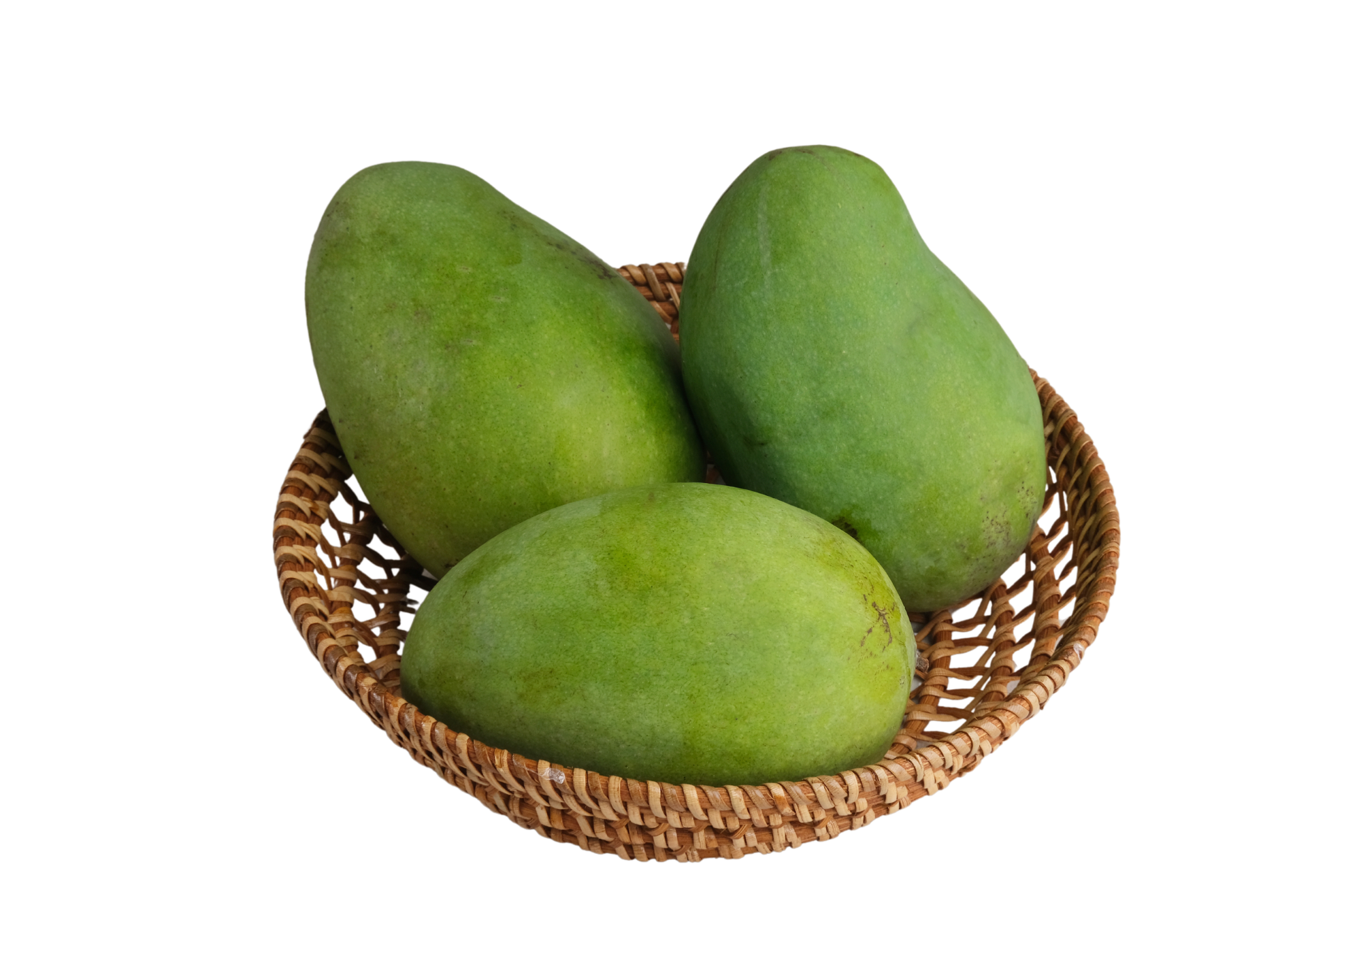
Press the spacebar or tap on the screen to begin.
ukiran yang besar
1000 points
1000 points
kaus yang kecil dan abu-abu
1000 points
2000 points
2000 points
6
Notes:
Jeopardy game created using What’s the question? from Digital Learning Selector, DoE NSW

Slide 7
Copyright
© State of New South Wales (Department of Education), 2024
The copyright material published in this resource is subject to the Copyright Act 1968 (Cth) and is owned by the NSW Department of Education or, where indicated, by a party other than the NSW Department of Education (third-party material).
Copyright material available in this resource and owned by the NSW Department of Education is licensed under a Creative Commons Attribution 4.0 International (CC BY 4.0) license.
This license allows you to share and adapt the material for any purpose, even commercially.
Attribution should be given to © State of New South Wales (Department of Education), 2024.
Material in this resource not available under a Creative Commons license:
the NSW Department of Education logo, other logos and trademark-protected material
material owned by a third party that has been reproduced with permission. You will need to obtain permission from the third party to reuse its material.
Links to third-party material and websites
Please note that the provided (reading/viewing material/list/links/texts) are a suggestion only and implies no endorsement, by the New South Wales Department of Education, of any author, publisher, or book title. School principals and teachers are best placed to assess the suitability of resources that would complement the curriculum and reflect the needs and interests of their students.
If you use the links provided in this document to access a third-party's website, you acknowledge that the terms of use, including licence terms set out on the third-party's website apply to the use which may be made of the materials on that third-party website or where permitted by the Copyright Act 1968 (Cth). The department accepts no responsibility for content on third-party websites.
Notes:
Slide not shared

