Slide 1
Shopping in Indonesia – Berbelanja di Indonesia

Slide 2
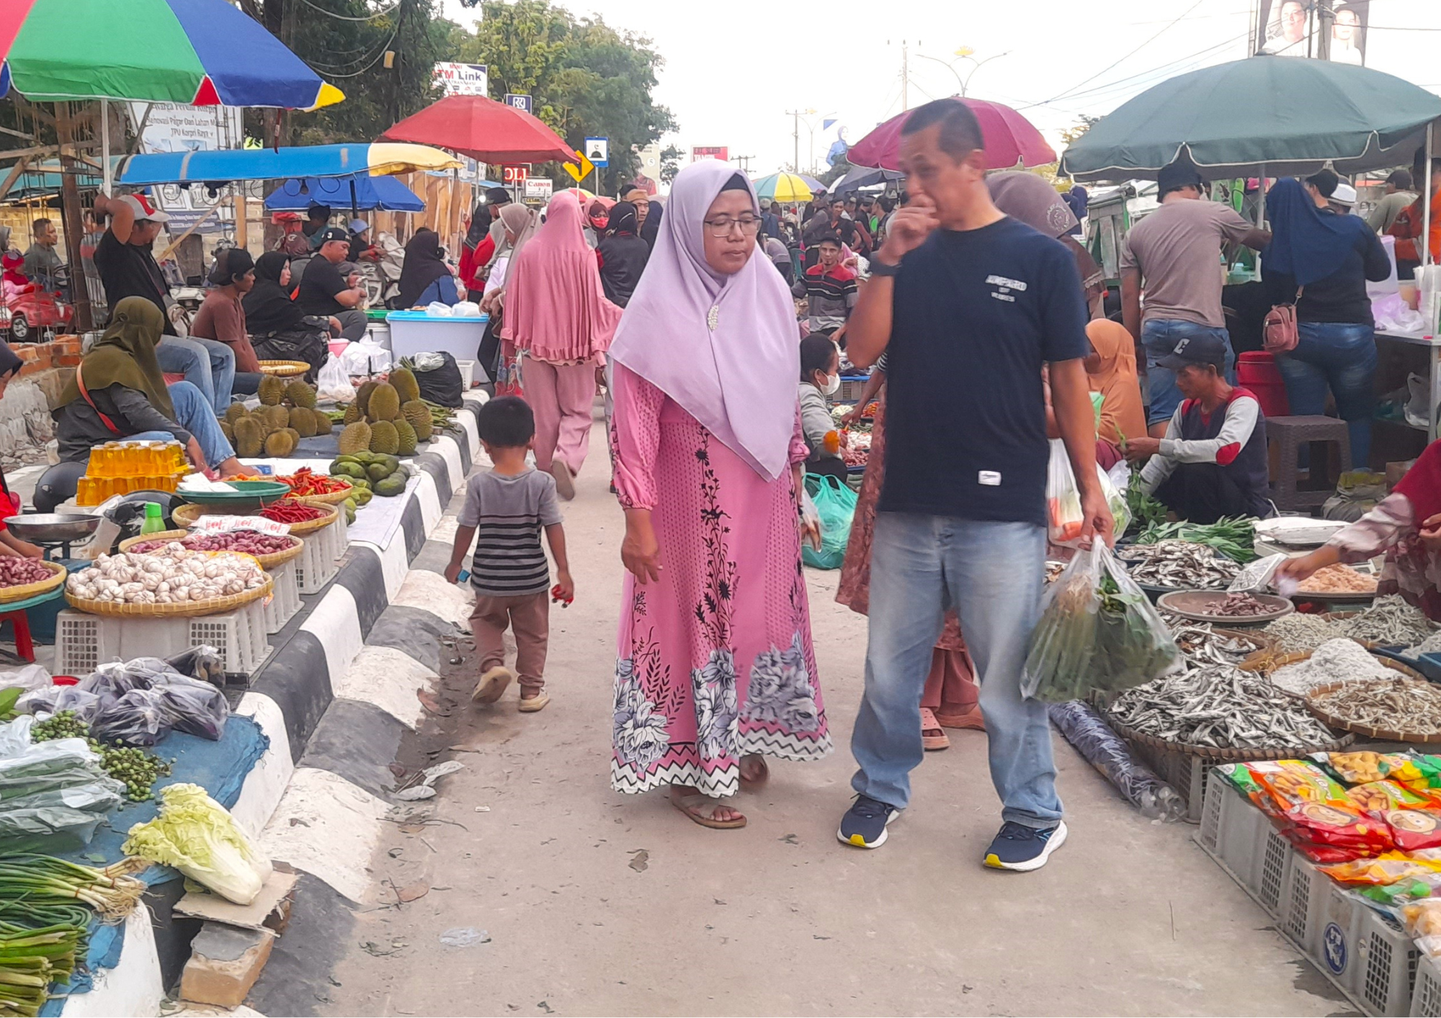
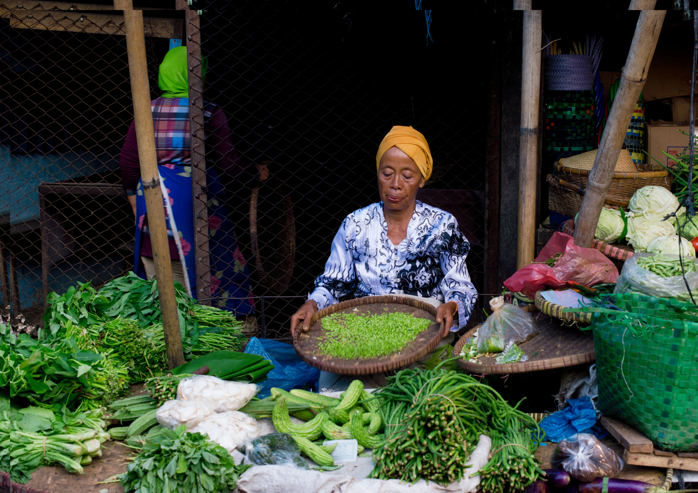
Traditional markets
Markets are the heart of shopping in Indonesia and are an integral part of Indonesian daily life.
Market stalls sell a variety of items like fresh food, handmade goods and clothing.
It is common for people to buy fresh produce at their local market each morning.
Bargaining is a common practice at markets in Indonesia.
The atmosphere is lively and colourful, with friendly interactions between people while they shop.

Slide 3
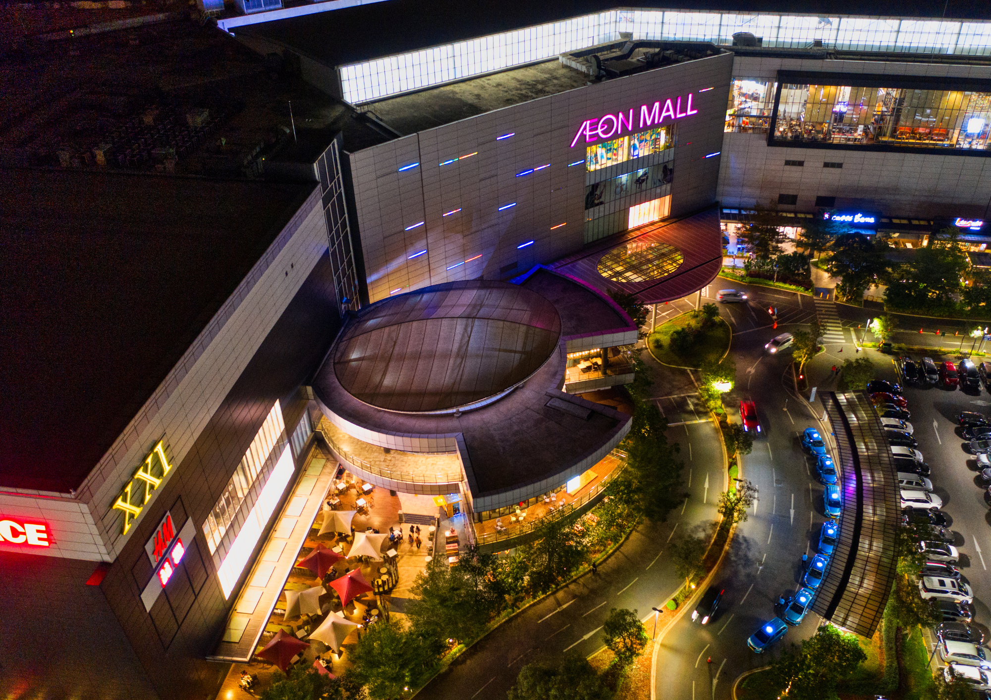
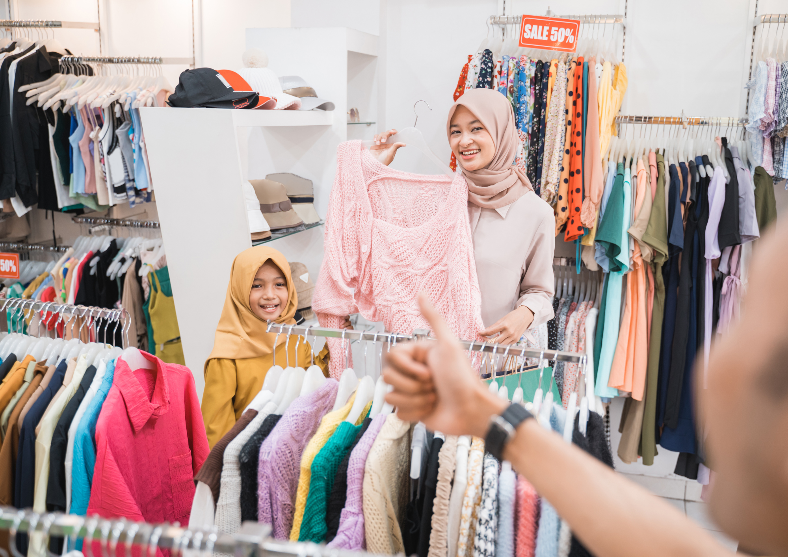
Modern shopping
Shopping centres offer a convenient and modern shopping experience in big cities in Indonesia.
You can find a wide range of local and international brands, as well as dining and entertainment options.
The atmosphere in large shopping malls is often modern and luxurious.
Shopping centres are also a popular hangout spot for Indonesian teenagers.
In addition to markets, modern supermarkets can be found across Indonesia for grocery shopping.

Slide 4
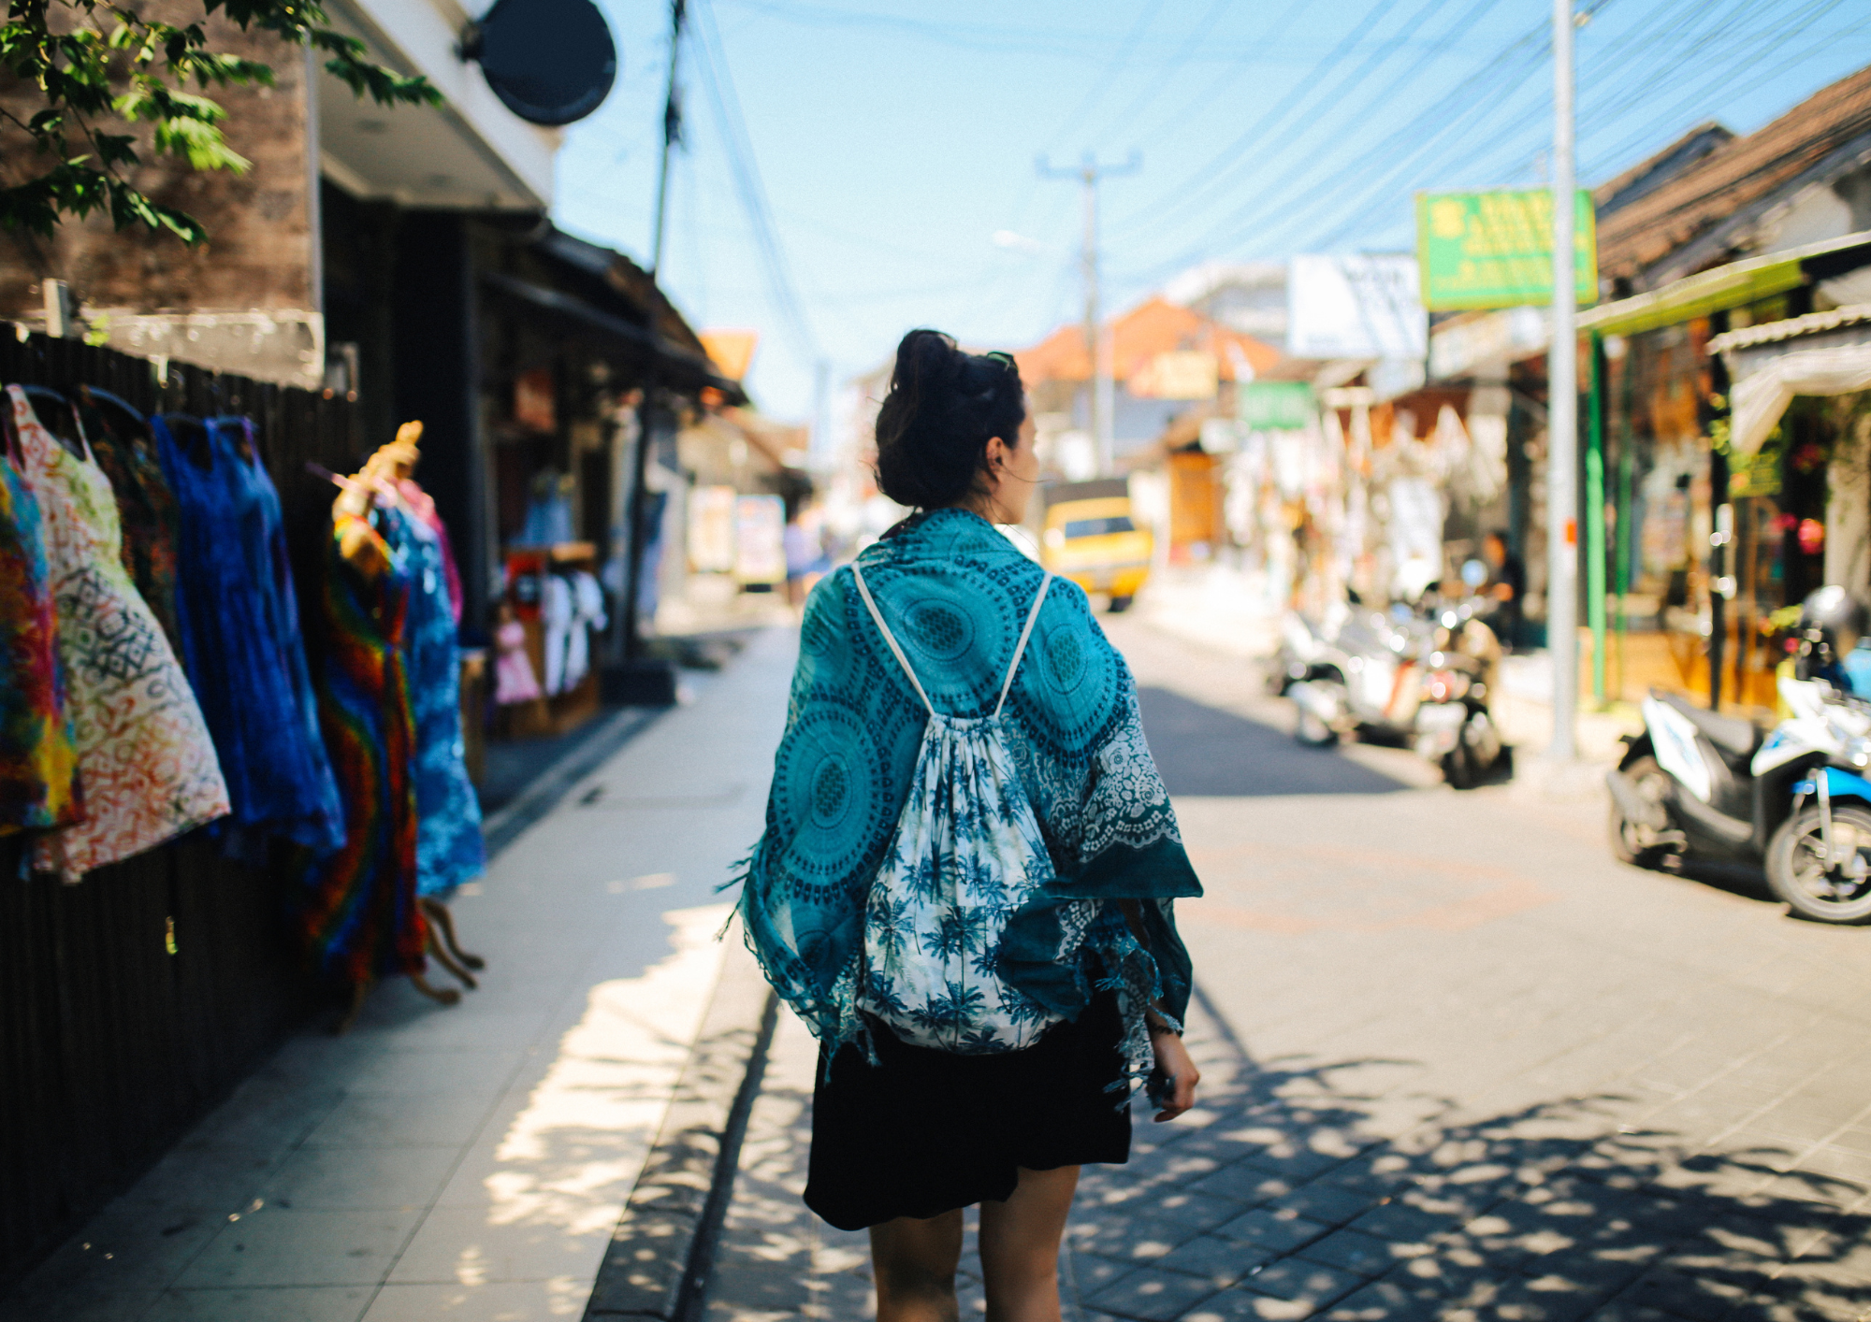
Shopping as a tourist
Tourists who visit Indonesia can experience many different styles of shopping.
Popular tourist destinations like Bali often have dedicated shopping markets where tourists can purchase handicrafts, clothing and souvenirs.
In big cities like Jakarta, there are many large shopping malls with modern stores and facilities.
There are also famous and bustling shopping streets like Jalan Malioboro in Yogyakarta, where shops sell local products like batik textiles and other souvenirs.

Slide 5
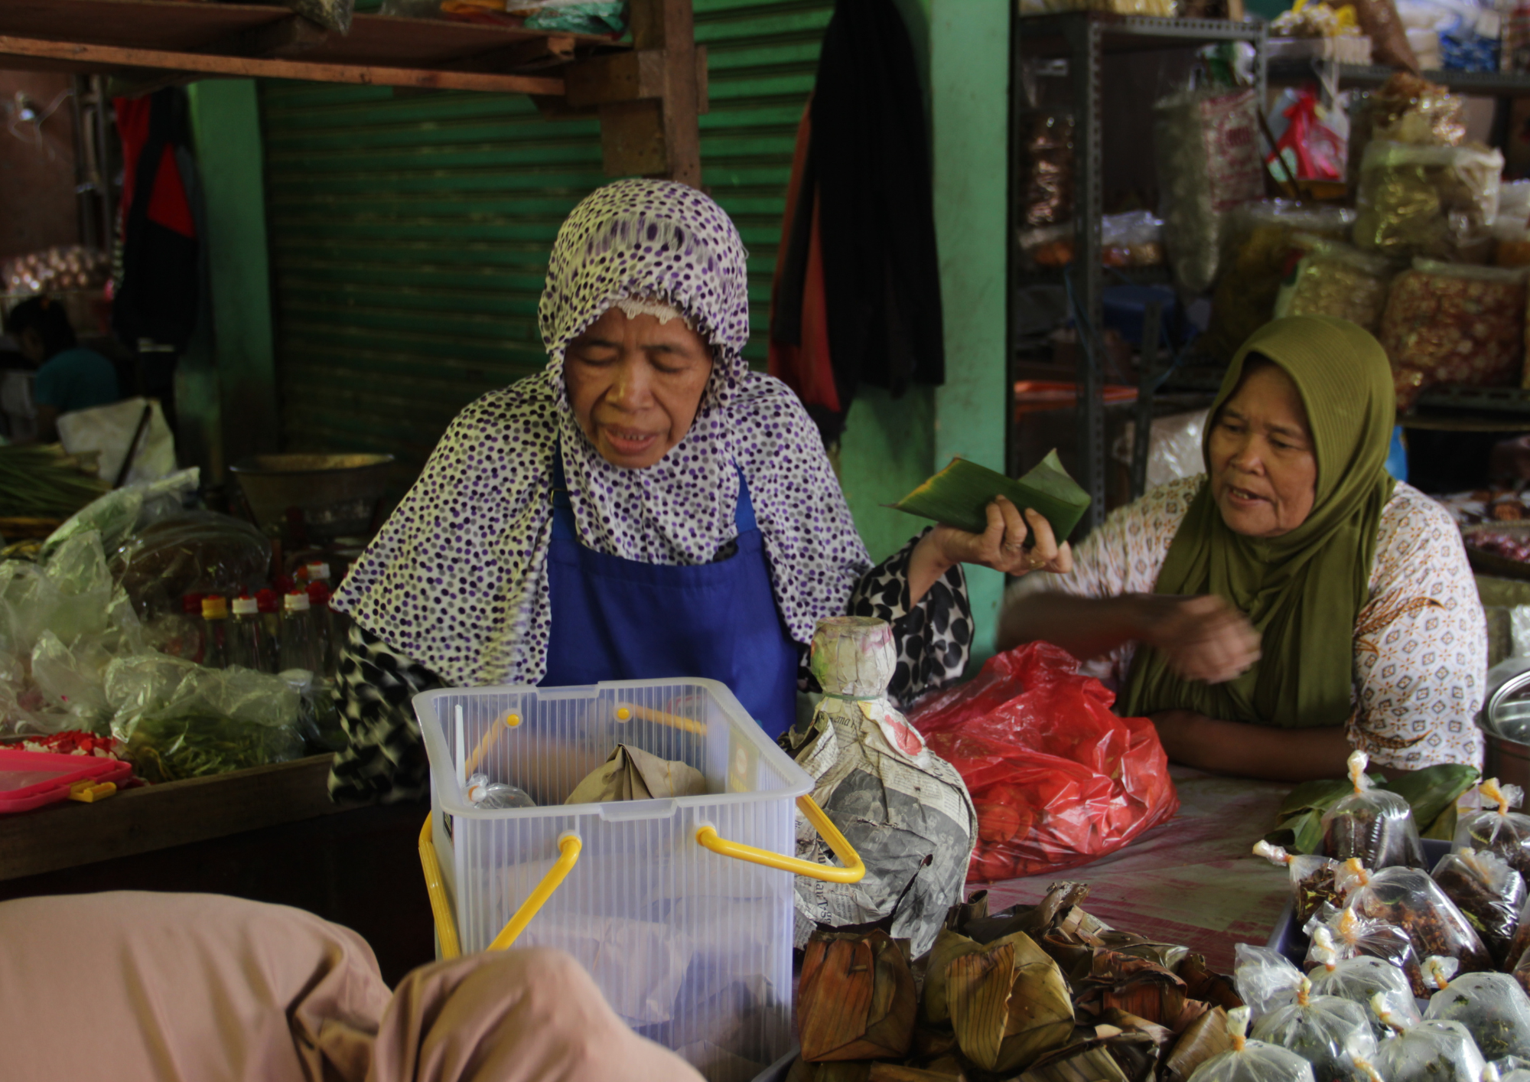
Shopping culture
Understanding shopping culture in Indonesia helps us to learn more about daily life and interactions.
Be mindful that while bargaining is common in markets, in stores or shopping centres items usually have a fixed price (harga pas).
Most markets open early in the morning and close by late afternoon, whereas modern shopping centres typically have extended shopping hours, from late morning to late evening. Some shops may close for a break during the hottest part of the day in the afternoon, especially in smaller towns.

Slide 6
See, Think, Wonder
After reading these slides and watching the Jalan Malioboro Yogyakarta (6:50) video, think about your answers to the questions below.
See: What did you see or notice about shopping in Indonesia?
Think: What do you think you would find most interesting if you went shopping in Indonesia?
Wonder: What do you wonder would be different or challenging for you if you went shopping in Indonesia?
Write your answers down and then share in a class discussion.
Notes:
For the teacher:
After displaying the slides to students and watching the Jalan Malioboro Yogyakarta video, students complete a See, Think, Wonder activity. Ask students to think about their answers to the 3 questions. Students can write their responses in their books, or the teacher can use an online tool such as Mentimeter to collect and display responses. If students require additional prompting, use the sample questions below to assist them.
See: What did you see or notice about shopping in Indonesia? Did you see anything interesting? What did you see that was similar to shopping in Australia? What did you see that was different to shopping in Australia?
Think: What do you think about shopping in Indonesia? Do you think it would be enjoyable? Is there anything you would find challenging? What do you think shopping in a traditional market or a modern shopping mall in Indonesia would be like?
Wonder: What do the slides/video make you wonder about shopping in Indonesia? What questions do you have about shopping in Indonesia?
Provide the opportunity for students to share and compare their responses in a class discussion.

Slide 7
Copyright
© State of New South Wales (Department of Education), 2024
The copyright material published in this resource is subject to the Copyright Act 1968 (Cth) and is owned by the NSW Department of Education or, where indicated, by a party other than the NSW Department of Education (third-party material).
Copyright material available in this resource and owned by the NSW Department of Education is licensed under a Creative Commons Attribution 4.0 International (CC BY 4.0) license.
This license allows you to share and adapt the material for any purpose, even commercially.
Attribution should be given to © State of New South Wales (Department of Education), 2024.
Material in this resource not available under a Creative Commons license:
the NSW Department of Education logo, other logos and trademark-protected material
Material owned by a third party that has been reproduced with permission. You will need to obtain permission from the third party to reuse its material.
Links to third-party material and websites
Please note that the provided (reading/viewing material/list/links/texts) are a suggestion only and implies no endorsement, by the New South Wales Department of Education, of any author, publisher, or book title. School principals and teachers are best placed to assess the suitability of resources that would complement the curriculum and reflect the needs and interests of their students.
If you use the links provided in this document to access a third party’s website, you acknowledge that the terms of use, including licence terms set out on the third-party’s website apply to the use which may be made of the materials on that third-party website or where permitted by the Copyright Act 1968 (Cth). The department accepts no responsibility for content on third-party websites.
Notes:
Slide not shared

