Slide 1
Souvenirs – Suvenir

Slide 2
suvenir
Notes:
Suvenir refers to souvenirs you might buy for yourself while travelling.

Slide 3
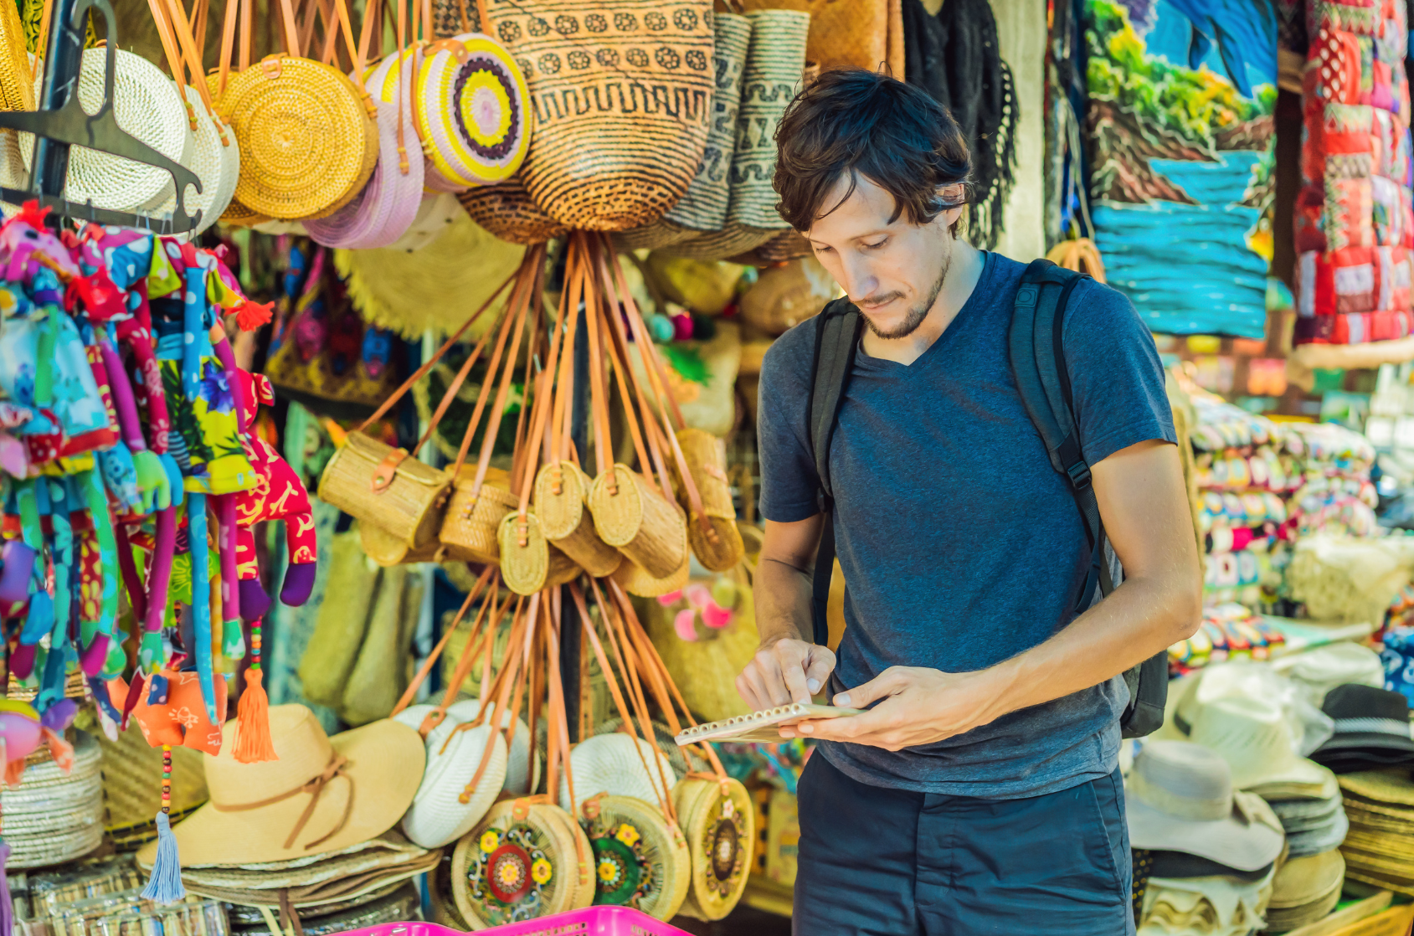
oleh-oleh
Notes:
Oleh-oleh refers to small souvenirs you might buy as gifts for other people, as opposed to suvenir. It is common in Indonesia for people to buy small gifts for others while they are away, to give to friends and family when they return home.

Slide 4
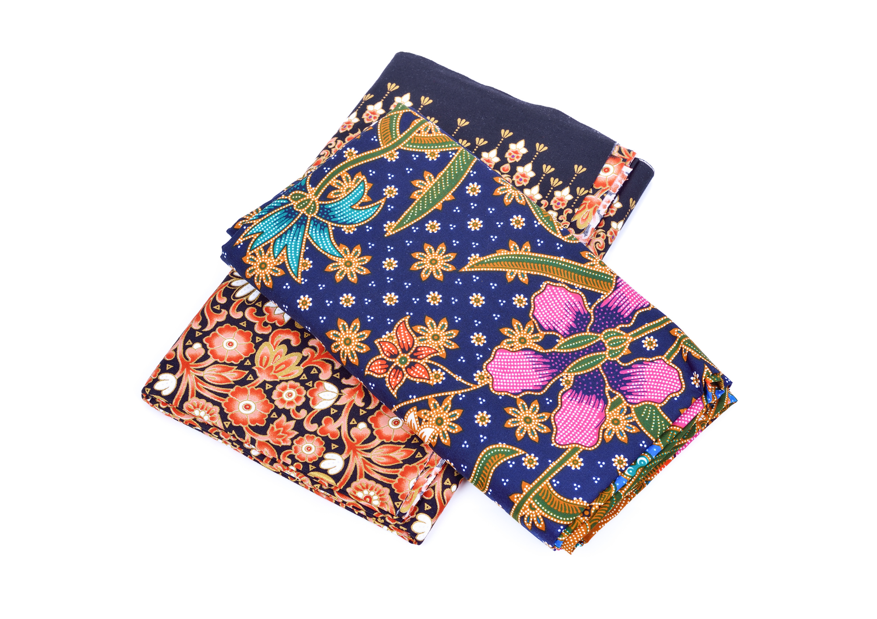
sarung
Notes:
Sarung means ‘sarong’.

Slide 5
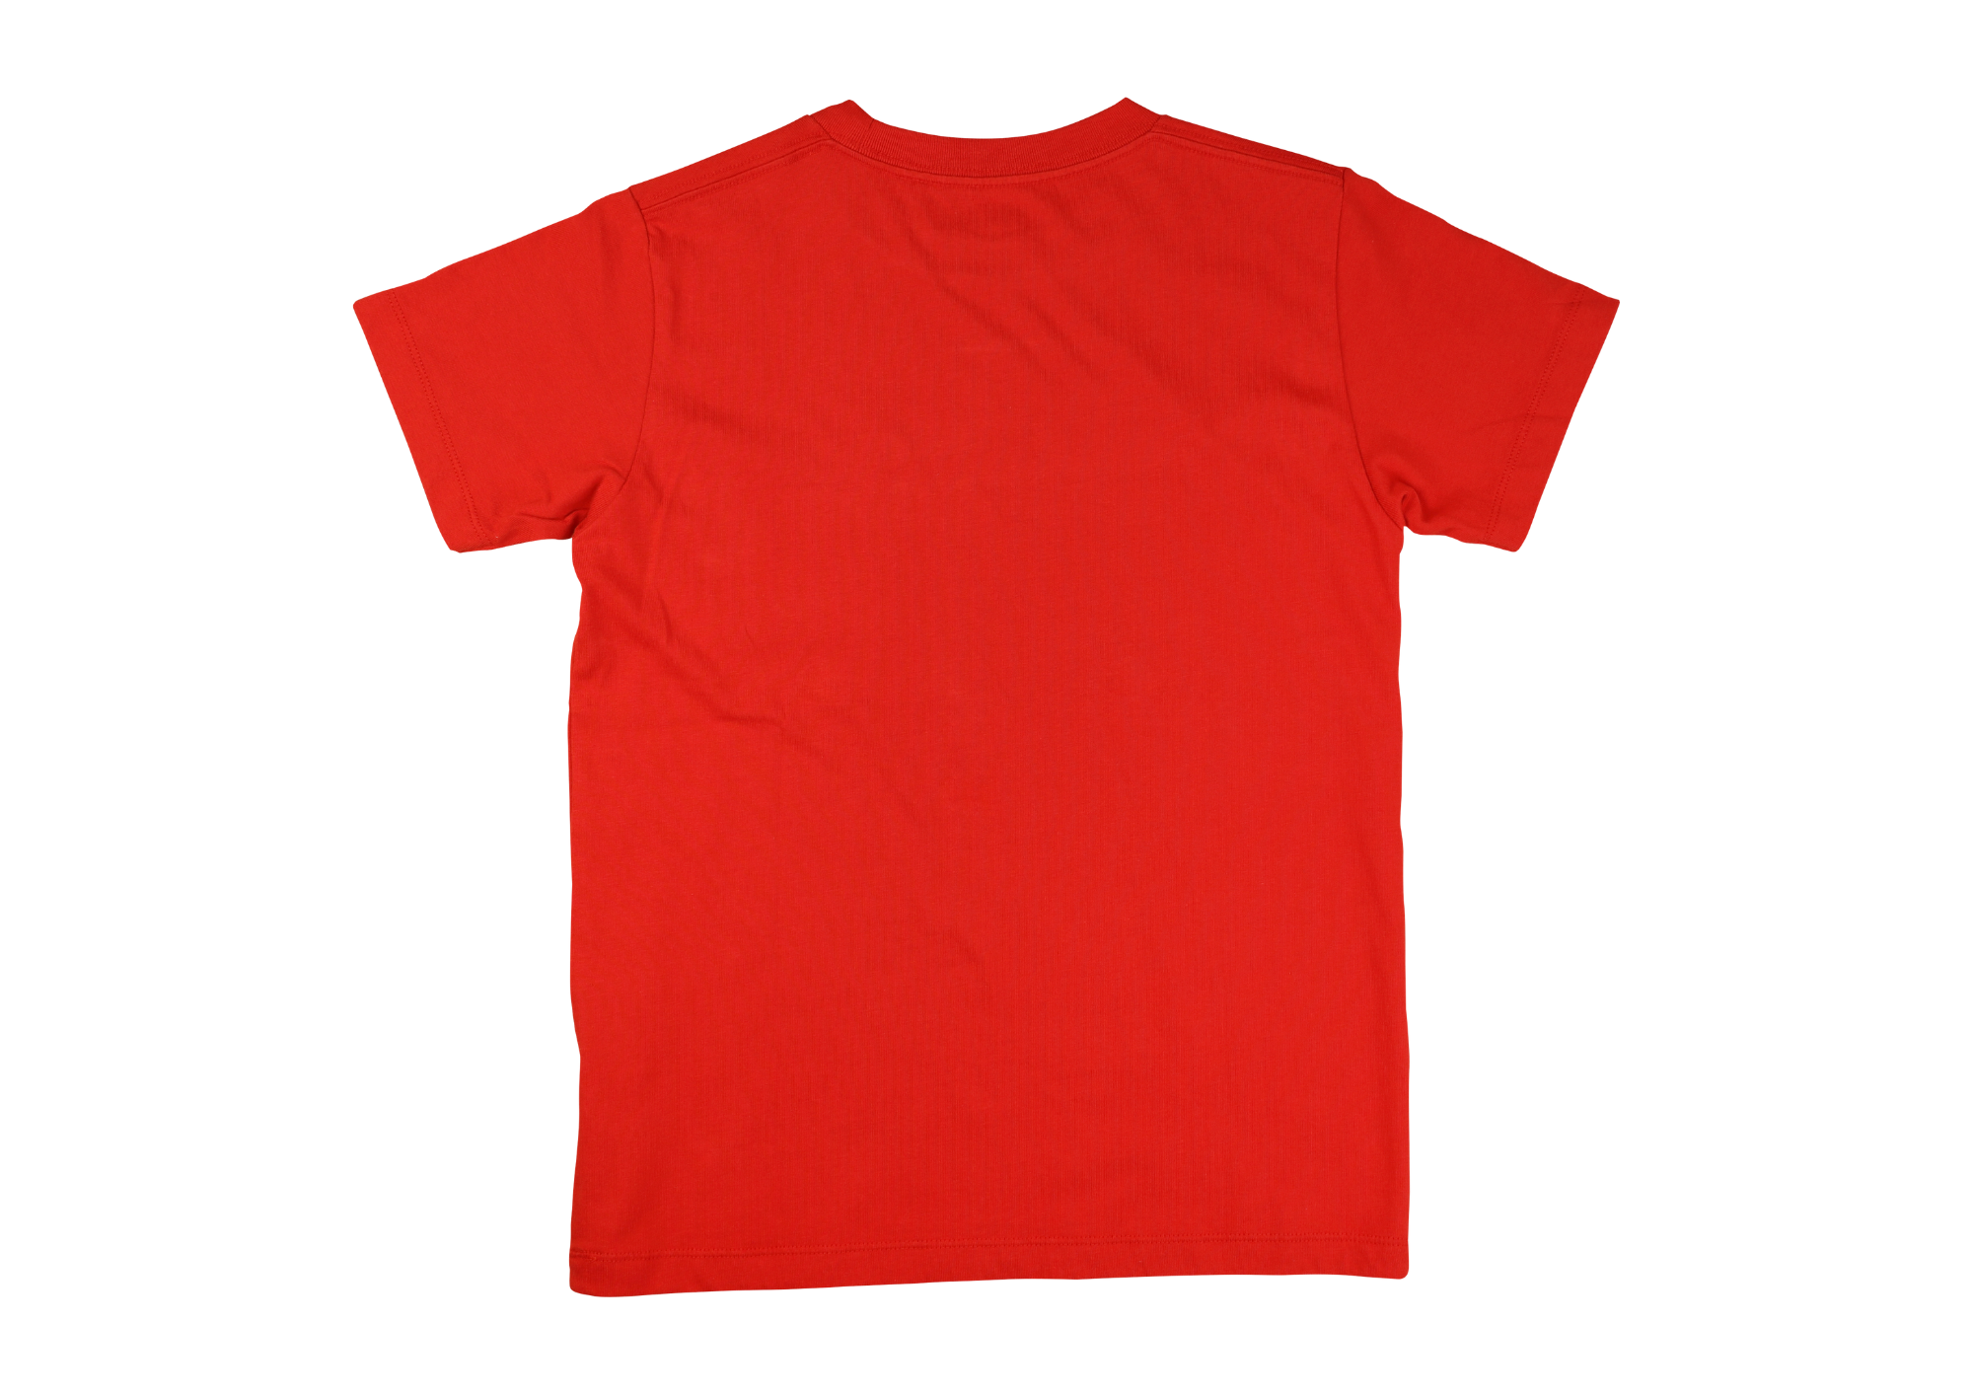
kaus
Notes:
Kaus means ‘t-shirt’. The word ‘t-shirt’ is also widely used.

Slide 6
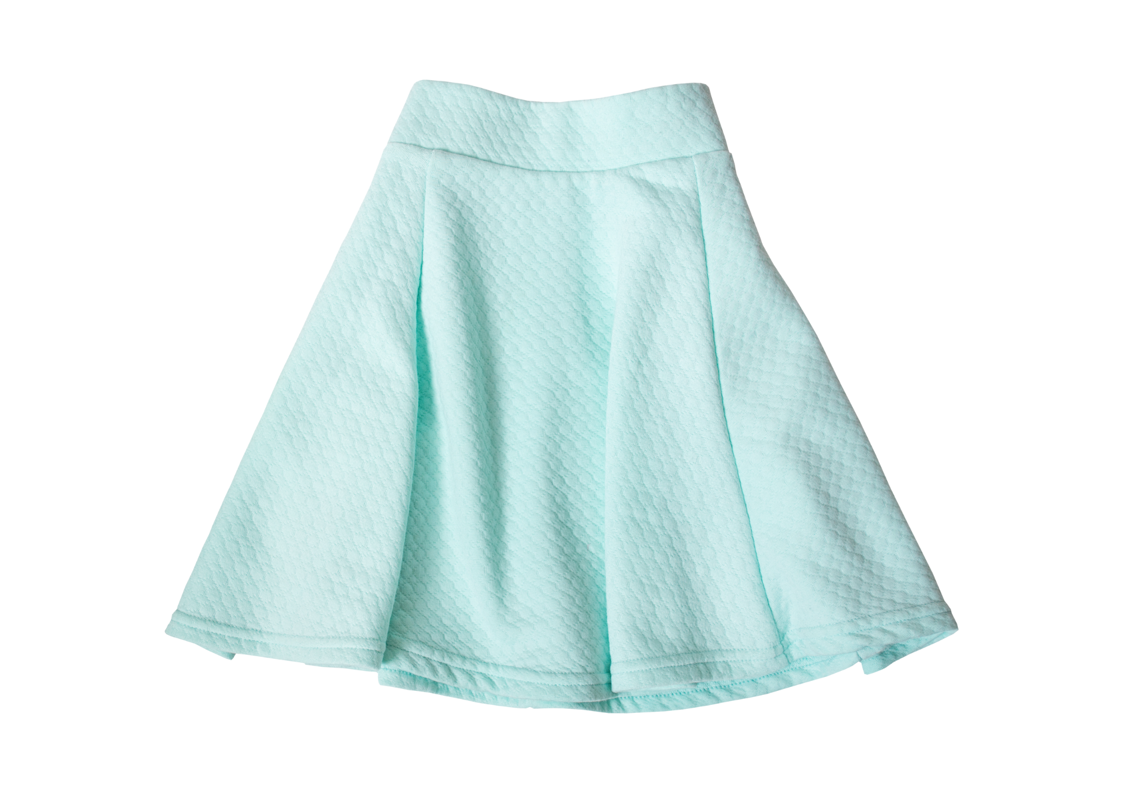
rok
Notes:
Rok can mean ‘skirt’ or ‘dress’.

Slide 7
topi
Notes:
Topi means ‘hat’.

Slide 8
kacamata hitam
Notes:
Kacamata hitam means ‘sunglasses’.

Slide 9
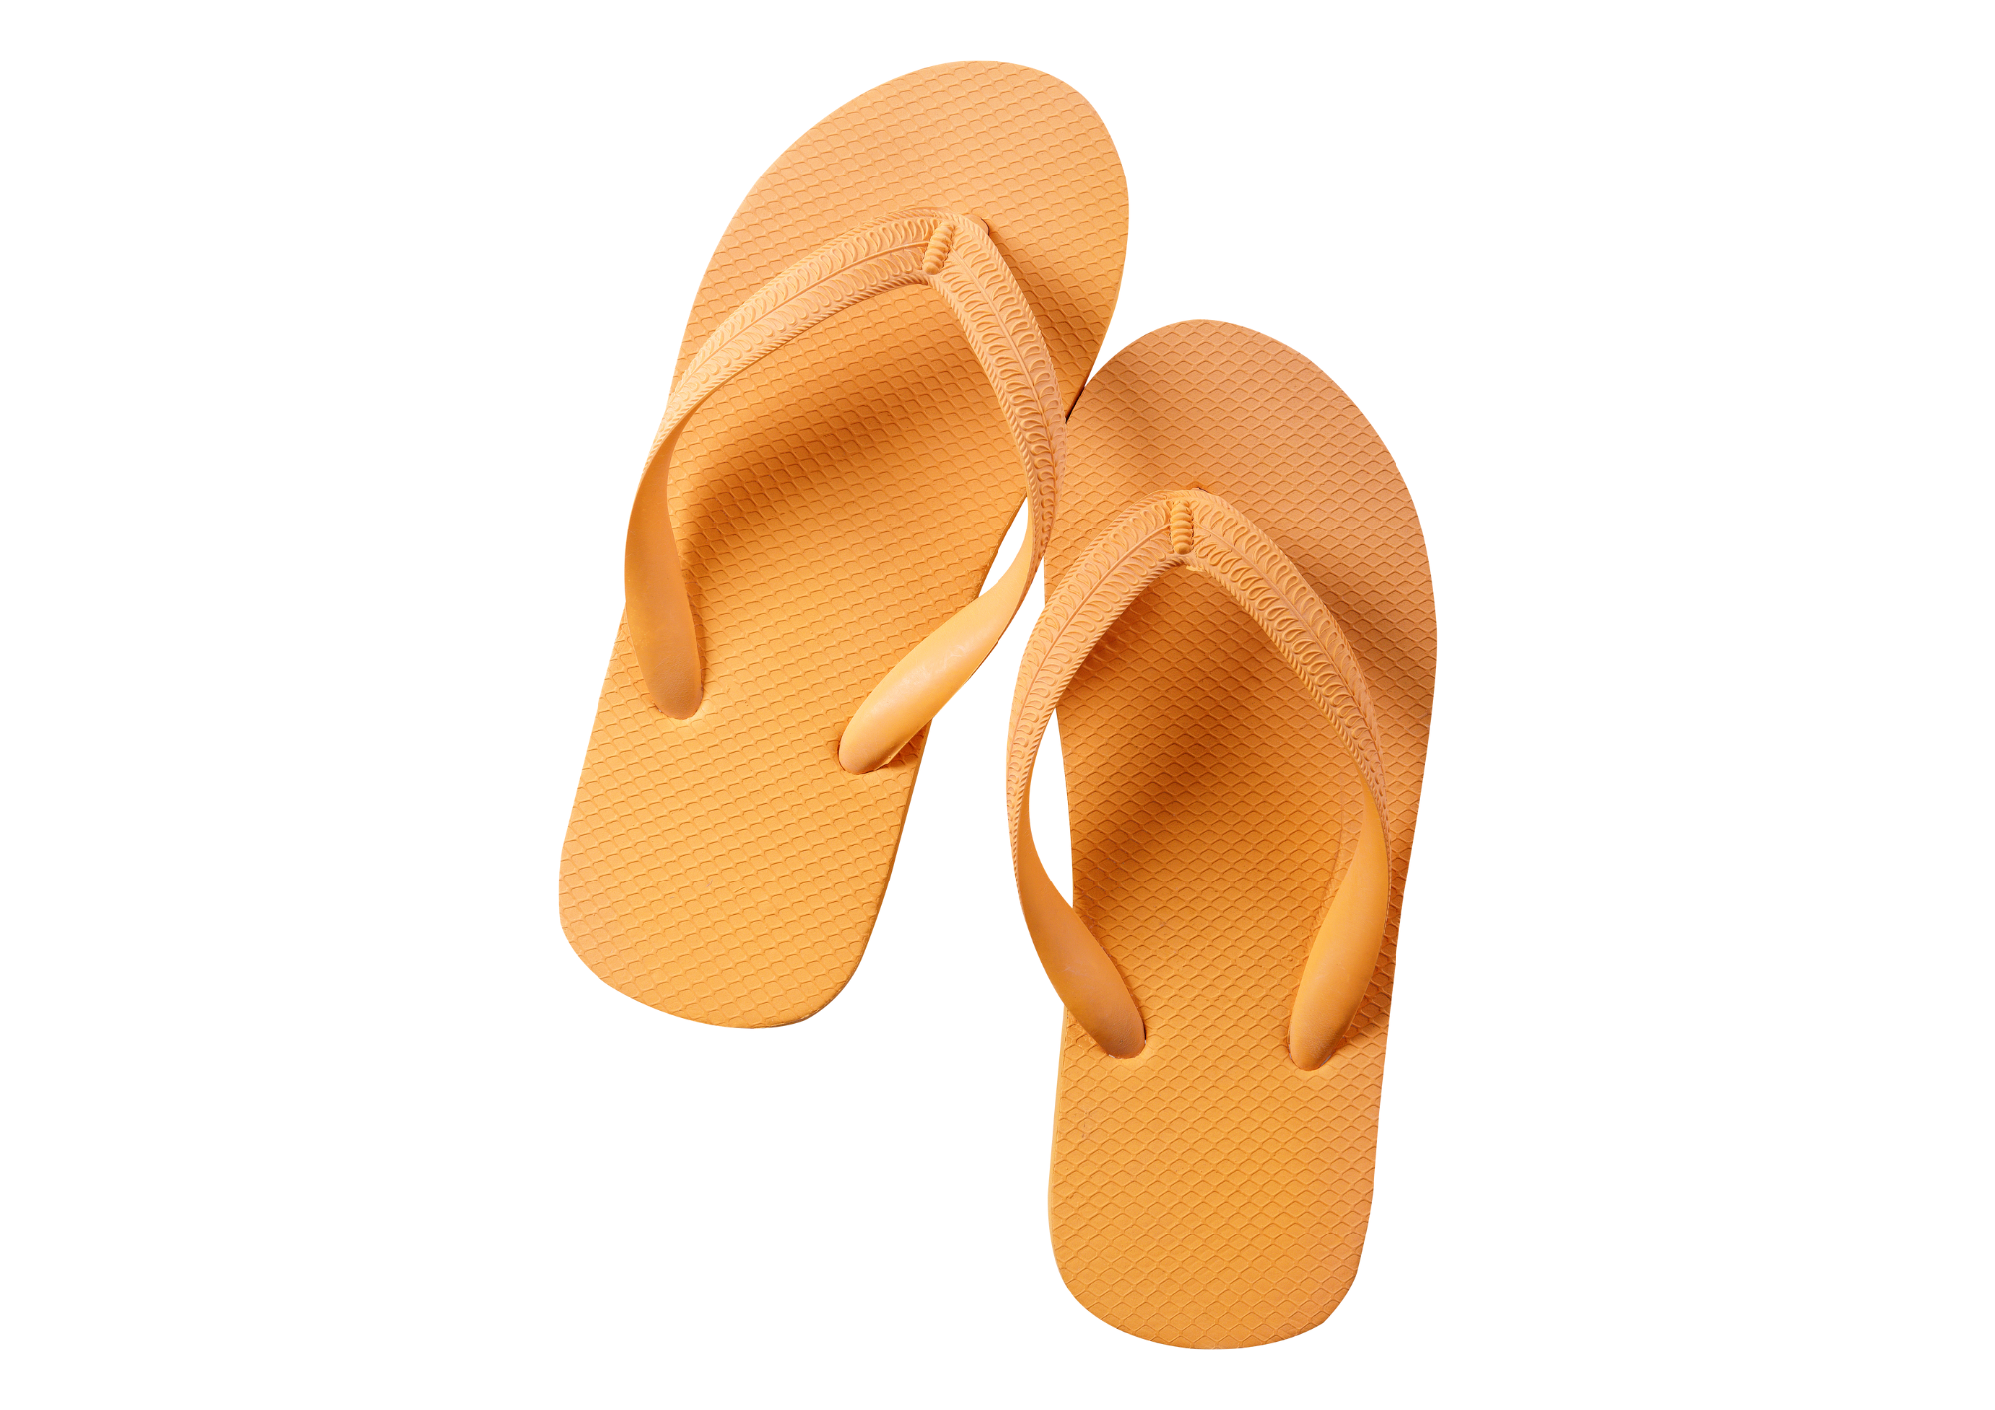
sandal jepit
Notes:
Sandal jepit means ‘flip-flops’ or ‘thongs’.

Slide 10
cincin
Notes:
Cincin means ‘ring’.

Slide 11
kalung
Notes:
Kalung means ‘necklace’.

Slide 12
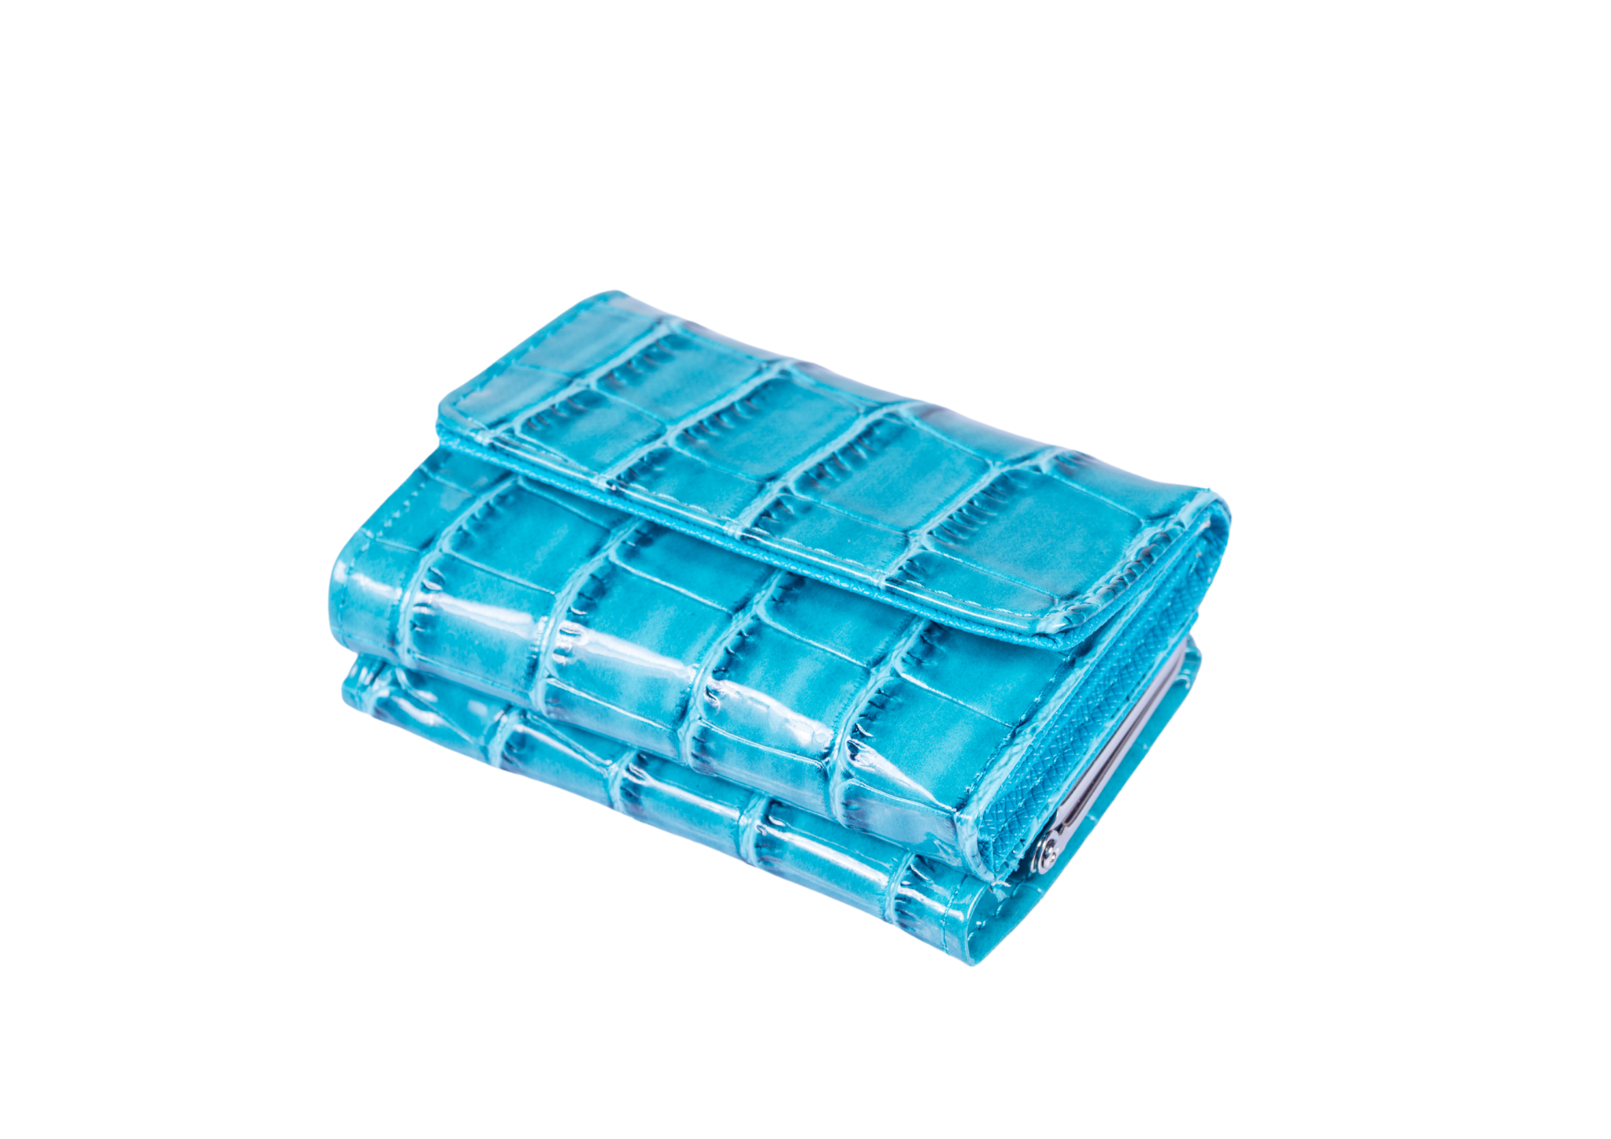
dompet
Notes:
Dompet means ‘wallet’.

Slide 13
tas
Notes:
Tas means ‘bag’.

Slide 14
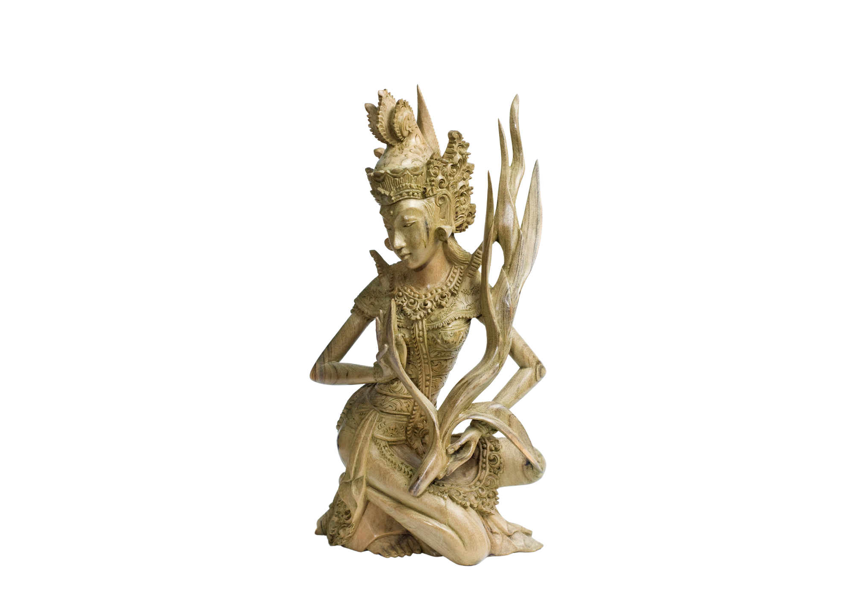
ukiran
Notes:
Ukiran means ‘carving’.

Slide 15
kopi
Notes:
Kopi means ‘coffee’.

Slide 16
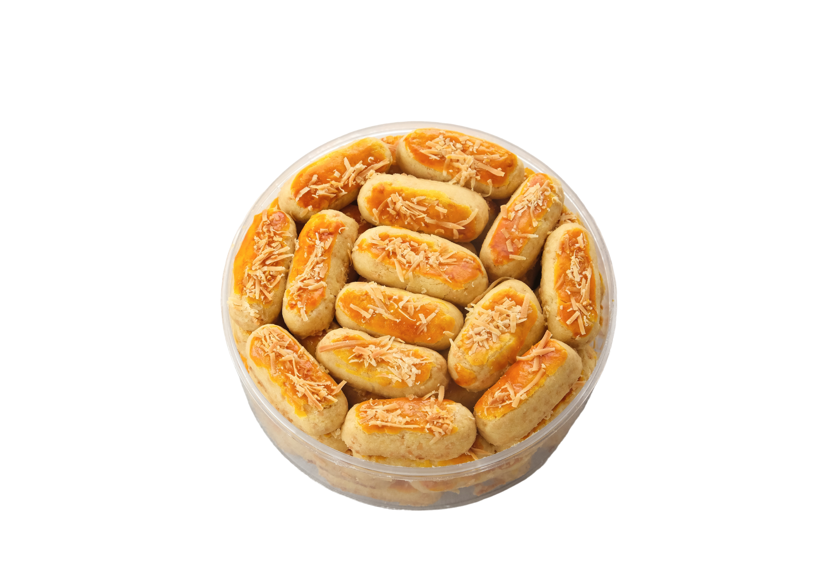
biskuit
Notes:
Biskuit means ‘biscuit’.

Slide 17
Copyright
© State of New South Wales (Department of Education), 2024
The copyright material published in this resource is subject to the Copyright Act 1968 (Cth) and is owned by the NSW Department of Education or, where indicated, by a party other than the NSW Department of Education (third-party material).
Copyright material available in this resource and owned by the NSW Department of Education is licensed under a Creative Commons Attribution 4.0 International (CC BY 4.0) license.
This license allows you to share and adapt the material for any purpose, even commercially.
Attribution should be given to © State of New South Wales (Department of Education), 2024.
Material in this resource not available under a Creative Commons license:
the NSW Department of Education logo, other logos and trademark-protected material
material owned by a third party that has been reproduced with permission. You will need to obtain permission from the third party to reuse its material.
Links to third-party material and websites
Please note that the provided (reading/viewing material/list/links/texts) are a suggestion only and implies no endorsement, by the New South Wales Department of Education, of any author, publisher, or book title. School principals and teachers are best placed to assess the suitability of resources that would complement the curriculum and reflect the needs and interests of their students.
If you use the links provided in this document to access a third-party's website, you acknowledge that the terms of use, including licence terms set out on the third-party's website apply to the use which may be made of the materials on that third-party website or where permitted by the Copyright Act 1968 (Cth). The department accepts no responsibility for content on third-party websites.
Notes:
Slide not shared

