Slide 1
The price is right!

Slide 2
Instructions
Distribute mini whiteboards to students to work individually, in pairs or in groups.
Move through the slides to display each item for sale.
Each time a new item is displayed, ask students Berapa harga…? Students look at the item on the slide and make a guess about the price, writing down their guesses on their mini whiteboards.
When everyone is ready, ask students to reveal their guesses by holding up their mini whiteboards. To provide an opportunity for interaction, ask students individually Berapa harganya? with students responding in Indonesian with the price they have guessed.
Reveal the correct price on the slide. The student or group who have the closest guess, wins a point. The student or group with the most points at the end of the game, wins.

Slide 3
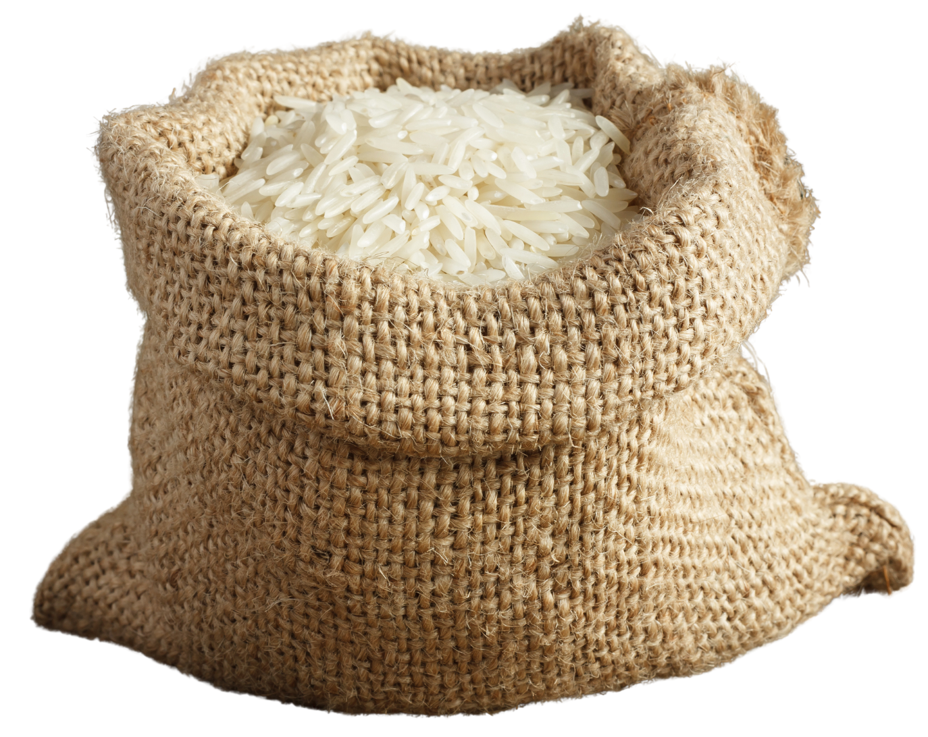
Item 1
Berapa harga sekilo beras?
Rp 13.000

Slide 4
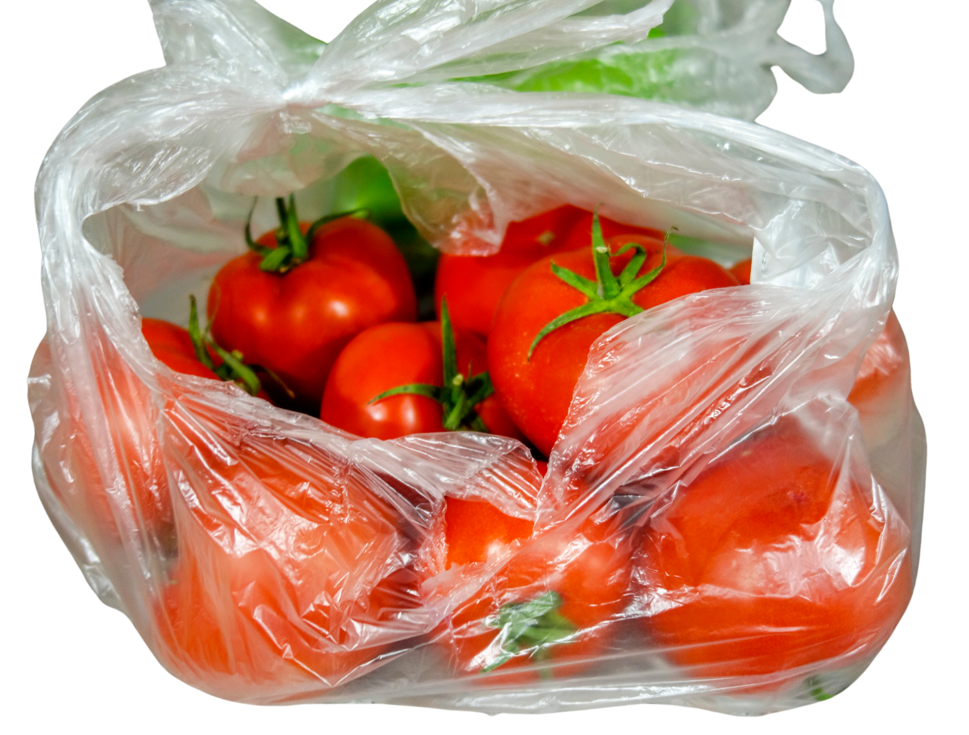
Item 2
Berapa harga sekilo tomat?
Rp 15.000

Slide 5
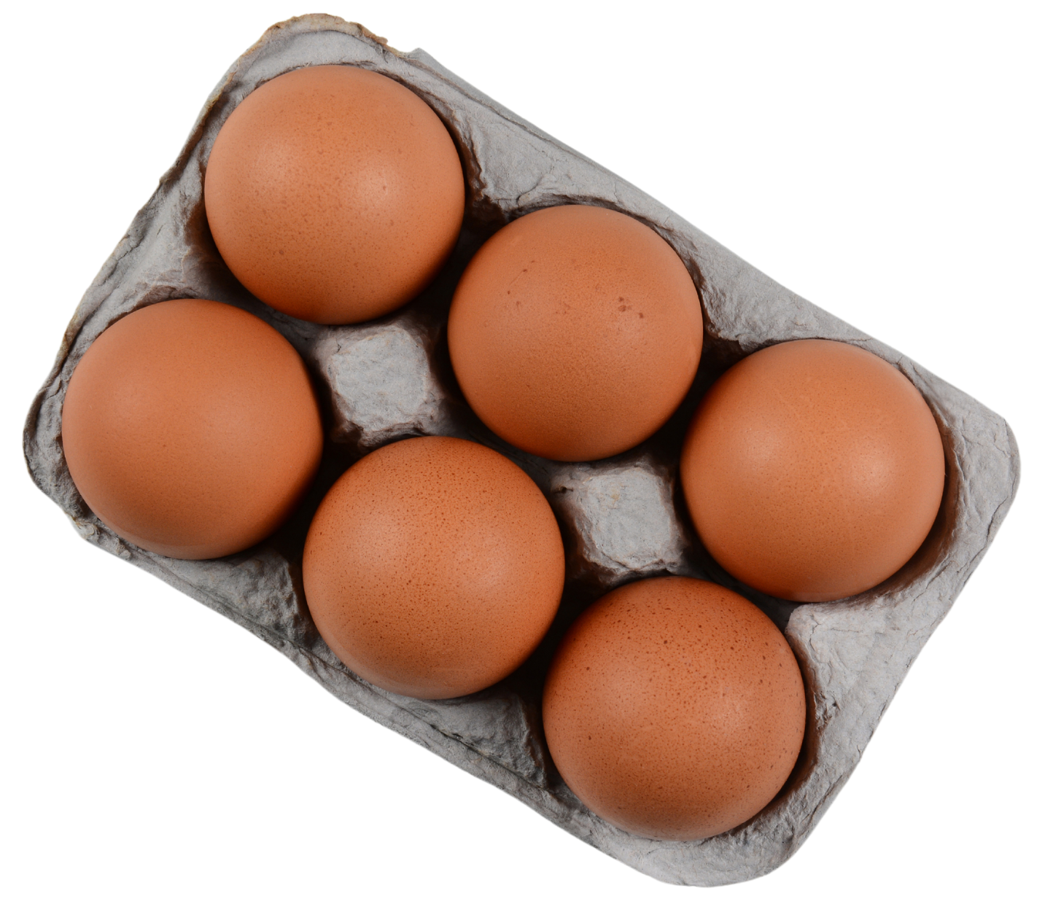
Item 3
Berapa harga enam telur?
Rp 5.000

Slide 6
Item 4
Berapa harga sekilo apel?
Rp 30.000

Slide 7
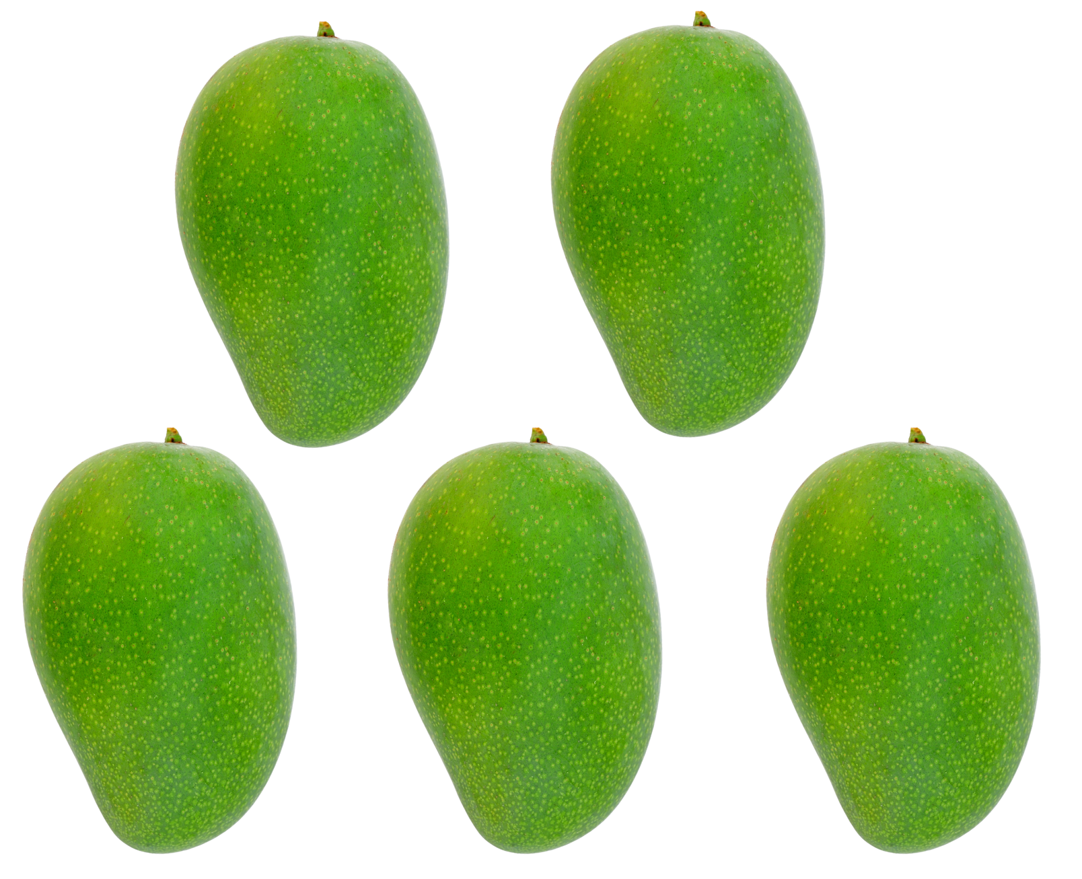
Item 5
Berapa harga lima mangga?
Rp 45.000

Slide 8
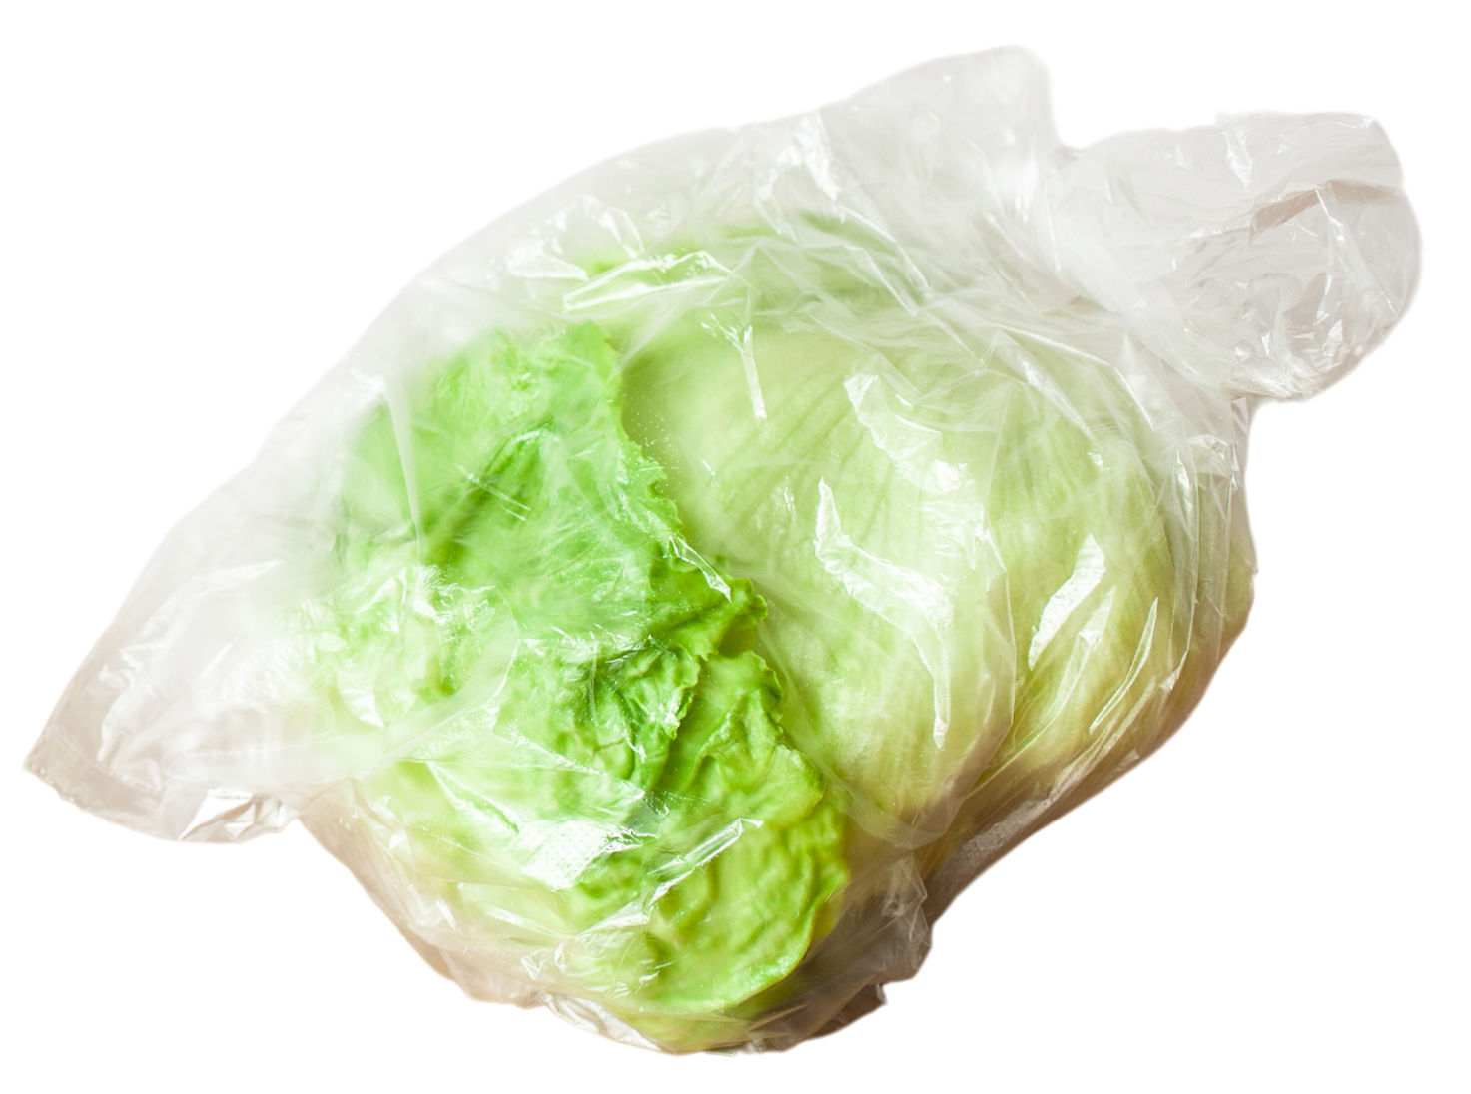
Item 6
Berapa harga selada?
Rp 9.000

Slide 9
Item 7
Berapa harga sekilo wortel?
Rp 20.000

Slide 10
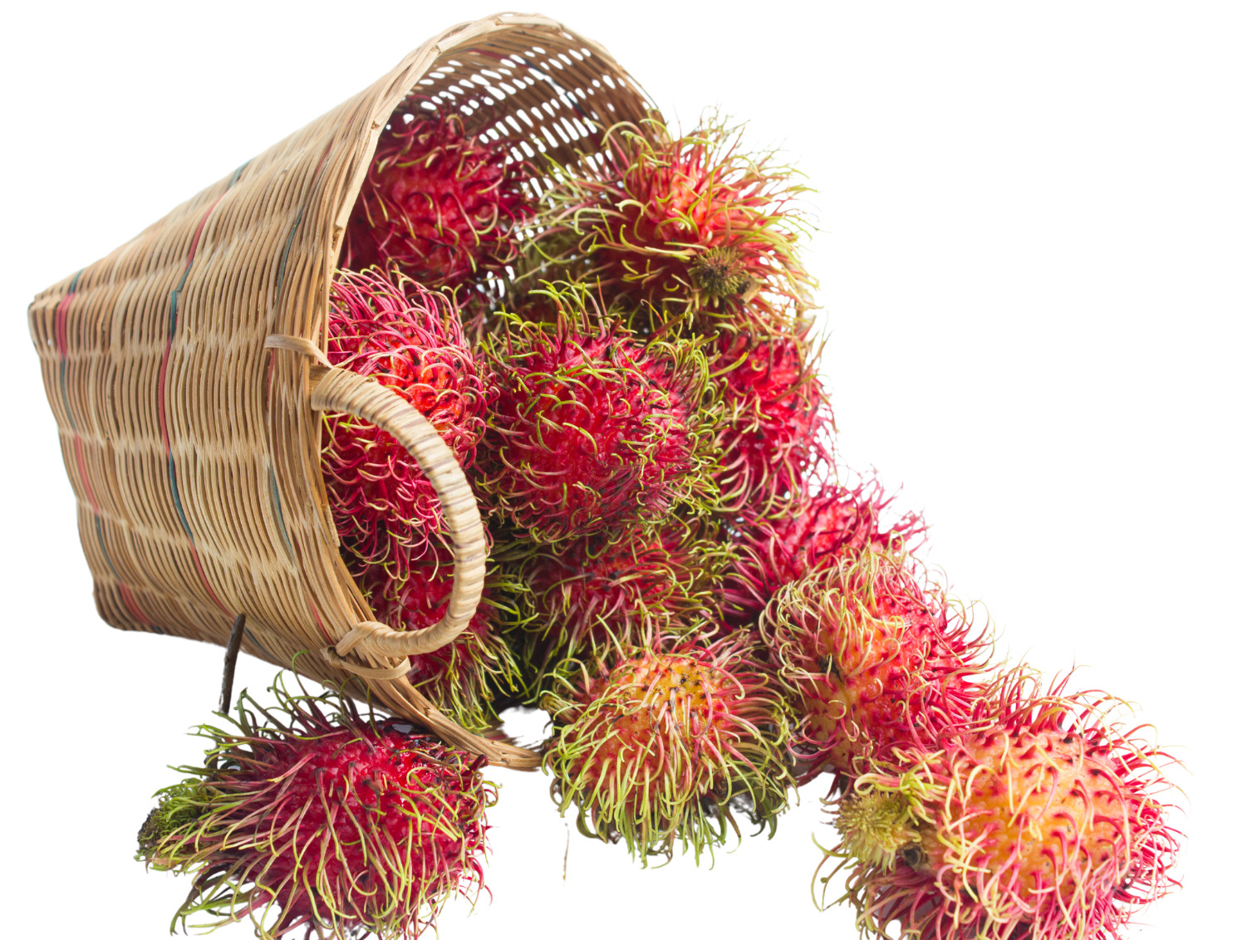
Item 8
Berapa harga sekilo rambutan?
Rp 24.000

Slide 11
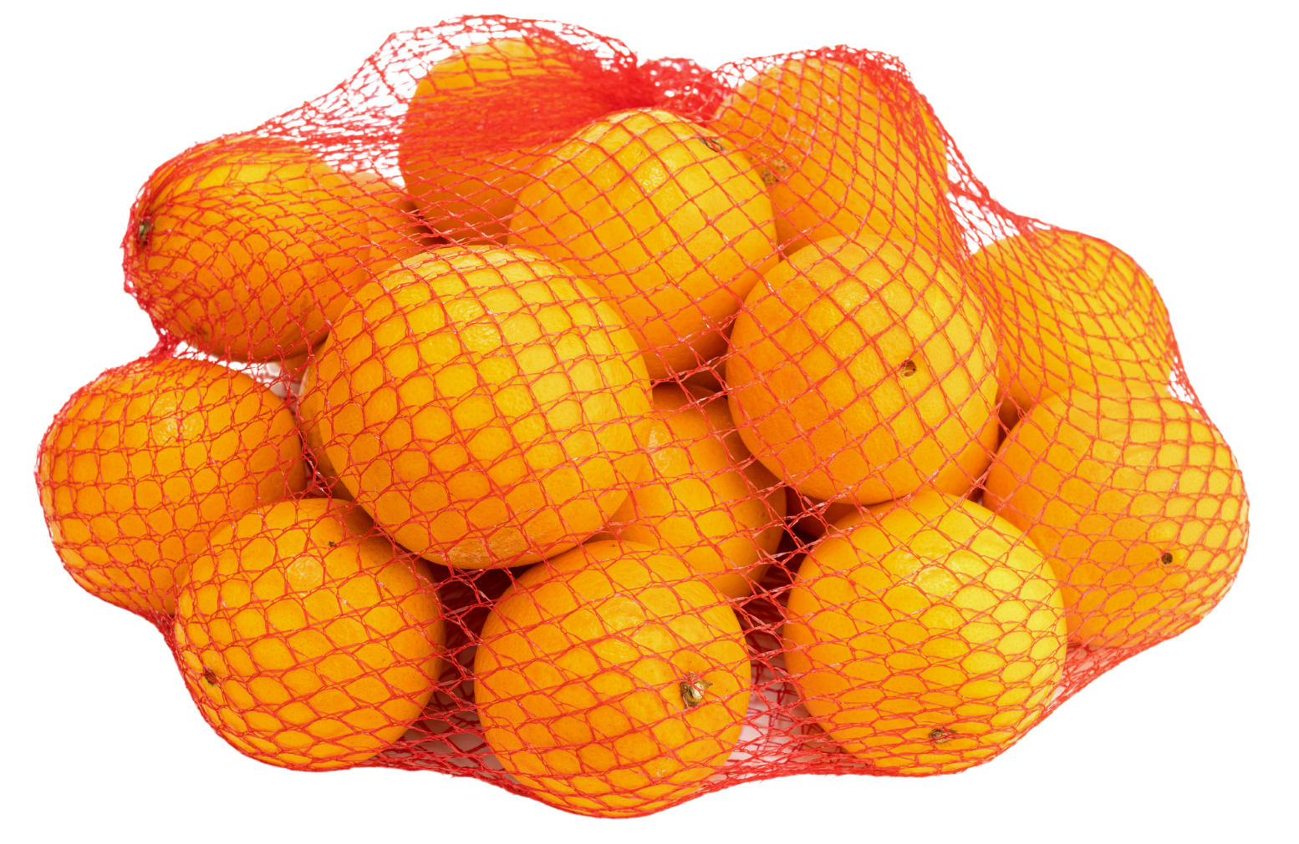
Item 9
Berapa harga sekilo jeruk?
Rp 28.000

Slide 12
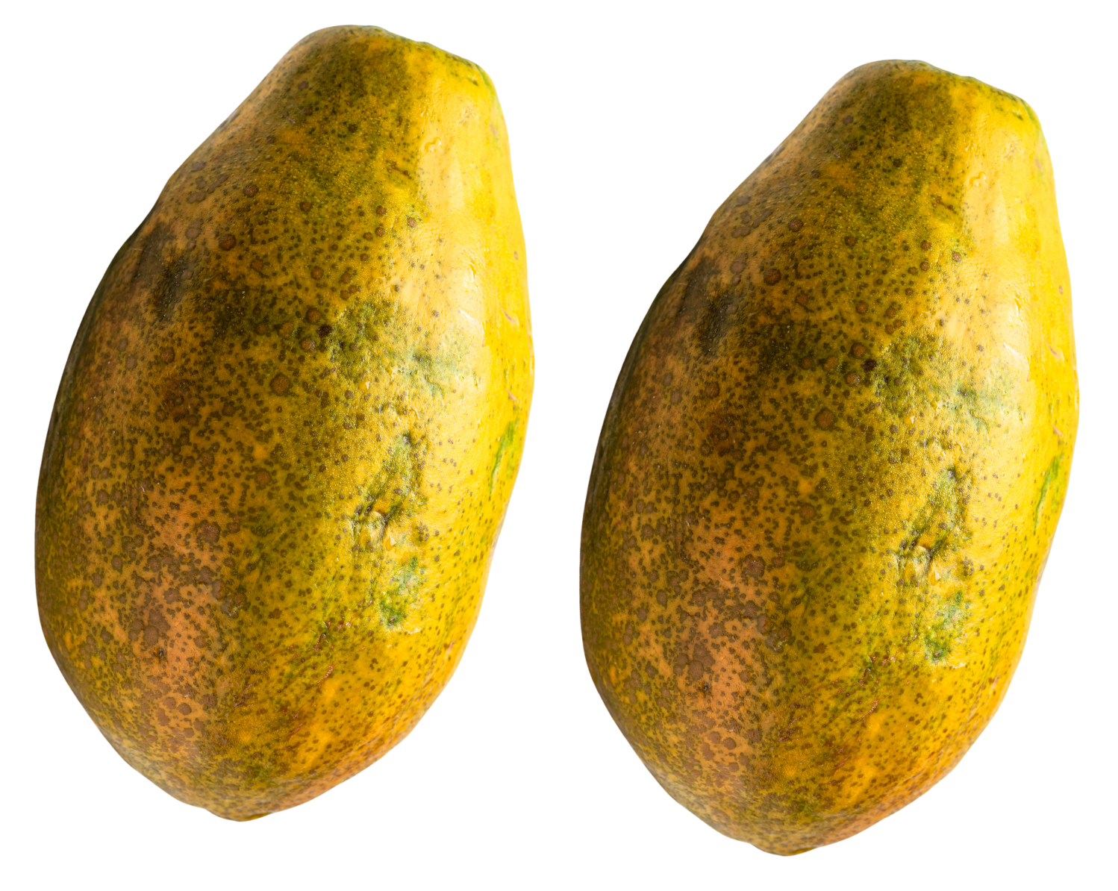
Item 10
Berapa harga dua pepaya?
Rp 38.000

Slide 13
Item 11
Berapa harga kelapa?
Rp 33.000

Slide 14
Item 12
Berapa harga cokelat?
Rp 8.000

Slide 15
Item 13
Berapa harga durian?
Rp 70.000

Slide 16
Item 14
Berapa harga dua ratus gram cabe?
Rp 23.000

Slide 17
Item 15
Berapa harga sekilo daging?
Rp 130.000

Slide 18
Copyright
© State of New South Wales (Department of Education), 2024
The copyright material published in this resource is subject to the Copyright Act 1968 (Cth) and is owned by the NSW Department of Education or, where indicated, by a party other than the NSW Department of Education (third-party material).
Copyright material available in this resource and owned by the NSW Department of Education is licensed under a Creative Commons Attribution 4.0 International (CC BY 4.0) license.
This license allows you to share and adapt the material for any purpose, even commercially.
Attribution should be given to © State of New South Wales (Department of Education), 2024.
Material in this resource not available under a Creative Commons license:
the NSW Department of Education logo, other logos and trademark-protected material
Material owned by a third party that has been reproduced with permission. You will need to obtain permission from the third party to reuse its material.
Links to third-party material and websites
Please note that the provided (reading/viewing material/list/links/texts) are a suggestion only and implies no endorsement, by the New South Wales Department of Education, of any author, publisher, or book title. School principals and teachers are best placed to assess the suitability of resources that would complement the curriculum and reflect the needs and interests of their students.
If you use the links provided in this document to access a third party’s website, you acknowledge that the terms of use, including licence terms set out on the third-party’s website apply to the use which may be made of the materials on that third-party website or where permitted by the Copyright Act 1968 (Cth). The department accepts no responsibility for content on third-party websites.
Notes:
Slide not shared

