Slide 1
What do you want to buy? – Mau beli apa?

Slide 2
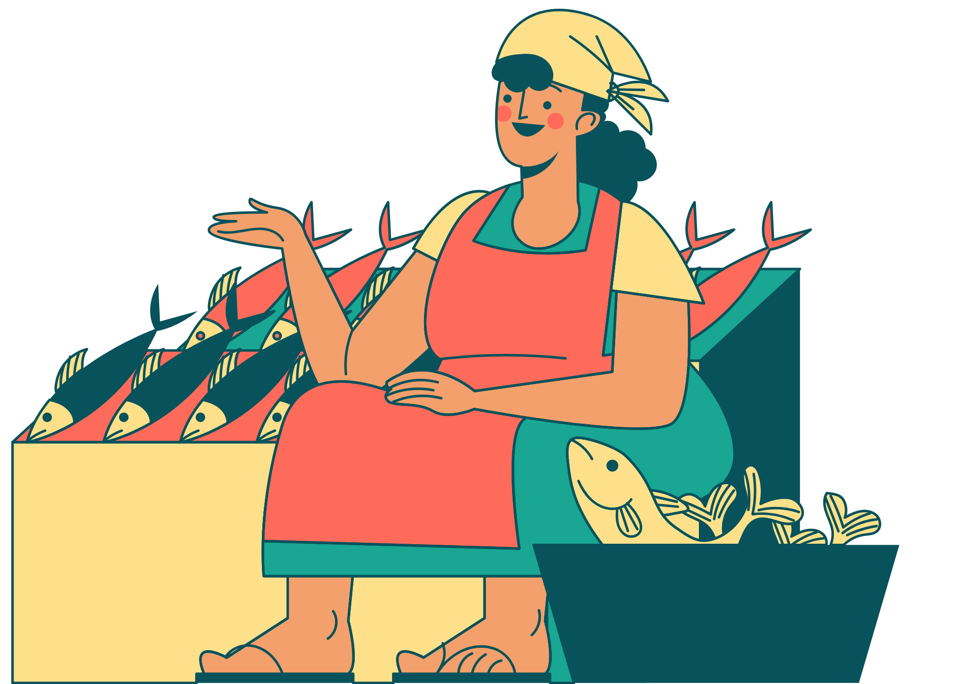
Asking someone what they want to buy
What do you want to buy?
To ask someone what they want to buy in Indonesian, we only need 3 words!
We can ask:
Mau beli apa?
mau means ‘want’.
beli means ‘to buy’.
apa is a question word, which means ‘what?’.
How do you think you could reply when someone asks you Mau beli apa?

Slide 3
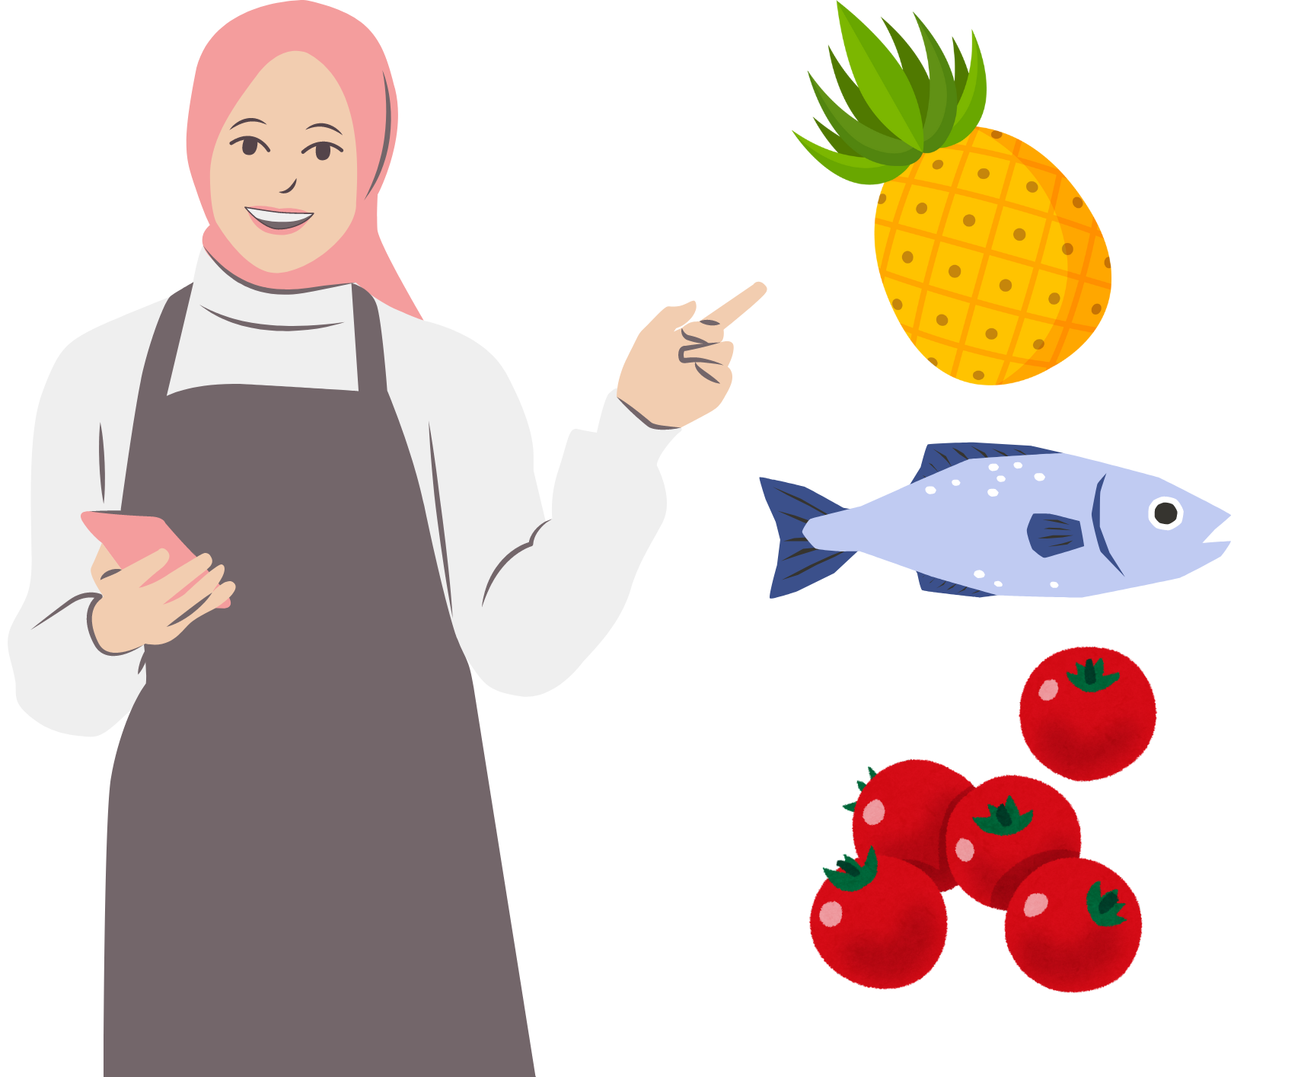
Saying what you want to buy
I want to buy …
To answer the question Mau beli apa?, we can say:
Saya mau beli…
Don’t forget to add an item at the end of the sentence. For example:
Saya mau beli nanas.
Saya mau beli ikan.
Saya mau beli tomat.
Notes:
For the teacher:
Translations of examples:
I want to buy pineapple.
I want to buy fish.
I want to buy tomatoes.

Slide 4
Let’s practise! Mau beli apa?
You will be given a number card.
Each slide will display a different food item. Each time the slide changes, a number will be called out in Indonesian. If it is your number, call out Saya!
You will be asked the question Mau beli apa?
Respond by saying that you want to buy the item you see on the slide. For example, Saya mau beli apel.
Notes:
For the teacher:
Give each student a number card (from the unit of work resources).
As you move through each slide, call out a number in Indonesian (for example, ‘dua belas!’).
The student who has the number 12 card should identify themselves by calling out ‘Saya!’.
Ask the student Mau beli apa?
The student should respond by saying that they want to buy the item displayed on the slide. For example, if the slide shows a picture of an apple, the student would answer Saya mau beli apel.
After moving through the 6 item slides, return to the beginning again. This time, have students work in pairs and follow the same pattern. Display each slide and students take turns asking each other Mau beli apa? and responding in Indonesian.

Slide 5
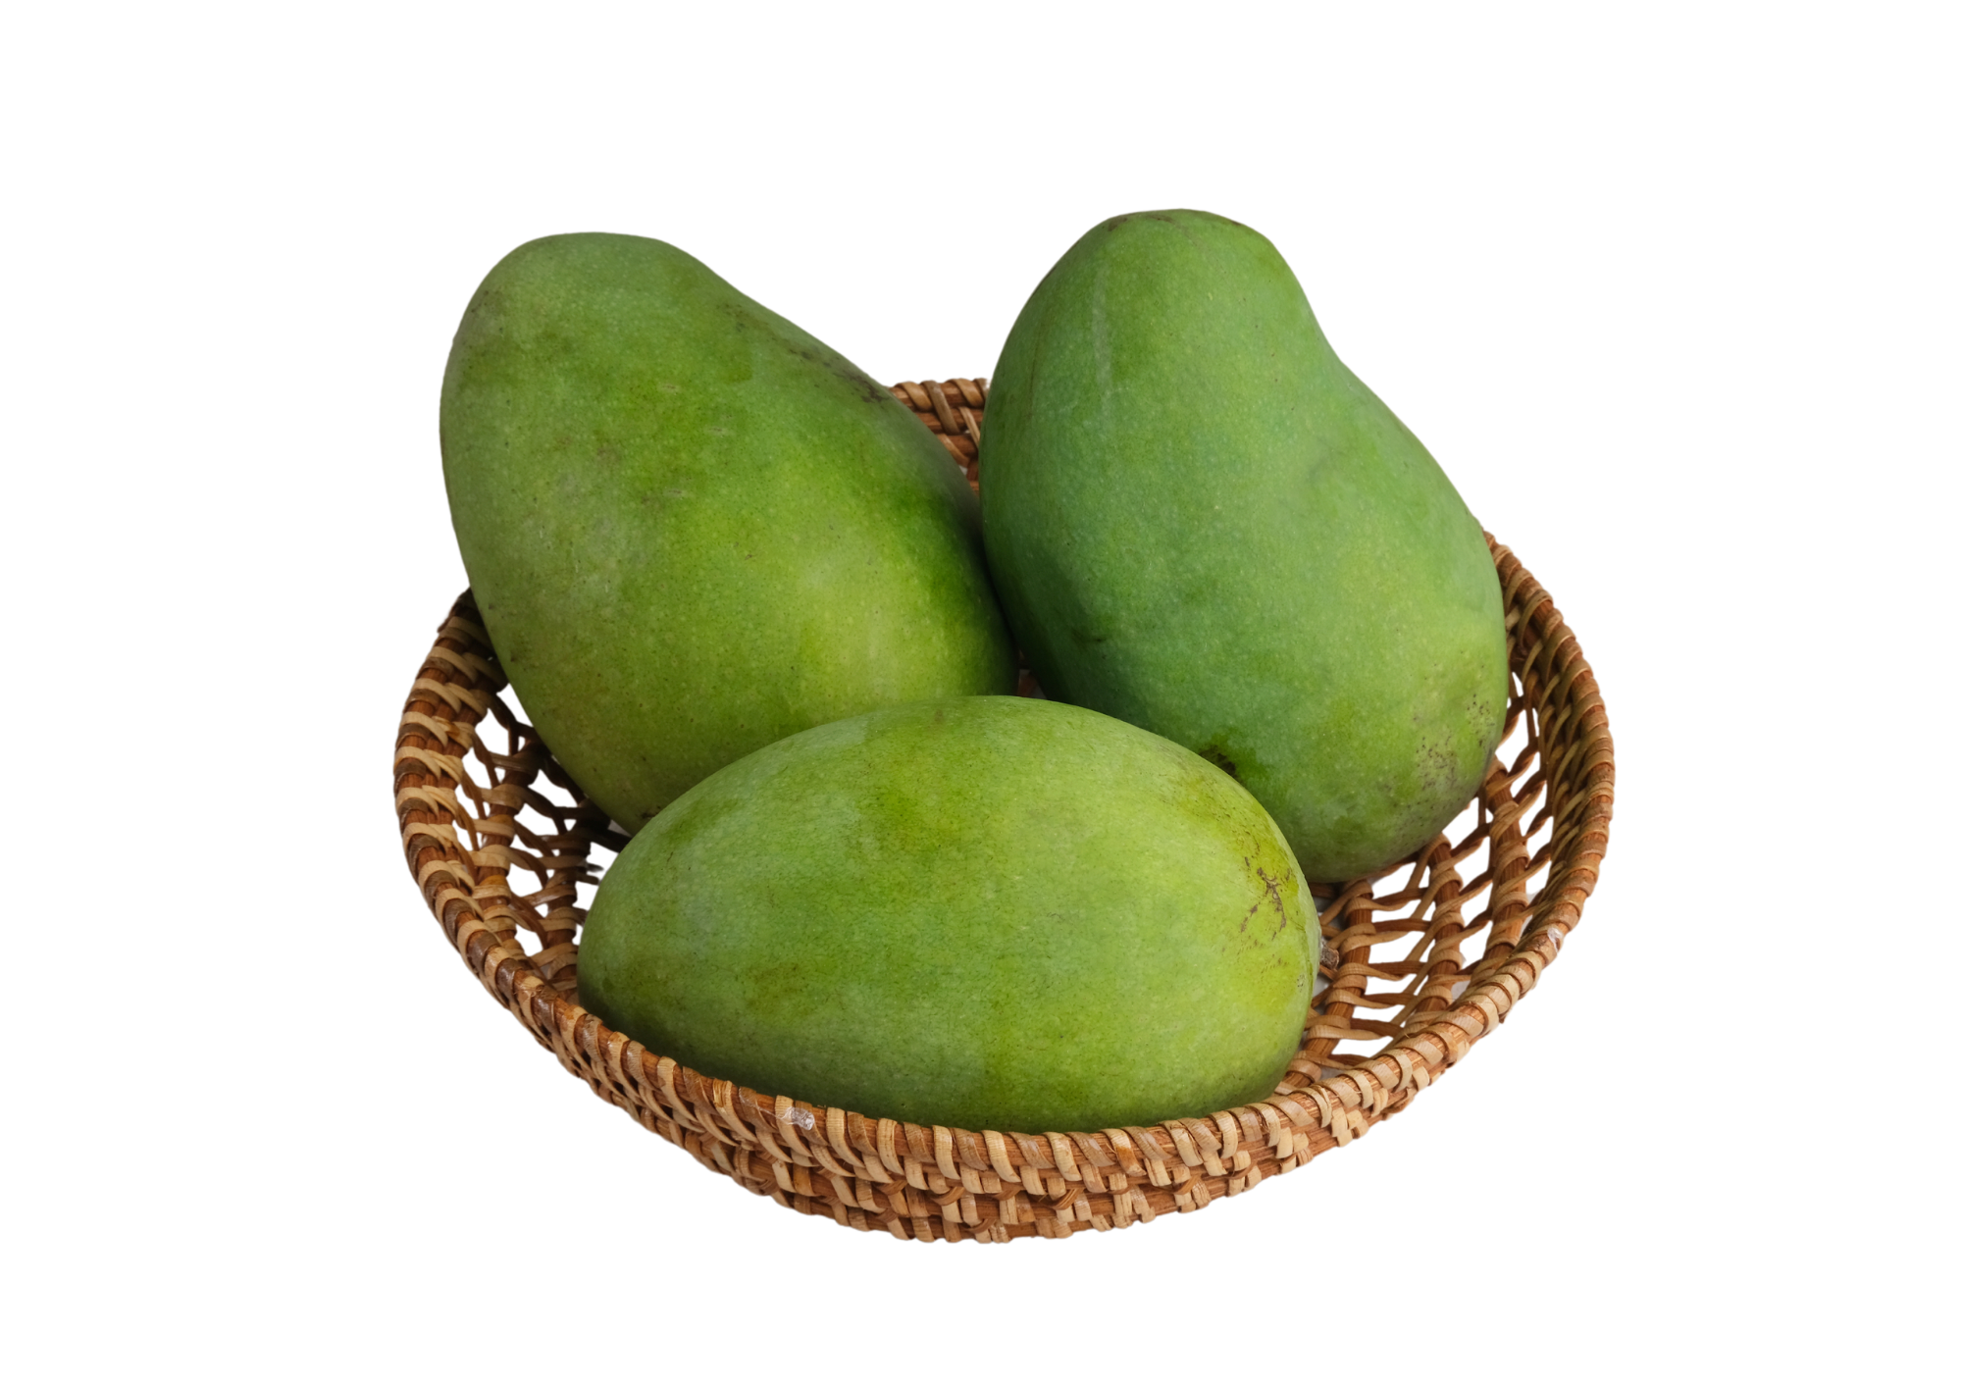
Item 1
Notes:
Teacher asks: Mau beli apa?
Student responds: Saya mau beli mangga.

Slide 6
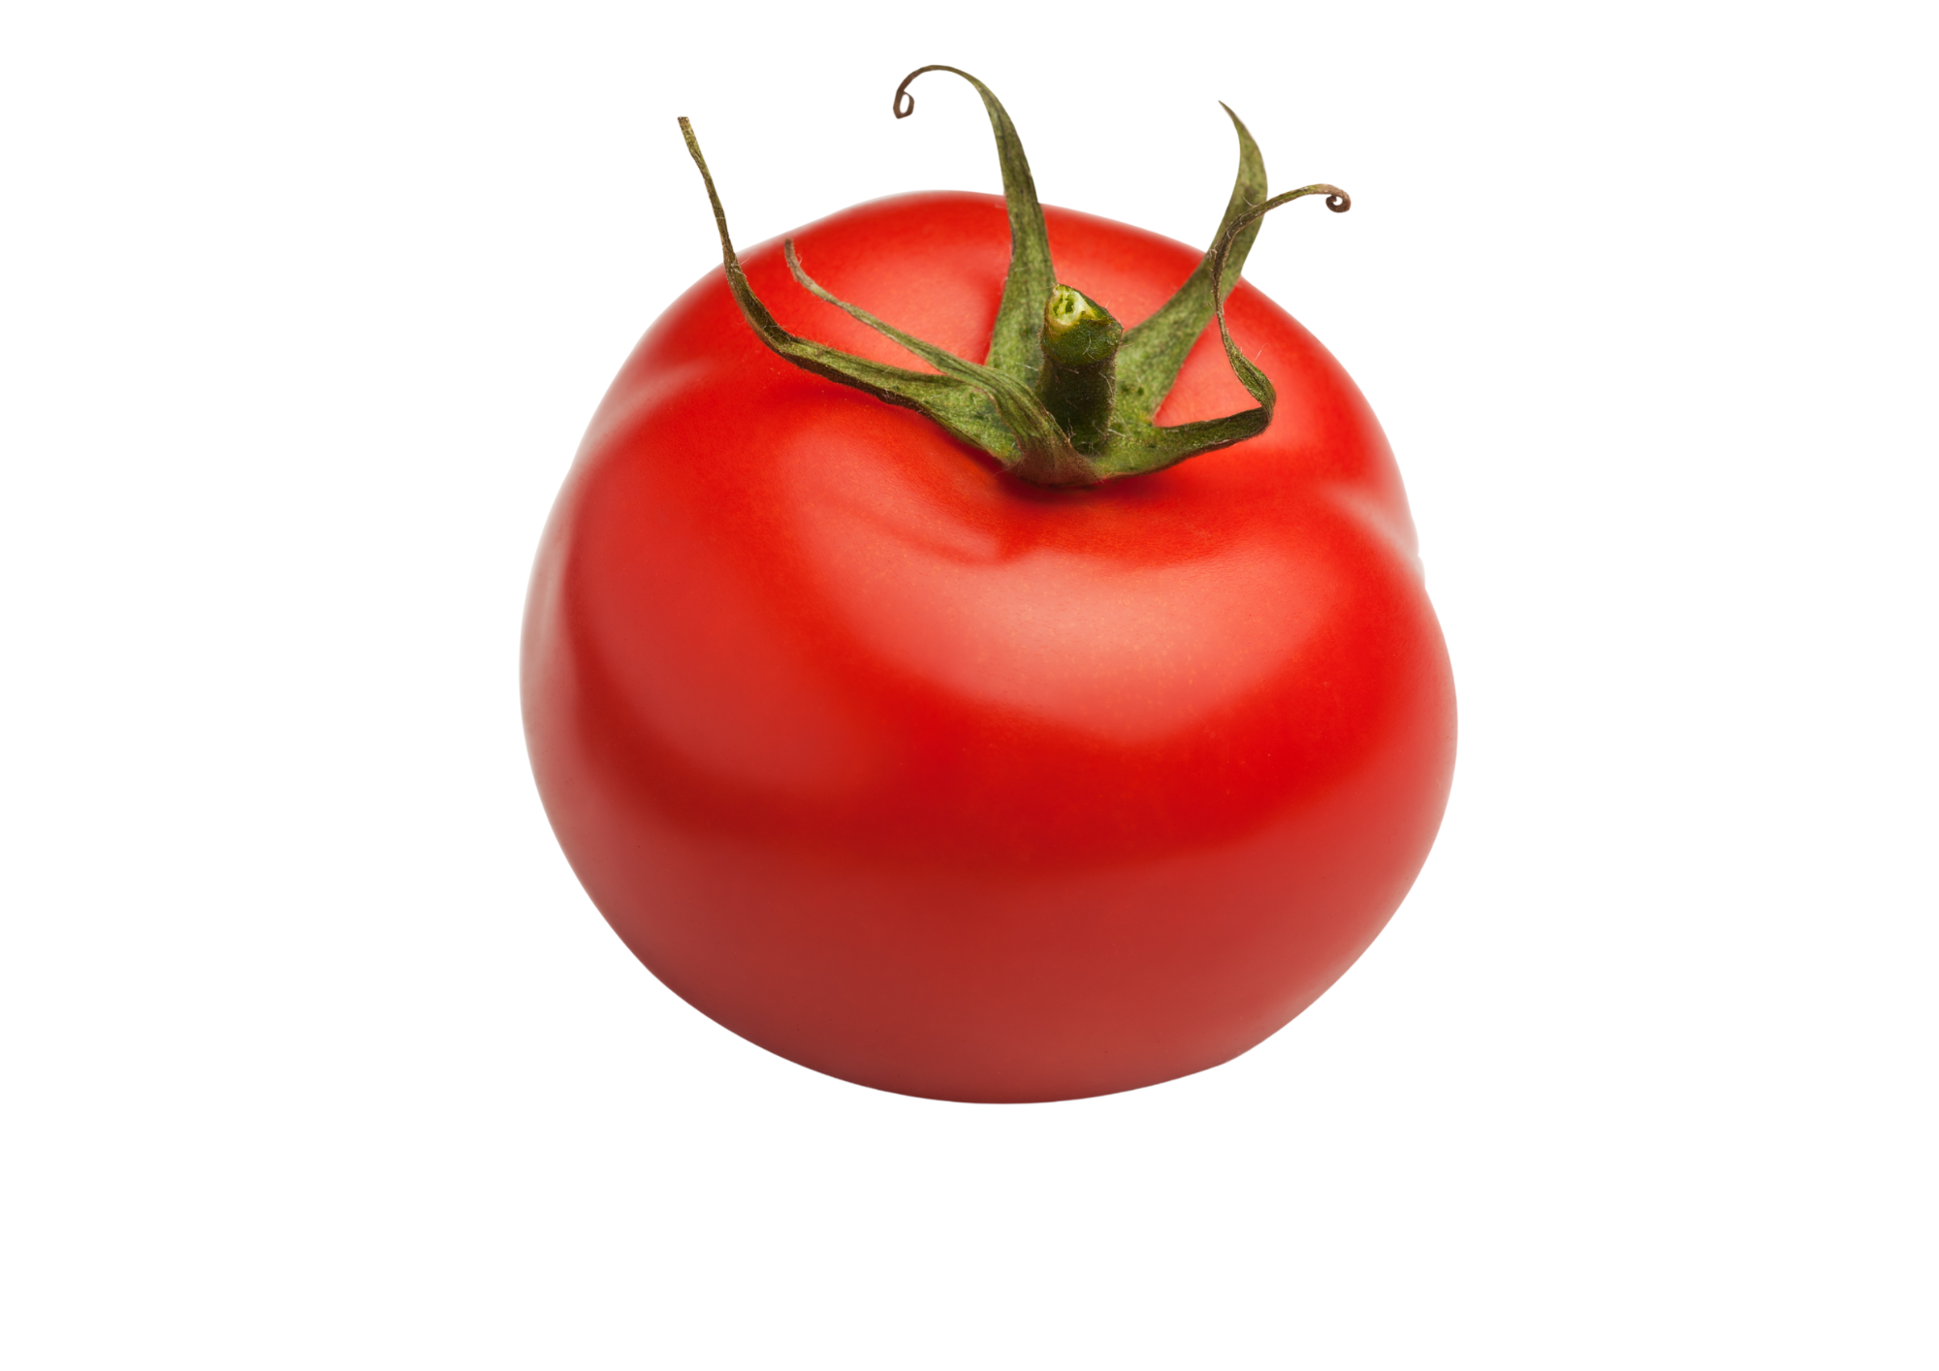
Item 2
Notes:
Teacher asks: Mau beli apa?
Student responds: Saya mau beli tomat.

Slide 7
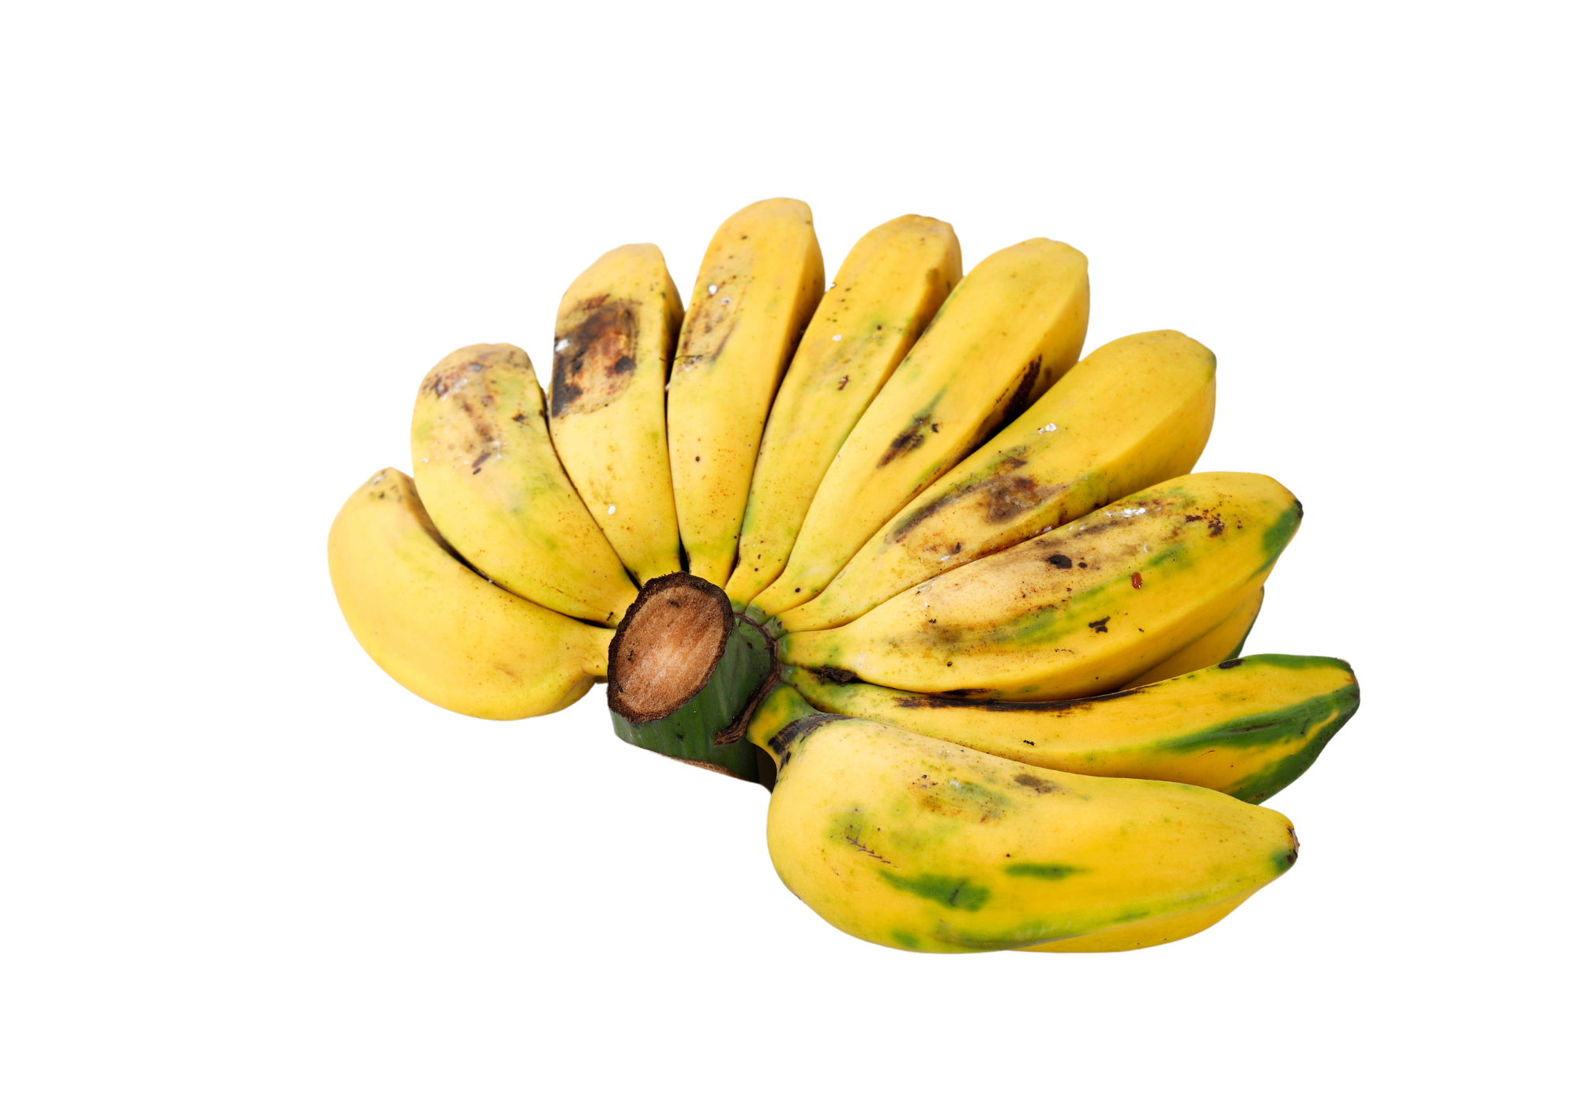
Item 3
Notes:
Teacher asks: Mau beli apa?
Student responds: Saya mau beli pisang.

Slide 8
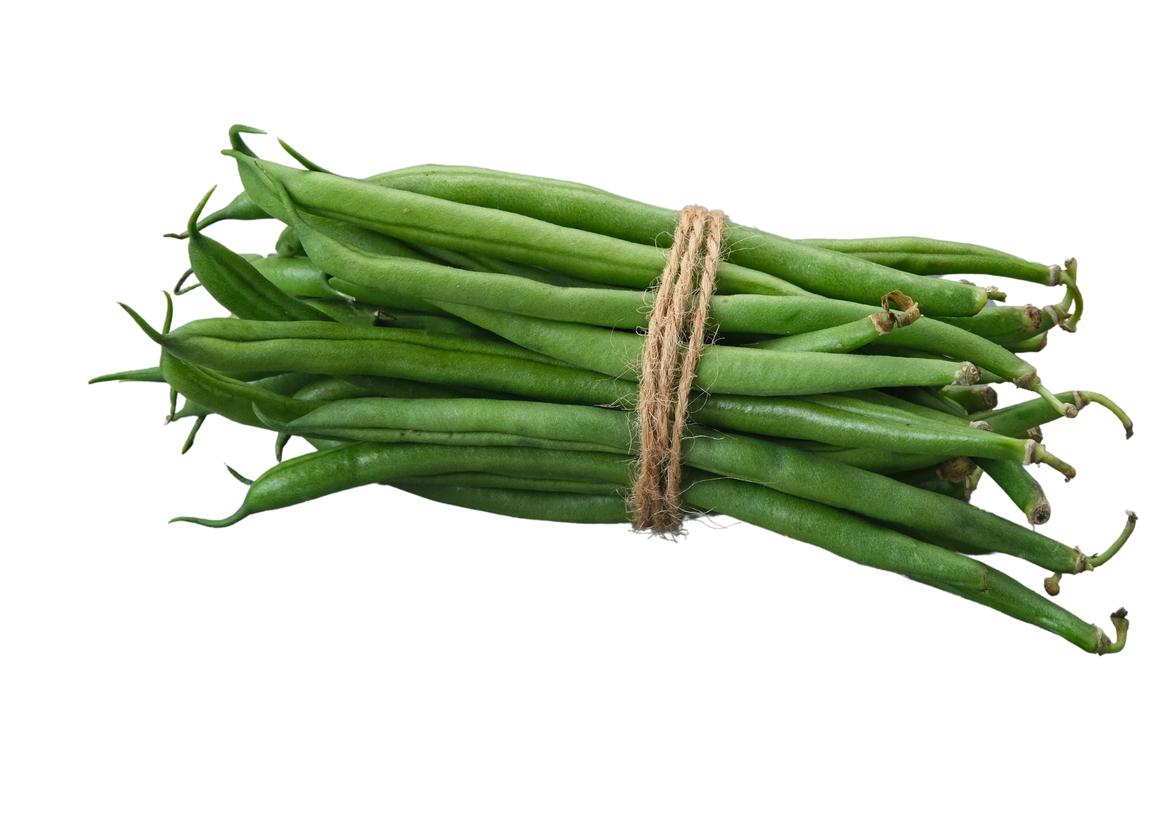
Item 4
Notes:
Teacher asks: Mau beli apa?
Student responds: Saya mau beli buncis.

Slide 9
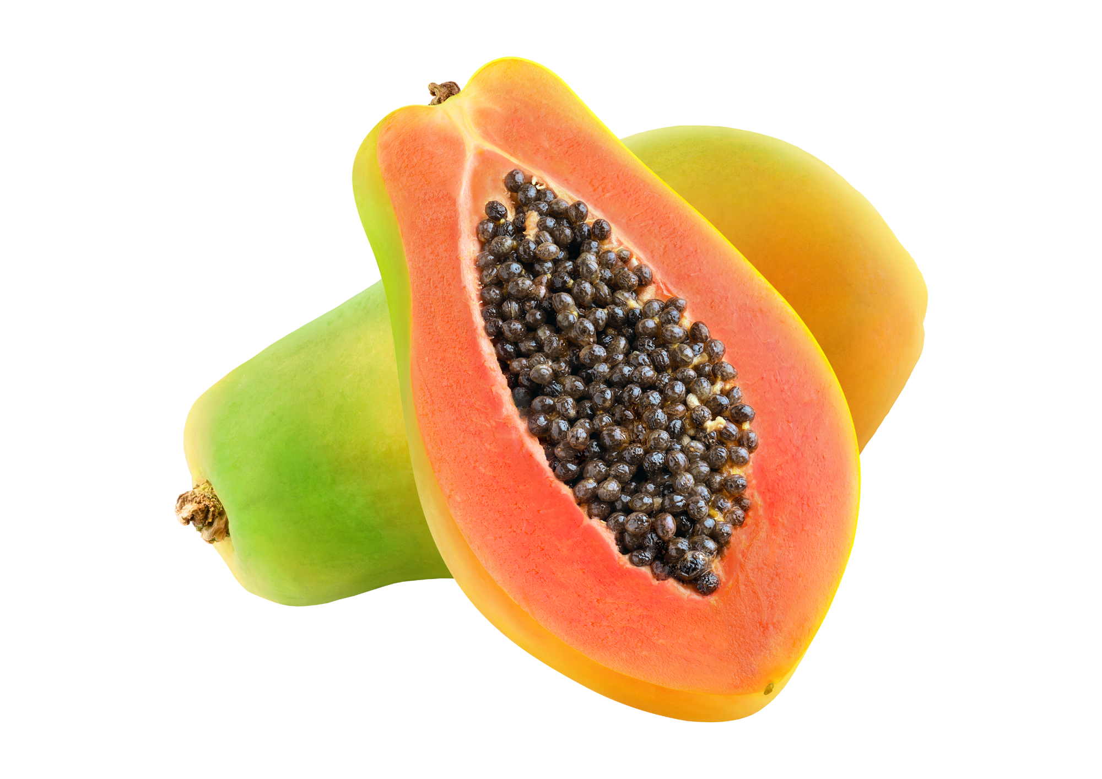
Item 5
Notes:
Teacher asks: Mau beli apa?
Student responds: Saya mau beli pepaya.

Slide 10
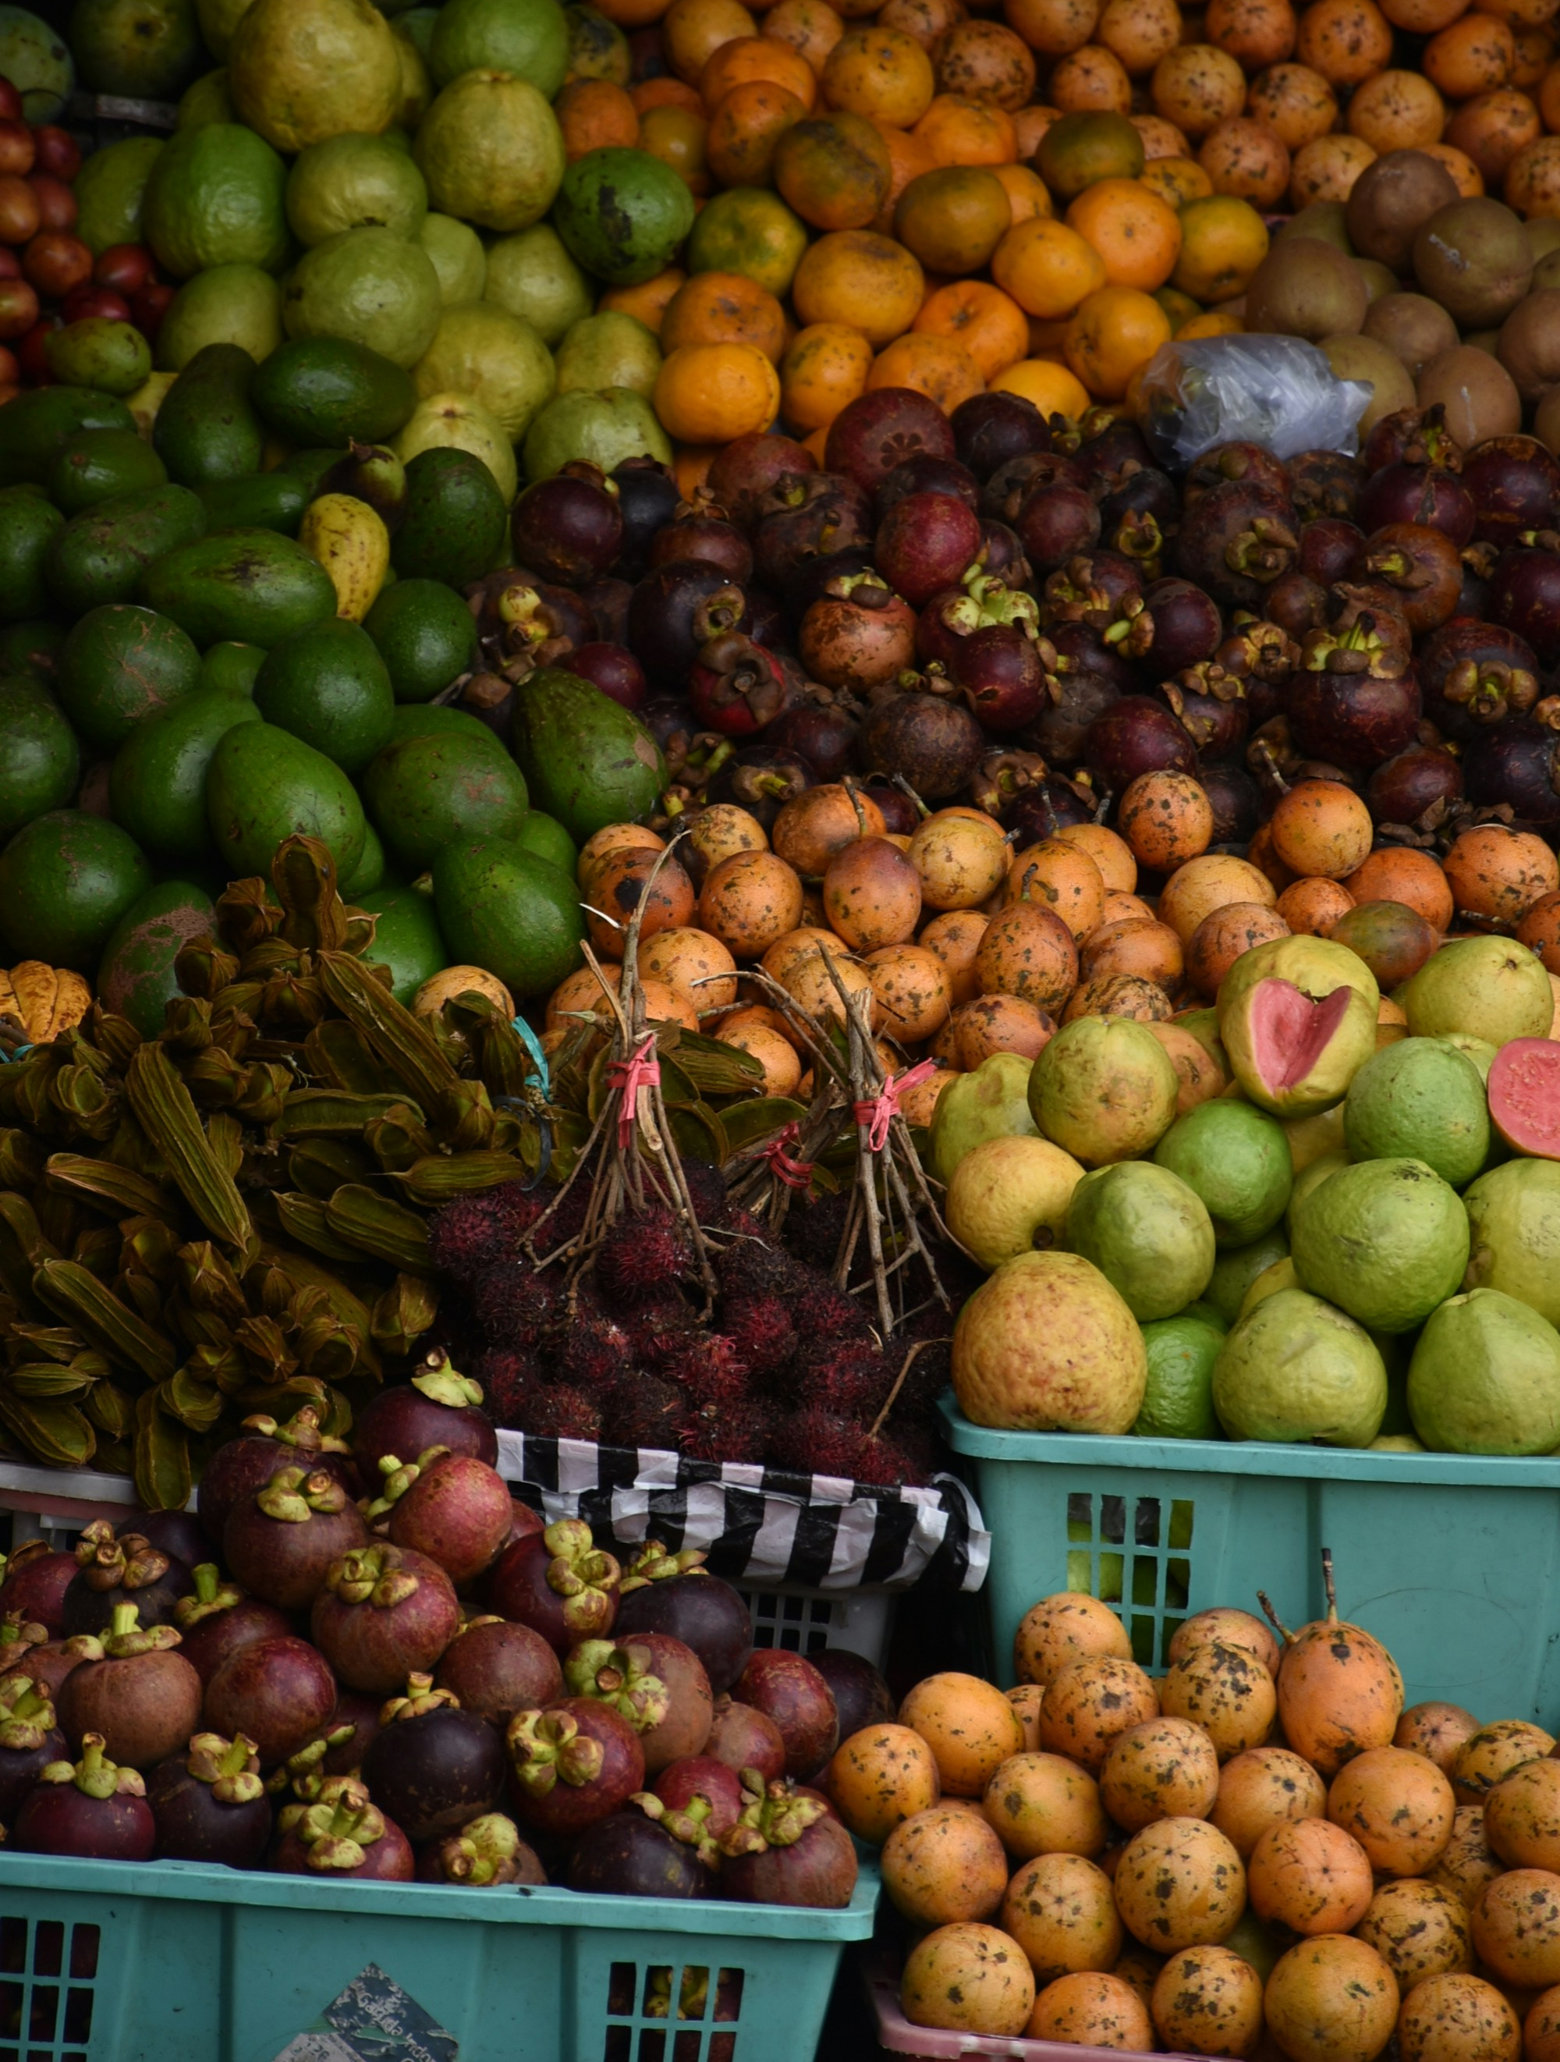
Item 6
Notes:
Teacher asks: Mau beli apa?
Student responds: Saya mau beli buah-buahan.

Slide 11
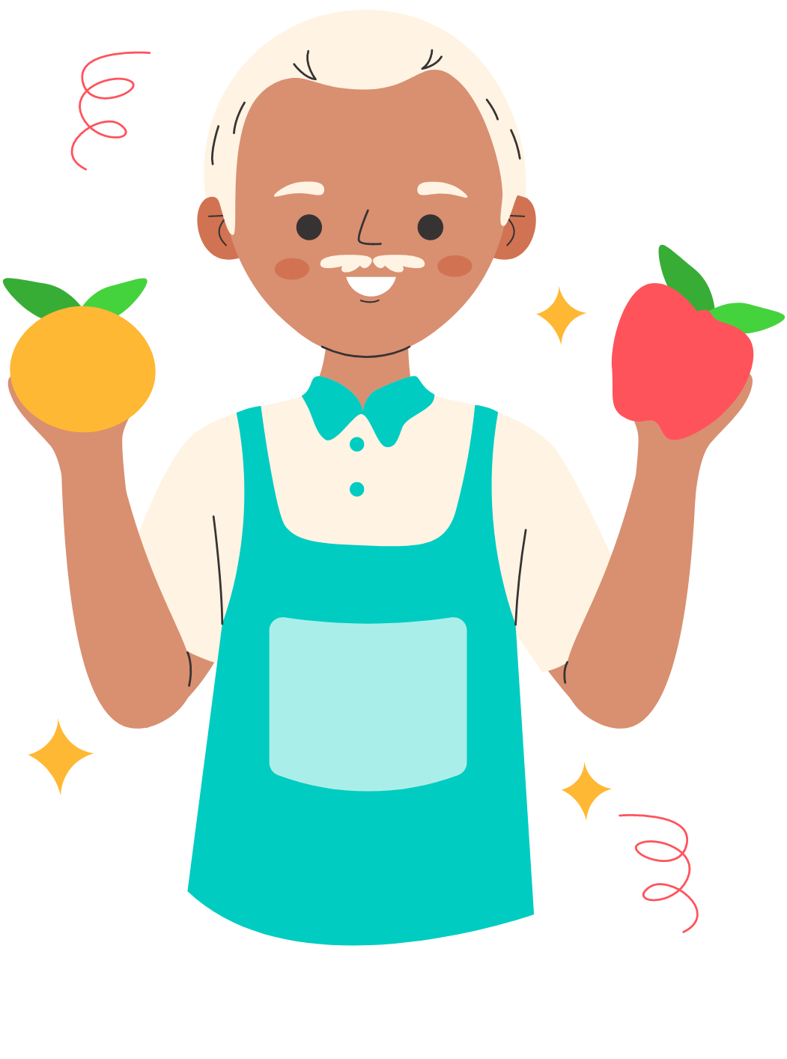
Asking someone if they want to buy a specific item
Do you want to buy …?
Sometimes you might want to ask someone whether they want to buy a particular item, or not.
We can ask:
Mau beli…?
Don’t forget to add an item at the end of the question. For example:
Mau beli buah-buahan?
Mau beli jeruk?
Mau beli apel?
Notes:
For the teacher:
Translations of examples:
Do you want to buy fruit?
Do you want to buy oranges?
Do you want to buy apples?

Slide 12
Saying you do/don’t want to buy something
I want/don’t want to buy…
If asked Mau beli… ?, we can say:
✓ Ya, saya mau beli…
✗ Saya tidak mau beli…
For example:
Ya, saya mau beli telur.
Ya, saya mau beli manggis.
Saya tidak mau beli pisang.
Notes:
For the teacher:
Translations of examples:
Yes, I want to buy eggs.
Yes, I want to buy mangosteen.
I don’t want to buy bananas.

Slide 13
Using conjunctions to give more detail
dan, tetapi, juga
Remember that we can use the conjunctions below to give more detail in our responses.
dan means ‘and’
tetapi means ‘but’
juga means ‘also’
For example:
Saya mau beli pepaya dan durian.
Saya mau beli beras tetapi saya tidak mau beli kue.
Saya mau beli wortel dan saya juga mau beli cabe.
Notes:
For the teacher:
Translations of examples:
I want to buy papaya and durian.
I want to buy rice but I don’t want to buy cake.
I want to buy carrots and I also want to buy chillis.

Slide 14
Let’s practise! Mau beli… ?
Make sure you still have your number card from earlier.
Each slide will display a different food item. Each time the slide changes, a number will be called out in Indonesian. If it is your number, call out Saya!
You will be asked the question Mau beli…?
Respond by saying that you either want or don’t want to buy the item on the slide. For example, Ya, saya mau beli apel or Saya tidak mau beli apel.
If you see the opportunity to use a conjunction (dan, tetapi or juga), try and incorporate it into your answer!
Notes:
For the teacher:
Make sure students still have their number cards from earlier in the slideshow.
As you move through each slide, call out a number in Indonesian (for example, ‘dua belas!’).
The student who has the number 12 card should identify themselves by calling out ‘Saya!’.
Ask the student Mau beli… ? based on the item displayed. For example, if the slide shows a picture of an apple, ask Mau beli apel? If 2 items are displayed on the same slide, for example, apples and oranges, use a conjunction. For example, Mau beli apel dan jeruk?
The student should respond by saying they either want or don’t want to buy the item/s displayed on the slide. For example, Ya, saya mau beli apel or Saya tidak mau beli apel. Encourage students to use conjunctions if they see an opportunity to. For example Ya, saya mau beli apel tetapi saya tidak mau beli jeruk.
After moving through the 8 item slides, return to the beginning again. This time, have students work in pairs and follow the same pattern. Display each slide and students take turns asking each other Mau beli… ? and responding in Indonesian.

Slide 15
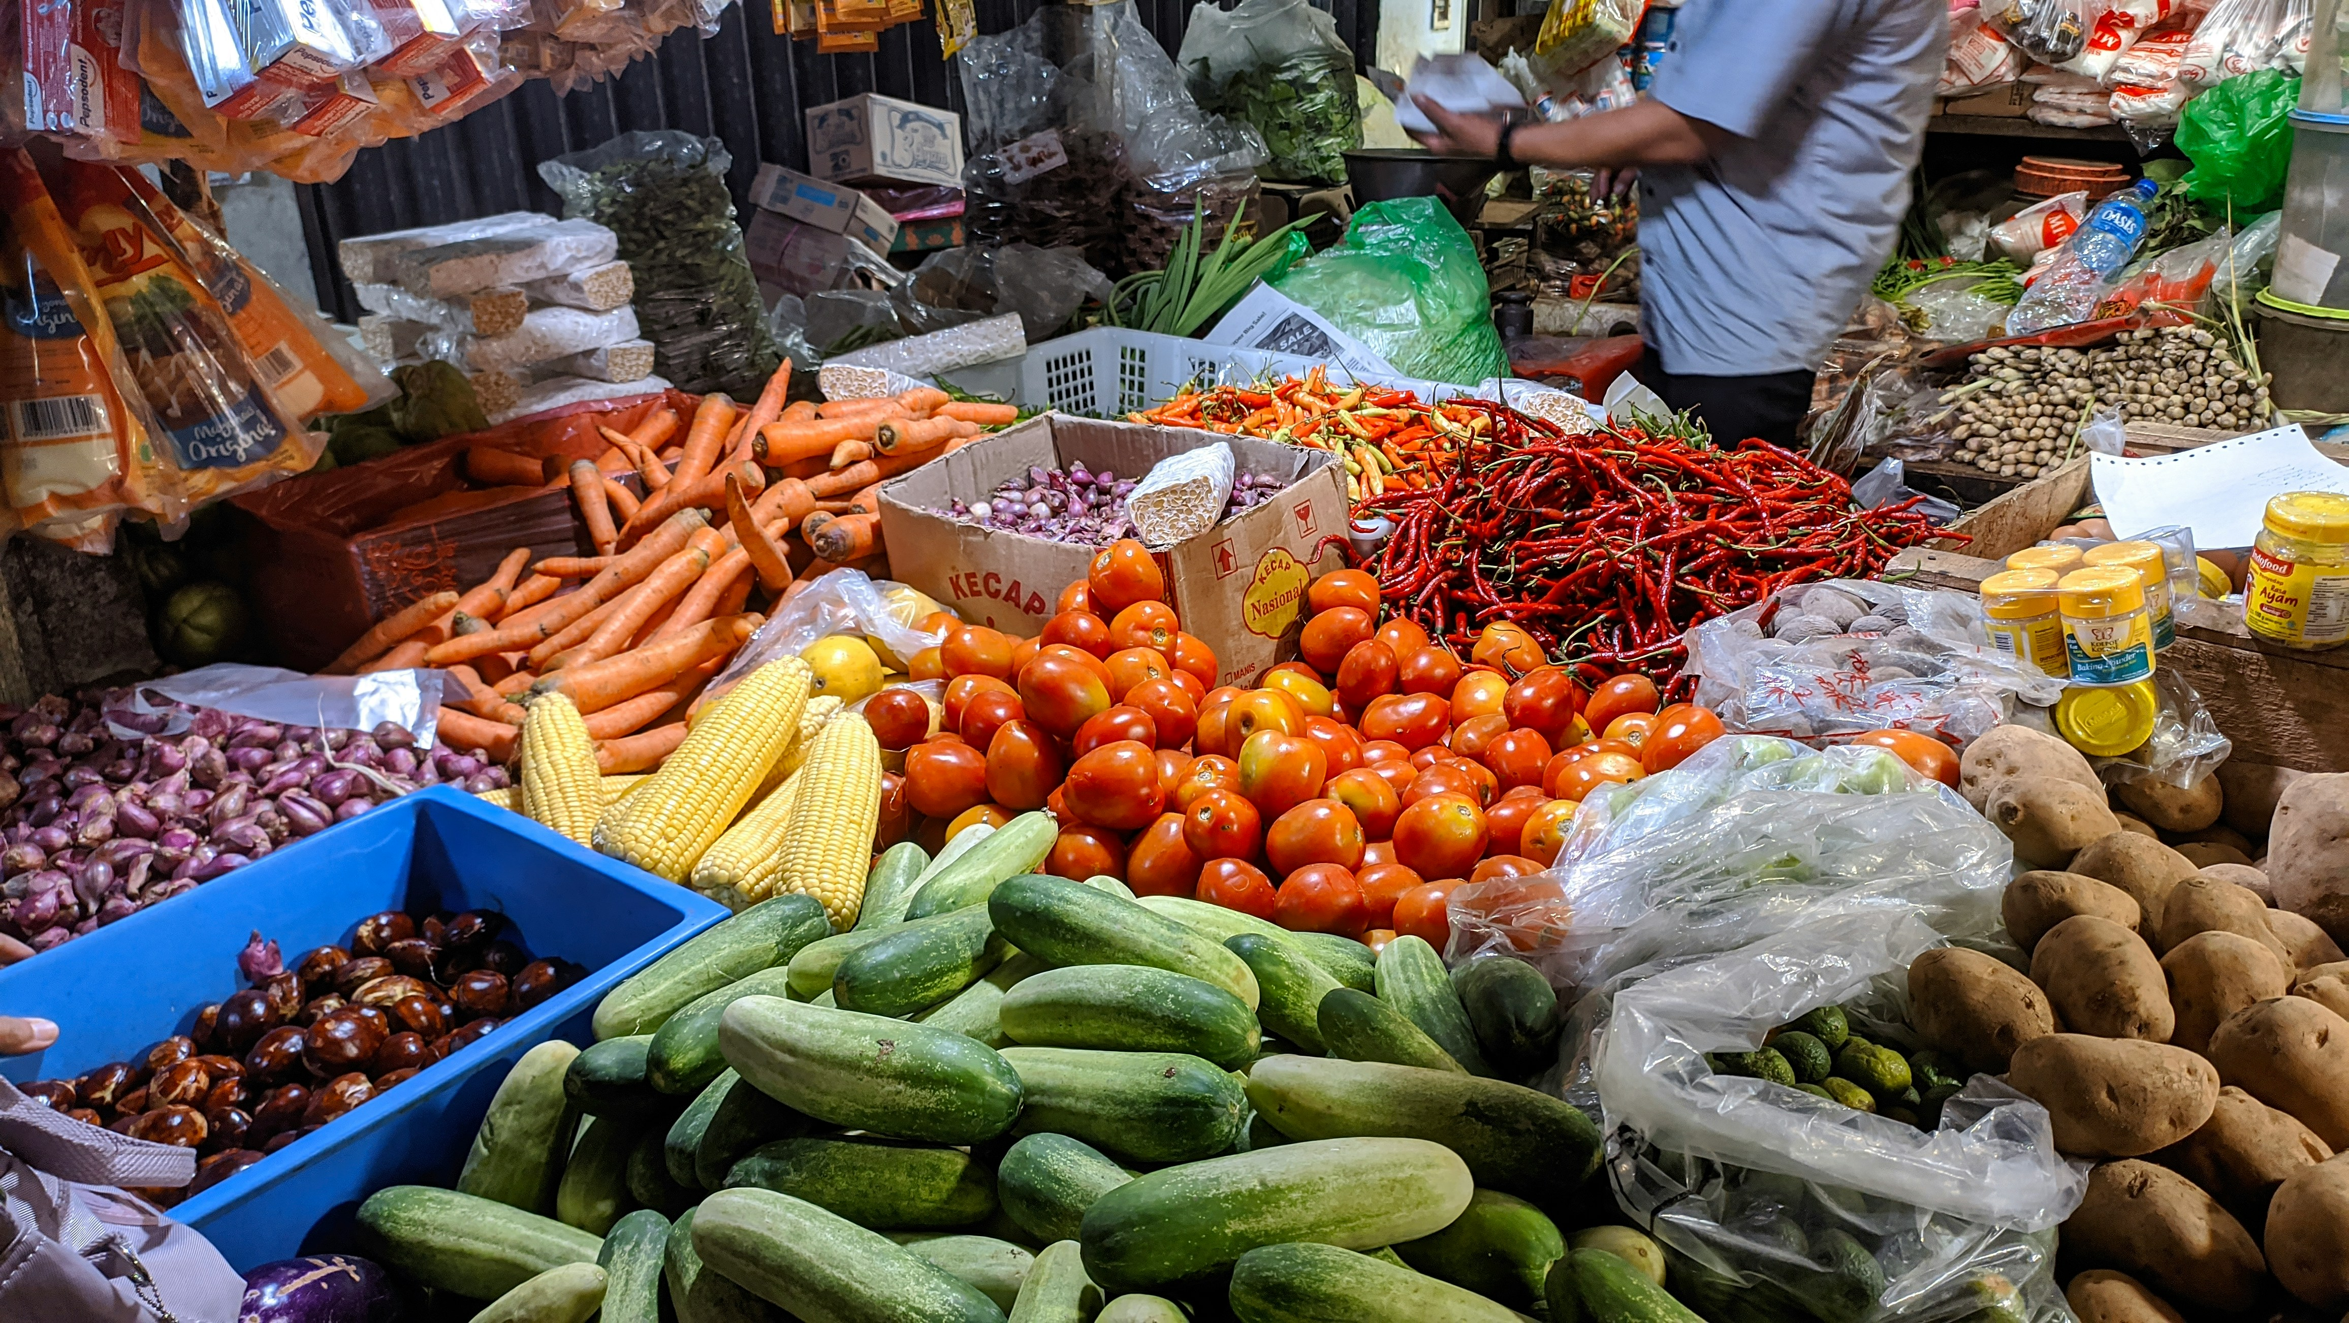
Item 7
Notes:
Teacher asks: Mau beli sayur-sayuran?
Student responds: Ya, saya mau beli sayur-sayuran or Saya tidak mau beli sayur-sayuran.

Slide 16
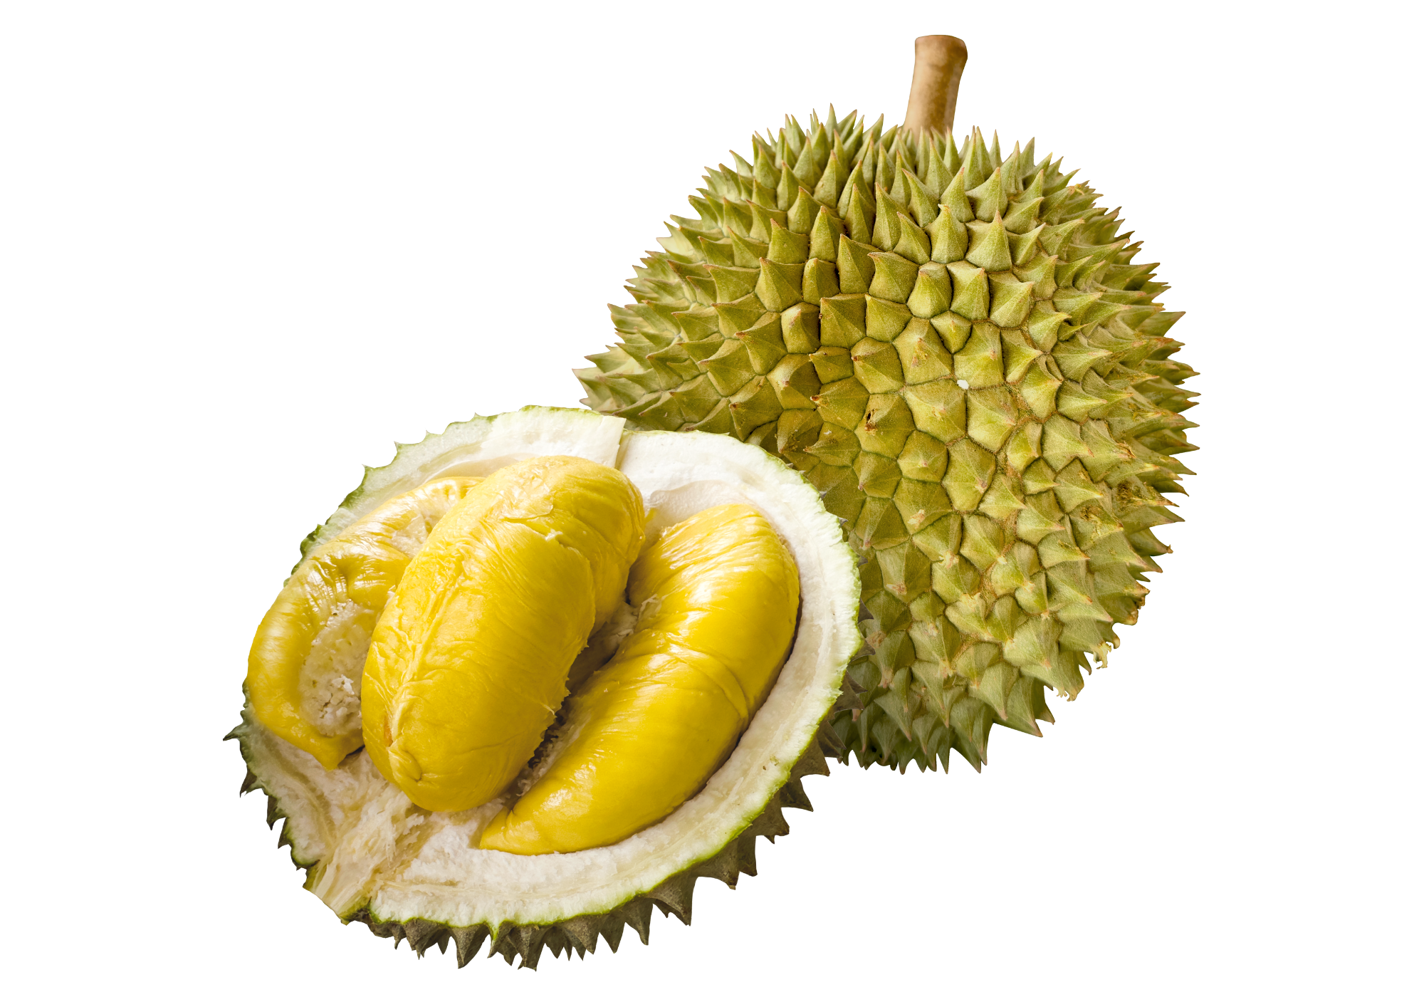
Item 8
Notes:
Teacher asks: Mau beli durian?
Student responds: Ya, saya mau beli durian or Saya tidak mau beli durian.

Slide 17
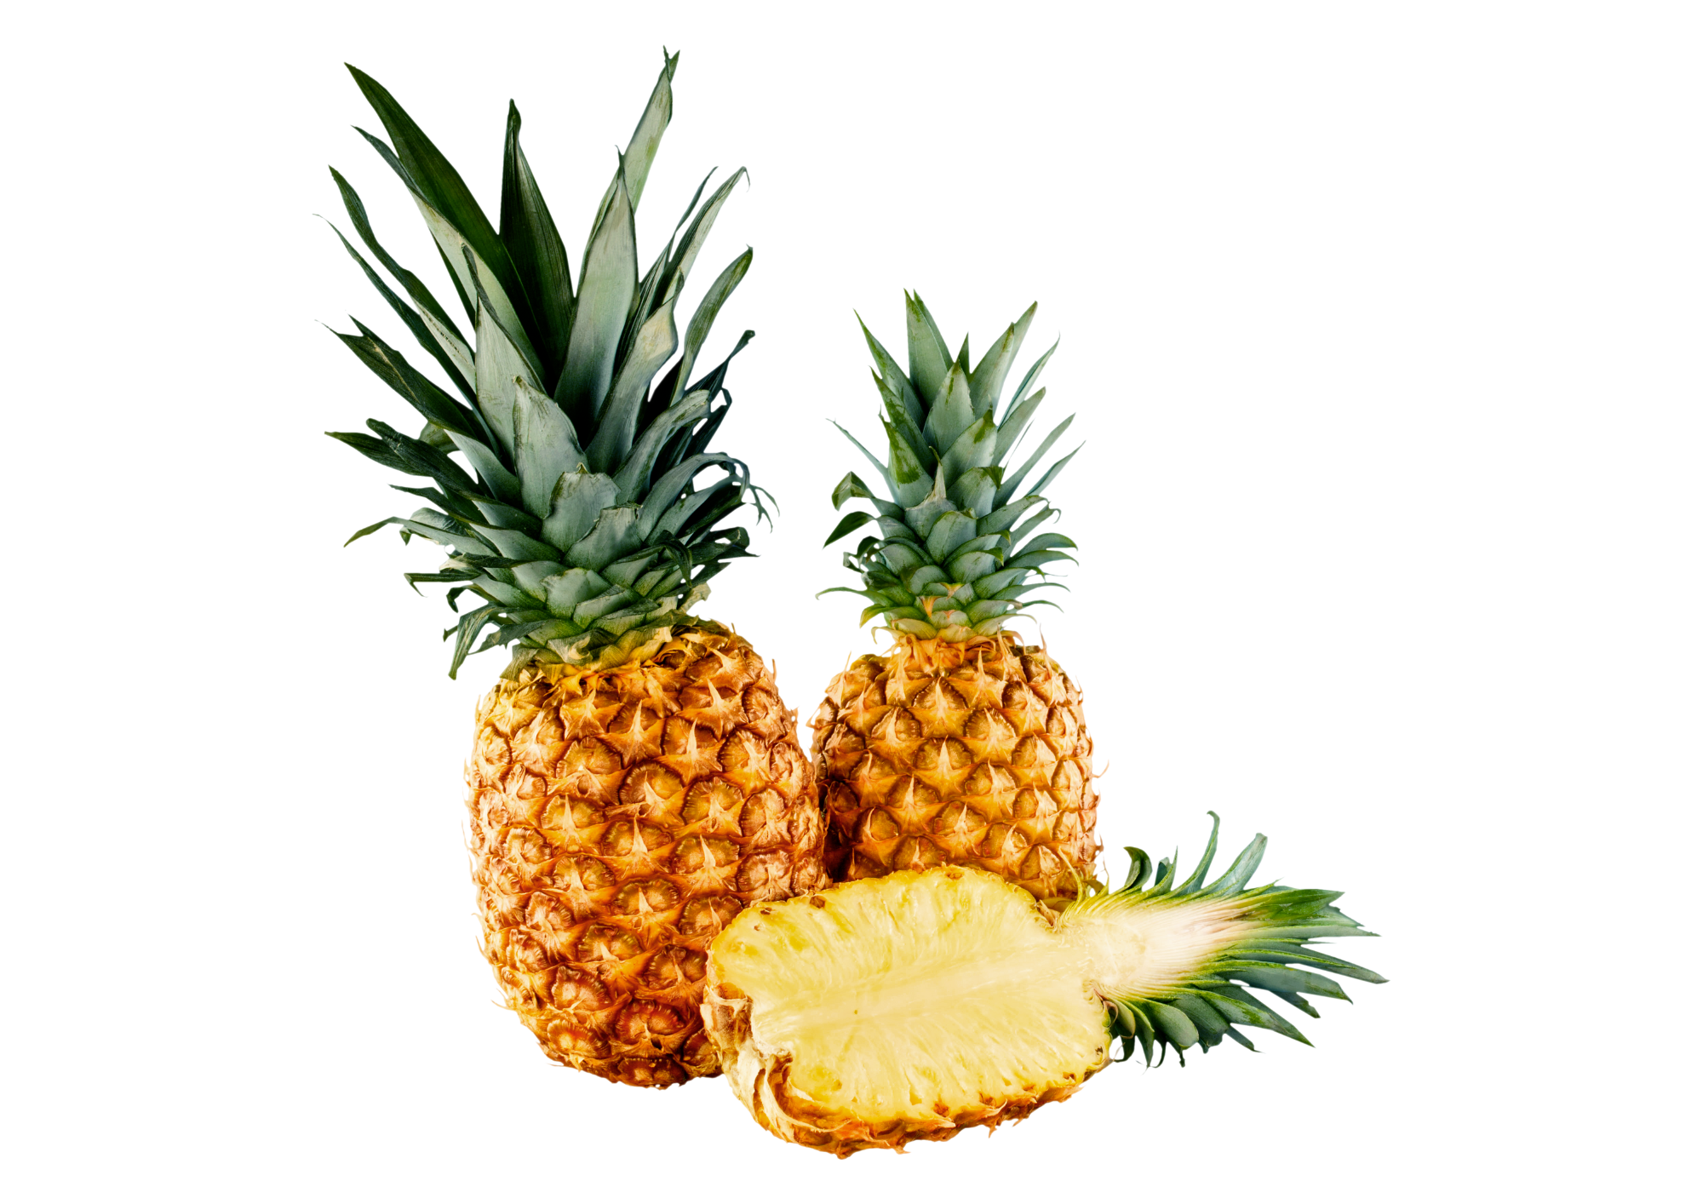
Item 9
Notes:
Teacher asks: Mau beli nanas?
Student responds: Ya, saya mau beli nanas or Saya tidak mau beli nanas.

Slide 18
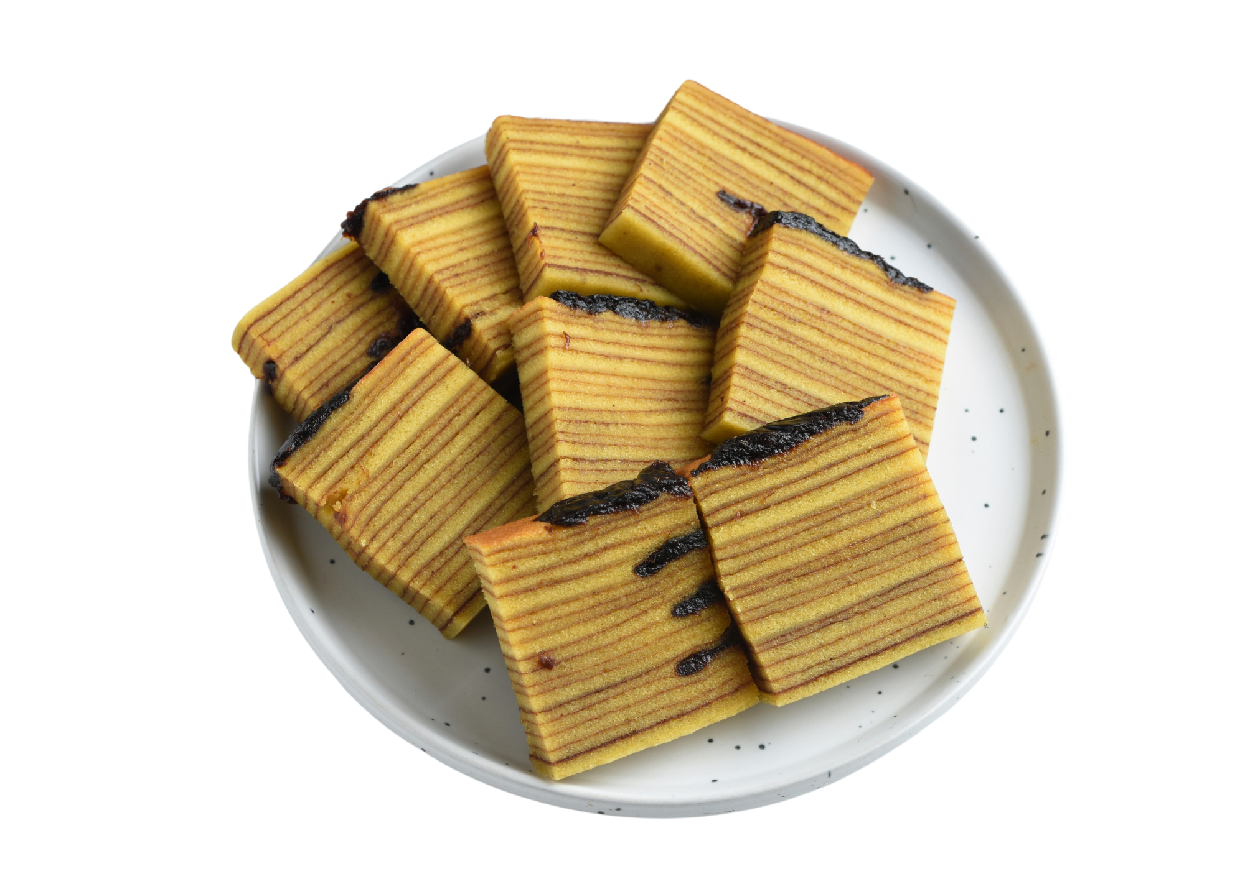
Item 10
Notes:
Teacher asks: Mau beli kue?
Student responds: Ya, saya mau beli kue or Saya tidak mau beli kue.

Slide 19
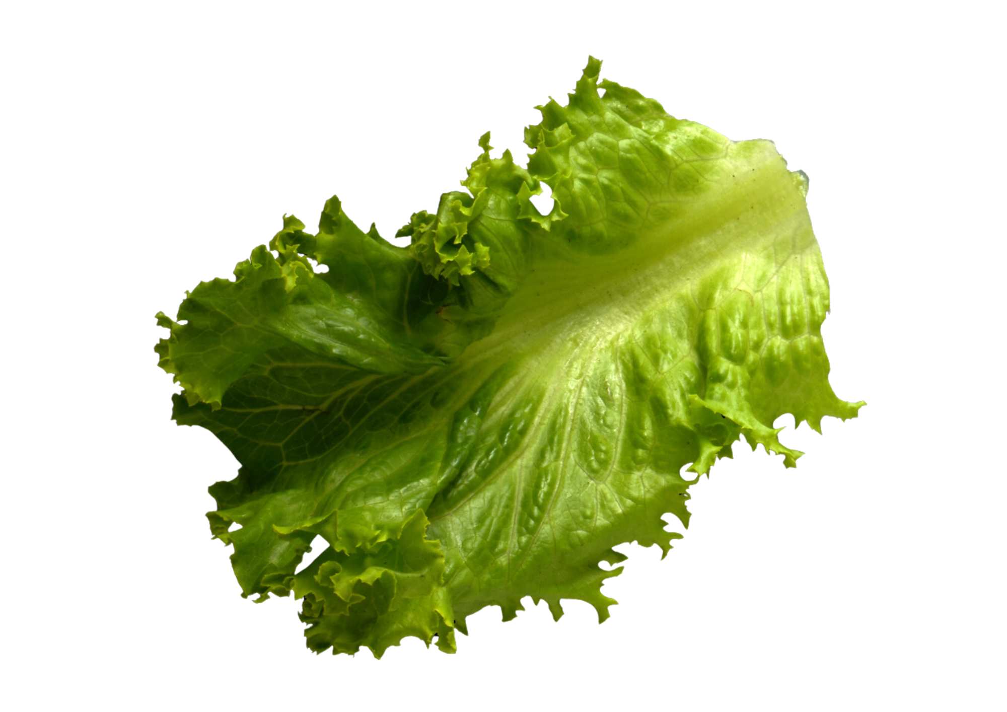
Item 11
Notes:
Teacher asks: Mau beli selada?
Student responds: Ya, saya mau beli selada or Saya tidak mau beli selada.

Slide 20
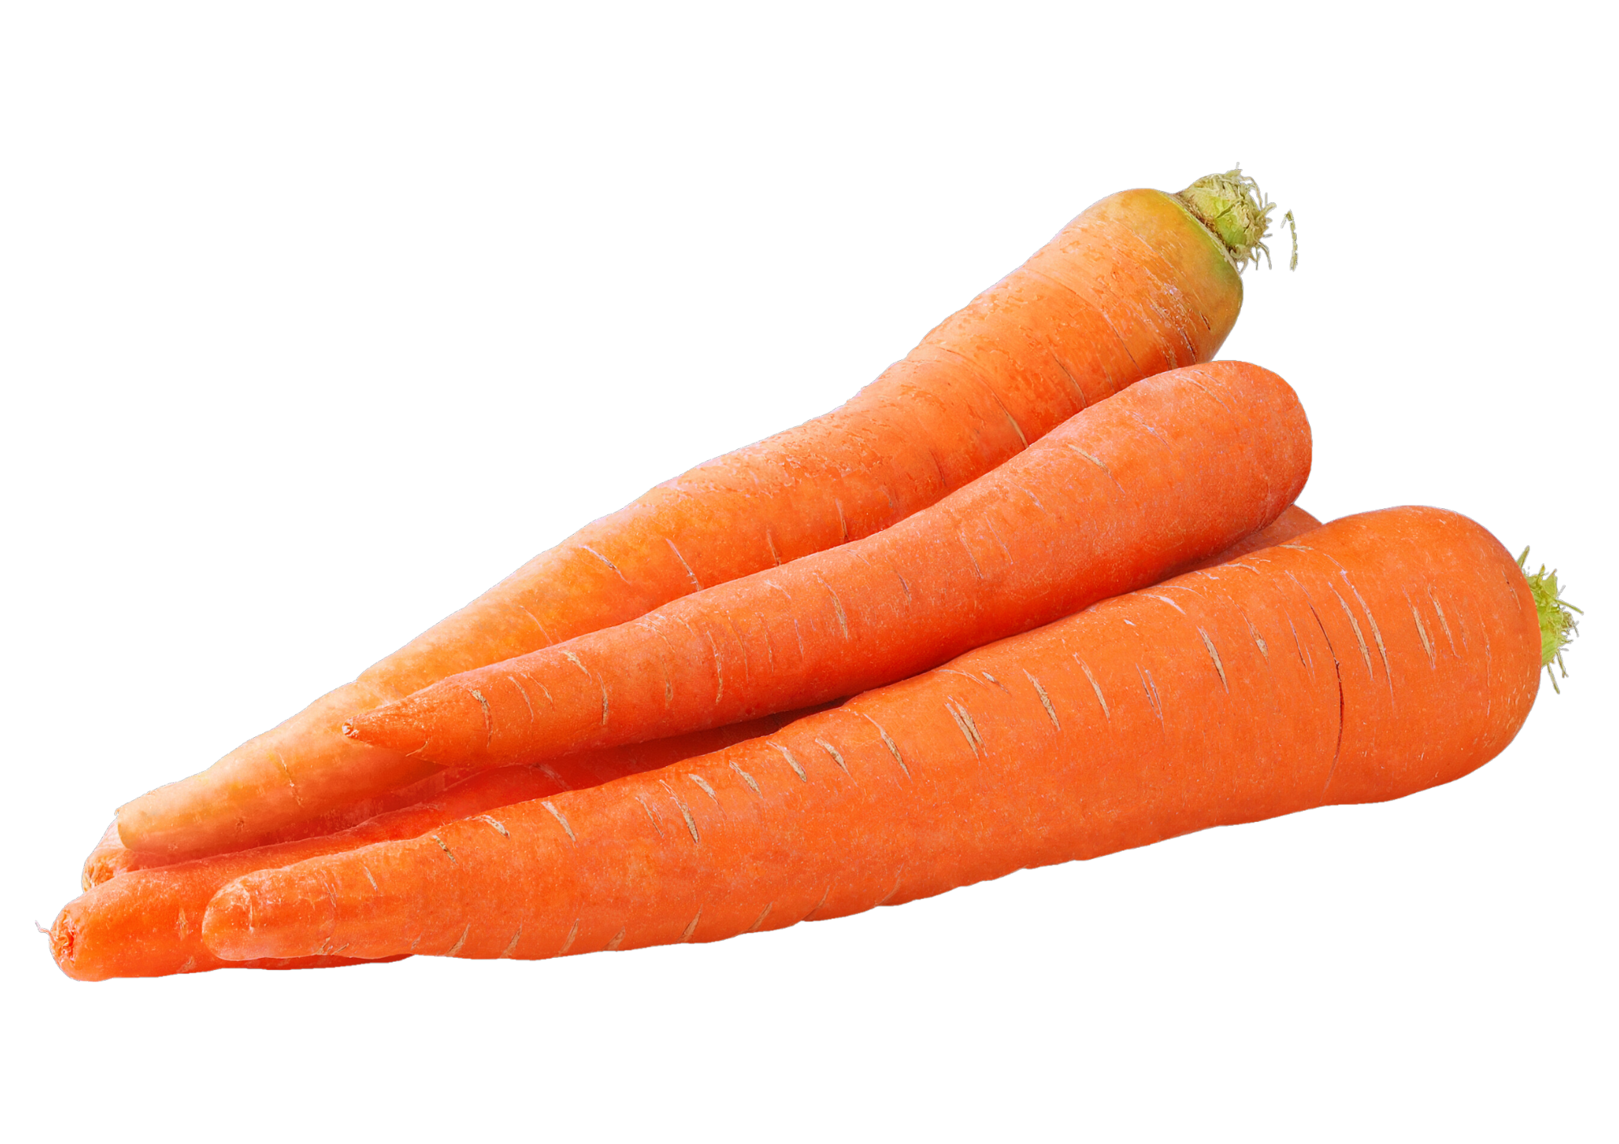
Item 12
Notes:
Teacher asks: Mau beli wortel?
Student responds: Ya, saya mau beli wortel or Saya tidak mau beli wortel.

Slide 21
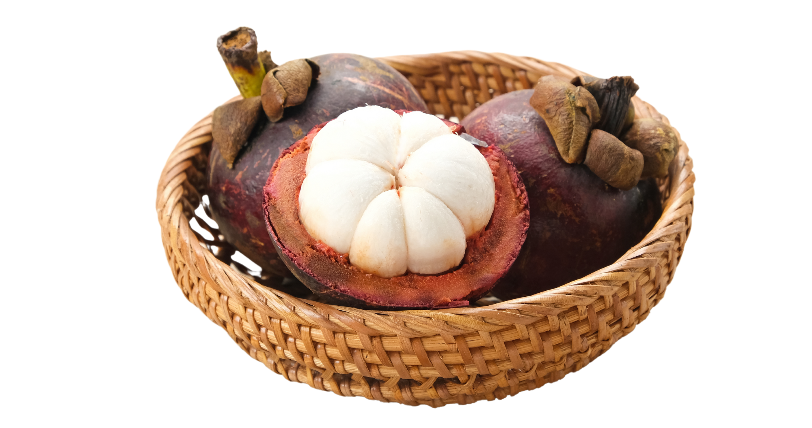
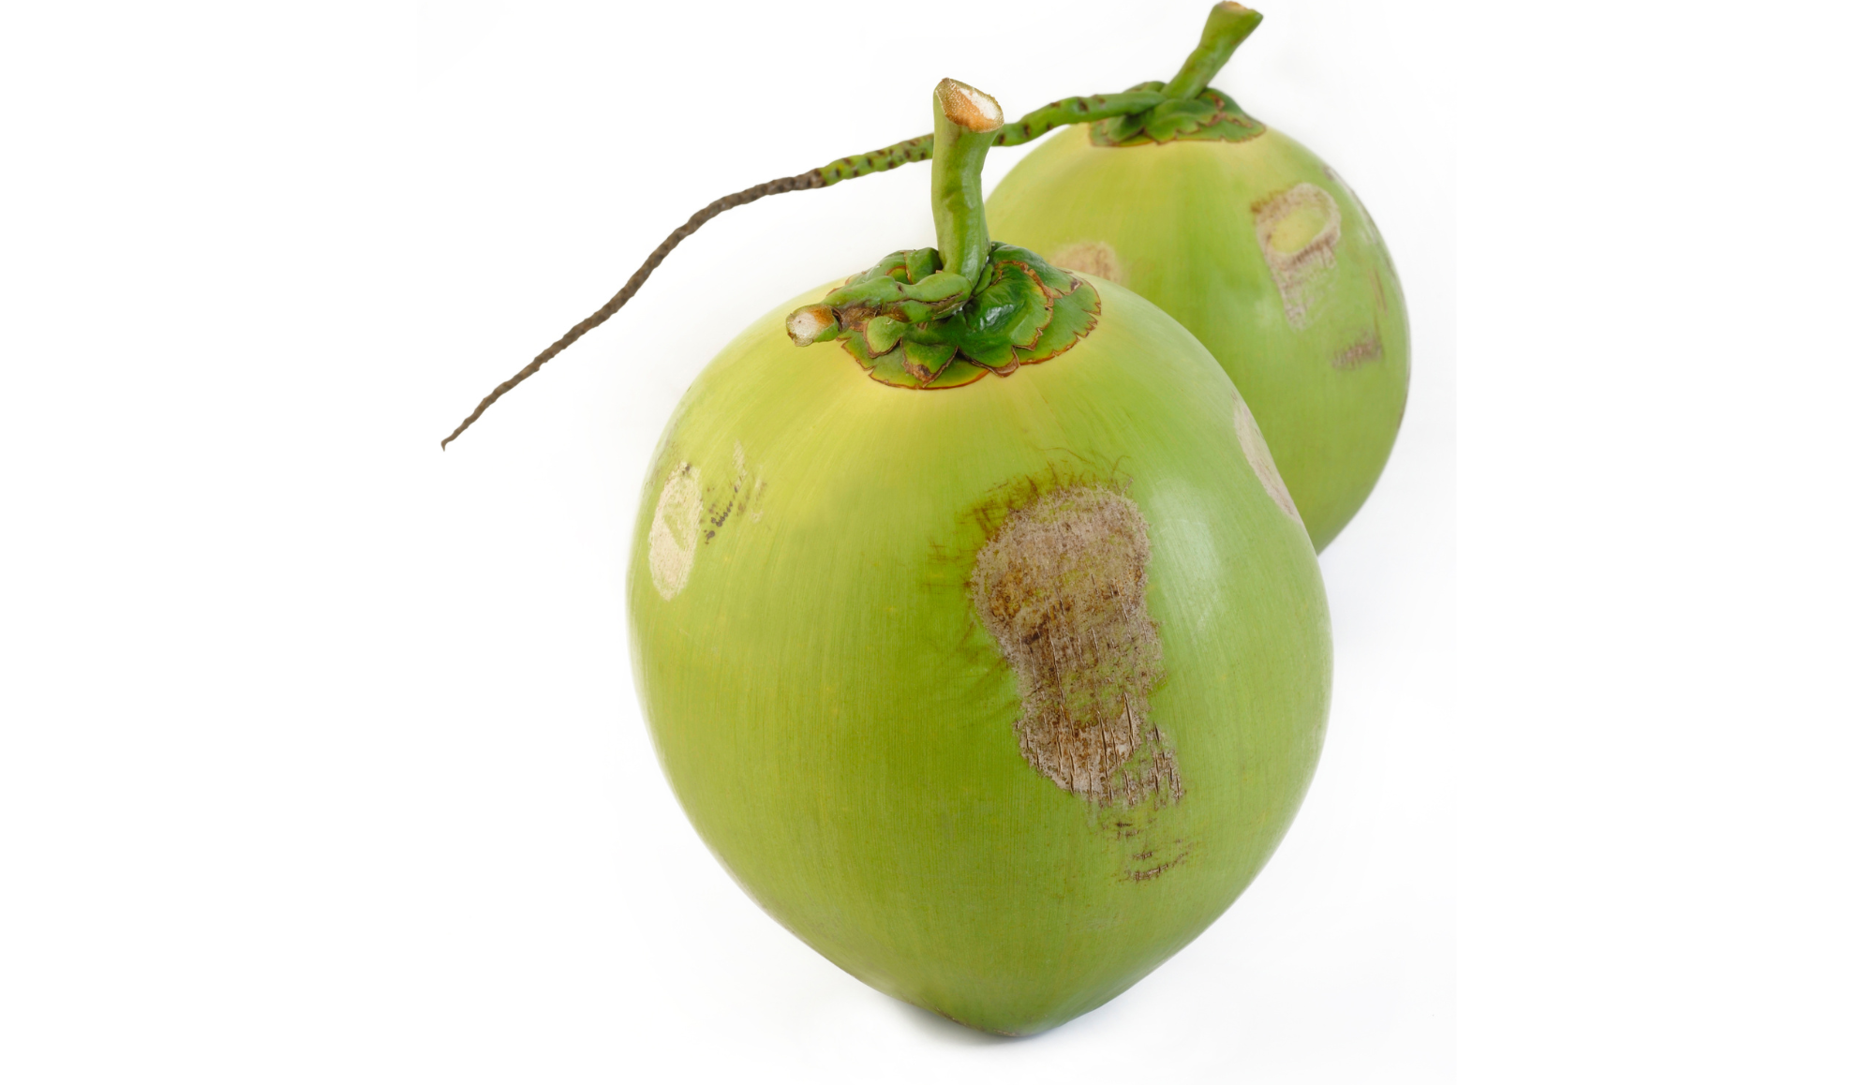
Item 13
Notes:
Teacher asks: Mau beli kelapa dan manggis?
Student responds: Ya, saya mau beli kelapa dan manggis or Ya, saya mau beli kelapa tetapi saya tidak mau beli manggis.

Slide 22
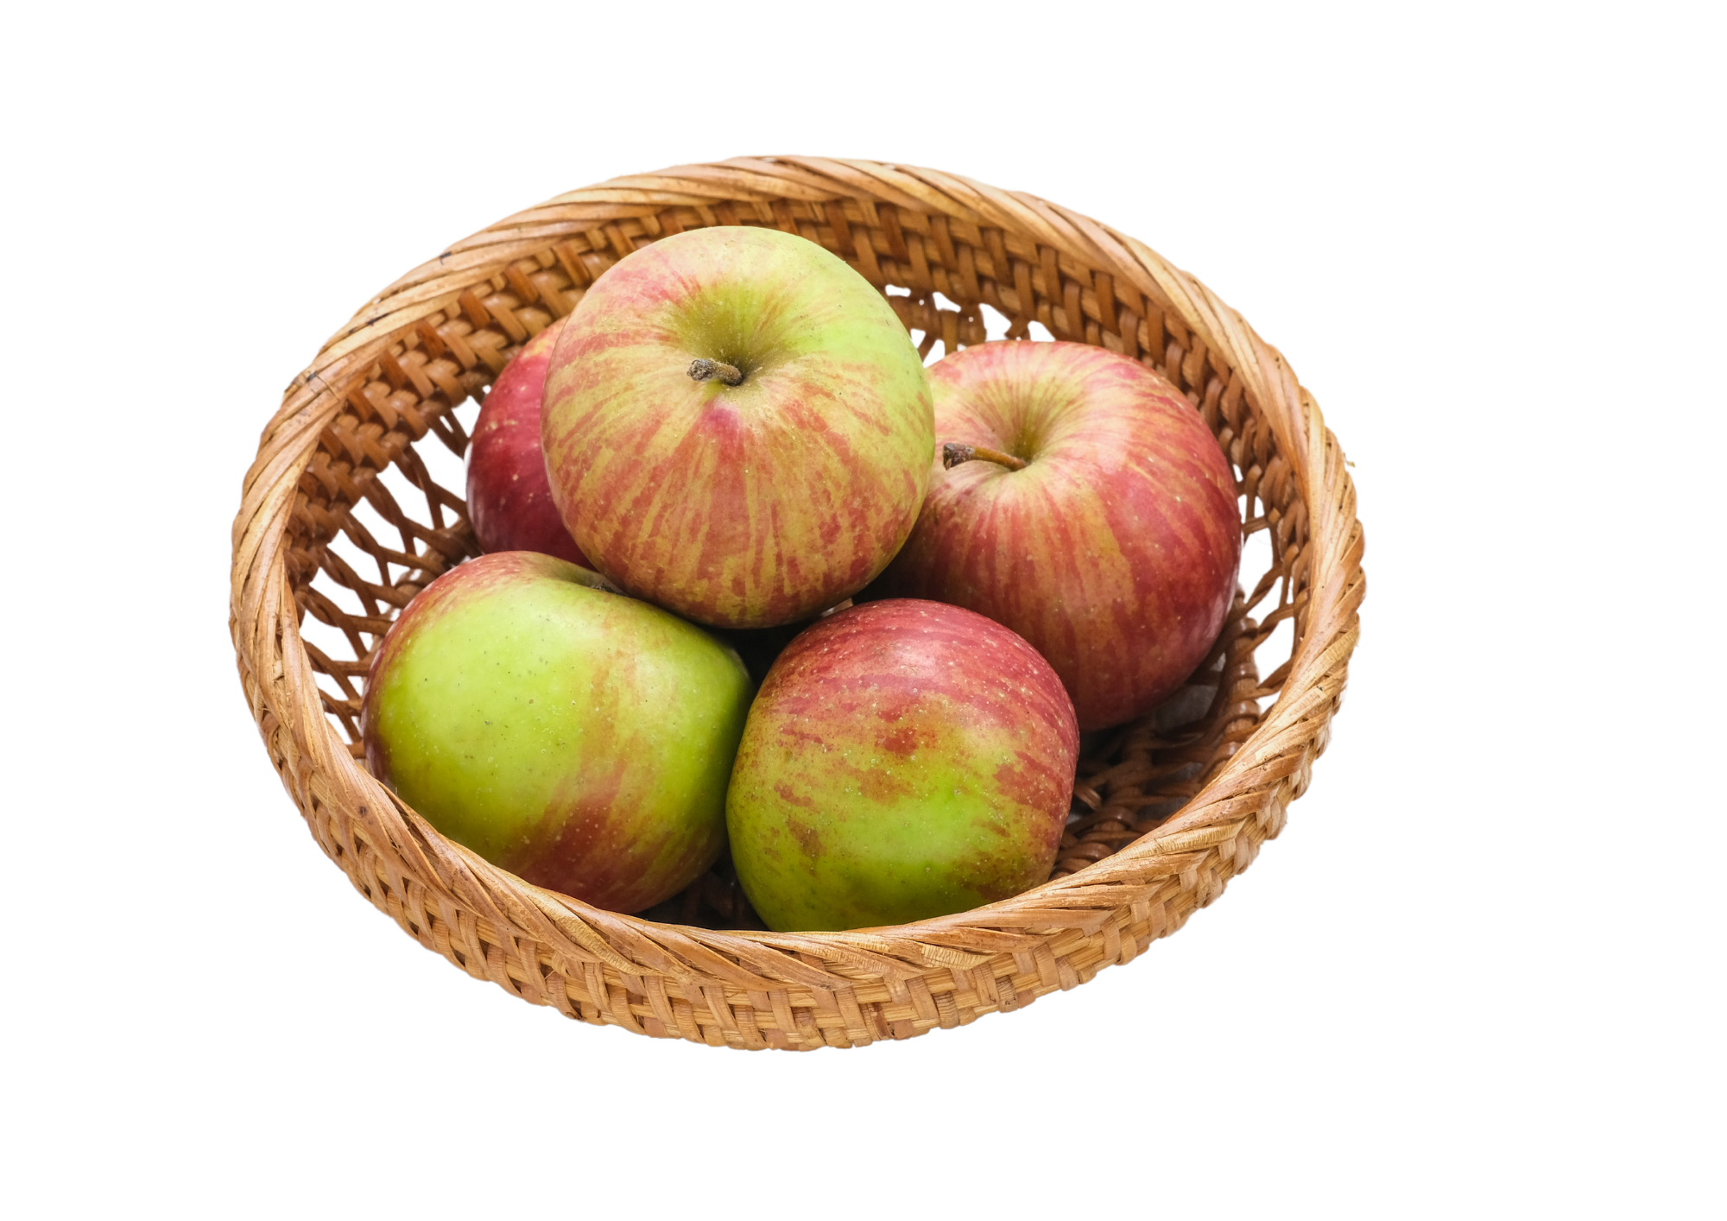
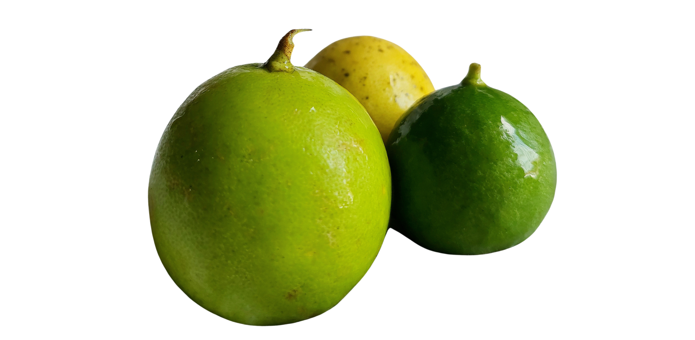
Item 14
Notes:
Teacher asks: Mau beli jeruk dan apel?
Student responds: Ya, saya mau beli jeruk dan apel or Saya mau beli jeruk dan saya juga mau beli apel.

Slide 23
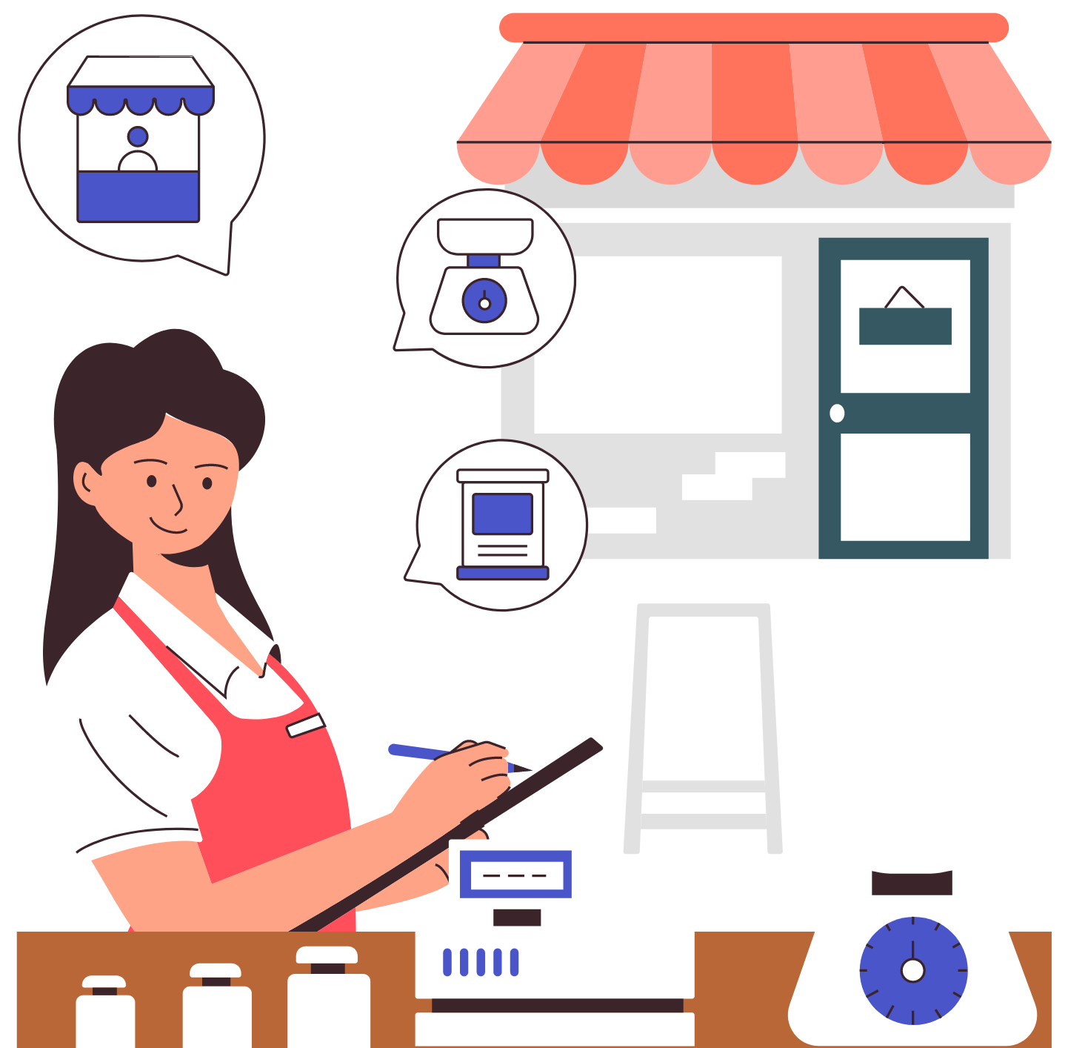
Asking about quantities
How many do you want to buy?
To ask someone ‘how many’ or ‘how much’ of the item they would like to buy when shopping, we need to know the vocabulary below.
berapa, which is a question word meaning ‘how many’ or ‘how much’
units of measurement such as gram (grams) or kilo (kilograms)
For example:
Mau beli berapa durian?
Mau beli berapa gram buncis?
Mau beli berapa kilo rambutan?
Notes:
For the teacher:
Explain to students that berapa is a question word used when asking a question that requires a number in response. Some examples students may already know from prior units include Berapa umurmu? and Jam berapa?.
Depending on the level of students, explain to students that there are also classifier words that are often used in Indonesian when discussing quantities, such as sebuah, sebungkus and seikat. However, the vocabulary and grammar point of classifiers is not covered in this unit of work.
Translations of examples:
How many durian do you want to buy?
How many grams of beans do you want to buy?
How many kilograms of rambutan do you want to buy?

Slide 24
Saying the quantity of items you want to buy
I want to buy [quantity] …
To say how many or how much of the item you would like to buy when shopping, we can use the numbers we already know.
For example:
Saya mau beli dua pepaya.
Saya mau beli lima puluh gram cabe.
Saya mau beli tiga kilo rambutan.
Hati-hati! (Be careful!)
When we want to say ‘one kilogram’ we say sekilo (instead of satu kilo). For example:
Saya mau beli sekilo apel.
Notes:
For the teacher:
Translations of examples:
I want to buy two papayas.
I want to buy 50 grams of chillis.
I want to buy 3 kilograms of rambutan.
I want to buy 1 kilogram of apples.

Slide 25
Let’s practise! Mau beli berapa…?
Use your number card from earlier.
Each slide will display a different food item. Each time the slide changes, a number will be called out in Indonesian. If it is your number, call out Saya!
You will be asked the question Mau beli berapa…?
Respond by saying the quantity of the item you want to buy on the slide. For example, Saya mau beli dua apel or Saya mau beli sekilo apel.
You can determine the quantity by counting the number of items in each picture, or roughly guessing the weight of what is displayed in the picture.
Notes:
For the teacher:
Make sure students still have their number cards from earlier in the slideshow.
As you move through each slide, call out a number in Indonesian (for example, ‘dua belas!’).
The student who has the number 12 card should identify themselves by calling out ‘Saya!’.
Ask the student Mau beli berapa… ? based on the item displayed. For example, if the slide shows a picture of 3 apples, ask Mau beli berapa apel?
The student should respond by saying they want to buy the quantity of the item/s displayed on the slide. For example, Saya mau beli 3 apel. Encourage students to give an accurate quantity based on the picture, either by counting or roughly guessing the weight.
After moving through the 6 item slides, return to the beginning again. This time, have students work in pairs and follow the same pattern. Display each slide and students take turns asking each other Mau beli berapa… ? and responding in Indonesian.

Slide 26
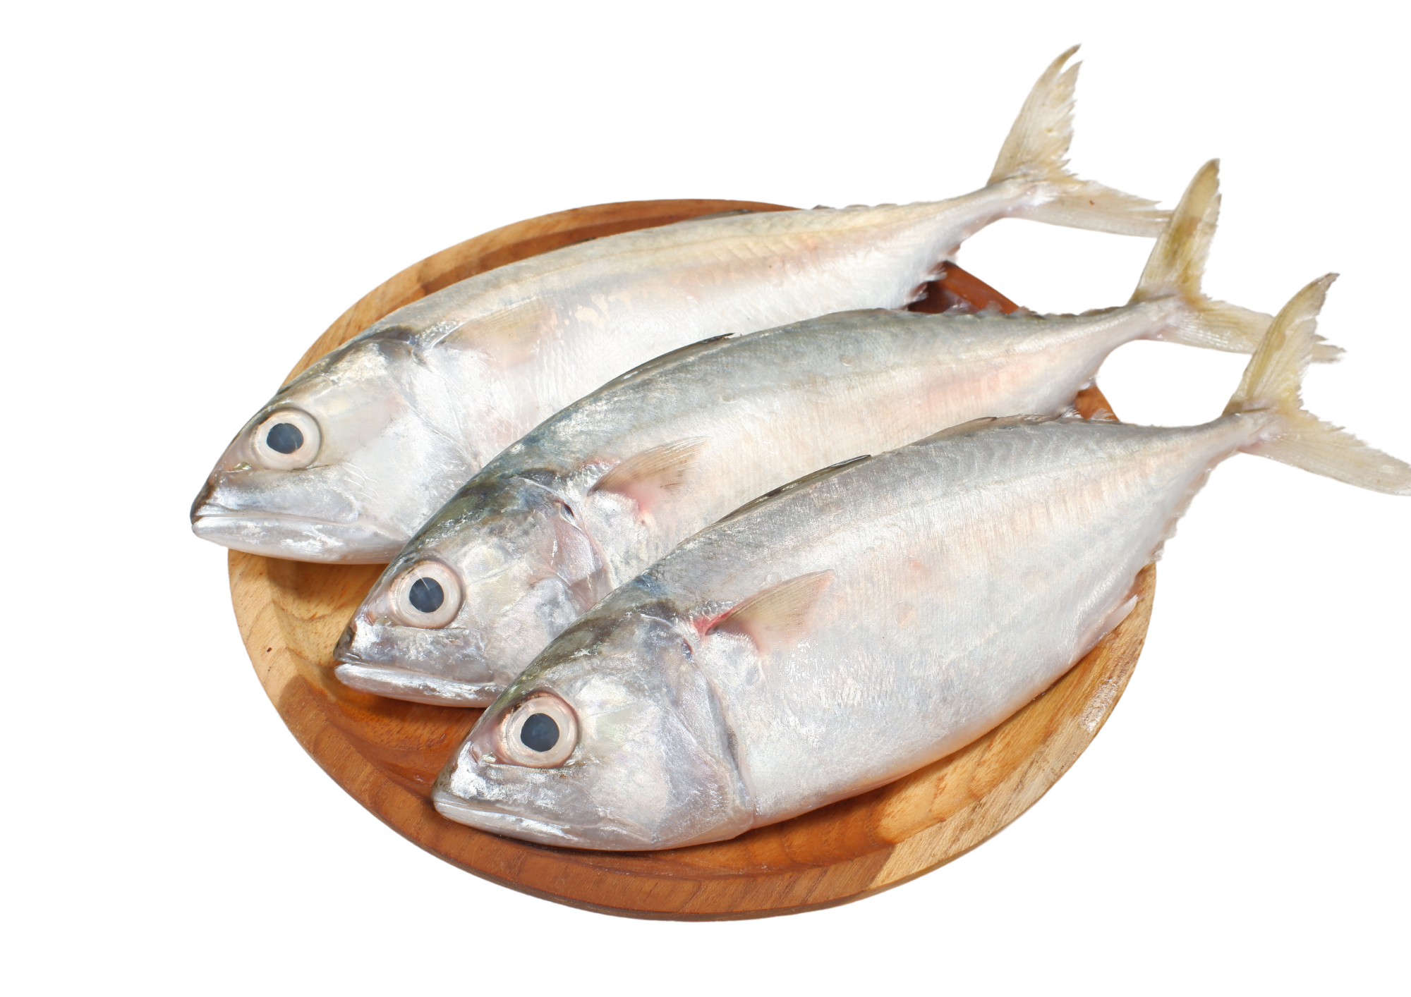
Item 15
Notes:
Teacher asks: Mau beli berapa ikan?
Student responds: Saya mau beli tiga ikan.

Slide 27
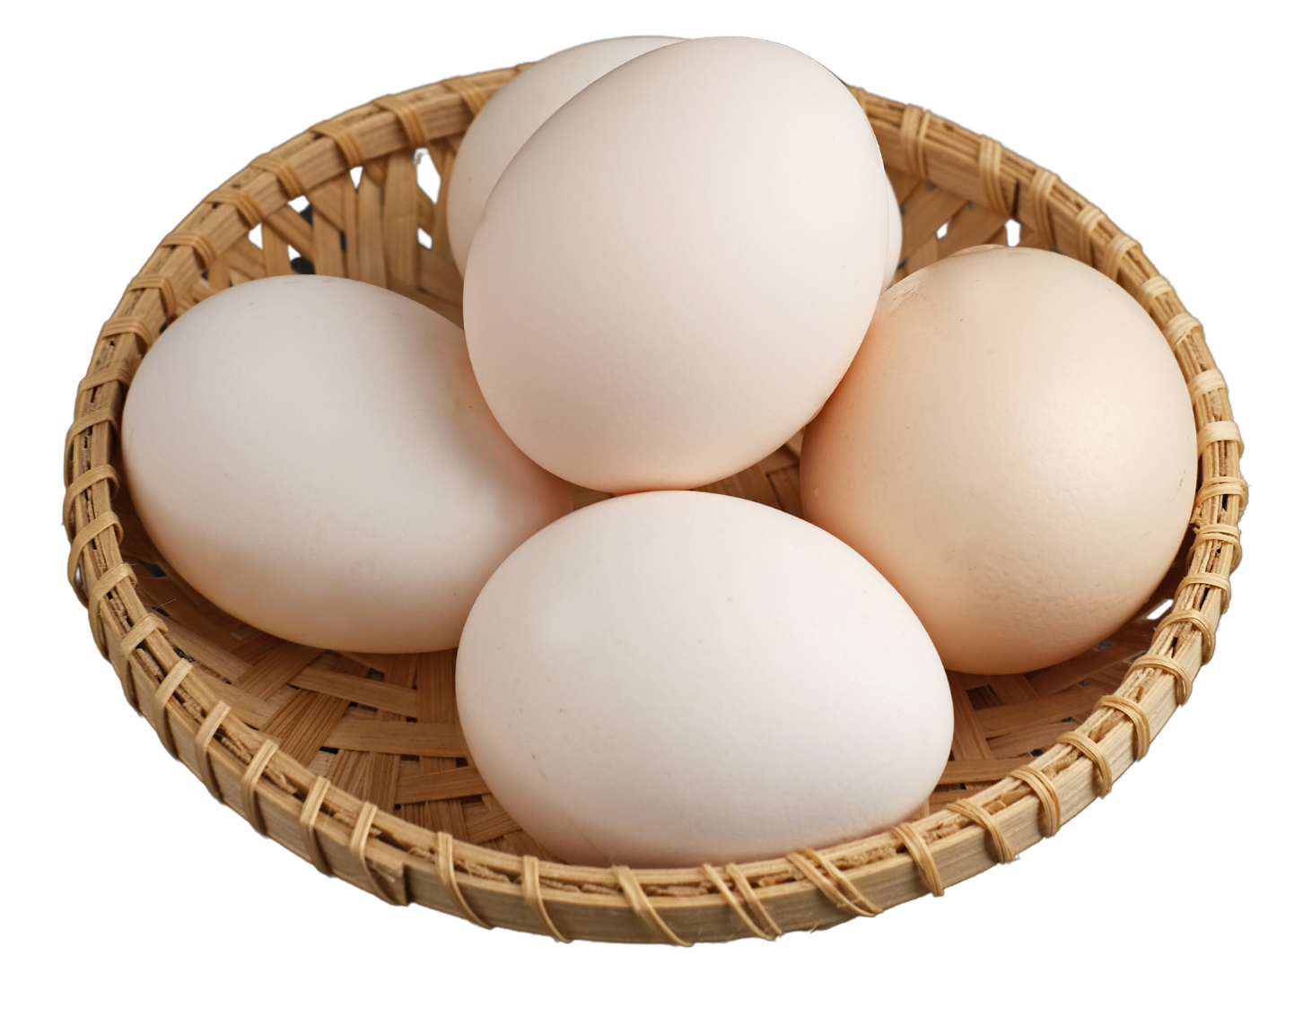
Item 16
Notes:
Teacher asks: Mau beli berapa telur?
Student responds: Saya mau beli lima ikan.

Slide 28
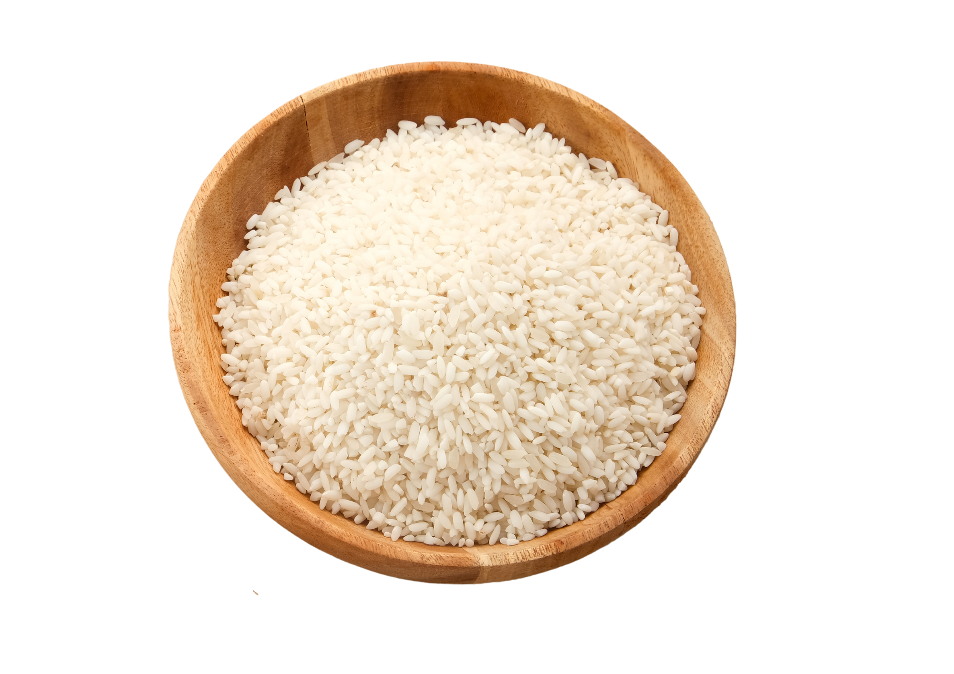
Item 17
Notes:
Teacher asks: Mau beli berapa kilo beras?
Student responds: Saya mau beli sekilo beras.

Slide 29
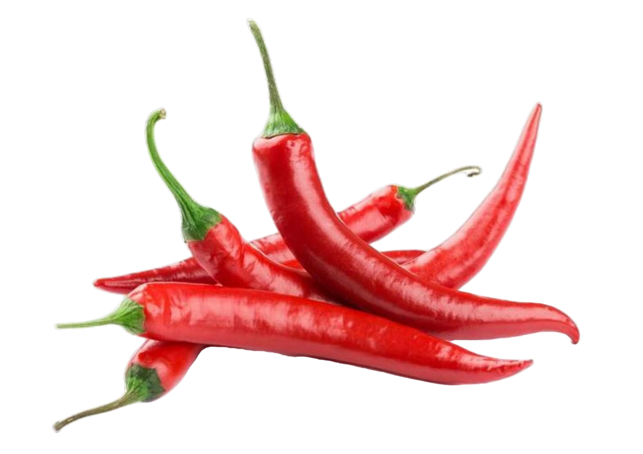
Item 18
Notes:
Teacher asks: Mau beli berapa gram cabe?
Student responds: Saya mau beli lima puluh gram cabe.

Slide 30
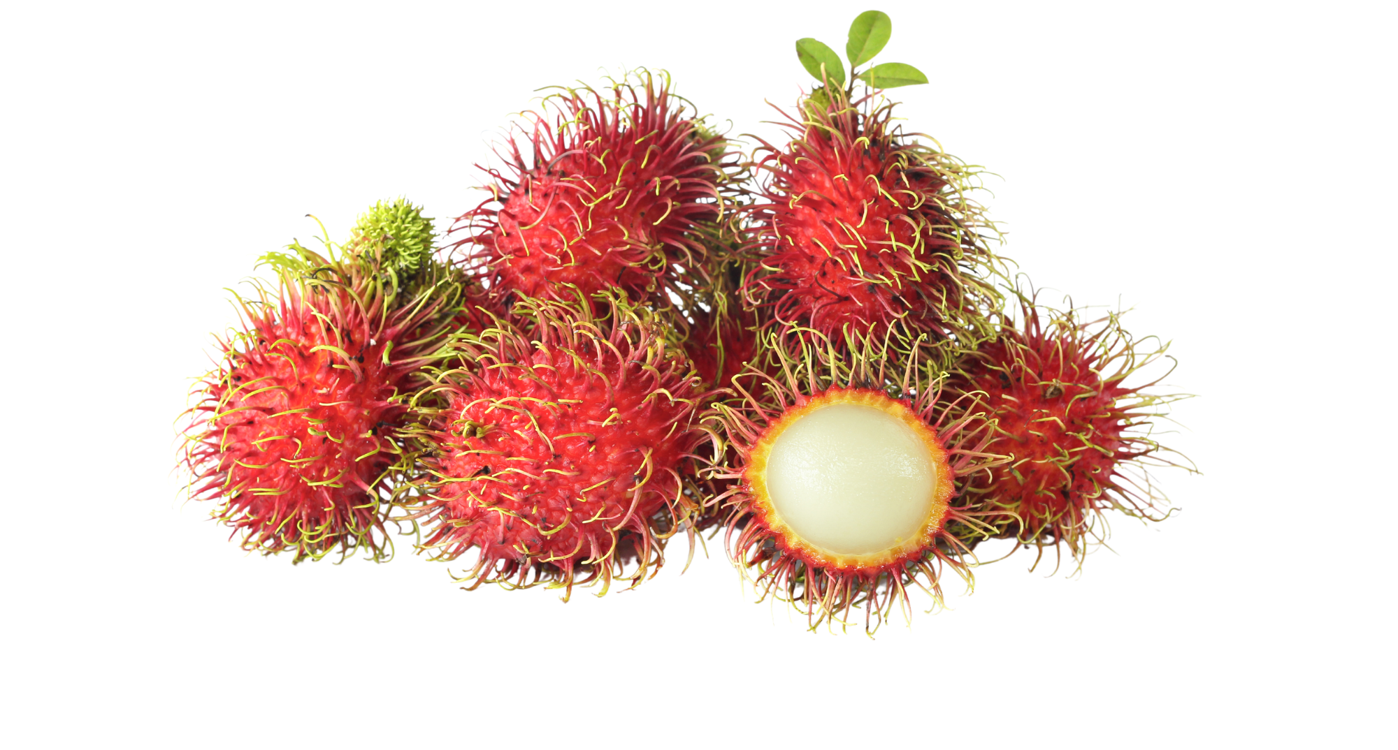
Item 19
Notes:
Teacher asks: Mau beli berapa kilo rambutan?
Student responds: Saya mau beli sekilo rambutan.

Slide 31
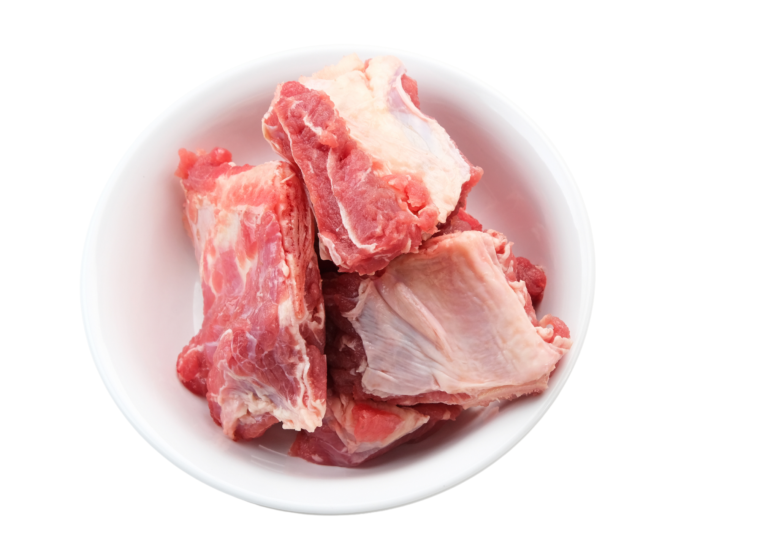
Item 20
Notes:
Teacher asks: Mau beli berapa kilo daging?
Student responds: Saya mau beli dua kilo daging.

Slide 32
Copyright
© State of New South Wales (Department of Education), 2024
The copyright material published in this resource is subject to the Copyright Act 1968 (Cth) and is owned by the NSW Department of Education or, where indicated, by a party other than the NSW Department of Education (third-party material).
Copyright material available in this resource and owned by the NSW Department of Education is licensed under a Creative Commons Attribution 4.0 International (CC BY 4.0) license.
This license allows you to share and adapt the material for any purpose, even commercially.
Attribution should be given to © State of New South Wales (Department of Education), 2024.
Material in this resource not available under a Creative Commons license:
the NSW Department of Education logo, other logos and trademark-protected material
Material owned by a third party that has been reproduced with permission. You will need to obtain permission from the third party to reuse its material.
Links to third-party material and websites
Please note that the provided (reading/viewing material/list/links/texts) are a suggestion only and implies no endorsement, by the New South Wales Department of Education, of any author, publisher, or book title. School principals and teachers are best placed to assess the suitability of resources that would complement the curriculum and reflect the needs and interests of their students.
If you use the links provided in this document to access a third party’s website, you acknowledge that the terms of use, including licence terms set out on the third-party’s website apply to the use which may be made of the materials on that third-party website or where permitted by the Copyright Act 1968 (Cth). The department accepts no responsibility for content on third-party websites.
Notes:
Slide not shared

