Slide 1
Multiple cubes
Explicit teaching

Slide 2
Launch

Slide 3
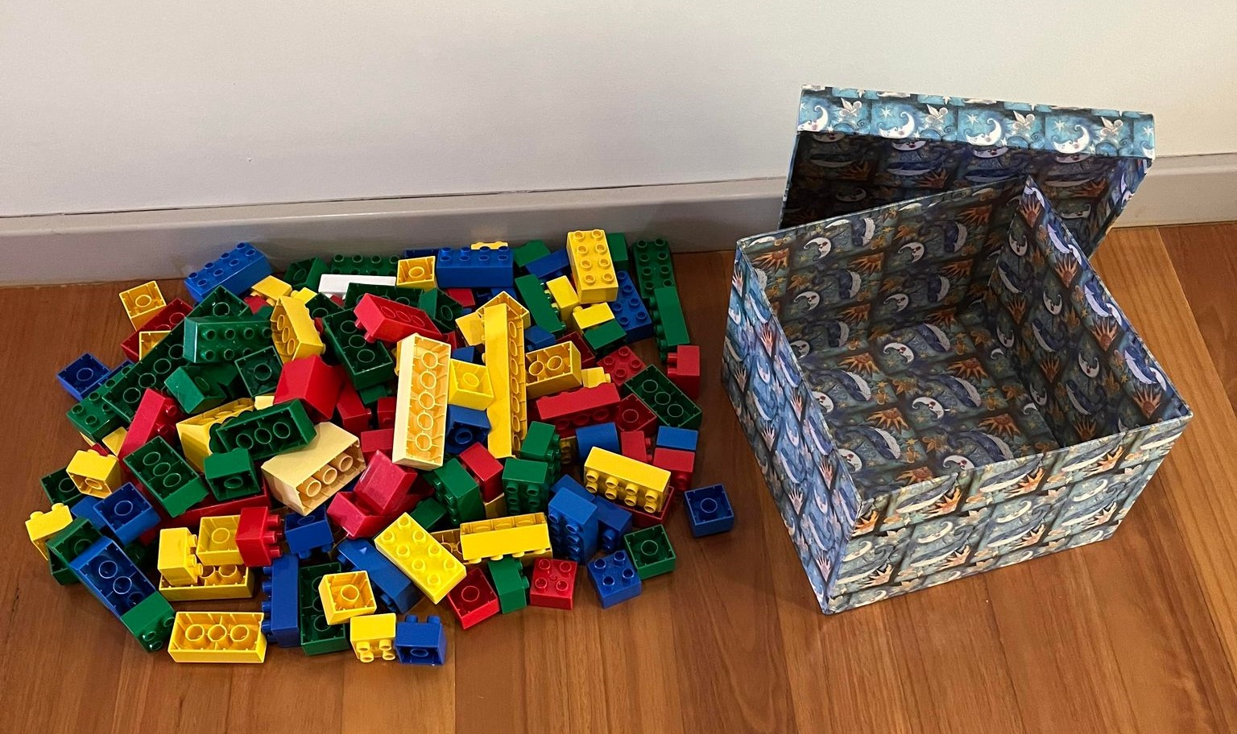
Multiple cubes (1)
Colourful blocks
What do you notice?
What do you wonder?

Slide 4
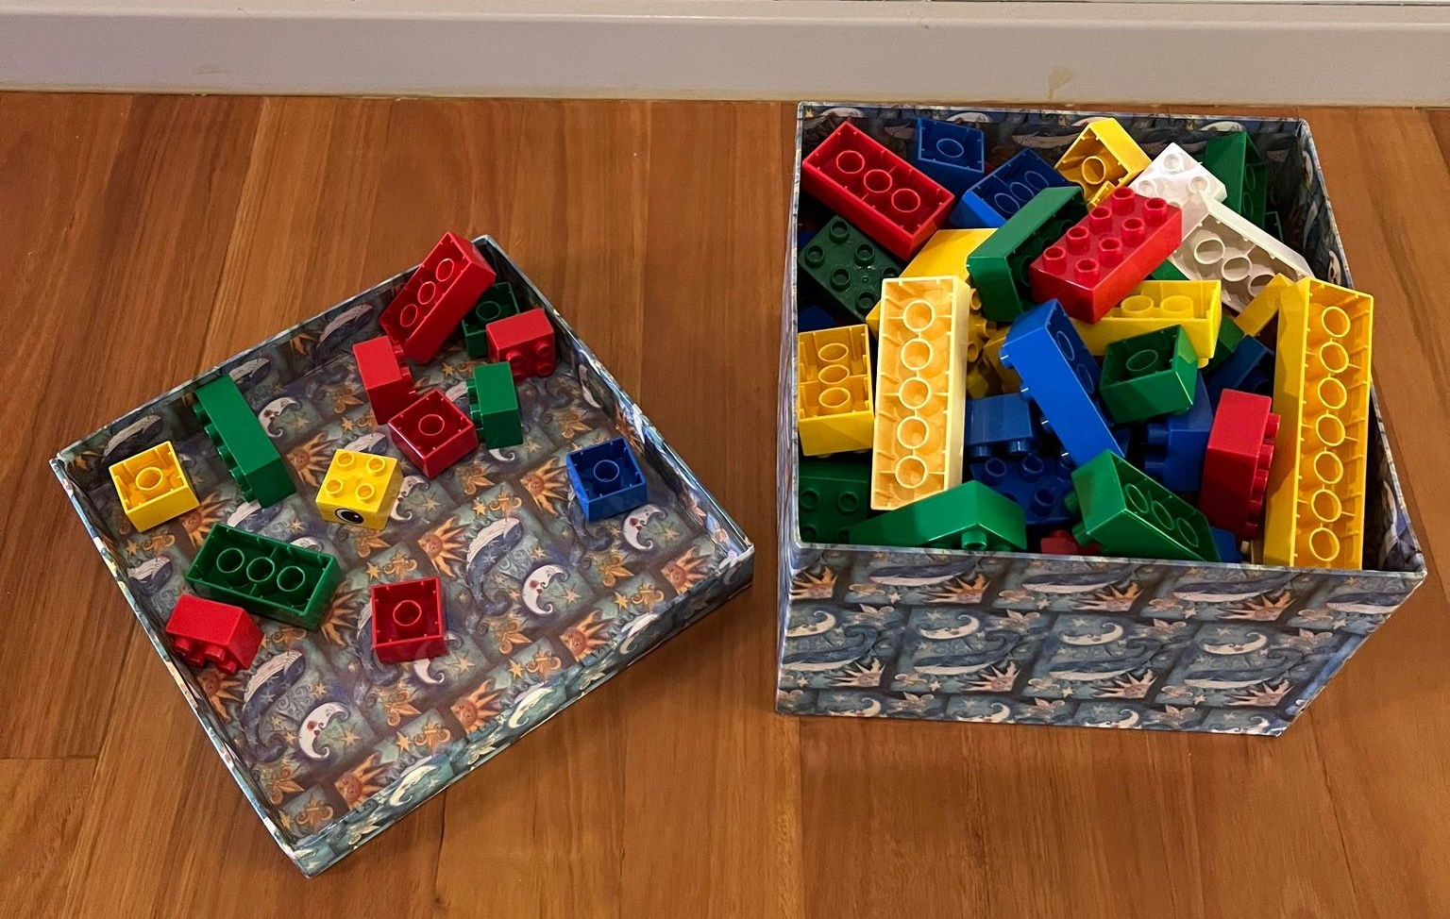
Multiple cubes (2)
Colourful blocks
What do you notice?
What do you wonder?

Slide 5
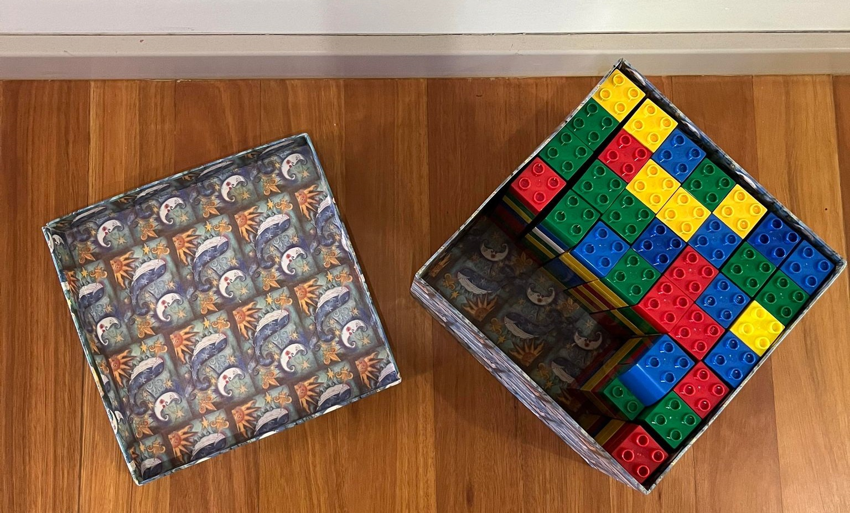
Multiple cubes (3)
Colourful blocks
What do you notice?
What do you wonder?

Slide 6
Summarise

Slide 7
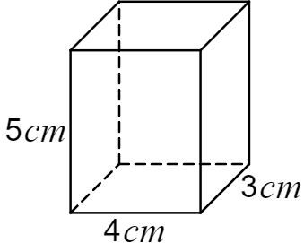
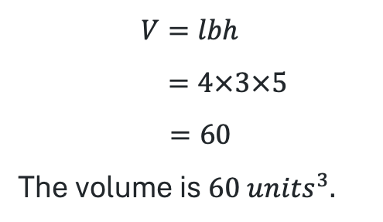
Multiple cubes (4)
Example 1
Calculate the volume of the rectangular prism.
$$V=lbh \\ =4×3×5$$
$$=60$$
The volume is $60 {units}^{3}.$

Slide 8
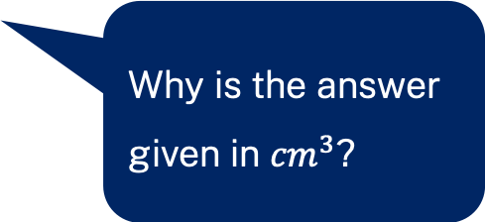
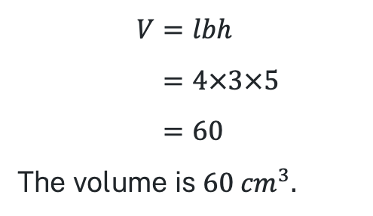
Multiple cubes (5)
Example 1 self-explanation prompts
Calculate the volume of the rectangular prism.
How else could this be written?
$$V=lbh \\ =4×3×5 \\ =60$$
The volume is $60 {cm}^{3}.$
Why is the answer given in ${cm}^{3}$?

Slide 9
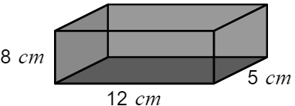
Multiple cubes (6)
Your turn – question 1
Calculate the volume of the rectangular prism.

Slide 10
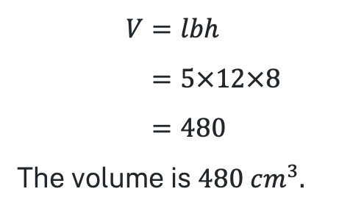
Multiple cubes (7)
Your turn – solution 1
Calculate the volume of the rectangular prism.
$$V=lbh \\ =5×12×8 \\ =480$$
The volume is $480 {cm}^{3}.$

Slide 11
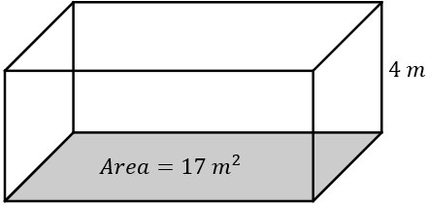
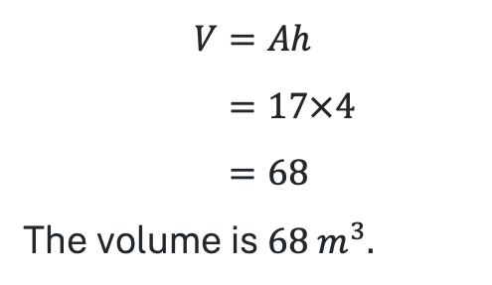
Multiple cubes (8)
Example 2
Calculate the volume of the rectangular prism.
$$V=Ah \\ =17×4 \\ =68$$
The volume is $68 m^{3}.$

Slide 12
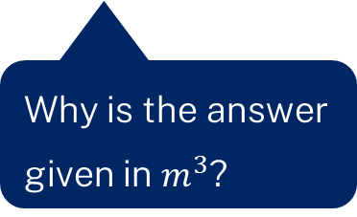
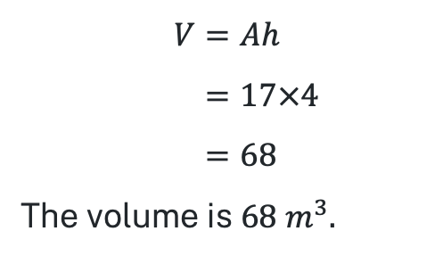
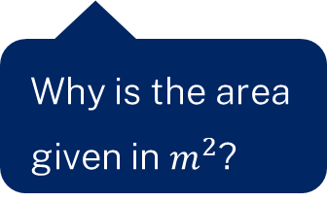
Multiple cubes (9)
Example 2 self-explanation prompts
Calculate the volume of the rectangular prism.
$$V=Ah \\ =17×4 \\ =68$$
The volume is $68 m^{3}.$
Why is the answer given in $m^{3}$?
Why is the area given in $m^{2}$?

Slide 13
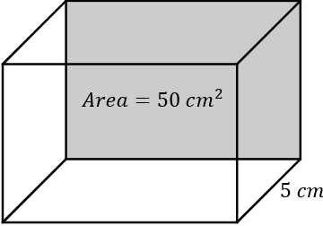
Multiple cubes (10)
Your turn – question 2
Calculate the volume of the rectangular prism.

Slide 14
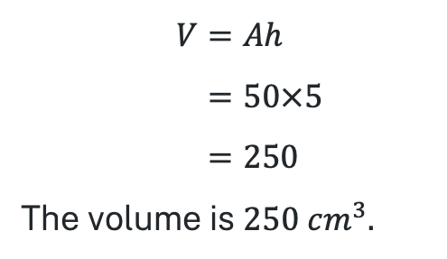
Multiple cubes (11)
Your turn – solution 2
Calculate the volume of the rectangular prism.
$$V=Ah \\ =50×5 \\ =250$$
The volume is $250 {cm}^{3}.$

Slide 15
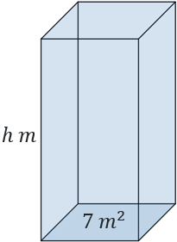


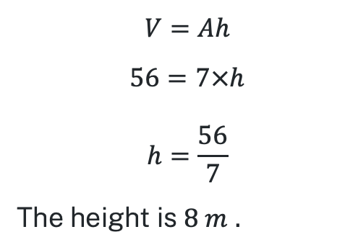
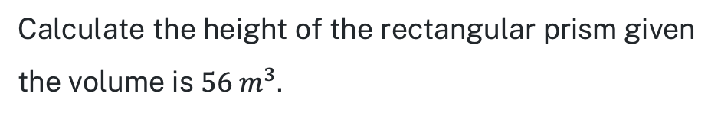
Multiple cubes (12)
Example 3
Calculate the height of the rectangular prism given the volume is $56 m^{3}$.
$$V=Ah$$
$$56=7×h$$
$$h=\frac{56}{7}$$
The height is $8 m$ $.$

Slide 16

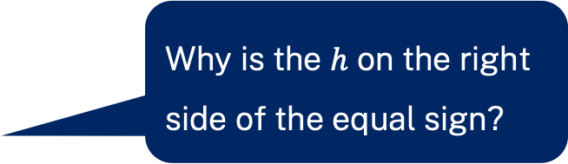
Multiple cubes (13)
Example 3 self-explanation prompts
Calculate the height of the rectangular prism given the volume is $56 m^{3}$.
Why is the $h$ on the right side of the equal sign?
$$V=Ah$$
$$56=7×h$$
$$h=\frac{56}{7}$$
The height is $8 m.$
How else could we write this?

Slide 17
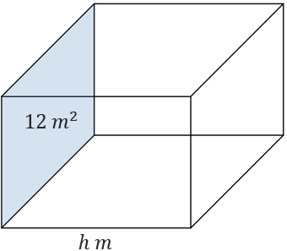

Multiple cubes (14)
Your turn – question 3
Calculate the length of the rectangular prism if the volume is $60 m^{3}.$

Slide 18


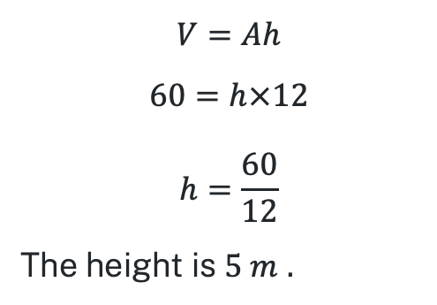
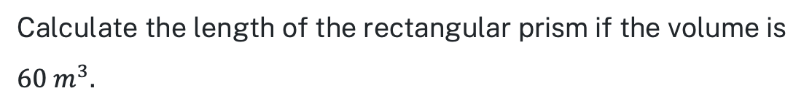
Multiple cubes (15)
Your turn – solution 3
Calculate the length of the rectangular prism if the volume is $60 m^{3}.$
$$V=Ah$$
$$60=h×12$$
$$h=\frac{60}{12}$$
The height is $5 m$ $.$

Slide 19
Copyright
© State of New South Wales (Department of Education), 2024
The copyright material published in this resource is subject to the Copyright Act 1968 (Cth) and is owned by the NSW Department of Education or, where indicated, by a party other than the NSW Department of Education (third-party material).
Copyright material available in this resource and owned by the NSW Department of Education is licensed under a Creative Commons Attribution 4.0 International (CC BY 4.0) license.
This license allows you to share and adapt the material for any purpose, even commercially.
Attribution should be given to © State of New South Wales (Department of Education), 2024.
Material in this resource not available under a Creative Commons license:
the NSW Department of Education logo, other logos and trademark-protected material
Material owned by a third party that has been reproduced with permission. You will need to obtain permission from the third party to reuse its material.
Links to third-party material and websites
Please note that the provided (reading/viewing material/list/links/texts) are a suggestion only and implies no endorsement, by the New South Wales Department of Education, of any author, publisher, or book title. School principals and teachers are best placed to assess the suitability of resources that would complement the curriculum and reflect the needs and interests of their students.
If you use the links provided in this document to access a third party’s website, you acknowledge that the terms of use, including licence terms set out on the third-party’s website apply to the use which may be made of the materials on that third-party website or where permitted by the Copyright Act 1968 (Cth). The department accepts no responsibility for content on third-party websites.

