Slide 1
Fuel
Explicit teaching

Slide 2
Explore

Slide 3
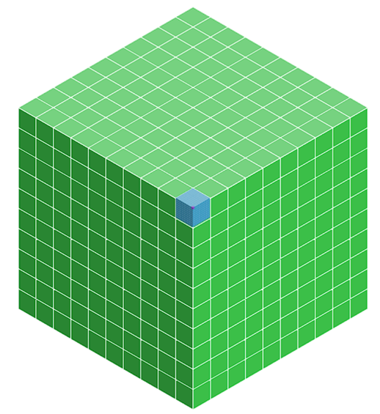
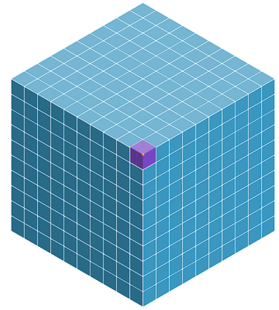
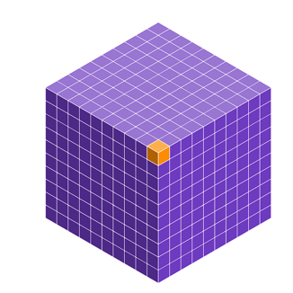





Conversions (1)
mL to ML
$$1 mL$$
$$1000 mL=1 L$$
$$1000 L=1 kL$$
$$1000 kL=1 ML$$

Slide 4
Conversions (2)
mL to ML
$$1 mL$$
$$1000 mL=1 L$$
$$1000 L=1 kL$$
$$1000 kL=1 ML$$
Explain why 1.5L is a larger number of ml?
Explain why 100 kL is a smaller number of ML?

Slide 5
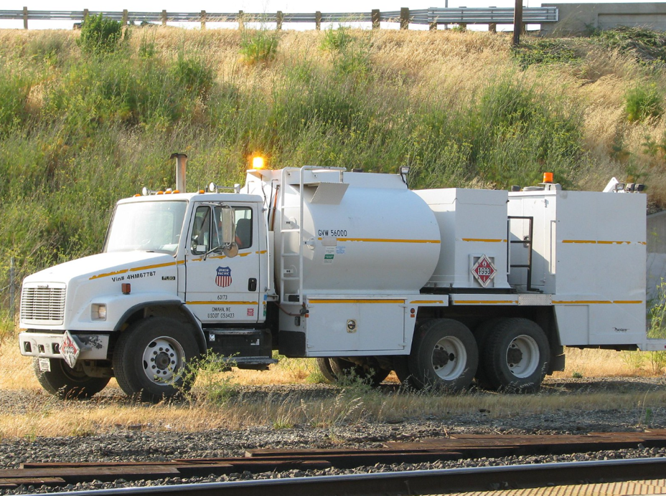
How much fuel? (1)
Tanker 1
‘Union Pacific 63173 Freightliner FL80 Fuel Truck 2’ by Jack Snell is licenced under CC BY-NC-SA 2.0.

Slide 6
How much fuel? (2)
Tanker 1
3800 L
‘Union Pacific 63173 Freightliner FL80 Fuel Truck 2’ by Jack Snell is licenced under CC BY-NC-SA 2.0.

Slide 7
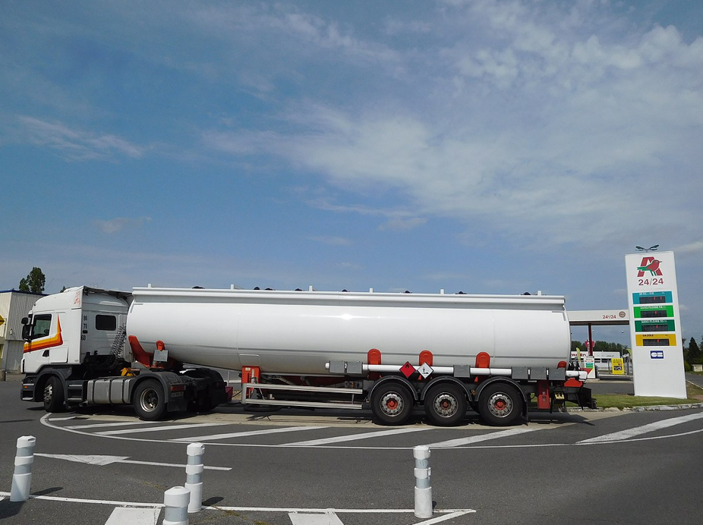
How much fuel? (3)
Tanker 2
‘Scania R440, fuel tank truck’ by Cjp25 is licenced under CC BY-SA 4.0.

Slide 8
How much fuel? (4)
Tanker 2
43.9 kL
‘Scania R440, fuel tank truck’ by Cjp25 is licenced under CC BY-SA 4.0.

Slide 9
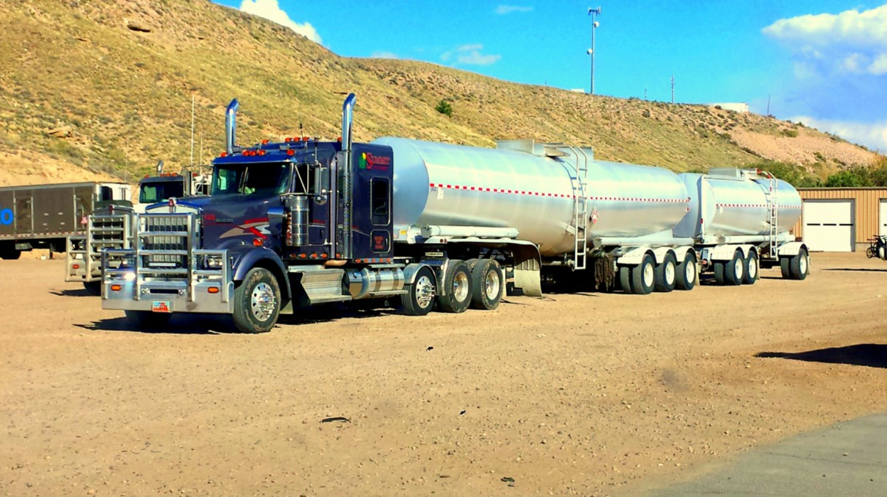
How much fuel? (5)
Tanker 3
‘PxHere’ by unknown author is licenced under CC0 1.0

Slide 10
How much fuel? (6)
Tanker 3
98 .4 kL
‘PxHere’ by unknown author is licenced under CC0 1.0

Slide 11
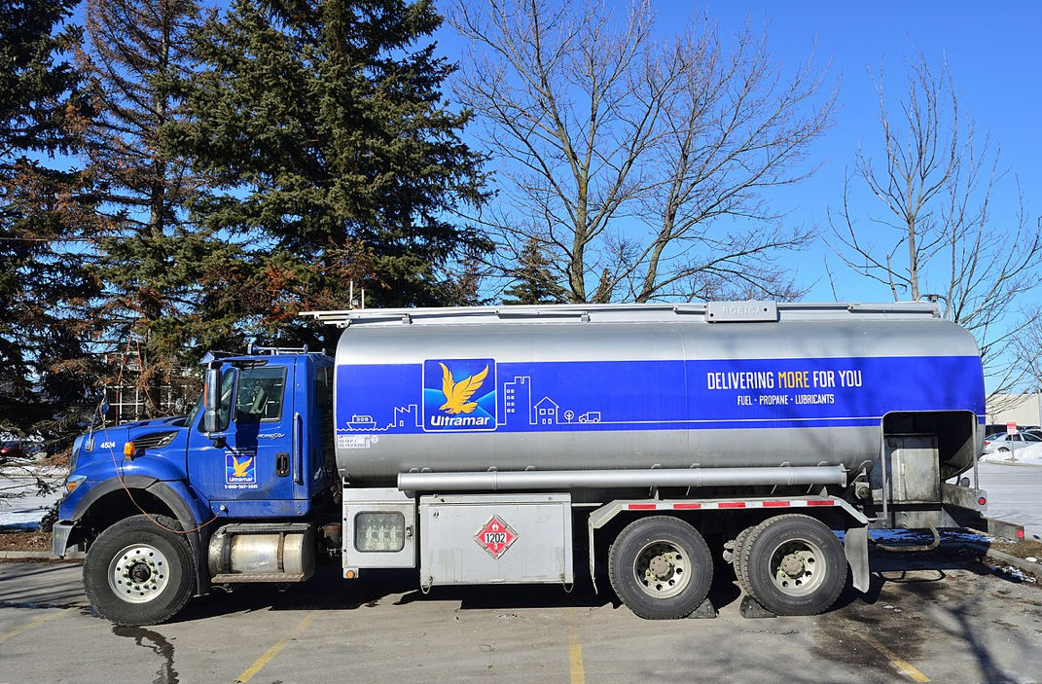
How much fuel? (7)
Tanker 4
‘Ultramar Fuel Truck’ by Raysonho is licenced under CC0 1.0.

Slide 12
How much fuel? (8)
Tanker 4
15.8 kL
‘Ultramar Fuel Truck’ by Raysonho is licenced under CC0 1.0.

Slide 13
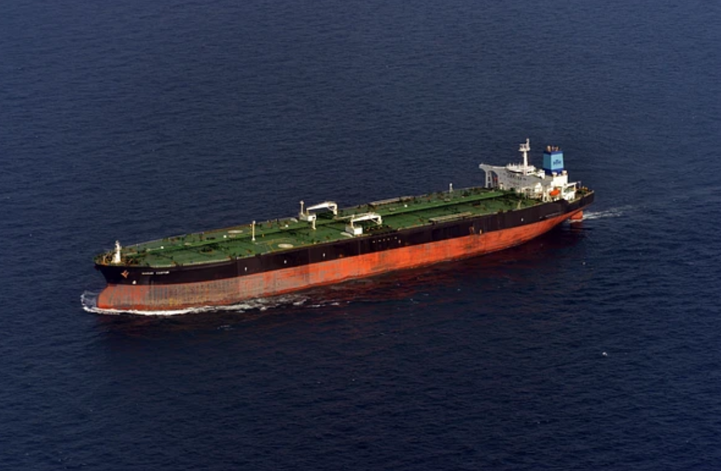
How much fuel? (9)
Tanker 5
‘Oil Tanker Image’ by rawpizel is licenced under CC0 1.0 Deed.

Slide 14
How much fuel? (10)
Tanker 5
238 ML
‘Oil Tanker Image’ by rawpizel is licenced under CC0 1.0 Deed.

Slide 15
Summarise

Slide 16

Conversion (3)
Example 1
A jumbo jet has a fuel capacity of 17 500 000 L.
a) How much is this in kilolitres?
17 500 000 L = 17 500 000 $÷$ 1000 kL
= 17 500 kL
b) How much is this in megalitres?
17 500 kL = 17 500 $÷$ 1000 ML
= 17.5 ML

Slide 17

Conversion (4)
Example 1 – self-explanation prompts
A jumbo jet has a fuel capacity of 17 500 000 L.
a) How much is this in kilolitres?
17 500 000 L = 17 500 000 $÷$ 1000 kL
= 17 500 kL
b) How much is this in megalitres?
17 500 kL = 17 500 $÷$ 1000 ML
= 17.5 ML
Why did we divide by 1000?
Can you think of a quick method of dividing by 1000?

Slide 18
Conversion (5)
Your turn – question 1
A large dam holds 14 670 000 L of water.
How many kilolitres does the dam hold?
How many megalitres does the dam hold?
…………………………………………………………………

Slide 19

Conversion (6)
Your turn – solution 1
A large dam holds 14 670 000 L of water.
a) How many kilolitres does the dam hold?
14 670 000 L = 14 670 000 $÷$ 1000 kL
= 14 670 kL
b) How many megalitres does the dam hold?
14 670 kL = 14 670 $÷$ 1000 ML
= 14.67 ML

Slide 20
Conversion (7)
Example 2
A jumbo jet has a fuel capacity of 0.98 ML.
a) How many kilolitres of fuel does it hold?
0.98 ML = 0.98 x 1000 kL
= 980 kL
b) How many litres of fuel does it hold?
980 kL = 980 x 1000 L
= 980 000 L

Slide 21
Conversion (8)
Example 2 – self-explanation prompts
A jumbo jet has a fuel capacity of 0.98 ML.
a) How many kilolitres of fuel does it hold?
0.98 ML = 0.98 x 1000 kL
= 980 kL
b) How many litres of fuel does it hold?
980 kL = 980 x 1000 L
= 980 000 L
Why did we multiply by 1000?
Can you think of a quick method for multiplying by 1000?

Slide 22
Conversion (9)
Your turn – question 2
A large dam holds 3.75 ML of water.
How many kilolitres does the dam hold?
How many litres does the dam hold?
…………………………………………………………………

Slide 23
Conversion (10)
Your turn – solution 2
A large dam holds 3.75 ML of water.
How many kilolitres does the dam hold?
            3.75 ML = 3.75 x 1000 kL
            = 3750 kL
How many litres does the dam hold?
            3750 kL = 3750 x 1000 L
            = 3750 000 L
…………………………………………………………………

Slide 24
Apply

Slide 25
Is it better to drive or fly? (1)
Scenario
Mr and Mrs Nguyen wish to get from Sydney to Perth. The distance between them is 3963 km. They can drive their car which averages 1L fuel per 10km or they can fly on the Boeing 737. The aircraft averages 1L fuel per 20 0m or 5L per km. The aircraft carries 190 passengers.

Slide 26
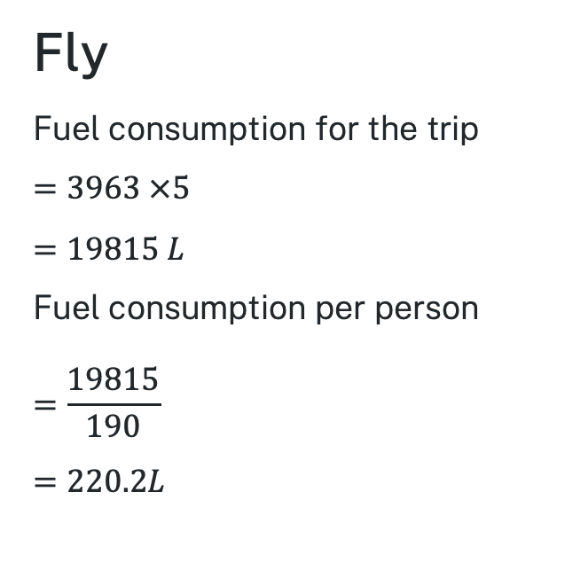
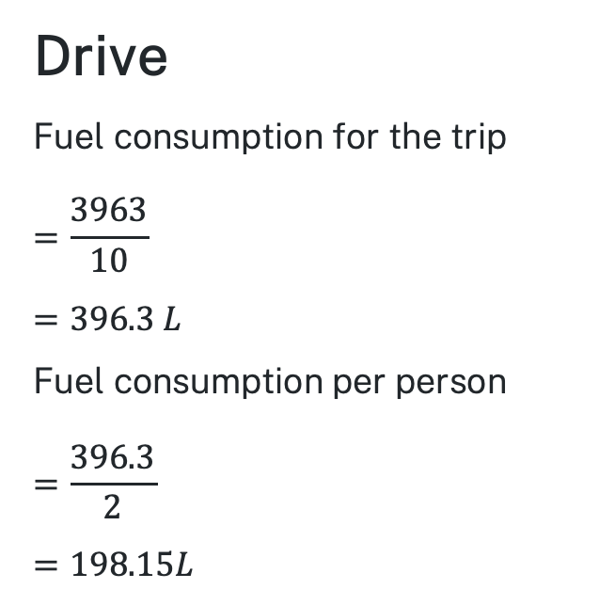
Is it better to drive or fly? (2)
Suggested solution
Drive
Fuel consumption for the trip
$$=\frac{3963}{10}$$
$$=396.3 L$$
Fuel consumption per person
$$=\frac{396.3}{2}$$
$$=198.15L$$
Fly
Fuel consumption for the trip
$$=3963 ×5$$
$$=19815 L$$
Fuel consumption per person
$$=\frac{19815}{190}$$
$$=220.2L$$

Slide 27
Copyright
© State of New South Wales (Department of Education), 2024
The copyright material published in this resource is subject to the Copyright Act 1968 (Cth) and is owned by the NSW Department of Education or, where indicated, by a party other than the NSW Department of Education (third-party material).
Copyright material available in this resource and owned by the NSW Department of Education is licensed under a Creative Commons Attribution 4.0 International (CC BY 4.0) licence.
This licence allows you to share and adapt the material for any purpose, even commercially.
Attribution should be given to © State of New South Wales (Department of Education), 2024.
Material in this resource not available under a Creative Commons licence:
the NSW Department of Education logo, other logos and trademark-protected material
Material owned by a third party that has been reproduced with permission. You will need to obtain permission from the third party to reuse its material.
Links to third-party material and websites
Please note that the provided (reading/viewing material/list/links/texts) are a suggestion only and implies no endorsement, by the New South Wales Department of Education, of any author, publisher, or book title. School principals and teachers are best placed to assess the suitability of resources that would complement the curriculum and reflect the needs and interests of their students.
If you use the links provided in this document to access a third party’s website, you acknowledge that the terms of use, including licence terms set out on the third-party’s website apply to the use which may be made of the materials on that third-party website or where permitted by the Copyright Act 1968 (Cth). The department accepts no responsibility for content on third-party websites.

