Slide 1
Goal-free soccer
Explicit teaching

Slide 2
Launch
World record score

Slide 3
Explore (1)
Goals scored in Matildas’ games
The data shows the number of goals scored in the Matilda’s last 32 soccer games.
0 0 0 1 1 1 1 1 2 2 2 2 2 2 3 3 3 3 3 4 4 4 4 4 5 5 5 6 7 7 7 8
Data sourced from https://www.matildas.com.au/fixtures#!/t6231 8 February 2024

Slide 4
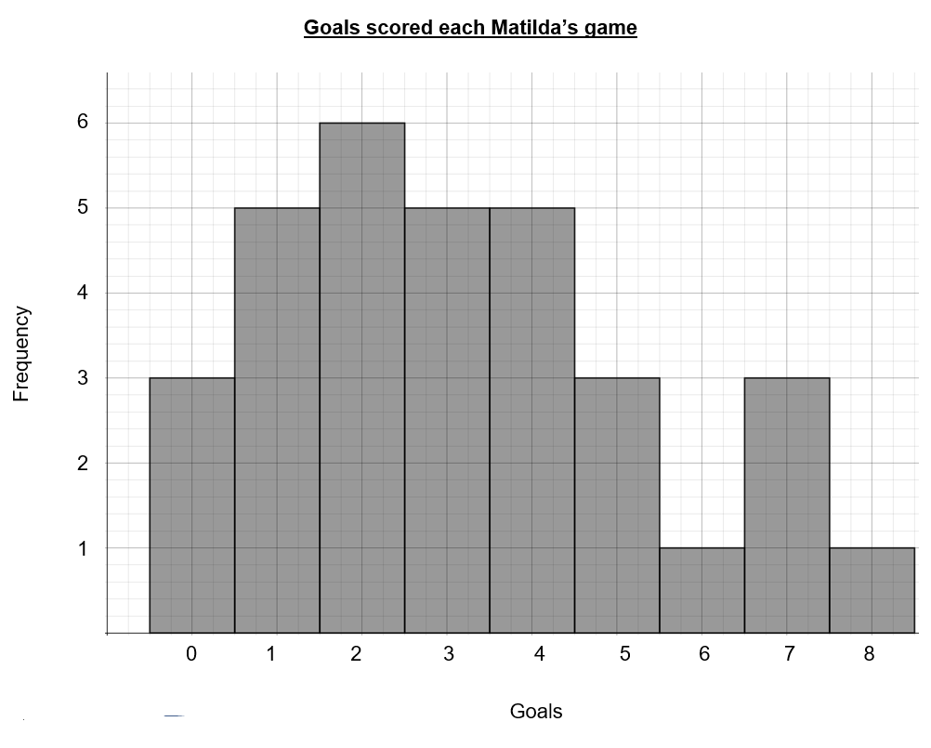
Explore (2)
Goals scored in Matildas’ games
The graph shows the number of goals scored in the Matilda’s last 32 soccer games.
Data sourced from Matildas, accessed 8 February 2024.

Slide 5
Explore (3)
Venn diagram
Double Venn Diagram
Shape and skew
Column graph
Features object 1
Features
similar to both
Features object 2
Frequency histogram

Slide 6
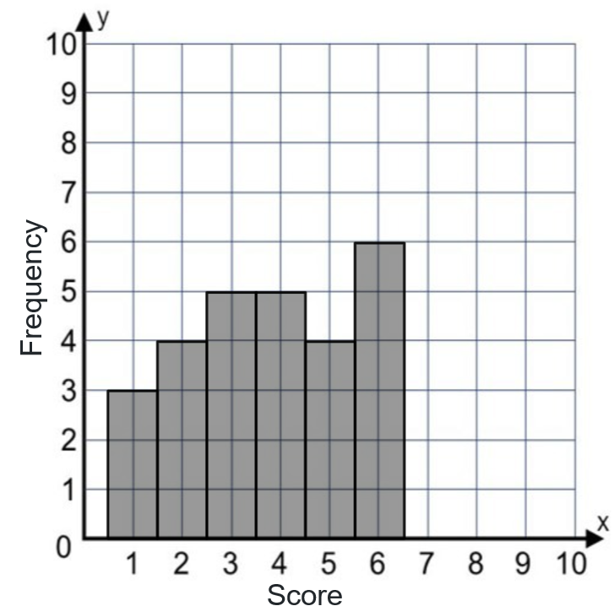
Summarise (1)
Example 1
Represent this data in a frequency histogram.
$$x$$ | $$f$$
1 | 3
2 | 4
3 | 5
4 | 5
5 | 4
6 | 6

Slide 7
Summarise (2)
Example 1 self-explanation prompts
Represent this data in a frequency histogram.
How do we know the height of the columns?
$$x$$ | $$f$$
1 | 3
2 | 4
3 | 5
4 | 5
5 | 4
6 | 6
What data is repress ented on the y-axis?
Describe the position of the first column.

Slide 8
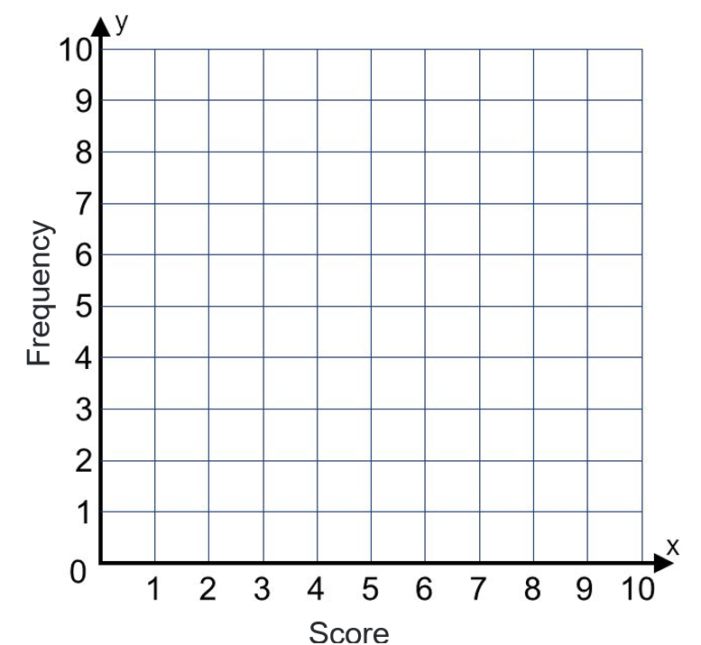
Summarise (3)
Your turn 1
Represent this data in a frequency histogram.
$$x$$ | $$f$$
1 | 9
2 | 8
3 | 3
4 | 4
5 | 0
6 | 2

Slide 9
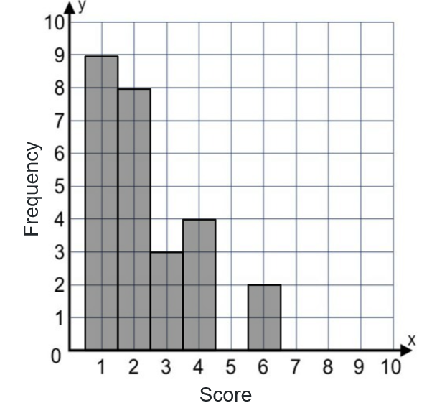
Summarise (4)
Your turn 1 solution
Represent this data in a frequency histogram.
$$x$$ | $$f$$
1 | 9
2 | 8
3 | 3
4 | 4
5 | 0
6 | 2

Slide 10
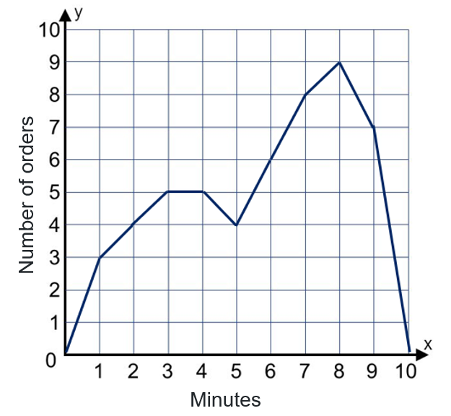
Summarise (5)
Example 2
A fast-food restaurant records how many minutes it takes from when people order their food in a drive-through until they receive it.
Represent this data in a frequency polygon.
Minutes | Number of orders
1 | 3
2 | 4
3 | 5
4 | 5
5 | 4
6 | 6
7 | 8
8 | 9
9 | 7

Slide 11
Summarise (6)
Where are the minutes represented in the graph?
Example 2 self-explanation prompts
Why do you think this graph is called a polygon?
A fast-food restaurant records how many minutes it takes from when people order their food in a drive-through until they receive it.
Represent this data in a frequency polygon.
Minutes | Number of orders
1 | 3
2 | 4
3 | 5
4 | 5
5 | 4
6 | 6
7 | 8
8 | 9
9 | 7
Describe how you would draw the polygon.

Slide 12
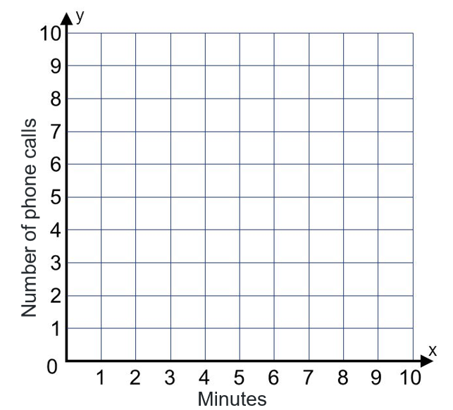
Summarise (7)
Your turn 2
Suzie records how many minutes each of her phone calls take on her work phone. She records them in the frequency table.
Draw a frequency polygon for this data.
Minutes | Number of phone calls
1 | 3
2 | 6
3 | 10
4 | 9
5 | 1
6 | 3
7 | 0
8 | 8

Slide 13
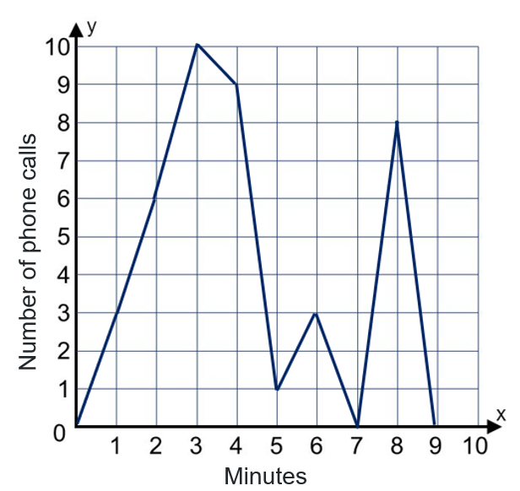
Summarise (8)
Your turn 2 solution
Suzie records how many minutes each of her phone calls take on her work phone. She records them in the frequency table.
Draw a frequency polygon for this data.
Minutes | Number of phone calls
1 | 3
2 | 6
3 | 10
4 | 9
5 | 1
6 | 3
7 | 0
8 | 8

Slide 14
Copyright
© State of New South Wales (Department of Education), 2024
The copyright material published in this resource is subject to the Copyright Act 1968 (Cth) and is owned by the NSW Department of Education or, where indicated, by a party other than the NSW Department of Education (third-party material).
Copyright material available in this resource and owned by the NSW Department of Education is licensed under a Creative Commons Attribution 4.0 International (CC BY 4.0) license.
This license allows you to share and adapt the material for any purpose, even commercially.
Attribution should be given to © State of New South Wales (Department of Education), 2024.
Material in this resource not available under a Creative Commons license:
the NSW Department of Education logo, other logos and trademark-protected material
Material owned by a third party that has been reproduced with permission. You will need to obtain permission from the third party to reuse its material.
Links to third-party material and websites
Please note that the provided (reading/viewing material/list/links/texts) are a suggestion only and implies no endorsement, by the New South Wales Department of Education, of any author, publisher, or book title. School principals and teachers are best placed to assess the suitability of resources that would complement the curriculum and reflect the needs and interests of their students.
If you use the links provided in this document to access a third party’s website, you acknowledge that the terms of use, including licence terms set out on the third-party’s website apply to the use which may be made of the materials on that third-party website or where permitted by the Copyright Act 1968 (Cth). The department accepts no responsibility for content on third-party websites.

