Slide 1
Footy fit
Explicit teaching

Slide 2
Launch

Slide 3
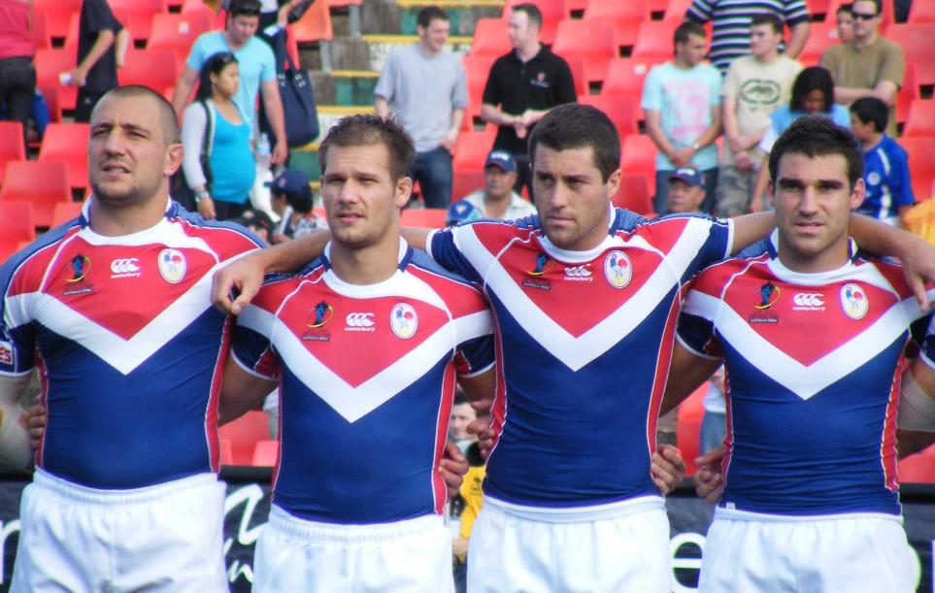
Footy fit (1)
Forwards and backs
What do you notice?
What do you wonder?
"French rugby league players" by NAPARAZZI is licensed under CC BY-SA 2.0

Slide 4
Footy fit (2)
Forward or back?
Rugby backs and forwards tend to be different sizes, with the forwards usually bigger than the backs. Backs are built for agility and speed, while the forwards are built for strength.
Tim Howard in Fitness Vs. Fatness in Rugby - Ruck Science, 18 November 2020
Which player is the forward?
Which player is the back?
Adam Clune
172 cm
80 kg
One of the lightest players in the competition.
Wiremu Greig
192 cm
124 kg
The heaviest player in the competition.

Slide 5
Explore

Slide 6
Analysing data
Height of backs in the Knights
Height (cm)
182
182
188
186
183
185
189
182
184
184
180
187
183
172
176
185
177
191
190
181

Slide 7
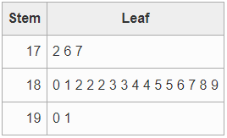
Creating a stem-and-leaf plot
Height of backs in the Knights
Height (cm)
182
182
188
186
183
185
189
182
184
184
180
187
183
172
176
185
177
191
190
181
Height of backs in the Newcastle Knights team
Why are there 2 columns of numbers?
What do you notice?
Why does the second column have lots of numbers in the same row?
What do you wonder?
17 | 2 means 172

Slide 8
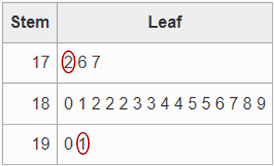
Stem-and-leaf plot (1)
Example 1
Calculate the range of the data in the stem-and-leaf plot.
Height of backs in the Newcastle Knights team
$$Range=191−172 \\ =19$$
The range is 19 cm

Slide 9
Stem-and-leaf plot (2)
Example 1 – explanation prompts
Calculate the range of the data in the stem-and-leaf plot.
Height of backs in the Newcastle Knights team
$$Range=191−172 \\ =19$$
The range is 19 cm
How do we know this?
Why are the numbers circled?

Slide 10
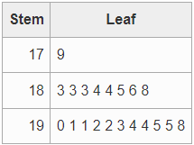
Stem-and-leaf plot (3)
Your turn – question 1
Calculate the range of the data in the stem-and-leaf plot.
Height of forwards in the Newcastle Knights team

Slide 11
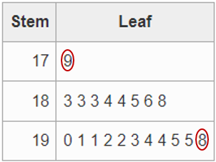
Stem-and-leaf plot (4)
Your turn – question 1 solutions
Calculate the range of the data in the stem-and-leaf plot.
Height of forwards in the Newcastle Knights team
$$Range=198−179 \\ =19$$
The range is 19 cm.

Slide 12
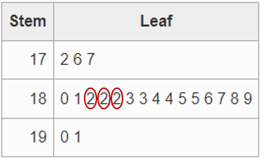
Stem-and-leaf plot (5)
Example 2
Calculate the mode of the data in the stem-and-leaf plot.
Height of backs in the Newcastle Knights team
$$Mode=182$$
There are 3 players who are 182 cm tall.

Slide 13
Stem-and-leaf plot (6)
Example 2 – explanation prompts
Calculate the mode of the data in the stem-and-leaf plot.
Height of backs in the Newcastle Knights team
$$Mode=182$$
There are 3 players who are 182 cm tall.
How do we know this?
Why are the numbers circled?

Slide 14
Stem-and-leaf plot (7)
Your turn – question 2
Calculate the mode of the data in the stem-and-leaf plot.
Height of forwards in the Newcastle Knights team

Slide 15
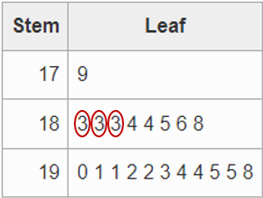
Stem-and-leaf plot (8)
Your turn – question 2 solutions
Calculate the mode of the data in the stem-and-leaf plot.
Height of forwards in the Newcastle Knights team
$$Mode=183$$
There are 3 players who are 183 cm tall.

Slide 16
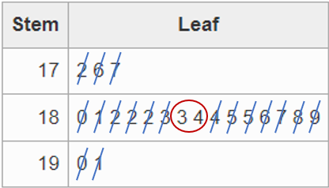
Stem-and-leaf plot (9)
Example 3
Calculate the median of the data in the stem-and-leaf plot.
Height of backs in the Newcastle Knights team
$$Median=\frac{183+184}{2} \\ =183.5$$
The median height is 183.5 cm.

Slide 17
Stem-and-leaf plot (10)
Example 3 – explanation prompts
Calculate the median of the data in the stem-and-leaf plot.
Why is a fraction here?
Height of backs in the Newcastle Knights team
$$Median=\frac{183+184}{2} \\ =183.5$$
The median height is 183.5 cm.
What if there was a single number in the middle?
Why is 183.5 not in the stem-and-leaf plot?

Slide 18
Stem-and-leaf plot (11)
Your turn – question 3
Calculate the median of the data in the stem-and-leaf plot.
Height of forwards in the Newcastle Knights team

Slide 19
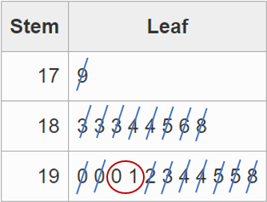
Stem-and-leaf plot (12)
Your turn – question 3 solutions
Calculate the median of the data in the stem-and-leaf plot.
Height of forwards in the Newcastle Knights team
$$Median=\frac{190+191}{2} \\ =190.5$$
The median height is 190.5 cm.

Slide 20
Stem-and-leaf plot (13)
Example 4
Calculate the mean of the data in the stem-and-leaf plot.
Height of backs in the Newcastle Knights team
$$Mean=\frac{3667}{20} \\ =183.35$$
The mean height is 183.35 cm.

Slide 21
Stem-and-leaf plot (14)
Example 4 – explanation prompts
Calculate the mean of the data in the stem-and-leaf plot.
Where did this number come from?
Height of backs in the Newcastle Knights team
$$Mean=\frac{3667}{20} \\ =183.35$$
The mean height is 183.35 cm.
Why is 183.35 not in the stem-and-leaf plot?

Slide 22
Stem-and-leaf plot (15)
Your turn – question 4
Calculate the mean of the data in the stem-and-leaf plot.
Height of forwards in the Newcastle Knights team

Slide 23
Stem-and-leaf plot (16)
Your turn – question 4 solutions
Calculate the mean of the data in the stem-and-leaf plot.
Height of forwards in the Newcastle Knights team
$$Mean=\frac{3780}{20} \\ =189$$
The mean height is 189 cm tall.

Slide 24
Copyright
© State of New South Wales (Department of Education), 2024
The copyright material published in this resource is subject to the Copyright Act 1968 (Cth) and is owned by the NSW Department of Education or, where indicated, by a party other than the NSW Department of Education (third-party material).
Copyright material available in this resource and owned by the NSW Department of Education is licensed under a Creative Commons Attribution 4.0 International (CC BY 4.0) license.
This license allows you to share and adapt the material for any purpose, even commercially.
Attribution should be given to © State of New South Wales (Department of Education), 2024.
Material in this resource not available under a Creative Commons license:
the NSW Department of Education logo, other logos and trademark-protected material
Material owned by a third party that has been reproduced with permission. You will need to obtain permission from the third party to reuse its material.
Links to third-party material and websites
Please note that the provided (reading/viewing material/list/links/texts) are a suggestion only and implies no endorsement, by the New South Wales Department of Education, of any author, publisher, or book title. School principals and teachers are best placed to assess the suitability of resources that would complement the curriculum and reflect the needs and interests of their students.
If you use the links provided in this document to access a third party’s website, you acknowledge that the terms of use, including licence terms set out on the third-party’s website apply to the use which may be made of the materials on that third-party website or where permitted by the Copyright Act 1968 (Cth). The department accepts no responsibility for content on third-party websites.

