Slide 1
Almost exactly
Explicit teaching

Slide 2
Explore

Slide 3
Explore (1)
Find the length of d?

Slide 4
Summarise

Slide 5
Summarise (1)
Exact form or decimal approximation
Exact form
$$\sqrt{3}$$
Decimal approximation
$$1.73$$
What’s the difference?

Slide 6
Summarise (2)
Exact form or decimal approximation
Exact form
$$\sqrt{3}×\sqrt{3}=\sqrt{9}$$
Decimal approximation
$$1.73×1.73=2.9929$$
What’s the difference?

Slide 7
Summarise (3)
Exact form or decimal approximation
Exact form
$$\sqrt{3}×\sqrt{3}×\sqrt{3}=\sqrt{27}$$
Decimal approximation
$$1.73×1.73×1.73=5.177717$$
What’s the difference?

Slide 8
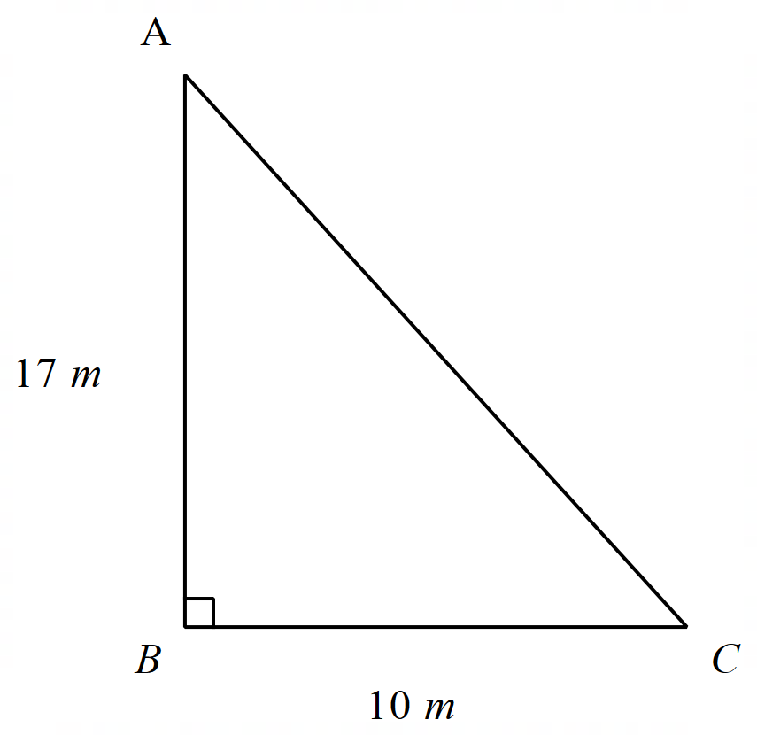
Summarise (4)
Example 1
Find the length of the hypotenuse of triangle $ABC.$ Give your answer in exact form.
$${AC^{2}=17}^{2}+{10}^{2} \\ AC^{2}=389 \\ AC=\sqrt{389} m$$

Slide 9
Summarise (5)
Example 1 – self-explanation prompts
Find the length of the hypotenuse of triangle $ABC. G$ive your answer in exact form.
Could you use a pronumeral instead of AC?
$${AC^{2}=17}^{2}+{10}^{2} \\ AC^{2}=389 \\ AC=\sqrt{389} m$$
Without using a calculator, estimate the approximate value of $\sqrt{389}$

Slide 10
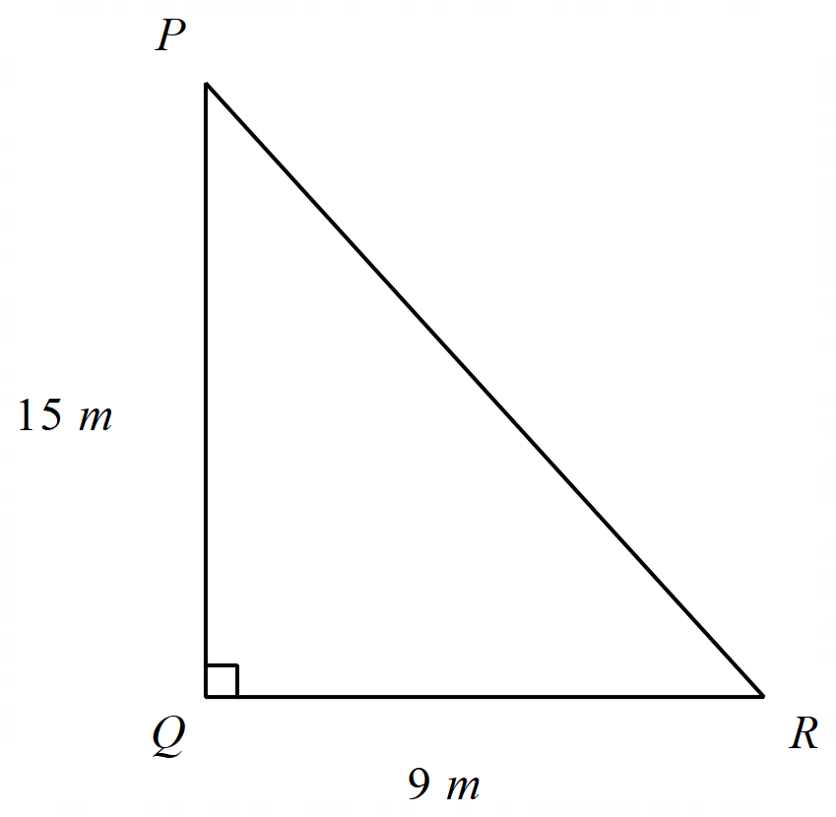
Summarise (6)
Your turn – problem 1
Find the length of the hypotenuse of triangle $PQR. G$ive your answer in exact form.

Slide 11
Summarise (7)
Your turn – solution 1
Find the length of the hypotenuse of triangle $PQR. G$ive your answer in exact form.
$${PR^{2}=15}^{2}+9^{2} \\ PR^{2}=306 \\ PR=\sqrt{306} m$$

Slide 12
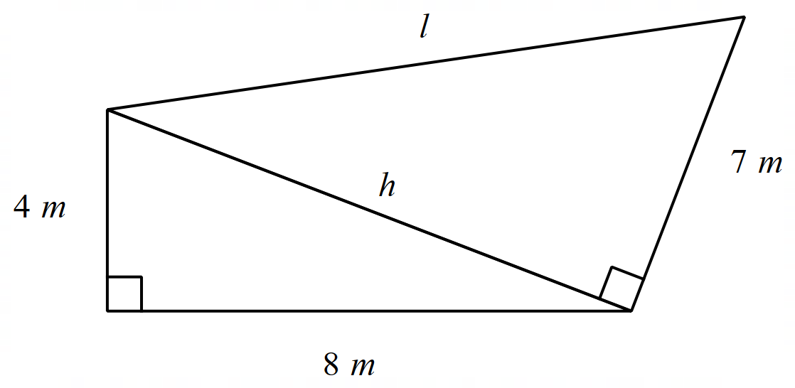
Summarise (8)
Example 2
Find the value of $l,$ giving your answer in exact form.
$$h^{2}=4^{2}+8^{2} \\ h^{2}=80 \\ h=\sqrt{80} m$$
$$l^{2}=h^{2}+7^{2} \\ {l^{2}=\sqrt{80}}^{2}+7^{2} \\ l^{2}=129 \\ l=\sqrt{129} m$$

Slide 13
Summarise (9)
Example 2 – self-explanation prompts
Find the value of $l,$ giving your answer in exact form.
$$h^{2}=4^{2}+8^{2} \\ h^{2}=80 \\ h=\sqrt{80} m$$
$$l^{2}=h^{2}+7^{2} \\ {l^{2}=\sqrt{80}}^{2}+7^{2} \\ l^{2}=129 \\ l=\sqrt{129} m$$
Would the value of $l$ be different if we rounded $h$ to 2 decimal places?
Why is it useful to use exact form for this example?

Slide 14
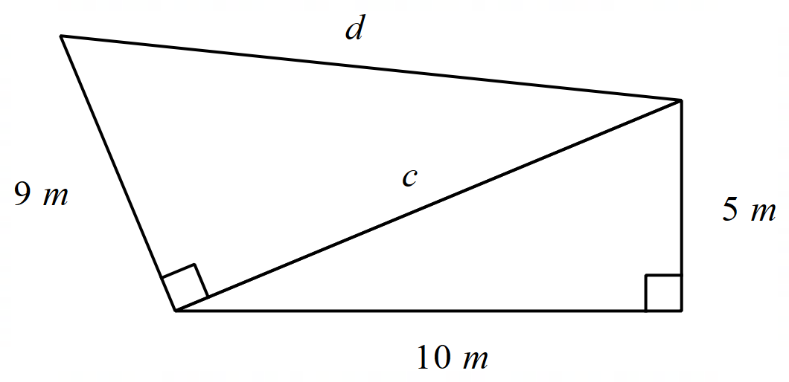
Summarise (10)
Your turn – problem 2
Find the value of $d,$ giving your answer in exact form.

Slide 15
Summarise (11)
Your turn – solution 2
Find the value of $d,$ giving your answer in exact form.
$$5^{2}+{10}^{2}=c^{2} \\ 125=c^{2} \\ c=\sqrt{125} m$$
$$c^{2}+9^{2}=d^{2} \\ {\sqrt{125}}^{2}+9^{2}=d^{2} \\ 206=d^{2} \\ d=\sqrt{206} m$$

Slide 16
Apply

Slide 17
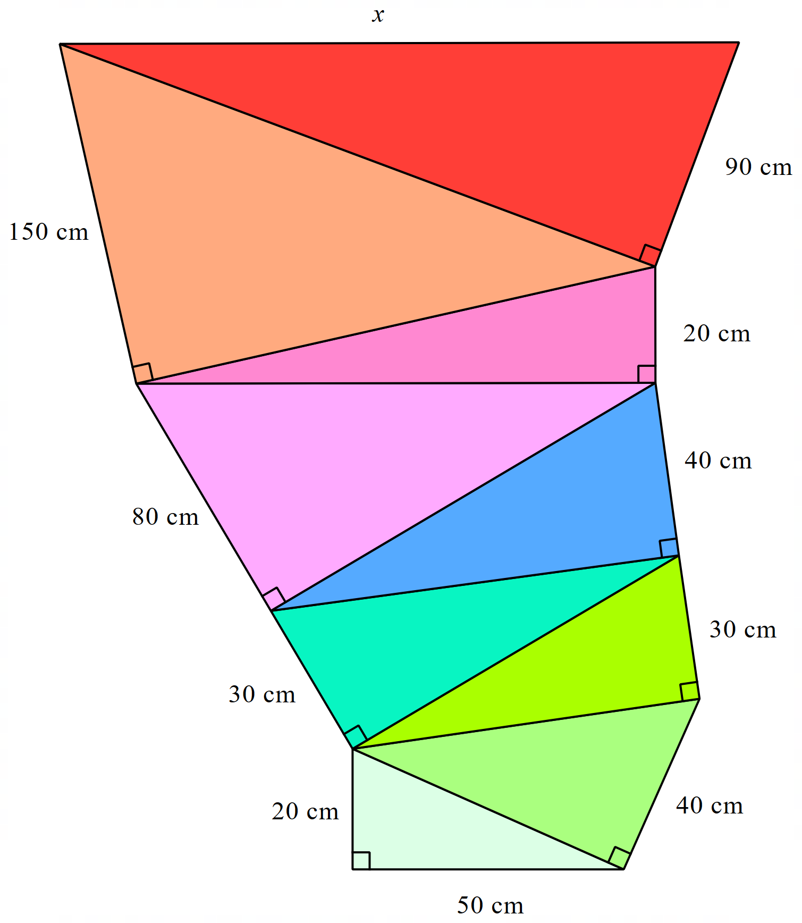
Apply (1)
Triangle stack

Slide 18
Copyright
© State of New South Wales (Department of Education), 2024
The copyright material published in this resource is subject to the Copyright Act 1968 (Cth) and is owned by the NSW Department of Education or, where indicated, by a party other than the NSW Department of Education (third-party material).
Copyright material available in this resource and owned by the NSW Department of Education is licensed under a Creative Commons Attribution 4.0 International (CC BY 4.0) license.
This license allows you to share and adapt the material for any purpose, even commercially.
Attribution should be given to © State of New South Wales (Department of Education), 2024.
Material in this resource not available under a Creative Commons license:
the NSW Department of Education logo, other logos and trademark-protected material
Material owned by a third party that has been reproduced with permission. You will need to obtain permission from the third party to reuse its material.
Links to third-party material and websites
Please note that the provided (reading/viewing material/list/links/texts) are a suggestion only and implies no endorsement, by the New South Wales Department of Education, of any author, publisher, or book title. School principals and teachers are best placed to assess the suitability of resources that would complement the curriculum and reflect the needs and interests of their students.
If you use the links provided in this document to access a third-party’s website, you acknowledge that the terms of use, including licence terms set out on the third-party’s website apply to the use which may be made of the materials on that third-party website or where permitted by the Copyright Act 1968 (Cth). The department accepts no responsibility for content on third-party websites.

