Slide 1
The cake thief
Stage 4

Slide 2
Launch
NSW Department of Education

Slide 3
The cake thief (1)
Joe’s afternoon tea
3 slices, ${30}^{°}$ each
a slice about ${50}^{°}$
a quarter of the cake
a third of the cake

Slide 4
Explore
NSW Department of Education

Slide 5
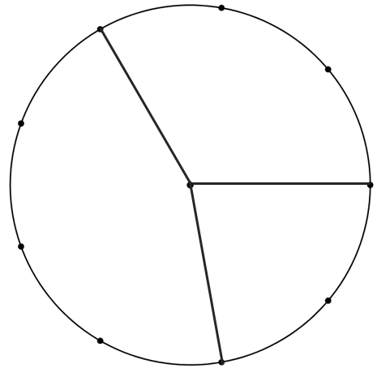
The cake thief (2)
Angles at a point

Slide 6
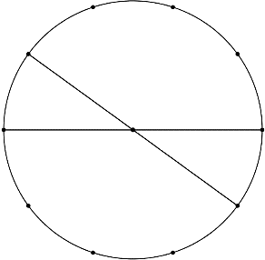
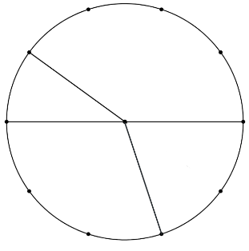
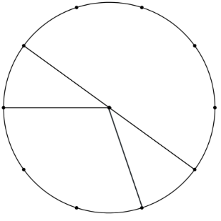
The cake thief (3)
Vertically opposite angles
This circle contains vertically opposite angles
These circles do not

Slide 7
Summarise
NSW Department of Education

Slide 8
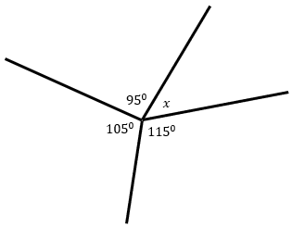
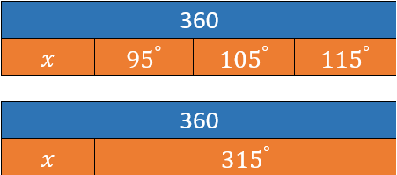
Angles at a point (1)
Worked example 1
Calculate the value of $x.$
Solution:
$$x+95°+105°+115°=360° \\ x+315°=360° \\ −315°=−315° \\ x=360°−315° \\ =45°$$

Slide 9
Angles at a point (2)
Worked example 1 – self-explanation prompts
Calculate the value of $x.$
Solution:
$$x+95°+105°+115°=360° \\ x°+315°=360° \\ −315°=−315° \\ x°=360°−315° \\ =45°$$
Why do we write this line?
Why are these values subtracted?

Slide 10
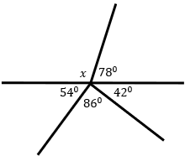
Angles at a point (3)
Your turn – question 1
Calculate the value of $x$.

Slide 11
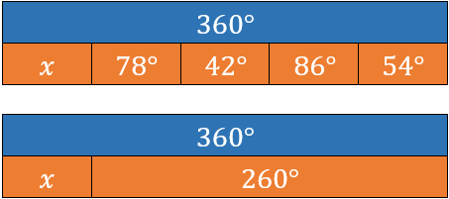
Angles at a point (4)
Your turn – solution 1
Calculate the value of $x$.
Solution:
$$x+78°+42°+86°+54°=360° \\ x°+260°=360° \\ −260°=−260° \\ x°=360°−260° \\ =100°$$

Slide 12
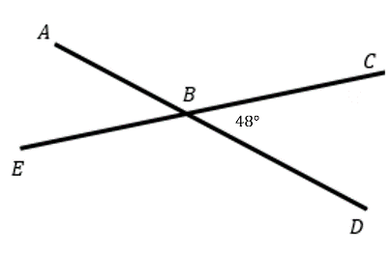
Vertically opposite angles (1)
Worked example 2
Find the size of $∠ABE$, given $∠CBD=48°$. Give a reason.
Solution:
$∠ABE=∠CBD$(vertically opposite angles)
$$∴∠ABE=48°$$

Slide 13
Vertically opposite angles (2)
Worked example 2 – self-explanation prompts
Find the size of $∠ABE$, given $∠CBD=48°$. Give a reason.
Solution:
$∠ABE=∠CBD$(vertically opposite angles)
$$∴∠ABE=48°$$
Where do these letters come from?
Why do we write this?
Does the order of the letters matter?

Slide 14
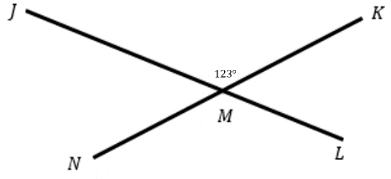
Vertically opposite angles (3)
Your turn – question 2
Find the size of $∠LMN$, given $∠JMK=123°$. Give a reason.

Slide 15
Vertically opposite angles (4)
Your turn – solution 2
Find the size of $∠LMN$, given $∠JMK=123°$. Give a reason.
Solution:
$∠JMK=∠LMN$(vertically opposite angles)
$$∴∠LMN=123°$$

Slide 16
Copyright
© State of New South Wales (Department of Education), 2024
The copyright material published in this resource is subject to the Copyright Act 1968 (Cth) and is owned by the NSW Department of Education or, where indicated, by a party other than the NSW Department of Education (third-party material).
Copyright material available in this resource and owned by the NSW Department of Education is licensed under a Creative Commons Attribution 4.0 International (CC BY 4.0) license.
This license allows you to share and adapt the material for any purpose, even commercially.
Attribution should be given to © State of New South Wales (Department of Education), 2024.
Material in this resource not available under a Creative Commons license:
the NSW Department of Education logo, other logos and trademark-protected material
Material owned by a third party that has been reproduced with permission. You will need to obtain permission from the third party to reuse its material.
Links to third-party material and websites
Please note that the provided (reading/viewing material/list/links/texts) are a suggestion only and implies no endorsement, by the New South Wales Department of Education, of any author, publisher, or book title. School principals and teachers are best placed to assess the suitability of resources that would complement the curriculum and reflect the needs and interests of their students.
If you use the links provided in this document to access a third-party’s website, you acknowledge that the terms of use, including licence terms set out on the third-party’s website apply to the use which may be made of the materials on that third-party website or where permitted by the Copyright Act 1968 (Cth). The department accepts no responsibility for content on third-party websites.

