Slide 1
Alternate views
Stage 4

Slide 2
Launch
NSW Department of Education

Slide 3
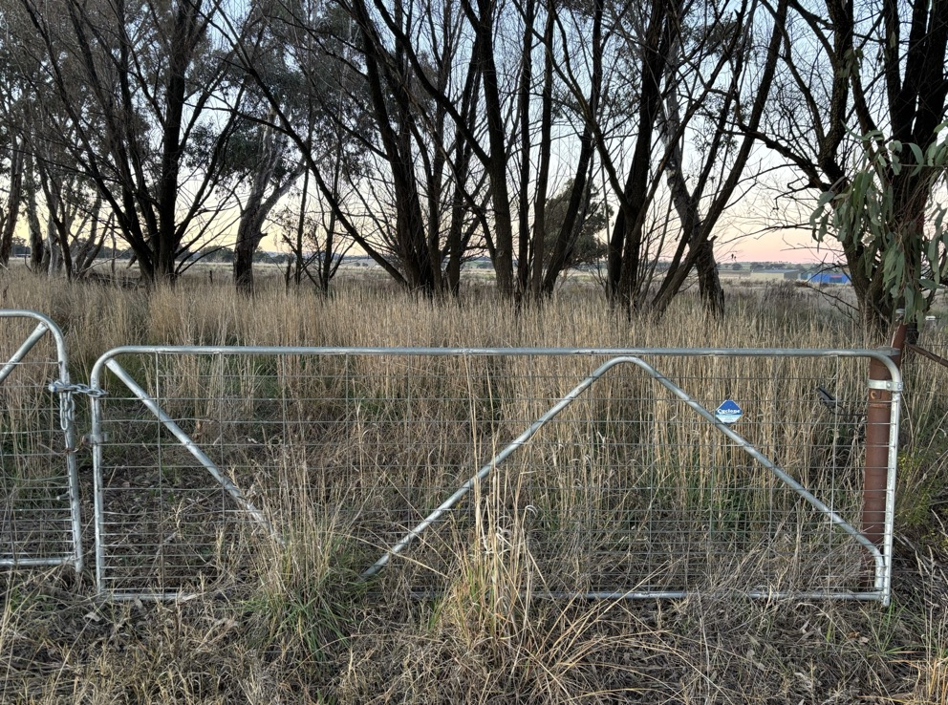
Alternate views (1)
Launch

Slide 4
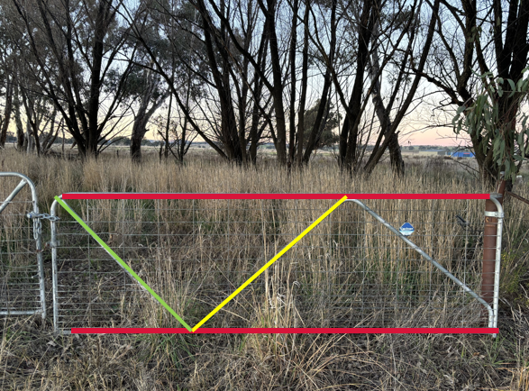
Alternate views (2)
Annotated farm gate

Slide 5
Explore
NSW Department of Education

Slide 6
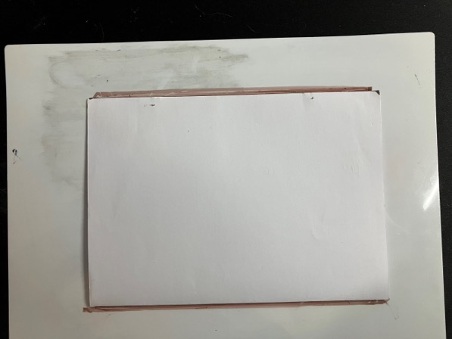
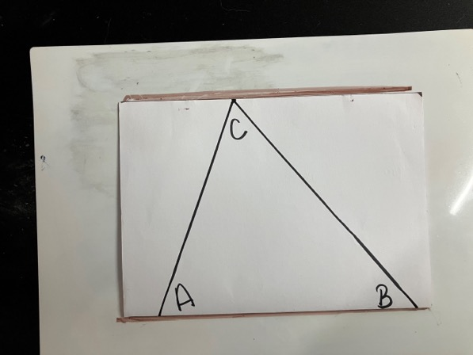
Alternate views (3)

Slide 7
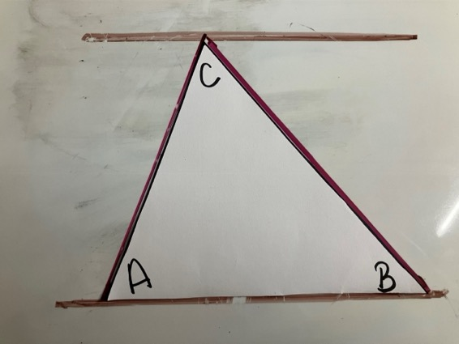
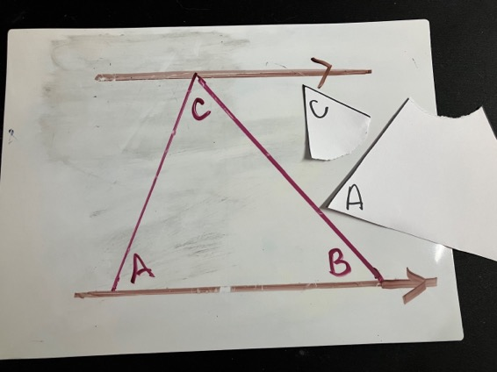
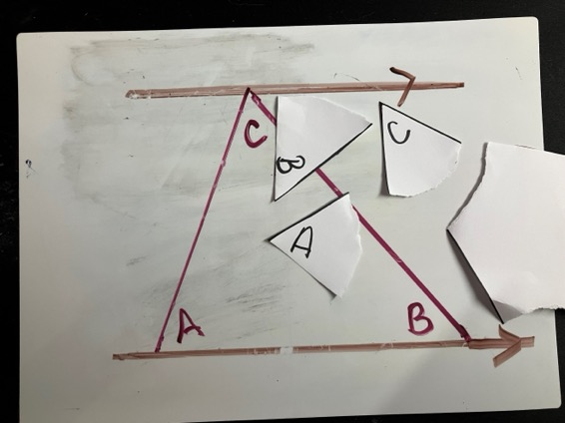
Alternate views (4)

Slide 8
Alternate views (5)

Slide 9
Summarise
NSW Department of Education

Slide 10
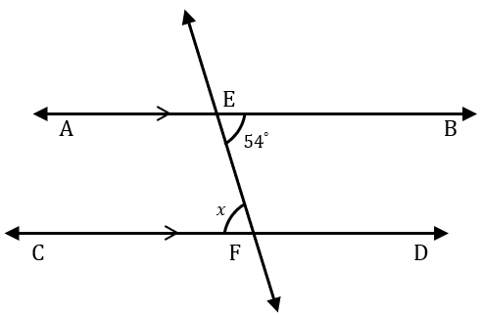
Alternate angles (1)
Worked example
$AB$ and $CD$ are parallel lines cut by a transversal line EF. $∠BEF$ is $54°$.
Find the size of $∠EFC$.
Solution
Since $AB∥CD$,
$∠BEF=∠EFC$as they are alternate angles in parallel lines.
$$∴∠EFC=54°$$

Slide 11
Alternate angles (2)
Worked example – explanation prompts
$AB$ and $CD$ are parallel lines cut by a transversal line EF. $∠BEF$ is $54°$.
Find the size of $∠EFC$.
Solution
Since $AB∥CD$,
$∠BEF=∠EFC$as they are alternate angles in parallel lines.
$$∴∠EFC=54°$$
Why is this important?
How do we know this?

Slide 12
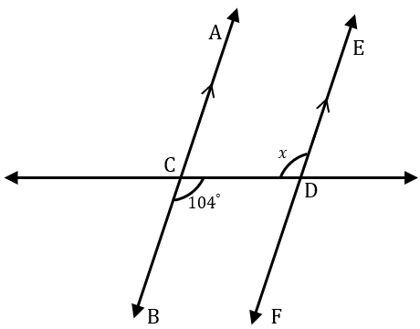
Alternate angles (3)
Your turn
$AB$ and $EF$ are parallel lines cut by a transversal line $CD$. $∠BCD$ is $104°$.
Find the size of $∠EDC$.

Slide 13
Alternate angles (4)
Your turn - solution
$AB$ and $EF$ are parallel lines cut by a transversal line $CD$. $∠BCD$ is $104°$.
Find the size of $∠EDC$.
Solution
Since $AB∥EF$,
$∠BCD=∠EDC$as they are alternate angles in parallel lines.
$$∴∠EDC=104°$$

Slide 14
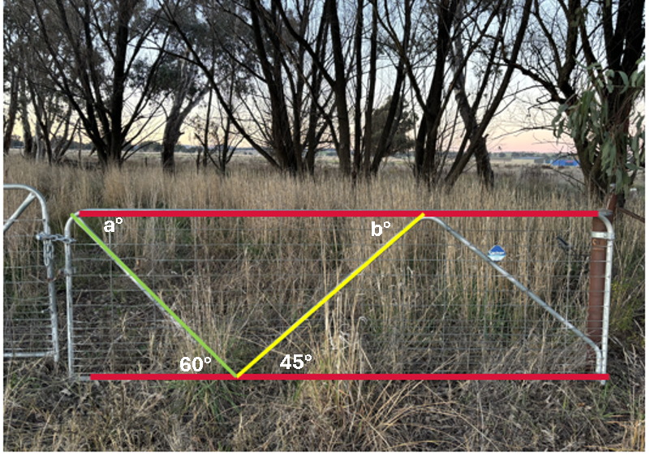
Alternate views (6)
Gate angles

Slide 15
Apply
NSW Department of Education

Slide 16
Alternate views (7)
Exit ticket
Can you answer the question correctly?
Can you explain what mistake each student has made?
How would you convince each student that their answer is not correct?
I think the answer is (a) as the angle is on one side of the transversal.
I think the answer is (d), as it is between the parallel line and the transversal.

Slide 17
Copyright
© State of New South Wales (Department of Education), 2024
The copyright material published in this resource is subject to the Copyright Act 1968 (Cth) and is owned by the NSW Department of Education or, where indicated, by a party other than the NSW Department of Education (third-party material).
Copyright material available in this resource and owned by the NSW Department of Education is licensed under a Creative Commons Attribution 4.0 International (CC BY 4.0) license.
This license allows you to share and adapt the material for any purpose, even commercially.
Attribution should be given to © State of New South Wales (Department of Education), 2024.
Material in this resource not available under a Creative Commons license:
the NSW Department of Education logo, other logos and trademark-protected material
Material owned by a third party that has been reproduced with permission. You will need to obtain permission from the third party to reuse its material.
Links to third-party material and websites
Please note that the provided (reading/viewing material/list/links/texts) are a suggestion only and implies no endorsement, by the New South Wales Department of Education, of any author, publisher, or book title. School principals and teachers are best placed to assess the suitability of resources that would complement the curriculum and reflect the needs and interests of their students.
If you use the links provided in this document to access a third-party’s website, you acknowledge that the terms of use, including licence terms set out on the third-party’s website apply to the use which may be made of the materials on that third-party website or where permitted by the Copyright Act 1968 (Cth). The department accepts no responsibility for content on third-party websites.

