Slide 1
Come inside
Stage 4

Slide 2
Warm up
NSW Department of Education

Slide 3
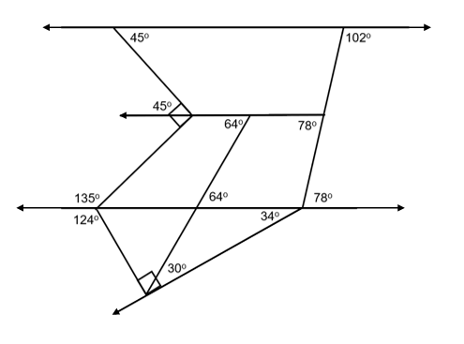
Come inside (1)
Warm up
Consider the diagram below. Work out or calculate as much information as you can from the diagram, giving the reasons used each time.

Slide 4
Summarise
NSW Department of Education

Slide 5
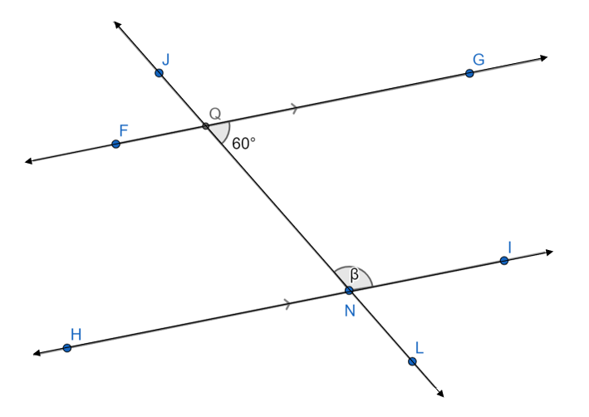
Come inside (2)
Worked example 1
Find the value of β.
$$∠INQ+∠GQN=180° \\ β+60=180° \\ β=180−60 \\ β=120°$$

Slide 6
Come inside (3)
Worked example 1 – self-explanation prompts
Find the value of β.
$$∠INQ+∠GQN=180° \\ β+60=180° \\ β=180−60 \\ β=120°$$
Why do the 2 angles add to $180°$?
Can you explain the connection between the equation and the bar diagram?

Slide 7
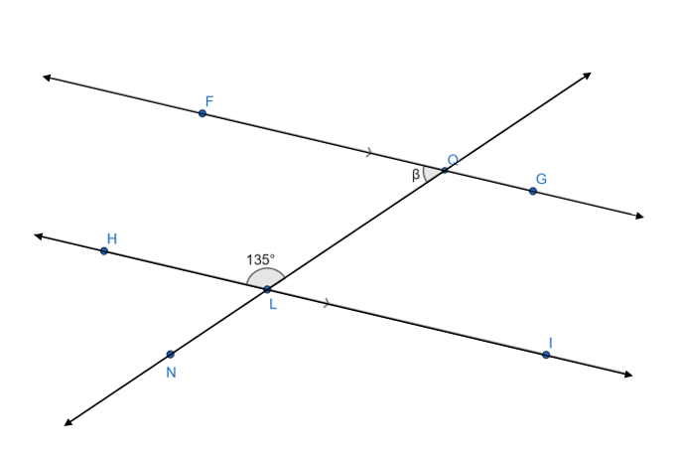
Come inside (4)
Your turn – question 1
Find the value of β.

Slide 8
Come inside (5)
Your turn – solution 1
Find the value of β.
$$∠FQL+∠HLQ=180° \\ β+135=180° \\ β=180−135 \\ β=45°$$

Slide 9
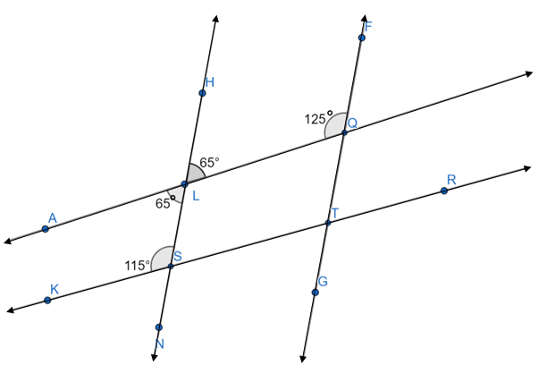
Come inside (6)
Considering $AQ \& KR$ $$∠ALS=65° \\ ∠KSL=115° \\ ∠ALS+∠KSL=180°$$ Co-interior angles in parallel
lines add to 180º $∴AQ∥KR$ Considering $HN \& FG$
$$∠HLQ=65° \\ ∠LQF=125° \\ ∠HLQ+∠LQF≠180° \\ ∴HN∦FG$$
Worked example 2
Which 2 lines are parallel and why?

Slide 10
Come inside (7)
Considering $AQ \& KR$ $$∠ALS=65° \\ ∠KSL=115° \\ ∠ALS+∠KSL=180°$$ Co-interior angles in parallel
lines add to 180º $∴AQ∥KR$ Considering $HN \& FG$
$$∠HLQ=65° \\ ∠LQF=125° \\ ∠HLQ+∠LQF≠180° \\ ∴HN∦FG$$
Worked example 2 – self-explanation prompts
Which 2 lines are parallel and why?
Which other angle properties could be used to verify if the lines are parallel?
What do each of the symbols mean in this statement?

Slide 11
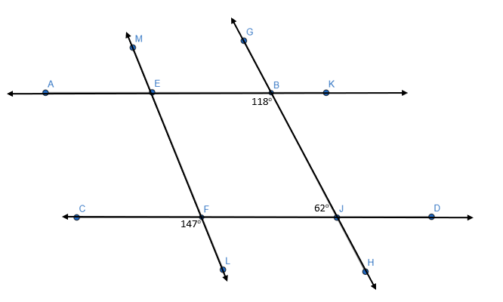
Come inside (8)
Your turn – question 2
Which lines are parallel and why?

Slide 12
Come inside (9)
Your turn – solution 2
Which lines are parallel and why?
$$AK∥CD as ∠ABJ+∠BJC=180°$$
$$∠EFJ=∠CFL=147°$$
$$as they are vertically opposite$$
$$LM∦GH as ∠EFJ+∠BJF≠180°$$
$$Co−interior angles in parallel$$
$$lines add to 180o$$

Slide 13
Apply
NSW Department of Education

Slide 14
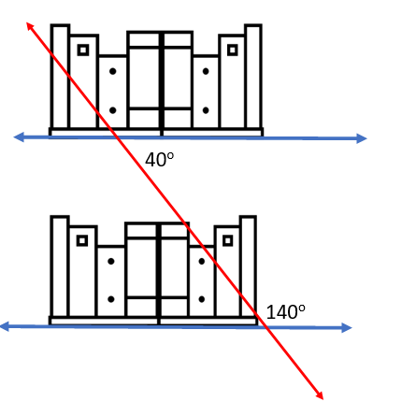
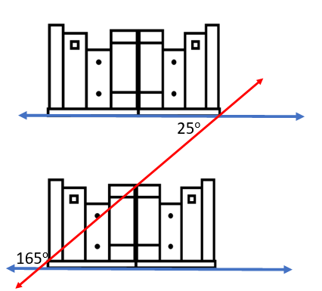
Come inside (10)
Launch revisit – Are the shelves parallel?
By looking at the 2 sets of shelves, determine whether the pair of shelves are parallel to each other. Explain why using geometrical reasoning.

Slide 15
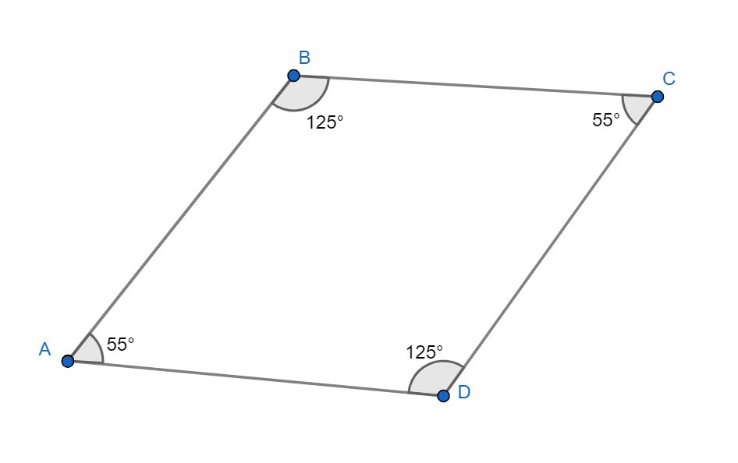
Come inside (11)
Exit ticket
Explain why this shape is a parallelogram. Use reasoning to justify your answer.

Slide 16
Copyright
© State of New South Wales (Department of Education), 2024
The copyright material published in this resource is subject to the Copyright Act 1968 (Cth) and is owned by the NSW Department of Education or, where indicated, by a party other than the NSW Department of Education (third-party material).
Copyright material available in this resource and owned by the NSW Department of Education is licensed under a Creative Commons Attribution 4.0 International (CC BY 4.0) license.
This license allows you to share and adapt the material for any purpose, even commercially.
Attribution should be given to © State of New South Wales (Department of Education), 2024.
Material in this resource not available under a Creative Commons license:
the NSW Department of Education logo, other logos and trademark-protected material
Material owned by a third party that has been reproduced with permission. You will need to obtain permission from the third party to reuse its material.
Links to third-party material and websites
Please note that the provided (reading/viewing material/list/links/texts) are a suggestion only and implies no endorsement, by the New South Wales Department of Education, of any author, publisher, or book title. School principals and teachers are best placed to assess the suitability of resources that would complement the curriculum and reflect the needs and interests of their students.
If you use the links provided in this document to access a third-party’s website, you acknowledge that the terms of use, including licence terms set out on the third-party’s website apply to the use which may be made of the materials on that third-party website or where permitted by the Copyright Act 1968 (Cth). The department accepts no responsibility for content on third-party websites.

