Slide 1
Distance-time graphs
Stage 4
Ratios and rates

Slide 2
Explore

Slide 3
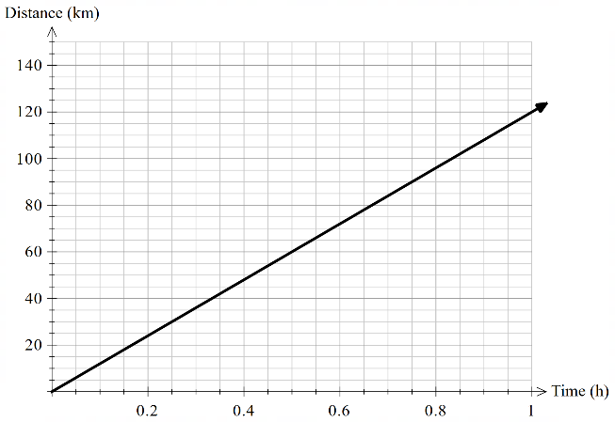
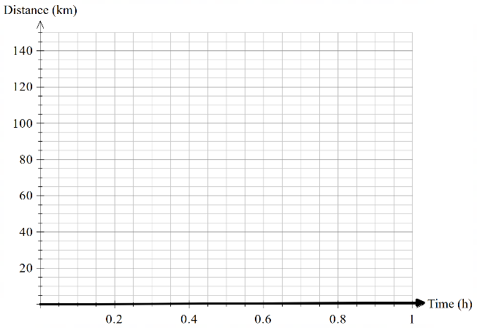
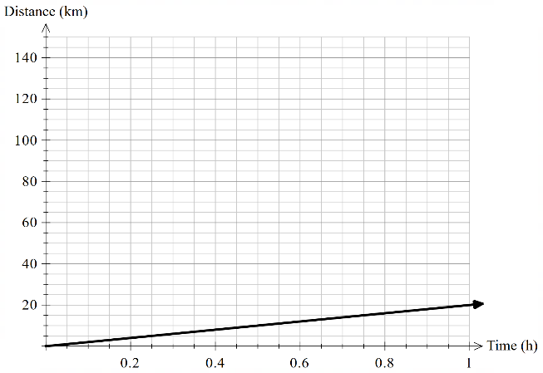
Distance-time graphs (1)
Tortoise, T-rex, cheetah

Slide 4
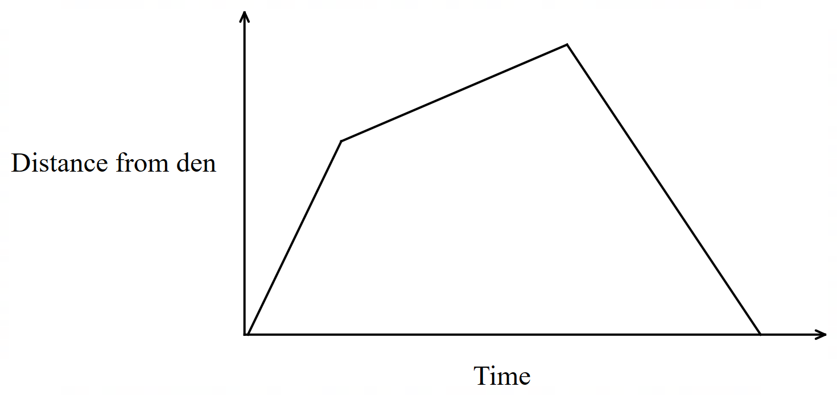
Distance-time graphs (2)
Match the story to the graph
A lion left his den. He set off slowly, then increased his pace as he chased a gazelle, then walked slowly back to the den.
A lion left his den. He set off at high speed, then slowed down as he stalked a gazelle, then ran back to the den.
A lion left his den. He set off at high speed chasing a gazelle, stopped to rest, then ran back to the den.

Slide 5
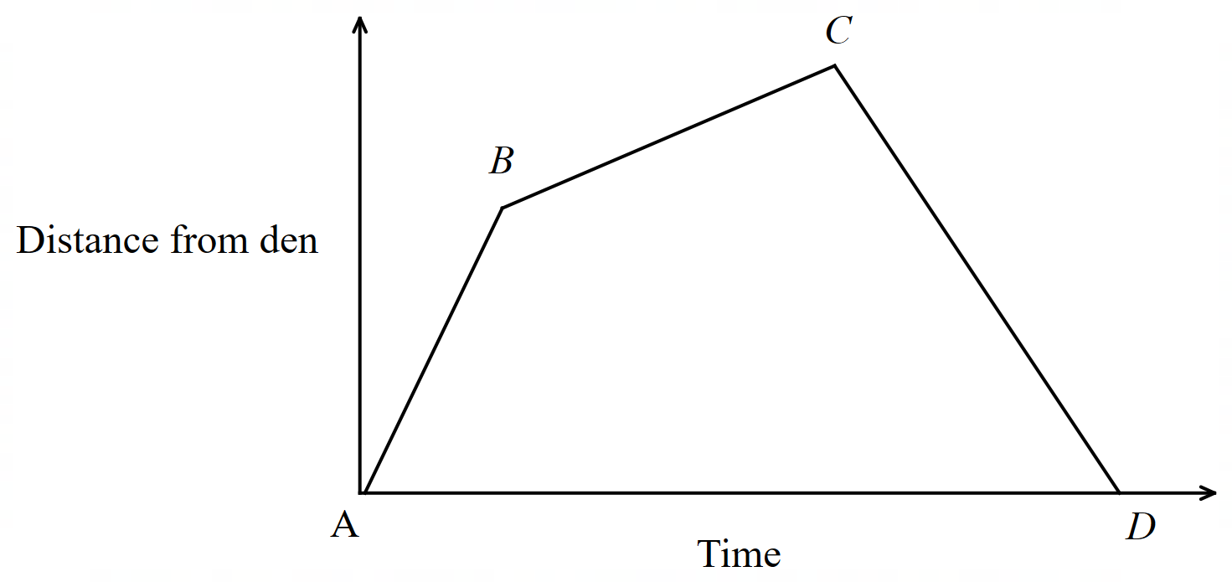
Distance-time graphs (3)
Match the story to the graph – correct answer
A lion left his den. He set off slowly, then increased his pace as he chased a gazelle, then walked slowly back to the den.
A lion left his den. He set off at high speed, then slowed down as he stalked a gazelle, then ran back to the den.
A lion left his den. He set off at high speed chasing a gazelle, stopped to rest, then ran back to the den.

Slide 6
Summarise

Slide 7
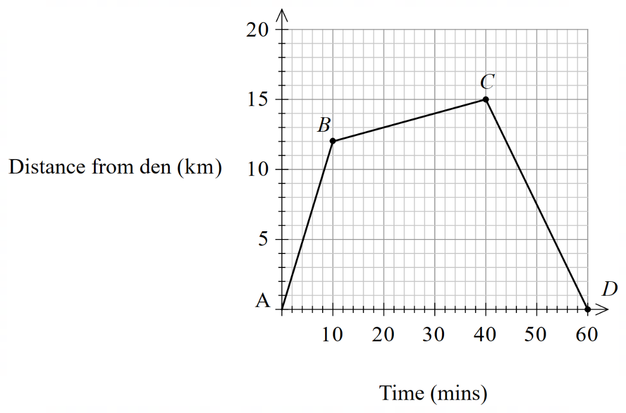
Distance-time graphs (4)
Speed
Speed of AB:
$$=12 km/10 min \\ =\frac{12 km}{10} \\ =1.2 km/min$$
Find the speed of BC and CD.

Slide 8
Distance-time graphs (5)
Worked example 1
The graph below shows the distance from home and time taken during a car journey of a person and their sibling who leave home to visit their relative’s house. After vising their relative, the person drops off their sibling at a friend’s house before going home. Using the graph, answer:
How long did they stay at their relative’s house?
$$1.5−1$$
$$=0.5 hours$$
Distance from home (km)
Time (h)

Slide 9
Distance-time graphs (6)
Worked example 1 – self-explanation prompts
The graph below shows the distance from home and time taken during a car journey of a person and their sibling who leave home to visit their relative’s house. After vising their relative, the person drops off their sibling at a friend’s house before going home. Using the graph, answer:
How do you know when the person isn’t moving?
How long did they stay at their relative’s house?
$$1.5−1$$
$$=0.5 hours$$
Distance from home (km)
Time (h)
Why does the graph return to $0$ km after 3 hours?

Slide 10
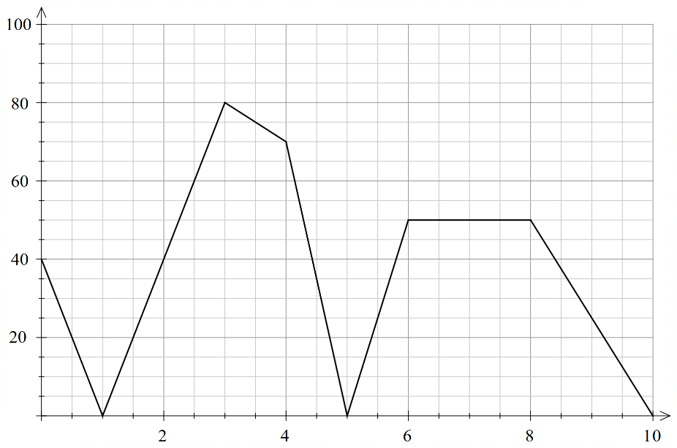
Distance-time graphs (7)
Your turn problem 1
The graph below shows the distance travelled from the warehouse by the delivery driver over 10 hours. The driver stopped for a lunch break during their shift. Using the graph, answer:
How long was the driver’s lunch break?
Distance from warehouse (km)
Time (h)

Slide 11
Distance-time graphs (8)
Your turn solution 1
The graph below shows the distance travelled from the warehouse by the delivery driver over 10 hours. The driver stopped for a lunch break during their shift. Using the graph, answer:
How long was the driver’s lunch break?
The driver is stationary between 6 and 8 hours so they must have had a 2-hour lunch break during this time.
Distance from warehouse (km)
Time (h)

Slide 12
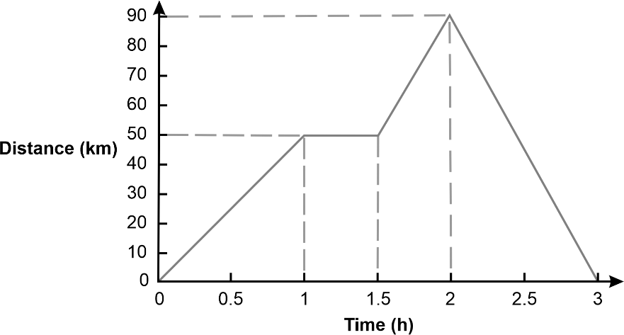
Distance-time graphs (9)
Worked example 2
The graph below shows the distance from home and time taken during a car journey of a person and their sibling who leave home to visit their relative’s house. After vising their relative, the person drops off their sibling at a friend’s house before going home. Using the graph, answer:
At what time was the person driving the fastest and what was their top speed?
The graph is steepest between 2 and 3 hours. $$Speed=\frac{90 km}{1 hour}$$
$$=90 km/h$$
Distance from home (km)
Time (h)

Slide 13
Distance-time graphs (10)
Worked example 2 – self-explanation prompts
The graph below shows the distance from home and time taken during a car journey of a person and their sibling who leave home to visit their relative’s house. After vising their relative, the person drops off their sibling at a friend’s house before going home. Using the graph, answer:
At what time was the person driving the fastest and what was their top speed?
The graph is steepest between 2 and 3 hours. $$Speed=\frac{90 km}{1 hour}$$
$$=90 km/h$$
Which segment would have the slowest speed?
Distance from home (km)
What does the triangle created by the graph tell us about the car’s speed?
Time (h)

Slide 14
Distance-time graphs (11)
Your turn solution 2
The graph below shows the distance travelled from the warehouse by the delivery driver over 10 hours. Using the graph, answer:
At what time was the driver travelling the fastest and what was their top speed?
Distance from warehouse (km)
Time h)

Slide 15
Distance-time graphs (12)
Your turn problem 2
The graph below shows the distance travelled from the warehouse by delivery driver over 10 hours. Using the graph, answer:
At what time was the driver travelling the fastest and what was their top speed?
The graph is steepest between 4 and 5 hours. $$Speed=\frac{70 km}{1 hour}$$
$$=70 km/h$$
Distance from warehouse (km)
Time h)

Slide 16
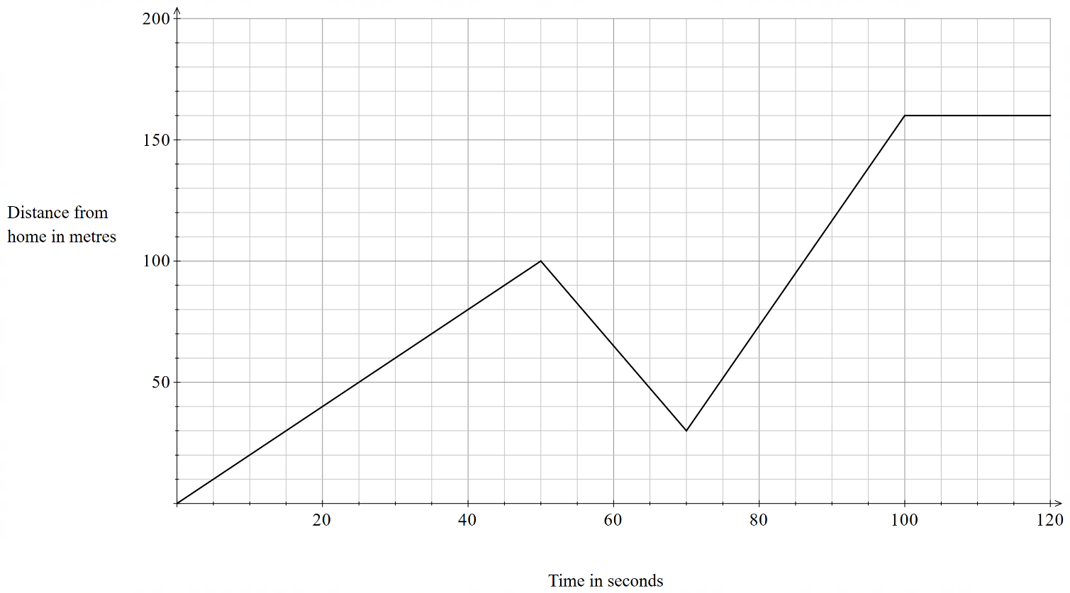
Distance-time graphs (13)
Bob’s journey to school

Slide 17
Apply

Slide 18
Distance-time graphs (14)
Heart rate zone training
Heart rate zone | % of maximum heart rate
Zone 1 | 50% to 60%
Zone 2 | 60% to 70%
Zone 3 | 70% to 80%
Zone 4 | 80% to 90%
Zone 5 | 90% to 100%
Targeted goals – it helps runners work towards specific fitness goals by staying in certain heart rate zones.
Right intensity – it ensures workouts are at the perfect level for improving fitness without overdoing it.
Track progress – it makes it easy to see how well you're improving and adjust your training as needed.

Slide 19
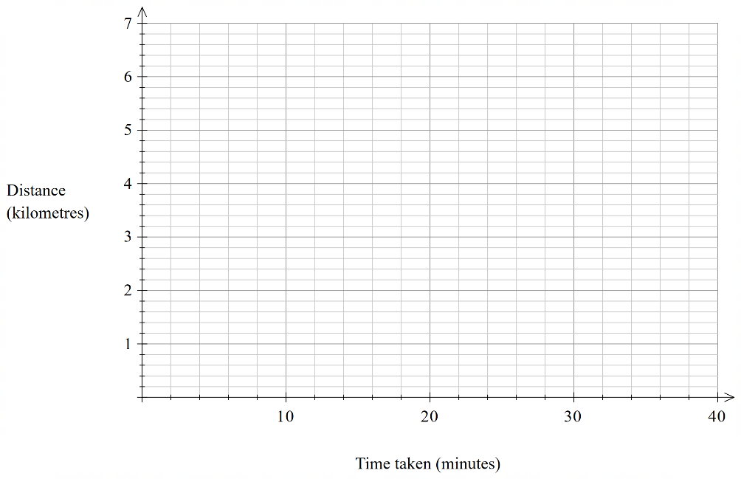
Distance-time graphs (15)
Heart rate zone training: distance-time graph
An athlete is running laps around an oval, their time taken to complete each lap (rounded to the nearest minute) and their average heart rate zone for each lap is provided in the table below.
Phase number | Time taken (nearest minute) | Average heart rate zone
Phase 1 | 6 | Zone 5
Phase 2 | 7 | Zone 4
Phase 3 | 7 | Zone 4
Phase 4 | 8 | Zone 2
Phase 5 | 10 | Zone 1

Slide 20
Copyright
© State of New South Wales (Department of Education), 2024
The copyright material published in this resource is subject to the Copyright Act 1968 (Cth) and is owned by the NSW Department of Education or, where indicated, by a party other than the NSW Department of Education (third-party material).
Copyright material available in this resource and owned by the NSW Department of Education is licensed under a Creative Commons Attribution 4.0 International (CC BY 4.0) licence.
This licence allows you to share and adapt the material for any purpose, even commercially.
Attribution should be given to © State of New South Wales (Department of Education), 2024.
Material in this resource not available under a Creative Commons licence:
the NSW Department of Education logo, other logos and trademark-protected material
Material owned by a third party that has been reproduced with permission. You will need to obtain permission from the third party to reuse its material.
Links to third-party material and websites
Please note that the provided (reading/viewing material/list/links/texts) are a suggestion only and implies no endorsement, by the New South Wales Department of Education, of any author, publisher, or book title. School principals and teachers are best placed to assess the suitability of resources that would complement the curriculum and reflect the needs and interests of their students.
If you use the links provided in this document to access a third party’s website, you acknowledge that the terms of use, including licence terms set out on the third-party’s website apply to the use which may be made of the materials on that third-party website or where permitted by the Copyright Act 1968 (Cth). The department accepts no responsibility for content on third-party websites.

