Slide 1
Describing geometrical patterns
Stage 4
Analysing patterns

Slide 2
Launch

Slide 3
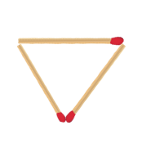
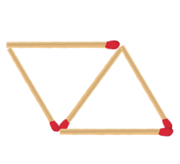
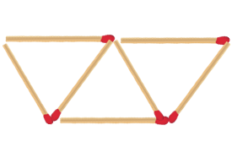
Describing geometrical patterns (1)
Matchstick pattern
Term 1
Term 2
Term 3
Adapted from Transum (1997–2024)

Slide 4
Summarise

Slide 5
Describing geometrical patterns (2)
John’s strategy
Term 1
$$1+2=3$$
Term 2
$$1+2+2=5$$
Term 3
$$1+2+2+2=7$$

Slide 6
Describing geometrical patterns (3)
John’s strategy
Term 1
$$1+2=3$$
How else can we express the number of 2’s?
Term 2
$$1+2+2=5$$
Term 3
$$1+2+2+2=7$$
Do you think there could be a relationship between the number of 2’s and the term number?

Slide 7
Describing geometrical patterns (4)
John’s strategy
Term 1
$$1+2=3$$
Term 2
$$1+2+2=5$$
Term 3
$$1+2+2+2=7$$
Number of matchsticks = 1 + 2 $×$ number of term
M = 1 + 2 $×$ t

Slide 8
Describing geometrical patterns (5)
Brendan’s strategy
Term 1
$$3$$
Term 2
$$3+2=5$$
Term 3
$$3+2+2=7$$

Slide 9
Describing geometrical patterns (6)
Brendan’s strategy
How is this strategy similar and different to John’s?
Term 1
$$3$$
Term 2
$$3+2=5$$
How can we write this using multiplication?
Term 3
$$3+2+2=7$$
Do you think there could be a relationship between the number of 2’s and the term number?

Slide 10
Describing geometrical patterns (7)
Brendan’s strategy
Term 1
$$3$$
Term 2
$$3+2=5$$
Term 3
$$3+2+2=7$$
Number of matchsticks = 3 + 2 $×$ (number of term – 1)
M = 1 + 2 $×$ (t - 1)

Slide 11
Apply

Slide 12
Describing geometrical patterns (8)
Appendix B ‘Matchstick patterns’ instructions
For each of the matchstick patterns:
complete the table of values for the first 3 terms
use a strategy to find what is happening with the pattern
describe the pattern in words
find how many matchsticks are in the 99th term.

Slide 13
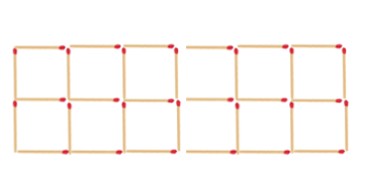
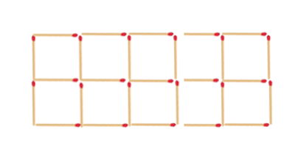
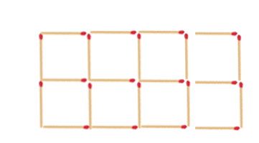
Describing geometrical patterns (9)
Reversed patterns
Pattern 1
Term 1
Term 2
Term 3

Slide 14
Describing geometrical patterns (10)
Reversed patterns
Pattern 2
Term 1
Term 2
Term 3

Slide 15
References
This presentation contains NSW Curriculum and syllabus content. The NSW Curriculum is developed by the NSW Education Standards Authority. This content is prepared by NESA for and on behalf of the Crown in the right of the State of New South Wales. The material is protected by Crown copyright.
Please refer to the NESA Copyright Disclaimer for more information https://educationstandards.nsw.edu.au/wps/portal/nesa/mini-footer/copyright.
NESA holds the only official and up-to-date versions of the NSW Curriculum and syllabus documents. Please visit the NSW Education Standards Authority (NESA) website https://educationstandards.nsw.edu.au/ and the NSW Curriculum website https://curriculum.nsw.edu.au.
Mathematics K–10 Syllabus © NSW Education Standards Authority (NESA) for and on behalf of the Crown in right of the State of New South Wales, 2022.
Transum (1997–2024) Matchstick Patterns: Level 1, Transum website, accessed 26 November 2024.

Slide 16
Copyright
© State of New South Wales (Department of Education), 2024
The copyright material published in this resource is subject to the Copyright Act 1968 (Cth) and is owned by the NSW Department of Education or, where indicated, by a party other than the NSW Department of Education (third-party material).
Copyright material available in this resource and owned by the NSW Department of Education is licensed under a Creative Commons Attribution 4.0 International (CC BY 4.0) licence.
This licence allows you to share and adapt the material for any purpose, even commercially.
Attribution should be given to © State of New South Wales (Department of Education), 2024.
Material in this resource not available under a Creative Commons licence:
the NSW Department of Education logo, other logos and trademark-protected material
Material owned by a third party that has been reproduced with permission. You will need to obtain permission from the third party to reuse its material.
Links to third-party material and websites
Please note that the provided (reading/viewing material/list/links/texts) are a suggestion only and implies no endorsement, by the New South Wales Department of Education, of any author, publisher, or book title. School principals and teachers are best placed to assess the suitability of resources that would complement the curriculum and reflect the needs and interests of their students.
If you use the links provided in this document to access a third party’s website, you acknowledge that the terms of use, including licence terms set out on the third-party’s website apply to the use which may be made of the materials on that third-party website or where permitted by the Copyright Act 1968 (Cth). The department accepts no responsibility for content on third-party websites.

