Slide 1
Describing linear relationships
Stage 4
Analysing patterns

Slide 2
Launch

Slide 3
Which one doesn’t belong?
A 0, 3, 6, 9, 12 | B 79.5, 82.5, 85.5, 90.5, 93.5
C 200, 197, 194, 191, 188 | D 1, 3, 9, 27, 81, 243

Slide 4
Summarise

Slide 5
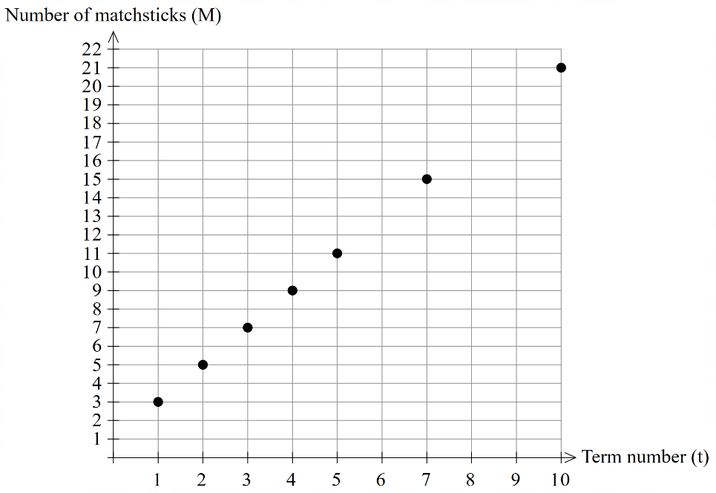
Describing linear relationships (1)
What makes a pattern linear?
Adapted from Transum (1997–2024)
Term number (t) | 1 | 2 | 3
Number of matchsticks (M) | 3 | 5 | 7

Slide 6
Apply

Slide 7
Tables and chairs (1)
Scenario 1

Slide 8
Tables and chairs (2)
Scenario 1 questions
What is the maximum seating capacity for the event if the school has 720 tables?
There are 721 people who have currently paid for the event. How many tables and chairs do we need to set up?

Slide 9
Tables and chairs (3)
Scenario 2
In Egypt in 2019, approximately 7000 people sat at a Ramadan feast table just over 3000m long.
How many tables would we need to seat 7000 people?

Slide 10
References
This presentation contains NSW Curriculum and syllabus content. The NSW Curriculum is developed by the NSW Education Standards Authority. This content is prepared by NESA for and on behalf of the Crown in the right of the State of New South Wales. The material is protected by Crown copyright.
Please refer to the NESA Copyright Disclaimer for more information https://educationstandards.nsw.edu.au/wps/portal/nesa/mini-footer/copyright.
NESA holds the only official and up-to-date versions of the NSW Curriculum and syllabus documents. Please visit the NSW Education Standards Authority (NESA) website https://educationstandards.nsw.edu.au/ and the NSW Curriculum website https://curriculum.nsw.edu.au.
Mathematics K–10 Syllabus © NSW Education Standards Authority (NESA) for and on behalf of the Crown in right of the State of New South Wales, 2022.
Transum (1997–2024) Matchstick Patterns: Level 1, Transum website, accessed 26 November 2024.

Slide 11
Copyright
© State of New South Wales (Department of Education), 2024
The copyright material published in this resource is subject to the Copyright Act 1968 (Cth) and is owned by the NSW Department of Education or, where indicated, by a party other than the NSW Department of Education (third-party material).
Copyright material available in this resource and owned by the NSW Department of Education is licensed under a Creative Commons Attribution 4.0 International (CC BY 4.0) licence.
This licence allows you to share and adapt the material for any purpose, even commercially.
Attribution should be given to © State of New South Wales (Department of Education), 2024.
Material in this resource not available under a Creative Commons licence:
the NSW Department of Education logo, other logos and trademark-protected material
Material owned by a third party that has been reproduced with permission. You will need to obtain permission from the third party to reuse its material.
Links to third-party material and websites
Please note that the provided (reading/viewing material/list/links/texts) are a suggestion only and implies no endorsement, by the New South Wales Department of Education, of any author, publisher, or book title. School principals and teachers are best placed to assess the suitability of resources that would complement the curriculum and reflect the needs and interests of their students.
If you use the links provided in this document to access a third party’s website, you acknowledge that the terms of use, including licence terms set out on the third-party’s website apply to the use which may be made of the materials on that third-party website or where permitted by the Copyright Act 1968 (Cth). The department accepts no responsibility for content on third-party websites.

