Slide 1
Linear equations
Stage 4
Analysing patterns

Slide 2
Launch

Slide 3
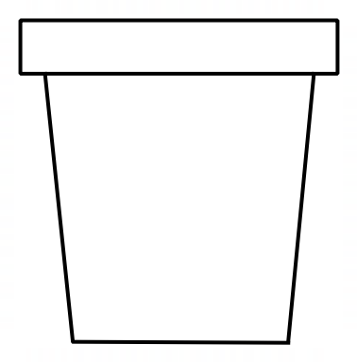
Linear equations (1)
Disposable cup

Slide 4
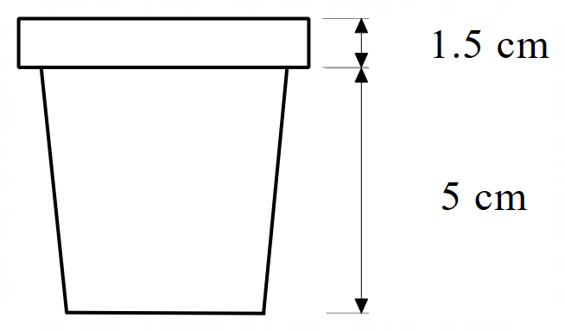
Linear equations (2)
Disposable cup – measurements

Slide 5
Explore

Slide 6
Linear equations (3)
Stacking cups pattern – table
Number of cups | Height of stack (cm)
0
1
2
3

Slide 7
Linear equations (4)
Stacking cups pattern – finding number of cups
How many cups to reach:
14 cm
15 cm
1 m

Slide 8
Linear equations (5)
Stacking cups pattern – equation
$$Height = 5 + number of cups × 1.5$$

Slide 9
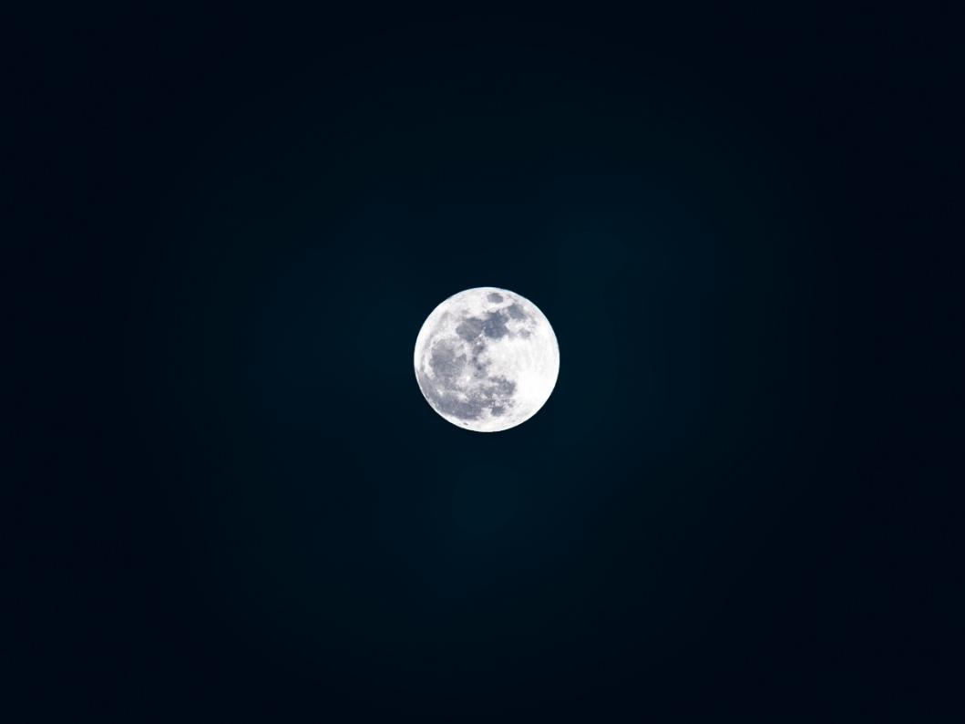
Linear equations (6)
How many cups to reach the moon?
“Moon” is licensed under CC0 1.0 Universal

Slide 10
Linear equations (7)
How many cups to reach the moon?
Distance from Earth:
384 400 km
“Moon” is licensed under CC0 1.0 Universal

Slide 11
Summarise

Slide 12
Linear equations (8)
Worked example 1
Find the linear equation that represents the pattern in the table.
$$x$$ | $$y$$
$$0$$ | $$3$$
$$1$$ | $$5$$
$$2$$ | $$7$$
$$3$$ | $$9$$
Rate of increase = 2
Constant = 3
$$y=2x+3$$

Slide 13
Linear equations (9)
Worked example 1 – self explanation prompts
Find the linear equation that represents the pattern in the table.
$$x$$ | $$y$$
$$0$$ | $$3$$
$$1$$ | $$5$$
$$2$$ | $$7$$
$$3$$ | $$9$$
How do you know the constant is 3?
Rate of increase = 2
Constant = 3
$$y=2x+3$$
What is the pattern increasing by?

Slide 14
Linear equations (10)
Your turn problem 1
Find the linear equation that represents the pattern in the table.
$$x$$ | $$y$$
$$0$$ | $$4$$
$$1$$ | $$7$$
$$2$$ | $$10$$
$$3$$ | $$13$$

Slide 15
Linear equations (11)
Your turn problem 1 – solution
Find the linear equation that represents the pattern in the table.
$$x$$ | $$y$$
$$0$$ | $$4$$
$$1$$ | $$7$$
$$2$$ | $$10$$
$$3$$ | $$13$$
Rate of increase = 3
Constant = 4
$$y=3x+4$$

Slide 16
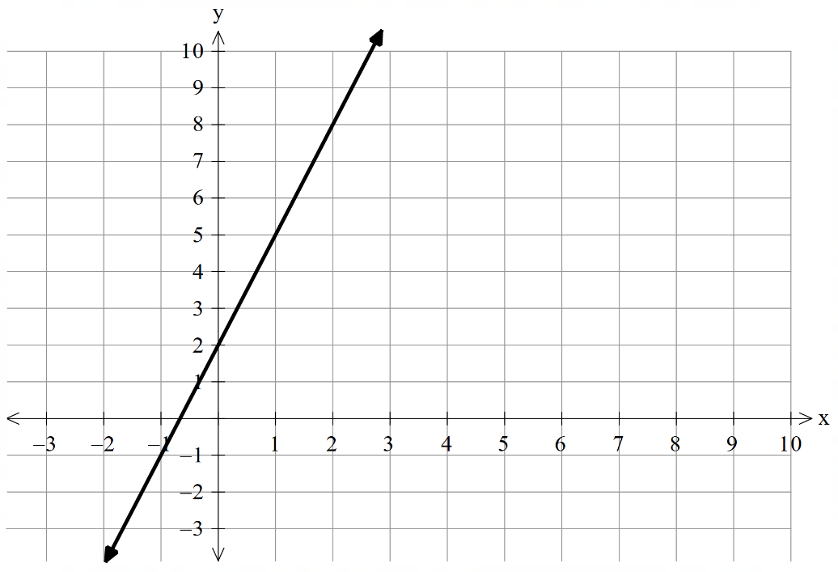
Linear equations (12)
Worked example 2
Find the linear equation that represents the pattern in the graph.
Rate of increase = 3
Constant = 2
$$y=3x+2$$

Slide 17
Linear equations (13)
Worked example 2 – self explanation prompts
Find the linear equation that represents the pattern in the graph.
What is the pattern increasing by?
Rate of increase = 3
Constant = 2
$$y=3x+2$$
How do you know the constant is 2?
In a graph, the variable is referred to as the gradient. Why do you think we use the term gradient?

Slide 18
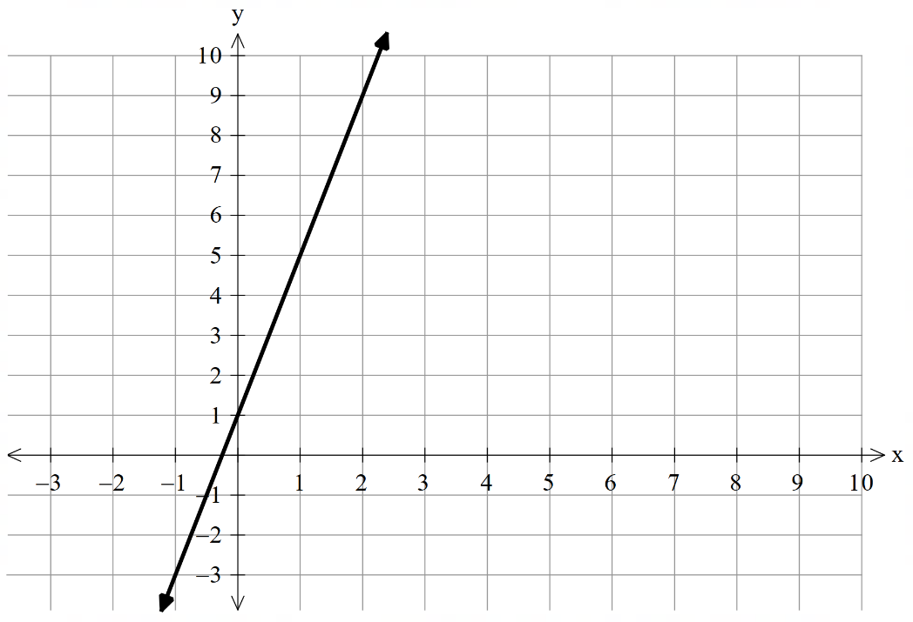
Linear equations (14)
Your turn problem 2
Find the linear equation that represents the pattern in the graph.

Slide 19
Linear equations (15)
Your turn problem 2
Find the linear equation that represents the pattern in the graph.
Rate of increase = 4
Constant = 1
$$y=4x+1$$

Slide 20
Copyright
© State of New South Wales (Department of Education), 2024
The copyright material published in this resource is subject to the Copyright Act 1968 (Cth) and is owned by the NSW Department of Education or, where indicated, by a party other than the NSW Department of Education (third-party material).
Copyright material available in this resource and owned by the NSW Department of Education is licensed under a Creative Commons Attribution 4.0 International (CC BY 4.0) licence.
This licence allows you to share and adapt the material for any purpose, even commercially.
Attribution should be given to © State of New South Wales (Department of Education), 2024.
Material in this resource not available under a Creative Commons licence:
the NSW Department of Education logo, other logos and trademark-protected material
Material owned by a third party that has been reproduced with permission. You will need to obtain permission from the third party to reuse its material.
Links to third-party material and websites
Please note that the provided (reading/viewing material/list/links/texts) are a suggestion only and implies no endorsement, by the New South Wales Department of Education, of any author, publisher, or book title. School principals and teachers are best placed to assess the suitability of resources that would complement the curriculum and reflect the needs and interests of their students.
If you use the links provided in this document to access a third party’s website, you acknowledge that the terms of use, including licence terms set out on the third-party’s website apply to the use which may be made of the materials on that third-party website or where permitted by the Copyright Act 1968 (Cth). The department accepts no responsibility for content on third-party websites.

