Slide 1

Solving equations
Stage 4
Analysing patterns

Slide 2
Launch

Slide 3
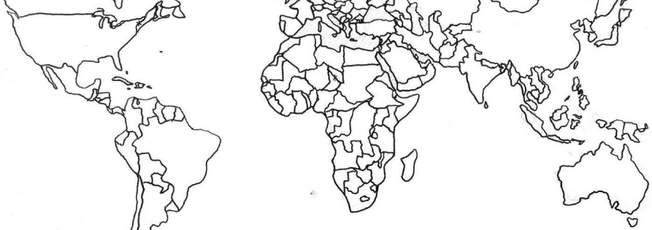
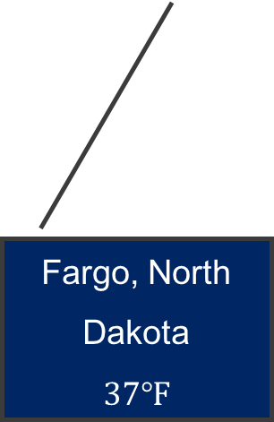
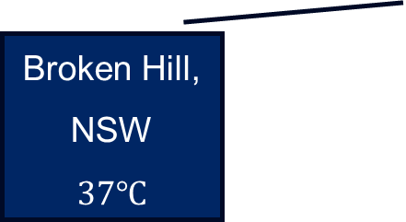
Temperature difference
Broken Hill and North Dakota
Fargo, North Dakota
$$37℉$$
Broken Hill, NSW
$$37℃$$
Screenshot of Free Printable Blank Outline Map of World by Blank World Map (2024)

Slide 4
Summarise

Slide 5
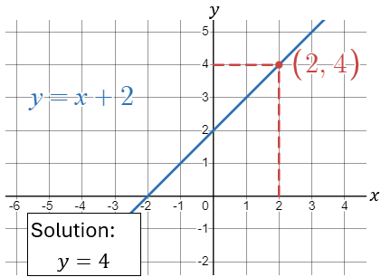
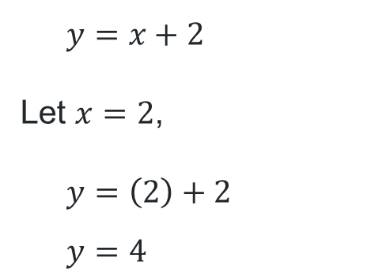
Solving equations (1)
Solving equations – example 1
Solve the equation 𝑦 = 𝑥 + 2 for 𝑥 = 2
Graphically
Algebraically
$$y=x+2$$
Let $x=2$,
$$y=\left(2\right)+2 \\ y=4$$

Slide 6
Solving equations (2)
Solving equations – example 1
Solve the equation 𝑦 = 𝑥 + 2 for 𝑥 = 2
Graphically
Algebraically
What does this line represent?
$$y=x+2$$
Let $x=2$,
$$y=\left(2\right)+2 \\ y=4$$
What does this mean?
What does this line represent?

Slide 7
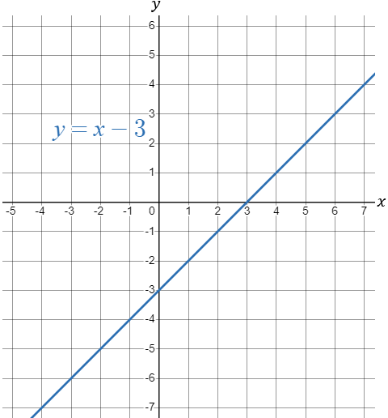
Solving equations (3)
Your turn – question 1
Solve the equation 𝑦 = 𝑥 − 3 for 𝑥 = 5
Graphically
Algebraically

Slide 8
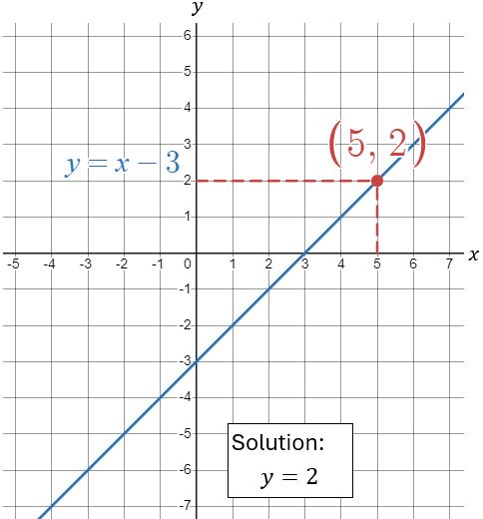
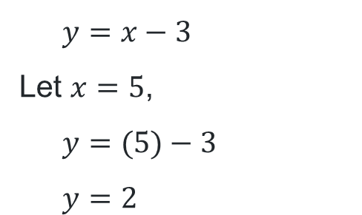
Solving equations (4)
Your turn – solution 1
Solve the equation 𝑦 = 𝑥 − 3 for 𝑥 = 5
Graphically
Algebraically
$$y=x−3$$
Let $x=5$,
$$y=(5)−3 \\ y=2$$

Slide 9
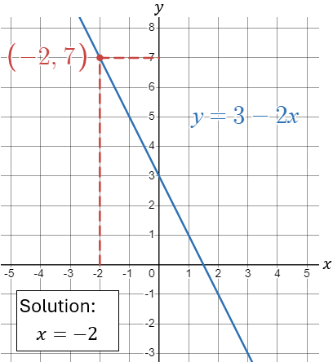
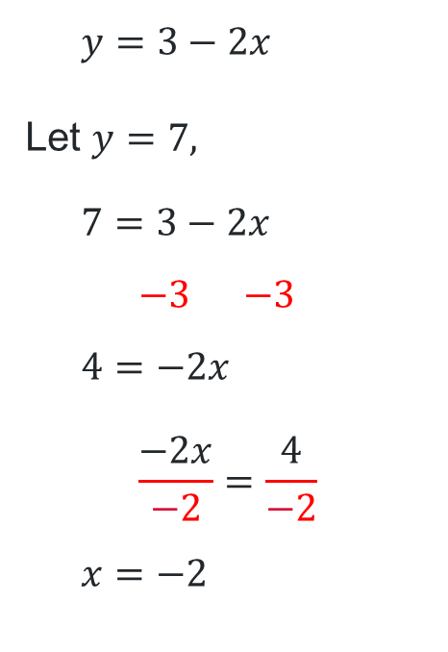
Solving equations (5)
Solving equations – example 2
Solve the equation 𝑦 = 3 − 2𝑥 for 𝑦 = 7
Graphically
Algebraically
$$y=3−2x$$
Let $y=7,$
$$7=3−2x$$
$$−3=−3$$
$$4=−2x$$
$$\frac{−2x}{−2}=\frac{4}{−2}$$
$$x=−2$$

Slide 10
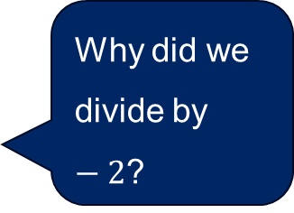
Solving equations (6)
Solving equations – example 2 prompts
Solve the equation 𝑦 = 3 − 2𝑥 for 𝑦 = 7
Graphically
Algebraically
$$y=3−2x$$
Let $y=7,$
$$7=3−2x$$
$$−3=−3$$
$$4=−2x$$
$$\frac{−2x}{−2}=\frac{4}{−2}$$
$$x=−2$$
What is this line?
Why did we divide by $−2$?
Why did we swap sides?

Slide 11
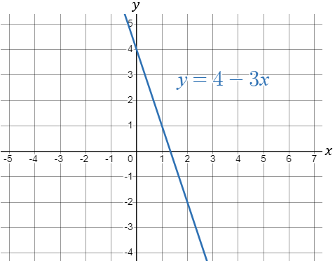
Solving equations (7)
Your turn – question 2
Solve the equation 𝑦 = 4 − 3𝑥 for 𝑦 = −2
Graphically
Algebraically

Slide 12
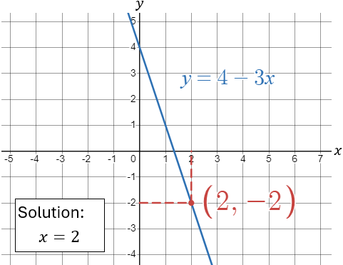
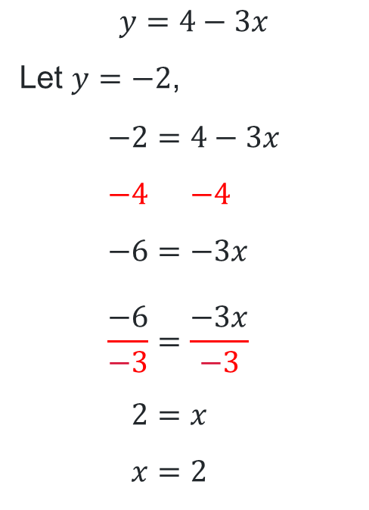
Solving equations (8)
Your turn – question 2
Solve the equation $y=4−3x$ for $y=−2$
Graphically
Algebraically
$$y=4−3x$$
Let $y=−2$,
$$−2=4−3x \\ −4=−4 \\ −6=−3x \\ \frac{−6}{−3}=\frac{−3x}{−3} \\ 2=x \\ x=2$$

Slide 13
Copyright
© State of New South Wales (Department of Education), 2024
The copyright material published in this resource is subject to the Copyright Act 1968 (Cth) and is owned by the NSW Department of Education or, where indicated, by a party other than the NSW Department of Education (third-party material).
Copyright material available in this resource and owned by the NSW Department of Education is licensed under a Creative Commons Attribution 4.0 International (CC BY 4.0) licence.
This licence allows you to share and adapt the material for any purpose, even commercially.
Attribution should be given to © State of New South Wales (Department of Education), 2024.
Material in this resource not available under a Creative Commons licence:
the NSW Department of Education logo, other logos and trademark-protected material
Material owned by a third party that has been reproduced with permission. You will need to obtain permission from the third party to reuse its material.
Links to third-party material and websites
Please note that the provided (reading/viewing material/list/links/texts) are a suggestion only and implies no endorsement, by the New South Wales Department of Education, of any author, publisher, or book title. School principals and teachers are best placed to assess the suitability of resources that would complement the curriculum and reflect the needs and interests of their students.
If you use the links provided in this document to access a third party’s website, you acknowledge that the terms of use, including licence terms set out on the third-party’s website apply to the use which may be made of the materials on that third-party website or where permitted by the Copyright Act 1968 (Cth). The department accepts no responsibility for content on third-party websites.

