Slide 1
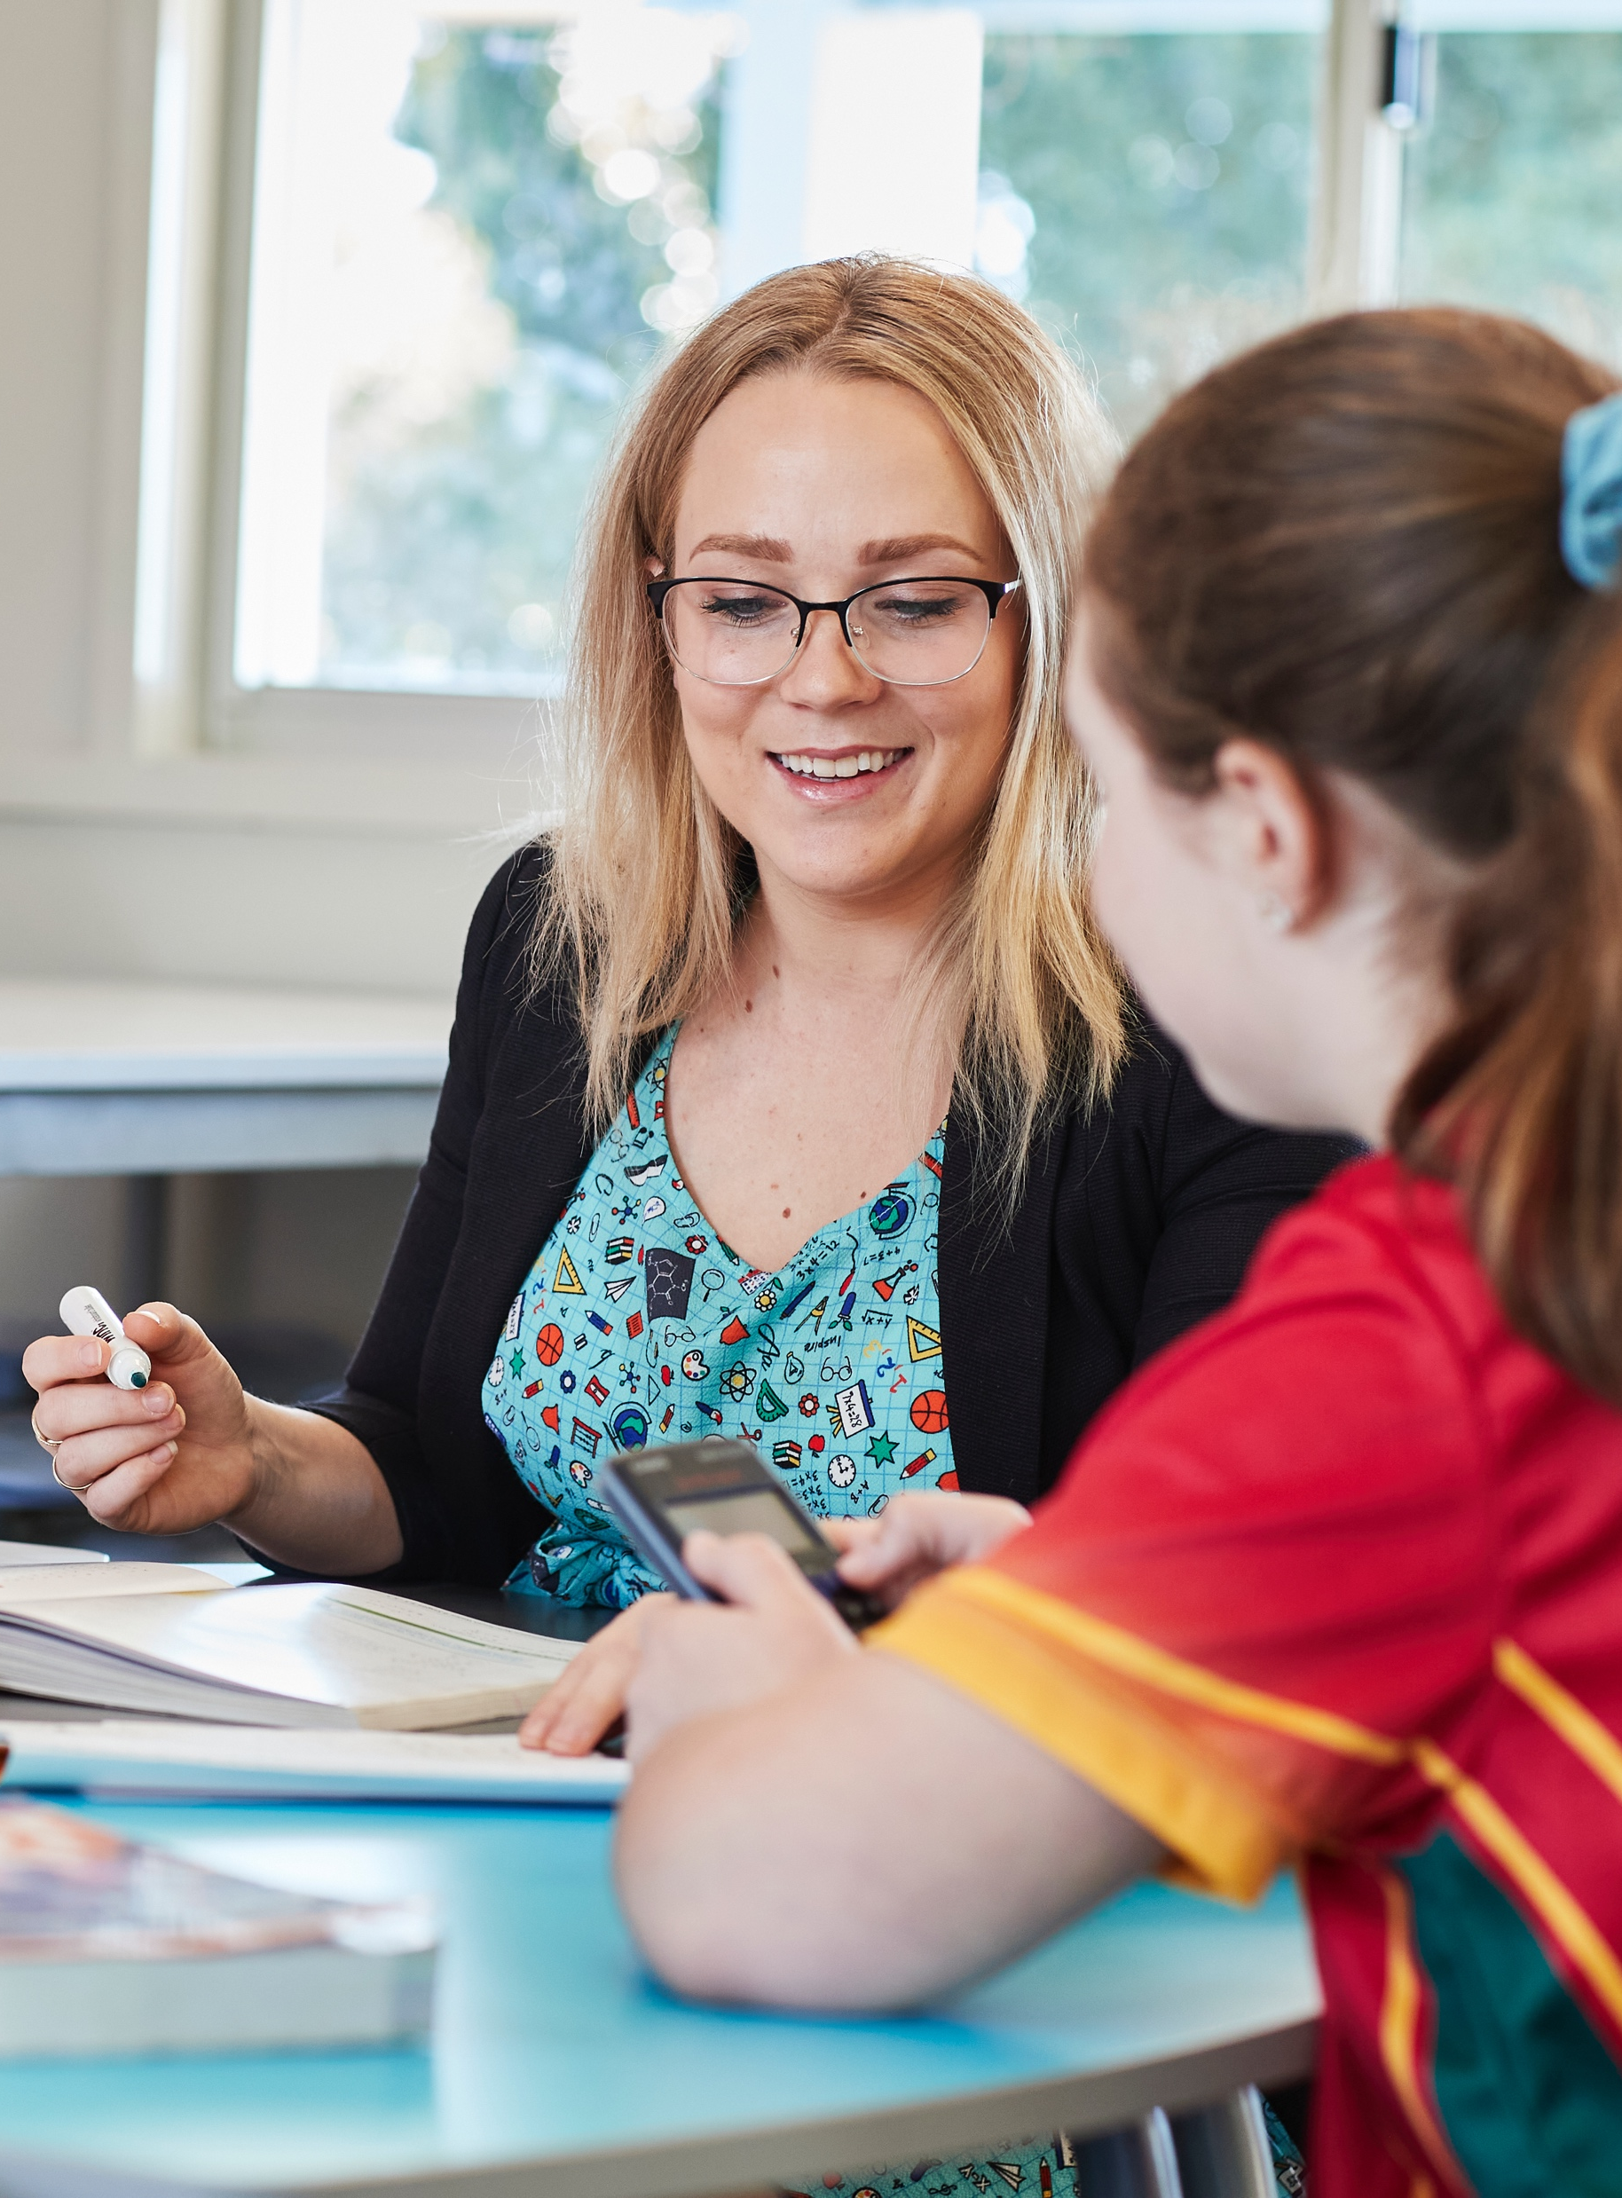
Point of intersection
Stage 4
Analysing patterns

Slide 2
Explore

Slide 3
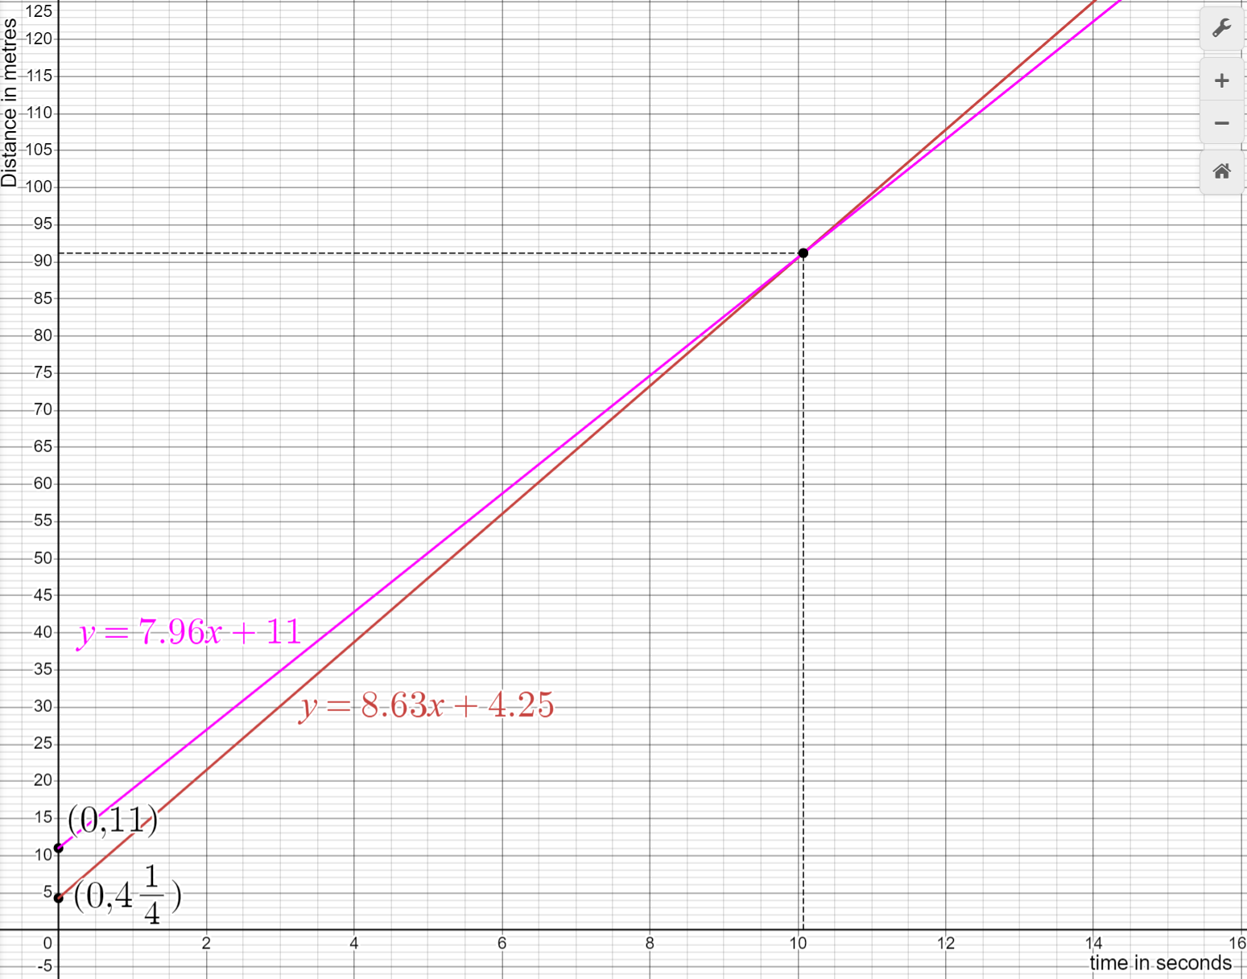
Point of intersection (1)
Chloe (red) and Jennifer (pink)

Slide 4
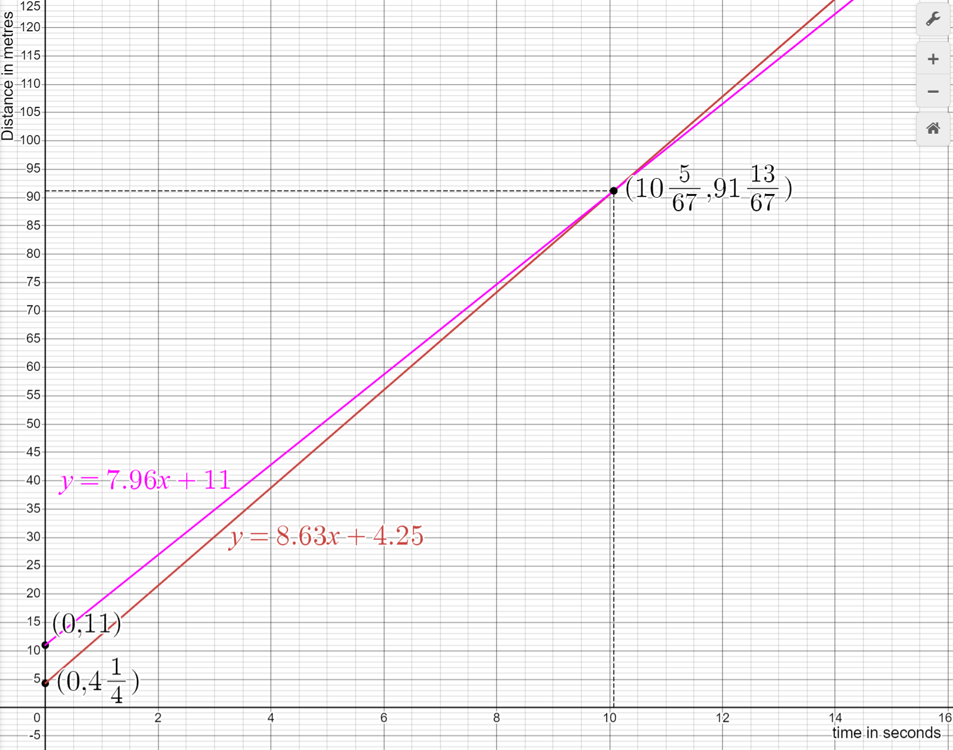
Point of intersection (2)
Chloe and Jennifer – point of intersection

Slide 5
Summarise

Slide 6
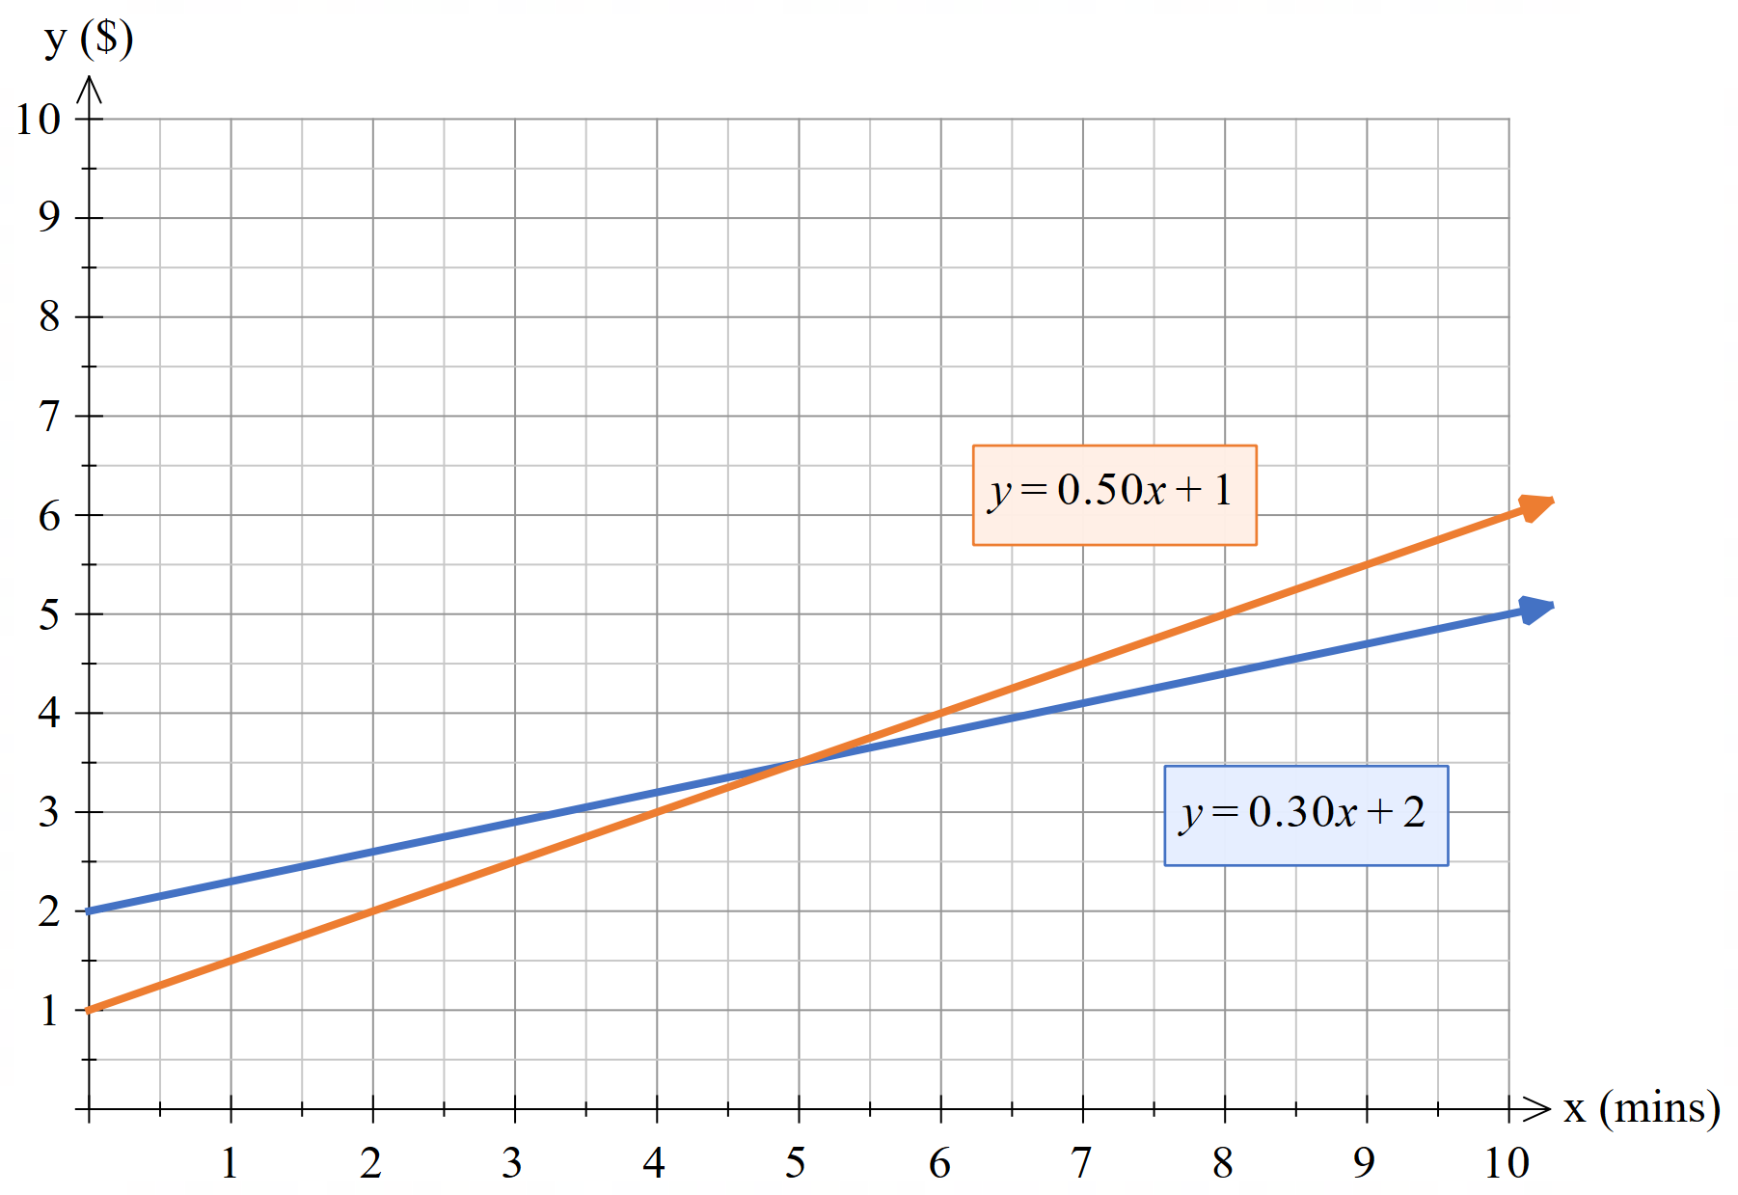
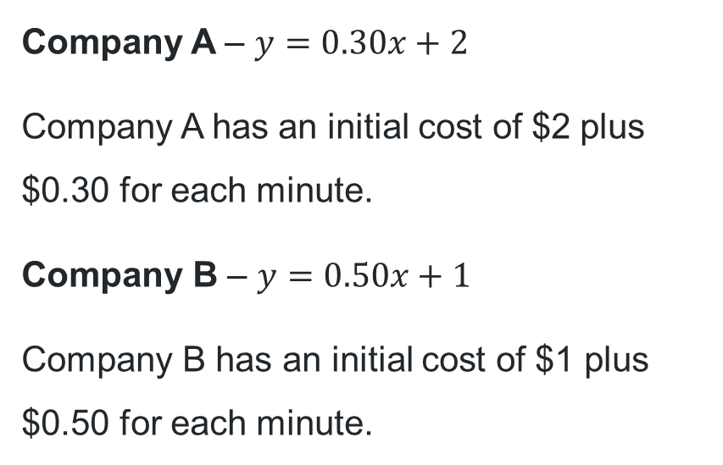
Point of intersection (3)
Electric scooter rentals
Company A – $y=0.30x+2$
Company A has an initial cost of $2 plus $0.30 for each minute.
Company B – $y=0.50x+1$
Company B has an initial cost of $1 plus $0.50 for each minute.

Slide 7
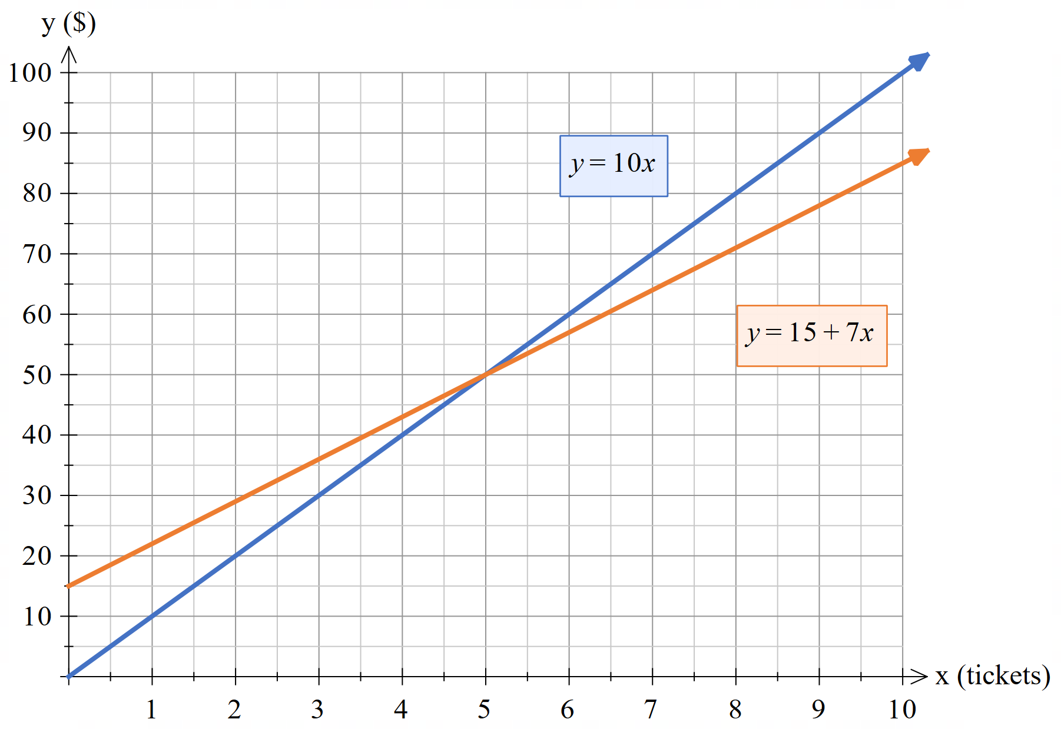
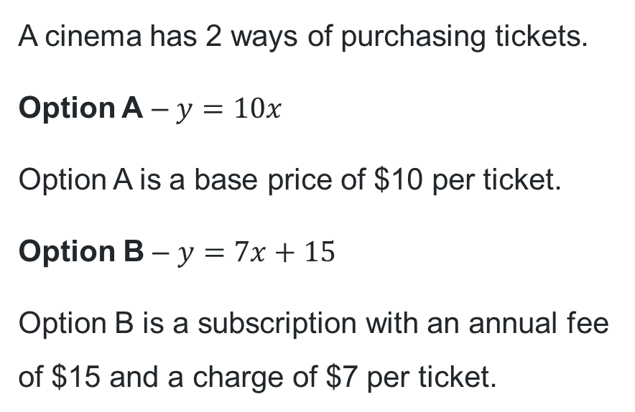
Point of intersection (4)
Cinema tickets
A cinema has 2 ways of purchasing tickets.
Option A – $y=10x$
Option A is a base price of $10 per ticket.
Option B – $y=7x+15$
Option B is a subscription with an annual fee of $15 and a charge of $7 per ticket.

Slide 8
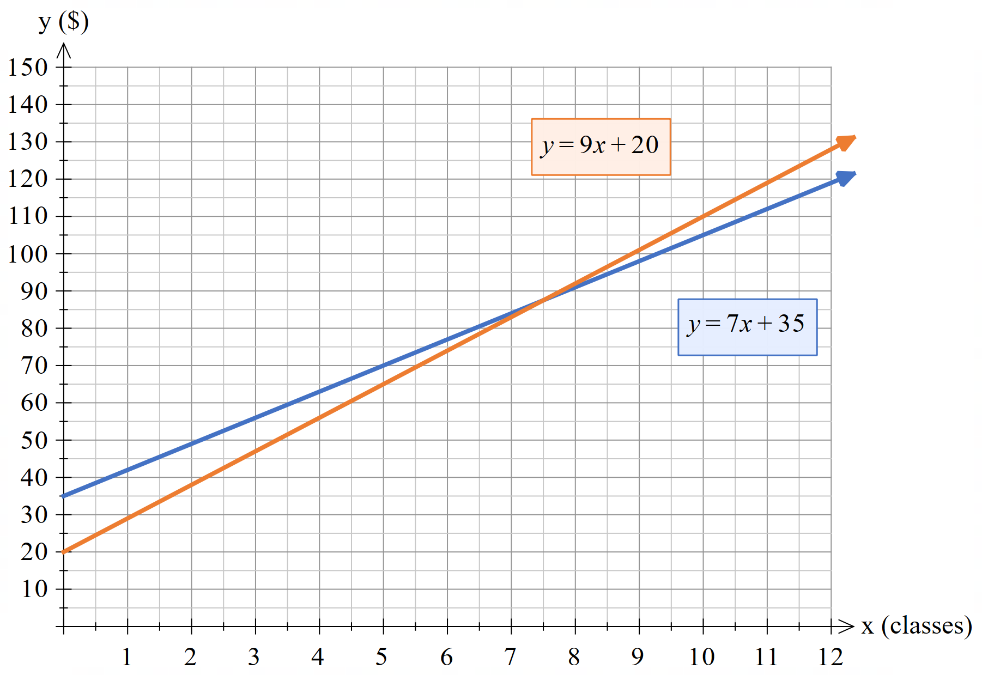
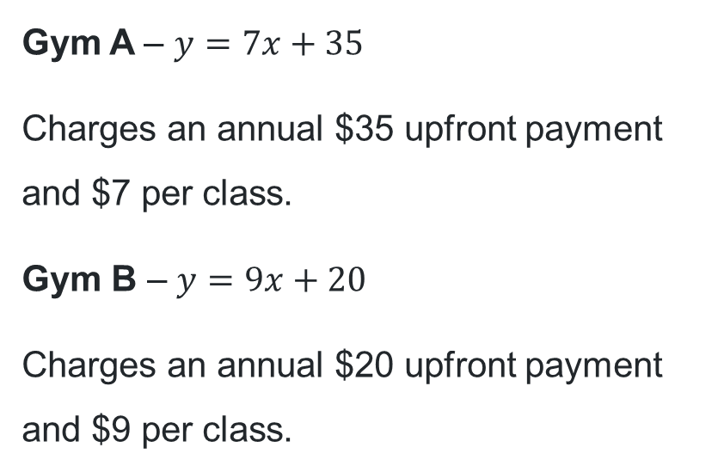
Point of intersection (5)
Gym membership
Gym A – $y=7x+35$
Charges an annual $35 upfront payment and $7 per class.
Gym B – $y=9x+20$
Charges an annual $20 upfront payment and $9 per class.

Slide 9
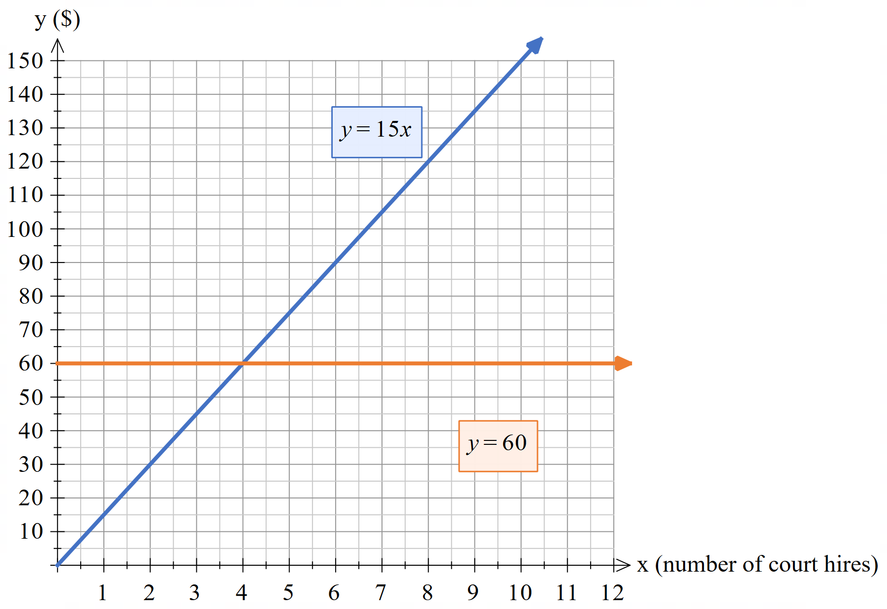
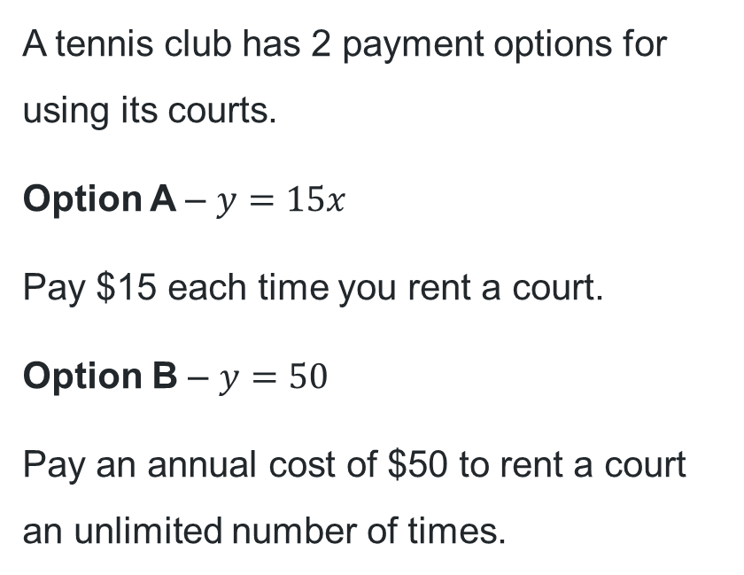
Point of intersection (6)
Tennis court hire
A tennis club has 2 payment options for using its courts.
Option A – $y=15x$
Pay $15 each time you rent a court.
Option B – $y=50$
Pay an annual cost of $50 to rent a court an unlimited number of times.

Slide 10
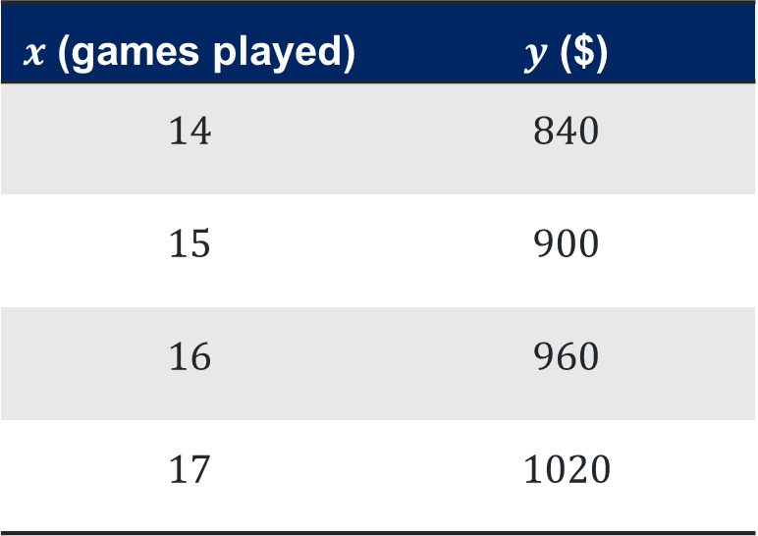
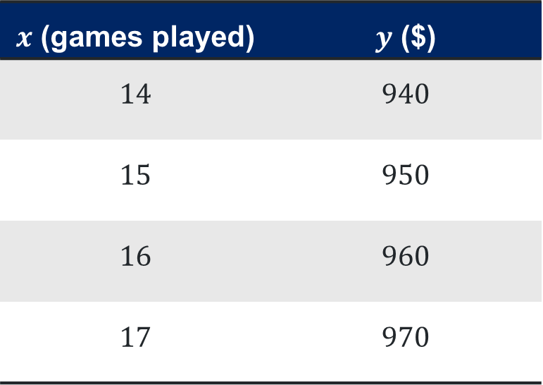
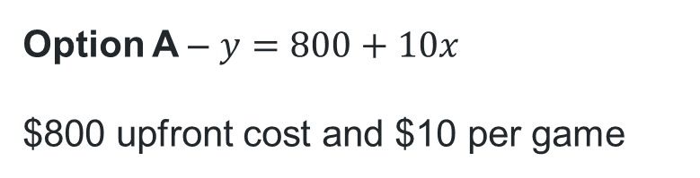
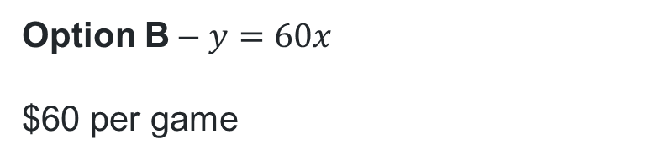
Point of intersection (7)
Golf membership
Option A – $y=800+10x$
$800 upfront cost and $10 per game
Option B – $y=60x$
$60 per game
$x$ (games played) | $y$ ($)
$$14$$ | $$940$$
$$15$$ | $$950$$
$$16$$ | $$960$$
$$17$$ | $$970$$
$x$ (games played) | $y$ ($)
$$14$$ | $$840$$
$$15$$ | $$900$$
$$16$$ | $$960$$
$$17$$ | $$1020$$

Slide 11
Copyright
© State of New South Wales (Department of Education), 2024
The copyright material published in this resource is subject to the Copyright Act 1968 (Cth) and is owned by the NSW Department of Education or, where indicated, by a party other than the NSW Department of Education (third-party material).
Copyright material available in this resource and owned by the NSW Department of Education is licensed under a Creative Commons Attribution 4.0 International (CC BY 4.0) licence.
This licence allows you to share and adapt the material for any purpose, even commercially.
Attribution should be given to © State of New South Wales (Department of Education), 2024.
Material in this resource not available under a Creative Commons licence:
the NSW Department of Education logo, other logos and trademark-protected material
Material owned by a third party that has been reproduced with permission. You will need to obtain permission from the third party to reuse its material.
Links to third-party material and websites
Please note that the provided (reading/viewing material/list/links/texts) are a suggestion only and implies no endorsement, by the New South Wales Department of Education, of any author, publisher, or book title. School principals and teachers are best placed to assess the suitability of resources that would complement the curriculum and reflect the needs and interests of their students.
If you use the links provided in this document to access a third party’s website, you acknowledge that the terms of use, including licence terms set out on the third-party’s website apply to the use which may be made of the materials on that third-party website or where permitted by the Copyright Act 1968 (Cth). The department accepts no responsibility for content on third-party websites.

