Slide 1
Prisms and cylinders
Stage 4
Constructing cylinders

Slide 2
Launch

Slide 3
Prisms and cylinders (1)
Cylinders

Slide 4
Explore

Slide 5
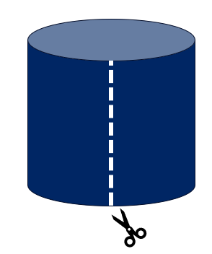
Prisms and cylinders (2)
Cylinder – combined shapes

Slide 6
Summarise

Slide 7
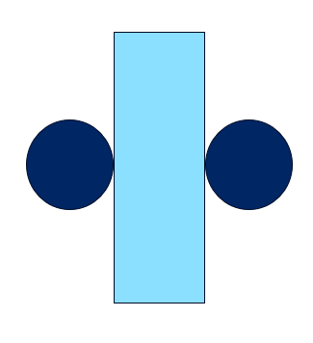
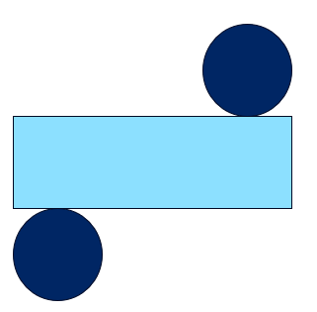
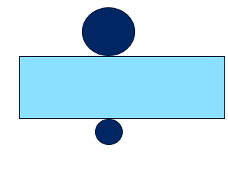
Prisms and cylinders (3)
Nets of cylinders
A
B
C
D
E

Slide 8
Apply

Slide 9
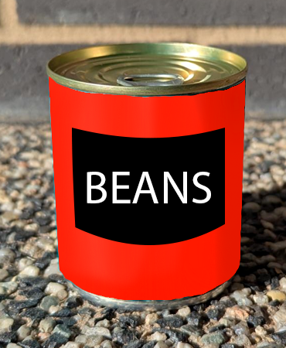
Prisms and cylinders (4)
Beans – closed tin

Slide 10
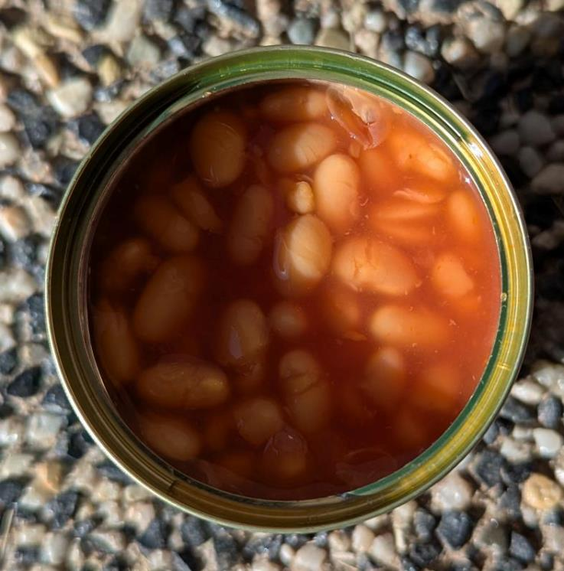
Prisms and cylinders (5)
Beans – open tin

Slide 11
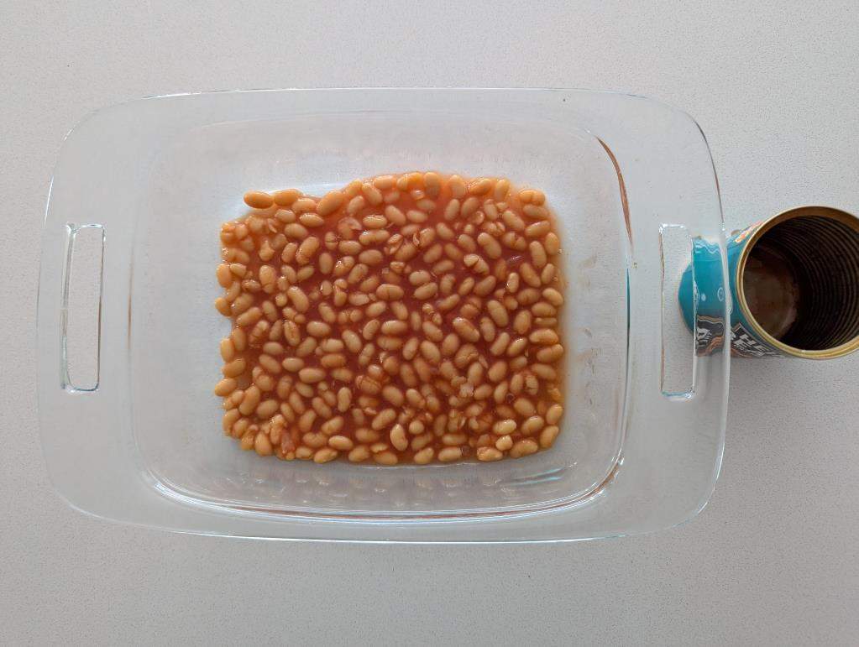
Prisms and cylinders (6)
Beans – flat container

Slide 12
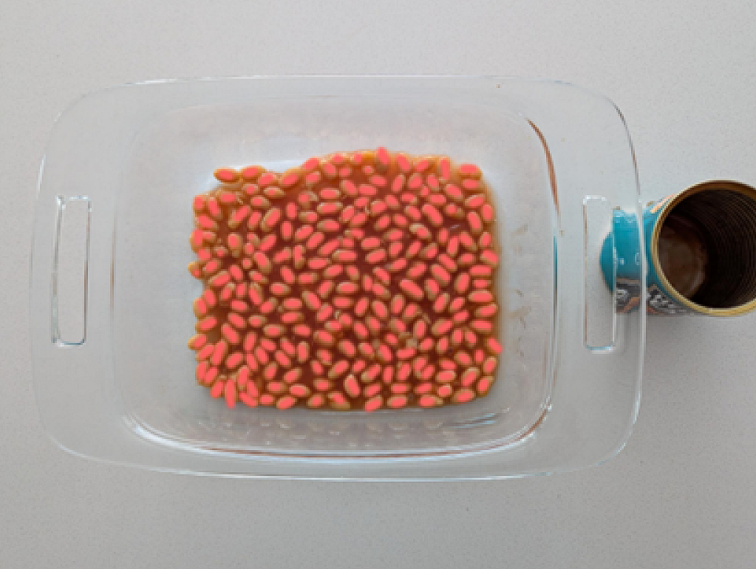
Prisms and cylinders (7)
Beans – reveal

Slide 13
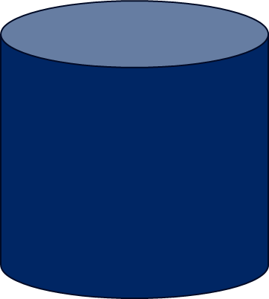
Prisms and cylinders (8)
Beans – volume of a cylinder
Cross-section = 31 Beans
Number of layers = 7
Volume = area of cross-section $×$ height
Estimated total number of beans = 217
How does this information relate to finding the volume of a cylinder?
How can I write the volume of a cylinder as a formula?

Slide 14
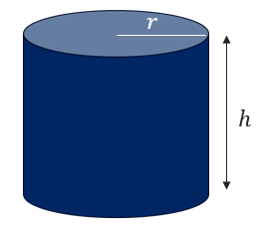
Prisms and cylinders (9)
Formula for the volume of a cylinder
Volume = area of a circle $×$ height
$$V= πr^{2}×h$$

Slide 15
Copyright
© State of New South Wales (Department of Education), 2025
The copyright material published in this resource is subject to the Copyright Act 1968 (Cth) and is owned by the NSW Department of Education or, where indicated, by a party other than the NSW Department of Education (third-party material).
Copyright material available in this resource and owned by the NSW Department of Education is licensed under a Creative Commons Attribution 4.0 International (CC BY 4.0) license.
This license allows you to share and adapt the material for any purpose, even commercially.
Attribution should be given to © State of New South Wales (Department of Education), 2025.
Material in this resource not available under a Creative Commons license:
the NSW Department of Education logo, other logos and trademark-protected material
material owned by a third party that has been reproduced with permission. You will need to obtain permission from the third party to reuse its material.
Links to third-party material and websites
Please note that the provided (reading/viewing material/list/links/texts) are a suggestion only and implies no endorsement, by the New South Wales Department of Education, of any author, publisher, or book title. School principals and teachers are best placed to assess the suitability of resources that would complement the curriculum and reflect the needs and interests of their students.
If you use the links provided in this document to access a third party’s website, you acknowledge that the terms of use, including licence terms set out on the third-party’s website apply to the use which may be made of the materials on that third-party website or where permitted by the Copyright Act 1968 (Cth). The department accepts no responsibility for content on third-party websites.

