Slide 1
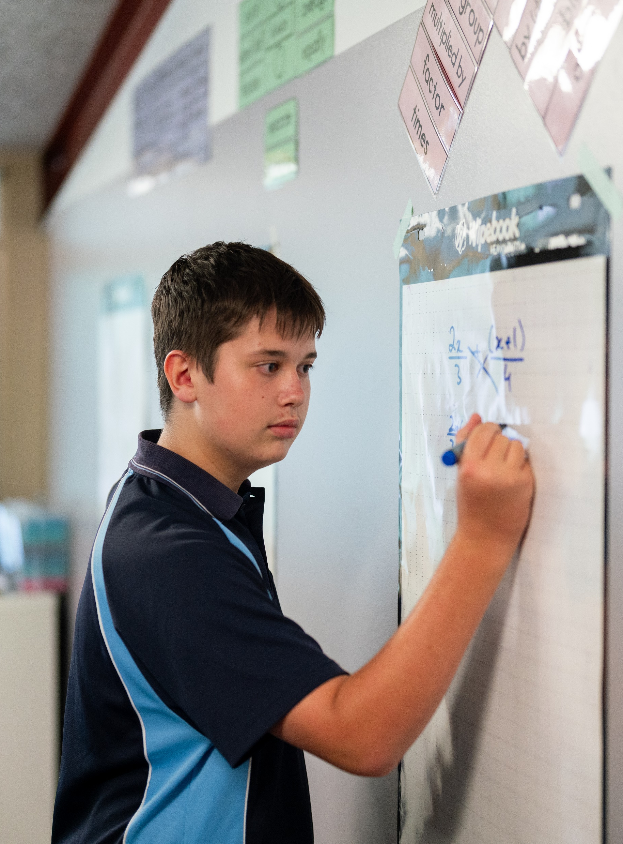
Cylinders and water
Stage 4
Constructing cylinders

Slide 2
Launch

Slide 3
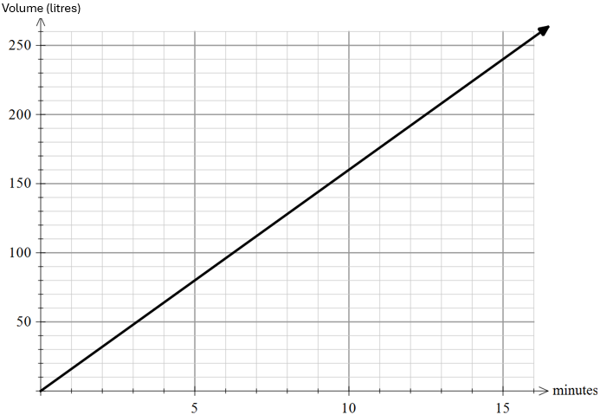

Cylinders and water (1)
Filling a swimming pool
How long will it take to fill the pool?

Slide 4
Explore

Slide 5
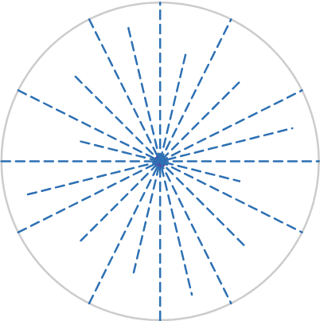
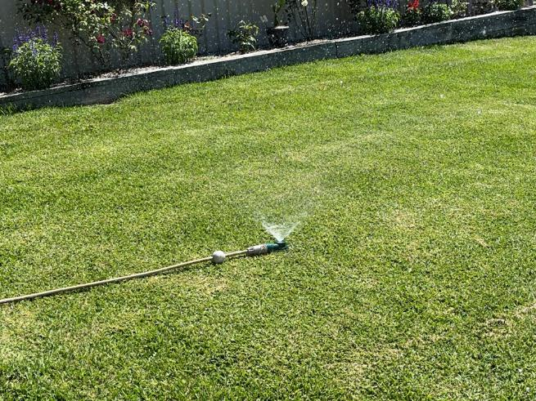
Cylinders and water (2)
Watering the lawn
3 metres

Slide 6
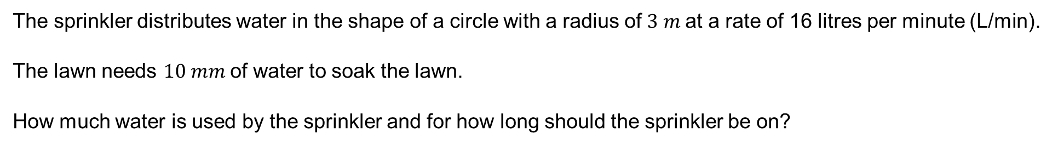
Cylinders and water (3)
Using a sprinkler
The sprinkler distributes water in the shape of a circle with a radius of $3 m$at a rate of 16 litres per minute (L/min).
The lawn needs $10 mm$of water to soak the lawn.
How much water is used by the sprinkler and for how long should the sprinkler be on?
3 metres

Slide 7
Summarise

Slide 8
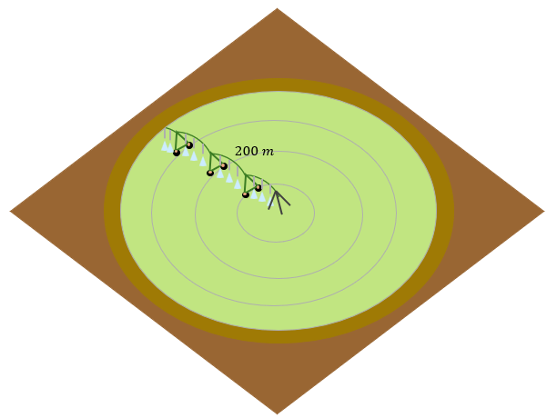
Cylinders and water (4)
Irrigating crops

Slide 9

Cylinders and water (5)
Irrigating crops
A farmer uses a pivot irrigation system to irrigate crops. The system can provide $12 mm$of water per day.
How much water is used to irrigate the crop?
Luca has attempted to answer the question but has made some errors in the solution.

Slide 10
Copyright
© State of New South Wales (Department of Education), 2025
The copyright material published in this resource is subject to the Copyright Act 1968 (Cth) and is owned by the NSW Department of Education or, where indicated, by a party other than the NSW Department of Education (third-party material).
Copyright material available in this resource and owned by the NSW Department of Education is licensed under a Creative Commons Attribution 4.0 International (CC BY 4.0) license.
This license allows you to share and adapt the material for any purpose, even commercially.
Attribution should be given to © State of New South Wales (Department of Education), 2025.
Material in this resource not available under a Creative Commons license:
the NSW Department of Education logo, other logos and trademark-protected material
material owned by a third party that has been reproduced with permission. You will need to obtain permission from the third party to reuse its material.
Links to third-party material and websites
Please note that the provided (reading/viewing material/list/links/texts) are a suggestion only and implies no endorsement, by the New South Wales Department of Education, of any author, publisher, or book title. School principals and teachers are best placed to assess the suitability of resources that would complement the curriculum and reflect the needs and interests of their students.
If you use the links provided in this document to access a third party’s website, you acknowledge that the terms of use, including licence terms set out on the third-party’s website apply to the use which may be made of the materials on that third-party website or where permitted by the Copyright Act 1968 (Cth). The department accepts no responsibility for content on third-party websites.

