Slide 1

Simplifying surds
Stage 5
The unit circle

Slide 2
Launch

Slide 3
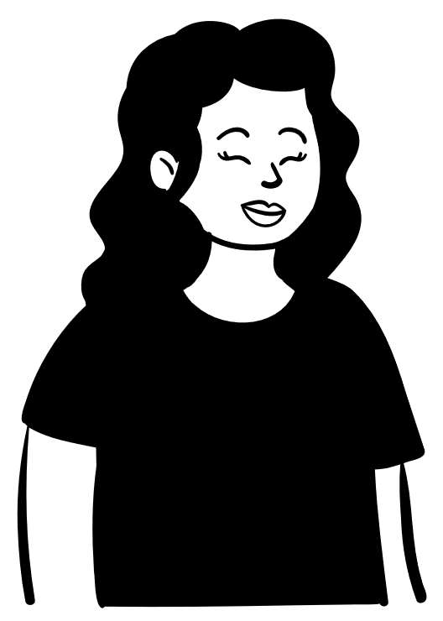
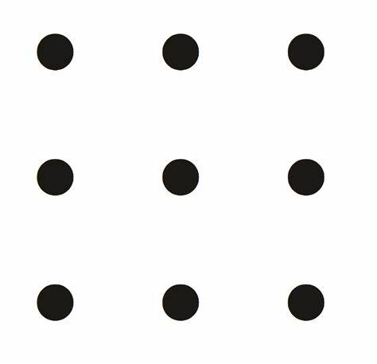

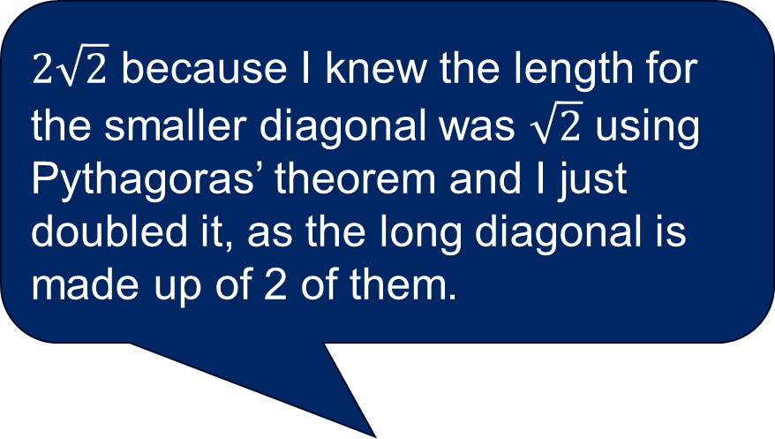
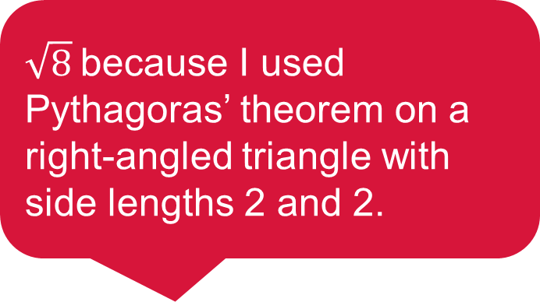
Two lengths
$2\sqrt{2}$ because I knew the length for the smaller diagonal was $\sqrt{2}$ using Pythagoras’ theorem and I just doubled it, as the long diagonal is made up of 2 of them.
9-dot grid
$\sqrt{8}$because I used Pythagoras’ theorem on a right-angled triangle with side lengths 2 and 2.

Slide 4
Explore

Slide 5


Simplifying surds (1)
Comparing surds
Which is larger?
$$2\sqrt{3}$$
$$3\sqrt{2}$$

Slide 6
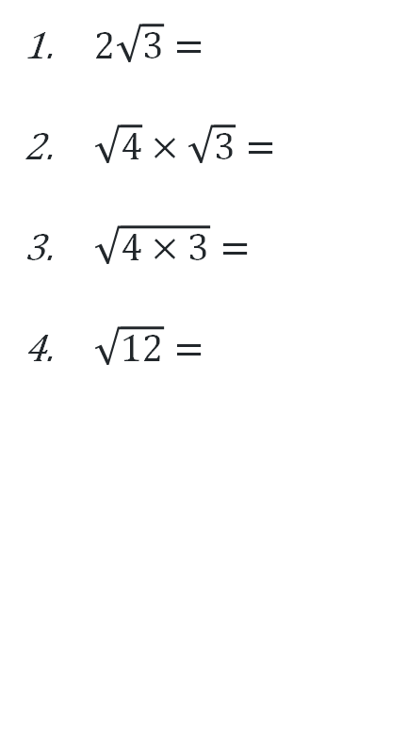
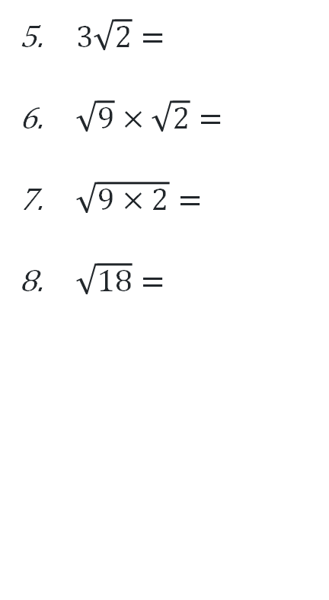
Simplifying surds (2)
Evaluating surds
$2\sqrt{3}=$
$\sqrt{4}×\sqrt{3}=$
$\sqrt{4×3}=$
$\sqrt{12}=$
$3\sqrt{2}=$
$\sqrt{9}×\sqrt{2}=$
$\sqrt{9×2}=$
$\sqrt{18}=$

Slide 7
Summarise

Slide 8

Simplifying surds (3)
Worked example
Simplify $\sqrt{50}$.
$$\sqrt{50}=\sqrt{25×2} \\ =\sqrt{25}×\sqrt{2} \\ =5\sqrt{2}$$

Slide 9

Simplifying surds (4)
Worked example – self explanation prompts
Simplify $\sqrt{50}$.
$$\sqrt{50}=\sqrt{25×2} \\ =\sqrt{25}×\sqrt{2} \\ =5\sqrt{2}$$
Why has 25 been factored out?
How could we find the square factors of a number?
Why am I allowed to separate the surds?

Slide 10

Simplifying surds (5)
Your turn
Simplify $\sqrt{27}$.

Slide 11

Simplifying surds (6)
Your turn - solution
Simplify $\sqrt{27}$.
$$\sqrt{27}=\sqrt{9×3} \\ =\sqrt{9}×\sqrt{3} \\ =3\sqrt{3}$$

Slide 12
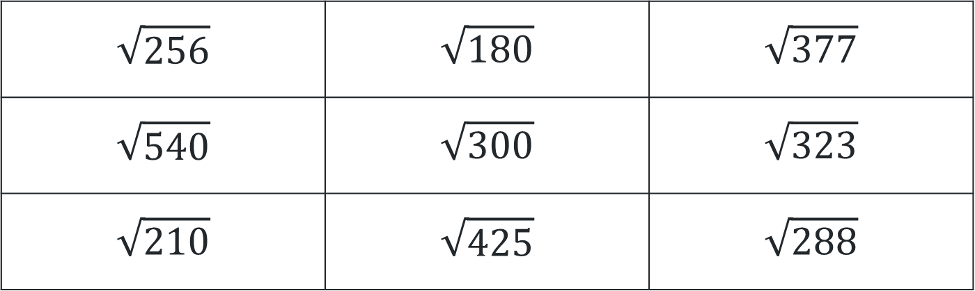
Simplifying surds (7)
Representing surds
Identify which surds in the table below can be simplified.
From those you identified that could be simplified, represent those surds in as many ways as possible.
$$\sqrt{256}$$ | $$\sqrt{180}$$ | $$\sqrt{377}$$
$$\sqrt{540}$$ | $$\sqrt{300}$$ | $$\sqrt{323}$$
$$\sqrt{210}$$ | $$\sqrt{425}$$ | $$\sqrt{288}$$

Slide 13
Apply

Slide 14
Which is larger? (1)
Question 1
$$2\sqrt{3}$$
$$3\sqrt{2}$$

Slide 15
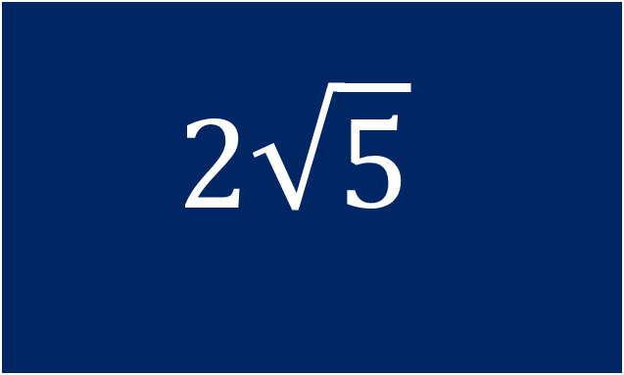
Which is larger? (2)
Question 2
$$2\sqrt{5}$$
$$3\sqrt{2}$$

Slide 16
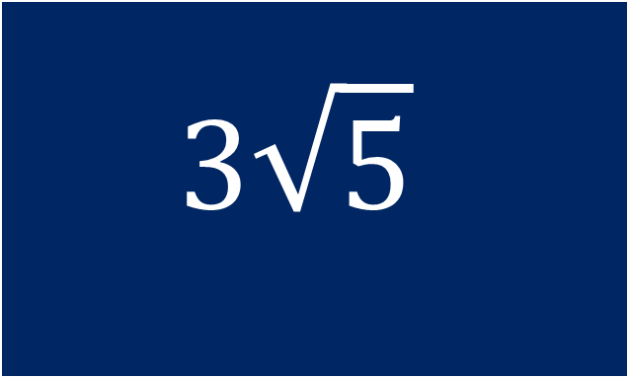
Which is larger? (3)
Question 3
$$2\sqrt{5}$$
$$3\sqrt{5}$$

Slide 17
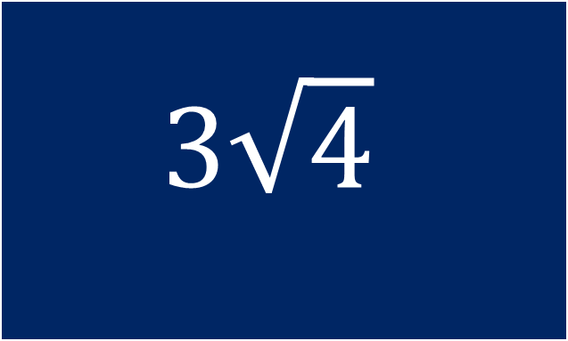
Which is larger? (4)
Question 4
$$3\sqrt{4}$$
$$3\sqrt{5}$$

Slide 18
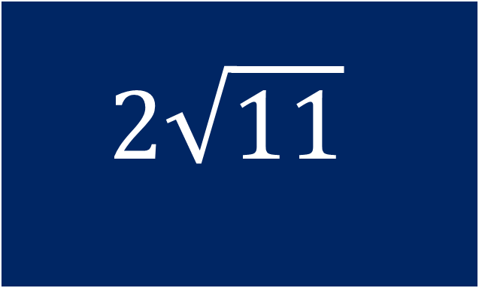
Which is larger? (5)
Question 5
$$2\sqrt{11}$$
$$3\sqrt{5}$$

Slide 19
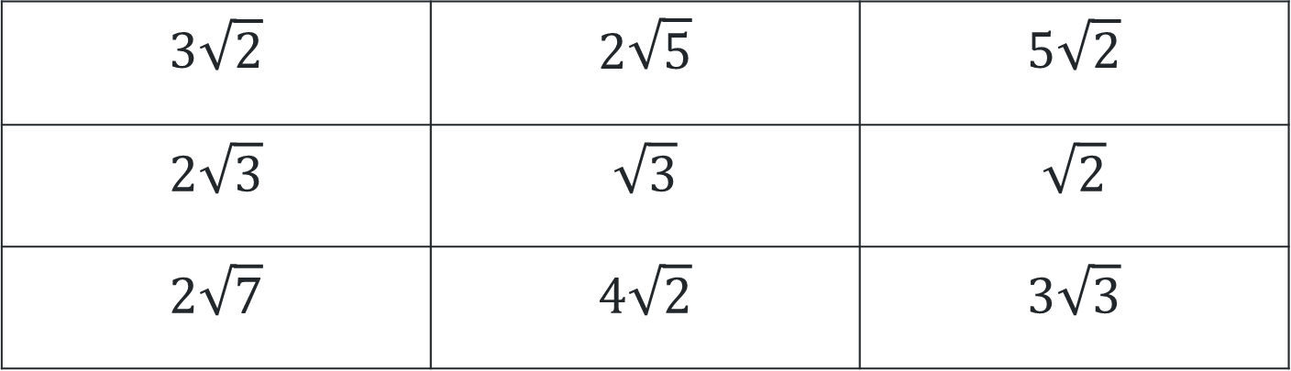
Simplifying surds (8)
Order the surds from smallest to largest
$$3\sqrt{2}$$ | $$2\sqrt{5}$$ | $$5\sqrt{2}$$
$$2\sqrt{3}$$ | $$\sqrt{3}$$ | $$\sqrt{2}$$
$$2\sqrt{7}$$ | $$4\sqrt{2}$$ | $$3\sqrt{3}$$

Slide 20
Copyright
© State of New South Wales (Department of Education), 2025
The copyright material published in this resource is subject to the Copyright Act 1968 (Cth) and is owned by the NSW Department of Education or, where indicated, by a party other than the NSW Department of Education (third-party material).
Copyright material available in this resource and owned by the NSW Department of Education is licensed under a Creative Commons Attribution 4.0 International (CC BY 4.0) licence.
This licence allows you to share and adapt the material for any purpose, even commercially.
Attribution should be given to © State of New South Wales (Department of Education), 2025.
Material in this resource not available under a Creative Commons licence:
the NSW Department of Education logo, other logos and trademark-protected material
Material owned by a third party that has been reproduced with permission. You will need to obtain permission from the third party to reuse its material.
Links to third-party material and websites
Please note that the provided (reading/viewing material/list/links/texts) are a suggestion only and implies no endorsement, by the New South Wales Department of Education, of any author, publisher, or book title. School principals and teachers are best placed to assess the suitability of resources that would complement the curriculum and reflect the needs and interests of their students.
If you use the links provided in this document to access a third party’s website, you acknowledge that the terms of use, including licence terms set out on the third-party’s website apply to the use which may be made of the materials on that third-party website or where permitted by the Copyright Act 1968 (Cth). The department accepts no responsibility for content on third-party websites.

