Slide 1
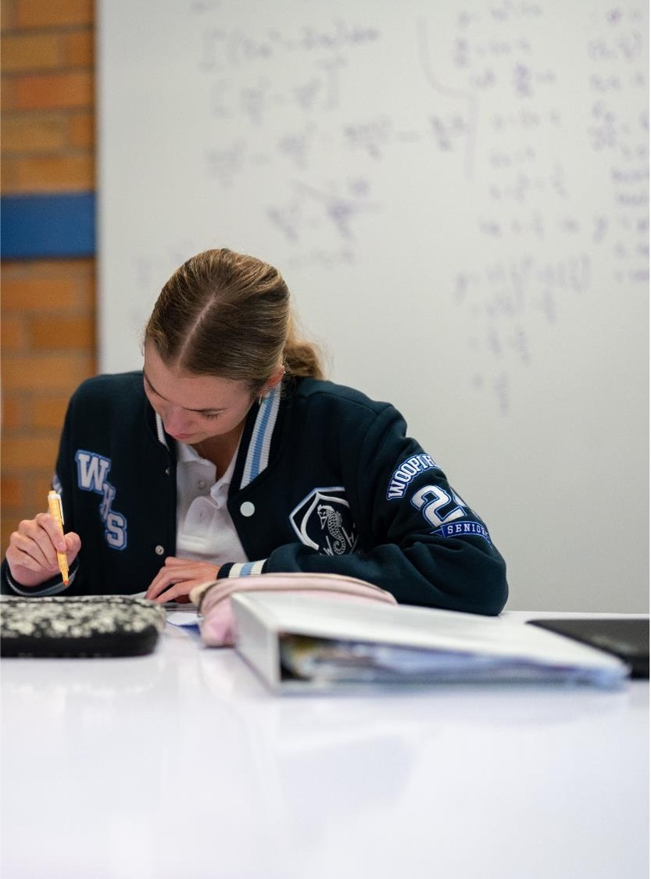
The unit circle
Stage 5
Elective – The unit circle

Slide 2
Launch

Slide 3
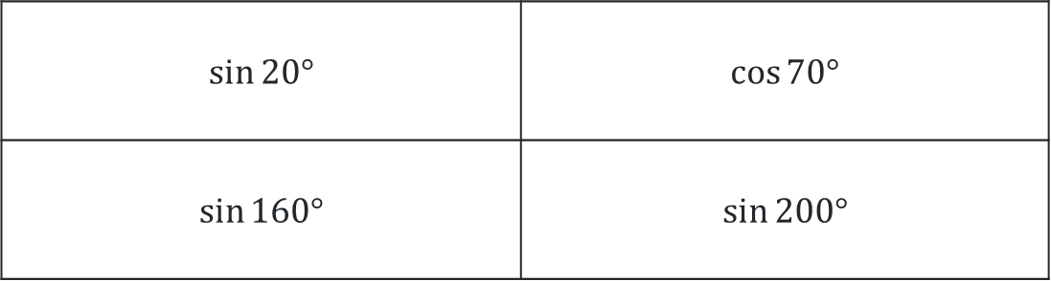
Which one does not belong?
Justify your thinking
$$\sin{20°}$$ | $$\cos{70°}$$
$$\sin{160°}$$ | $\sin{200°}$

Slide 4
Explore

Slide 5
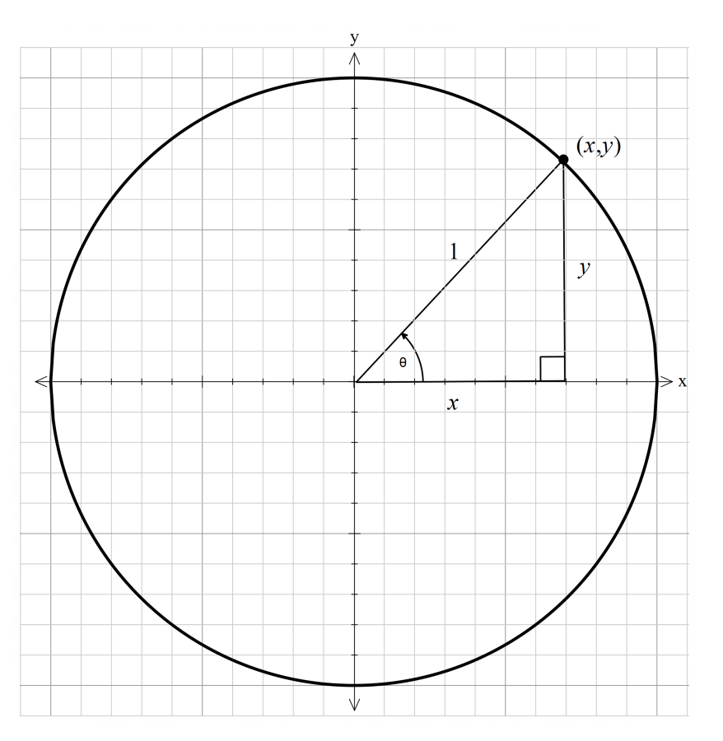
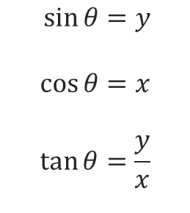
The unit circle (1)
Quadrant 1
$$\sin{θ}=y \\ \cos{θ}=x$$
$$\tan{θ}=\frac{y}{x}$$

Slide 6
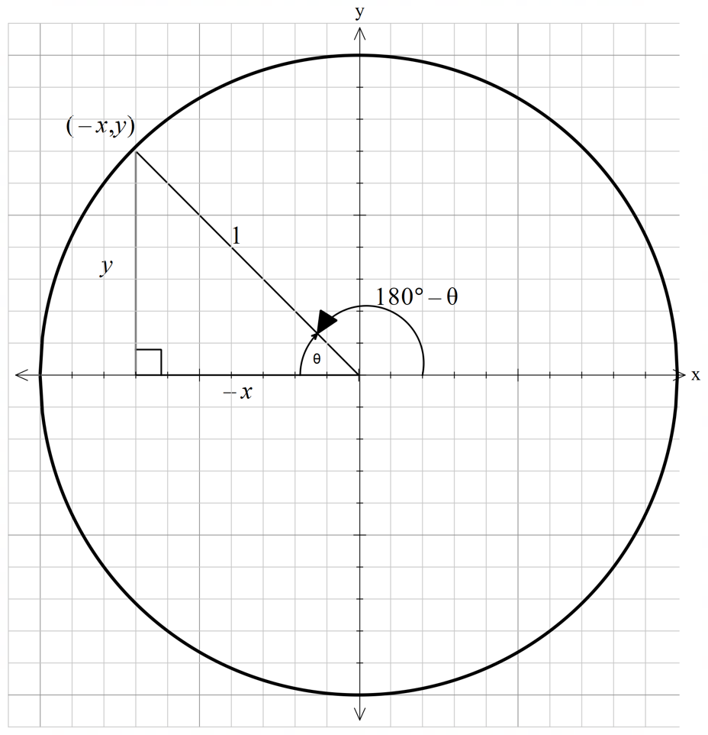
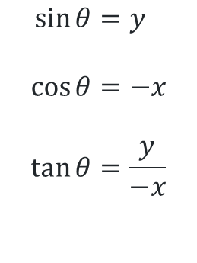
The unit circle (2)
Quadrant 2
$$\sin{θ}=y \\ \cos{θ}=−x$$
$$\tan{θ}=\frac{y}{−x}$$

Slide 7
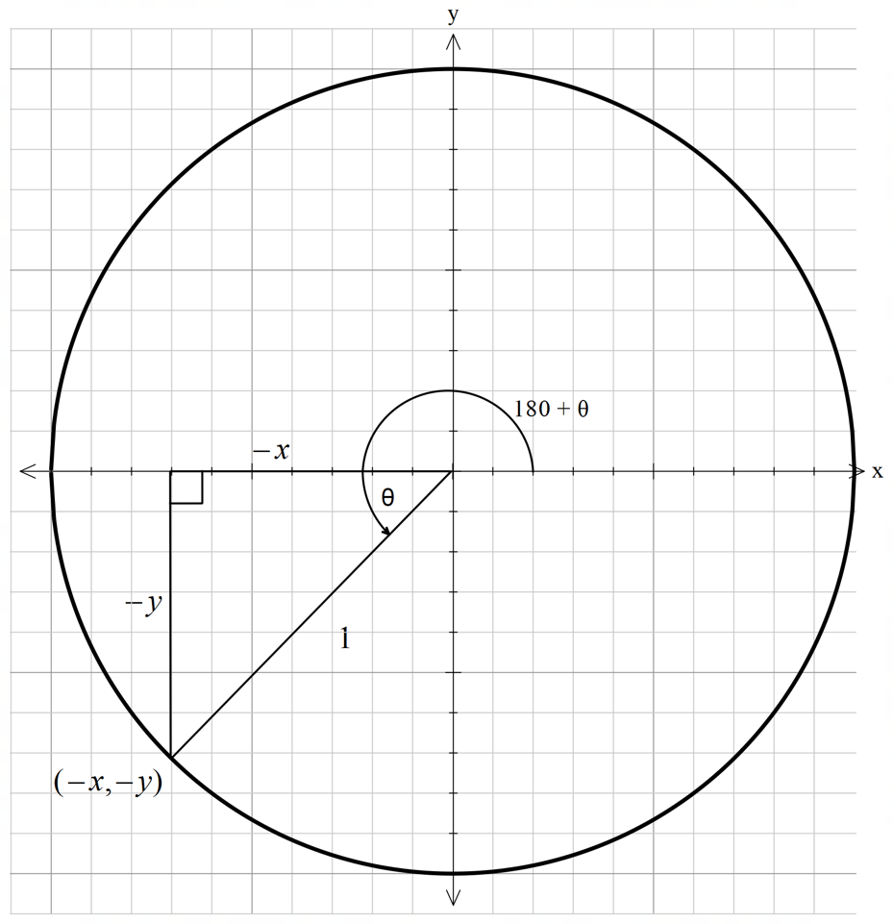
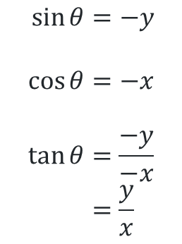
The unit circle (3)
Quadrant 3
$$\sin{θ}=−y \\ \cos{θ}=−x$$
$$\tan{θ}=\frac{−y}{−x} \\ =\frac{y}{x}$$

Slide 8
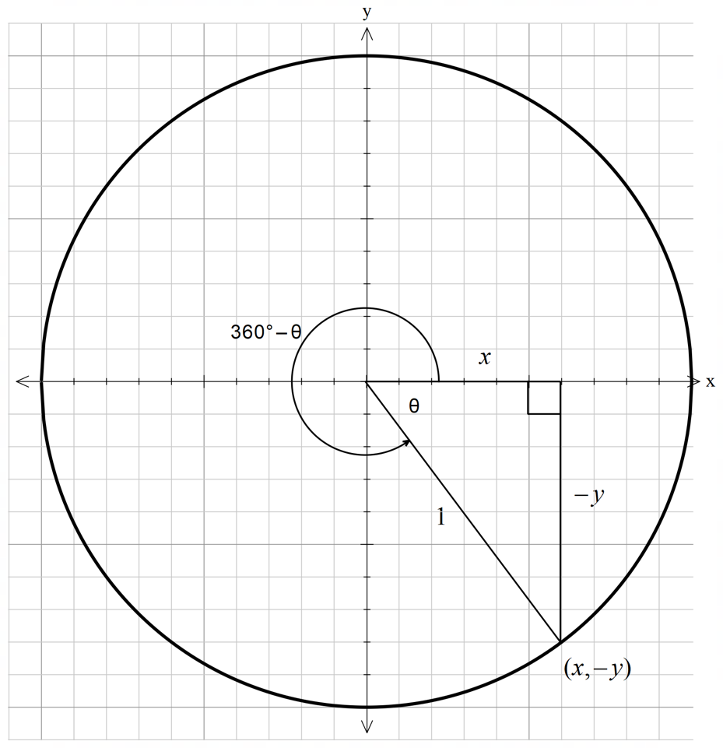
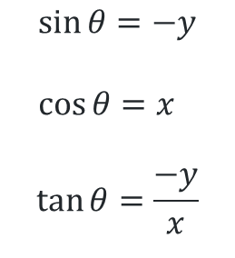
The unit circle (4)
Quadrant 4
$$\sin{θ}=−y \\ \cos{θ}=x$$
$$\tan{θ}=\frac{−y}{x}$$

Slide 9
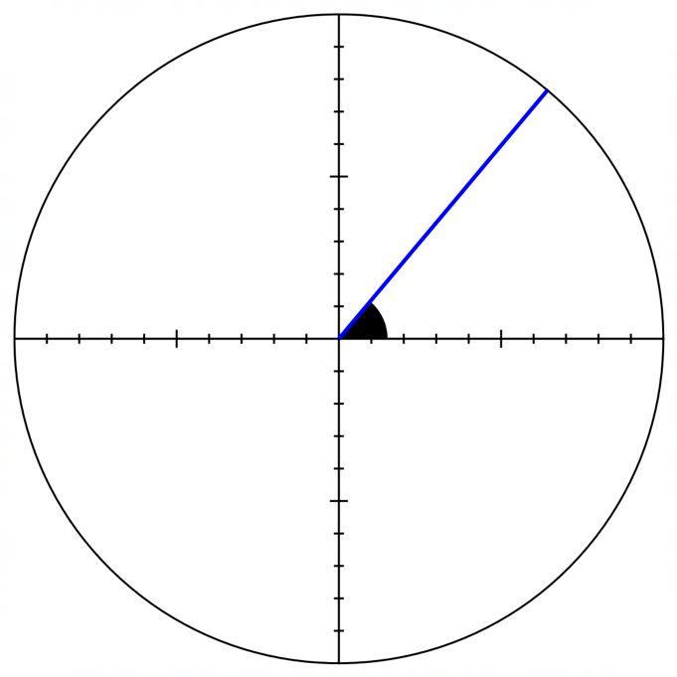
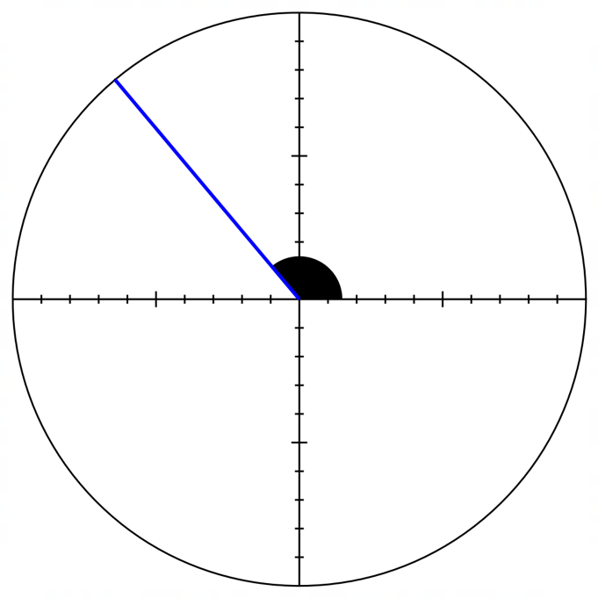


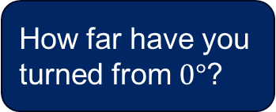


General angle (1)
Quadrant 1 and 2
How far have you turned from $0°$?
$$Quadrant 1= θ$$
$$Quadrant 2=180− θ$$
$$Θ$$
$$Θ$$

Slide 10
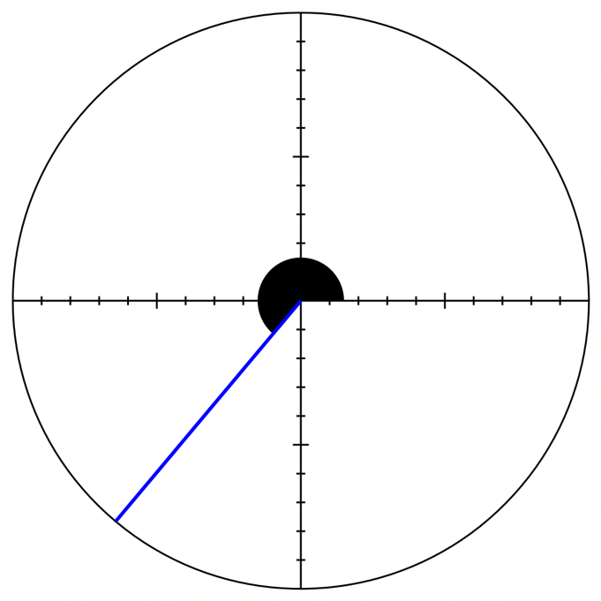
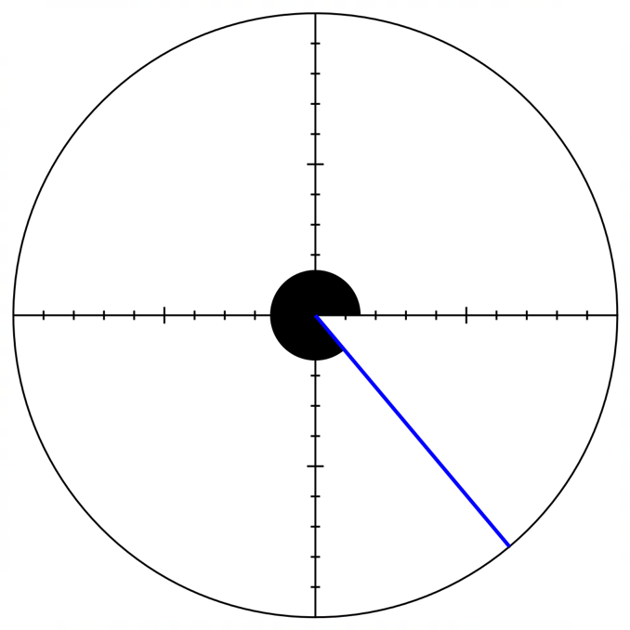


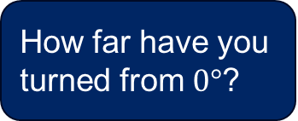


General angle (2)
Quadrant 3 and 4
How far have you turned from $0°$?
$$Quadrant 3=180+ θ$$
$$Quadrant 4=360− θ$$
$$Θ$$
$$Θ$$

Slide 11
Summarise

Slide 12
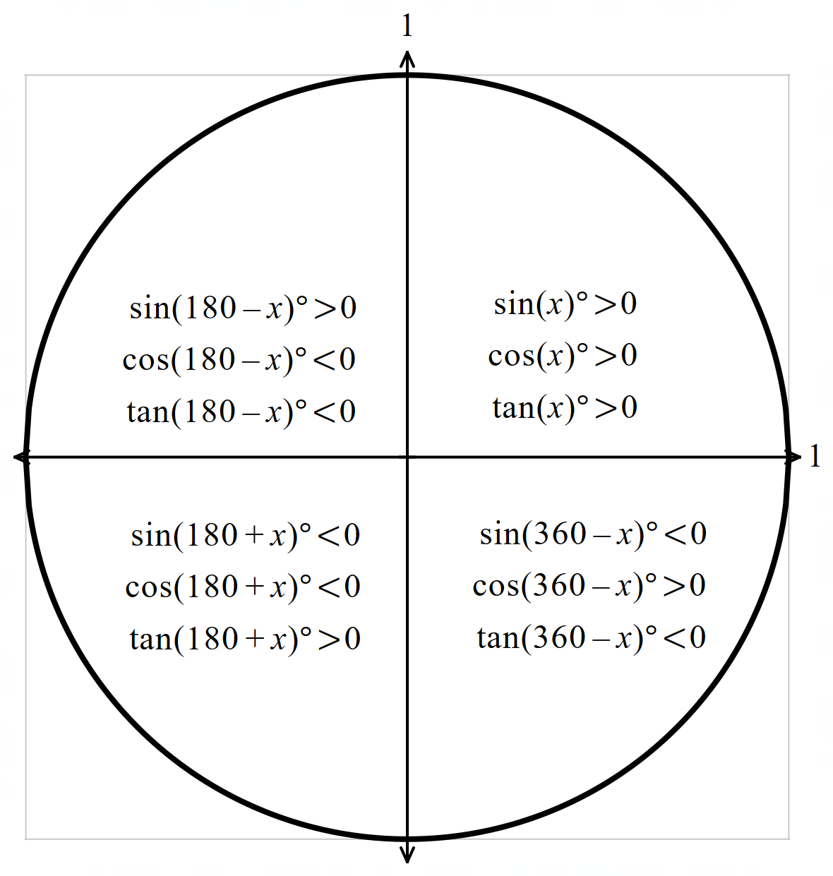
Summary
The unit circle

Slide 13
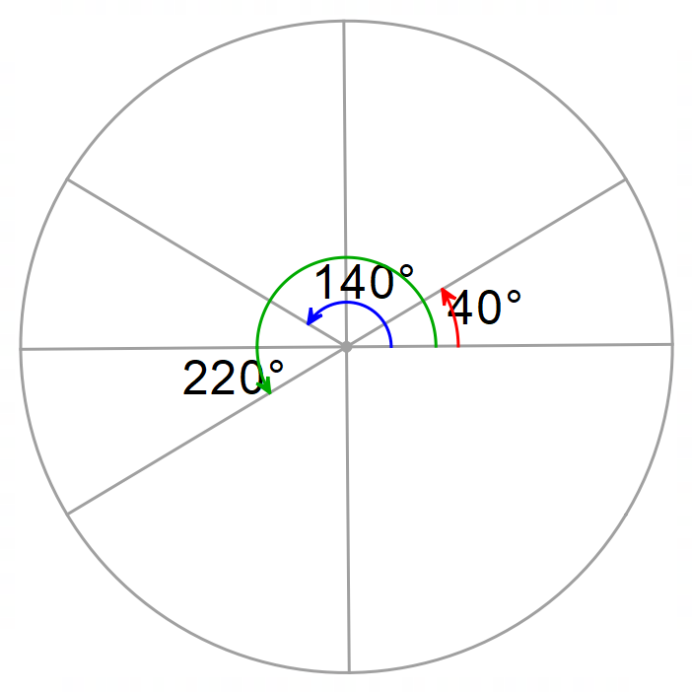





Equivalent trigonometric ratios (1)
Example 1
Which ratios has the same value as $\tan{40°}?$ $\tan{140°}$ or $\tan{220°}$
$\tan{40°}$ is in the 1st quadrant $∴≥0$
$\tan{140°}$ is in the 2nd quadrant $∴≤0$
$\tan{220°}$ is in the 3rd quadrant $∴≥0$
$\tan{40°}$ and $\tan{220°}$ are both positive
$$220°=180+40$$
$$∴\tan{40°=\tan{220°}}$$
$$−$$
$$+$$
$$+$$
$$−$$

Slide 14
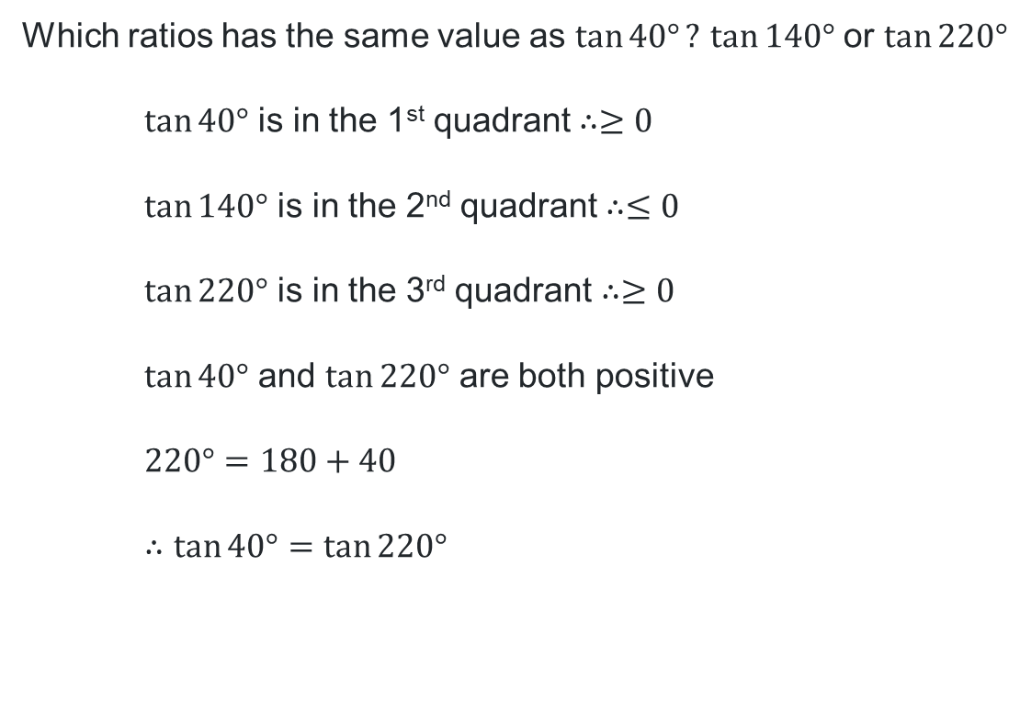
Equivalent trigonometric ratios (2)
How do you know what sign to put in each quadrant?
Example 1 Self explanation prompts
Which ratios has the same value as $\tan{40°}?$ $\tan{140°}$ or $\tan{220°}$
$\tan{40°}$ is in the 1st quadrant $∴≥0$
$\tan{140°}$ is in the 2nd quadrant $∴≤0$
$\tan{220°}$ is in the 3rd quadrant $∴≥0$
$\tan{40°}$ and $\tan{220°}$ are both positive
$$220°=180+40$$
$$∴\tan{40°=\tan{220°}}$$
$$−$$
$$+$$
Why is it important to break the angle up like this?
$$+$$
$$−$$
How do you know which quadrant the angle is in?

Slide 15

Equivalent trigonometric ratios (3)
Your turn - Question 1
Which ratio has the same value as $\cos{155°}?$ $\cos{25°}$ or $\cos{335°}$?

Slide 16
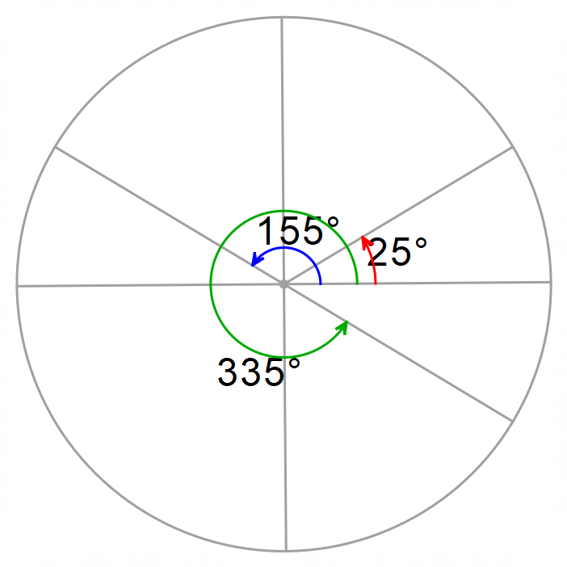





Equivalent trigonometric ratios (4)
Your turn - Solution 1
Which ratio has the same value as $\cos{155°}?$ $\cos{25°}$ or $\cos{335°}$
$\cos{25°}$ is in the 1st quadrant $∴≥0$
$\cos{155°}$ is in the 2nd quadrant $∴≤0$
$\cos{335°}$ is in the 4th quadrant $∴≥0$
$\cos{25°}$ and $\cos{335°}$ are both positive
$$335°=360−25$$
$$∴\cos{25°=\cos{335°}}$$
$$−$$
$$+$$
$$−$$
$$+$$

Slide 17
Copyright
© State of New South Wales (Department of Education), 2025
The copyright material published in this resource is subject to the Copyright Act 1968 (Cth) and is owned by the NSW Department of Education or, where indicated, by a party other than the NSW Department of Education (third-party material).
Copyright material available in this resource and owned by the NSW Department of Education is licensed under a Creative Commons Attribution 4.0 International (CC BY 4.0) licence.
This licence allows you to share and adapt the material for any purpose, even commercially.
Attribution should be given to © State of New South Wales (Department of Education), 2025.
Material in this resource not available under a Creative Commons licence:
the NSW Department of Education logo, other logos and trademark-protected material
Material owned by a third party that has been reproduced with permission. You will need to obtain permission from the third party to reuse its material.
Links to third-party material and websites
Please note that the provided (reading/viewing material/list/links/texts) are a suggestion only and implies no endorsement, by the New South Wales Department of Education, of any author, publisher, or book title. School principals and teachers are best placed to assess the suitability of resources that would complement the curriculum and reflect the needs and interests of their students.
If you use the links provided in this document to access a third party’s website, you acknowledge that the terms of use, including licence terms set out on the third-party’s website apply to the use which may be made of the materials on that third-party website or where permitted by the Copyright Act 1968 (Cth). The department accepts no responsibility for content on third-party websites.

