Slide 1
Average from the average
Explicit teaching

Slide 2
Launch

Slide 3
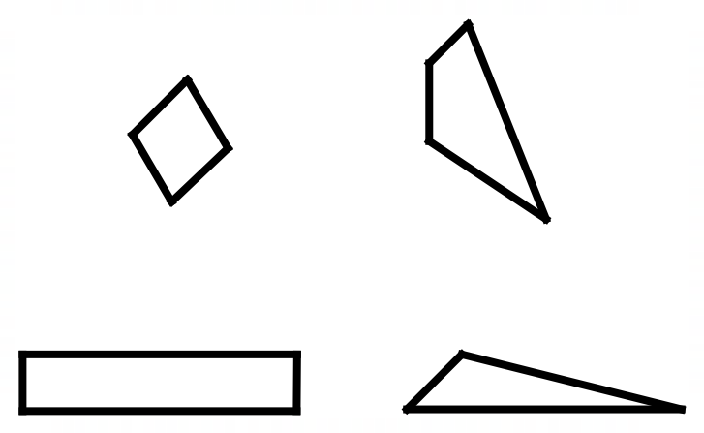
4 polygons (1)
Which one doesn’t belong?
Figure 1: 4 polygons

Slide 4
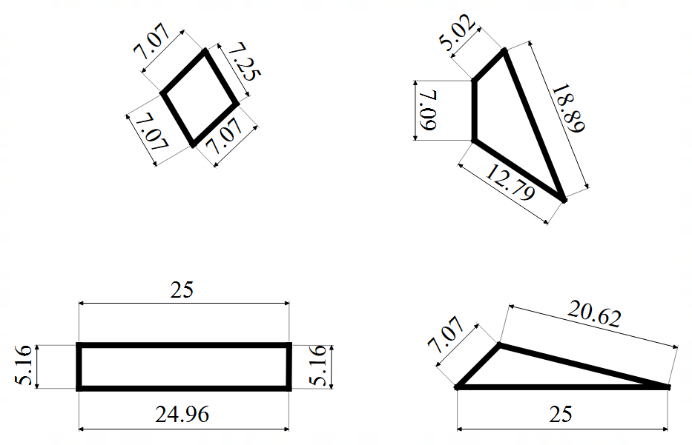
4 polygons (2)
Which one doesn’t belong?

Slide 5
Explore

Slide 6
Average from the average (1)
Hair length instructions
Calculate the mean hair length for your group. This is represented as $\overline{x}$.
Find the difference between the mean length and each hair length.
Find the mean of the differences found above. This is called ‘mean difference’.

Slide 7
Summarise

Slide 8
Average from the average (2)
Example 1
Find the standard deviation of the dataset: 1, 2, 3, 4, 5
$\overline{x}=\frac{1+2+3+4+5}{5}$
$\overline{x}=\frac{15}{5}$
$\overline{x}=3$
Differences from the mean: 2, 1, 0, 1, 2
$σ=\frac{2+1+0+1+2}{5}$
$σ=\frac{6}{5}$
$σ=1.2$

Slide 9
Average from the average (3)
Example 1 – self-explanation prompts
Find the standard deviation of the dataset: 1, 2, 3, 4, 5.
$\overline{x}=\frac{1+2+3+4+5}{5}$
$\overline{x}=\frac{15}{5}$
$\overline{x}=3$
Differences from the mean: 2, 1, 0, 1, 2
$σ=\frac{2+1+0+1+2}{5}$
$σ=\frac{6}{5}$
$σ=1.2$
Why don’t we say that 1 has a difference of −2 from the mean?
What does a standard deviation of 1.2 tell us about the spread of data?

Slide 10
Average from the average (4)
Your turn – question 1
Find the standard deviation of the dataset: 1, 3, 5, 7, 9

Slide 11
Average from the average (5)
Your turn – question 1 solution
Find the standard deviation of the dataset: 1, 3, 5, 7, 9
$\overline{x}=\frac{1+3+5+7+9}{5}$
$\overline{x}=\frac{25}{5}$
$\overline{x}=5$
Differences from the mean: 4, 2, 0, 2, 4
$σ=\frac{4+2+0+2+4}{5}$
$σ=\frac{12}{5}$
$σ=2.4$

Slide 12
Average from the average (6)
Example 2
Find the standard deviation of the dataset: 0, 1, 2, 2, 8, 9, 18, 20
$\overline{x}=\frac{0+1+2+2+8+9+18+20}{8}$
$\overline{x}=\frac{60}{8}$
$\overline{x}=7.5$
Differences from the mean: 7.5, 6.5, 5.5, 5.5, 0.5, 1.5, 10.5, 12.5
$σ=\frac{7.5+6.5+5.5+0.5+1.5+10.5+12.5}{8}$
$σ=\frac{50}{8}$
$σ=6.25$

Slide 13
Average from the average (7)
Example 2 – self-explanation prompts
Find the standard deviation of the dataset: 0, 1, 2, 2, 8, 9, 18, 20
$\overline{x}=\frac{0+1+2+2+8+9+18+20}{8}$
$\overline{x}=\frac{60}{8}$
$\overline{x}=7.5$
Differences from the mean: 7.5, 6.5, 5.5, 5.5, 0.5, 1.5, 10.5, 12.5
$σ=\frac{7.5+6.5+5.5+0.5+1.5+10.5+12.5}{8}$
$σ=\frac{50}{8}$
$σ=6.25$
What is the effect of 0 on the mean and the standard deviation?
How were the numbers 7.5, 8.5, 5.5 ... calculated?

Slide 14
Average from the average (8)
Your turn – question 2
Find the standard deviation of the dataset: 0, 0, 5, 7, 10, 13, 56

Slide 15
Average from the average (9)
Your turn – question 2 solution
Find the standard deviation of the dataset: 0, 0, 5, 7, 10, 13, 56
$\overline{x}=\frac{0+0+5+7+10+13+56}{7}$
$\overline{x}=\frac{91}{7}$
$\overline{x}=13$
Differences from the mean: 13, 13, 8, 6, 3, 0, 43
$σ=\frac{13+13+8+6+3+0+43}{7}$
$σ=\frac{89}{7}$
$σ=11.125$

Slide 16
Apply

Slide 17
Average from the average (10)
Polygons
Draw a polygon with side lengths that have a standard deviation of 0.
Draw a rectangle with side lengths that have a standard deviation of 5.
Draw a triangle with side lengths that have a standard deviation greater than 5.
Draw a triangle with side lengths that have a standard deviation between 1 and 2.

Slide 18
Copyright
© State of New South Wales (Department of Education), 2024
The copyright material published in this resource is subject to the Copyright Act 1968 (Cth) and is owned by the NSW Department of Education or, where indicated, by a party other than the NSW Department of Education (third-party material).
Copyright material available in this resource and owned by the NSW Department of Education is licensed under a Creative Commons Attribution 4.0 International (CC BY 4.0) license.
This license allows you to share and adapt the material for any purpose, even commercially.
Attribution should be given to © State of New South Wales (Department of Education), 2024.
Material in this resource not available under a Creative Commons license:
the NSW Department of Education logo, other logos and trademark-protected material
Material owned by a third party that has been reproduced with permission. You will need to obtain permission from the third party to reuse its material.
Links to third-party material and websites
Please note that the provided (reading/viewing material/list/links/texts) are a suggestion only and implies no endorsement, by the New South Wales Department of Education, of any author, publisher, or book title. School principals and teachers are best placed to assess the suitability of resources that would complement the curriculum and reflect the needs and interests of their students.
If you use the links provided in this document to access a third-party’s website, you acknowledge that the terms of use, including licence terms set out on the third-party’s website apply to the use which may be made of the materials on that third-party website or where permitted by the Copyright Act 1968 (Cth). The department accepts no responsibility for content on third-party websites.

