Slide 1
Traverse survey
Explicit teaching

Slide 2
Launch

Slide 3
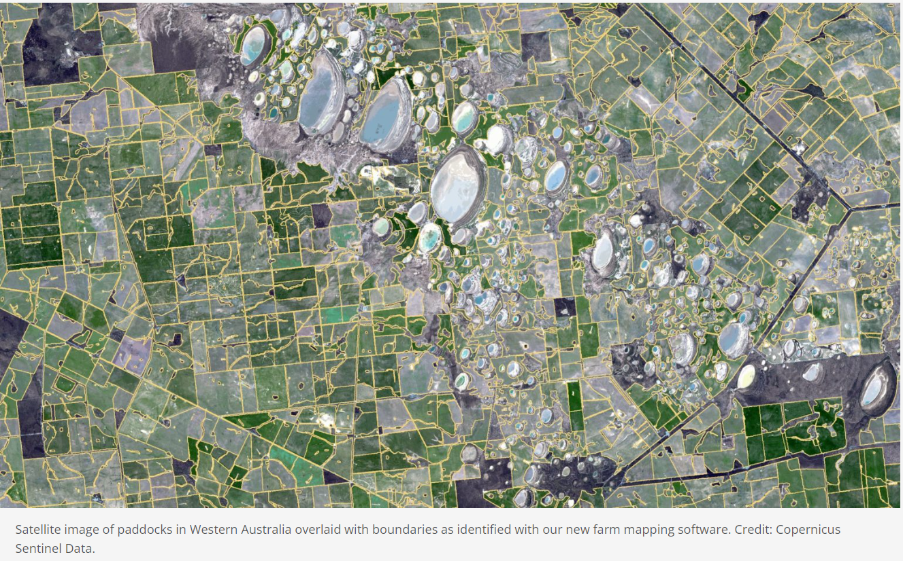
Traverse survey (1)
Launch
Map data by CSIRO is licensed under Commonwealth Scientific and Industrial Research Organisation copyright license.

Slide 4
Explore

Slide 5
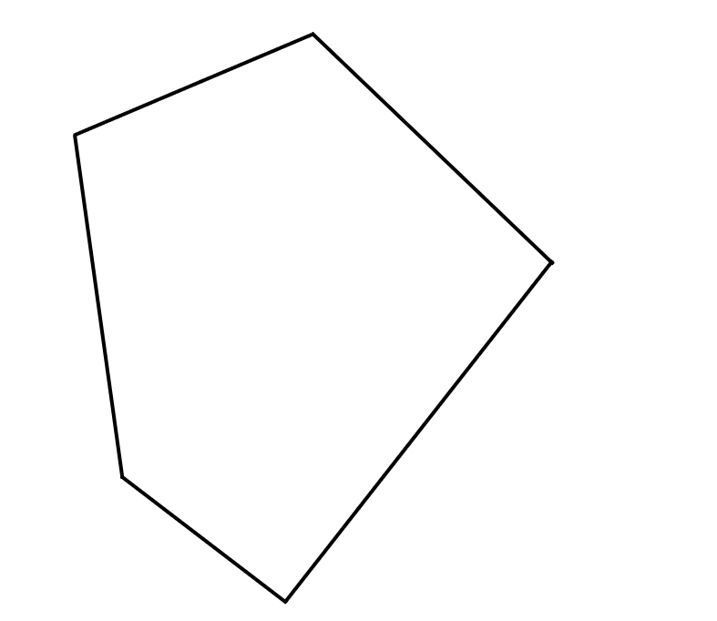
Traverse Survey (2)
5-sided paddock

Slide 6
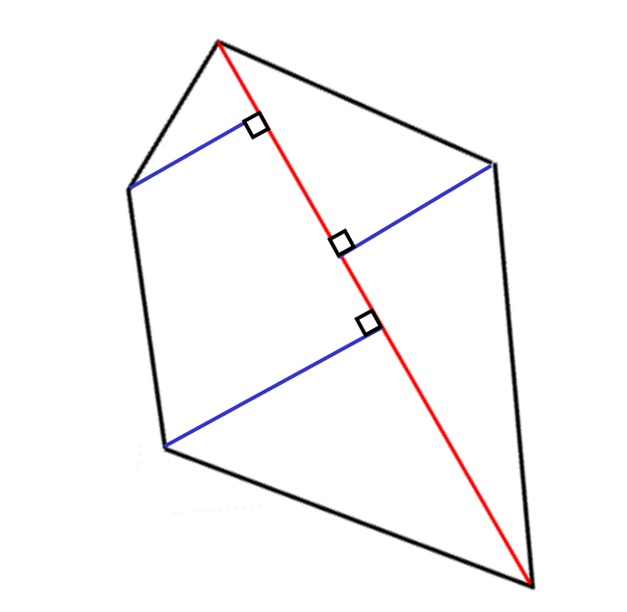
Traverse survey (3)
Centrelines and offsets

Slide 7
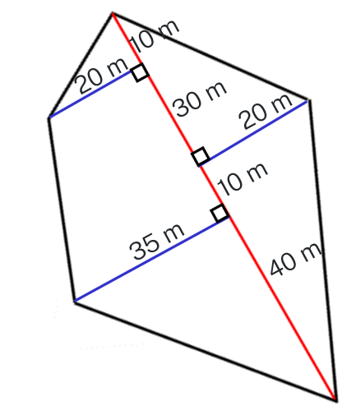
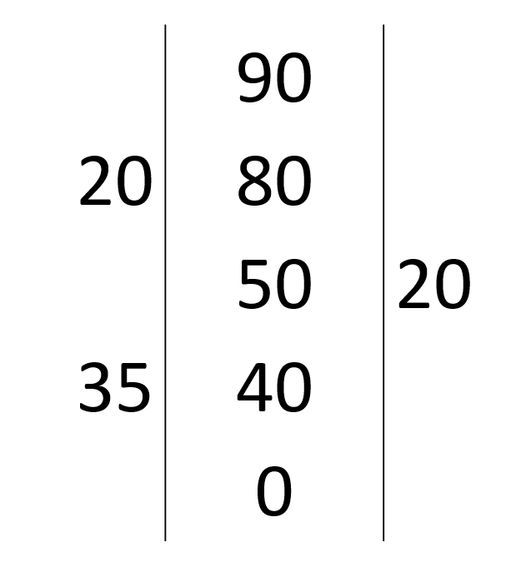
Traverse Survey (4)
Traverse survey and notebook entry
Traverse survey
Notebook entry

Slide 8
Summarise

Slide 9
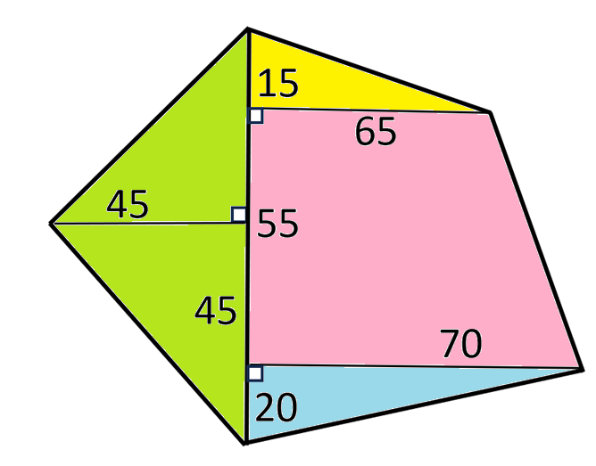
Traverse survey (5)
Example 1
Find the area of this figure.
$$\text{Green} \text{area} A=\frac{1}{2}×45×90 \\ =2025 \\ \text{Blue} \text{area} A=\frac{1}{2}×20×70 \\ =700 \\ \text{Pink} \text{area} A=\frac{1}{2}×55×\left(65+70\right) \\ =3712.5 \\ \text{Yellow} \text{area} A=\frac{1}{2}×15×65 \\ =487.5 \\ \text{Area} \text{total} A=2025+700+3712.5+487.5 \\ =6925 m2$$
All measurements are in metres.

Slide 10
Traverse survey (6)
Example 1 self-explanation prompts
Find the area of this figure.
$$\text{Green} \text{area} A=\frac{1}{2}×45×90 \\ =2025 \\ \text{Blue} \text{area} A=\frac{1}{2}×20×70 \\ =700 \\ \text{Pink} \text{area} A=\frac{1}{2}×55×\left(65+70\right) \\ =3712.5 \\ \text{Yellow} \text{area} A=\frac{1}{2}×15×65 \\ =487.5 \\ \text{Area} \text{total} A=2025+700+3712.5+487.5 \\ =6925 m2$$
How do we know this is 90?
What shape is this?
All measurements are in metres.

Slide 11
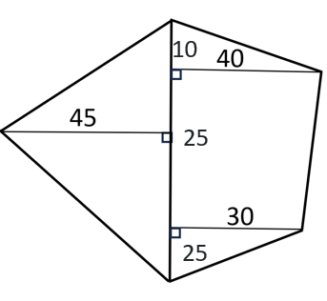
Traverse survey (7)
Your turn – question 1
Find the area of this figure.
All measurements are in metres.

Slide 12
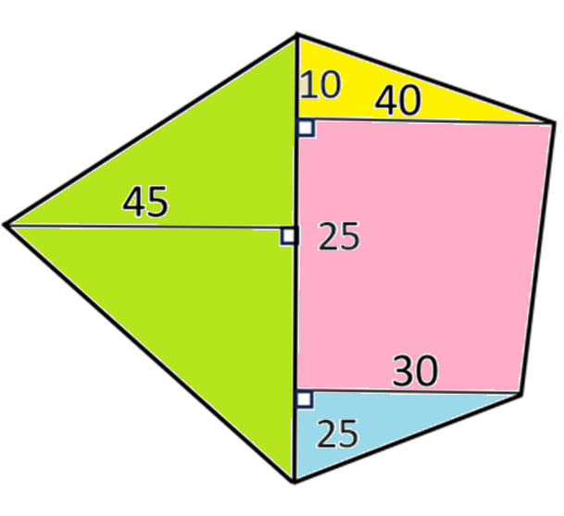
Traverse survey (8)
Your turn – solution 1
Find the area of this figure.
$$\text{Green} \text{area} A=\frac{1}{2}×45×60 \\ =1350 \\ \text{Blue} \text{area} A=\frac{1}{2}×25×30 \\ =375 \\ \text{Pink} \text{area} A=\frac{1}{2}×25×\left(30+40\right) \\ =875 \\ \text{Yellow} \text{area} A=\frac{1}{2}×10×40 \\ =200 \\ \text{Area} \text{total} A=1350+375+875+200 \\ =2800 m2$$
All measurements are in metres.

Slide 13
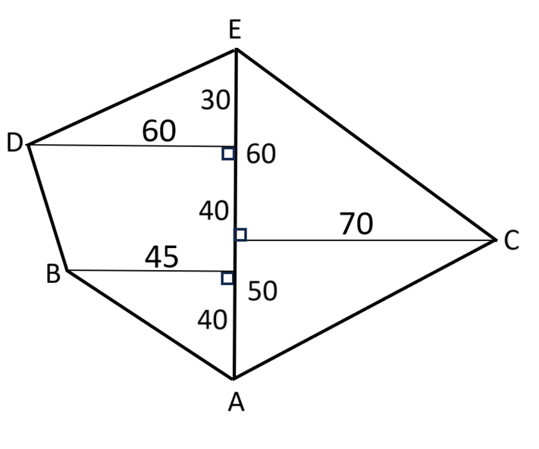
Traverse survey (9)
Example 2
Length DE
$$l=\sqrt{{60}^{2}+{30}^{2}}$$
$$= 67.082…$$
Length BD
$$l=\sqrt{{40}^{2}+{15}^{2}} \\ = 42.720…$$
Length AB
$$l=\sqrt{{45}^{2}+{40}^{2}} \\ =60.207…$$
Length AC
$$l=\sqrt{{70}^{2}+{50}^{2}} \\ =86.023…$$
Length CE
$$l=\sqrt{{70}^{2}+{60}^{2}} \\ =92.195…$$
Find the perimeter of this figure.
Perimeter
$$l=67.082+42.720$$
$$+60.207+86.023+92.195$$
$=348.227…$
$≈348 m$
All measurements are in metres.

Slide 14
Traverse survey (10)
Example 2 self-explanation prompts
Length DE
$$l=\sqrt{{60}^{2}+{30}^{2}} \\ = 67.082…$$
Length BD
$$l=\sqrt{{40}^{2}+{15}^{2}} \\ =42.720…$$
Length AB
$$l=\sqrt{{45}^{2}+{40}^{2}} \\ =60.207…$$
Length AC
$$l=\sqrt{{70}^{2}+{50}^{2}} \\ =86.023…$$
Length CE
$$l=\sqrt{{70}^{2}+{60}^{2}} \\ =92.195…$$
Where do the 40 and 15 come from?
Find the perimeter of this figure.
Perimeter
$$l=67.082+42.720$$
$$+60.207+86.023+92.195$$
$=348.227…$
$≈348 m$
What shape is this?
All measurements are in metres.

Slide 15
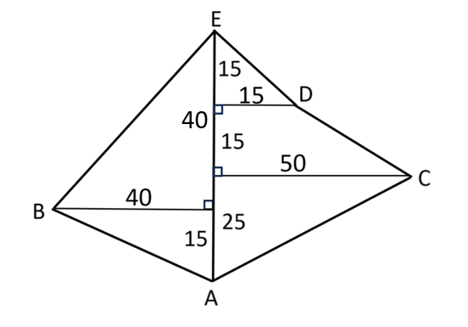
Traverse survey (11)
Your turn – question 2
Find the perimeter of this figure.
All measurements are in metres.

Slide 16
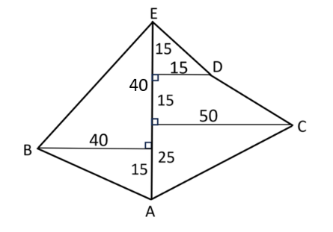
Traverse survey (12)
Your turn – solution 2
Length BE
$$l=\sqrt{{40}^{2}+{40}^{2}} \\ =56.568…$$
Length AB
$$l=\sqrt{{40}^{2}+{15}^{2}} \\ =42.720…$$
Length AC
$$l=\sqrt{{25}^{2}+{50}^{2}} \\ =55.901…$$
Length CD
$$l=\sqrt{{15}^{2}+{35}^{2}} \\ =38.078…$$
Length DE
$$l=\sqrt{{15}^{2}+{15}^{2}} \\ =21.213…$$
Find the perimeter of this figure
Perimeter
$$l=56.568+42.720$$
$$+55.901+38.078+21.213 \\ =214.48… \\ ≈ 214 m$$
All measurements are in metres.

Slide 17
Copyright
© State of New South Wales (Department of Education), 2024
The copyright material published in this resource is subject to the Copyright Act 1968 (Cth) and is owned by the NSW Department of Education or, where indicated, by a party other than the NSW Department of Education (third-party material).
Copyright material available in this resource and owned by the NSW Department of Education is licensed under a Creative Commons Attribution 4.0 International (CC BY 4.0) license.
This license allows you to share and adapt the material for any purpose, even commercially.
Attribution should be given to © State of New South Wales (Department of Education), 2024.
Material in this resource not available under a Creative Commons license:
the NSW Department of Education logo, other logos and trademark-protected material
Material owned by a third party that has been reproduced with permission. You will need to obtain permission from the third party to reuse its material.
Links to third-party material and websites
Please note that the provided (reading/viewing material/list/links/texts) are a suggestion only and implies no endorsement, by the New South Wales Department of Education, of any author, publisher, or book title. School principals and teachers are best placed to assess the suitability of resources that would complement the curriculum and reflect the needs and interests of their students.
If you use the links provided in this document to access a third party’s website, you acknowledge that the terms of use, including licence terms set out on the third-party’s website apply to the use which may be made of the materials on that third-party website or where permitted by the Copyright Act 1968 (Cth). The department accepts no responsibility for content on third-party websites.

