Slide 1
Slope seekers
Explicit teaching

Slide 2
Warm up
Would you rather…?
Would you rather take a flight of stairs that…
has a horizontal length of 3 m and a vertical height of 3.24 m
has a slanted height of 5.6 m with a vertical height of 3.24 m

Slide 3
Launch

Slide 4
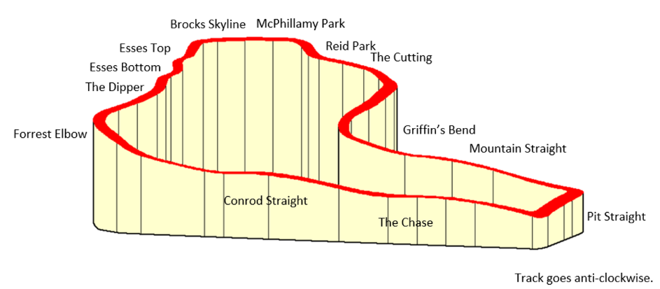
Slope seekers (1)
Mount Panorama
How do we determine the slope of each section?
Screenshot modified from Tracks: Bathurst, Mount Panorama.

Slide 5
Explore

Slide 6
Slope seekers (2)
Ramp set up
How can we find this angle?

Slide 7
Summarise

Slide 8
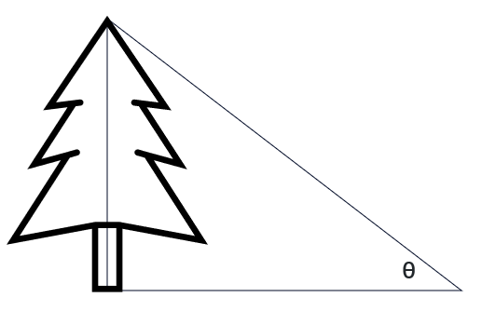
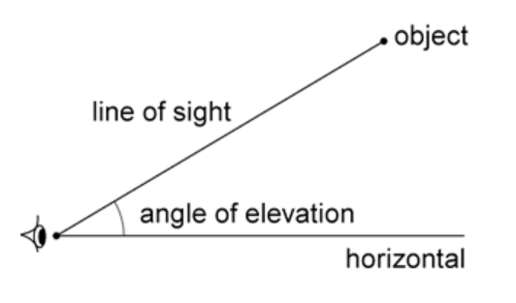
Slope seekers (3)
Angle of elevation
When an observer looks at an object that is higher than ‘the eye of the observer’, the angle between the line of sight and the horizontal is called the angle of elevation.

Slide 9
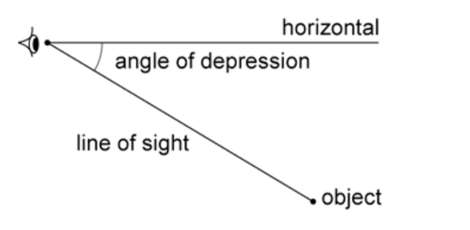
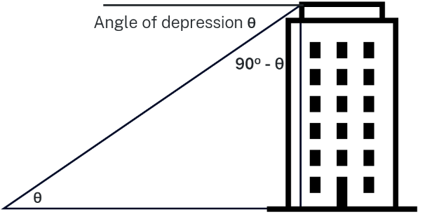
Slope seekers (4)
Angle of depression
When an observer looks at an object that is lower than ‘the eye of the observer’, the angle between the line of sight and the horizontal is called the angle of depression.

Slide 10
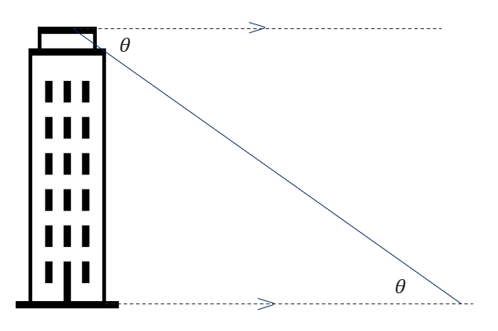
Slope seekers (5)
Alternate angles

Slide 11
Slope seekers (6)
Alternate angles
The horizontal at eye height is parallel to the ground.
$$>$$
$$θ$$
The angles are alternate.
$$α$$
$$<$$
$$θ=α$$

Slide 12
Copyright
© State of New South Wales (Department of Education), 2024
The copyright material published in this resource is subject to the Copyright Act 1968 (Cth) and is owned by the NSW Department of Education or, where indicated, by a party other than the NSW Department of Education (third-party material).
Copyright material available in this resource and owned by the NSW Department of Education is licensed under a Creative Commons Attribution 4.0 International (CC BY 4.0) license.
This license allows you to share and adapt the material for any purpose, even commercially.
Attribution should be given to © State of New South Wales (Department of Education), 2024.
Material in this resource not available under a Creative Commons license:
the NSW Department of Education logo, other logos and trademark-protected material
Material owned by a third party that has been reproduced with permission. You will need to obtain permission from the third party to reuse its material.
Links to third-party material and websites
Please note that the provided (reading/viewing material/list/links/texts) are a suggestion only and implies no endorsement, by the New South Wales Department of Education, of any author, publisher, or book title. School principals and teachers are best placed to assess the suitability of resources that would complement the curriculum and reflect the needs and interests of their students.
If you use the links provided in this document to access a third party’s website, you acknowledge that the terms of use, including licence terms set out on the third-party’s website apply to the use which may be made of the materials on that third-party website or where permitted by the Copyright Act 1968 (Cth). The department accepts no responsibility for content on third-party websites.

