Slide 1
The Great Pyramid
Explicit teaching

Slide 2
Explore

Slide 3
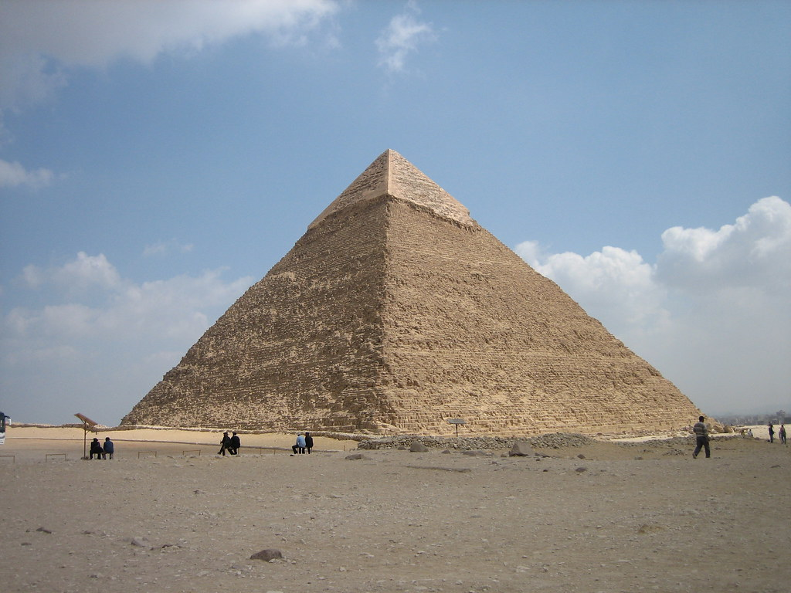
The Great Pyramid (1)
How could we measure the dimensions?
‘Great Pyramid of Giza’ by girolame is licensed under CC BY 2.0.

Slide 4
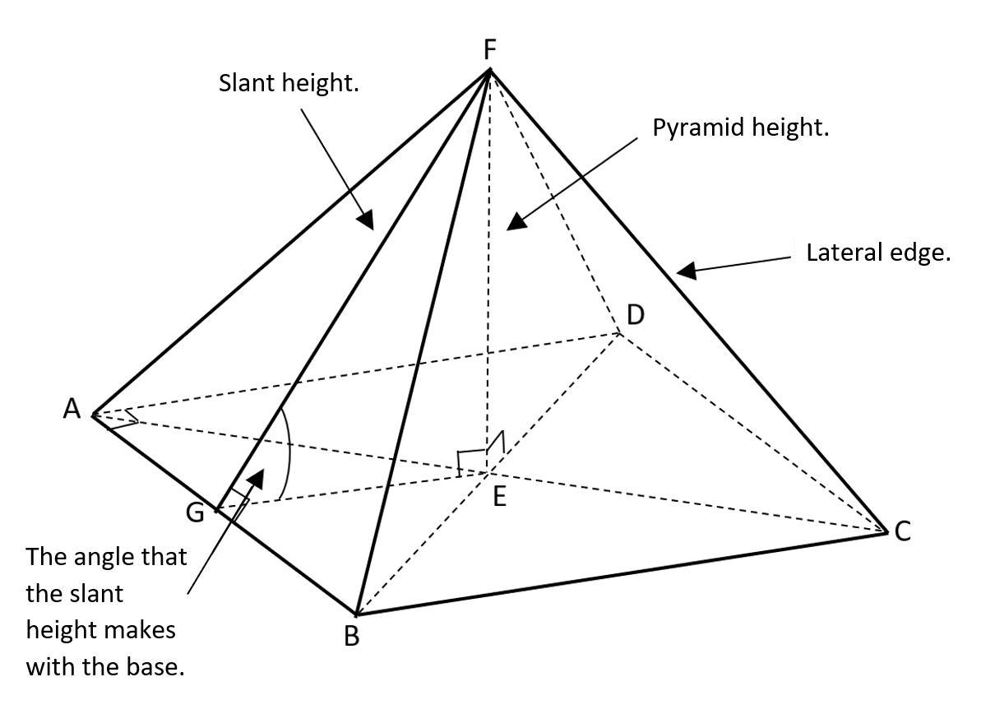
The Great Pyramid (2)
Goal-free problems

Slide 5
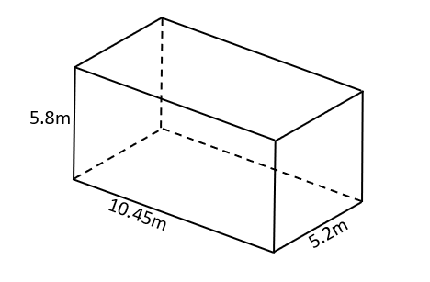
The Great Pyramid (3)
The King’s chamber

Slide 6
Summarise

Slide 7
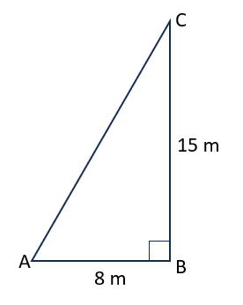
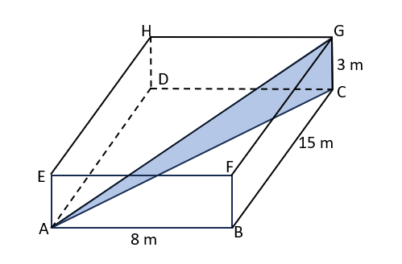
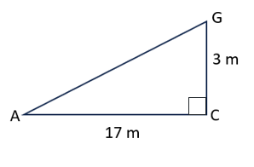
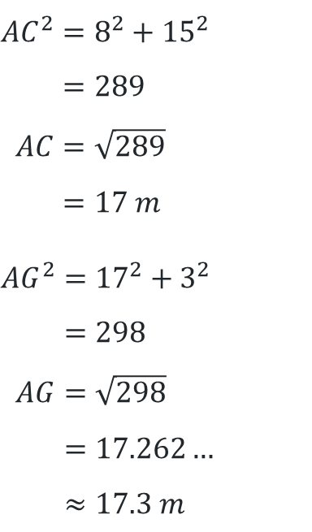
The Great Pyramid (4)
Example 1
Find the length of the diagonal AG.
$${AC}^{2}=8^{2}+{15}^{2} \\ =289 \\ AC=\sqrt{289} \\ =17 m$$
$${AG}^{2}={17}^{2}+3^{2} \\ =298 \\ AG=\sqrt{298} \\ =17.262… \\ ≈17.3 m$$

Slide 8
The Great Pyramid (5)
Why do we calculate AC first?
Example 1 – self-explanation prompts
Find the length of the diagonal AG.
$${AC}^{2}=8^{2}+{15}^{2} \\ =289 \\ AC=\sqrt{289} \\ =17 m$$
$${AG}^{2}={17}^{2}+3^{2} \\ =298 \\ AG=\sqrt{298} \\ =17.262… \\ ≈17.3 m$$
Where is the right-angle in triangle ACG?

Slide 9
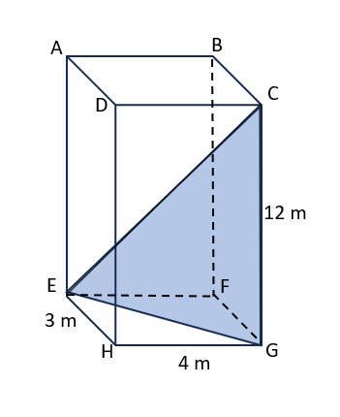
The Great Pyramid (6)
Your turn – question 1
Find the length of the diagonal EC.

Slide 10
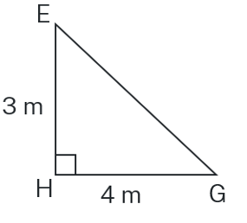
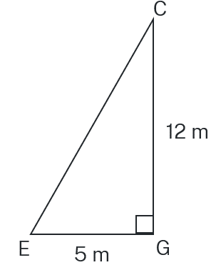
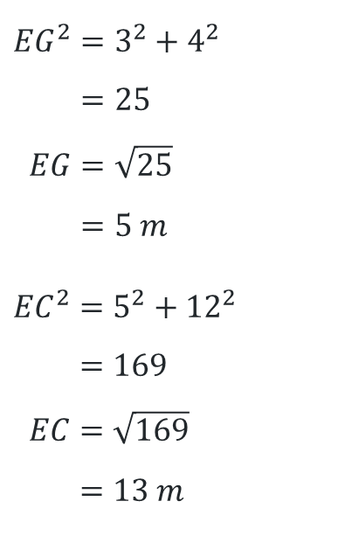
The Great Pyramid (7)
Your turn – solution 1
Find the length of the diagonal EC.
$${EG}^{2}=3^{2}+4^{2} \\ =25 \\ EG=\sqrt{25} \\ =5 m$$
$${EC}^{2}=5^{2}+{12}^{2} \\ =169 \\ EC=\sqrt{169} \\ =13 m$$

Slide 11
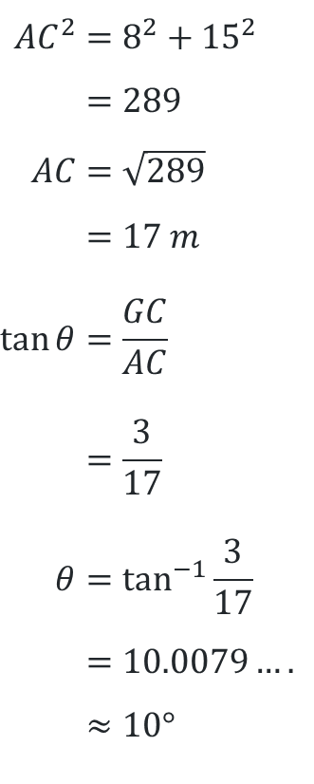
The Great Pyramid (8)
Example 2
Calculate the size of the angle that AG makes with the plane ABCD.
$${AC}^{2}=8^{2}+{15}^{2} \\ =289 \\ AC=\sqrt{289} \\ =17 m \\ \tan{θ}=\frac{GC}{AC} \\ =\frac{3}{17} \\ θ=\tan^{−1}{\frac{3}{17}} \\ =10.0079…. \\ ≈10°$$

Slide 12
The Great Pyramid (9)
Why do I need to find the distance AC first?
Example 2 self-explanation prompts
Calculate the size of the angle that AG makes with the plane ABCD.
$${AC}^{2}=8^{2}+{15}^{2} \\ =289 \\ AC=\sqrt{289} \\ =17 m \\ \tan{θ}=\frac{GC}{AC} \\ =\frac{3}{17} \\ θ=\tan^{−1}{\frac{3}{17}} \\ =10.0079…. \\ ≈10°$$
How do we know the angle we want to find is GAC?

Slide 13
The Great Pyramid (10)
Your turn – question 2
Calculate the size of the angle that EC makes with the plane ABCD.

Slide 14
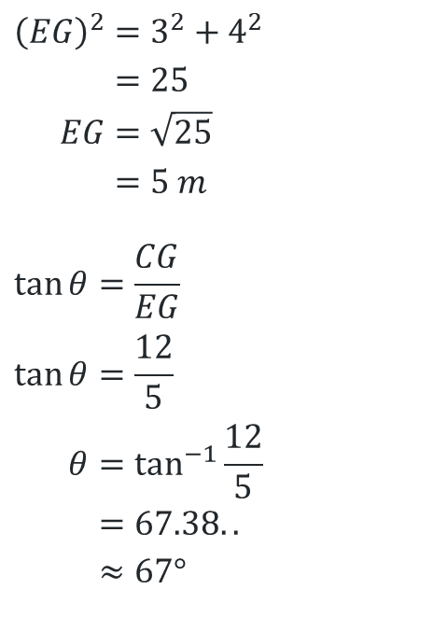
The Great Pyramid (11)
Your turn – solution 2
Calculate the size of the angle that EC makes with the plane ABCD.
$${\left(EG\right)}^{2}=3^{2}+4^{2} \\ =25 \\ EG=\sqrt{25} \\ =5 m$$
$$\tan{θ}=\frac{CG}{EG} \\ \tan{θ}=\frac{12}{5} \\ θ=\tan^{−1}{\frac{12}{5}} \\ =67.38.. \\ ≈67°$$

Slide 15
Copyright
© State of New South Wales (Department of Education), 2024
The copyright material published in this resource is subject to the Copyright Act 1968 (Cth) and is owned by the NSW Department of Education or, where indicated, by a party other than the NSW Department of Education (third-party material).
Copyright material available in this resource and owned by the NSW Department of Education is licensed under a Creative Commons Attribution 4.0 International (CC BY 4.0) license.
This license allows you to share and adapt the material for any purpose, even commercially.
Attribution should be given to © State of New South Wales (Department of Education), 2024.
Material in this resource not available under a Creative Commons license:
the NSW Department of Education logo, other logos and trademark-protected material
Material owned by a third party that has been reproduced with permission. You will need to obtain permission from the third party to reuse its material.
Links to third-party material and websites
Please note that the provided (reading/viewing material/list/links/texts) are a suggestion only and implies no endorsement, by the New South Wales Department of Education, of any author, publisher, or book title. School principals and teachers are best placed to assess the suitability of resources that would complement the curriculum and reflect the needs and interests of their students.
If you use the links provided in this document to access a third-party’s website, you acknowledge that the terms of use, including licence terms set out on the third-party’s website apply to the use which may be made of the materials on that third-party website or where permitted by the Copyright Act 1968 (Cth). The department accepts no responsibility for content on third-party websites.

